Slide 1



Slide 2
• It remains the sixth most common malignancy in males in world.
• India 8-20 / 100,000 , more seen in karnataka & orrissa, while in china it is 100: 100,000
• Squamous cell carcinoma still accounts for most of esophageal cancers diagnosed all over world. But recently adenocarcinoma is rising in west to about 5-26: 100,000
• M:F – 3:1 (SCC) .. …..15:1 (adeno)
• Adeno – whites …....&…….. SCC – in asia

Slide 3
Reason of more adenocarcinoma in white is probably due to rising cases of GERD ( mainly due to obesity) and sub sequent Barrette's oesophagus

Slide 4
Epithelial: Non – Epithelial:
• Squamous Cell Ca. • Leiomyosarcoma.
• Adeno Ca.
• Malignant Melanoma.
• Mucoepidermoid Ca. • Rhabdomyosarcoma.
• Adenoid Cystic Ca. • Malignant Lymphoma
• Small Cell Ca.
• Undifferentiated Ca.

Slide 5
• Squamous cell carcinomas arise from the squamous mucosa - native to the esophagus -
70% of the upper and middle thirds Ca. esophagus
• Most common type of esophageal Ca. in India (90%)
• Smoking and alcohol are common eitiologic factors (5 fold increase in risk)
• Combined increase risk from 25 - 100 folds

Slide 6
Dietary aetilogy
• Nitrosamines (pickled foods , smoked food)
• long term ingestion of hot liquids like tea, coffee
• Micronutrient deficiency (Vit. A, & E).
• Trace Element deficiency ( Selenium).
Acquired
• Cigarette smoking…..Alcohol.
• Chronic esophagitis.-GERD
• Caustic ingestion……stricture ……scc

Slide 7
Premalignant conditions :
• Plummer – Vinson syndrome or Peterson Kelly syndrome (iron deficiency anaemia + dysphagia + esophageal web)
• Tylosis- Diffuse over growth of keratin on palm and sole. Inherited disease. 60% family members develop Ca. Esophagus after 60 years
• Achalasia Cardia
• Esophageal strictures and diverticula .
p53—small protein & part of cell wall and steroid receptor

Slide 8
• common in western countries. It arises from sub mucosal glands/ Barrett's oesophagus Etiology :
• Increasing incidence of obesity….. GERD…BARRETT’S oesophagus
Histologically it is from :
• Submucosal glands of the esophagus
• Heterotopic islands of columnar epithelium…goblet cells
• Malignant change of metaplastic columnar epithelium, goblet cells in Barrette’s esophagus
(Barrett’s esophagus) – 40 fold incresed risk

Slide 9



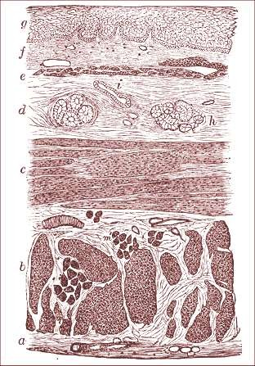
Layers
of
the
Esophagus
g. Stratified epithelial lining
f. Mucous membrane
e. Muscularis mucosa
d. submucosa
c. Transverse muscle
b. Longitudinal muscle
a. Fibrous covering

Slide 10
BARRETS OESOPHAGUS :
• Traditionally - the presence of columnar mucosa extending at
least 1-2 cm into the lower esophagus.
• Recently - the specialized, intestinal-type epithelium (presence of goblet cells) found in the Barrett’s mucosa is the only tissue predisposed to malignant degeneration - the diagnosis of BE is presently made by, given any length of endoscopically identifiable columnar mucosa that proves, on biopsy.
• 10 % of GERD pts develop – BARRETS
• Approx 1 in every 100 patient /years of followup of barrets develop ADENOCARCINOMA (40 fold increased risk)

Slide 11
Pathology:
Common in
Middle 1/3……50%
Lower 1/3…….33%
Upper 1/3…….17%
Adenocarcinoma is more common in lower 1/3 due to columnar epithelium lining there

Slide 12
GROSS TYPES
Annular ….15%
Ulcerative……20%
Fungating or cauliflower type….60%
Polypoid…….
Diffuse submucous type

Slide 13
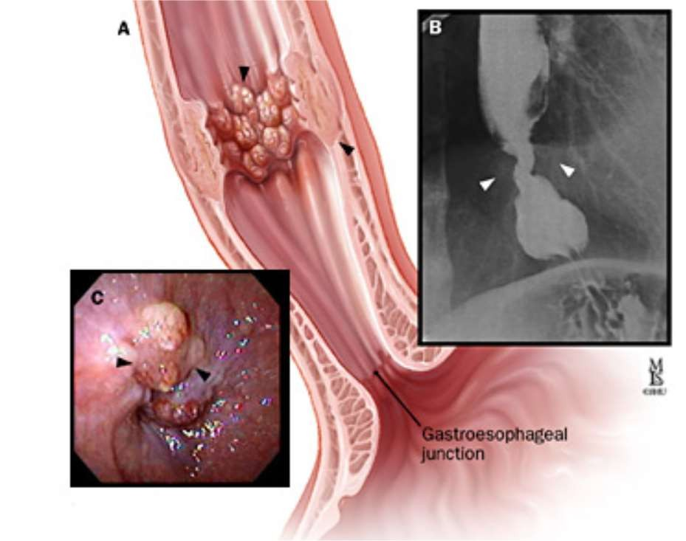

Slide 14
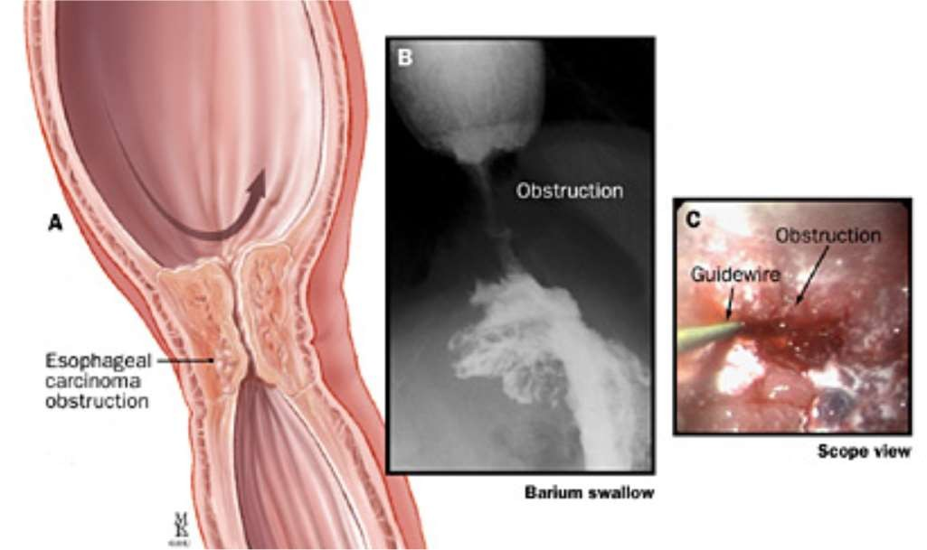

Slide 15
Spread
Direct : invasion to near by organs
lack of serosa favours this spread faster. It involve….
Trachea, lt. recurrent laryngeal nerve, aorta,
May perforate and cause mediastinitis
Spread to pleura , diaphragm

Slide 16
Lymphatic spread: vertically & laterally
Spreads by lymphatic permeation and embolization both
May produce satellite growth in oesophagus away from primary growth, or sub mucous spread
Upwards may spread to supraclavicular nodes
In mediastinum to Para oesophageal, along trachea and bronchus, sub phrenic nodes

Slide 17
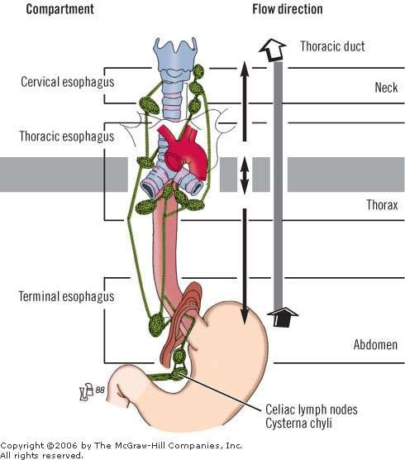

Slide 18
In abdomen spreads to coeliac group of nodes
BLOOD SPREAD:
To liver, lungs, brain, & bones
Trans coelomic spread : from intra abdominal growth is also possible

Slide 19
• Early - asymptomatic – mimic GERD
• Dysphagia.
• Weight Loss > 10 %, most common symptoms
• > 2/3rds of lumen has to be obstructed (lack of serosa)
anorexia
• Vomiting / Regurgitation
• Pain during swallowing…odynophagia
• Cough , choking , asp.pneumonia (Tracheo esophageal fistula)
• Hoarseness.(lt. recurrent Laryngeal Nerve palsy , vocal cords)
• Dyspnea
Bony pains due to secondaries

Slide 20
• most prominent early symptom is pain on swallowing rough or dry food, later even for liquids also
• Systemic disease –
jaundice ,excessive pain in back due to L.N. Involved, ,bone pain, liver secondary's, ascites
respiratory symptoms due to tracheo- oesophageal fistula like aspiration pneumonia, cough in upper 1/3 carcinoma
Left supraclavicular lymph node enlarged

Slide 21
• Endoscopy and biopsy……. 2/3 of patients are inoperable at time of diagnosis
• CT
• PET scan- Positron Emission Scan
• MRI
• EUS…endoscopic ultrasound

Slide 22
Barium swallow
1.
2.
visualize areas of obstruction and assess stricture
Extravasation of contrast may indicate a fistula
X ray chest…for aspiration pneumonia, lung secondary
U.S.G. abdomen for liver and nodal secondaries
Apple core appearance on barium swallow is characteristic
.

Slide 23
USG abdomen for ascites or liver secondaries
Laparoscopy may be done occasionally for liver secondaries in doubtful cases

Slide 24
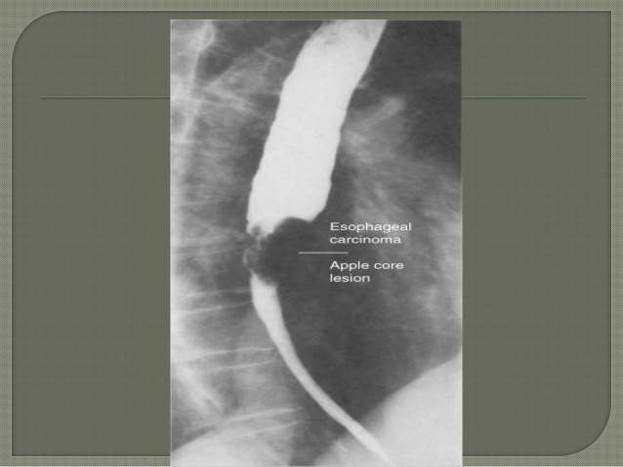
Apple core appearance

Slide 25
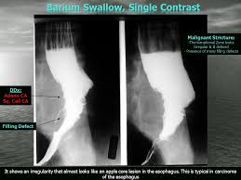
Dilated proximal esophagus

Slide 26
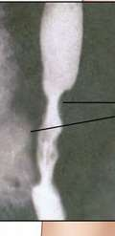
Esophagoscopy :
• Good 1st test – dysphagia &
suspecting ca esophagus
Can differentiate intra luminal
From intramural &
intrinsic from extrinsic
Also can take biopsy
Methylene blue can help identify tumour cells
Apple core appearance

Slide 27
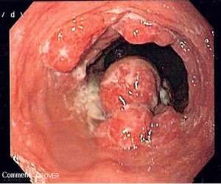
Endoscopy :
• Dx of esophageal Ca. is best made by endoscopic biopsy
Critical points :
• Location of lesion from tooth
• Nature of lesion (polypoid etc)
• Extent & relationship
to cricophayngeus ,GEJ

Slide 28
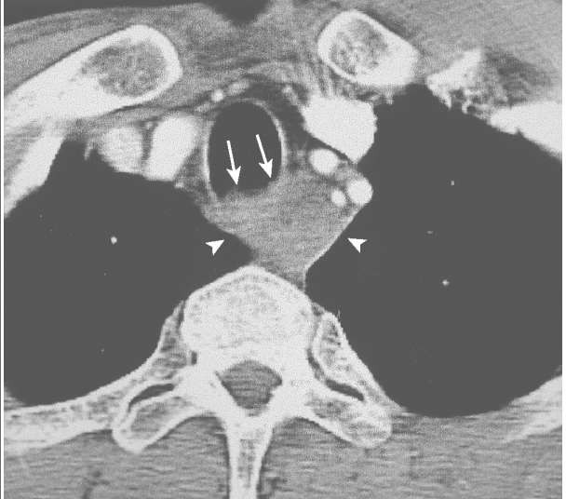
CT : chest & abdomen
• Imp for staging.
–
Length , thickness, LN
Liver and lung mets , T4
• Accuracy 95%
• Many unresectable tumors by
CT scan are deemed resectable at the
time of surgery.

Slide 29
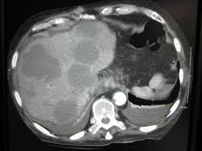
CT abdomen –secondaries in liver

Slide 30
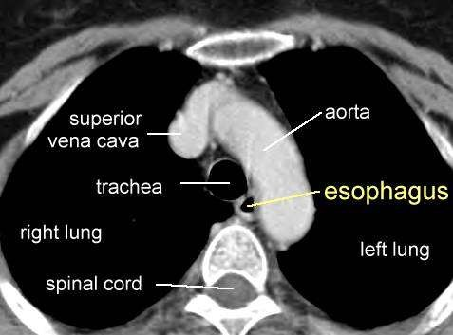
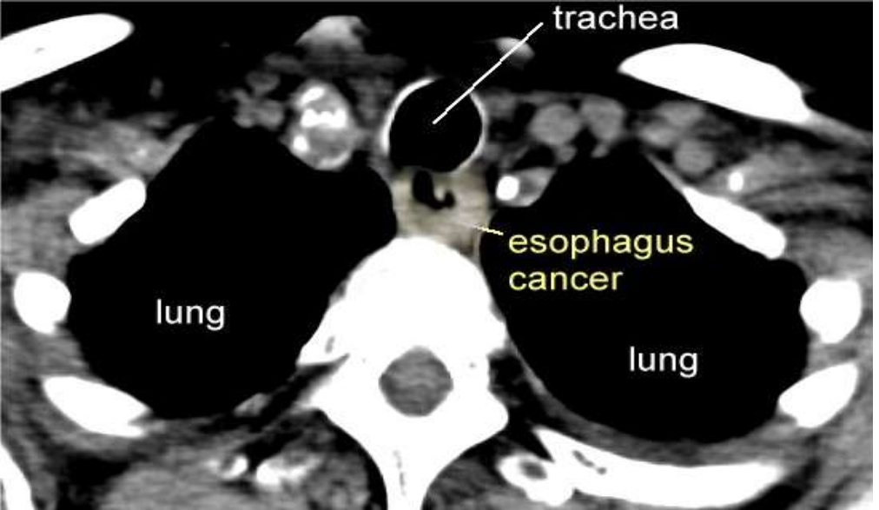

Slide 31
PET : Positron Emission Scan
• FDG (FLURODEOXYGLUCOSE) –PET CT
• Evaluates primary mass
LN - staging
Mets
• Sensitivity and specificity
slightly greater than CT
• Not reliable as single Dx tool]
• Value in evaluating response to chemo and RT

Slide 32
The drug is injected i.v. and will concentrate in cells with high metabolic activity which is present in tumour cells.
Usually along with PET scan also done CT scan to get better information

Slide 33


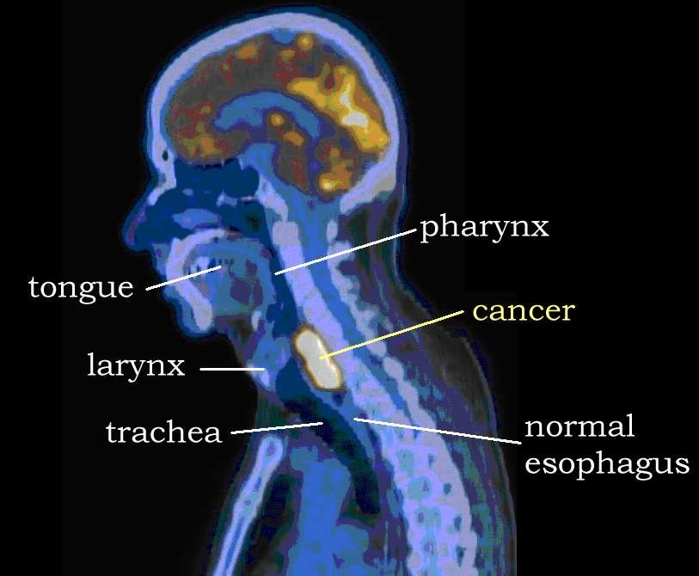
PET Scan: Large Squamous Cancer of the
Upper Esophagus

Slide 34

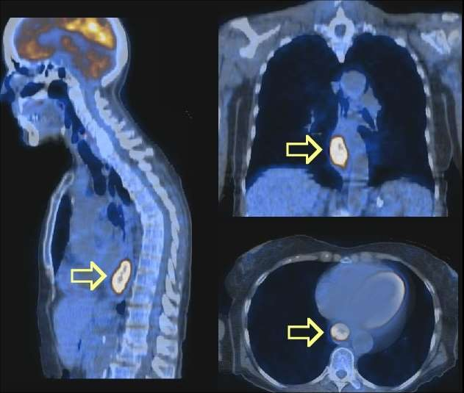
PET Scan Lower Esophagus Cancer

Slide 35

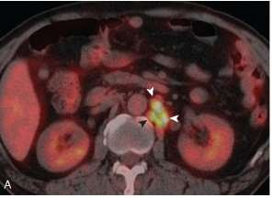
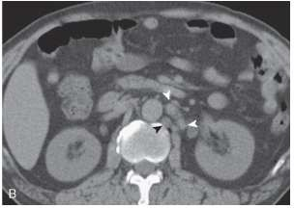
Figure Distant lymph node metastases of esophageal cancer detected by integrated CT PET. A, Integrated CT PET demonstrates para-aortic lymph node metastases showing increased FDG uptake (arrowheads). B, Corresponding CT image shows lymph nodes (arrowheads) measuring 5 to 8 mm in diameter. Based on size criteria, these lymph nodes may be considered benign on CT scan

Slide 36
MRI
• Not done routinely
• To identify involvement of vascular & neural
• Accurately detects T4 and mets
• Overstages T & N status

Slide 37
EUS : endoscopic ultrasound
can identify
• depth and length of the tumor
• degree of luminal compromise
• status of regional LN & involvement of adjacent structures like trachea or pleura. So imp. for staging
• In addition, biopsy samples - mass and lymph nodes in the paratracheal, subcarinal, paraesophageal, celiac, lesser curvature

Slide 38
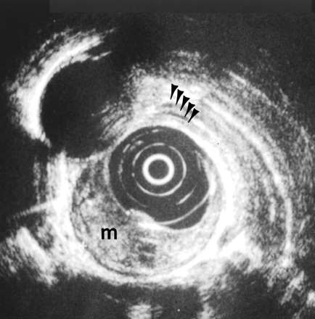
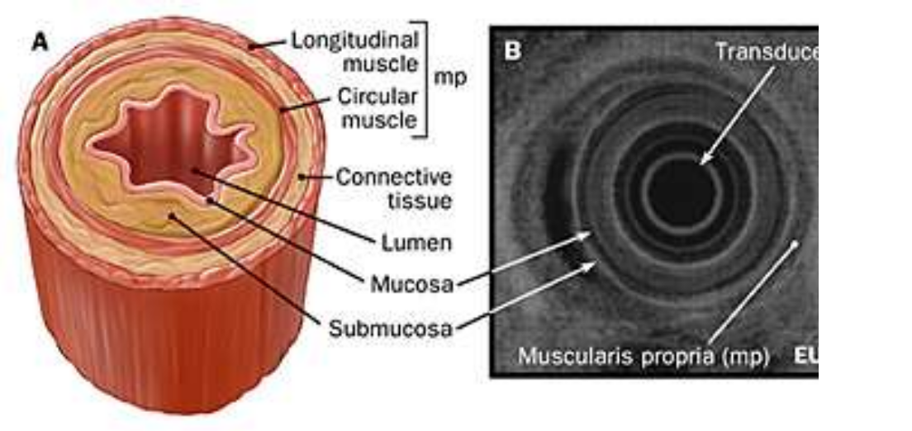

Slide 39
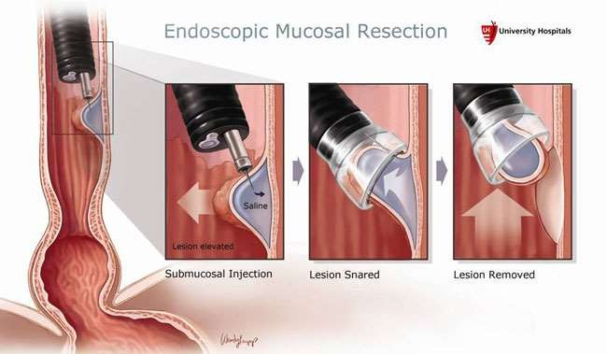
EMR : endoscopic mucosal resection
• double-channel endoscope with a soft plastic cap at its tip inserted
The cap is placed over the top of the lesion, suction is applied,
and a snare is brought down over the top of the lesion to remove growth up to 1-1.5 cm size for biopsy.
• it removes mucosa
And submucosa

Slide 40
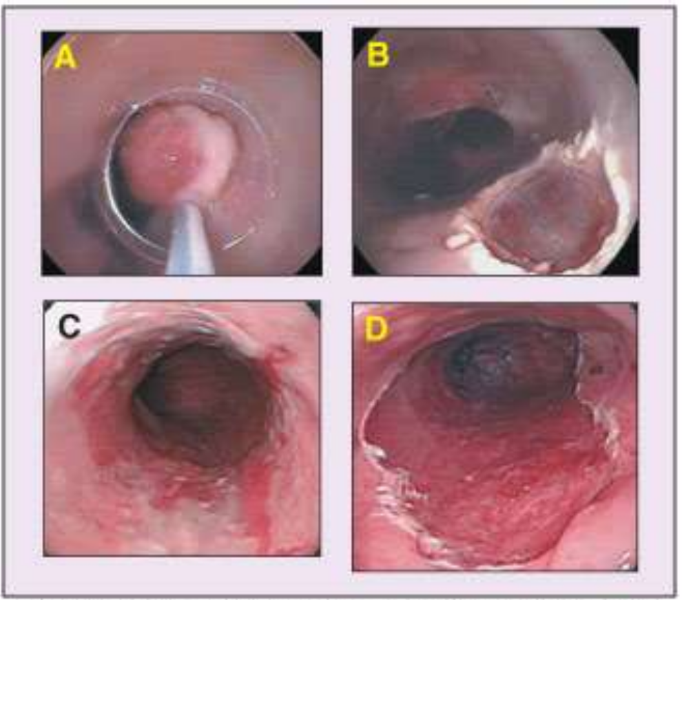
• endoscopic mucosal resection may also be used as a therapeutic modality for premalignant and early malignant conditions

Slide 41
• Minimal invasive surgical modalities :
• Includes bronchoscopy ,Thoracoscopy and Laparoscopy. To detect invasion of these parts of body
• Highly accurate in evaluating N & M Status.
• Right sided thoracoscopy is usually done.

Slide 42
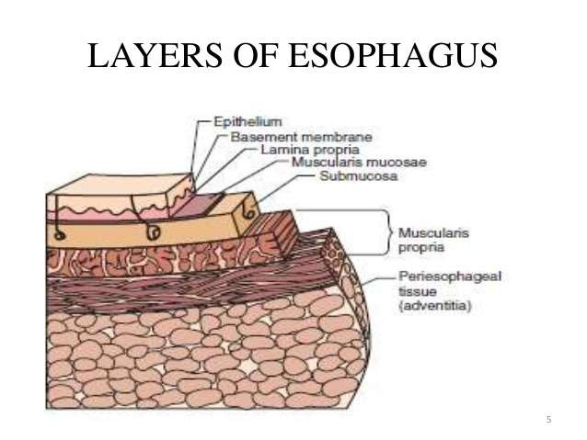

Slide 43
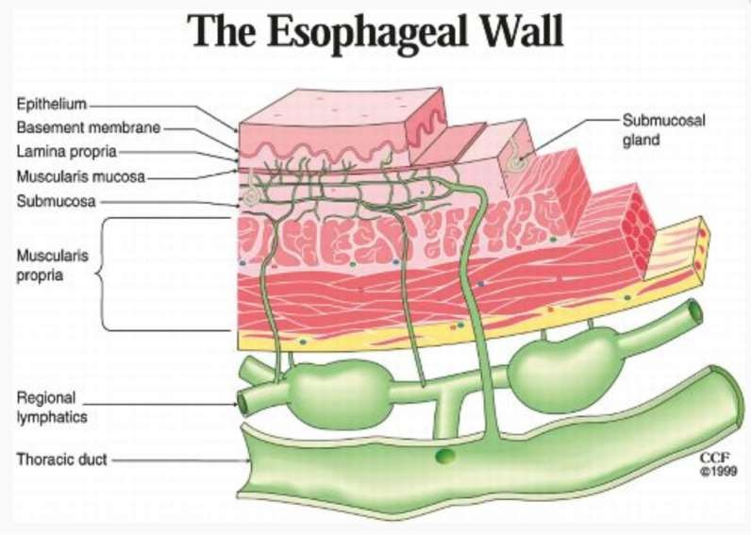

Slide 44
(TNM)
• Tumor
• Lymph node (N0 , N1)
• Metastasis (M )
• Most widely accepted

Slide 45
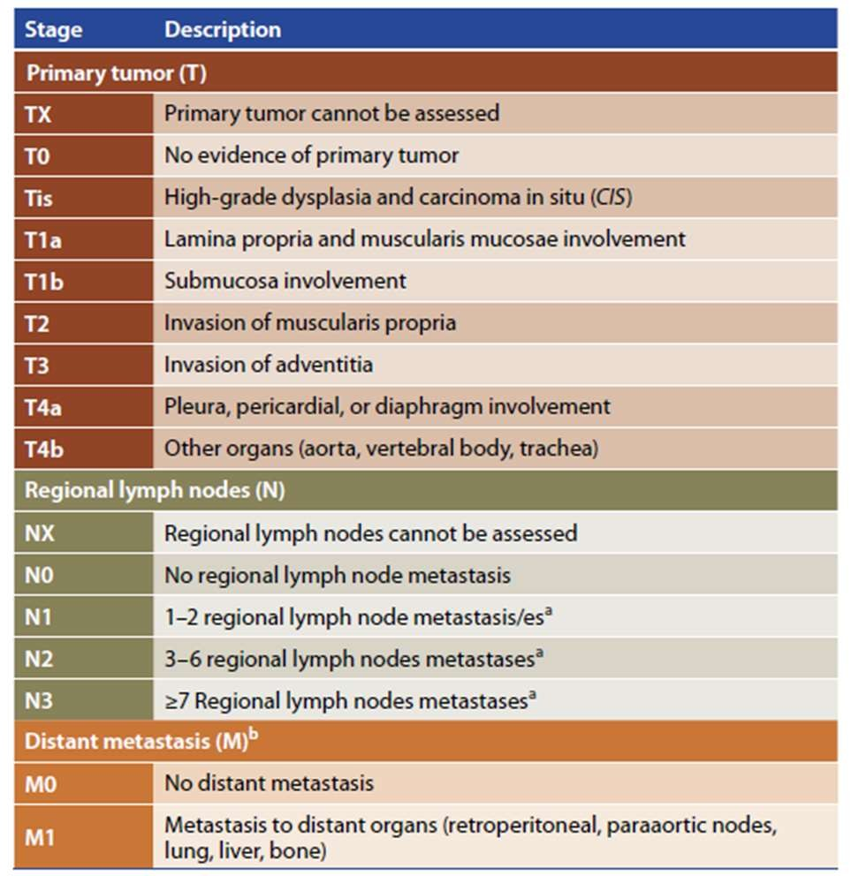

Slide 46
Staging TNM
STAGE 0……Tis,N0,M0
STAGE 1…….T1, N0, M0
Stage Ila…..T2,N0,M0…..T3,NO,MO
Stage Ilb…..T1,N1,MO…..T2,N1,MO
Stage III…….T3,N1,M0…..T4,any N, M0
Stage IVa…..any T, any N, TRACHEA, PLEURA
Stage Ivb …..any T, any N, WITH M

Slide 47
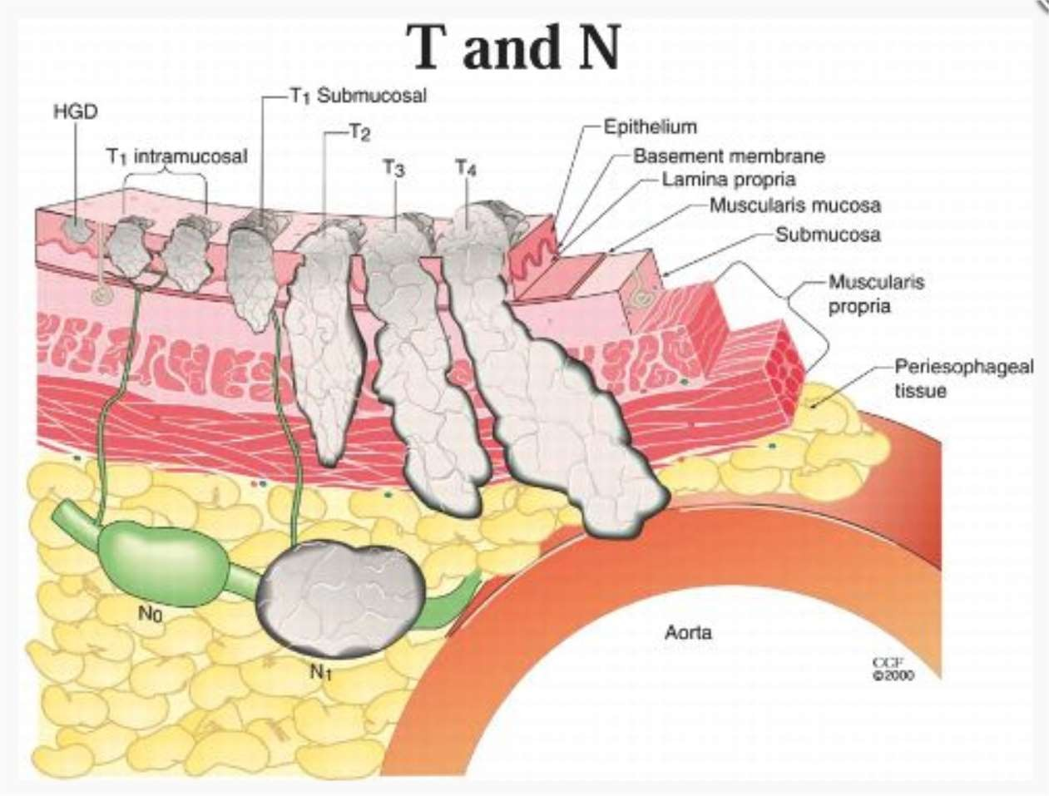

Slide 48
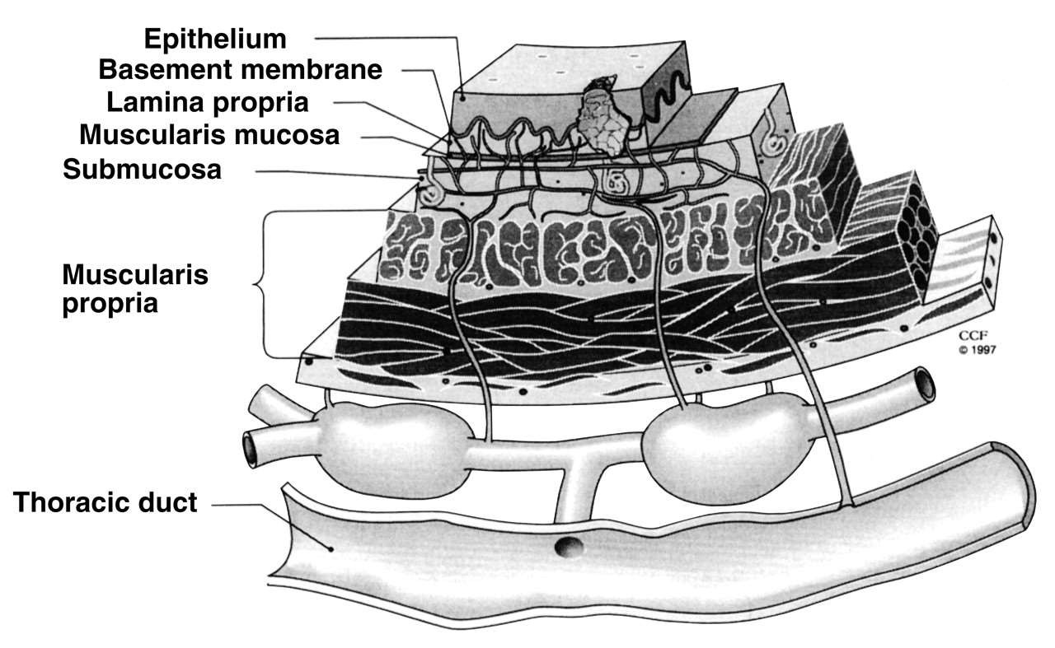
T 1A
T1B
T2
T3
N1

Slide 49
• Tumors confined to
• epithelial layer have no associated LN.
• lamina propria and muscularis mucosae - 5% and 18%
• Superficial and deep submucosal lesions - 50% and 55%
lymph node involvement.

Slide 50
• depth of tumor penetration (T stage) affects lymph node involvement (LNI)
• Intramucosal T1 lesions (18% LNI)
• submucosal T1 lesions (55% LNI)
• T2 lesions (60% LNI)
• T3 lesions (80% LNI)
• Chance if LN <50% - conservative esophagus resection and limited lymph node dissection
• LN>50% - neoadjuvant therapy followed by resection

Slide 51
Primary Site Based on
Proximal Edge of Tumor
Anatomic Esophageal Distance
name location from teeth
Cervical Upper 15 to < 20cm
Thoracic Upper 20 to < 25cm Middle 25 to < 30cm Lower 30 to < 40cm
Abdominal Lower 40 to 45 cm
EGJ/Cardia 40 to 45 cm

Slide 52
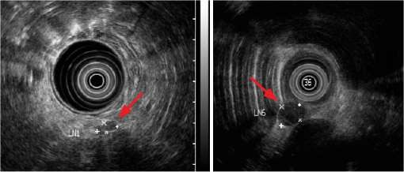
Endoscopic Ultrasound
and
Nodes
Peri-esophageal
Lymph
Benign < 6 mm
Malignant> 6 mm

Slide 53
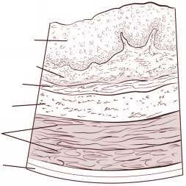
Layers of the Esophagus
epithelium
Lamina propria
Muscularis mucosa
Submucosa
Muscularis propria
Adventitia

Slide 54
Layers
of
the
Esophagus
g. Stratified epithelial lining
f. Mucous membrane
e. Muscularis mucosa
d. submucosa
c. Transverse muscle
b. Longitudinal muscle
a. Fibrous covering

Slide 55
• Chemotherapy
• Radiotherapy
• Surgery
Prognosis and 5 year survival rate increase in last decade due to improved staging and diagnostic tactics as well as surgical technics

Slide 56
• Unlike other malignancies chemo in esophageal and gastric ca is poorly able to control local and distant disease
• The best complete response rate for adenocarcinomas is
25% when chemotherapy is given in combination with radiation. So platinum based chemotherapy is more convenient then endoscopic palliative treatment. Pt. has better quality of life.
• Squamous cell cancers respond more favorably to chemotherapy for palliation.

Slide 57
• A neoadjuvant (given before the treatment of primary tumour) regimen – induction with chemotherapy cisplatin and
paclitaxel followed by combination chemoradiotherapy with
5-fluorouracil, cisplatin, and paclitaxel and 4500 cGy of external beam radiation.
• < 4500 cGy are used in neoadjuvant therapy (reduce bleeds
in radiation tissue during surgery)
Note: adjuvant therapy is one which is given after the treatment of primary tumour e.g. after surgery

Slide 58
Decision of surgery is usually only for favourable cases where complete cure is possible.
As 2/3 cases are inoperable when diagnosed only and results of surgery are not encouraging ( 5 year survival rate after surgery is very low) in advanced malignancy, so pt. is thoroughly investigated for staging before surgery

Slide 59
For inoperable cases palliative treatment is best option.
Palliation must be simple and effective to relieve patient of his most distressing symptoms.

Slide 60
• Factors affecting surgical decision –
1.Location of the tumor
2.Surgical approach
3.Location of the anastomosis
4.Anastomotic technique
5.Type of replacement conduit
6.Position of the conduit e.g. presternal or retrosternal
Usually radical esophagectomy with replacement of conduit and end to end anastomosis

Slide 61
• For any GI anastomosis - good blood supply and a tension- free repair required
• Difficult in esophageal anastomosis – most of them –
diabetes,HTN,smokers – compromised blood supply
• The cervical anastomosis - necrosis of the tip of the
tubularized stomach- compromised blood flow - compression
of the conduit in the mediastinum
• An intrathoracic anastomosis has a slightly better chance of healing when compared with the cervical
• Timing <48 hrs – inadequate arterial blood supply
• 7-9 days – consequence of venous compromise

Slide 62
• APPROACH TO CERVICAL ESOPHAGEAL TUMORS:
• Above the level of carina – SCC
• surgery is initiated with endoscopy, bronchoscopy and cervical exploration
• if No invasion to trachea, spine, larynx, or vessels then tumor
resected primarily
• if Tumors near to cricopharyngeus muscle / larynx, then 2 to 3cycles of chemotherapy and RT before resection
• Extension into the thoracic inlet – near total esophageal resection - transhiatal or transthoracic approach to ensure a safe and complete resection.

Slide 63
EN BLOC ESOPHAGECTOMY:
• most extensive of all esophageal resections -
• addition of a radical thoracic and abdominal lymphadenectomy
• 3 incisions—left neck, right chest, and abdomen
• Rt thoracotomy - esophagus is mobilized - azygos, hemiazygos &intercostal veins are ligated and divided - removed en bloc with the specimen
• All mediastinal lymph nodes , diaphragmatic lymph nodes,lymphatic tissues associated with the thoracic duct are removed

Slide 64
TTE :
• 2 incisions –thoracic and midline upper abdomen
initiated through an upper midline laparotomy incision
the stomach & esophagus are mobilized, a feeding jejunostomy tube is placed Patient is repositioned on the rtright side

Slide 65
Rt. Thoracotomy.
Esophagus enbloc resected
Stomach tube taken in the thorax and anastomosis done end to end.
Thorasic and abdominal drains kept and both wounds are closed.

Slide 66
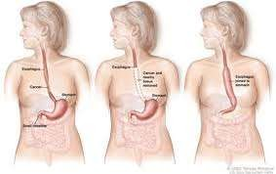

Slide 67
A thoracotomy incision is made esophagus is mobilized.
The esophagus is transected at the level of the azygos vein
intrathoracic esophagogastric anastomosis is performed

Slide 68
• stomach (gastric pull-up) – CONDUIT OF CHOICE
• Free jejunal flap – microvascular anastamosis with internal mammary artery
Colonic inter position, presternal or mediastinal post sternal
• Except in gastric pull-up, for all - additional enteroenteric anastomosis - increases the risk for leaks

Slide 69
• who has no chance for cure or would not withstand surgery
• chemotherapy,
radiation therapy,
photodynamic therapy, : after injecting photo dynamic substance, part is exposed to radiation which kills cells
laser therapy : core excision, or thermal destruction of mass
esophageal stenting LIKE souttar tube (silver mesh ) self expanding mesh
feeding gastrostomy or jejunostomy, and esophagectomy

Slide 70
Gastrostomy
Serves to eat and not die of hunger at least.

Slide 71
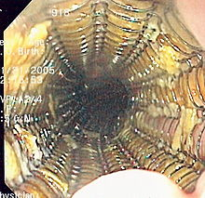
Souttar’s tube self expanding mesh

Slide 72
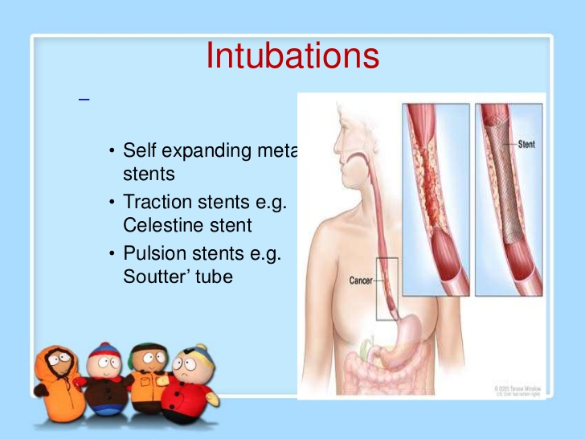

Slide 73
MCQ 1
IMPORTANT PREDISPOSING FACTORS FOR CA. ESPHAGUS ………..
A: GERD
B: STRICTURE ESPHAGUS
C: ALCOHOLISM
D: ALL OF ABOVE

Slide 74
2
Adenocarcinoma of esophagus is more common in ………….. of esophagus
A: UPPER 1/3
B: LOWER 1/3
C: UPPER 2/3
D: LOWER 2/3

Slide 75
3
IN BARIUM EXAMINATION THE “ APPLE CORE DEFORMITY” IS CHARACTERISTIC SIGN OF
A: CA. STOMACH
B: CA. TONGUE
C: CA. ESOPHAGUS
D: NONE OF ABOVE

Slide 76
4
AFTER THE BLOC DISSECTION OF ESOPHAGUS, ITS REPLACEMENT IS DONE BY……………
A: STOMACH
B: JEJUNUM
C: COLON
D: ANY OF ABOVE

Slide 77
5
In western countries the incidence of ………….. of esophagus is rising.
A: squamous cell carcinoma
B: adenocarcinoma
C: malignant melanoma
D: leiomyosarcoma

