Slide 1

METHODS OF GAINING SPACE
Dr. Romil Shah
Professor & PG Guide,
Dept. of Orthodontics and Dentofacial Orthopaedics,
KMSDC&H, SVDU

Slide 2
1. PROXIMAL STRIPPING
2. EXTRACTION
3. EXPANSION
4. DEROTATION OF POSTERIOR TEETH
MOLAR DISTALIZATION
MOLAR UPRIGHTING
PROCLINATION OF ANTERIOR TEETH

Slide 3
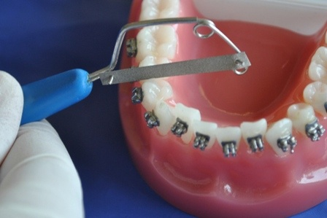
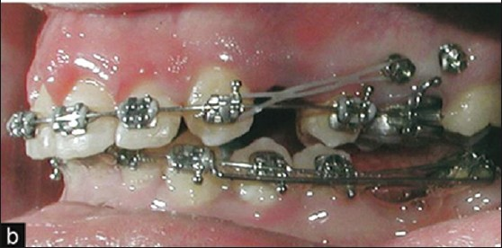
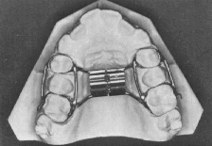
Methods of gaining space
PROXIMAL STRIPPING
EXTRACTION
ARCH EXPANSION

Slide 4
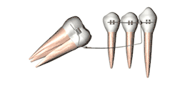
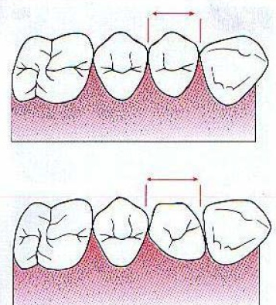
Methods of gaining space
UPRIGHTING OF MOLAR
DEROTATION OF POSTERIOR TEETH

Slide 5
PROXIMAL STRIPPING
Synonyms
Reproximation
Slenderization
Disking
Proximal slicing

Slide 6
ADVANTAGES
WHEN MINIMAL SPACE REQUIRED (0 TO 2.5 MM)
BODRELINE CASE TO NON EXTRACTION
ESTABLISH NORMAL OVERJET AND OVERBITE
CONTACT AREAS ARE BROADENED SO MORE STABLE RESULTS, MAINLY IN LOWER ANTERIOR CROWDING

Slide 7
DISADVANTAGES
INCREASE CARRIES SUSSEPTIBILITY
TOOTH SENSITIVITY
LOSS OF CONTACT- FOOD IMPACTION
ALTERATION OF TOOTH MORPHOLOGY
PULP EXPOSURE IN TOOTH WITH LARGE PULP CHAMBERS

Slide 8
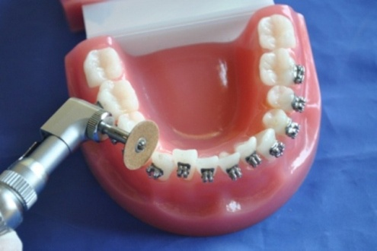
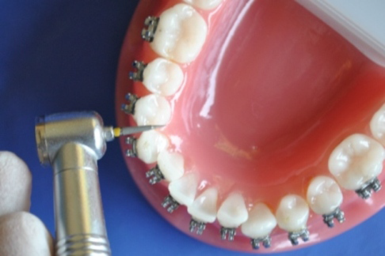
DIFFERENT METHODS OF PROXIMAL STRIPPING

Slide 9
NOT MORE THAN 50% OF ENAMEL THICKNESS SHOULD BE REDUCED
FLOURIDE APPLICATION
PROXIMAL STRIPPING DONE BY:
1. METALIC ABRASIVE STRIPS
2. SAFE SIDED CARBORUNDUM DISC
3. LONG AND THIN TAPPER FISSURE BUR

Slide 10
EXPANSION

Slide 11
Expansion
Non invasive method of gaining space
Constricted maxillary arch
Unilateral or bilateral cross bite
It can be skeletal or dentoalveolar

Slide 12
METHODS
1. SLOW MAXILLARY EXPANSION- DENTOALVEOLAR
JACK SCREWS
COFFIN SPRING
QUAD HELIX
EXPANSION USING FIXED APPLIANCE
2. RAPID MAXILLARY EXPANSION- SKELETAL
SPLITTING THE MIDPALATAL SUTURE
BY RME SCREWS

Slide 13
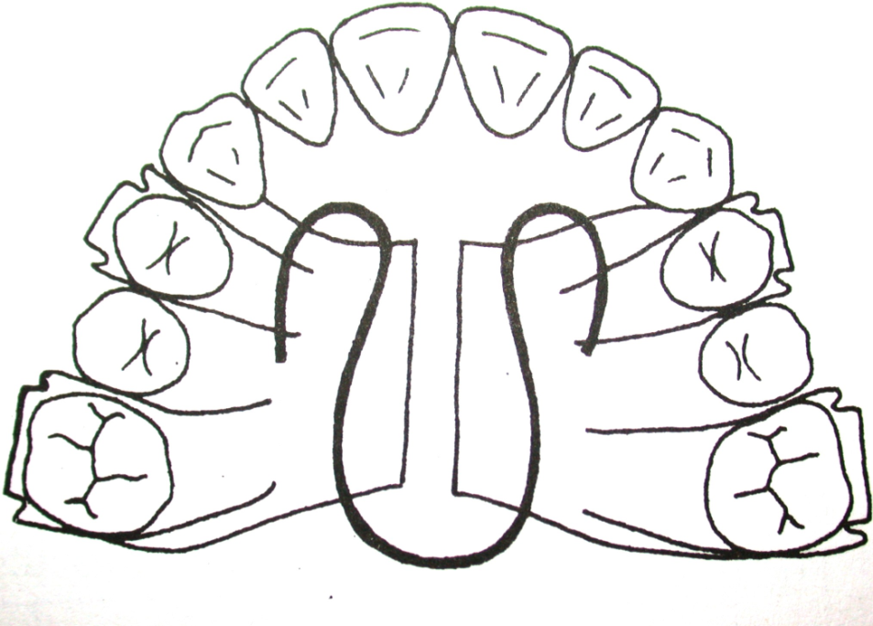
METHODS OF EXPANSION
SLOW MAXILLARY EXPANSION
RAPID MAXILLARY EXPANSION

Slide 14
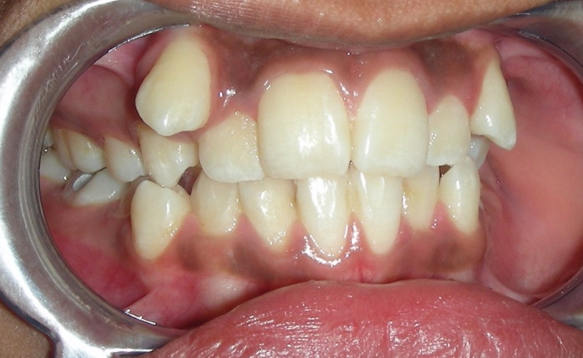
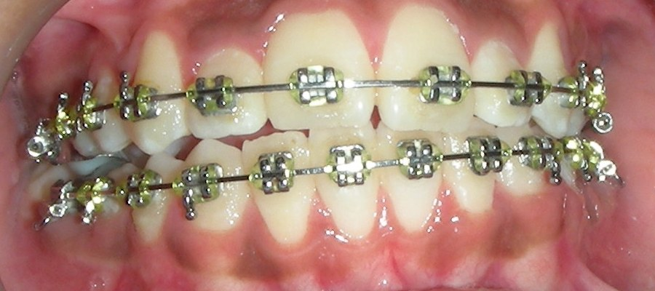
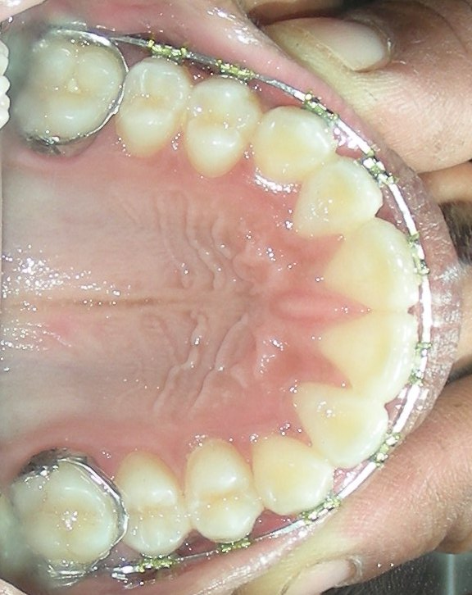
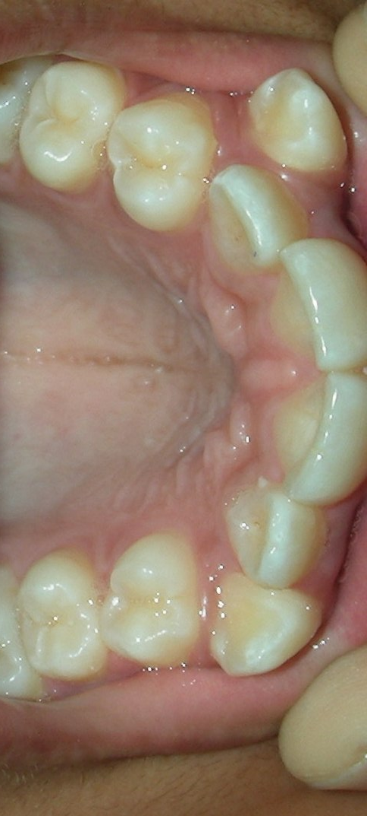
AESHA

Slide 15
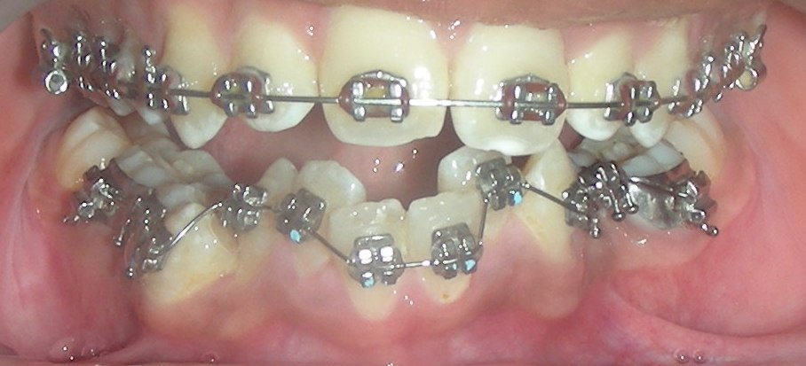
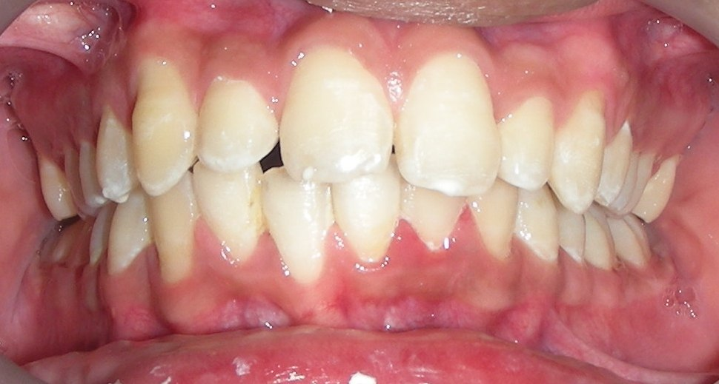
SHIVAM

Slide 16
EXTRACTION

Slide 17
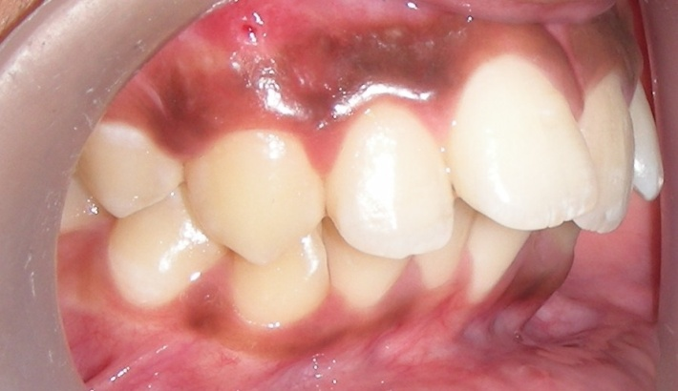
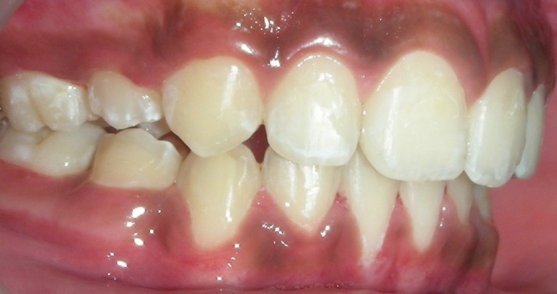
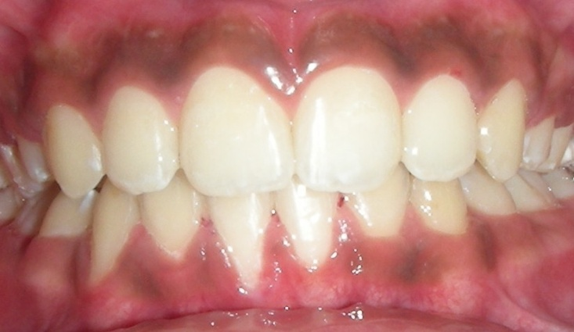
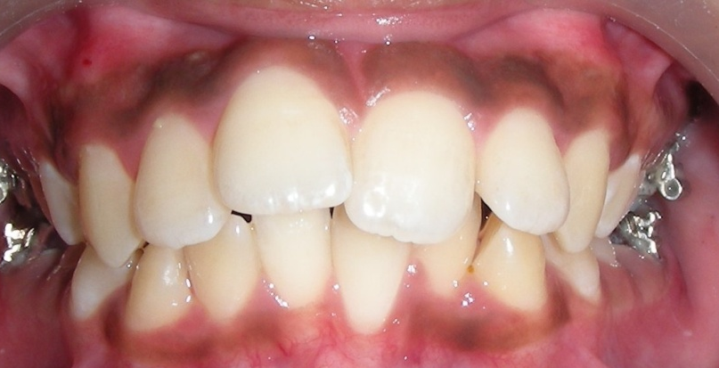

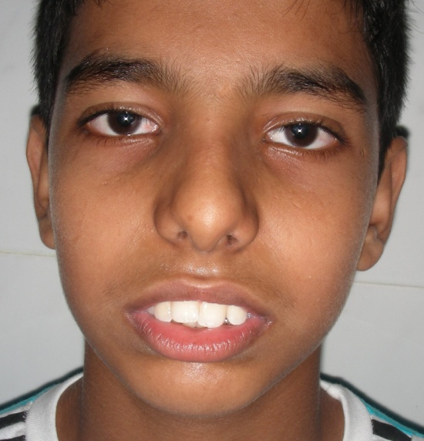
NIKHIL

Slide 18
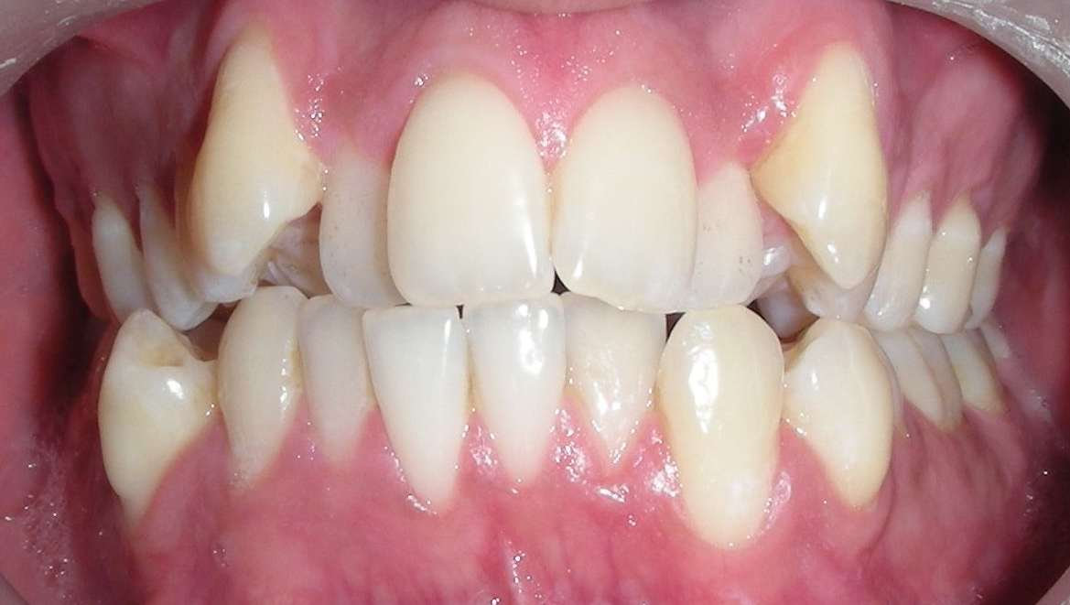
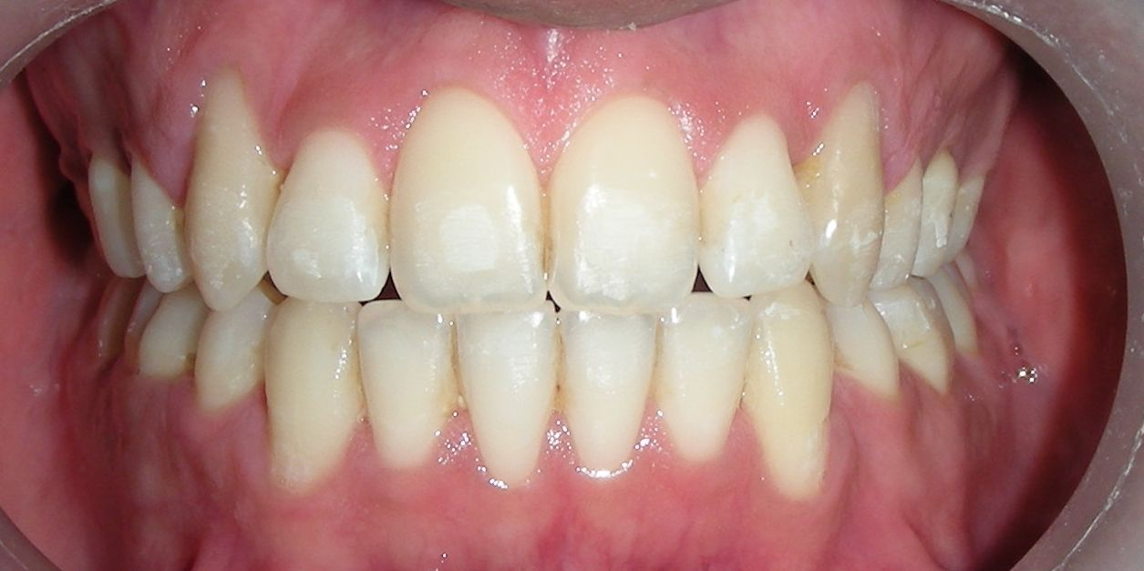
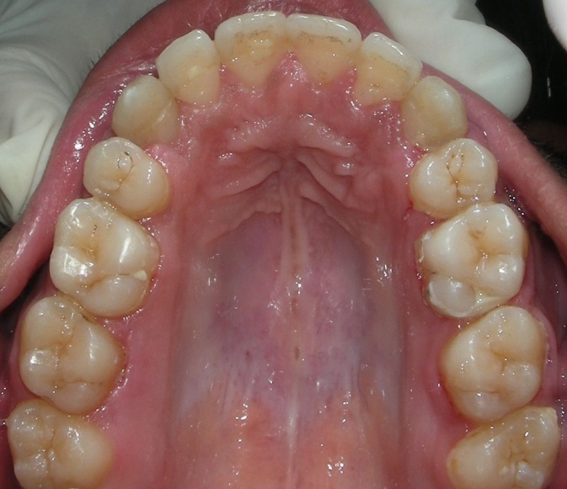
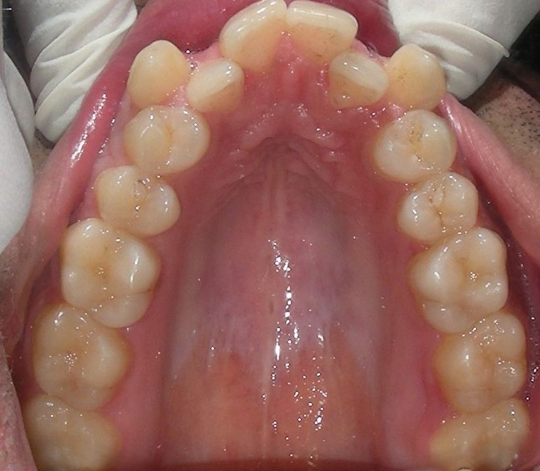
BHARGAV
BEFORE
AFTER

Slide 19
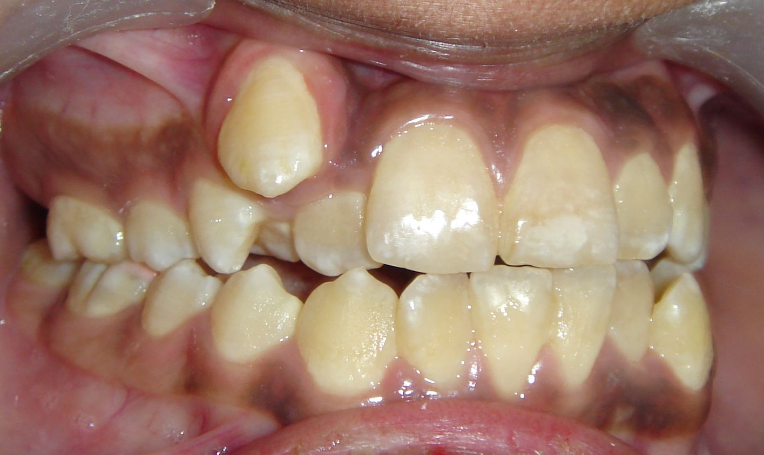
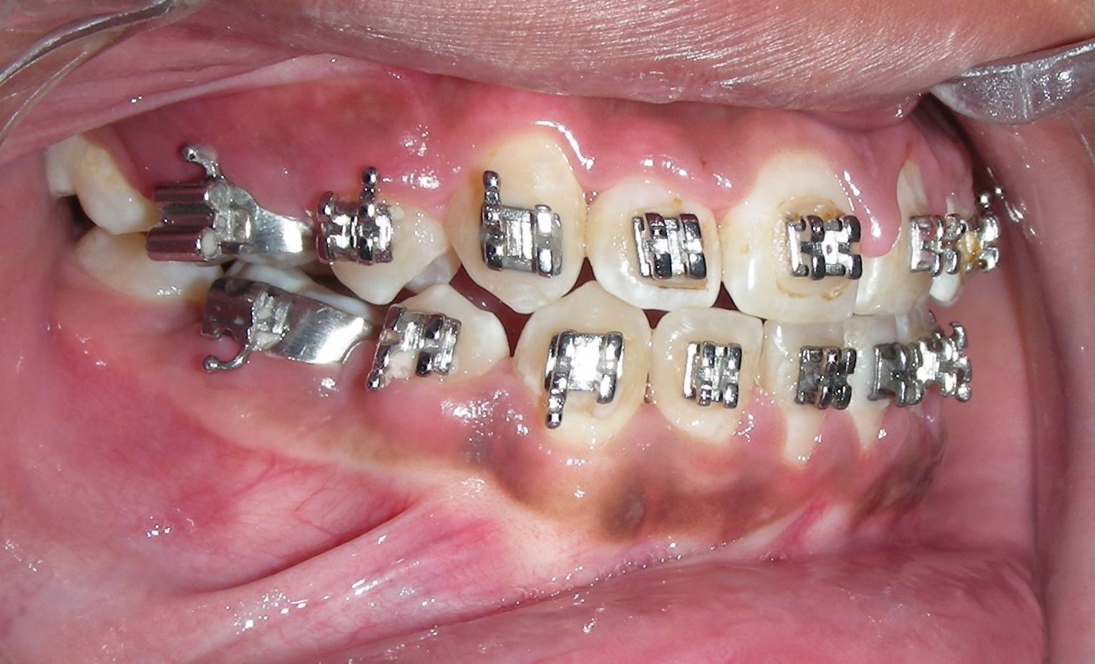
VIVEK
BEFORE
AFTER

Slide 20
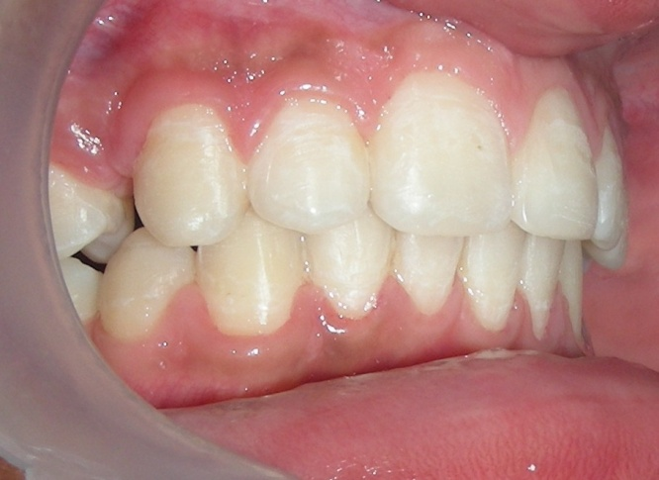
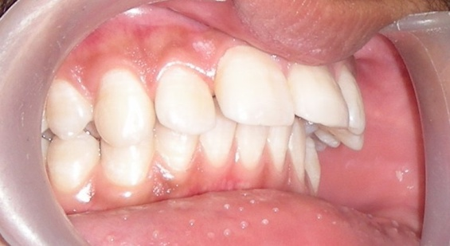
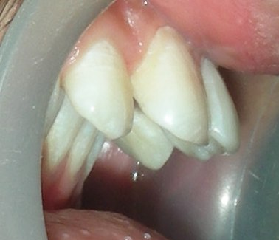
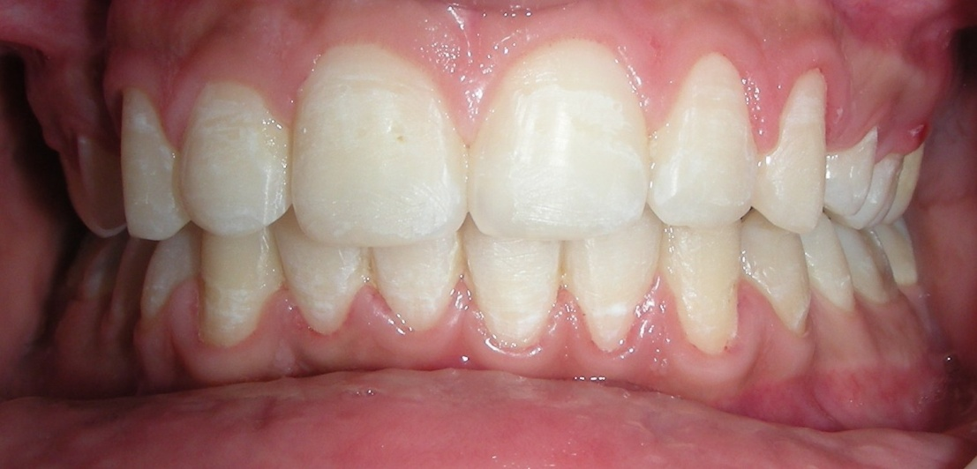
ROHIT

Slide 21
ALL FIRST PREMOLARS
ALL SECOND PREMOLARS
UPPER FIRST/ LOWER SECOND OR VISA VERSA
FIRST MOLAR
SECOND MOLAR
SINGLE INCISOR

Slide 22
MOLAR DISTALIZATION

Slide 23
TO AVOID EXTRACTIONS
IDEAL TIME IS DURING THE MIXED DENTITION PERIOD PRIOR TO ERUPTION OF THE SECOND PERMANENT MOLAR
METHODS:
1. EXTRA-ORAL- HEADGEARS
2. INTRA-ORAL- SAGITTAL APPLIANCE, COIL SPRING, PENDULUM APPLIANCE.

Slide 24
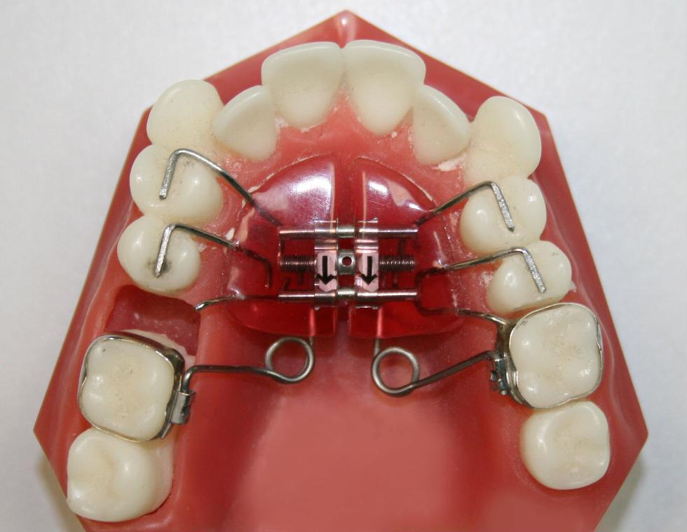
PENDAX APPLIANCE

Slide 25
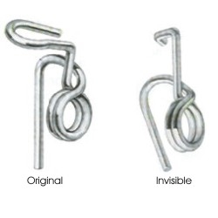
MOLAR UPRIGHTING
MOLAR UPRIGHTING SPRINGS

Slide 26
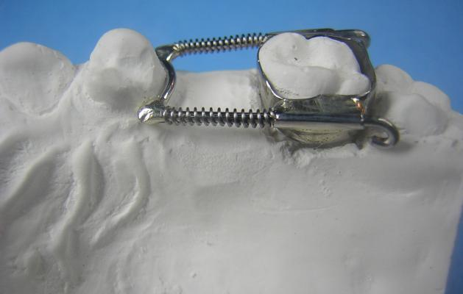
SPACE REGAINER

Slide 27
DEROTATION OF POSTERIOR TEETH

Slide 28
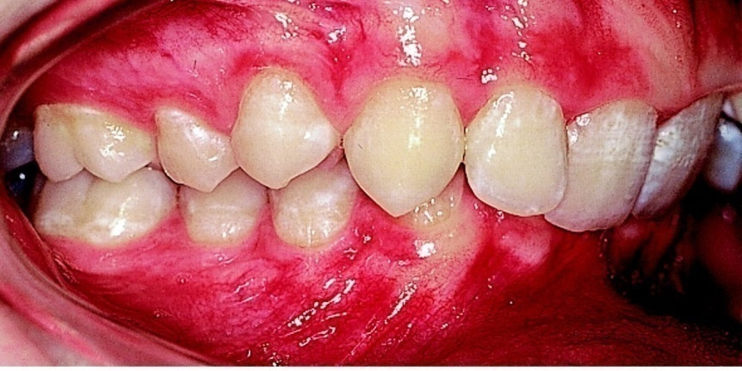
PROCLINATION OF ANTERIOR TEETH
Proclination of a retruded anterior tooth results in increase of arch length.
This is usually indicated in cases where the teeth are retroclined.
Cases where protracting the anteriors will not affect the soft tissue profile of the patient.

Slide 29
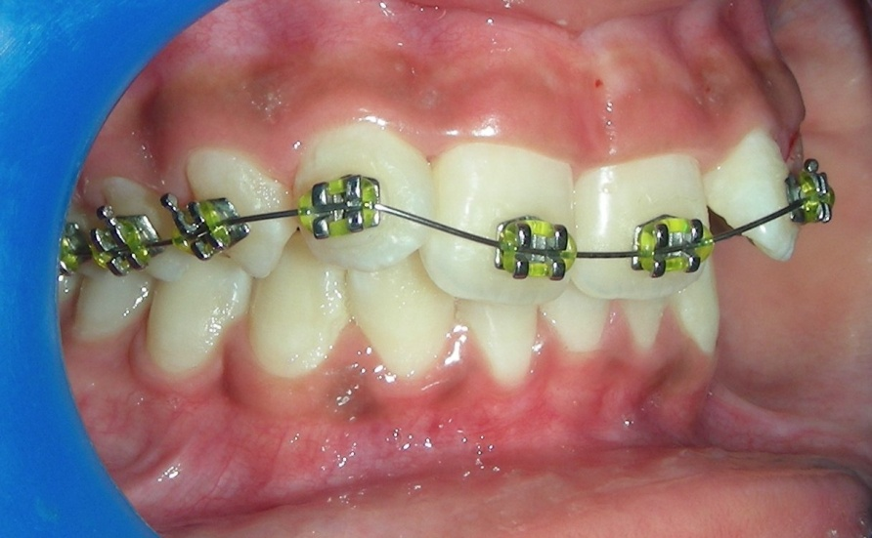
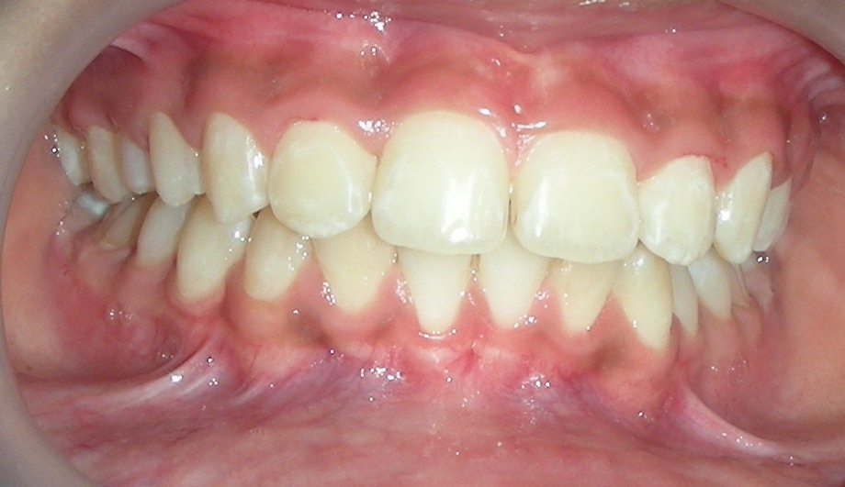
RAHI

Slide 30
EBES :CURRENT STATUS OF INTERPROXIMAL ENAMEL REDUCTION
Authors and year | Journal | Study design & levelling evidence | Aims & objective | Results & conclusion
Shrish et al. 2012 | Pakistan Oral & Dental Journal | Level 4 | The aim of this study was to collect evidence related to proximal striping by conducting a survey. | 95% respondents did proximal stripping in their patients. 83 % respondents felt that teeth become more susceptible to caries but only 13.5% of them had actually seen dental carries because of PS. 55% respondents did proximal stripping to treat relapse.

Slide 31
MCQS

Slide 32
Mcq-1
1. Methods of gaining space are-
Proximal stripping
Extraction
Expansion
All of the above

Slide 33
Mcq-2
2. Space is required for-
Correction of median diastema
Correction of derotation of anterior teeth
Correction of derotation of posterior teeth
None of above

Slide 34
Mcq-3
3. Proximal stripping is also known as-
Slenderization
Disking
Reproximation
All of the above

Slide 35
Mcq-4
4. Proximal stripping are indicated in-
Severe crowding
Deep bite cases
When Space required is minimal
Retroclination of incisors

Slide 36
Mcq-5
5. Methods of Distalization are-
Head gear
Lip bumper with open coil spring
Pendulum appliance
All of the above

Slide 37
Answer key
D
B
D
C
D

Slide 38
THANK YOU

