Slide 1
COMMON FACE CONDITIONS
BY DR. JAGDISH KARIA

Slide 2
1:- sebaceous cyst
2:- Basal cell carcinoma
3:- haemangioma
4:- naevus
5:- cleft lip & palate
6:- dermoid cyst
7;- burn
8:- wounds
9;- keloid
10 : boil

Slide 3
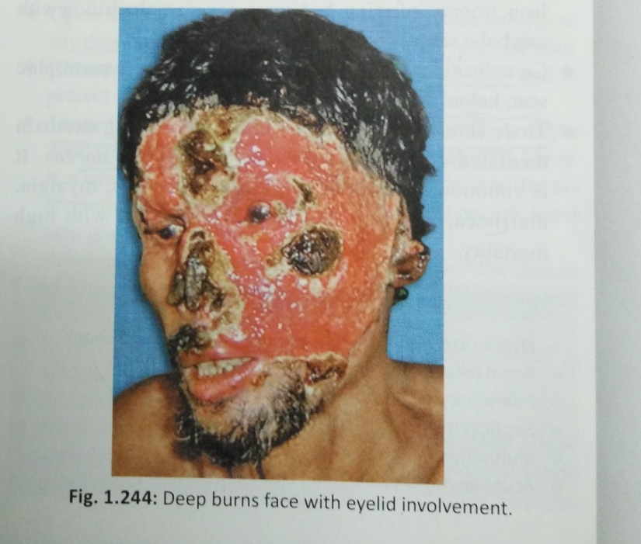
DEEP BURN FACE WITH EYELIDS

Slide 4
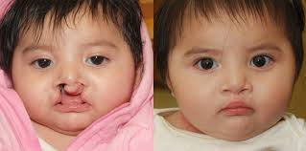
Cleft lip and palate

Slide 5
dermoid cyst
Dermoid cyst: develop in the line of embryonic fusion
are of 4 types
1 : sequestration dermoid which develops from embryonic line of fusion
2: tubulo embryonic dermoid: e.g. Thyroglossal cyst, Urachal cyst
Teratomatous dermoid: arises from germinal line of ecto, meso or endoderm

Slide 6
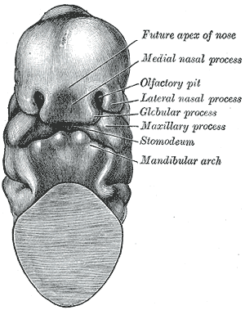

Slide 7
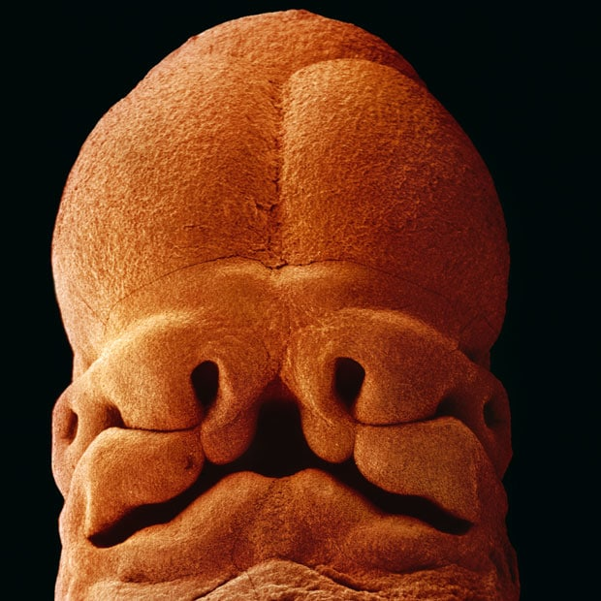
Embryo with fusion of embryonic lines

Slide 8
It occurs in testis, ovary, retro peritoneum or mediastinum. It contains hair, teeth, cartilage or muscle with putty like material made of desquamated cells
Implantation dermoid: it occurs due to minor trauma or pricks which drives epidermal cells in subcutaneous tissue. Due to reaction of s/c tissue then cyst develops. So its acquired cyst. Commonly seen on fingers, toes or feet

Slide 9
Sequestration dermoid
Sequestration dermoids are cysts which develop from embryonic line of fusion. So they are seen in midline as well as where the two embryonic processes meet together e.g. outer angle of orbit (frontonasal process and maxillary process unite) , behind pinna or post auricular, just below the tongue in midline .. Sub lingual dermoid

Slide 10
Clinically
Fluctuation +
Transillumination -ve
Contains pultaceous material
Margin will yield to pressure
Free from skin and deeper structure
Contains hair, tooth etc mesodermal tissue

Slide 11
Scalp dermoid may be
1: fully outside the skull bone
2: out side the skull bone but attached to the dura through the defect in skull bone
3: partly extra cranial and partly intracranial connected with a stalk
4: fully intra cranial lying between dura and skull bone

Slide 12
Complications:
May be extending intra cranially
Infection
Looks bad
Repeated trauma

Slide 13
Investigations
X ray skull AP & lateral:-to see for intracranial extension
Bony erosion of outer table will confirm diagnosis

Slide 14
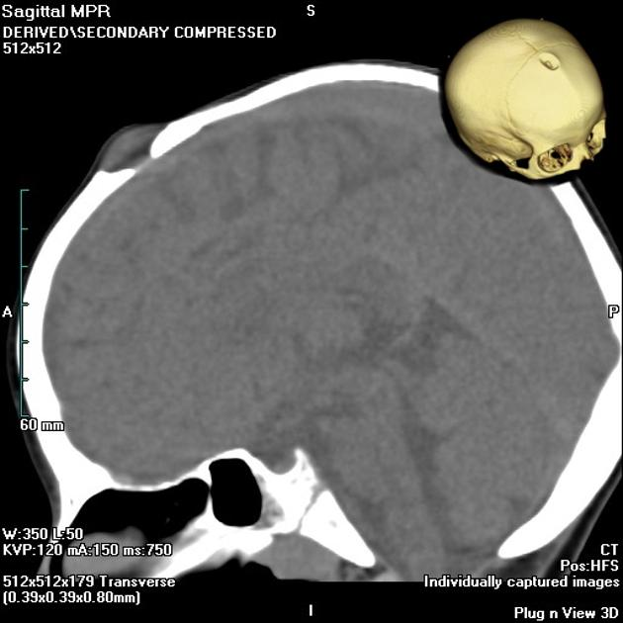
Erosion of skull by dermoid cyst

Slide 15
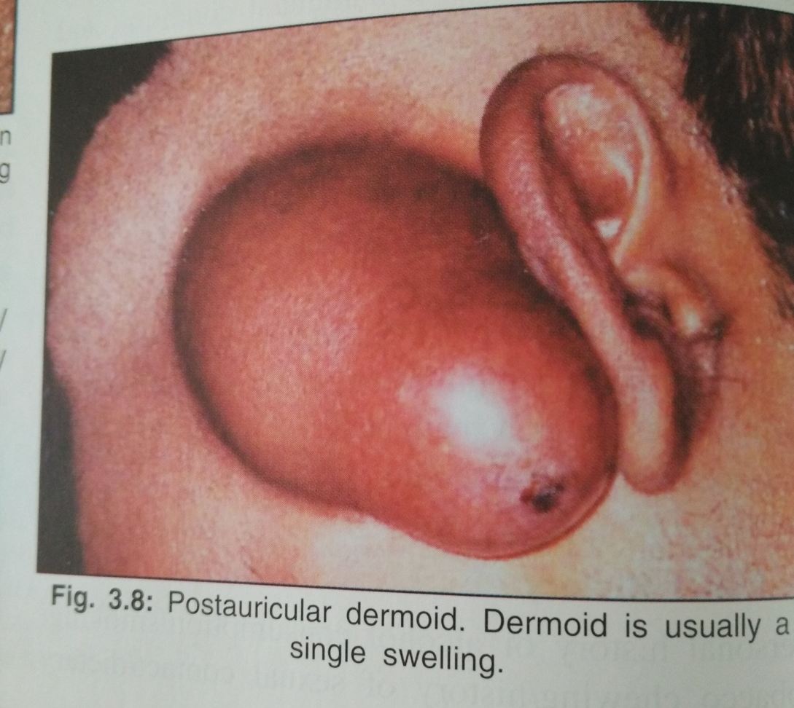
post auricular dermoid

Slide 16
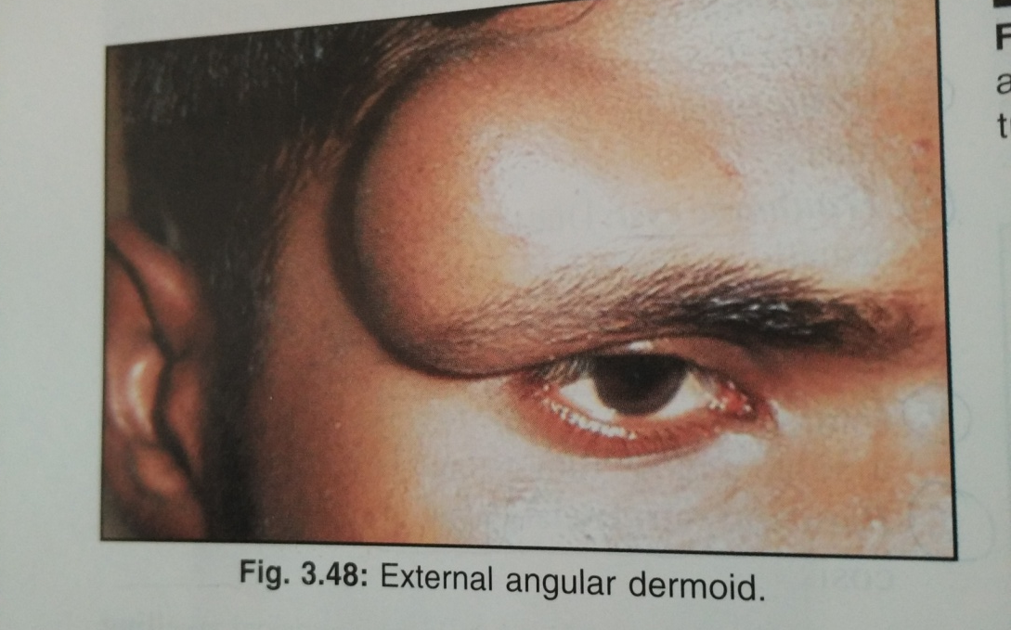

Slide 17
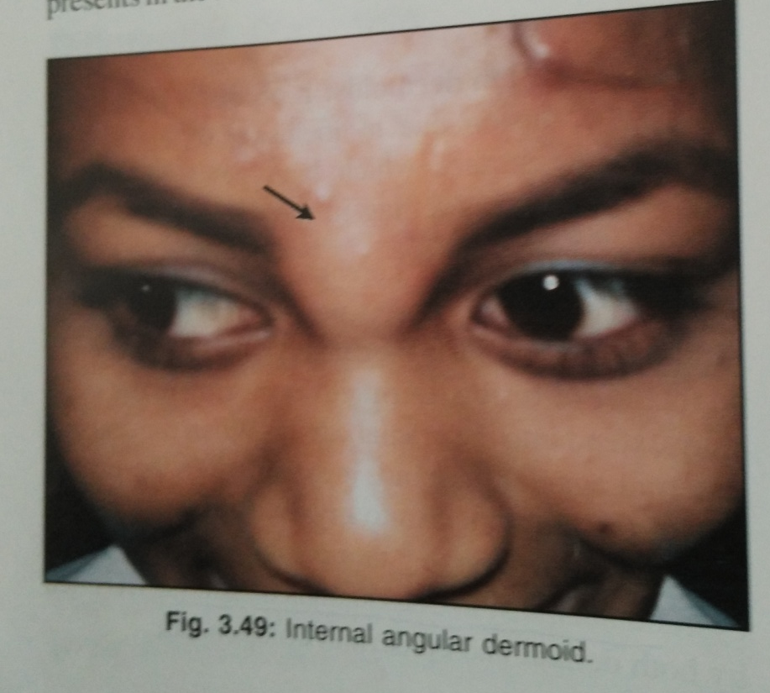
Internal angular dermoid

Slide 18
Treatment
Complete excision of cyst, or recurrence
Plane of cleavage(dissection) should be found between skin and cyst wall
Meticulously remove whole cyst with complete wall, as remaining a small piece of wall will cause recurrence

Slide 19
Vascular malformations
A collective term used for vascular malformation and haemangioma
haemangioma may arise from capillary, artery or vein
Types of haemangioma
1 : Capillary haemangioma,
2 Cavernous haemangiomas
3: Plexiform (cirsoid) haemangioma

Slide 20
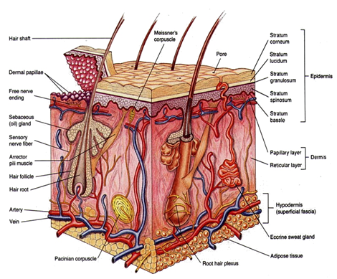

Slide 21
Capillary haemangioma
Bright red or purple coloured patch on skin
Generally flat and not much raised above skin
Pressure may cause complete disappearance of colour and resumes immediately by relieving pressure.
Onset few weeks after birth and disappears by 5-7 years
Common in children, 10 % of live deliveries
Common in skin, s/c and often muscles, liver, brain etc.

Slide 22
Capillary haemangioma
A :: port wine stain: practically no swelling, but red, blue or purple smooth, flat area
Persists life long
Treated by laser, excision & grafting

Slide 23
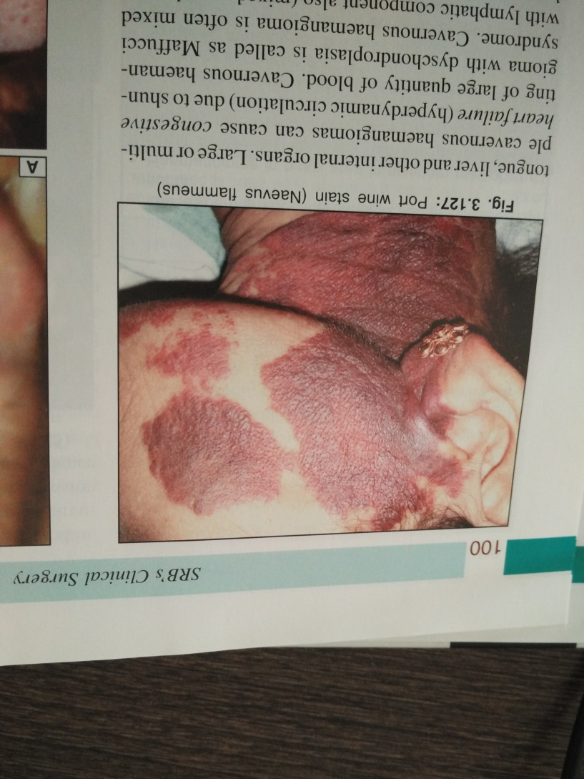
PORT WINE STAIN

Slide 24
B :: salmon patch:
disappear completely in 1 year
Present at birth
Common on neck, face, limbs

Slide 25
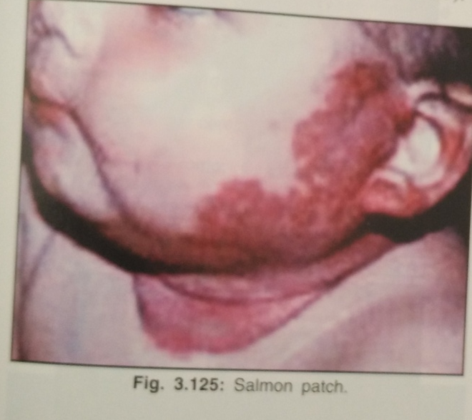
SALMON PATCH

Slide 26
Spider nevus
C : spider naevus: a type of talengiectasis (swollen blood vessel) with central red spot and radiating numerous fine vessels looks like legs OF SPIDER.
Treatment : in children it may disappear after few years…. In ladies it disappear after child birth or cessation of O.C….in cirrhotic pt. it vanish after liver transplant…on face & bad looking leison treated by laser or electric desiccation

Slide 27
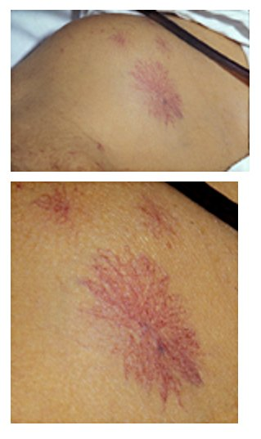
Spider naevus

Slide 28
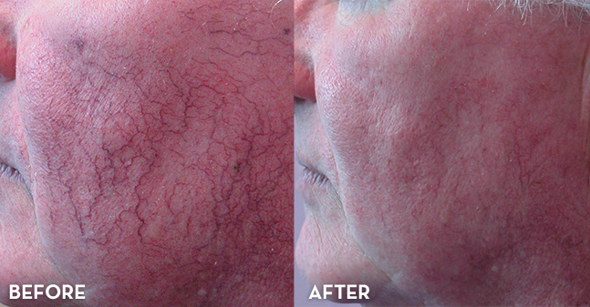
Spider naevus –spider shaped small veins on face before & after remedy

Slide 29
D : Strawberry tumour
It appears at birth or son after birth within 2-3 weeks
Common in white girls
M:F::1:3
True capillary haemangioma which disappear by age of 6-7 years
Most common type of haemangioma

Slide 30
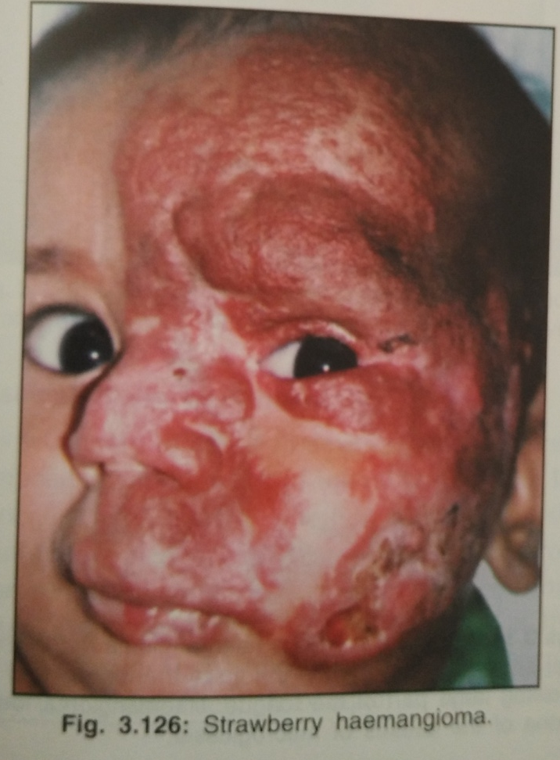
STRAWBERRY HAEMANGIOMA

Slide 31
Treatment :-
of haemangioma requires ligation of feeding vessel after wide exposure.
Ligation must be done before complete excision.

Slide 32
2 : Cavernous haemangioma:
consists of dilated spaces containing blood and produces a spongy swelling.
Compressible and refills after release of pressure
Many times associated with internal similar swellings also, like haemangioma in brain with face tumour-haemangioma

Slide 33
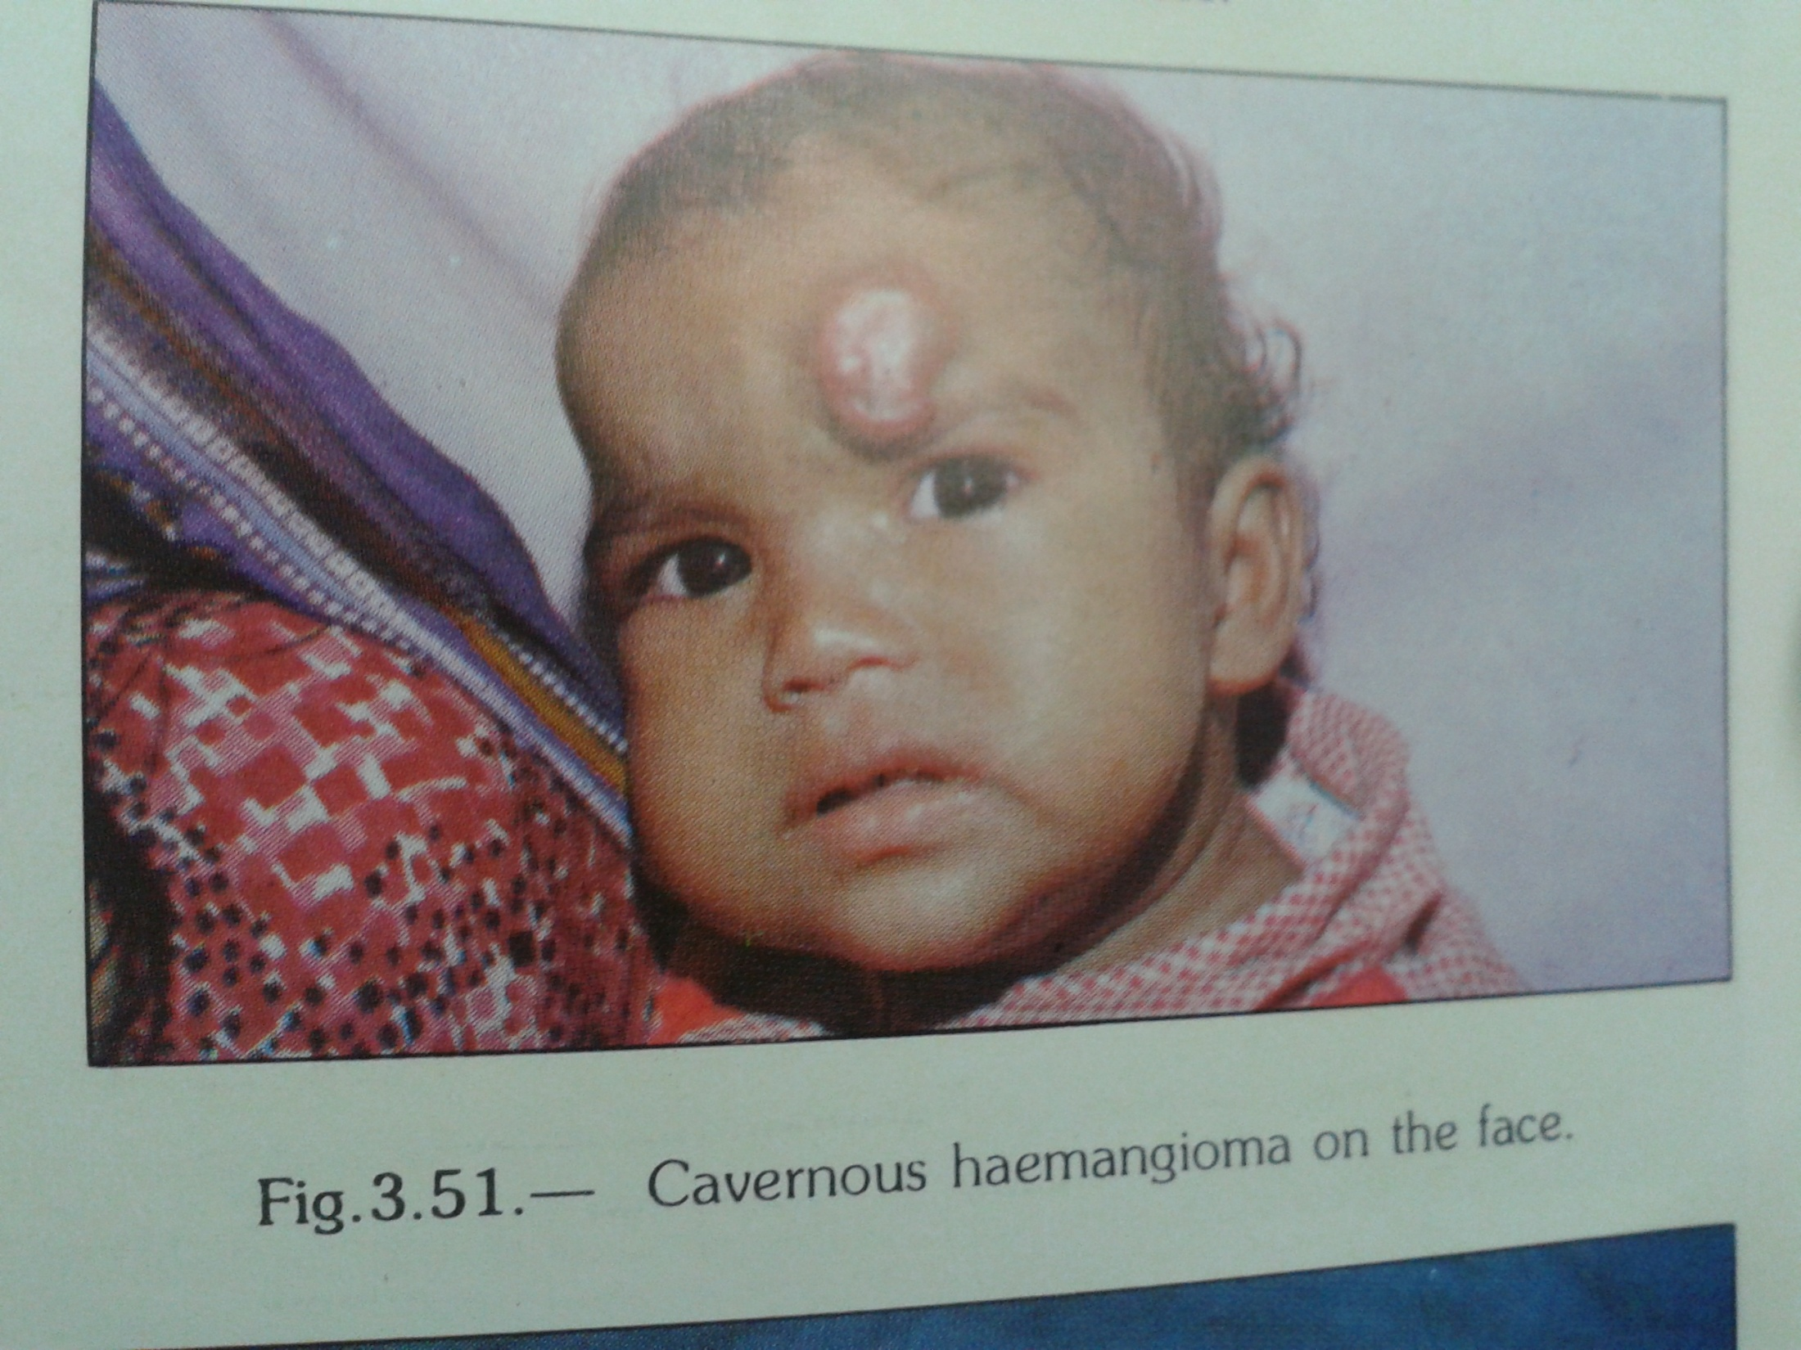
Cavernous haemangioma on face

Slide 34
3 : Cirsoid aneurysm : a group of dilated blood vessels-arteries
It is like pulsatile earth warms
A net work of inter woven arteries
Congenital arteriovenous fistula : usually in limbs: local warmness, enlarged size of limb, varicose veins + insufficiency of distal limb circulation

Slide 35
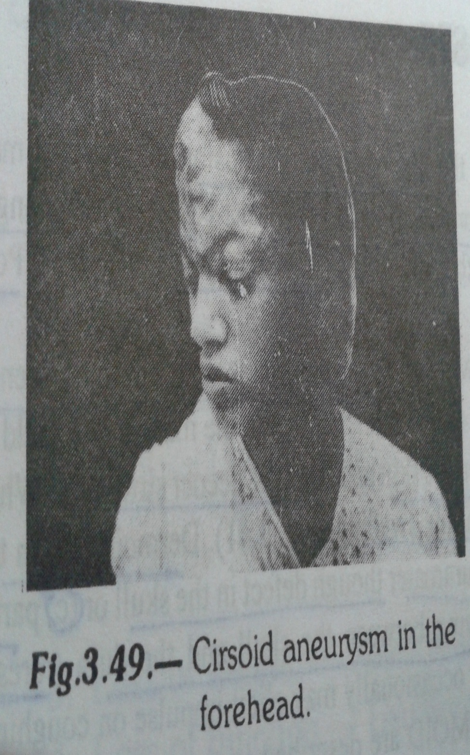
Cirsoid aneurysm

Slide 36
Sebaceous cyst
This is the cyst of sebaceous gland as a result of retention of its secretions
Blockage of the duct of the gland which may open in the hair follicle sometimes or on skin
Dermatomia hominis organism sometime blocks the duct.
Contains sebum which is whitish yellow cheesy, pultaceous material

Slide 37
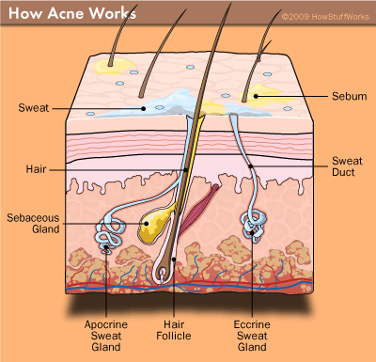

Slide 38
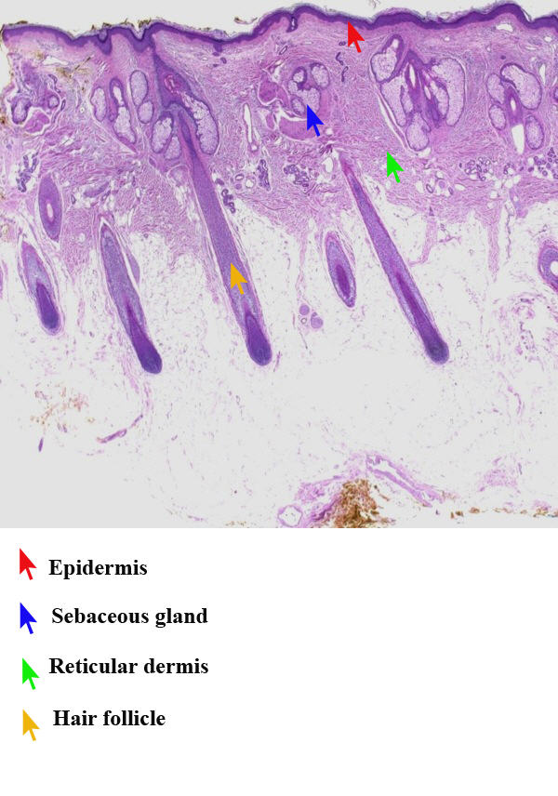
s

Slide 39
Fixed to the skin but moves freely over the underlying structures
70 % cases have a black spot on cyst which is the blocked opening of duct, called punctum
Occur anywhere in body except sole and palm
Common on face, scalp, scrotum
Hair is lost over swelling due to pressure effect
Margin will yield to pressure of finger-indentation
Harbour parasite in wall DEMODEX FOLLICULORUM

Slide 40
Giant sebaceous cyst: cyst more than 5 cm size
Risk of malignancy more
Complications:
1: infection
2: ulceration
3: rupture and sinus
4: calcification
5: carcinomatous change

Slide 41
6: cock’s peculiar tumour: infected sebaceous gland ruptures and infection spreads in the surrounding tissue. There it forms a boggy swelling, fungating, discharging mass is called cock’s peculiar tumour
7 : sebaceous horn:

Slide 42
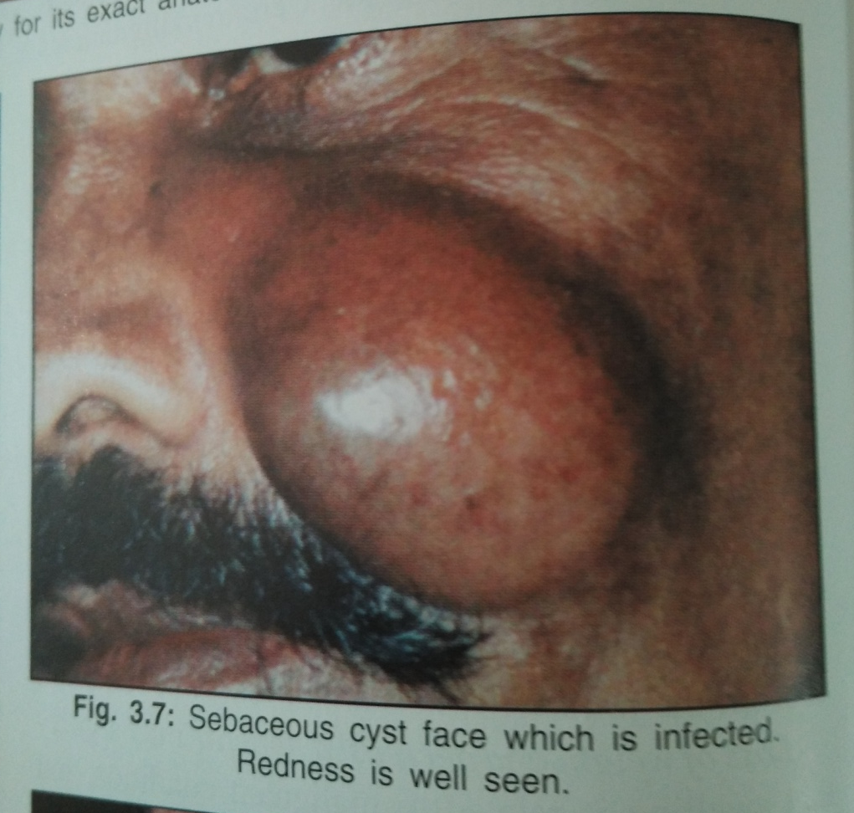
Infected sebaceous cyst

Slide 43
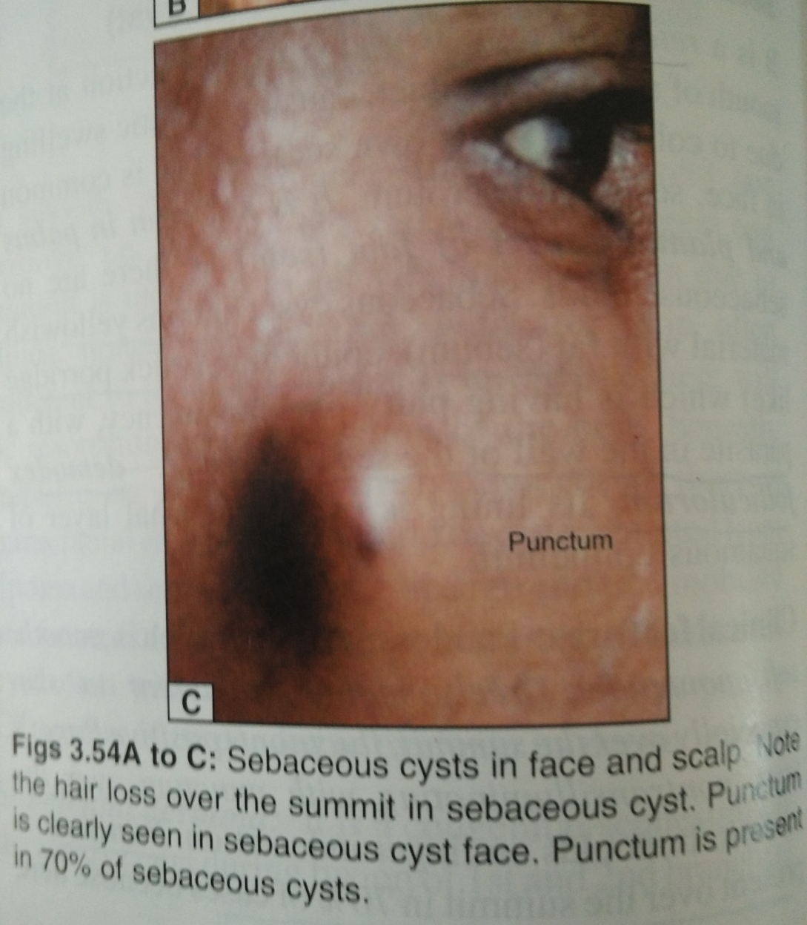
Sebaceous cyst face with punctum

Slide 44
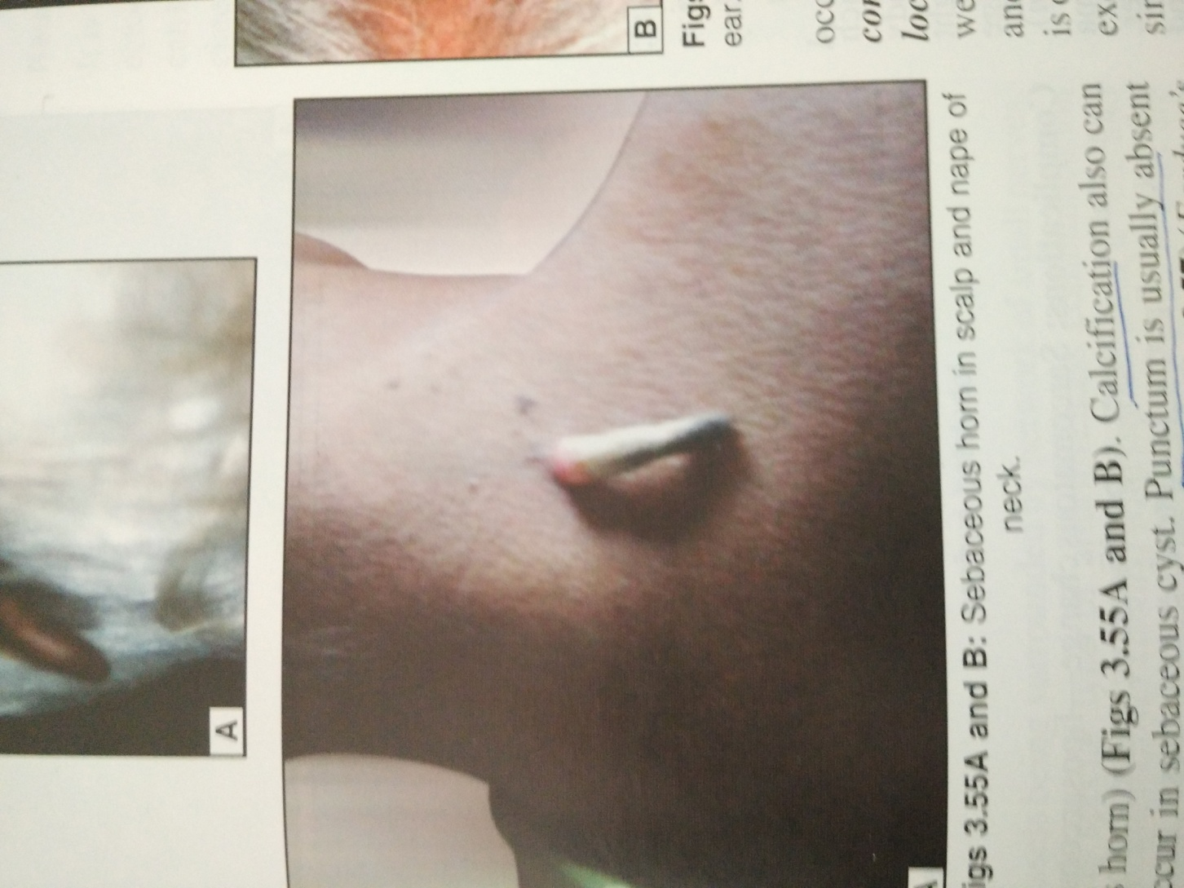
Sebaceous horn

Slide 45
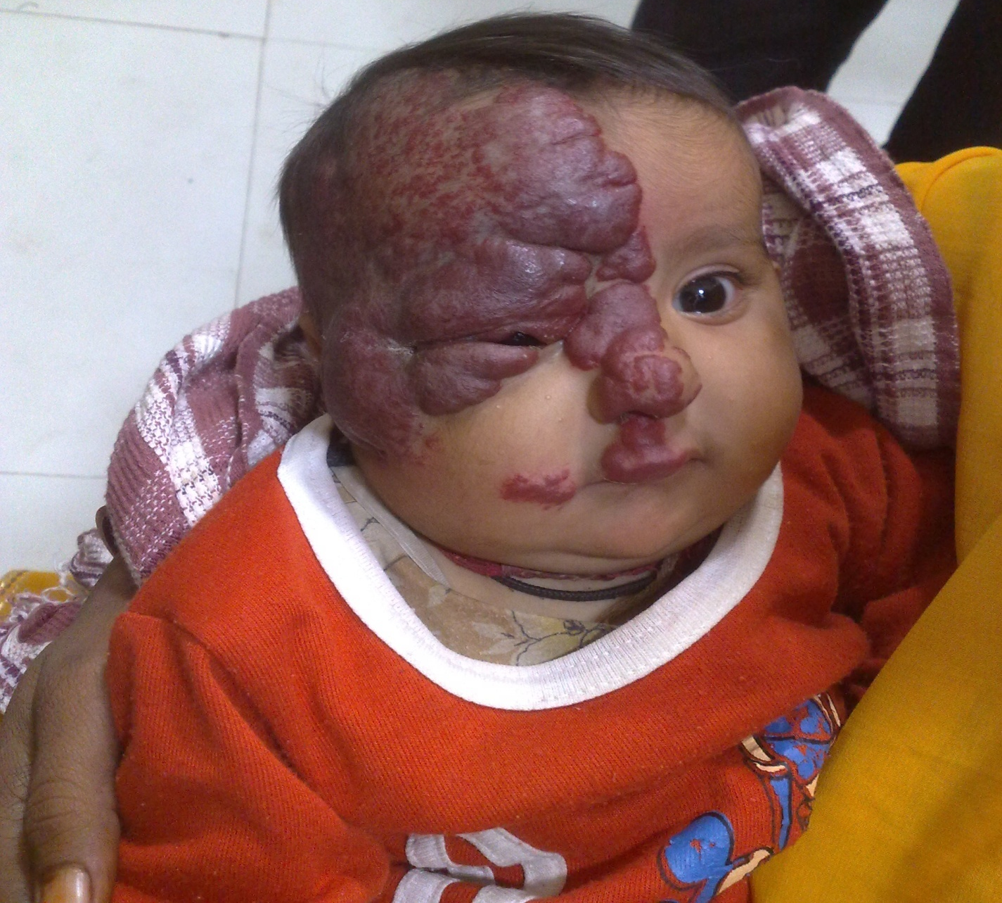
Raspberry haemangioma

Slide 46
Basal cell carcinoma
Also called rodent ulcer or field fire ulcer
Situated above a line drawn from ear lobule to angle of mouth
Common site is near the inner canthus of eye
Margin is beaded and raised
Locally malignant, means no lymphatic or blood spread, burrows deeply
Healing in the centre and spreading in periphery
Arises from basal layer of epidermis

Slide 47
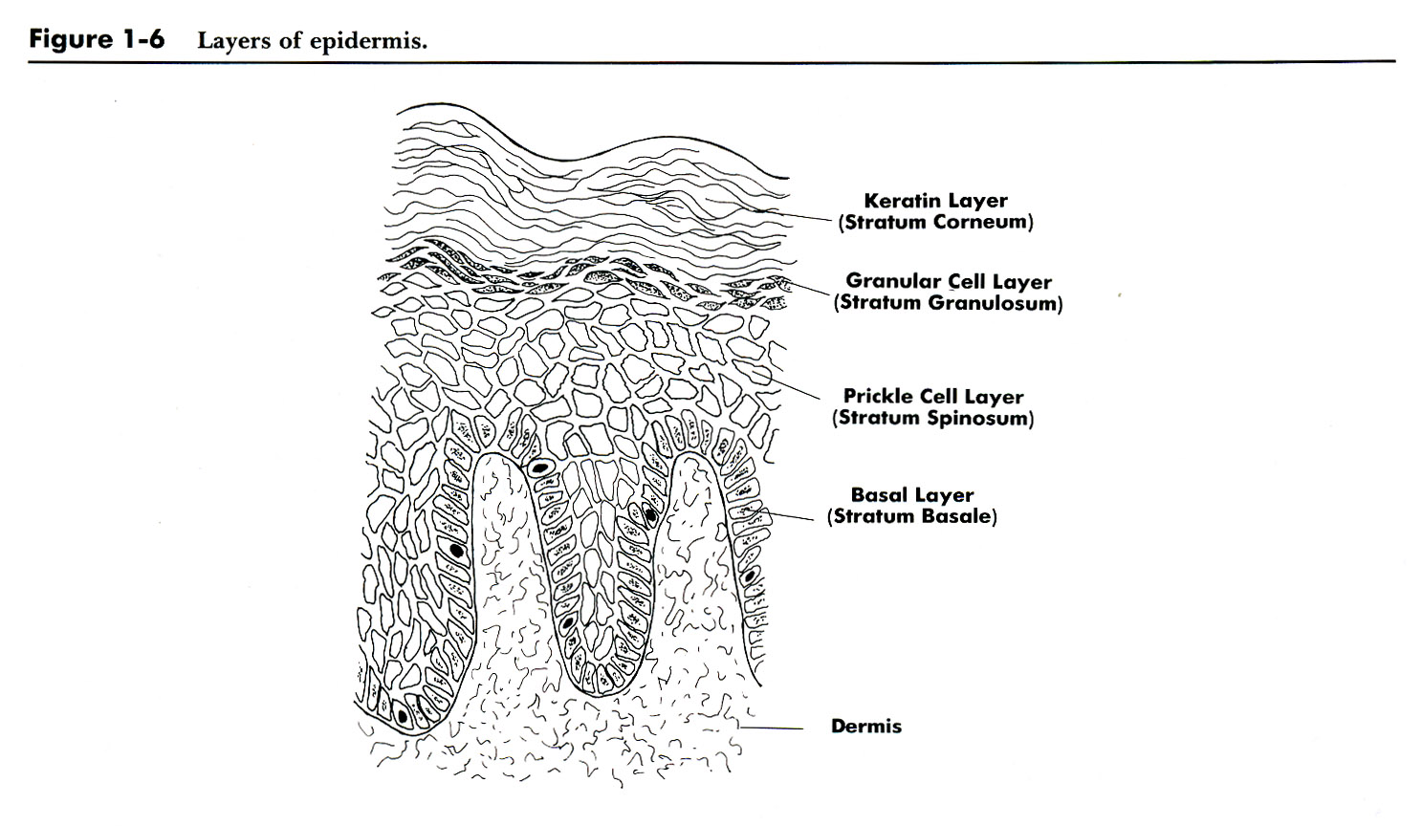
SKIN: Anatomy

Slide 48
Common in white skinned people due more exposure to UV rays
Ulcer burrows deep structures like rat and erode bone
Diagnosis : ulcer < 1 cm …excision biopsy
Larger ulcer ….wedge biopsy to confirm

Slide 49
Ulcerative form
Nodular …… which ultimately will ulcerate
Pigmented
Plaque: firm , raised and red plaque
Treatment : curable malignancy. surgery excision of ulcer with 3-5 mm clear margin with immediate skin graft like rhomboid flap-or rotation flap
Radiotherapy
Local 5 FU application

Slide 50
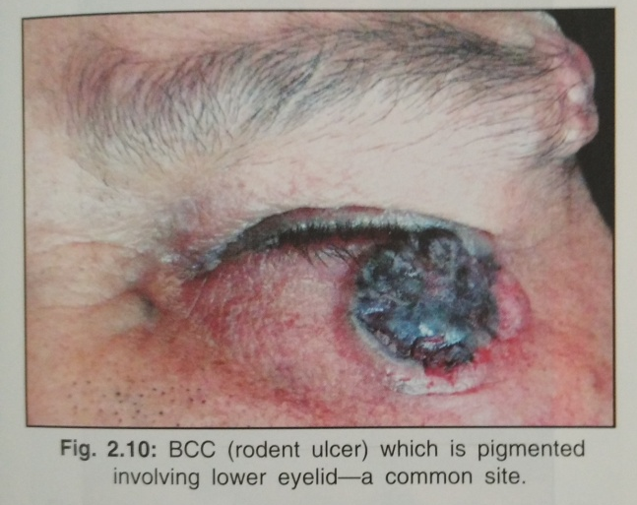
Basal cell carcinoma with pigment

Slide 51
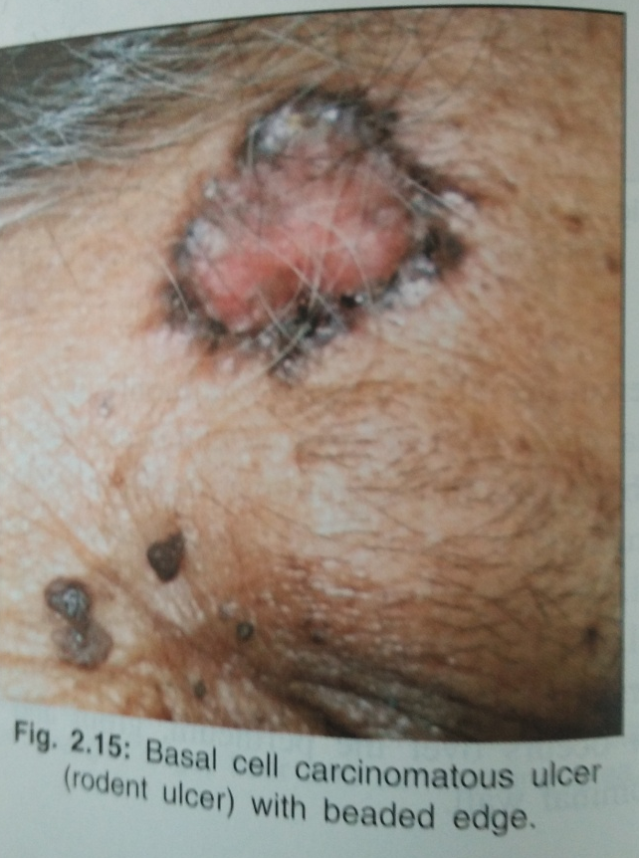
Basal cell carcinoma –ulcer with beaded margin

Slide 52
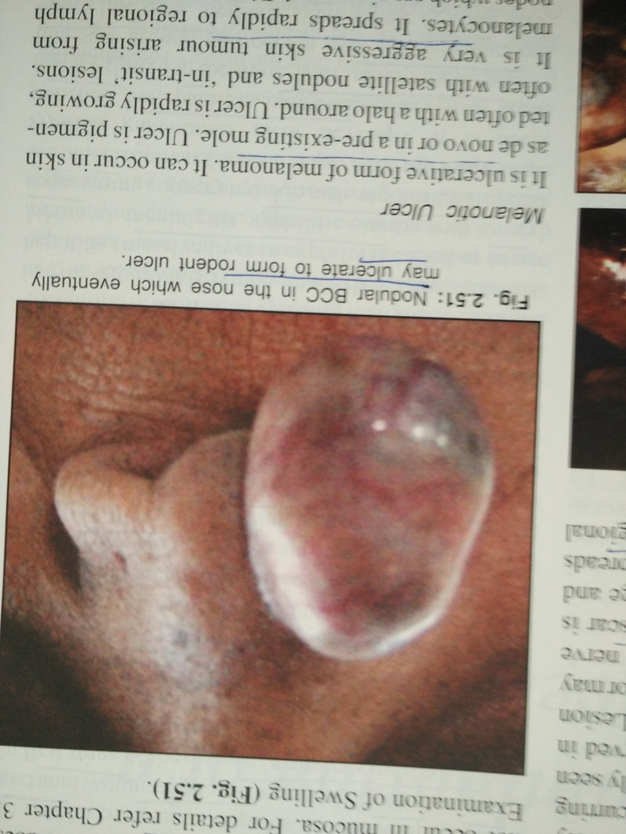
Nodular Basal cell carcinoma- eventually ulcerate -ulcer

Slide 53
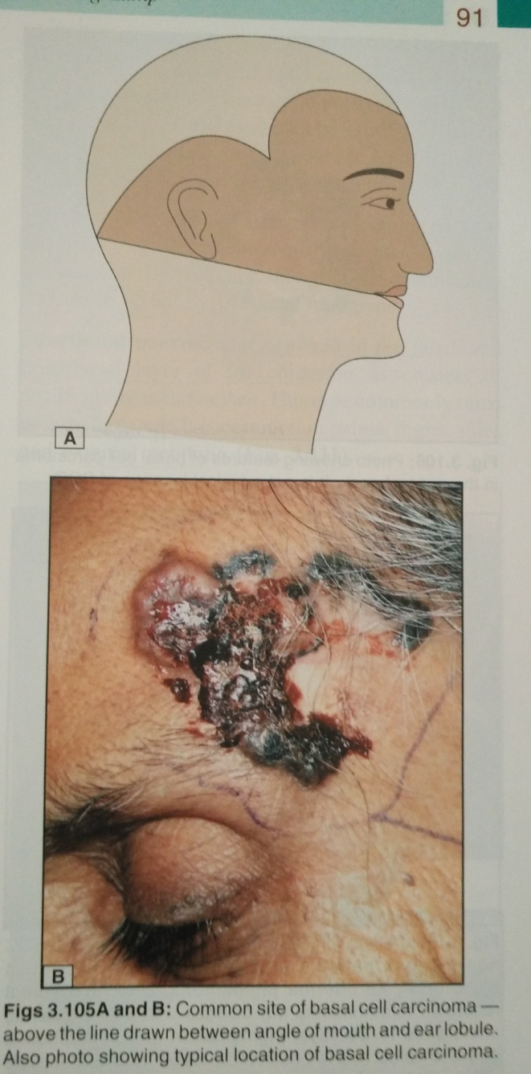
BASAL CELL CARCINOMA

Slide 54
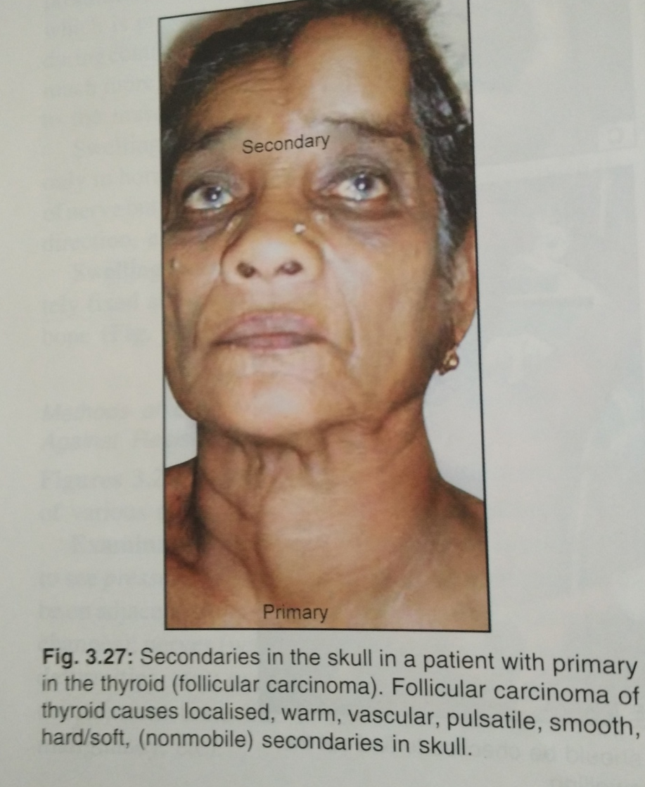
Secondary from thyroid in skull

Slide 55
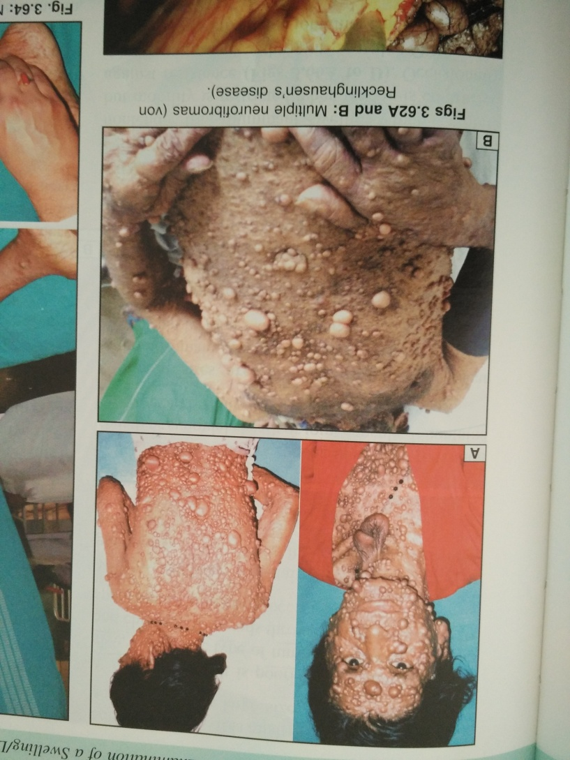
Multiple neurofibromatosis- von Recklinghausen’s disease

Slide 56
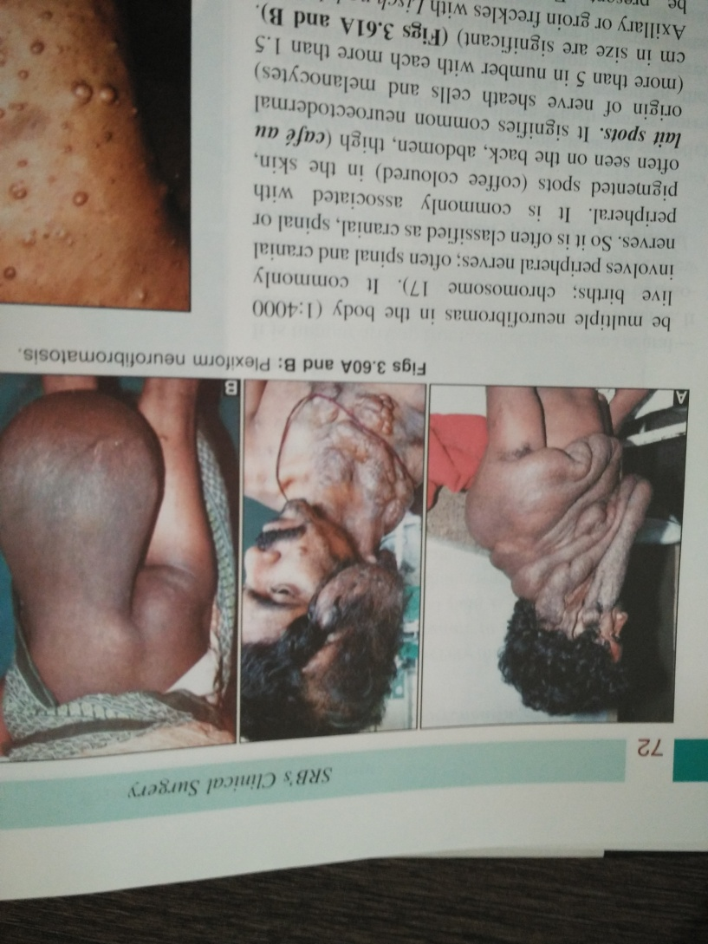
Plexiform neurofibromatosis

Slide 57
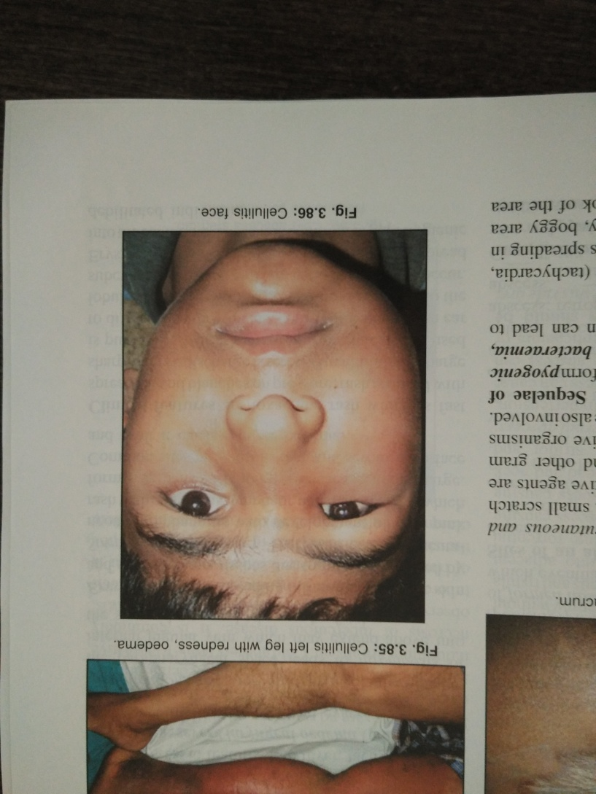
Cellulitis face

Slide 58
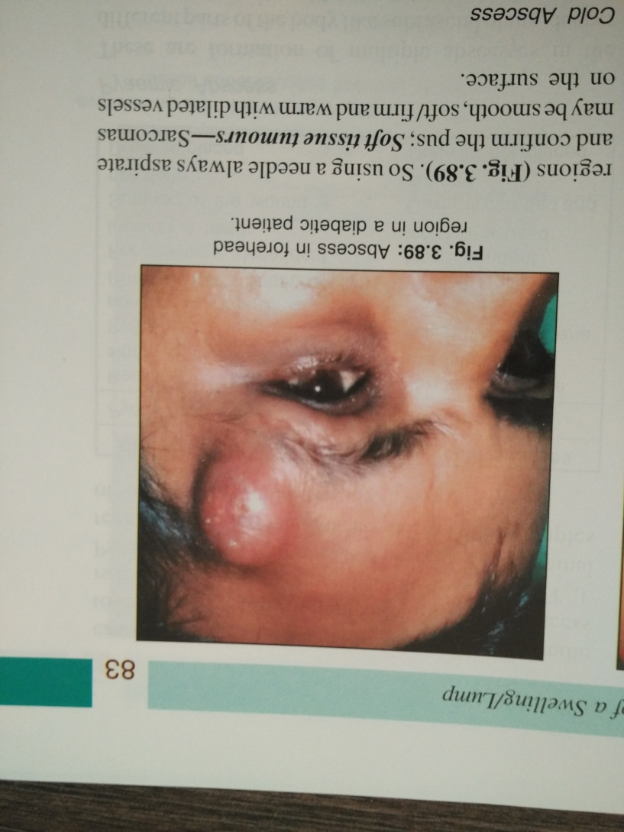
FOREHEAD ABSCESS

Slide 59
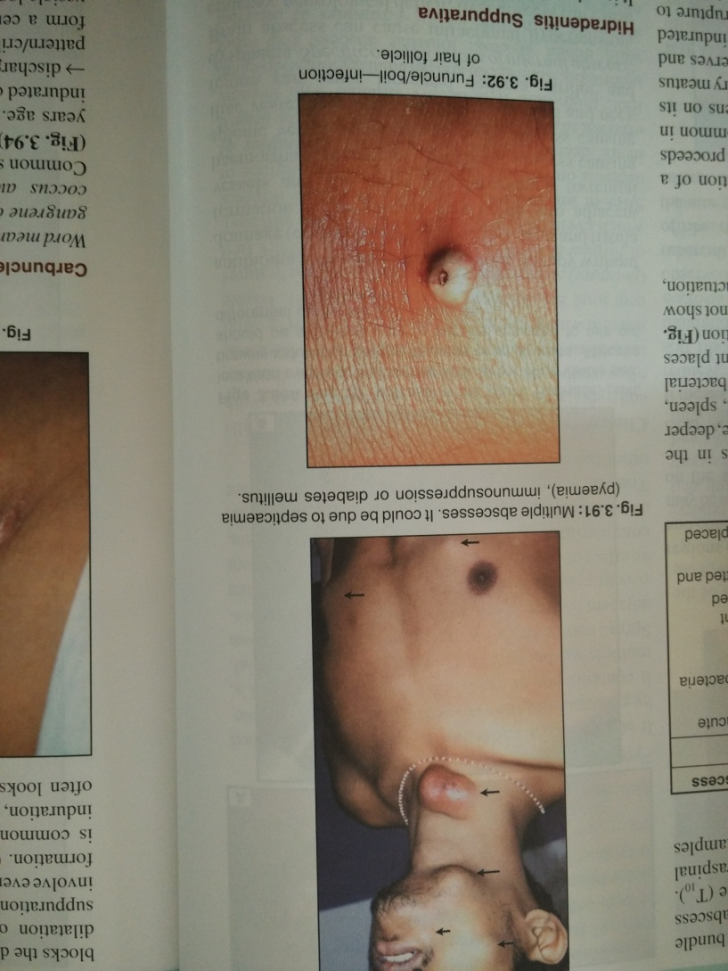
MULTIPLE ABSCESS FACE AND FURUNCLE-HAIR FOLLICLE INFECTION

Slide 60
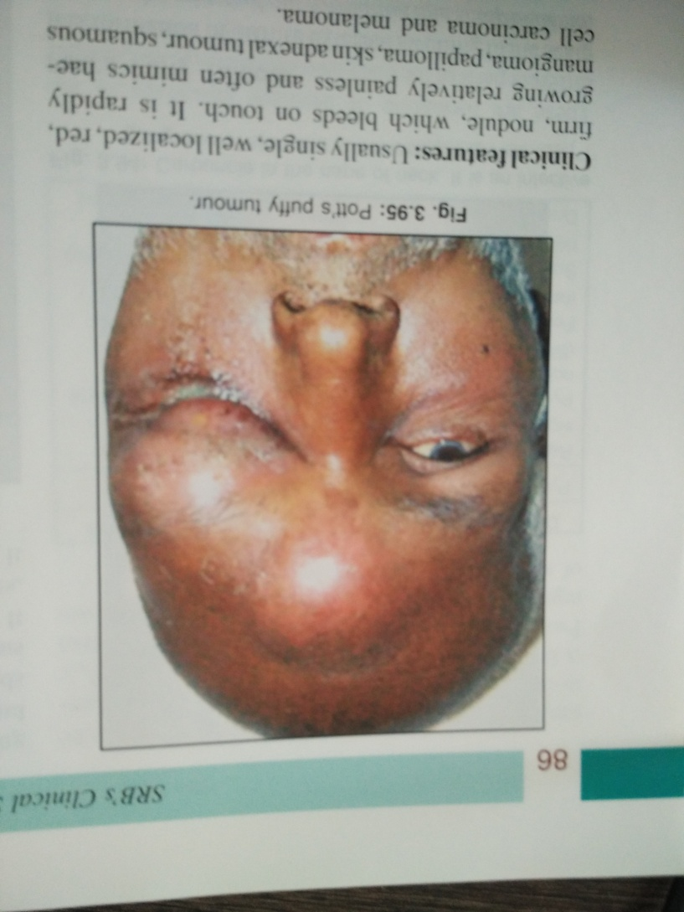
POTT’S PUFFY TUMOUR-infected sebaceous cyst on face

Slide 61
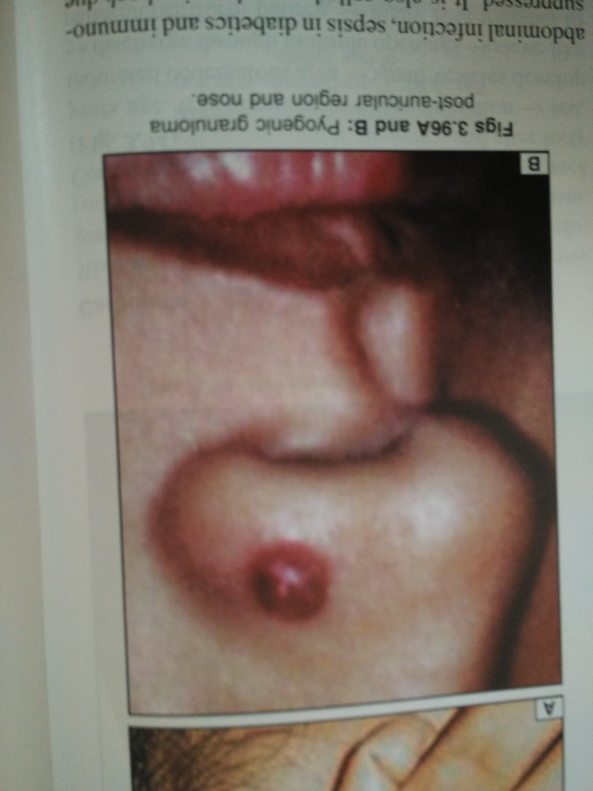
PYOGENIC GRANULOMA

Slide 62
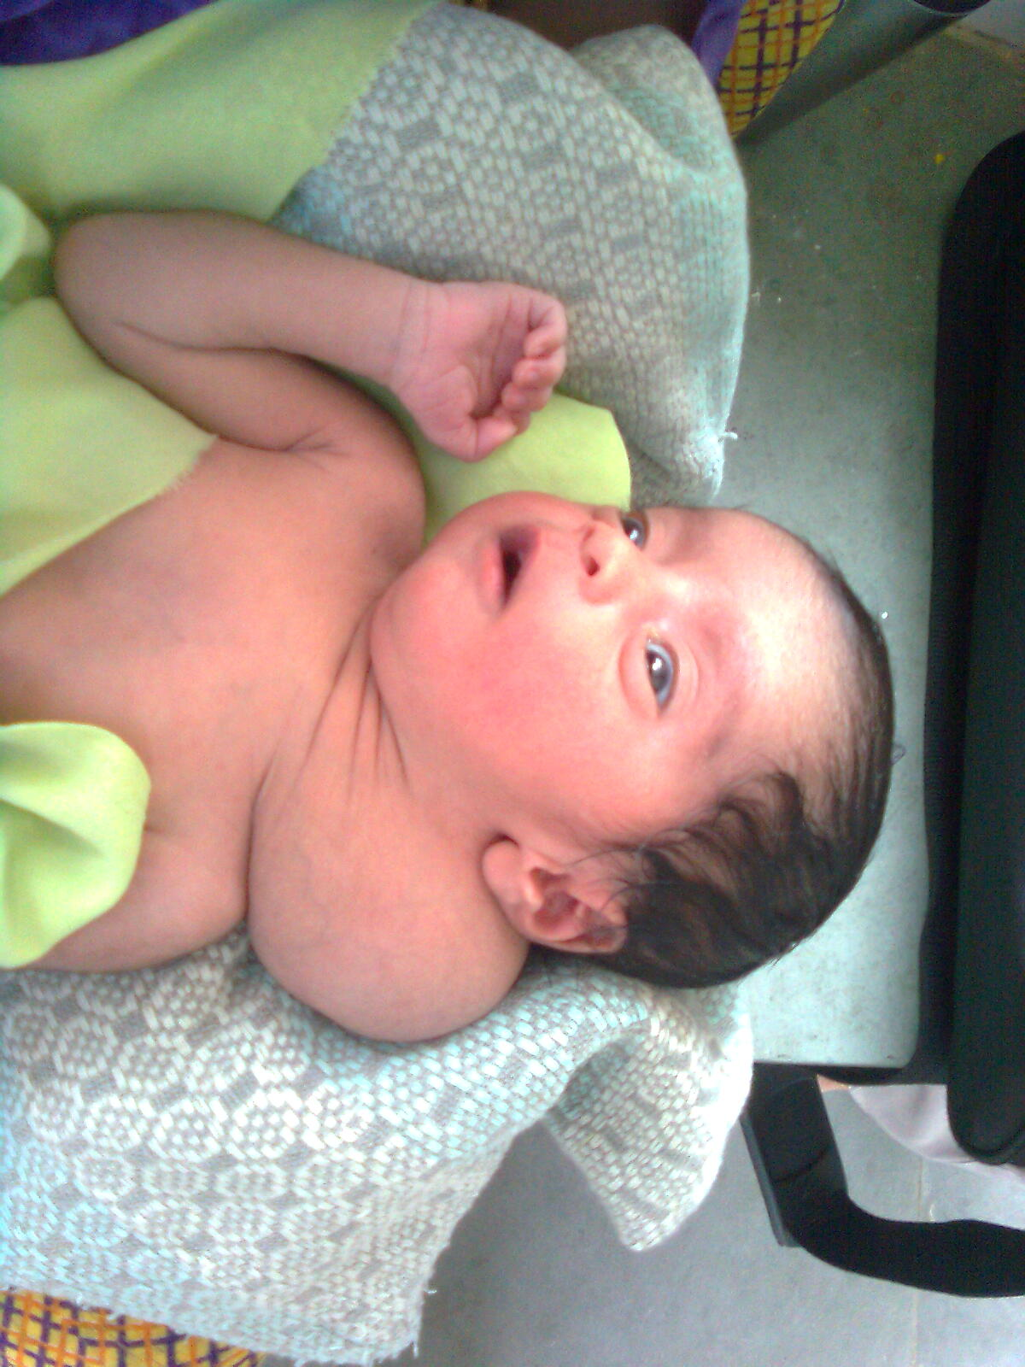
Cystic hygroma

Slide 63
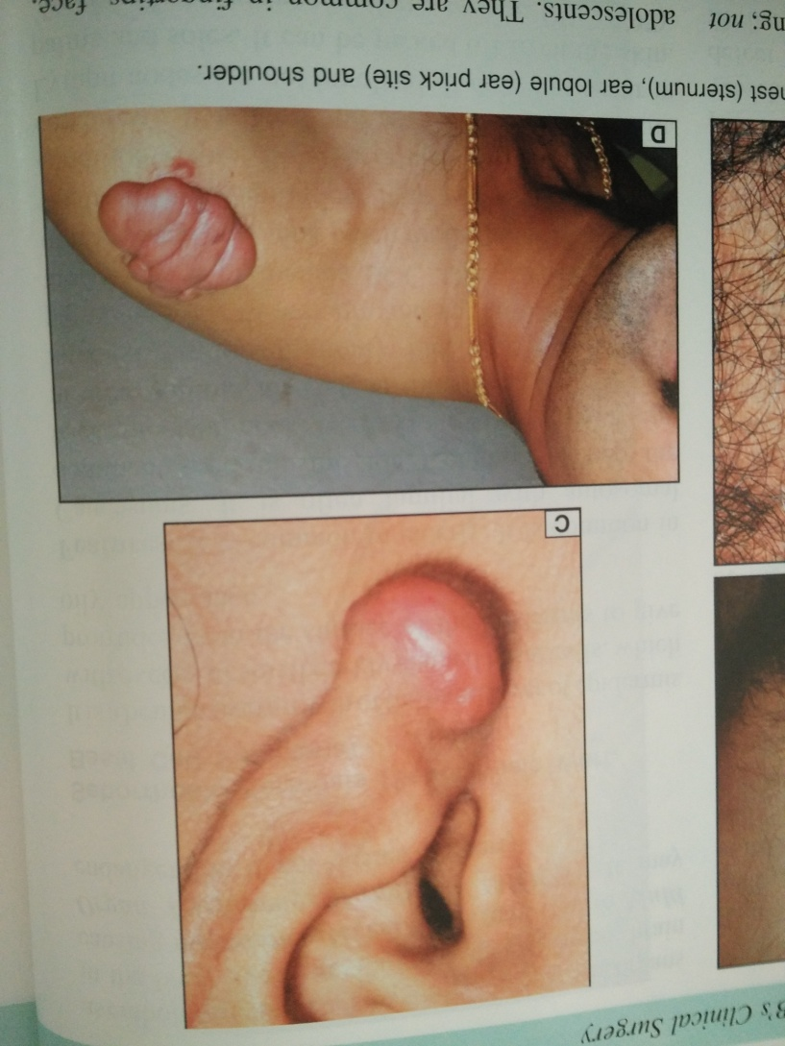
KELOID EAR AND RIGHT SHOULDER

Slide 64
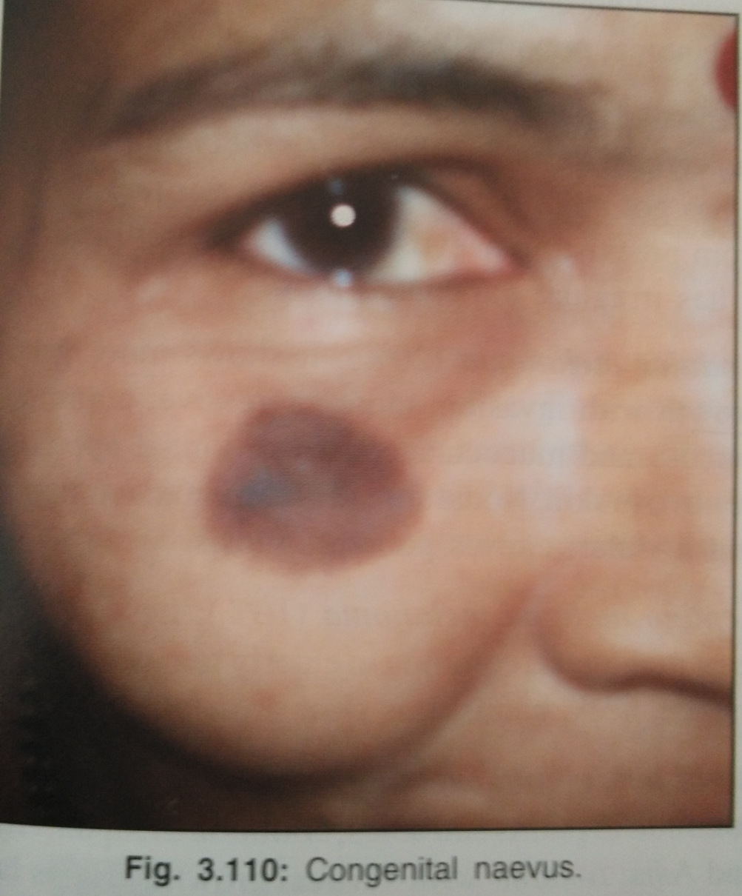
CONGENITAL NAEVUS

Slide 65
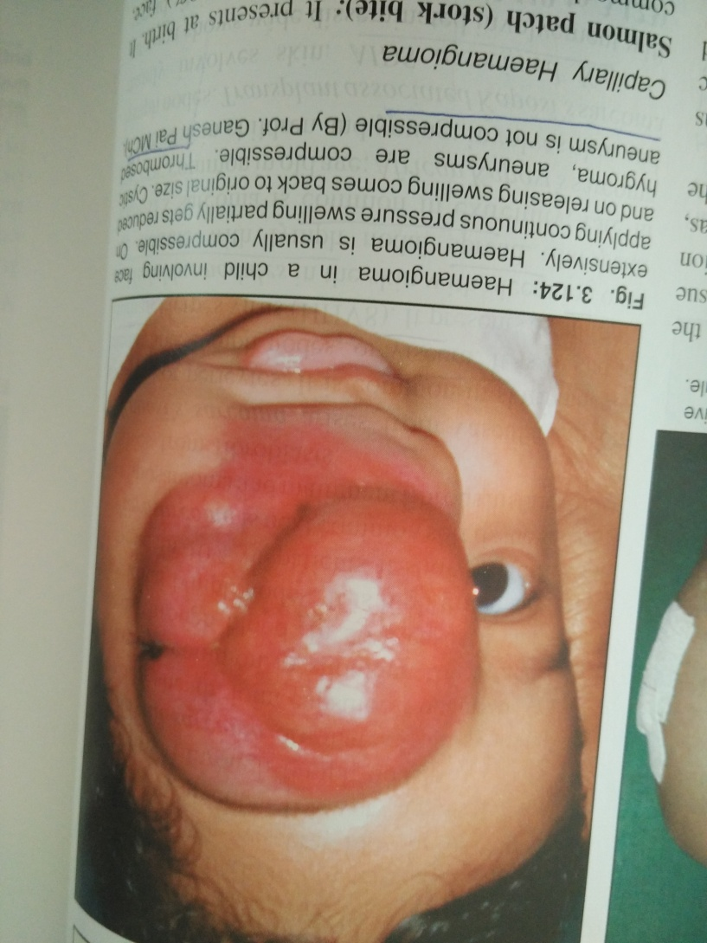
HEMANGIOMA

Slide 66
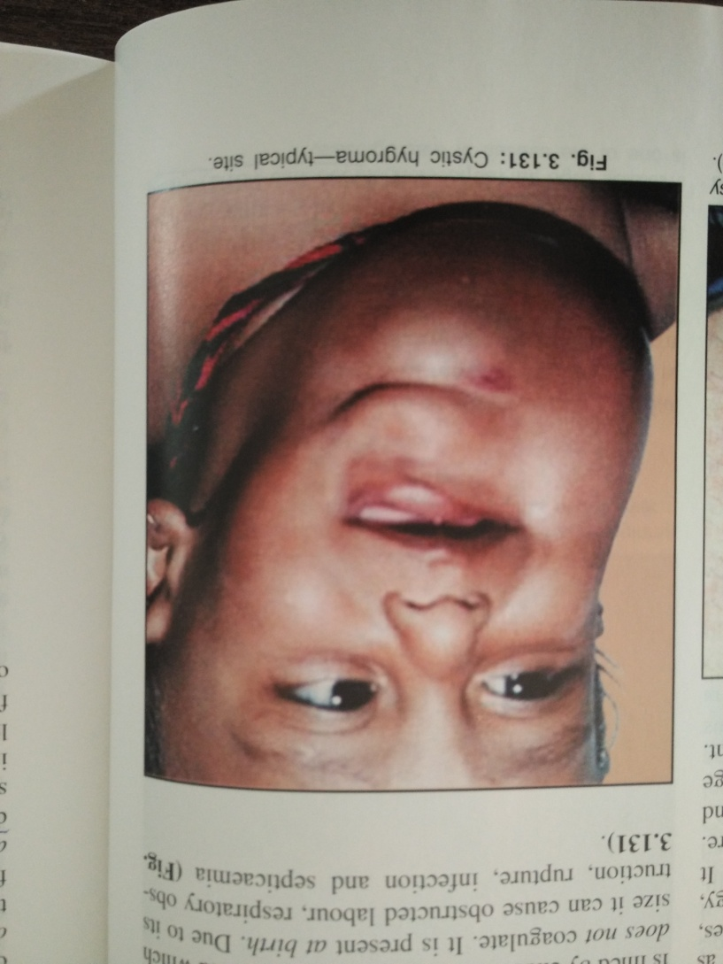
GIANT CYSTIC HYGROMA

Slide 67
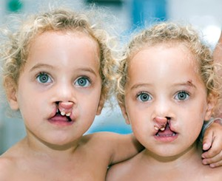
Cleft lip & palate

Slide 68
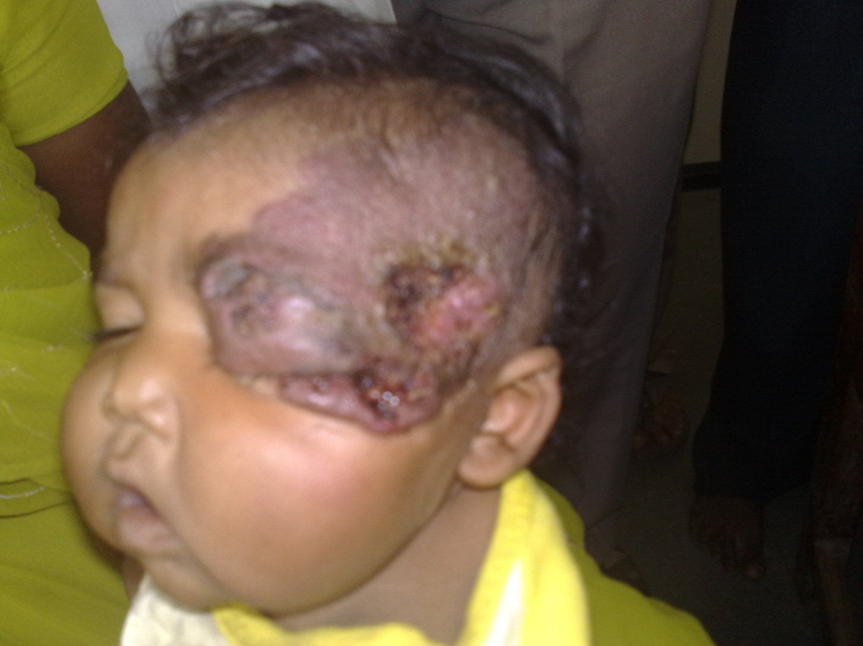
Haemangioma with ulcer

Slide 69
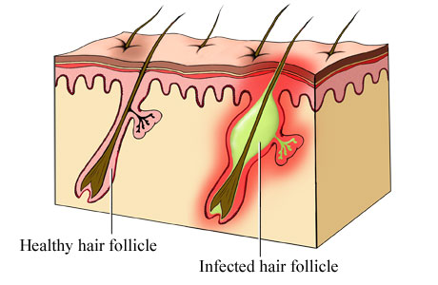
Boils
A boil, also called a furuncle, is a deep folliculitis, infection of the hair follicle.
-Staphylococcus aureus

Slide 70
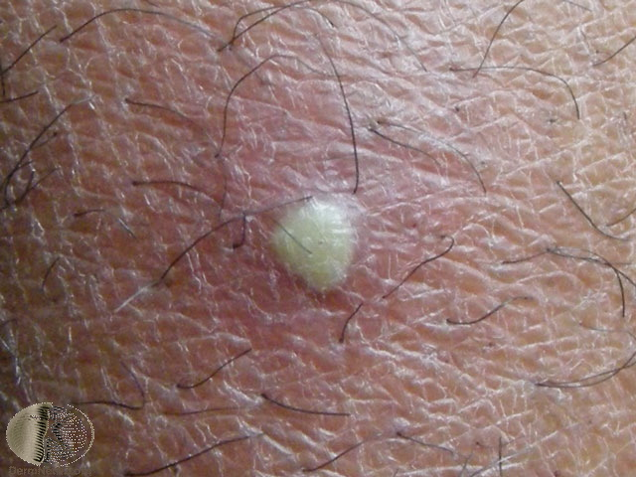
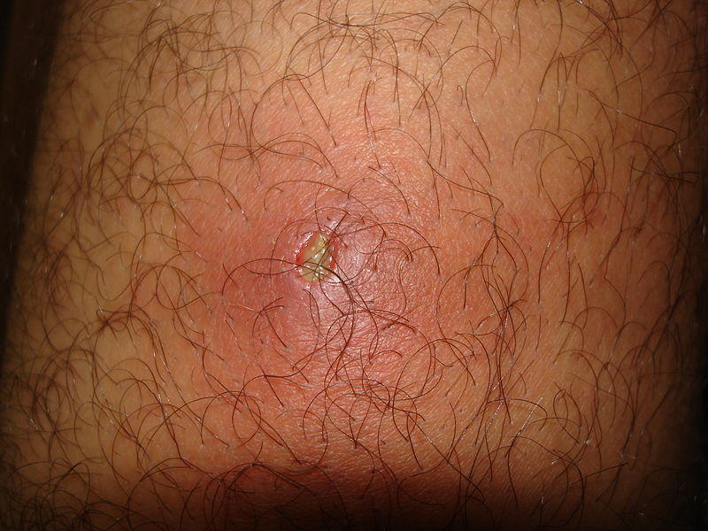
Boils are red lumps around a hair follicle that are tender, warm, and very painful (signs of inflammation).
- pea-sized to golf ball-sized.
- yellow or white point at the center of the lump / discharge pus.
severe fever, swollen lymph nodes, and fatigue.
chronic furunculosis is recurring boil + Systemic factors that lower resistance : diabetes, obesity, and hematologic disorders.

Slide 71
Treatment
Antibiotics against Staphylococcus aureus .
small boil burst and drain spontaneously
recurrent boils a systemic cause should be looked for and treated.

Slide 72
Mcq 1
Characteristic of sequestration dermoid cyst is……
A ::- presence of punctum
B : light blue colour
C : develops in line of embryonic fusion
D: never occur over palm or sole

Slide 73
Mcq 2
Strawberry haemangioma is a ……
A: cavernous haemangioma
B: capillary haemangioma
C: cirsoid haemangioma
D: hemartoma

Slide 74
Mcq 3
Cock’s peculiar tumor is an ………
A : Infected sebaceous cyst on scalp with sinus
B : Infected lipoma
C: benign tumour of skin
D: tumour of eye

Slide 75
Mcq 4
Basal cell carcinoma is a…….
A: benign tumour of skin
B: malignant tumour of skin
C: locally malignant tumour of skin
D: incurable carcinoma

Slide 76
Mcq 5
Burns of face usually treated by …….
A: closed dressing
B: open dressing with silver sulfadiazine
C: local application of mercurochrome
D: immediate excision of burn skin

Slide 77
key
Mcq no. Answer
1 C
2 B
3 A
4 C
5 B

