Slide 1
RENAL TUBERCULOSIS
DR.OHANG CHAUDHARI

Slide 2
TUBERCULOSIS
Mycobacterium tuberculosis
Humans are the only reservoir of M.TB
It doesn’t have it’s own toxins
In lung they forms granuloma
Caseous necrosis
Abscess

Slide 3
HOW GRANULOMA FORM??
Bacteria enters in lung alveoli
Activated Macrophage & monocytes try to destroy it
Initiation of PHAGOCYTOSIS--- but unable to do complete phagocytosis - as bacterial sulfolipids inhibits fusion of phagocytic vesicles with lysosomes
Bacteria will remain alive & will multiply there

Slide 4
IN 2-4 WEEKS
Poorly digestable bacteria act as an antigen
Lead to activation of CD4+ lymphocytes
which later get activated and elaborate cytokines ( interferon- gama )
Interferon gama act on Activated macrophages who have engulf bacteria turns into epithelioid histiocytes
Which later aggregate to form GRANULOMAS

Slide 5
EXTRAPULMONARY TB
Immune system will destroy the bacteria by interferon gama
BUT some will survive and are spread by BLOOD to --- EXTRAPULMONARY SITES
Bacteria will do the same thing in other host cells also

Slide 6
RENAL TUBERCULOSIS
Usually secondary
Primary most of the times in lung
Initially lesion in RENAL CORTEX –which leads to bacillurea
and then spreads to URETER - leads to ureteritis and stricture

Slide 7
PATHOLOGICAL TYPES
Bacteria reach GLOMERULI– causing caseating granuloma with - Langhan type of giant cells - epithelioid cells
This granulomas aggregates and form papillary ulcer and other forms -tuberculous papillary ulcer -cavernous form -hydronephrosis -pyonephrosis ( e.coli,klebsiella)

Slide 8
OTHER
Tuberculous perinephric abscess
Calcified tuberculous area ( look like stone-also termed as PSEUDOCALCULI)
Caseous kidney- also termed as putty kidney or cement kidney( autonephrectomy)
Miliary tuberculosis

Slide 9
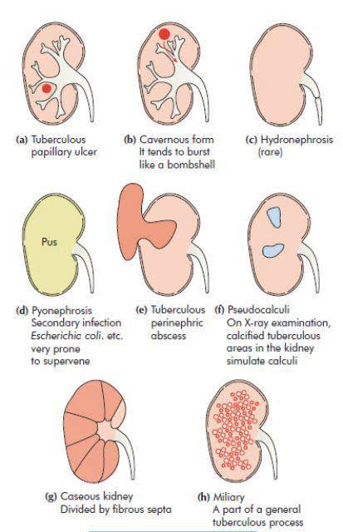
.

Slide 10
Other pathology
Tuberculous bacillurea -in early stage -lead to tuberculous ureteritis and stricture ureter -most common site for stricture
-ureterovesicle junction - second most common -pelviureteric junction

Slide 11
Tuberculous cystitis
Due to fibrosis entire bladder gets fibrosis
lead to dilated ureteric orifice - golf hole ureter
Due to fibrosis bladder become stiff & unable to dilate and filled with retained urine -thimble bladder

Slide 12
other
Tuberculous prostatitis
Seminal vesiculitis
Tuberculous epididymitis
Funiculitis -beaded thickened vas deference

Slide 13
Clinical features
Common in male
Common on right side
History of pulmonary TB
Increased urinary frequency -both day & night
Polyuria
Sterile pyuria- -pale acidic urine with pus but no organisms in urine culture

Slide 14
other
Painful micturition with hematuria
Pain at renal angle
Suprapubic pain due to cystitis
Impotence & sterility due to involvement of seminal vesicles ,prostate
If hydronephrosis & perinephric abscess - palpable kidney

Slide 15
other
Fever
Cough with expectoration and hemoptysis
weight loss
Dyspareunia,menstrual dysfunction,vaginal discharge – in FEMALE

Slide 16
INVESTIGATIONS
CBC
ESR
MANTOUX TEST- positive skin test
CHEST X RAY
USG ABDOMEN
EMSU --3 consecutive early morning sample of urine - microscopy Z-N staining, -culture on L J MEDIUM

Slide 17
INVESTIGATIONS
PLAIN X RAY KUB - shows calcification
IVP- stricture , hydronephrosis
CECT ABDOMEN PELVIS -hydronephrosis, shrunken kidney, -stricture, necrosis
RETROGRADE PYELOGRAPHY
CYSTOSCOPY-golf hole ureter
PCR- tuberculosis detection
MCU- stricture ureter

Slide 18
TREATMENT
ANTITUBERCULAR THERAPY - HRZE for 1 year - isoniazide, rifampicin, -pyrazinamide, ethambutol
After 6-12 weeks of drug therapy -surgical exploration -drain pus -cut edge of capsule sutured - hanley’s renal cavernostomy

Slide 19
Hydronephrosis
NEPHROSTOMY
ANDERSON HYNES PYELOPLASTY
DJ STENT

Slide 20
Stricture ureter
DJ STENT
reimplantation of ureter in bladder
Ileal conduit
Boari’s flap

Slide 21
Thimble bladder
Hydraulic dilatation
Ileocystoplasty
Caecocystoplasty
Sigmoid colocystoplasty

Slide 22
other
Renal TB abscess not resolving after 2 week of drug n therapy - do surgical exploration
In unilateral lesion & gross impairment of renal function - nephroureterectomy

Slide 23
MCQ 1
Antitubercular drug therapy given for 1. 2 years 2. 6 months 3. 1 year 4. 2 months

Slide 24
MCQ 2
Which of the following is responsible for granuloma formation?? 1.interferon gama 2. interferon alpha 3.toxin of mycobacterium 4. secondary infection

Slide 25
MCQ 3
ALL are component of ANTITUBERCULAR DRUG therapy for renal TB EXCEPT.. 1 isoniazide 2.rifampicine 3.zidovudine 4.pyrazinamide

Slide 26
MCQ 4
Culture media for tuberculosis 1. L.J. media 2. macConkey 3. mannitol salt 4. tripticase

Slide 27
MCQ 5
All are features of tuberculosis EXCEPT 1. fever 2 . Weight loss 3. heamatemasis 4.hemoptysis

