Slide 1
Surgical complications of typhoid
Dr. Ohang Chaudhari

Slide 2
Typhoid/enteric fever
Organism-Salmonella typhi, Gram neg.
Mode of transmission- faecooral route
Initial presentation- fever, chills, abdo.pain
Asymptomatic human carriers are most important reservoirs

Slide 3
complications
Paralytic ileus most common
Intestinal haemorrhage due to ulcer
Perforation- at 3rd week
Cholecystitis
DVT
Cystitis
Typhoid abscess in liver ,spleen, brain, parotid

Slide 4
Enteric perforation
Multiple ulcers arranged in parallel and in antimesenteric border of ileum
One or more ulcers might perforate
Many ulcers may be on impending perforation

Slide 5
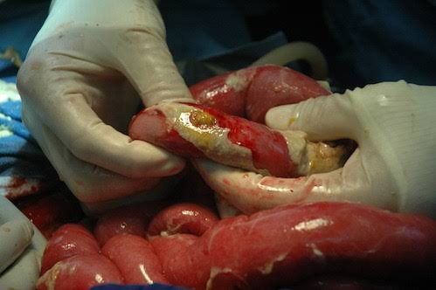
0n table view

Slide 6
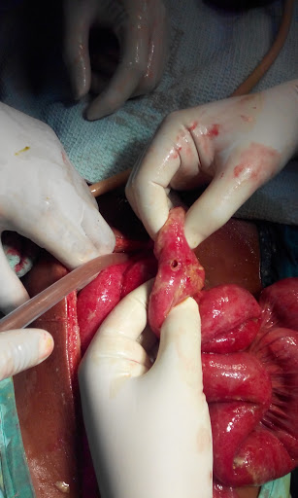
.

Slide 7
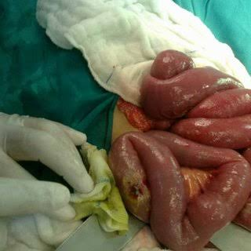
.

Slide 8
presentation
Severe diarrhoea
Bradycardia
Soft abdomen
Abdomen without guarding and rigidity
Initial history of fever then abd pain with progressive tenderness.
With spleenomegaly, headache, rose spots on skin

Slide 9
investigations
X ray abdomen standing-gas under right dome of diaphragm
Widal test
Neutropenia
Blood and stool culture
IgG\IgM STUDY
CT SCAN

Slide 10
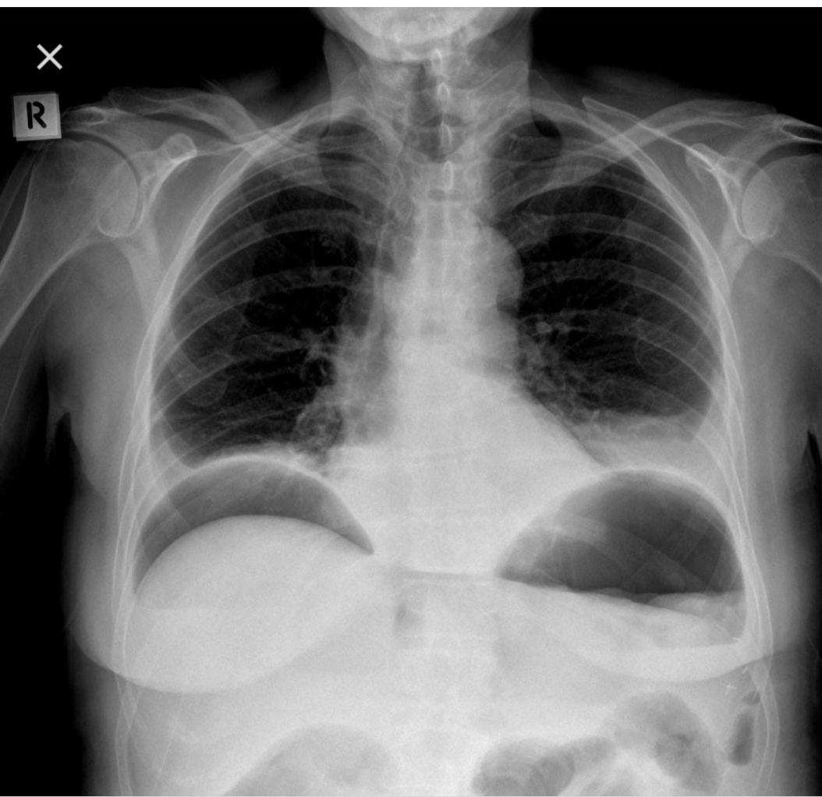
Gas under right diaphragm

Slide 11
MANAGEMENT
Keep NBM
IV FLUIDS
IV antibiotics (quinolones,chloramphenicol,ceftriaxone)
Post for exploratory laparotomy

Slide 12
surgery
Simple closure after taking biopsy from edge of ulcer
If multiple perforations– resection anastomosis, or ileostomy
Once patient recover after 6-12 weeks…closure of ileostomy

Slide 13
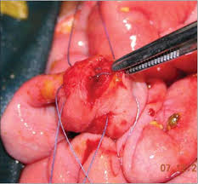
closure

Slide 14
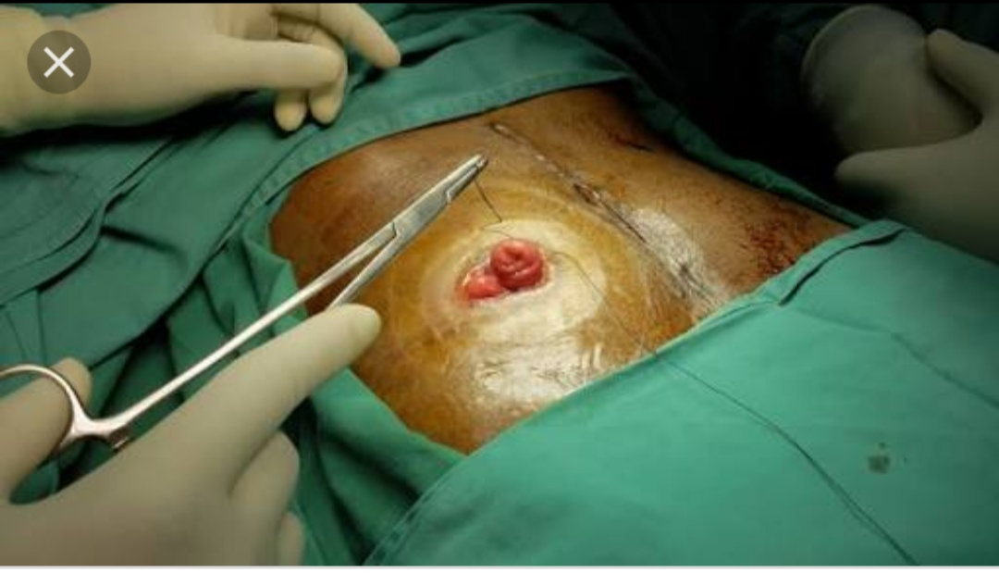
ileostomy

Slide 15
MCQ 1
Salmonella typhi spread by 1. feco oral 2. blood 3.lymphatic 4.local

Slide 16
MCQ 2
Closure of ileostomy done after 1. 1-2 week 2. 3-4 week 3.6-12 week 4. 16-18 week

Slide 17
MCQ 3
Ileal perforation in case of typhoid occur at 1. 1 week 2. 2 week 3. 3 week 4. 4 week

Slide 18
MCQ 4
All are complications of TYPHOID ULCER except 1. DVT 2. choleycystitis 3. cystitis 4. pancreatitis

Slide 19
MCQ 5
Which test is positive in typhoid?? 1.mantoux test 2. widal test 3. sereny test 4.tuberculin test

