Slide 1
ANATOMY OF TEMPORAL BONE

Slide 2
Levels of Evidence
Grade A – Systemic reviews, Meta analyses, RCT
Grade B – Non-randomised studies
Grade C – Observational studies
Grade D – Case Series, Expert opinion

Slide 3
Levels of Evidence
**** ~ Systematic reviews, meta analysis of randomized control studies
*** ~ Non randomised studies
** ~ Observational or non experimental studies
* ~ Expert opinion

Slide 4
PARTS OF TEMPORAL BONE
Tympanic bone
Mastoid process
Squama
Petrosa

Slide 5
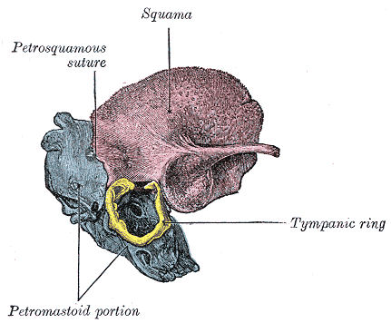

Slide 6
EMBRYOLOGY
A) Prenatal development
Development of squama begins at 8 wks, marked by the appearance of a membranous bone ossification center.
Beginning at 4 months, the squama projects posterior to the tympanic ring, forming what will become the lateral (squamous) portion of the mastoid, roof of the external auditory canal, and lateral wall of the antrum.

Slide 7
The medial (petrous) portion of the mastoid develops as air cells invade the periosteal layer of the bony labyrinth.
The external petrosquamous fissure marks the junction of the petrosa with the squama.
After the eighth month, the tympanic ring begins to fuse with the otic capsule, a process that is not completed until birth.

Slide 8
B) Postnatal development
Postnatally, lateral extensions of the tympanic ring and the squama extend the external auditory canal and carry the tympanic membrane from the horizontal angulation of the neonate to the acute angulation of the adult.
The styloid process does not make its appearance until after birth, arising in an ossification center at the upper aspect of Reichert’s cartilage.

Slide 9
LATERAL VIEW
Tympanic bone
Mastoid
Squamous part

Slide 10
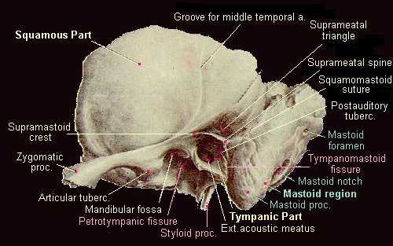

Slide 11
A) TYMPANIC BONE
Forms the anterior, inferior and part of the posterior wall of the EAC
Part of glenoid fossa for the TMJ
Tympanosquamous suture
Tympanomastoid suture : Arnold’s nerve
Petrotympanic fissure : chorda tympani nerve, ant process of malleus, ant tympanic artery

Slide 12
Inferiorly : vaginal process which forms the sheath of the styloid process
Laterally : cartilagenous part of the EAC
Medially : annular sulcus

Slide 13
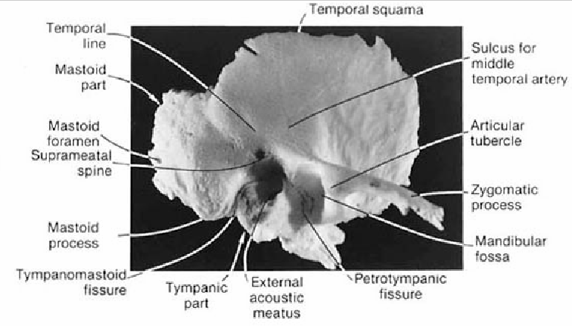

Slide 14
B) SQUAMOUS PART
Lateral part of the middle cranial fossa
Superior interface – parietal bone
Anterior interface – zygomatic process and sphenoid
Medial surface : sulcus for middle meningeal artery
Lateral surface : groove for middle temporal artery

Slide 15
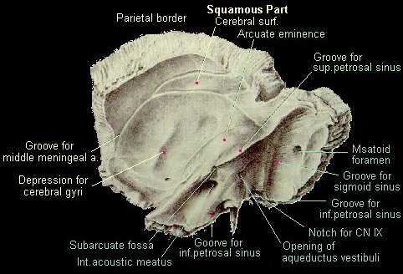

Slide 16
C) MASTOID PROCESS
Inferior projection
Squamous portion laterally, petrous portion medially seperated by Korner’s septum
Fossa mastoidea (Maceven’s triangle) boundaries
Laterally overlies the mastoid antrum
Mastoid foramen
SCM attached to the tip of the mastoid

Slide 17
MUSCULAR ATTACHMENTS
Temporalis arises from the temporal fossa
SCM attached to lateral surface of mastoid process
Splenius capitis inserted into the mastoid process
Longisimuss capitis inserted deep to splenius capitis

Slide 18
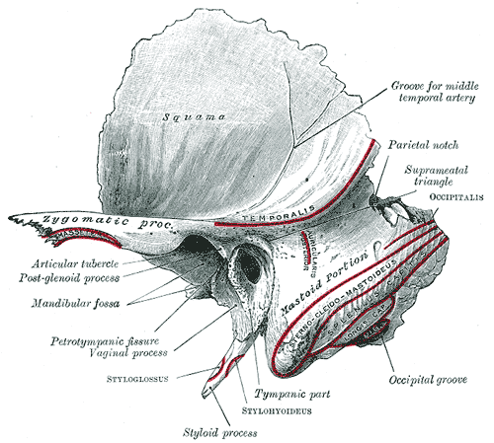

Slide 19
Styloid process:
Stylohyoid – posterior aspect
Styloglossus – anterior aspect
Stylopharnygeus – medial aspect
Stylohyoid lig – to tip
Stylomandibular lig – lateral aspect

Slide 20
NAME OF STUDY | AUTHOR | REFERENCE | SAMPLE SIZE | RESULT | P value | CONCLUSION
Meniere's syndrome and endolymphatic hydrops. Double-blind temporal bone study. | Rauch SD¹, Merchant SN, Thedinger BA. | Ann Otol Rhinol Laryngol. 1989 Nov;98(11):873-83. | 30 | Thirteen of 13 cases of clinical Meniere's syndrome were found to have endolymphatic hydrops not attributable to other causes. However, some patients with idiopathic endolymphatic hydrops did not exhibit clinical Meniere's syndrome as revealed in their medical records | Not more than 0.05 | hese results challenge the dogma that endolymphatic hydrops per se generates the symptoms of Meniere's syndrome.

Slide 21
1.The development of squama begins at what gestational age
4 weeks
8 weeks
10 weeks
12 weeks

Slide 22
2. Styloid process appears at
32 weeks of gestation
40 weeks of gestation
At birth
none

Slide 23
3. Largest part of the temporal bone is
Squamous
Petrous
Mastoid
Styloid

Slide 24
4. Splenius capitis is inserted in what part of temporal bone
a)Lateral surface of mastoid process
b)Temporal process
c)Mastoid process
d)Zygomatic process

Slide 25
5. Most common inflammatory condition affecting twmporal bone
a)CSOM
b)AOM
c)Labyrinthitis ossificans
d)Coalescent mastoiditis

Slide 26
THANK YOU

