Slide 1
ANATOMY OF THE
LATERAL NASAL WALL

Slide 2
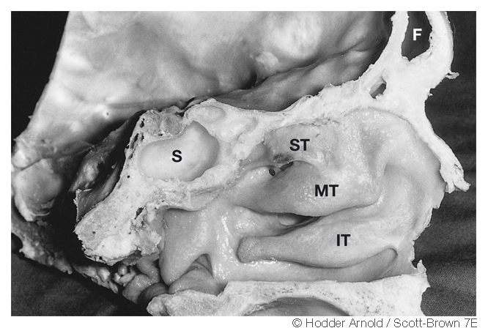

Slide 3
INFERIOR TURBINATE
Irregular surface, mucoperiosteum firmly attached
Maxillary process
Submucosal cavernous plexus
Covered by the Respiratory epithelium with high no of goblet cells

Slide 4
INFERIOR MEATUS
It is the largest meatus
Naso-lacrimal duct opens in this meatus

Slide 5
MIDDLE MEATUS
It lies lateral to the middle turbinate
Maxillary hiatus in medial wall
Accessory ostia found in the fontanelles

Slide 6
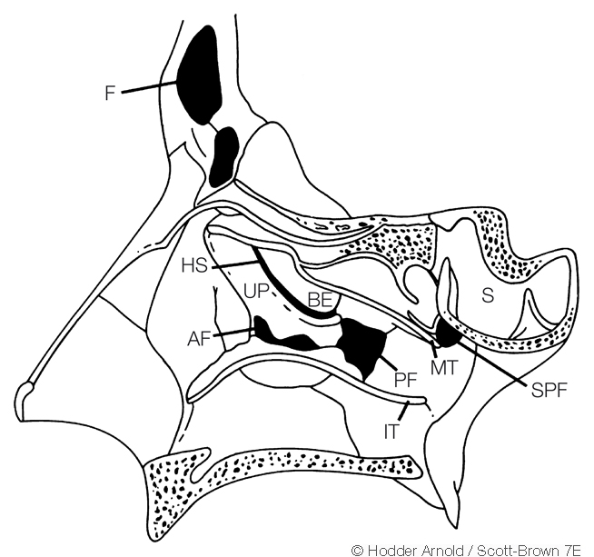

Slide 7
ETHMOIDAL INFUNDIBULUM
Cleft like 3 dimensional space
Maxillary sinus opening is located in the medial wall

Slide 8
HIATUS SEMILUNARIS
Inferior hiatus semilunaris
2 dimensional space
Superior hiatus semilunaris

Slide 9
AGGER NASI
Most anterior part of ethmoid
Represented by a small crest or mound just anterior to the attachment of middle turbinate
Pneumatization of agger nasi may encroach upon the nasolacrimal duct

Slide 10
ETHMOIDAL BULLA
Torus lateralis
Forms the posterior margin of the hiatus semilunaris and the ethmoidal infundibulum

Slide 11
ANATOMICAL VARIATIONS

Slide 12
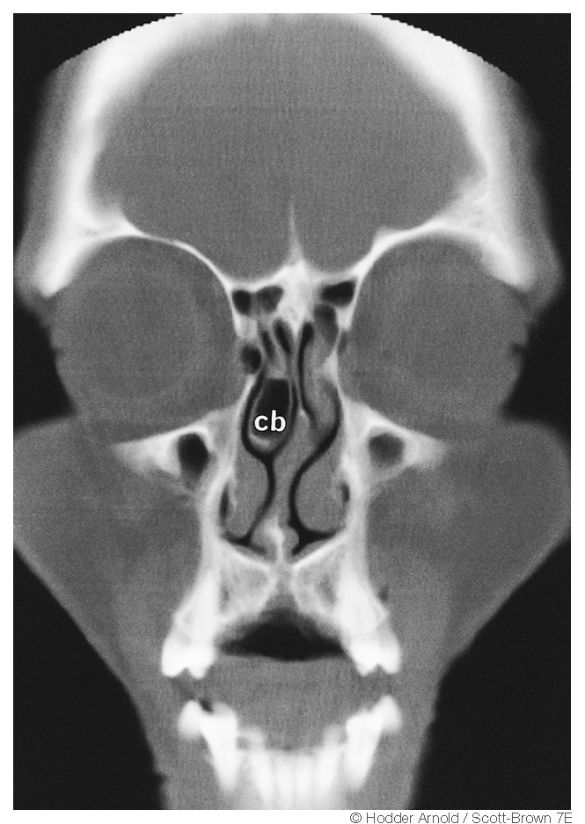

Slide 13
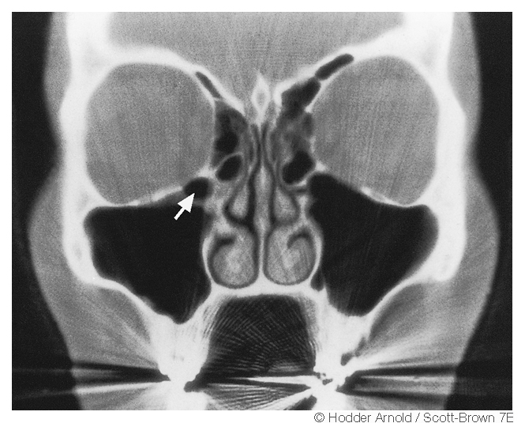

Slide 14
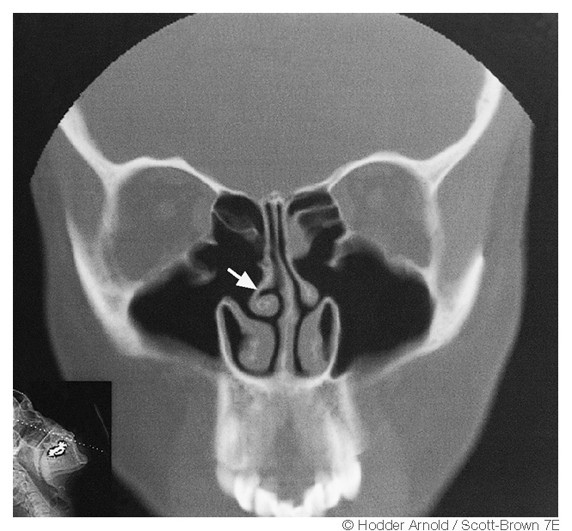

Slide 15
SUPERIOR MEATUS
Post 1/3rd of wall
Posterior ethmoidal sinus opening
Supreme turbinate
Notes:
Lies abouve the superior turbinate so known as supreme turbinate

Slide 16
POSTERIOR ETHMOID COMPLEX
Ground lamella of middle turbinate boundary between anterior and posterior ethmoidal sinuses
Notes:
Border between ant and posterior ethmoidal sinus

Slide 17
SPHENOETHMOIDAL RECESS
Medial to the superior turbinate
Opening of sphenoid sinus

Slide 18
BLOOD SUPPLY
External and internal carotid arteries
Spheno-palatine artery
Facial artery
Greater palatine artery
Anterior and posterior ethmoidal arteries
VENOUS DRAINAGE
Spheno-palatine veins
Ethmoidal veins

Slide 19
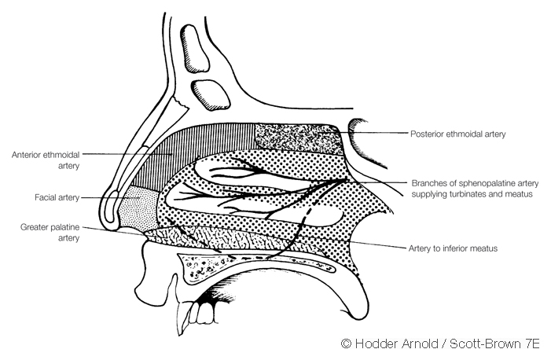

Slide 20
NERVE SUPPLY
Olfactory Nerve
Anterior ethmoidal nerve
Branches of pterygopalatine ganglion
Anterior palatine nerves
Infraorbital nerve
Anterior superior alveolar nerve

Slide 21
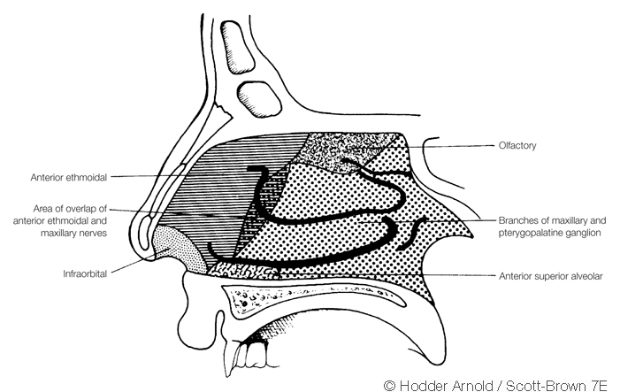

Slide 22
LYMPHATIC DRAINAGE
Submandibular nodes anteriorly
Lateral pharyngeal, retropharyngeal and upper deep cervical posteriorly

Slide 23
SURGICAL IMPORTANCE
Endoscopic dacryocystorhinostomy
Concha bullosa
FESS
Joining of accessory and main maxillary ostia

Slide 24
NAME OF STUDY | AUTHOR | REFERENCE | SAMPLE SIZE | RESULT | P value | CONCLUSION
Anatomical variations of the lateral nasal wall and paranasal sinuses: A CT study for endoscopic sinus surgery (ESS) in Thai patients. | Nitinavakarn B¹, Thanaviratananich S, Sangsilp N. | J Med Assoc Thai. 2005 Jun;88(6):763-8. | 88 | The study showed the presence of frontal sinuses in 88% of cases (95%CI 82.3-92.5%), agger nasi cells in 92% (95%CI 87-95.6%), concha bullosa in 34% (95%CI27.1-41.6%), Haller's cell in 24% (95%CI 17.8-30.9%), Onodi cell in 25% (95%CI 19.8-32.1%), dehiscence of the internal carotid artery in 10.2% (95%CI 6.2-15.7%) and the optic canal in the sphenoid sinus in 18.2% (95%CI 12.8-24.7%). | Not more than 0.05 | The most common olfactory fossa was type II. Haller's cell was a coincident finding not a risk factor for maxillary rhinosinusitis. Concha bullosa was a non-statistically significant, risk factor for maxillary rhinosinustis

Slide 25
THANK YOU

Slide 26
MCQ

Slide 27
Which is the largest meatus:
Inferior meatus
Superior meatus
Middle meatus
All are equal

Slide 28
2. Maxillary sinus opening is located in the medial wall of :
Inferior turbinate
Middle turbinate
Superior turbinate
Ethmoidal Infundibulum

Slide 29
3. Sphenoid sinus opens into:
Superior meatus
Sphenoethmoidal recess
Middle turbinate
None of the above

Slide 30
4. Which of the following does not supply lateral nasal wall:
A.External and internal carotid arteries
B. Spheno-palatine artery
C.Facial artery
D.Greater palatine artery
E. None of the above

Slide 31
5. Which of the following in not the lymphatic drainage of lateral wall of nose:
A. Submandibular nodes
B.Lateral pharyngeal
C.Retropharyngeal
D. upper deep cervical
E. None of the above

