Slide 1
ATROPHIC RHINITIS AND RHINITIS SICCA

Slide 2
Levels of Evidence
Grade A – Systemic reviews, Meta analyses, RCT
Grade B – Non-randomized studies
Grade C – Observational studies
Grade D – Case Series, Expert opinion

Slide 3
Levels of Evidence
**** ~ Systematic reviews, meta analysis of randomized control studies
*** ~ Non randomised studies
** ~ Observational or non experimental studies
* ~ Expert opinion

Slide 4
ATROPHIC RHINITIS
Described in 1876 by Dr. Bernhard Fraenkel as a triad of:
  Fetor
  Crusting
  Atrophy of nasal structures
Dr. Francke Bosworth. A Manual of Diseases of the Nose and Throat. 1881.
  “the breath is often so penetrating as to render the near presence of the sufferer not only unpleasant but almost unendurable.”

Slide 5
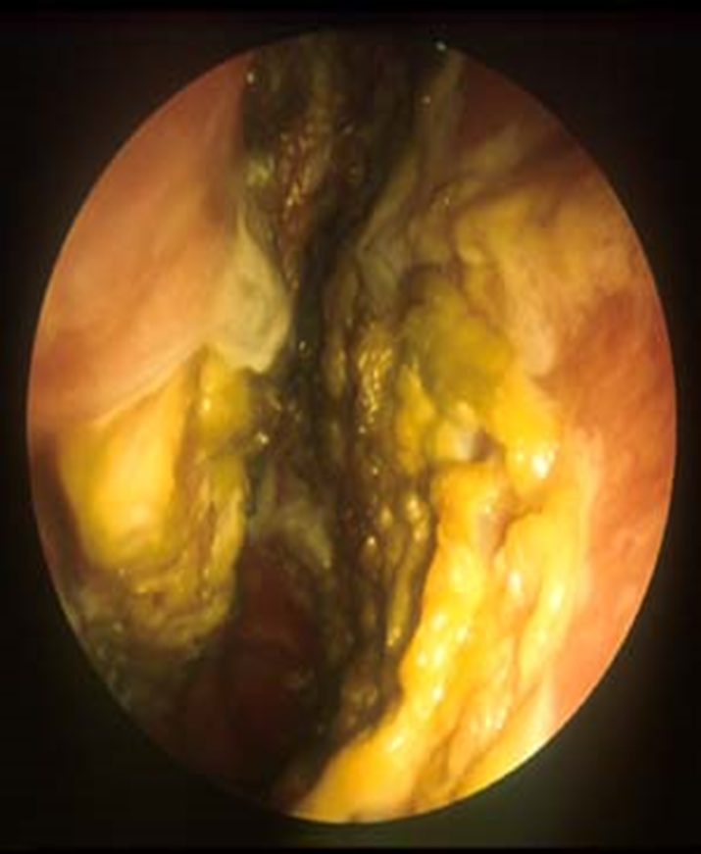
ATROPHIC RHINITIS
It is a chronic inflammation of nose characterized by atrophy of nasal mucosa and turbinate bones
The nasal cavities are roomy and full of foul smelling crusts

Slide 6
Atrophic rhinitis
primary
secondary

Slide 7
PRIMARY
Aetiology:
Hereditary factors
Endocrinal disturbance
Racial factors
Nutritional deficiencies
Infective

Slide 8
Secondary AR:
  Complication of sinus surgery
  Complication of radiation
  Following nasal trauma
  Sequela of granulomatous diseases and other infections : TB, Sarcoidosis, Leprosy, Rhinoscleroma, Syphilis

Slide 9
PATHOLOGY
Ciliated columnar epithelium is lost and is replaced by stratified squamous type
There is atrophy of seromucinous glands, venous blood sinusoids and nerve elements
Arteries in the mucosa, periostium and bones show obliterative endarteritis
The bone of turbinates under goes resorption causing widening of nasal chamber

Slide 10
CLINICAL FEATURES
  Anosmia
  Ozena, i.e. foul odor
  Extensive nasal crusting
  Subjective nasal congestion
  Enlargement of the nasal cavity
  Resorption or absence of turbinates
  Squamous metaplasia of nasal mucosa
  Depression

Slide 11
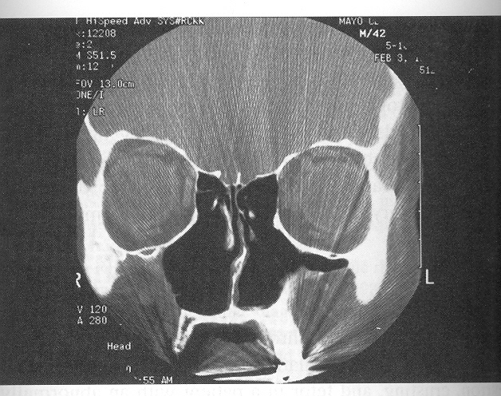
Radiographic Findings
Enlargement of the nasal cavities with erosion and bowing of the lateral nasal wall.
Bony resorption and mucosal atrophy of the inferior and middle turbinates.

Slide 12
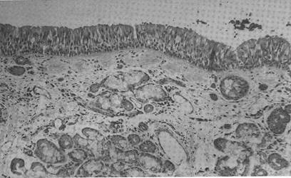
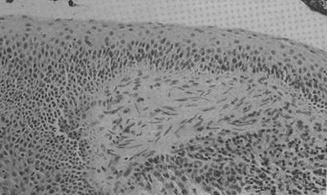
MICROSCOPIC PICTURE
Normal Mucosa
  Pseudostratified Columnar
  Presence of serous and mucous glands
Atrophic Rhinitis
  Squamous metaplasia
  Atrophy of mucous glands
  Scarce or absent cilia
  Endarteritis obliterans

Slide 13
Microbiology
Klebsiella ozenae
  May be found in almost 100% of primary AR
  No predominance in secondary AR
Staphylococcus aureus
Proteus mirabilis
Escherichia coli
Corynebacterium diphtheriae

Slide 14
Current Therapies
Goals of therapy
  Restore nasal hydration
  Minimize crusting and debris
Therapy options
  Topical therapy
  Saline irrigations
  Antibiotic irrigations
  Systemic antibiotics
  Implants to fill nasal volume
  Closure of the nostrils

Slide 15
Treatment
It may be medical or surgical
Medical
- Treatment aims at maintaining nasal hygiene by removal of crusts and the associated putrefying smell.
a) nasal irrigation and removal of crusts
- warm normal saline or alkaline solution made by dissolving tea spoonful of powder containing soda bicarbonate 1 part, sodium biborate 1 part, sodium chlorate 2parts in 280ml of water is used to irrigate the nasal cavity.

Slide 16
b) 25% glucose in glycerine
- nose is painted with 25% of glucose in glycerine
- this inhibits the growth of proteolytic organisms which are responsible for foul smelling.
c) Local antibiotics
- chloromycetin, oestradiol and vitamin d2 may be found usefull.

Slide 17
d) Oestreadiol spray
- helps to increase vascularity of nasal mucosa and regeneration of seromucinous glands
e) Placental extract injected submucosally in the nose may provide some relief
f)Systemic use of streptomycin
- 1g/day for 10 days has given good results in reducing crusting and odour
g)Potassium iodide given by mouth promotes and liquifies nasal secretion

Slide 18
Surgical therapies
Young procedure
Modified Young procedure
Turbinate reconstruction
Volume reduction procedures
Denervating operations

Slide 19
Young’s procedure
Circumferential flap elevation 1 cm cephalic to the alar rim.
Sutures placed in center of elevated flap to close the nostril
Staged second side in 3 months

Slide 20
Modified Young’s⁽¹⁾
Elevation of extended perichondrial flap through contralateral hemitransfixion incision.
Short skin flap elevated from the intercartilaginous line on the ipsilateral side.
lateral and medial flaps are sutured.
Staged second side with first side takedown in 6 month.

Slide 21
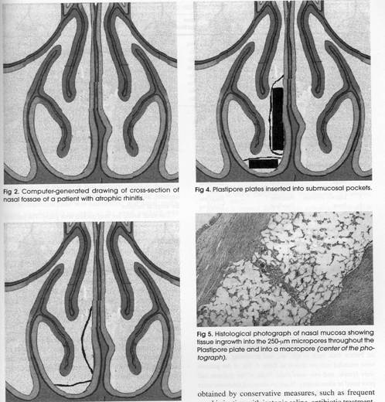
Volume reduction
Plastipore implantation
  Porus material allows tissue ingrowth.
  Implants shaped then fenestrated for ingrowth.
  Implants placed submucosally along the septum and nasal floor.

Slide 22
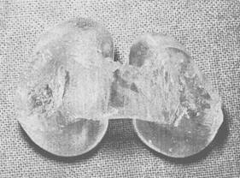
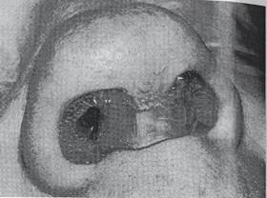
Non-surgical nasal closure
Nasal vestibule impressions taken similar to hearing aid moulds.
Impressions are used to create a silastic obturator.

Slide 23
Other methods
Other Implants
  Acrylic
  Silicone
  Teflon
  Silastic
  Boplant
Denervation
  Cervical sympathectomy (Bertein)
  Stellate ganglion block (Bahl)
  Sphenopalatine ganglion block (Girgis)
  Parasympathectomy, i.e. GSPN section (Krmptotic)
Salivary Irrigation
  Involves reimplantation of parotid duct into the maxillary sinus

Slide 24
Rhinitis sicca
Mild form of atrophic rhinitis.
Seen in hot,dry,dusty places(bakers,goldsmiths)
Crusting present only anteriorly
Bone atrophy and foetor are absent.
t/t nasal douching and changing surrounding

Slide 25
REFERNCES
1)Sangeet Kumar Poddar ~, M.V. Jagade.modification of modified young's operation in the management of primary atrophic rhinitis , Indian Journal q[' Otolarygology and Head and Neck Surgery Vol. 53 No. 3, July - September 2001

Slide 26
NAME OF STUDY | NAME OF AUTHOR | REFERENCE DETAILS | SAMPLE SIZE | RESULT | CONCLUSION
Modification of modified young's operation in the management of primary atrophic rhinitis | Sangeet. JagaKumar Poddar, M.V jagade | Indian Journal qf' Otolarygology and Head and Neck Surgery Vol. 53 No. 3, July - September 2001 | 30 | a.complete recovery 50% b.Partial recovery 40% c.No recovery 10% | procedure is advantageous over the pre-existing surgical procedures as - a. Breathing difficulty to the patient is minimized. b. Regular examination and cleaning of the nasal cavity can be done even postoperatively. c. This procedure can be done on both nostrils simultaneously. d. It is a technically easier procedure compared to the pre-existing techniques

Slide 27
QUESTIONS
WHAT IS RHINITIS SICCA?
MILD FORM OF ATROPHIC RHINITIS
MILD FORM OF ALLERGIC RHINITIS
ALL OF THE ABOVE
NONE OF THE ABOVE

Slide 28
Thank u

Slide 29
1.WHAT IS ATROPHIC RHINITIS
Chronic inflamation of nasal mucosa
Chronic inflamation of the ear mucosa
All of the above
none of the above

Slide 30
2.WHAT ARE THE COMPONENTS OF THE TRIAD OF AR?
  A. Fetor
  B. Crusting
  C. Atrophy of nasal structures
D. ALL OF THE ABOVE

Slide 31
  3. WHAT ARE THE GOALS OF THE TREATMENT OF AR?
  Restore nasal hydration
  Minimize crusting and debris
  All of the above
  None of the above

Slide 32
4.WHAT ARE THE CURRENT THERAPIES FOR THE T/T OF AR?
  A. Topical therapy
  B. Saline irrigations
  C. Antibiotic irrigations
  D. Systemic antibiotics
  E.Implants to fill nasal volume

