Slide 1
CSOM – SAFE TYPE
Dr Nirali Chauhan

Slide 2
Levels of Evidence
Grade A – Systemic reviews, Meta analyses, RCT
Grade B – Non-randomized studies
Grade C – Observational studies
Grade D – Case Series, Expert opinion

Slide 3
Levels of Evidence
**** ~ Systematic reviews, meta analysis of randomized control studies
*** ~ Non randomised studies
** ~ Observational or non experimental studies
* ~ Expert opinion

Slide 4
Defination
Inflammatory changes of the mucoperiosteal lining of the middle ear cleft of insidious onset and protracted course, characterized by development of irreversible tissue pathology.

Slide 5
Classification
Tubo-tympanic
(safe type)
Mucosal
Attico-antral
(unsafe type)
Squamosal

Slide 6
TYPES OF COM
COM
Healed O.M.
Mucosal C.O.M.
Sq. epithelial C.O.M.
Tympanosclerosis
Inactive
Active
Inactive
Active
Dry
Perforation
Wet
Perforation
Retraction Pocket
Cholesteatoma

Slide 7
Tubo-tympanic/ mucosal COM
Safe / benign
Involve anteroinferior part of ME cleft
Associated with central perforation

Slide 8
 | TT | AA
Discharge | Profuse Mucoid, white Sticky Non foul smelling Intermittent Non blood stained | Scanty Purulent, yellow Non sticky Foul smelling Conti. Blood stained
Perforation | Central in PT | Attic or marginal
Polyp | Pale | Red
Granulations | Uncommon | Common
Cholesteatoma | Absent | Present
Hearing loss | CHL | CHL/ mixed
Complications | Rare | Common

Slide 9
Bacteriology
Streptococcus pneumoniae.
Pseudomonas aeruginosa,
Haemophilus influenzae,
Moraxella catarrhalis.
Respiratory syncytial virus

Slide 10
Etiology
Allergy to food
AOM & otitis media with effusion
Genetic & race
Environment
Poor socioeconomic status
Ascending infection from ET-URTI[***]
ET dysfunction [*]
GERD
Craniofacial anomalies
Autoimmune disease- ankylosing spondylitis [***]
Immune deficiency [*]

Slide 11
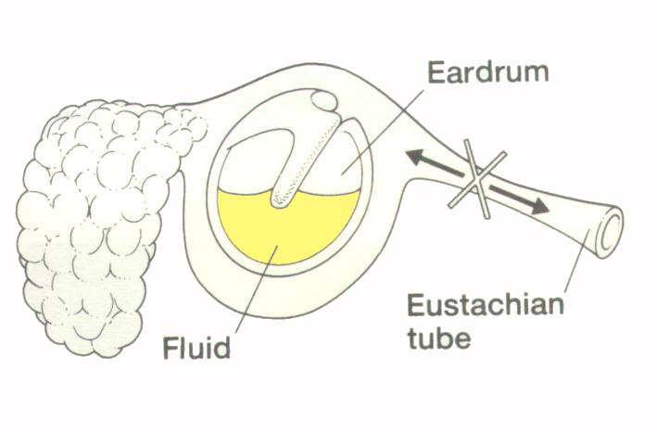

Slide 12
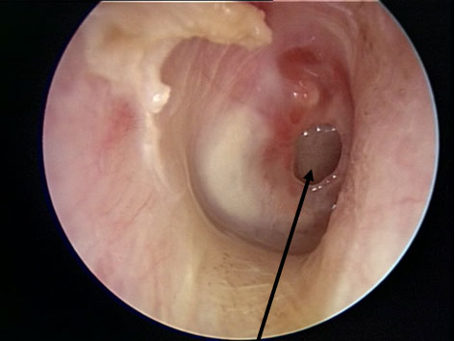

Slide 13
Active mucosl COM associated with resorptive osteitis of part or all ossicular chain. [****]
Affected ossicles show hyperemia with proliferation of capillaries & prominent histiocytes.[****]
Long process of incus, stapes crurae, body of incus & manubrium are involved in this order of frequency. [***/**]
Reason that the long process of incus & SS most frequently affected due to their delicate structure & location rather than their tenuous blood supply.

Slide 14
Resorption for bone is feature of both active mucosal & squamosal COM & mechnisam for resorption of bone is same for both types of COM. [***/**]
-hyperamic decalcification
- osteitis
Infection , inflamation, pressure & keratin lead to release of cytokines.

Slide 15
Pathology
Perforation
Polypoidal /edematous ME mucosa
Polyp
Tympanosclerosis
Ossicular necrosis
Adhesions

Slide 16
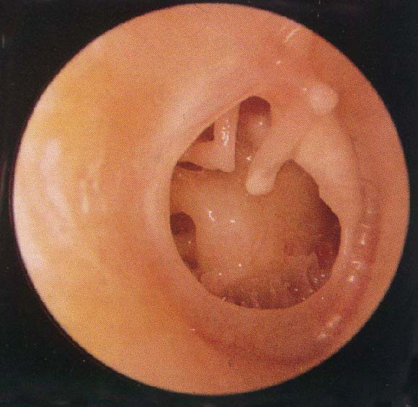

Slide 17


Slide 18
Symptoms
Chronically draining ear (>2 weeks),
Otalgia
Fever
Hearing loss

Slide 19
Signs
The external auditory canal may possibly be oedematous but is not usually tender.
The discharge varies from fetid, purulent and cheese-like to clear and serous.
Granulation tissue is often seen in the medial canal or middle ear space.
The middle ear mucosa seen through the perforation may be oedematous or even polypoid, pale, or erythematous.

Slide 20
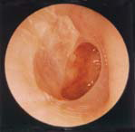
Otoscopy
Perforation
Central, in pars tensa.
Cholesteatoma/
granulations Absent

Slide 21
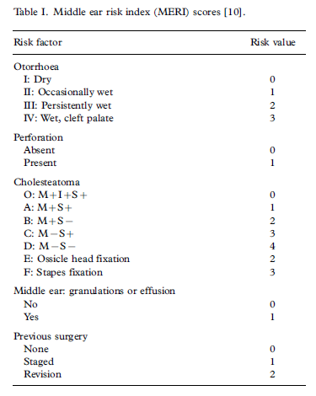

Slide 22
Differential diagnosis
Otitis externa (inflamed, eczematous canal without a perforation)
Foreign body
Impacted ear wax
Cholesteatoma
Wegener's granulomatosis
Neoplasm

Slide 23
Investigation
Miscroscopic examination
PTA
C & S
X – ray mastoid (schuller’s view)
CT temporal bone

Slide 24
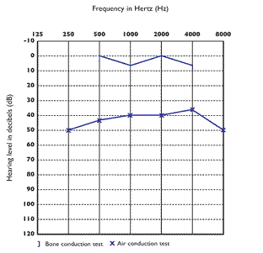

Slide 25
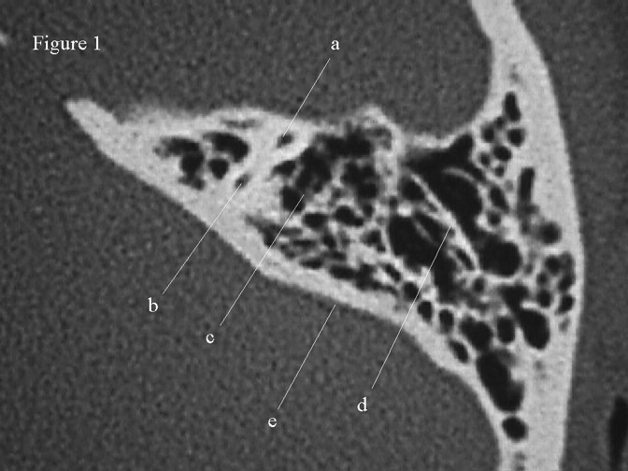
    CT-scan temporal bone

Slide 26
Treatment
Medical Treatment
Aural toilet [*]
Ear drops – more effective than systemic drugs [****]
dry mopping + ear drops [****]
Antibiotics according to C&S.
Precaution – avoid nose blowing, KED

Slide 27
Surgical management
Chemical cautery of perforation margins.
Myringoplasty [***]
Tympanoplasty [**]
Myringoplasty + ossiculoplasty
Treatmeat of contributory causes – adenoids, tonsil, sinusitis, allergy

Slide 28
Complications
Intratemporal
Petrositis
Facial paralysis – prognosis is good[***/**]
Labyrinthitis
Intracranial
Lateral sinus thrombophlebitis
Meningitis
Intracranial abscess
Sequelae include
Hearing loss
Tympanoscerosis

Slide 29
Prognosis
There is a good chance of control of infection.
The recovery of hearing loss varies, depending on the cause. Conductive hearing loss often can be partially corrected with surgery.

Slide 30
Austin’s Prognostic Features
GROUP | FEATURE | INCIDENCE
A | MH+, SS+ | 60%
B | MH+, SS- | 23%
C | MH-, SS+ | 8%
D | MH-, SS- | 8%

Slide 31
NAME OF STUDY | NAME OF AUTHOR | REFERENCE DETAILS | SAMPLE SIZE | RESULT | P VALUE | CONCLUSION
Clinical Profile of Tubotympanic CSOM and Its Management With Special Reference to Site and Size of Tympanic Membrane Perforation, Eustachian Tube Function and Three Flap Tympanoplasty | Nishant Kumar,¹ Devashri Chilke,² and M. P. Puttewar³ | Indian J Otolaryngol Head Neck Surg. Mar 2012; 64(1): 5–12. Published online Jul 6, 2011. doi: 10.1007/s12070-010-0114-5 | 90 | . Otitis media is an important and a highly prevalent disease of the middle ear and poses serious health problem world wide especially in developing countries where large percentage of the population lack specialized medical care, suffer from malnutrition and live in poor hygienic environmental conditions. It has been a general view that the hearing loss increases with the size of the perforation, more so if it is in the posterio inferior quadrant. It was found that the maximum average loss occurred at 250 Hz. The hearing loss is less in small perforations (less than 2 mm diameter) then in larger ones; less in perforations touching the manubrium than in those away from it, and also less in perforations of the anterioinferior quadrant than in those on posterio-inferior quadrant. A normally functioning eustachian tube is also an essential physiologic requirement for a healthy middle ear and normal hearing. |  | . Young and middle aged population of low socio-economic class are the most common suffers of suppurative otitis media. Tympanic membrane perforations are long standing and they are poorly treated (usually with ear drops only) by general practitioners in this group. Unilateral ear involvement (that too on left side in majority of cases) in CSOM has been found more commonly than bilateral ear involvement. Hearing losses as on PTA in dry TM perforations range from 16 to 46 dB (conductive) and roughly 2/3rd of the cases have mild conductive hearing loss. Average hearing loss has been observed to be greater at lower frequencies than at higher frequencies. Malleolar perforations reveal greater hearing loss a compared to non-malleolar ones (even if both are of identical size). Hearing loss increases with the increase in the size of tympanic membrane perforation. Site of perforation is also an important factor as posterior quadrant pars tensa perforations have greater hearing loss than anterior quadrant perforations. Roughly 1/3rd cases of safe CSOM with dry TM perforation have normally functioning Eustachian tube and slightly less than 50% have only mild dysfunction as noted by Eustachian tube opening pressure. It is concluded that a good correlation exists between the functional status of eustachian tube and success of myringoplasty operation. The success rates of myringoplasty in normal ET function (81.8%) an in mild ET hypofunction (72.7%) are significant as compared to failures in the presence of moderate and severe ET hypofunction, whatever may be the technique.

Slide 32
REFERENCES
JUNG Jy, Chole RA. Bone resorption in COM. ORL. 2002; 64: 95-107.
Berman S. otitis media in developing countries. Paediatrics. 1995; 96: 126-31.
Blevins NK. Routine pre operative imaging in chronic ear surgery. American journal of otology. 1998; 19: 527-38.
Lee P, Kelly G. does size of perforation matters for myringoplasty? Clinical otolaryngology & allied sciences. 2002; 27; 331-4.

Slide 33
MCQ

Slide 34
1. What are the characteristics of ear discharge in safe com except?
Profuse & sticky
Mucoid, white
Foul smelling & Blood stained
Intermittent

Slide 35
2.What are the characteristics of ear discharge in unsafe com?
Scanty & Conti.
Purulent, blood stained
Non sticky, Foul smelling
All of the above

Slide 36
3. Which ossicle is eroded first in COM?
Long process of incus
Stapes foot plate
Stapes superastructure
Malleus

Slide 37
4.Which is the best x-ray view for mastoid?
Schuller’s view
Water’s view
Luc’s view
Cadwell’s view

Slide 38
5. Which are the following are intracranial complications of COM except?
Lateral sinus thrombophlebitis
Meningitis
Intracranial abscess
Mastoiditis

Slide 39
Thank you

Slide 40
C
D
A
A
D

