Slide 1
Epistaxis

Slide 2
What is Epistaxis?

Slide 3
Blood supply of nose
COMMON CAROTID
EXTERNAL
FACIAL
MAXILLARY
INTERNAL
OPHTHALMIC

Slide 4
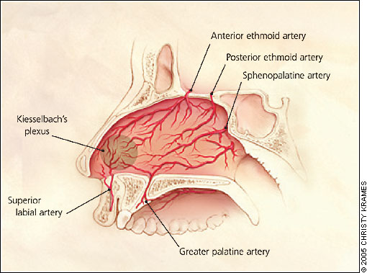
LITTLE’S AREA

Slide 5
Keisselbach’s plexus
Woodroff’s area:
Post end of IT
(Sphenopalatine anastomosis with post pharyngeal artery)
Retrocolumellar vein:
  The vein runs directly downwards just behind the collumela, crosses the floor of nose and joins the venous plexus on the lateral nasal wall.

Slide 6
LOCAL CAUSES
Idiopathic
Trauma
– Nose picking
– Facial injury
– Foreign body
Inflammation
– Allergic rhinosinusitis
– Nasal polyps
Neoplasia
– Benign (juvenile angiofibroma)
– Malignant (squamous cell carcinoma)
Structural
– Septal spurs
– Septal perforations

Slide 7
LOCAL CAUSES
Vascular
– Congenital (hereditary hemorrhagic
telangiectasia)
– Acquired (Wegener’s granulomatosis)
Iatrogenic
--Surgery (ENT/maxillofacial/ophthalmic)
– Nasal apparatus (nasogastric tube)
Drugs
--Nasal spray
--Abuse (cocaine)

Slide 8
GENERAL CAUSES
Haematological
– Coagulopathies (haemophilia)
– Thrombocytopenia (leukaemia)
– Platelet dysfunction (Von Willebrand’s disease)
Environmental
– Temperature
– Humidity
– Altitude
Drugs
– Anticoagulants (heparin, warfarin)
– Antiplatelet (aspirin, clopidogrel)
Organ failure
– Liver (cirrhosis)
Other
--Atherosclerosis/hypertension

Slide 9
SUMMARY OF AETIOLOGY EVIDENCE
Weather ~ Proven association(***)
NSAIDs ~ Proven association (***)
Alcohol ~ Proven association (***)
Hypertension ~ No association (***)
Septal deviation ~ No association (**)

Slide 10
CLINICAL CLASSIFICATION
Primary no proven causal factor
Secondary proven causal factor
Childhood <16 years
Adult >16 years
Anterior anterior to pyriform aperture
Posterior posterior to pyriform aperture
    (coffee coloured)

Slide 11
Epistaxis
Anterior
Posterior
More common
Littles’ area or ant lateral wall
Children & younger adult
Cause: Trauma
Mild
Rx: Local pressure & ANP
Less common
Mostly posterosuperior part or may difficult to locate
After 40yrs of age
HT or artherosclerosis
Severe
Hospitalization & PNP

Slide 12
Sites of epistaxis
Little’s area: 90%
Above the level of MT: (ICA)
Below the level of MT: (ECA)
Posterior part of nasal cavity
Diffuse : Blood dyscrasias & systemic disorders
Nasopharynx

Slide 13
Management
The Goal is Control

Slide 14
Detailed history
Blood investigations
First Aid
Trotter’s method
Pinching nose for 5 min

Slide 15
DIRECT THERAPY
Bipolar diathermy(**)
Chemical cautery
INDIRECT THERAPY
Nasal packing
Hot water irrigation (***)
Systemic medical therapy(***)

Slide 16
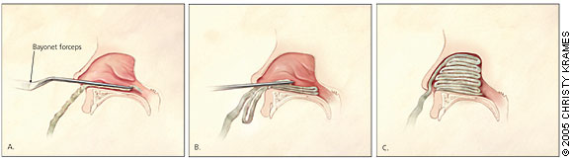

Anterior nasal packing
Ribbon gauze impregnated with petroleum jelly

Slide 17
SURGICAL MANAGEMENT
Posterior nasal packing
Ligation technique
Septal surgery(***)
Embolization (**)

Slide 18
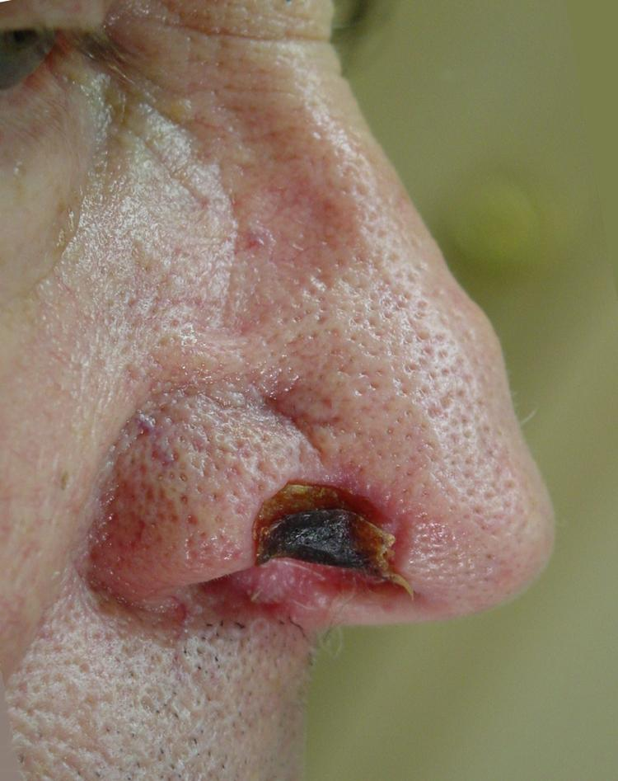
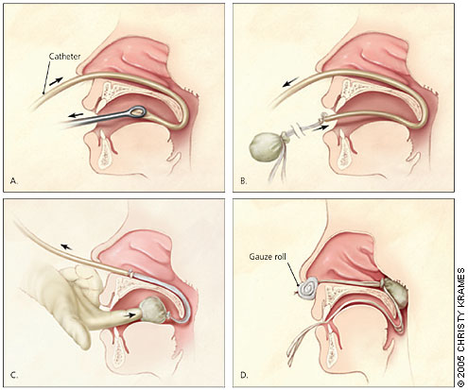
POSTERIOR NASAL PACKING(*)

Slide 19
LIGATION TECHNIQUES
Endoscopic sphenopalatine artery ligation(**)
Internal maxillary artery ligation
External carotid artery ligation
Anterior/posterior ethmoid artery ligation

Slide 20
Septal surgery(***)
Embolization (**)

Slide 21
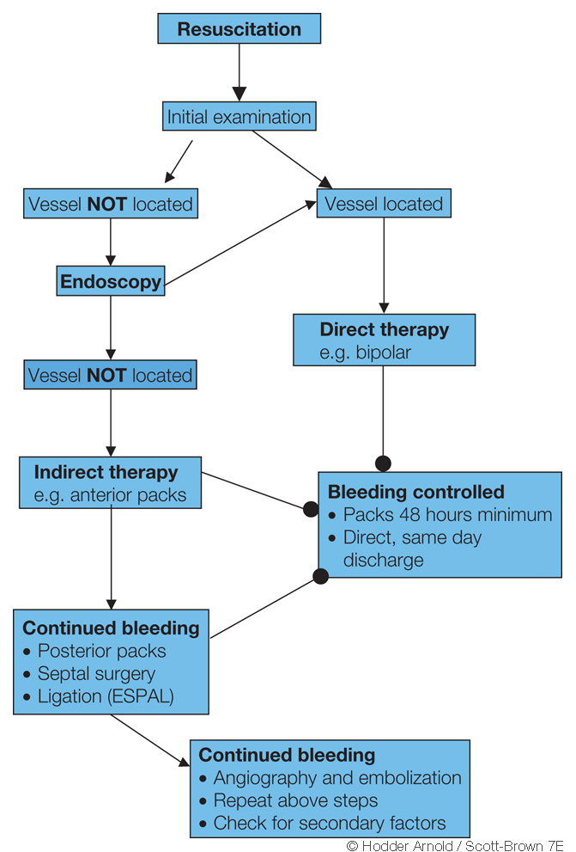

Slide 22
MCQ

Slide 23
1. WHAT IS EPISTAXIS?
Symptom
Sign
Disease
None of the above

Slide 24
2. WHERE IS LITTLE’S AREA SITUATED?
Antero-inferior part of the septum
Postero-inferior part of the septum
Antero-inferior part of the lateral wall of nose
Postero-inferior part of the lateral wall of nose

Slide 25
3. WHICH OF THE FOLLOWING ARTERIES ARE TAKING PART IN KISSELBACH’S PLAXUS FORMATION?
Internal carotid artery
External carotid artery
All of the above
None of the above

Slide 26
4. WHICH OF THE FOLLOWING ARTERY CAN BE LIGATD FOR MANAGEMENT OF EPISTAXIS EXCEPT?
Sphenopalatine artery
Internal maxillary artery
External carotid artery
Internal carotid artery

Slide 27
b
a
c
d

