Slide 1
Injuries to Nose & Facial Skeleton
Dr Nirali Chauhan

Slide 2
Levels of Evidence
Grade A – Systemic reviews, Meta analyses, RCT
Grade B – Non-randomized studies
Grade C – Observational studies
Grade D – Case Series, Expert opinion

Slide 3
Levels of Evidence
**** ~ Systematic reviews, meta analysis of randomized control studies
*** ~ Non randomised studies
** ~ Observational or non experimental studies
* ~ Expert opinion

Slide 4
Objectives
Discuss relevant anatomy and physiology
Discuss identification and emergent treatment ocular injuries
Discuss identification and emergent treatment of maxillo-facial injuries, dental and oral injuries

Slide 5
Aetiology
Road traffic accidents
Interpersonal violence
Attempted suicide
Sports injury

Slide 6
Ocular Injuries
Eye trauma accounts for 1% of visits
Often associated with facial fractures
Approximately 90% of injuries could be prevented with protective lenses

Slide 7
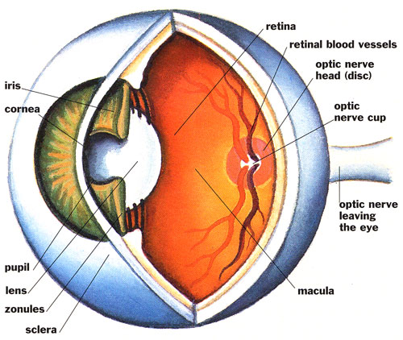

Slide 8
Mechanisms of Injury
Burn
Blunt force
Laceration/abrasion
Penetrating Trauma

Slide 9
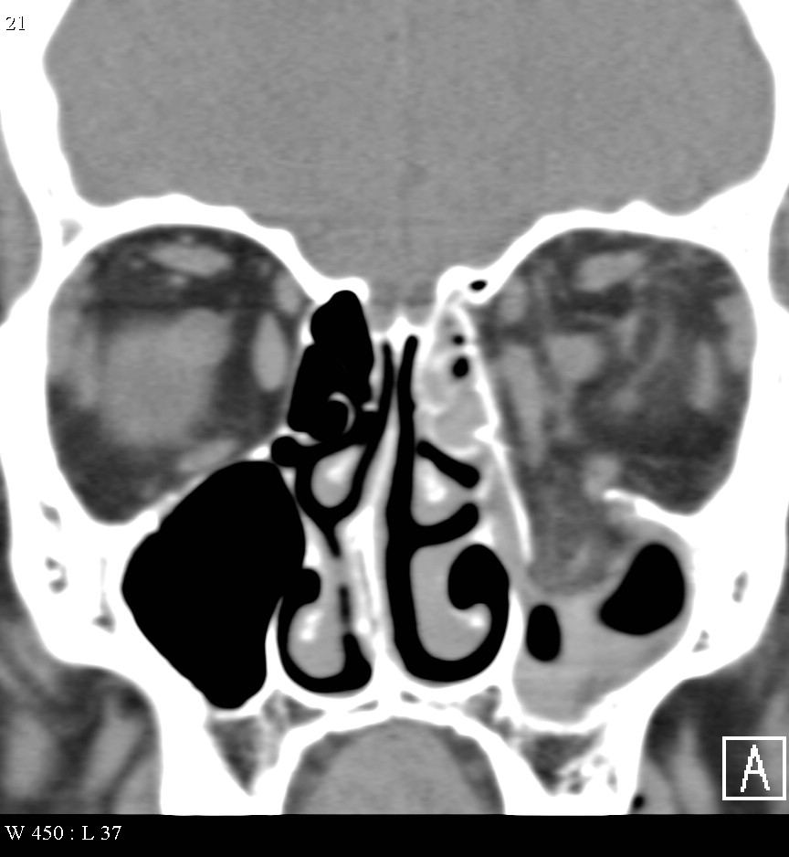

Slide 10
Orbital Injuries
Generally refers to structures surrounding globes
Need to assess globe and vision
Check extra ocular motion (EOM)
Do not let pt blow nose

Slide 11
Assessment
Determine mechanism of injury
Quick visual acuity
Examine lids and periorbital structures
Neurologic exam

Slide 12
Maxillo-Facial Trauma
Blunt trauma much more common than penetrating
Airway issues of main concern
Neurologic issues
Hemorrhage
Other trauma

Slide 13
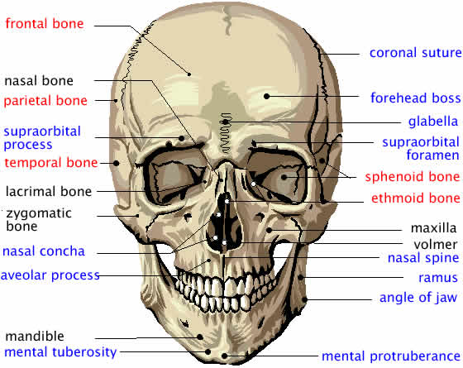
Facial bones

Slide 14
Facial Bone Strength
High impact
  Supraorbital rim: 200 g
  Symphysis mandible: 100 g
  Frontal-glabellar: 100 g
  Angle of mandible: 70 g
Low impact
  Zygoma: 50 g
  Nasal bone: 30 g

Slide 15
Facial Fractures
Nasal bone most common
Look for fluid coming from nose (CSF)
Cover area with gauze, ice if available
Control bleeding with compression

Slide 16
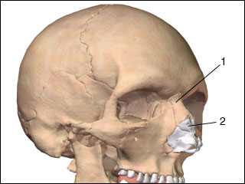
Fracture nasal bone

Slide 17
Types : Depressed – open book variety (depressed frontal & splay out nasal bone fracture)
: Angulated
Signs & Sympoms:
Swelling & laceration & deformity of nose
Periorbital echymosis & epistaxis
Tenderness
Nasal obstruction
Crepitus & mobility of fracture fragments

Slide 18
Management
Investigations :
x-ray
CT pns
Treatment :
Conservative
Closed reduction
Open reduction

Slide 19
Frontal Bone Fracture
One of the hardest bones to break
Significant trauma
Often associated brain/eye injury
Cover any open areas with saline soaked gauze
Trauma center

Slide 20
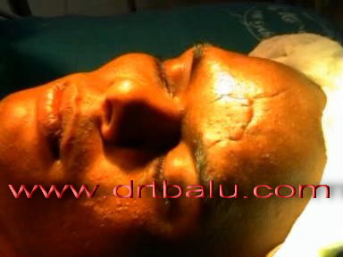

Slide 21
Maxillary Fractures
Classified by Le Fort System [**/*]
I – separates hard palate from bone
II – separates central maxilla and hard palate from rest of face
III – craniofacial disassociation – entire facial skeleton is seperated from cranium

Slide 22
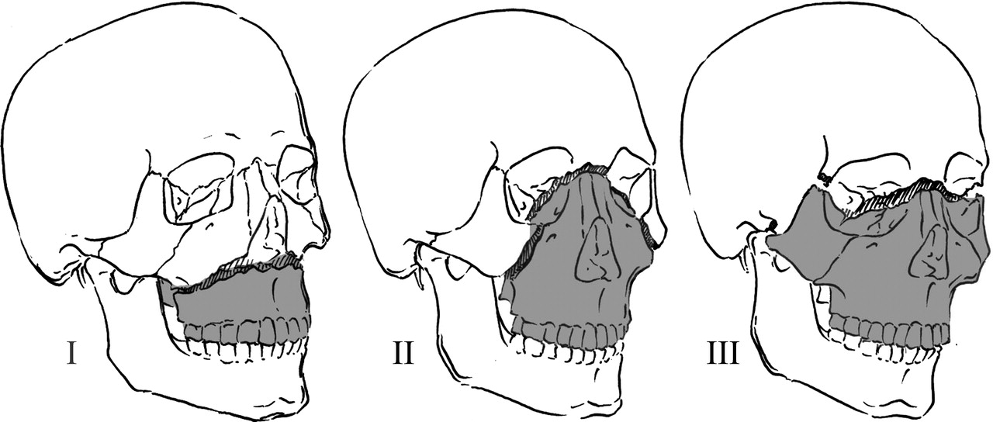

Slide 23
If suspected, can use gentle pull on upper incisor area
Often associated with other structures such as blood vessels, nerve, parotid glands
Le Fort III almost always has CSF leak
Difficult airway

Slide 24
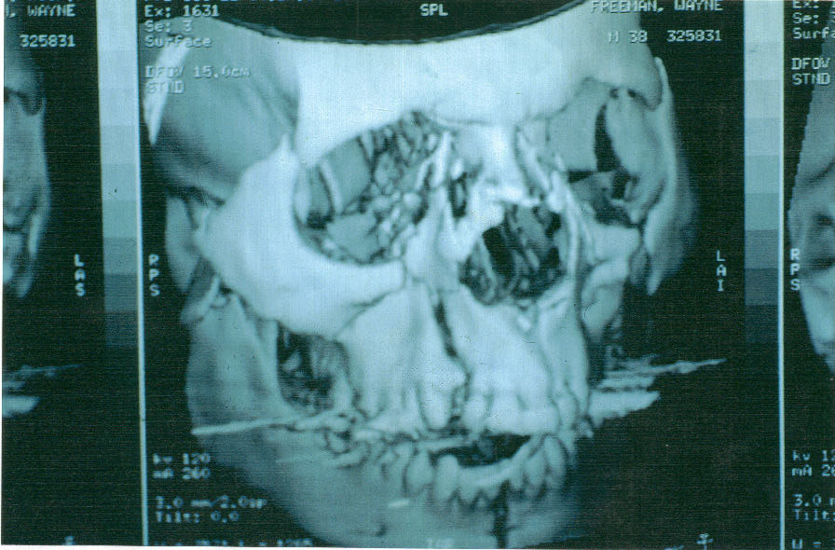

Slide 25
Signs & symptoms
Epistaxis
Circumorbital ecchymosis
Facial edema
Surgical emphysema
Lenthening of face
Infraorbital anasthesia
Anterior open bite in Le forte II & III fractures
Haematoma at the junction of hard & soft palate
Floting palate & teeth in Le Forte I

Slide 26
Management
Reduction
Fixation
Maxilla stabilized by no of methods. [**/*]
IMF
Internal suspension
Ixternal / external fixation

Slide 27
Mandible Fractures
After nasal bone, most common fracture of face
Usually 2 types of fractures
Open or closed
May note malocclusion, numbness, dislocation
Look in preauricular area

Slide 28
Often have dental fractures or subluxed teeth
May have significant intra-oral debris
Airway issues
Screening test is bite stick test
Immobilization is uncomfortable & inconvinient due to dietary resrictions.[**]
Wiring may leads to needle stick injuries.[****]
Tracheostomy can be avoided if IMF is not done.[**]

Slide 29
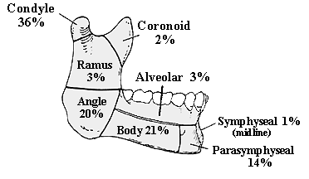

Slide 30
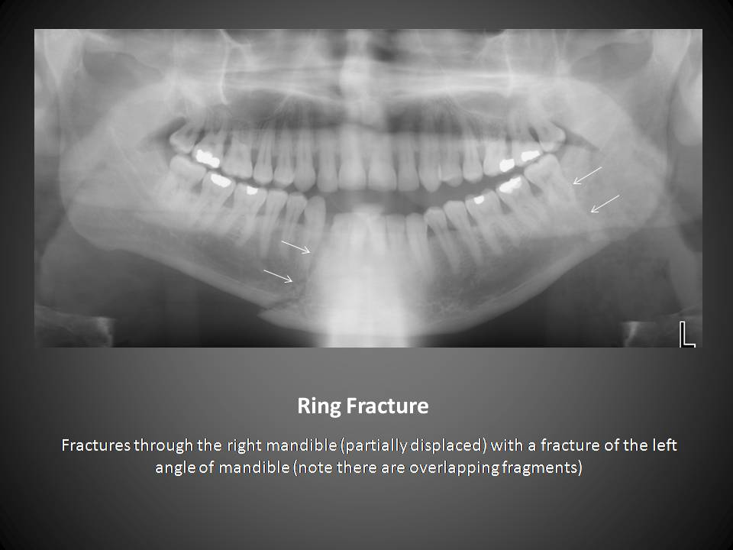

Slide 31
Mandibular Dislocations
Usually occur from motion that opens mouth widely – yawning, vomiting, singing
May occur from seizure or direct trauma
Anterior most common
May be unilateral or bilateral

Slide 32
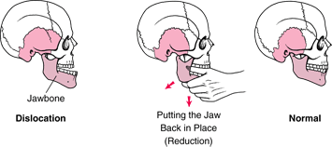

Slide 33
Signs & symptoms
MANDIBULAR FRACTURE
Step deformity
Assymetry of lower dental arch & derangement of occlusion
Pain & paradoxical movement & crepitus
Sublingual hematoma , blood stain saliva, anasthesia of lower lip

Slide 34
CONDYLAR NECK FRACTURE
Tenderness, trismus
Deviation of jaw on injured side on opening mouth
Inability to move mandible on opposite site of fracture
Lateral open bite/ anterior open bite

Slide 35
Management
Intact dental arch –IMF
Incomplete dental arch
Arch bar
Intermaxillary bone pins
Cast silver splints
Gunning splints
External fixation
Internal fixation

Slide 36
Zygomatic complex fractures
Refers to “cheekbones”
Lateral third of facial skeleton
Tripod fracture- disruption of three articulations
Zygoma fractures may affect vision, may also cause numbness on cheek due to nerve entrapment
Trismus

Slide 37
Sign & symptoms:
subconjuctival haemorrhage, echymosis, step deformity,
restricted eye movement, eyelid closed due to oedema
Management : plating

Slide 38
Orbital floor fracture
Blunt trauma to globe or adjacent bone leads to fracture [**]
Naso-orbit-ethmoid fracture
Markowitz et al. who defined term in relation with medial canthal ligaments[**/*]

Slide 39
Pediatrics
Head is larger in proportion to body than in adults
Up to 60% of children with facial fractures have intracranial injury
Children more likely to have serious exsanguination from facial wounds than adults

Slide 40
Oral Injuries
Includes dental and tongue injuries
Penetrating trauma
Airway issues

Slide 41
Dental Avulsion
Primary tooth – implantation not done
Permanent tooth – mechanism, time out of socket, what tooth was lying in
Inspect tooth to see if intact
Inspect site of tooth loss

Slide 42
Dental Avulsion Care
Do not touch root or scrub tooth
May use gentle saline irrigation
If possible, attempt reimplantation in field
If unable to reimplant in field, place tooth in transport medium – Hank’s solution, milk, saline

Slide 43
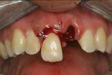

Slide 44
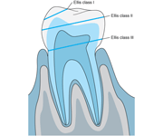
Dental Fractures
85% maxillary teeth

Slide 45
Intra-oral Lacerations
May require suction
Can cover with saline dressings
If penetrating trauma, and object still in place, secure object and transport

Slide 46
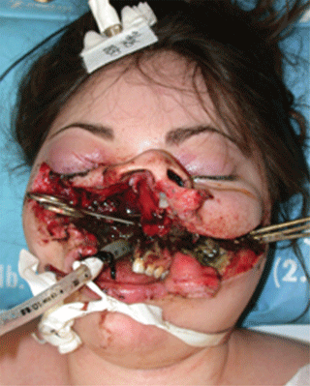

Slide 47
Facial Gunshot Wounds
High mortality, dependant on angle and bullet
Bullet may travel in unpredictable pattern

Slide 48
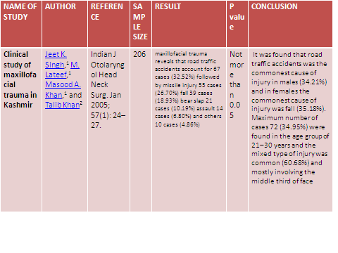

Slide 49
REFERENCES
Le Forte. Etude experimentale sur les de la machoire. Revue Chirugie 1901; 23: 20, 360. 479.
O’ Sullivan , O’ connor. Is there role of traditional methods in mx of fracture of zygomatic complex? Injury. 1998; 29: 413-5.
Adams W. internal wire fixation of facial fractures. Surgery. 1942; 523-40.

Slide 50
MCQ

Slide 51
1. Which are the following are low impact bone?
Nasal bone
Zygoma
Frontal bone
Maxilla

Slide 52
2. Which is the commonest bone to be fractured in facial trauma?
Frontal bone
Maxilla
Mandible
Nasal bone

Slide 53
3. What is Le Fort III?
Naso orbital ethmoid fracture
Craniofacial dysassociation
Separation of maxilla & hard palate from rest of face
Orbital floorfracture

Slide 54
4. Which bone is referred as cheeck bone?
Nasal bone
Zygoma
Frontal bone
Maxilla

Slide 55
5. Which is the commonest site for mandibular fracture?
Ramus
Condyle
Angle
Symphysis

Slide 56

THANK YOU

