Slide 1

Crown Lengthening
Dr.Monali Shah
Professor & Head
Department of Periodontology
K.M.Shah Dental College & Hospital
Sumandeep Vidyapeeth

Slide 2
Periodontal Plastic Surgery
Surgical procedure performed to correct or eliminate anatomic, developmental, or traumatic deformities of the gingiva or alveolar mucosa.
Various procedures included in periodontal plastic surgery:
Gingival augmentation
Root coverage
Crown lengthening
Removal of aberrant frenum
Ridge augmentation procedures

Slide 3
Crown Lengthening
The concept was introduced by D.W. Cohen (1962)
A surgical procedure designed to increase the extent of
supra-gingival tooth structure for esthetic and restorative purposes.
It is done to increase the clinical crown length without violating the biologic width.
CLINICAL CROWN – crown visible in the oral cavity
ANATOMIC CROWN – crown till the CEJ

Slide 4
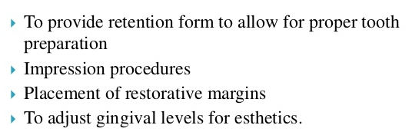
Why it is performed ?

Slide 5
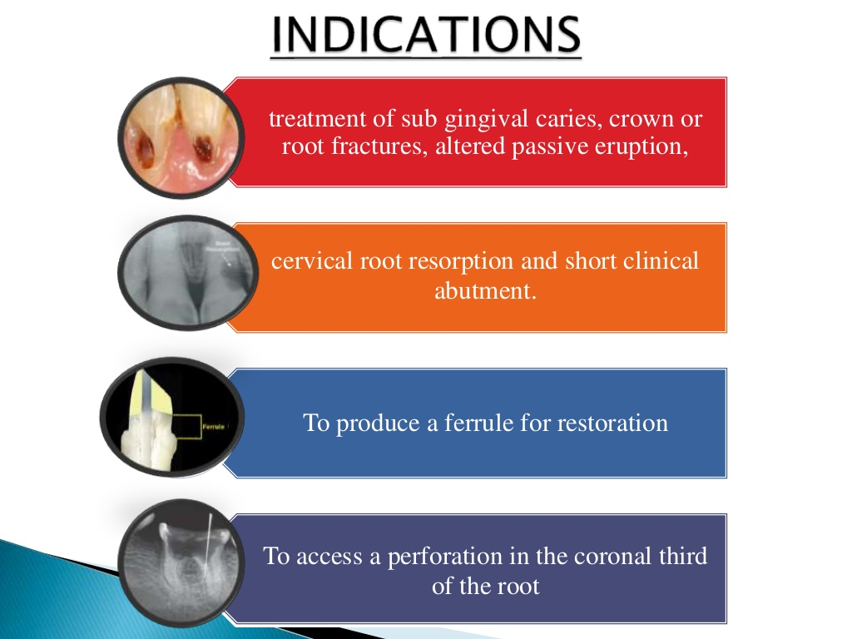
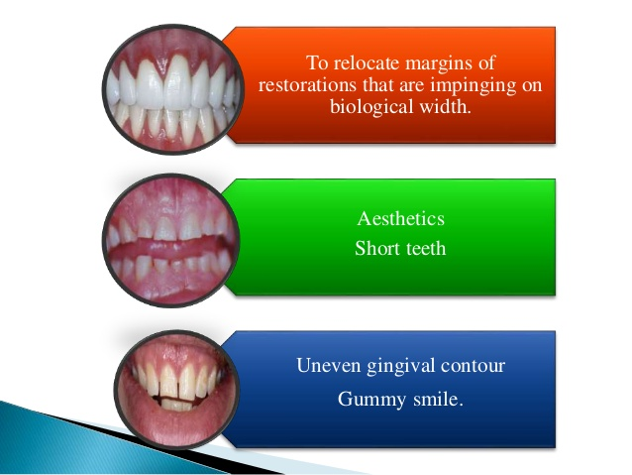
Indications

Slide 6
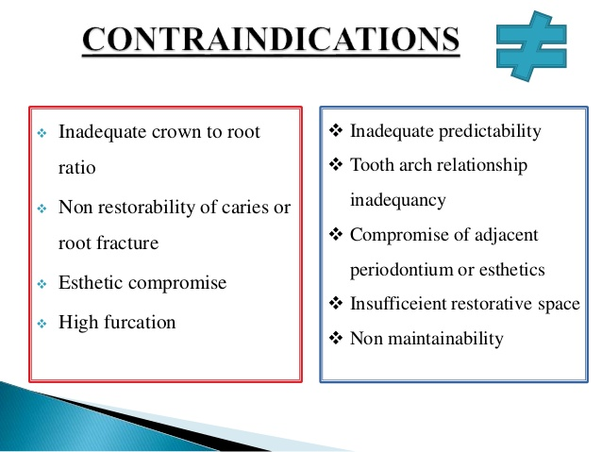
Contraindication

Slide 7
Evaluation
Clinical
Sulcus depth
Radiographic
Level of bone
Biologic width
Osseous crest
Pulpal involvement
Apical extent of caries
Gingival health
Furcation location
Apical extent of caries
Pulpal involvement
Root Length & Form
Crown to root ratio
Root trunk
Notes:
Evaluation of this procedure can be done clinically by checking the

Slide 8
Biomechanical Consideration That Governs CLP
Biologic Width
Ferrule Effect
Crown to Root Ratio

Slide 9
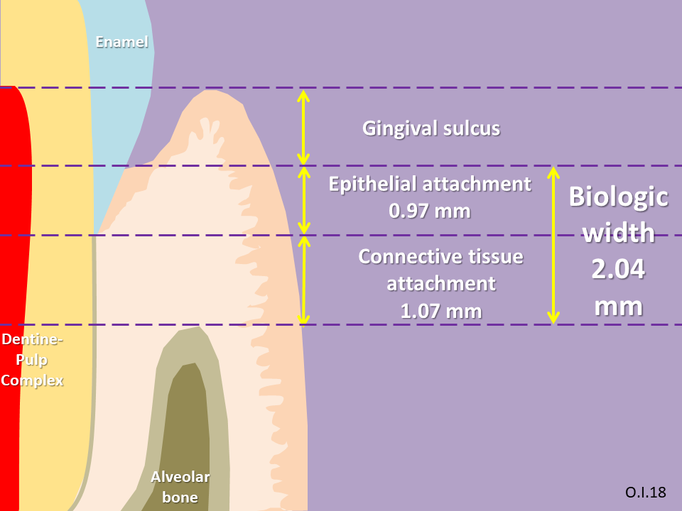
Biologic Width
The distance established by Junctional Epithelium and Connective Tissue Attachment to the root surface of a tooth.
When restorations do not take
these considerations into account,
3 things tend to occur :
Chronic pain
Chronic inflammation of
the gingiva
Unpredictable loss of Alveolar
bone
Notes:
So we have to leave 3 mm the restoration and the crest

Slide 10
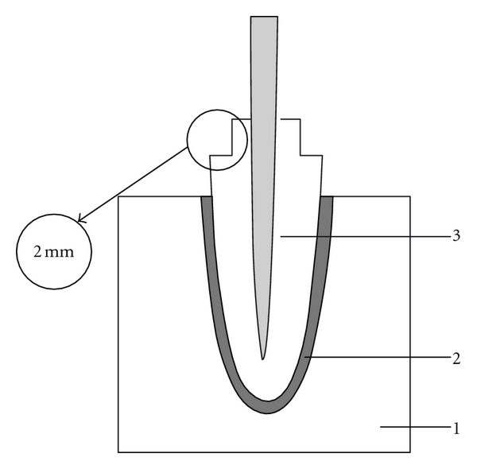
Ferrule Effect
A band that encircles the external dimension of residual tooth structure.
Another 2 mm should be removed to
reveal enough tooth structure to allow for
a 2 mm ferrule.
It has been shown that it significantly
reduces the incidence of fracture in the endodontically treated tooth.

Slide 11
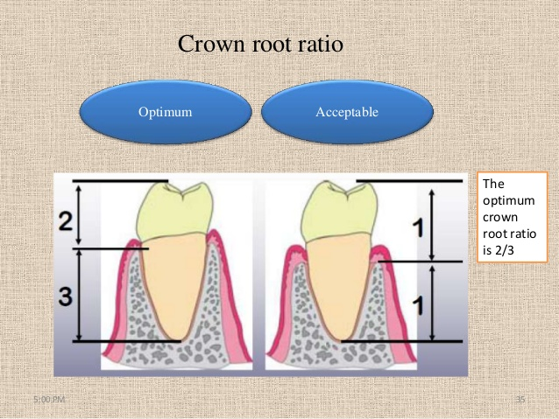
Crown to Root Ratio
Removing bone for a crown lengthening procedure will damage the bony support of adjacent teeth unfavorably increase the crown-to-root ratio.
It is almost impossible to regain it to previous levels and it will make problem when patient wants to do an implant in the future.
Optimum
Minimum

Slide 12
Classification
Ernesto 2004
TYPE I : Sufficient soft tissue allows gingival exposure of the tooth without exposure of the alveolar crest and violation of the biologic width.
TYPE II : Sufficient soft tissue allows gingival excision without exposure of the alveolar crest but in violation of the biologic width.
TYPE III : Gingival excision to the desired clinical crown length will expose the alveolar crest.
TYPE IV : Gingival excision will result in inadequate band of attached gingiva

Slide 13
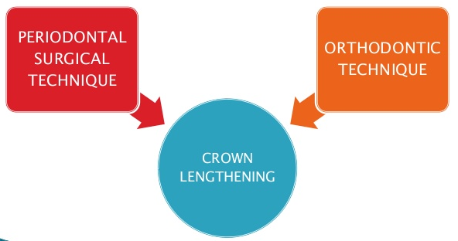
Treatment & Techniques

Slide 14
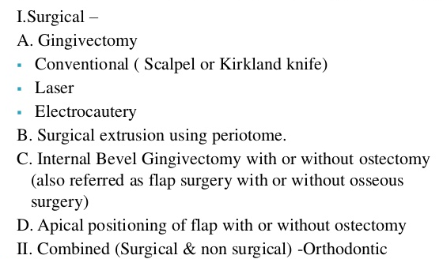
Treatment for CLP

Slide 15
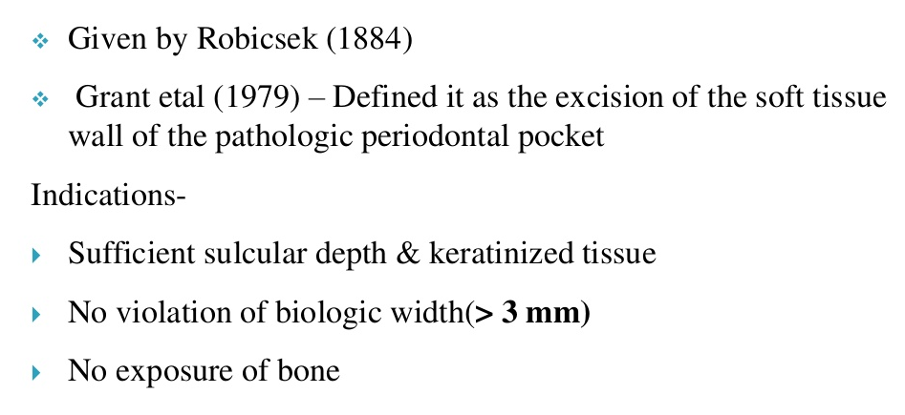
External Bevel Gingivectomy

Slide 16
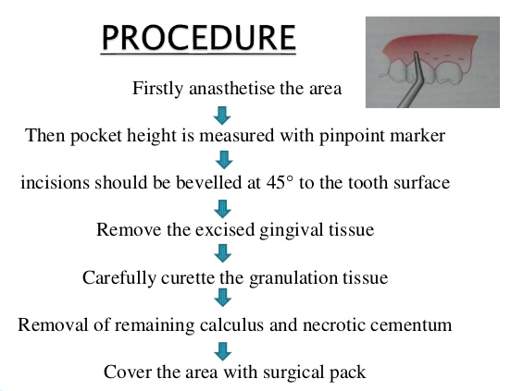
Procedure

Slide 17
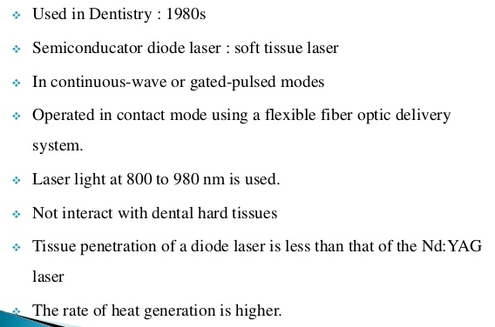
LASER

Slide 18
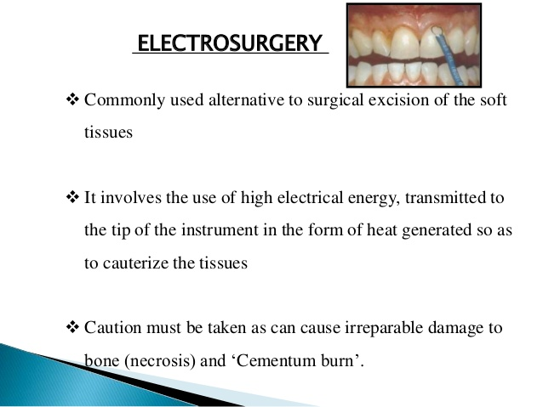
Electrosurgery

Slide 19
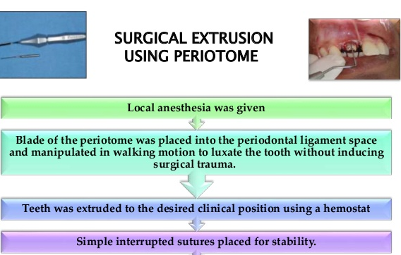

Slide 20
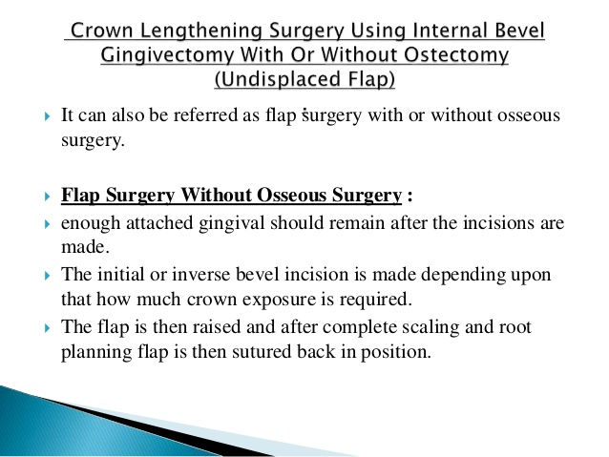
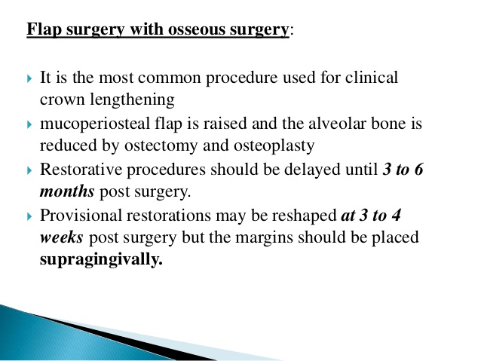
Crown Lengthening Surgery Using Internal Bevel Gingivectomy With Or Without Ostectomy (Undisplaced Flap)

Slide 21
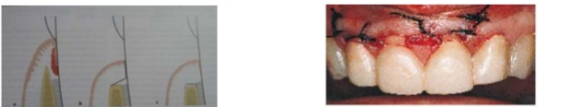
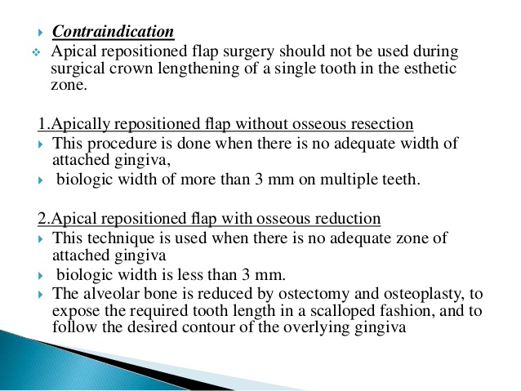
Apically Repositioned Flap for CLP

Slide 22
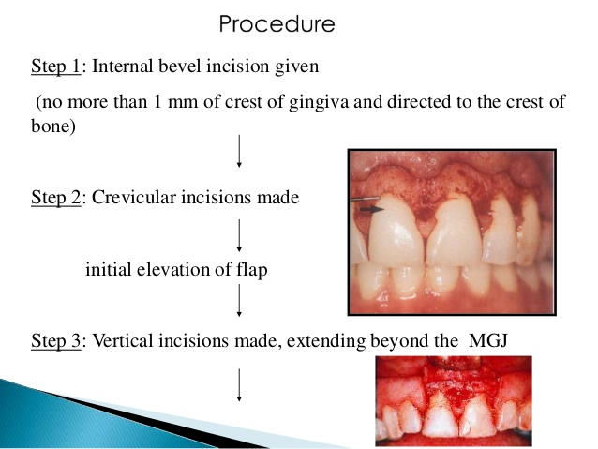
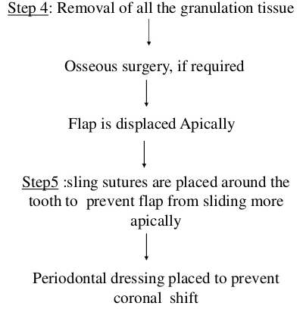
Procedure

Slide 23
Orthodontic Techniques
1) Extrusive technique – Extruding a tooth with orthodontic forces to provide adequate tooth structure for restorative dentistry.
2) Intrusive technique – the crown of the tooth is intruded until the gingival margin is located at the same level as that of the contralateral tooth.

Slide 24
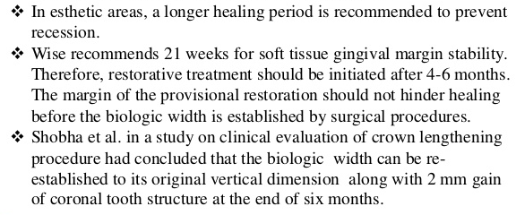
Healing after CLP

Slide 25
Complications
Unaesthetic appearance due to
- Improper contour
- Loss of papilla
- Open interdental space
Improper Crown : Root
Loss of PDL and bone of adjacent tooth
Not enough bone for implant in the future
Prolonged bleeding during procedure
Risk of developing an infection
Sensitivity to hot and cold because the roots of the teeth are exposed

Slide 26
Conclusion
There are number of alternative modalities that will correct the esthetic problems.
The decisive factor is what works best for the individual patient.
Although individual variations exist in the soft tissue attachment around the teeth, there is general agreement that a minimum of 3 mm should exist from the restorative margin to the alveolar bone, allowing for 2 mm of biologic width and 1 mm of sulcus depth.

Slide 27
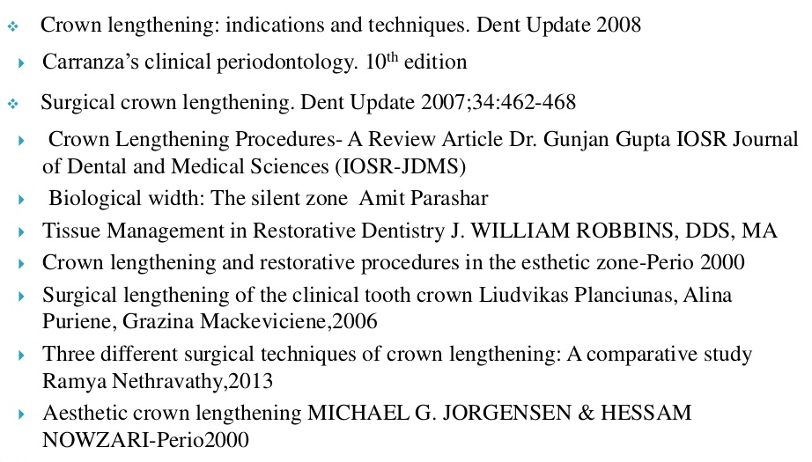
References

Slide 28


Thank You !
Follow us on
Periodontology Kmsdch
#periokmsdch
Acknowledgement : To Dr. Nikee Upadhyay for her contribution

