Slide 1

CASE HISTORY TAKING
Dept. of Periodontology

Slide 2
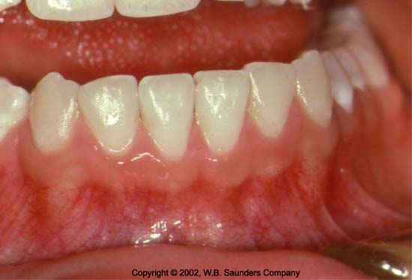
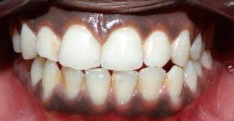
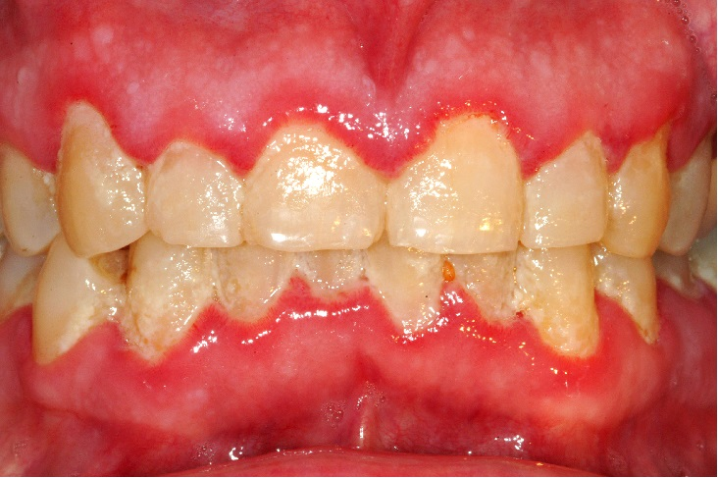
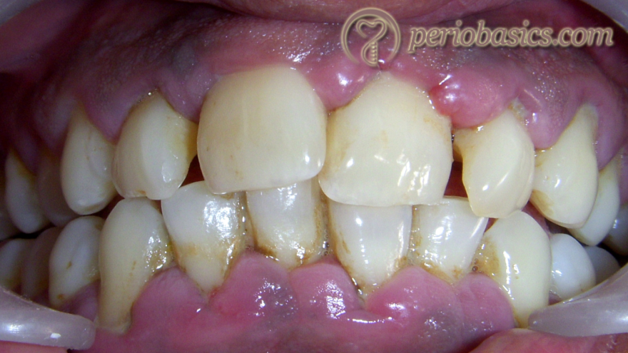
COLOUR
Coral Pink
Pink with melanin pigmentation
Reddish Pink(marginal)
Bluish Pink(diffused)

Slide 3
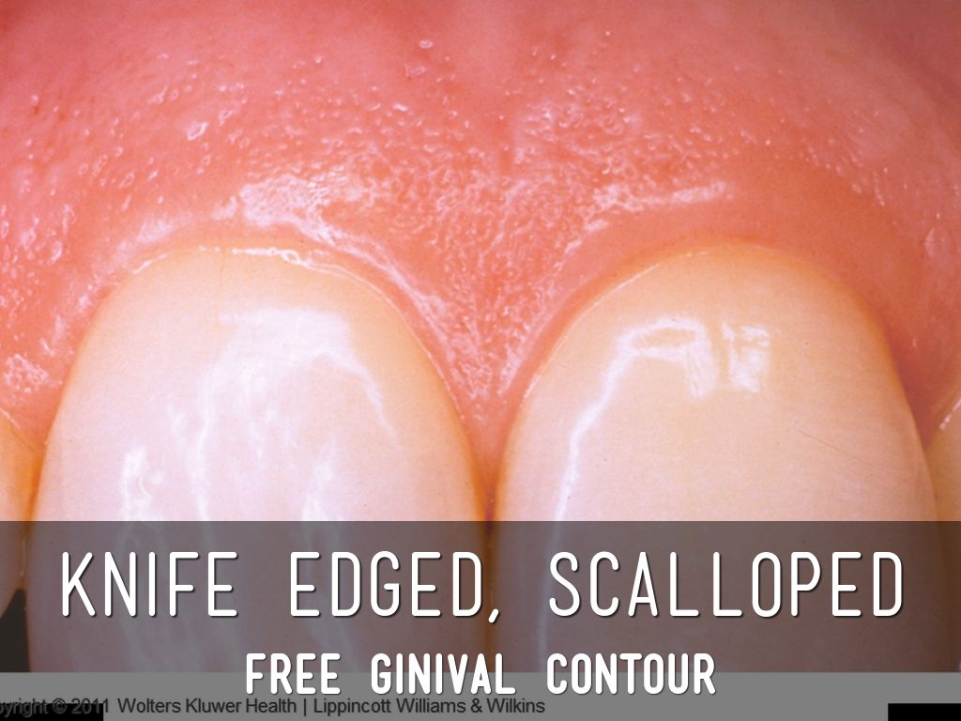
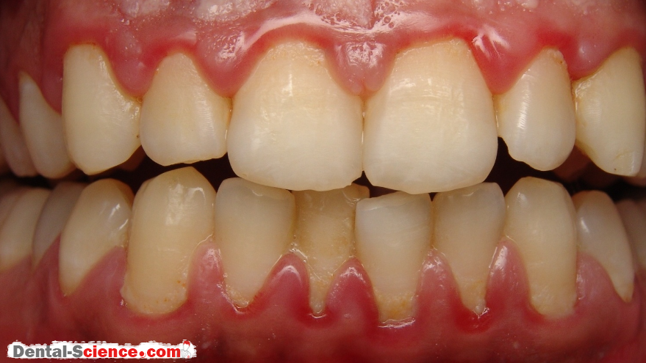
CONTOUR
Scalloped with knife edged margins
Loss of scalloping with rounded/blunt margins

Slide 4
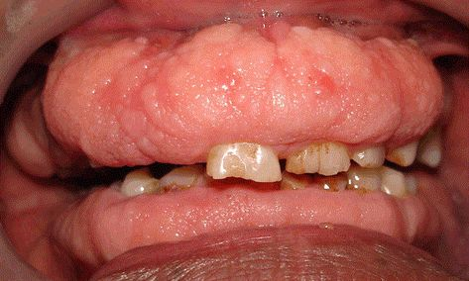
CONSISTENCY
Firm and Resilient
Firm n leathery
Soft and Edematous
Notes:
Firm n leathery fibrotic

Slide 5
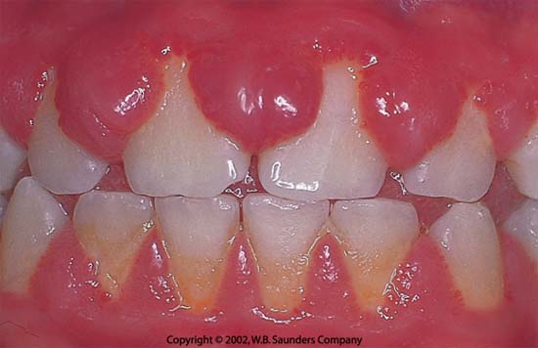
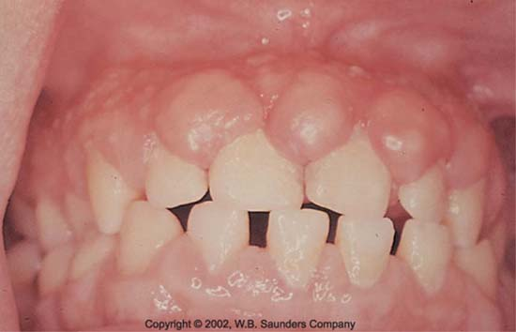

SIZE
Normal
Increased

Slide 6
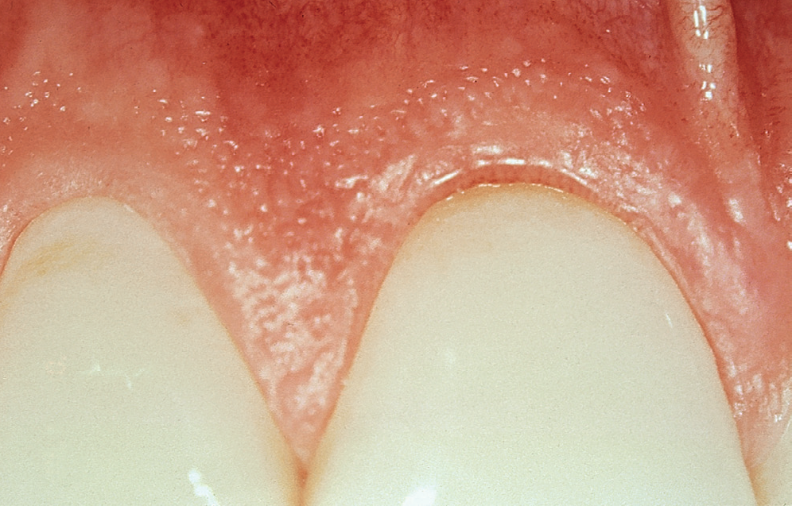
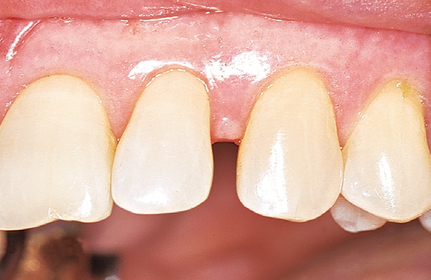
SHAPE
Normal
Flat

Slide 7
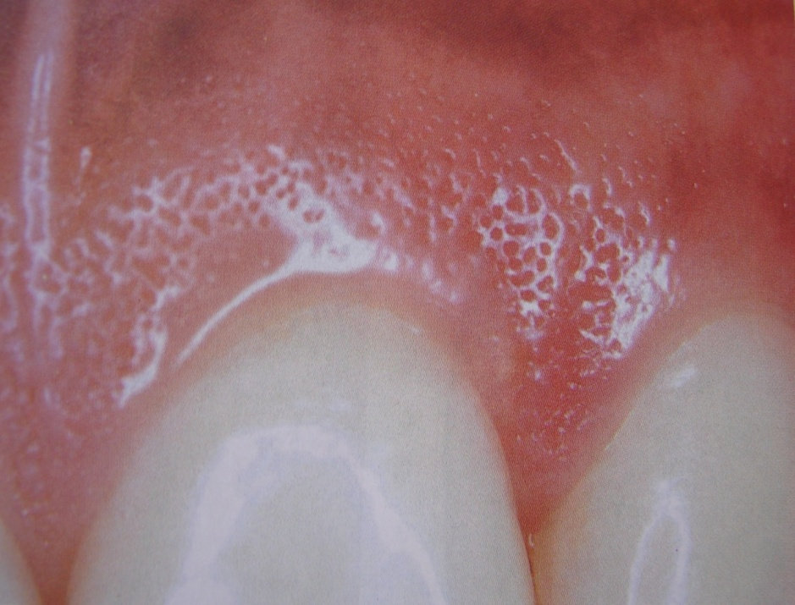
SURFACE TEXTURE
Stippling present
Stippling absent

Slide 8
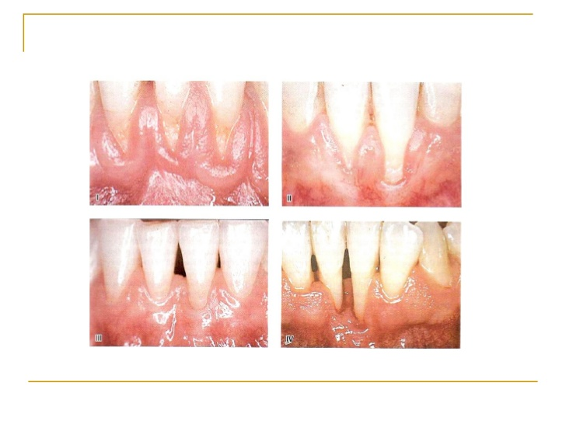
POSITION
At CEJ
Apical to CEJ
Coronal to CEJ

Slide 9
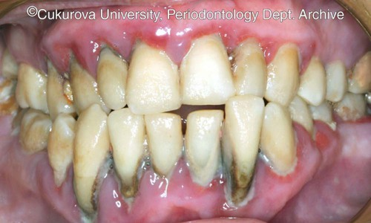
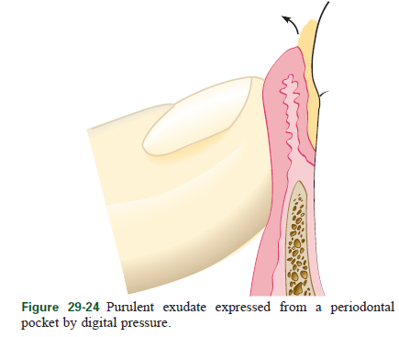
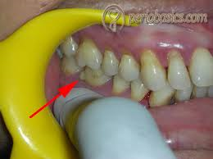
SUPPURATION

Slide 10
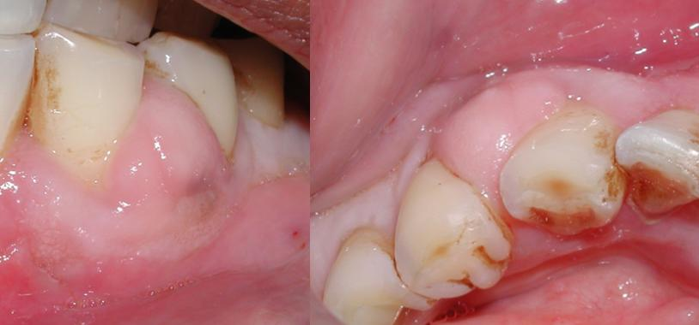
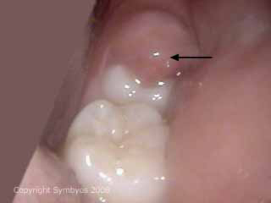
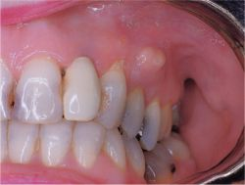
ABSCESS
Pericoronal abscess
Gingival abscess
Periodontal abscess

Slide 11
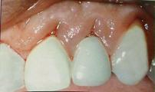
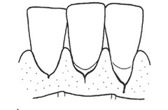
Stillman’s cleft:
Present /Absent

Slide 12
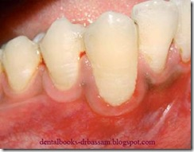
Mc-call festoons:
Present /Absent

Slide 13
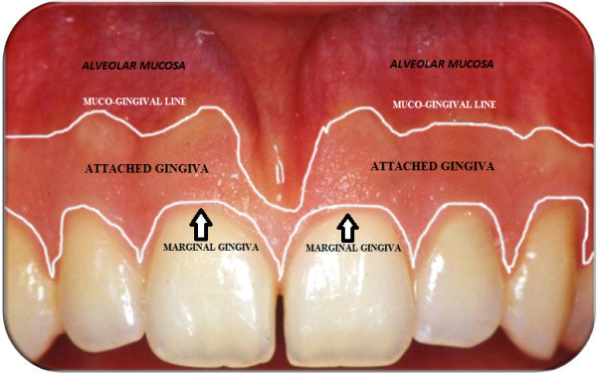
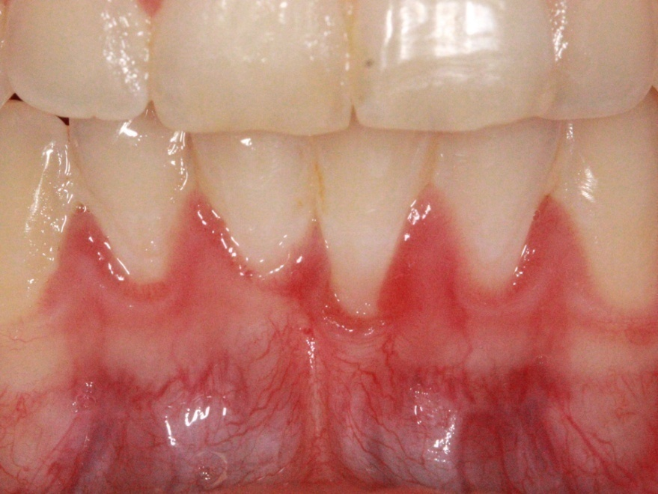
Amount of attached gingiva
Tension test
- Adequate
Tension test
- Inadequate

Slide 14
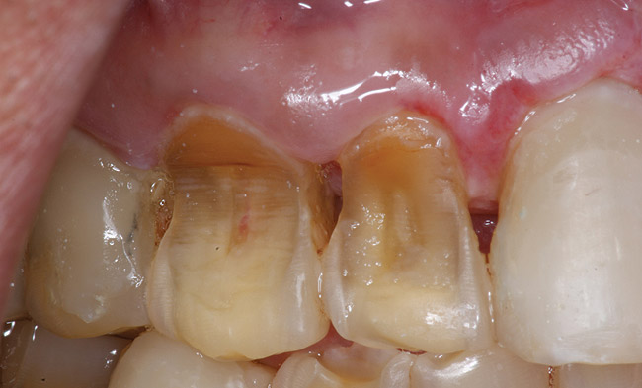
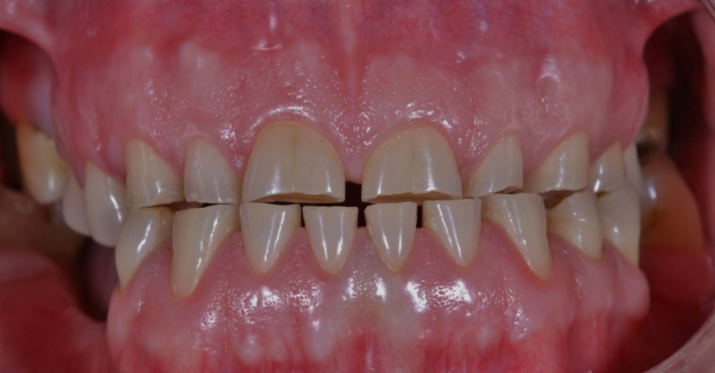
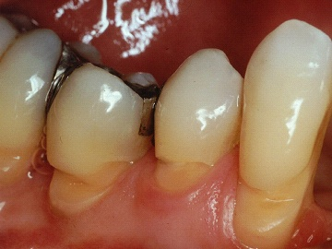
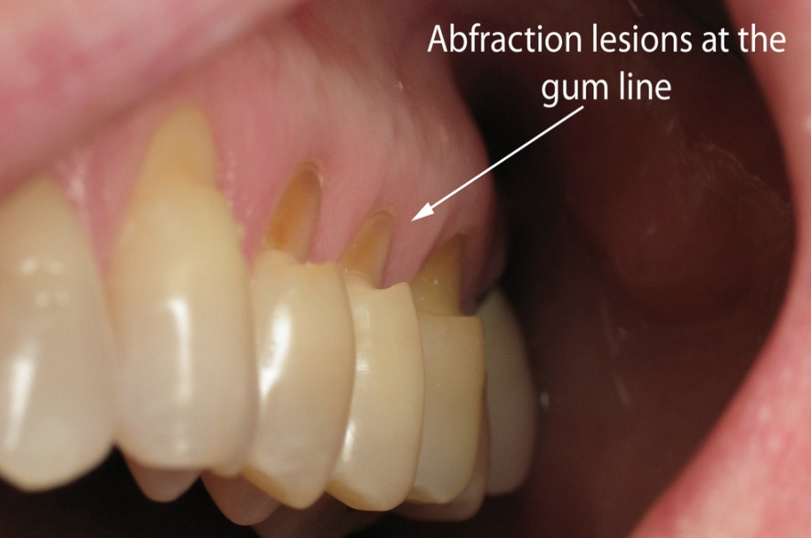
Wasting disease of the teeth
Erosion
Attrition
Abrasion
Abfraction
Present /Absent

Slide 15
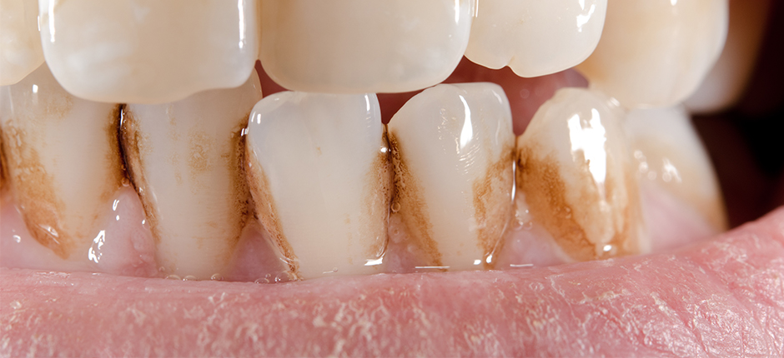
Dental stains
Present /Absent

Slide 16
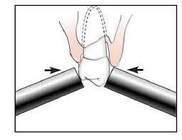
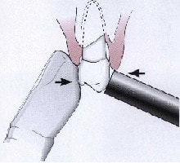
Tooth mobility
GRADES OF MOBILITY
Grade I : Slightly more than normal
Grade II : Moderately more than normal
Grade III : Severe mobility facio-lingually and /or mesiodistally combined with vertical displacement

Slide 17
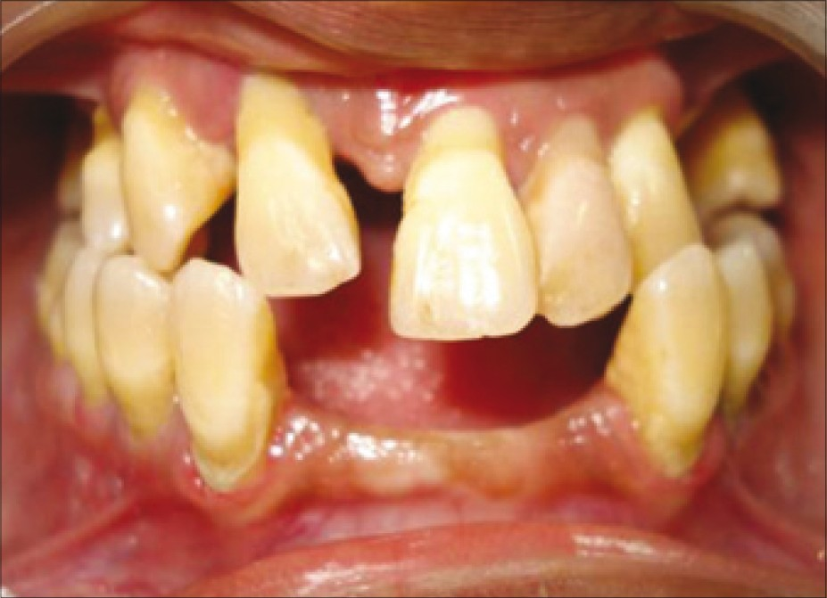
Pathologic tooth migration:
Present /Absent

Slide 18
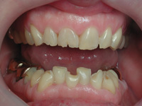
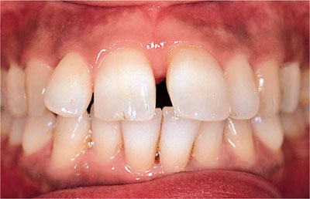
Trauma from occlusion:
Clinical Features
Mobility
Fremitus
Wear facets in the presence of other clinical indicators
Chipped or fractured teeth
Tooth migration
Normal/Traumatic

Slide 19
Furcation

Slide 20
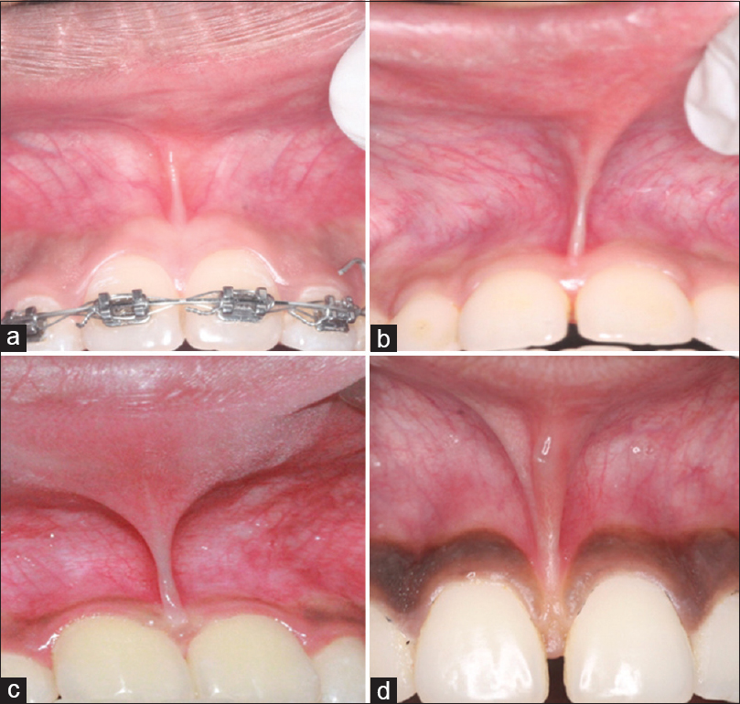
Frenal attachment
Mucosal frenal attachment
Gingival frenal attachment
Papillary frenal attachment
Papillary Penetrating frenal
attachment

Slide 21
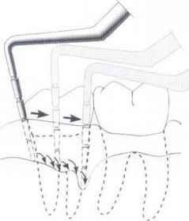
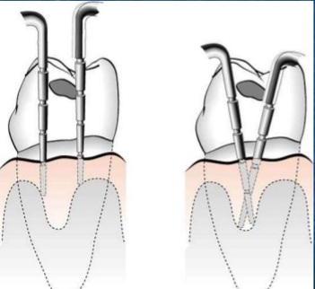
Probing technique:

Slide 22
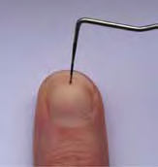
Probing force:
According to Armitage et al: 25 gms
According to the Vander Valden : 0.75 N

Slide 23
Probing Depth
 | 8 | 7 | 6 | 5 | 4 | 3 | 2 | 1 | 1 | 2 | 3 | 4 | 5 | 6 | 7 | 8
MAX
MAND
 | 8 | 7 | 6 | 5 | 4 | 3 | 2 | 1 | 1 | 2 | 3 | 4 | 5 | 6 | 7 | 8
Maximum probing depth of the tooth should be written in the chart above

Slide 24
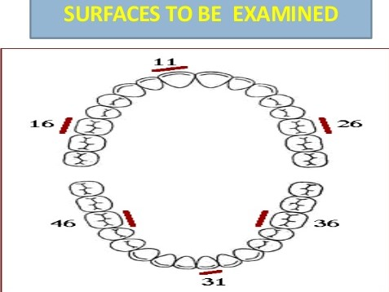
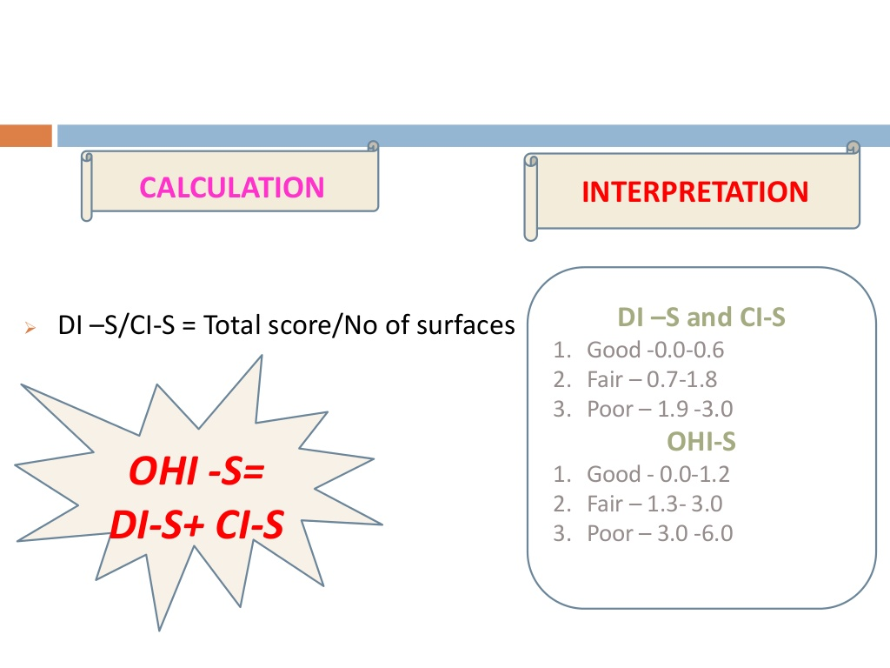
Oral Hygiene Index-Simplified

Slide 25
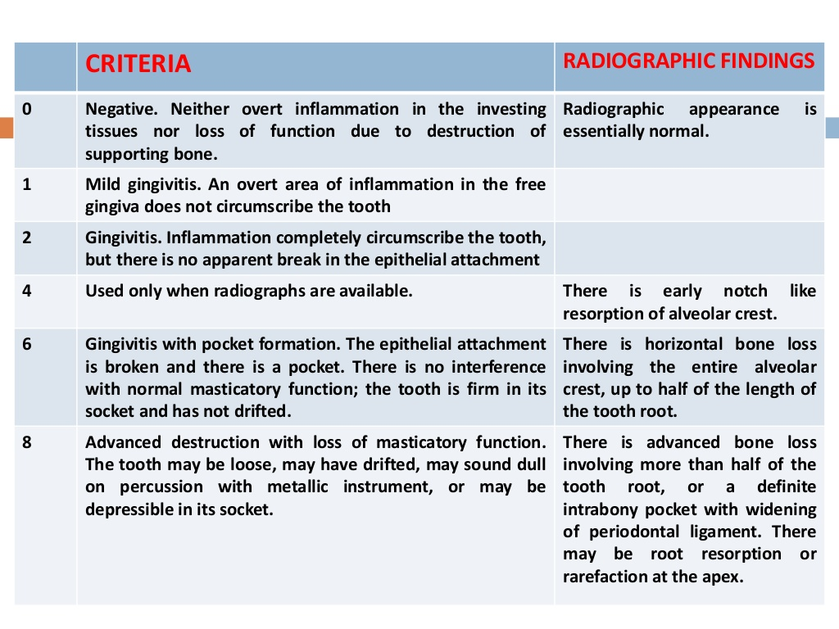
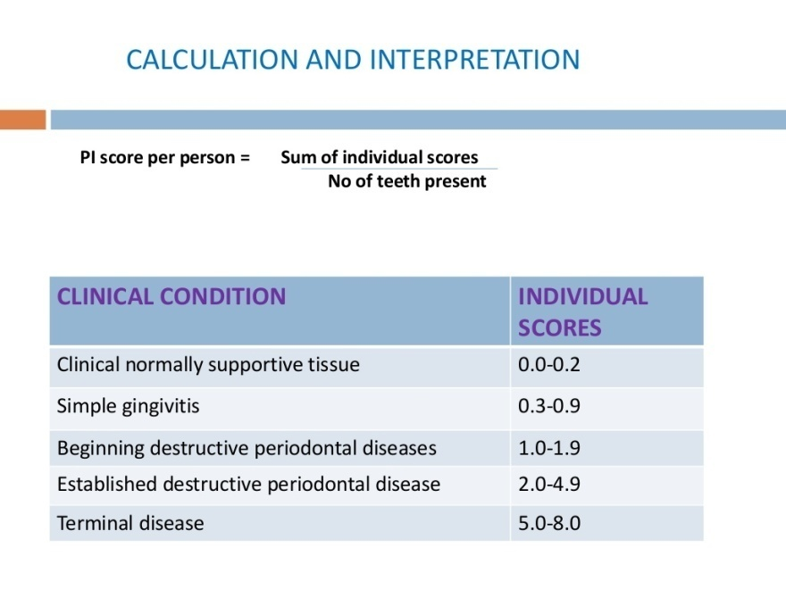
Russell Periodontal Index
RUSSELL RULE
While in doubt assign the lesser score
All the teeth are examined

Slide 26
Radiographs Investigations /Findings
Advise:
IOPA
OPG

Slide 27
Laboratory Investigations
Advise:
Complete hemogram with BT and CT for all cases of surgery
Other investigations as per need

Slide 28
Provisional Diagnosis
Chronic generalized gingivitis
Chronic generalized gingivitis with localized periodontitis irt
2 1 12
Chronic generalized periodontitis

Slide 29
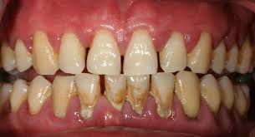
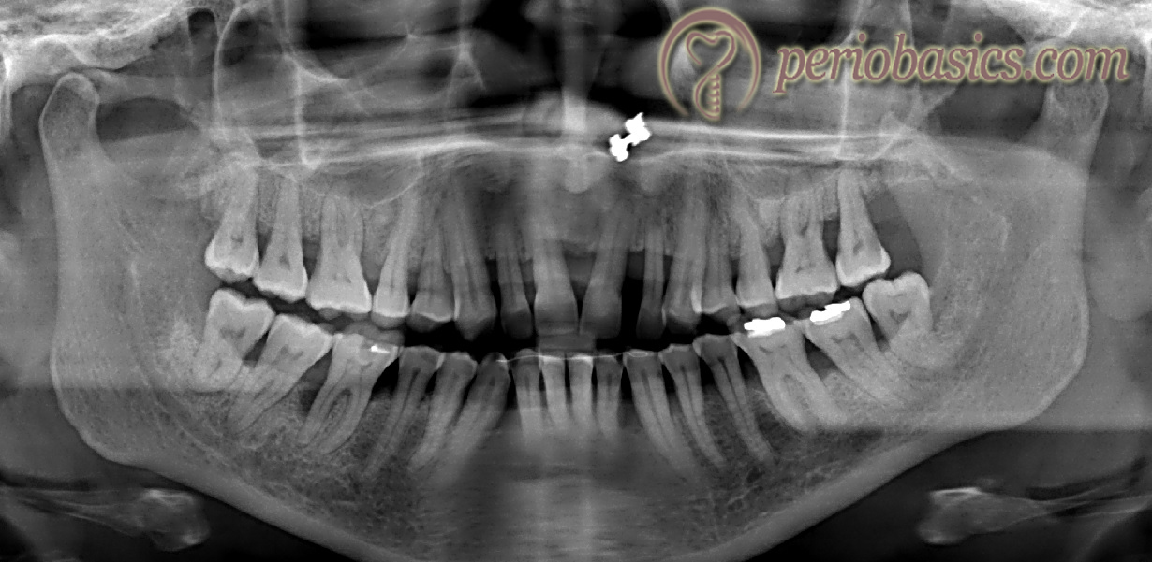
Chronic periodontitis
Chronic periodontitis

Slide 30
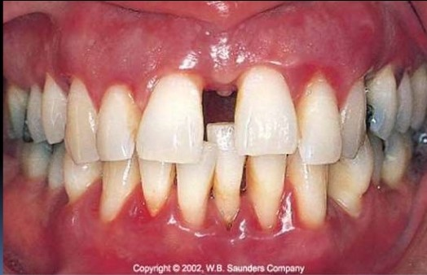
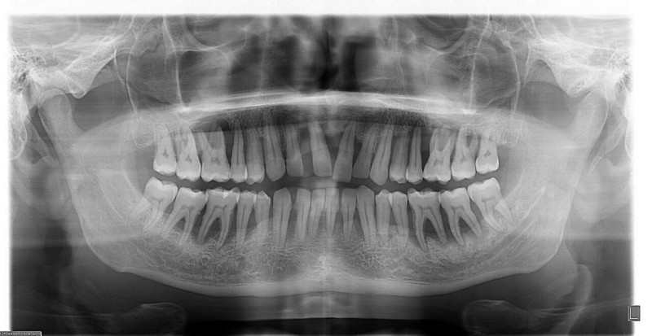
Aggressive periodontitis

Slide 31
Prognosis
Overall prognosis
Individual Prognosis
Good
Fair
Poor
Questionable
Hopeless

Slide 32
Treatment Plan
Emergency Phase:
  Periodontal abscess
  Extraction of hopeless teeth
Phase I
  Scaling & root planing
  Antimicrobial therapy (local or systemic)
  Splinting
  Occlusal therapy
  Oral Hygiene Education
Phase II
  Flap surgery/ root coverage procedures/ gingivectomy/ frenectomy etc…
Phase III
  Final restorations
Phase IV
  Periodic rechecking, Gingival Inflammation (pockets. Inflammation)
  Tooth mobility, Occlusion

Slide 33


