Slide 1
Interferential Current
By: Dr. Nalina Gupta

Slide 2
Direct current and low-frequency alternating currents (> 1 kHz) encounter a high electrical resistance in the outer layers of the skin.
This makes the treatment of deep structures painful because a large transcutaneous current must flow so that adequate current passes deeply.

Slide 3
Alternating currents of medium (> 1kHz to < 10kHz) or high frequency (> 10kHz) meet little resistance (due to a marked reduction in the effects of skin capacitance upon current flow) and penetrate the tissues easily
Such currents generally oscillate too rapidly to stimulate the tissues directly
These difficulties were overcome in the early 1950s with the development of interferential current therapy.
It was originally proposed in the mid 1950's by Dr Hans Nemeck, working in Austria.

Slide 4
The term interferential therapy stems from the idea of two currents Interfering‘ with each other and this gives rise to the term 'interferential therapy' or 'interference therapy'.
When two or more sinusoidal currents alternate at the same frequency, rising and falling at exactly the same time, they are said to be in phase.
Waves become out of phase when they are a half wavelength out of step and the rising segment of one coincides with the falling segment of the other.

Slide 5
Waves in phase interfere constructively to produce a resultant wave with an amplitude greater than that of either of the originals.
Waves out of phase interact in a similar way but interfere destructively to cancel each other out
Interference also occurs between waves of slightly differing frequency.

Slide 6
As one wave peak 'catches up‘ with the other, constructive interference causes an increase in the amplitude of the resultant wave, which declines subsequently as the waves again drift out of phase and interfere destructively.
The rate at which the amplitude of the resultant rises and falls is equal to the difference in frequency present between the two original waves and is called a 'beat frequency'.

Slide 7
It is important to remember that it is the 'beat' frequency which is in the biological frequency range and that the 4,000 Hz, medium frequency current is used as a 'carrier wave' in order to overcome the electrical resistance of the skin.
Thus the current produced underneath the electrodes is in the region of 4,000 Hz, whilst the interference effect is produced within the patient's tissues. There is no interference effect underneath the four electrodes.

Slide 8
The two currents *beat' together in such a way that at some points they will join together and produce an increased amplitude, whilst at other times they will completely negate each other and produce no effect at all.
This effect is known as amplitude or 'envelope' modulation. The number of these 'envelopes per second is known as the beat frequency.

Slide 9
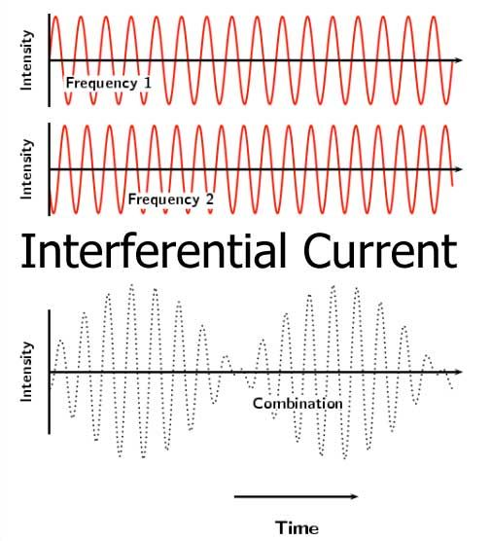

Slide 10
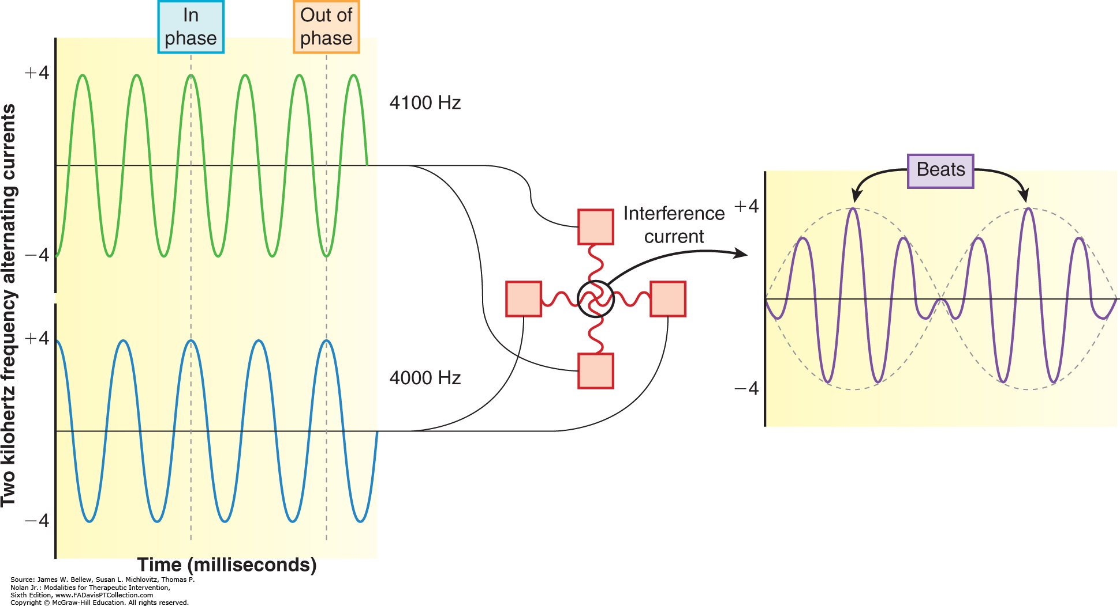

Slide 11
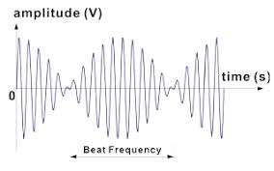

Slide 12
The principle component of interferential unit are a pair of signal generators, the output of one oscillating at the fixed frequency 4000 Hz whilst the other is variable in frequency between 4000 and 4100cps or 4000 and 4250 Hz.
These signals are then amplified to a therapeutically useful intensity.
The variable-frequency oscillator can sweep automatically between one pre-set frequency and another, thus producing a range of beat frequencies that yield several therapeutic effects

Slide 13
Two pairs of electrodes, conveying separately the amplified output of the oscillators, are aligned on the skin so that the currents flowing between each pair intersect and interfere within the structure to be treated.
A resultant current of low frequency is generated that alternates at 0-250 Hz. The precise frequency will depend upon the difference that exists between the frequencies of the original currents.

Slide 14
The beat frequency current flows maximally in the region of maximum interference that develops along diagonals extending at 45 degree to the direct paths between the two sets of electrodes.

Slide 15
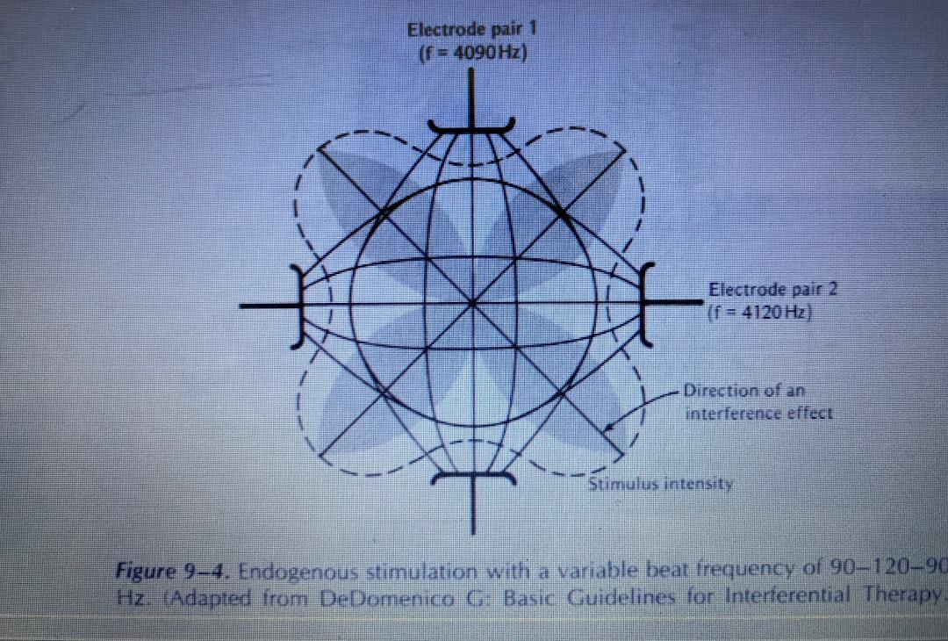

Slide 17
A snowflakeshaped field is created because one current flows laterally from its direct path to interact with the adjacent current.
This region of maximal therapeutic effect is usually static and situated deep within the tissues.
Static fields are used to treat small, well defined lesions but may miss sites of more diffuse damage.
This difficulty is overcome by scanning the region of maximum interference systematically through the tissues.

Slide 18
A voltage (and hence a current) applied to one of the pairs of electrodes, varying rhythmically in intensity with respect to the other, will influence an area that expands and recedes regularly.
This causes the region of maximum interference to pan through the tissue.

Slide 19
Principle of IFT
Tissue resistance is inversely proportional to frequency
Z=1/2πfc
Z= Skin resistance by ohm
F= Frequency
C= Capacity of the skin in microfarad
The tissue impedence at 50Hz is 3200 ohms and at 4000Hz is 40 ohms
IFT
is associated with lower skin resistance
more comfortable and tolerable
Deep penetration

Slide 20
Parameters of IFT
Parameters | IFT Patterns (Modes)
 | 2 poles (Bipolar) IFC | 4 poles (Quadripolar) IFC
 |  | Static | Vector Scan
1. Output | 2 Electrodes/1 channel | 4 electrodes/ 2 channel
2. Modulation | Premodulated | Current modulated at tissue level
3. Field | Static | Static | Dynamic
4. Shape | Oval | Four leaf clover | Circular
5. Uses | Suitable for small areas (ankle, elbow) | It is used for acute conditions | It is best suited for large areas and diffuse pain

Slide 21
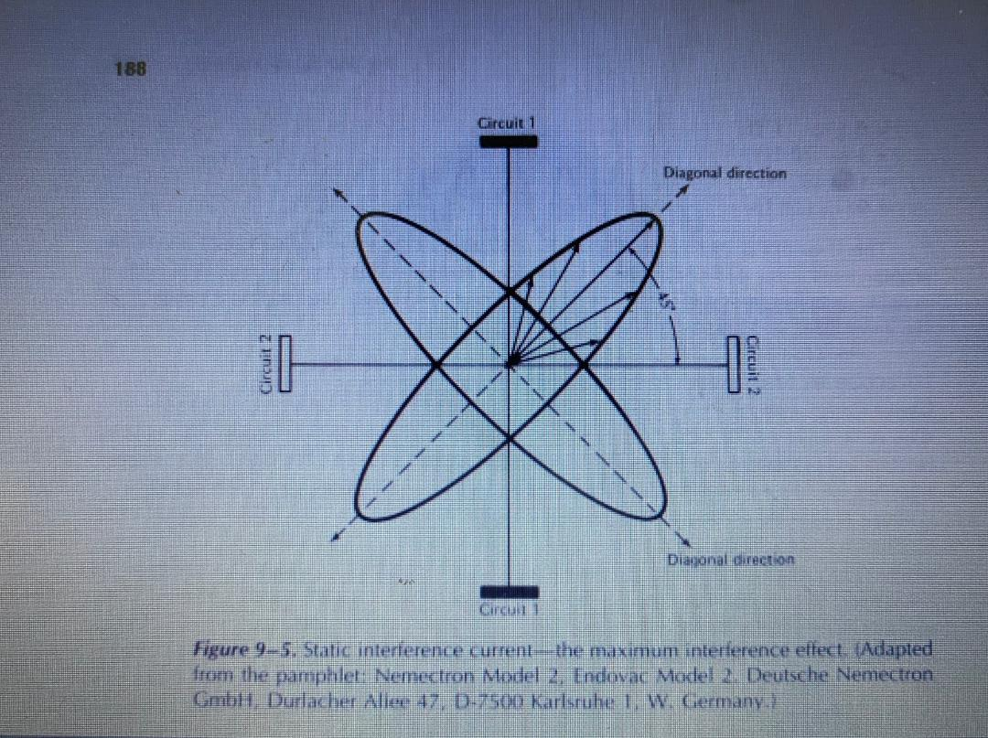

Slide 22
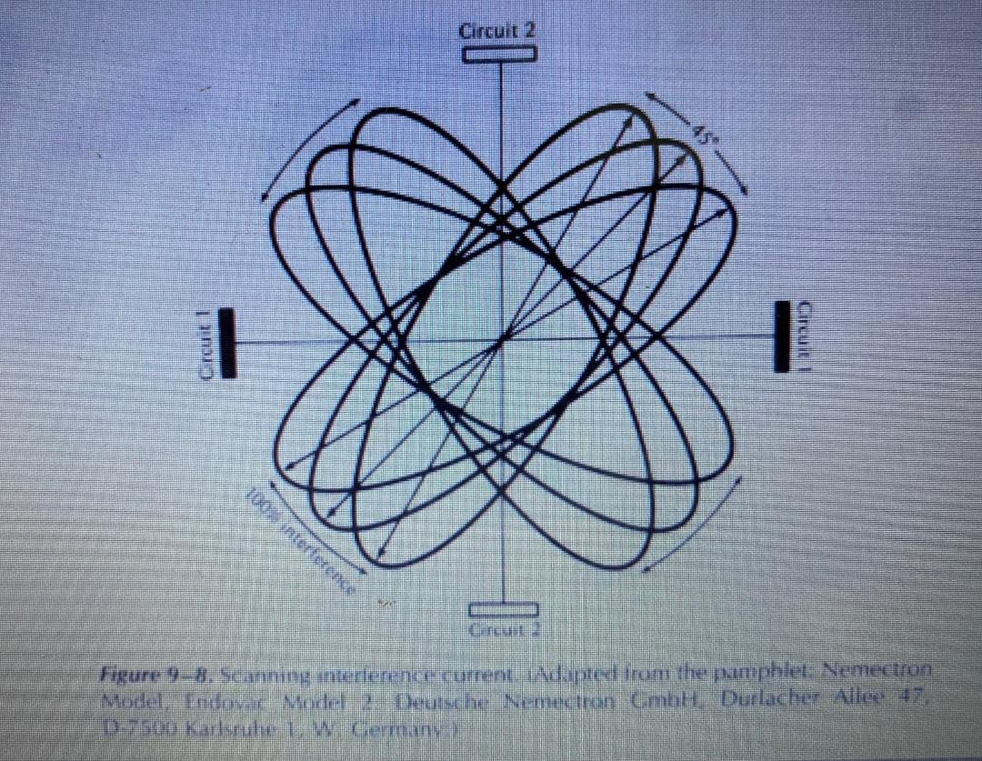

Slide 23
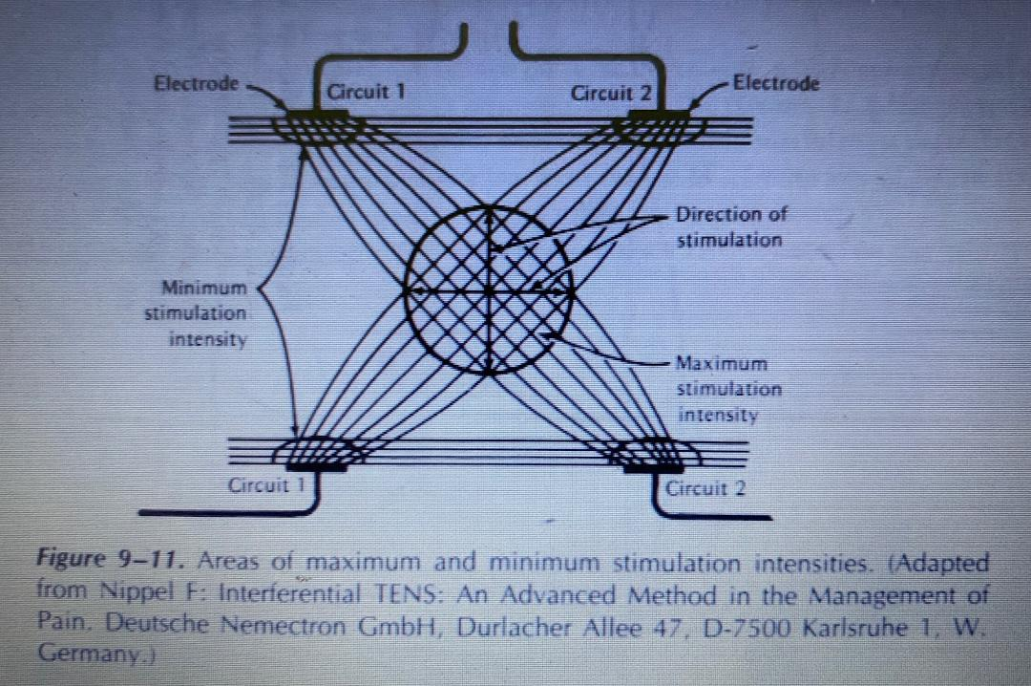

Slide 24
A skin current tends to occur when the electrodes of two separate circuits are close together if these are of opposite polarity.
The current then tends to choose the easiest pathway instead of passing diagonally through the tissues.
For this reason skin currents can also be avoided by taking polarity into account when placing the electrodes

Slide 25
It is also necessary to "balance" the intensity in both circuits so that there is, as far as possible, equal sensation under the four electrodes.
Because two circuits are present one circuit may have a slightly longer pathway than another and so the intensity in the circuits must be adjusted to meet this difference.

Slide 26
When these adjustments have been made, it takes a minute or two to become aware of the beat frequency between the four electrodes.
This interference feels like a slight vibration or flutter or a mild sense of pressure.

Slide 27
It is necessary to feel the difference between a contraction of muscle produced by an interferential current and that produced by faradism; there is less sensory stimulus and greater depth of contraction with the former.

Slide 28
Physiological effects of interference currents
Magnitude of the current- rhythmic or constant
Frequency range used
Accuracy of electrode positioning
Relief of pain
Increase in local circulation
Removal of chemicals from the area
Short duration pulses at a frequency of 100 Hz may stimulate large diameter nerve fibers
Frequency of 80-100 Hz rhythmic is usually chosen

Slide 29
To selectively activate the descending pain suppression system, a frequency of 15 Hz is required
Maximum frequency of transmission in C nerve fibres is 15Hz and in A-delta fibers is 40 Hz. The application of frequencies higher than this maximum could block transmission along these fibres altogether

Slide 30
2. Motor stimulation
Normal innervated muscles will be made to contract if IF between 1 and 100 Hz are used
The type of contraction depends on the frequency of stimulation
At low frequencies, a twitch is produced
Between 5 and 20 Hz a partial tetany
30 to 100 Hz a tetanic contraction
Little sensory stimulation

Slide 31
3. Absorption of exudate
This is accelerated by a frequency of 1-10Hz rhythmic
Rhythmical pumping action is produced by muscle contraction, and there is possibly an effect on the autonomic nerves which can affect the diameter of blood vessels and therefore the circulation.
Both of these factors help absorb exudate and thus reduce swelling

Slide 32
Indications and Contra-indications
Adjunct to other techniques such as ice, ultra-sound and mobilization
Reduction of pain and oedema, (sports injuries)
Stress incontinence
Contra-indications are the same as for any low-frequency treatment

Slide 33
Dangers
Electric burn
Apparatus should be operated well away from SWD

