Slide 1
Other Heat Therapies
Niketa Patel

Slide 2
Contrast Bath
Contrast baths involve alternate immersion of an area, generally a distal extremity, first in warm and then in cold water producing marked hyperaemia (increasing in blood flow) of the skin.
Contrast baths have been shown to cause fluctuations in blood flow over a 20-minute treatment.

Slide 3
Contrast Bath (contd…)
The temperature in the subcutaneous tissue just below the skin can fluctuate from 8⁰C to 14⁰C when using contrast bathing, but little change, 0.5⁰C, occurs at a1cm depth intramuscularly.
Ice packs produced intramuscular temperature drops of approximately 7⁰C and subcutaneous tissue drops of 17⁰C.

Slide 4
Contrast Bath (contd…)
Contrast baths are used because of the considerable sensory stimulation they produce as the cutaneous hot and cold receptors are alternately activated.
This stimulation is relatively vigorous because each time neural accommodation starts to occur the temperature stimulation is reversed.

Slide 5
Contrast Bath (contd…)
This strong sensory stimulation may act to desensitization and to suppress pain by means of gating mechanism and results in subjective relief of pain that occurs in patients receiving this treatment.
Thus treatment with a contrast bath may be considered when patients present with chronic edema, sub acute trauma, inflammatory conditions like sprains, strains or tendinitis.

Slide 6
Contrast Bath (contd…)
The use of contrast baths for edema is based on the rationale that the alternating vasodilatation and vasoconstriction produced by alternating immersion in hot and cold water may help to train or condition the smooth muscles of the blood vessels.

Slide 7
Application techniques
Equipment required:
2 water containers
Thermometer
Towels

Slide 8
Application techniques (contd…)
Procedure:
Fill 2 adjacent containers with water. Fill one container with warm or hot water, at 38⁰C to 44⁰C and the other with cold water, at 10⁰C to 18⁰C.
NOTE: When contrast bath are used to control pain and edema, it is recommended that the temperature difference between the warm and water be large.

Slide 9
Application techniques (contd…)
2. First immerse the area to be treated in warm water for 4 minutes; then immerse the area in cold water for 1min.
3. Repeat this sequence 5 to 6 times to provide a total treatment time of 25 to 30min, and end treatment with immersion in warm water.

Slide 10
Application techniques (contd…)
NOTE: During the treatment the hot water will cool and the cold will be warmed, partly due to transfer of the warm/cold wet limb from one bath to the other. It might be necessary to add both baths during treatment to maintain the required temperature.

Slide 11
Application techniques (contd…)
A thermometer should be available to monitor the water temperature.
4. When the treatment is completed, dry the area quickly and thoroughly.

Slide 12
Advantages of Contrast Baths
May promote a more vigorous circulatory effect than heat or cold alone.
Provides good contact with contoured distal extremities compared with other thermal agents.
May help to provide pain control without aggravating edema
Allows movement in water for increased circulatory effects.

Slide 13
Disadvantages of Contrast Baths
Some patients do not tolerate cold immersion.

Slide 14
FLUIDOTHERAPY
Fluidotherapy is a dry heating agent that transfers heat by convection.
It consists of a cabinet containing finely ground cellulose particles made from corn cobs.
Heated air is circulated through the particles, suspending and moving them so that they act like a liquid.

Slide 15
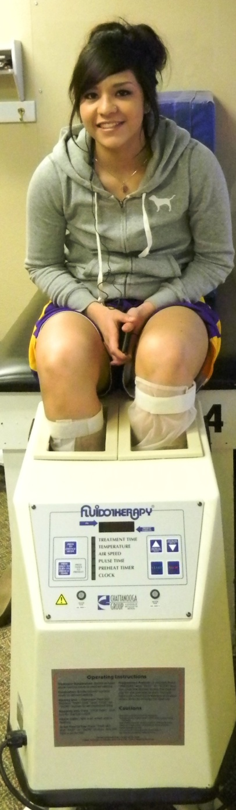
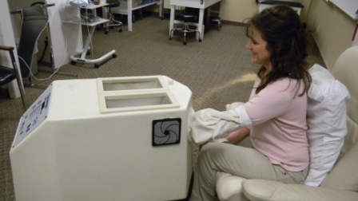


Slide 16
FLUIDOTHERAPY (contd…)
The patient extends a body part into the cabinet, where it floats, as if in water.
Portals (opening) in the cabinet allow the therapist to access the patient’s body part when it is in being treated.
Fluidotherapy unit comes in variety of sizes suitable for treating different body parts.

Slide 17
FLUIDOTHERAPY (contd…)
Both temperature and the amount of particle agitation (stirring) can be controlled by the clinician.
Treatment time is 20min.

Slide 18
Advantages of Fluidotherapy
Minimal pressure applied to the area being treated.
Temperature well-controlled and constant throughout intervention.
Easy to administer.

Slide 19
Disadvantages of Fluidotherapy
Expensive equipment
The constant heat source may result in overheating.
If the corncob particles spill onto a smooth floor, floor will become slippery.

Slide 20
Hydrotherapy
Warm water has been used for therapeutic purposes.
Whole body is immersed in the water.
Swimming and exercising in the warm water have beneficial effects.

Slide 21
Whirlpool Baths
Whirlpool baths are stainless steel tanks or baths of various sizes.
The smaller whirlpool tanks are made to accommodate one limb while larger ones allow the patient to sit.
The whirlpool refers to turbulence produced by a jet of air produced by an electric pump which mixes air and water into a jetstream.

Slide 22
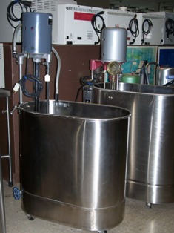

Slide 23
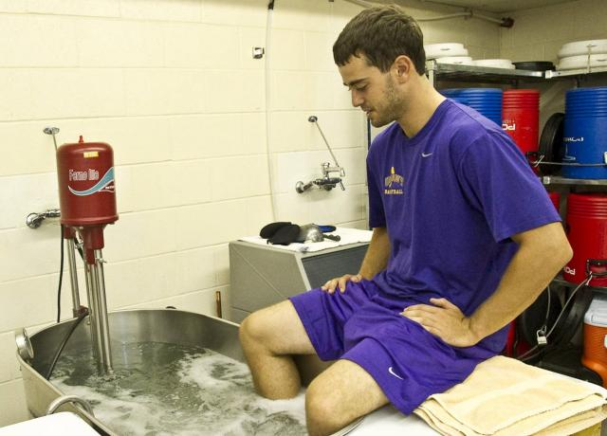

Slide 24
Whirlpool Baths (contd…)
This water agitation can be varied in forces by control on the pump and air pressure.
The direction of the stream can be altered by changing the position of the output nozzle.
Temperatures between 36⁰C to 41⁰C are used.
The agitation of the water, the whirlpool effect, serves to stimulate the skin surface mechanically.

Slide 25
Whirlpool Baths (contd…)
This mechanical effect can also be used for cleaning open wounds – gentle debridement of dirt and necrotic tissue.
But vigorous action can destroy the delicate granulation.

Slide 26
Whirlpool Baths (contd…)
In problems such as varicose veins where healing is slow, the mechanical effect is considered to provoke granulation tissue formation by increasing the local blood flow.
There is evident that the temperature of the subcutaneous tissues rises with whirlpool bath treatment, as with any other form of conduction heating and so there is some increase in blood flow.

Slide 27
Whirlpool Baths (contd…)
There is also evidence that treatment in the bath increases edema; an increased tissue volume was found both in patients and in healthy subjects.
Then treatment should be followed by exercise with limb in elevation.
Treatment is for 20min.

Slide 28
Whirlpool Baths (contd…)
Prolonged immersion in hot water leads to temporary wrinkling of the skin which in healthy skin recovers rapidly on drying.

Slide 29
Disadvantages of Whirlpool Baths
Repeated soaking tends to increase risk of skin infection
Exacerbate any infection already present
Atrophic skin is particularly at risk.
Local burns can occur if very hot water contacts the skin.

Slide 30
Contraindications to Whirlpool Baths
Ischaemic disease
Infections especially fungal
Exacerbations of acute dermatitis eczema

Slide 31
Heated Air Treatment
Both hot, dry air and a mixture of air and water vapor are described as hot air baths.
Small air cabinets – a metal box fitted with an electric fan or element heater, both thermostatically controlled – are useful for hand injuries with edema and open wounds as the hand can be exercised in elevation and nothing but warm air comes in contact with the tissues.

Slide 32
Heated Air Treatment (contd…)
Temperature in the metal cabinet should be about 70⁰C, but because of the low thermal conductivity of the air, the skin temperature is kept much lower.
Hot or hot moist air can also be applied by enclosing the whole body in special cabinets.
This can produce a small rise in whole body temperature and so needs strict control and adequate body fluid replacement.

Slide 33
Electric Heating Pads
These vary from small pads about 30 by 30cm to electric blankets.
Electric resistance wire is contained in a suitable fabric and the current flow is controlled and selectable so that the pad produces various levels of heating when placed against the skin.

Slide 34
Electric Heating Pads (contd…)
This pads are particularly useful for treatment at home and for producing muscle relaxation prior to other treatments such as exercise or mobilization.

