Slide 1
PARKINSON’S DISEASE
Dr Krina Ved
MPT Neuro – GPC0214

Slide 2
NORMAL
Extra-
Pyramidal
System
Pyramidal
System
Cerebellum
Voluntry Movement Control

Slide 3
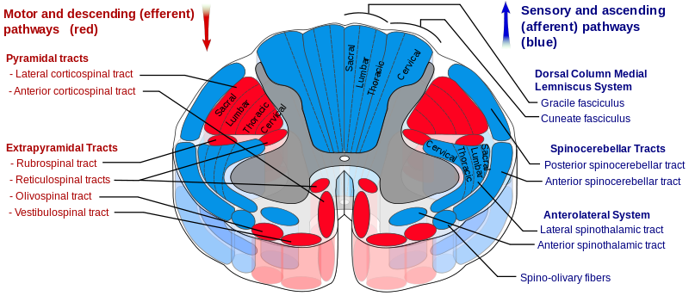
EXTRA-PYRAMIDAL SYSTEM

Slide 4
Rubrospinal – facilitate flexor group of ms.
Reticulospinal – axial postural ms & limb extensor ms
Olivospinal – motor coordination and learning
Vestibulospinal – coordination of head postion, neck and eye movements & antigravity extensor ms.
BG-

Slide 5
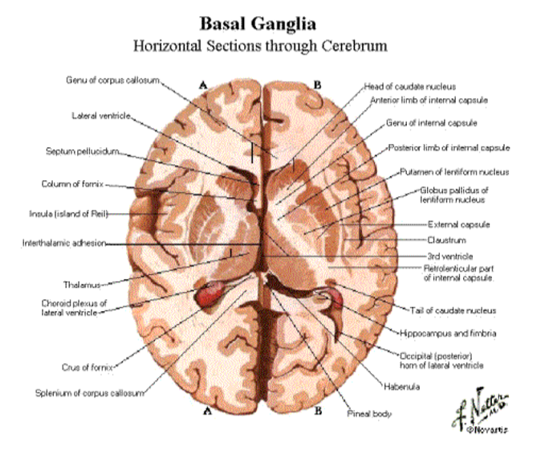

Slide 6
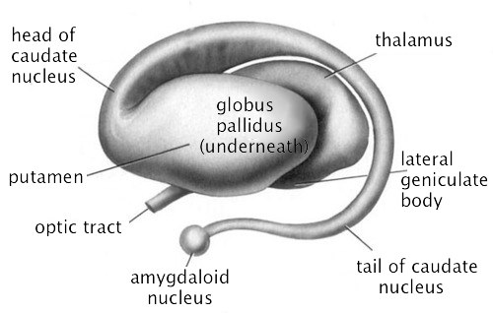
BASAL GANGLIA

Slide 7
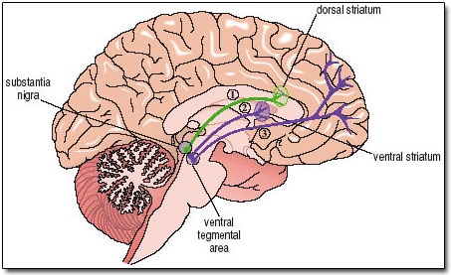
NIGROSTRIATAL PATHWAY
(BG motor loop)
Notes:
SN present in midbrain
Black pigmented, Neuromelanin
Densely packed – calcium and protein structured DA unmyelinated neurons
B/L present, ipsilateral and contralateral connections
Fn – eye movt, motor planning, reward seeking, learning, addiction.

Slide 8
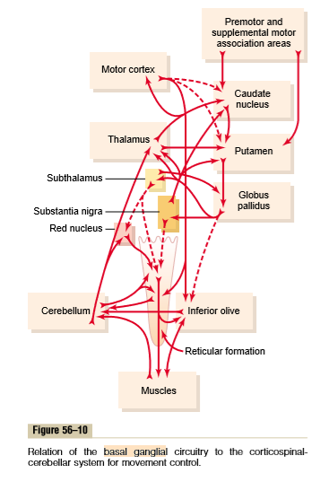

Slide 9
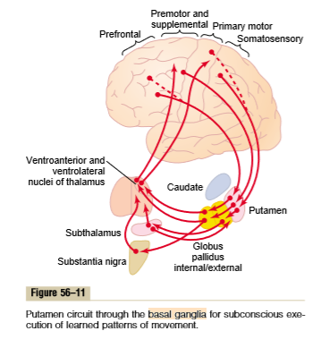

Slide 10
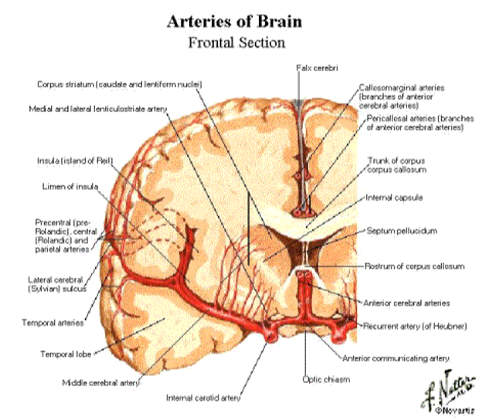

Slide 11
FUNCTIONS OF BG
BG has ACh & DA neurons
BG neurons activate before the voluntary movement signals is passed (initiation of voluntary movement).
It controls Ɣ (gamma) motor system (ms tone)
It plans and controls complex patterns of ms movt.
It intricate co-ordination of total motor activity.
It aids in maintaining equilibrium via cerebellar pathways from vestibular system.
It maintains reciprocal contraction of agonist and antagonist ms.
Notes:
Initiation of movt – @direct pathways
signals from premotor cortex → BG ( caudate, putamen, substantia nigra) & thalamus ( ventrolateral n ventroanterior nucleus) → to primary motor cortex → corticospinal tract.
@indirect pathways motor cortex to cerebellum, brainstem ( red nucleus, reticular, vestibular, pontine, inf olivary, limbic system-behaviour,memory, speech, visual pathways.

Slide 12
FUNCTIONS OF BG
It has afferents and efferents from premotor, primary and supplementary motor cortex (works as accessory motor system)
It is responsible for spontaneous/ subconscious but learned patterns of movements.
It is also responsible for cognitive control of motor activity.
It is helps in sequential patterns of movements. (how rapidly movt is to be? To control how large movt will be?) (timing and scaling function)
It does modification of movement.

Slide 13
DIFFERENCE BETWEEN ACETYLECHOLINE & DOPAMINE
Neurotransmitter | Acetylecholine | Dopamine
Synthesised in | Small striatal cells | Substantia nigra cells
Greatest concentration | Striatum | Substantia nigra
Effect | Excitatory | Inhibitory

Slide 14
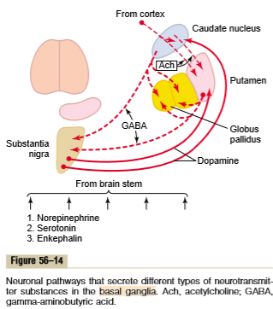

Slide 15
DIFFERENCE BETWEEN PYRAMIDAL AND EXTRAPYRAMIDAL SYSTEM
The pyramidal pathways control discrete voluntary skilled movements, such as precise movement of the fingers and toes.
Whereas the extrapyramidal pathways control reflexes, locomotion, complex movements, and postural control.

Slide 16
PARKINSON’S DISEASE
PARKINSON DISEASE,
PARKINSON'S,
IDIOPATHIC PARKINSONISM, PRIMARY PARKINSONISM,
PD,
HYPOKINETIC RIGID SYNDROME, OR PARALYSIS AGITANS

Slide 17
INTRODUCTION
It is described by James Parkinson (1817), Recognized as an extra pyramidal disorder by Kinnier Wilson (1912).
Parkinson`s disease is a chronic, progressive disease of the extra pyramidal system characterized by the cardinal features of rigidity, brady kinesia, tremor and postural instability.
Onset is insidious with a slow rate of progression.

Slide 18
EPIDEMIOLOGY - More than 2% of population older than 65 years of age
Average age of PD onset is 50-60 years
Male : female - 3:2

Slide 19
ETIOLOGY
IDIOPATHIC: Paralysis agitans
SECONDARY :
Virus (encephalitis lethargica, HIV etc)
Toxins (CO,MZ,MPTP etc)
Drugs(phenothiazines, resrpine, haloperidol, tetrabenzene etc) (presynaptic inhibition & postsynaptic block)
Vascular disease (multiple infarct, atherosclerosis etc)
Tumors of basal ganglia
Head injury
Degenerative (Alzheimer's disease, communicating hydrocephalus etc)

Slide 20
(PATHOPHYSIOLOGY)
Dopamine
Acetylcholine
Notes:
Loss of inhibition at caudate & putamen, due to destruction of DA neurons → overactive BG → gives continous o/p to corticospinal excitatory signals in agonist and antagonist ms grp → rigidity.
2. loss of feedback circuits → tremor
3. bcoz of rigidity → bradykinesia/ akinesia
DA also secretated in limbic system, behaviour, memory, psychic drive, depression

Slide 21
PARKINSON`S DISEASE
(CLINICAL FEATURES)
Initial symptoms are vague pain and aches
Rigidity clinical hallmarks of PD
Bradykinesia slowness of movement (speed, range and amplitude) (mask like face)
Tremor is initial symptom of 70% pt (4-6 hz)

Slide 22
RIGIDITY
Cogwheel &
Leadpipe
Rigidity is defined as increased resistance to passive rotatory motion uniformly in both agonist and antagonist muscles and in movements in both directions.
Spinal stretch reflexes are normal.
Cogwheel rigidity is a jerky, ratchetlike resistance to passive movement as muscles alternately tense and relax.
Leadpipe rigidity is more sustained resistance to passive movement with no fluctuations
It involves proximal muscles first, especially the shoulders and neck. and it progresses to involve muscles of the face and extremities.
Active movement, mental concentration or emotional stress may all increase rigidity.
Reduces with relaxation, sleep
Rigidity also has a direct impact on increasing resting energy expenditure and fatigue levels.

Slide 23
TREMOR
It is an involuntary oscillation of a body part occurring at a slow frequency of 4 to 6 Hz.
Parkinsonian tremor is described as a resting tremor because it is typically present at rest and disappears with voluntary movement.
Types - pill-rolling tremor, pronation-supination, jaw, or tongue, postural tremor.
Aggravated by emotional stress or fatigue and interferes with daily activities.
Reduces with relaxation, sleep

Slide 24
PARKINSON`S DISEASE
(CLINICAL FEATURES)
Postural instability and balance abnormalities
Abnormal and inflexible postural response, increase in body sway
Narrowing of BOS
Difficulties in dynamic stabilization
Inability to use normal postural synergies to recover balance
Frequent fall and fall injury

Slide 25
PARKINSON`S DISEASE
(CLINICAL FEATURES)
Torque production at muscle is reduced resulting in weakness and fatigue (due to rigidity)
Movement become arrhythmic with frequent hesitation and arrest
Gait become festinated and shuffling
Generalized musculoskeletal deconditioning
Contracture in hip, knee, shoulder and elbow
Kyphosis and scoliosis

Slide 26
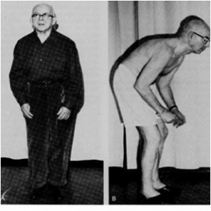
POSTURE IN PARKINSON’S DISEASE
Notes:
Line of Gravity falls anteriorly

Slide 27
PARKINSON`S DISEASE
(CLINICAL FEATURES)
Motor planning difficulties
Start hesitation
Micrographia
Freezing episode
Poverty of movement
Hypomimia (mask like face)
Motor learning is difficult

Slide 28
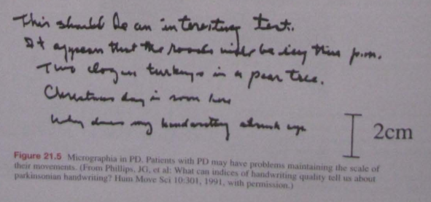

Slide 29
PARKINSON`S DISEASE
(CLINICAL FEATURES)
Primary sensory loss
50% pt experiences pain, paresthesias, numbness, tingling, coldness, aching pain and burning
Akathisia
Proprioceptive control of voluntary movement is reduced
Blurred vision and photophobia, loss of ocular convergence and upward gaze
Notes:
Akathisia – feeling of inner restlessness

Slide 30
PARKINSON`S DISEASE
(CLINICAL FEATURES)
Dyaphagia
Excessive drooling of saliva (sialorrhea)
Hypokinetic dysarthria, decrease voice volume, monotonus speech, distorted articulation and uncontrolled speech rate
Vocal quality hoarse and breathy
Dysautonomia (excessive sweating and abnormal or uncomfortable sensation of warmth and coldness)

Slide 31
PARKINSON`S DISEASE
(CLINICAL FEATURES)
Seborrhea (increase oil secretion of the sebaceous gland of the skin )
Gastrointestinal dysfunction, constipation
Urinary problem ,frequency, urgency, urge incontinence and nocturia
Sexual dysfunction
Orthostatic hypotension
Restrictive lung problems

Slide 32
PARKINSON`S DISEASE
(CLINICAL FEATURES)
Edema of feet
Depression and dementia in 30 % pt

Slide 33
PARKINSON`S DISEASE
(DIAGNOSIS)
MRI
PET
SPECT
2 cardinal features should present out of 4 lasting for past 5 years.
Patient should respond to Levodopa

Slide 34
Physiotherapy assessment

Slide 35
Demographic data – age, gender, language, education
Hand dominance
Occupation/work
Chief complaints
HOPI – frequent falls, slowness of movement (Early)
Stiffness, drooping of saliva, shaking of hands/feets, urinary incontinence, needs postural support (Later)
Medical
Surgical
Medications
Environment – home/work barriers
Family history
Social history – cultural beliefs, behaviour, family caregivers
General health status – physical, psychological, social, role function, habits
Functional status and activity level
On observation
Posture – alignment, position, symmetry, body mechanics, forward stooped (phantom pillow)
Kyphotic/scoliotic
Skin condition & pressure sensitive areas, positioning and postures
Tremor
Assistive or adaptive devices – fittings, alignment, function, use, safety

Slide 36
On palpation
Chest examination – Ventilation and gas exchange, expansion, symmetry
Autonomic nervous system integrity – thermal responses, sweating
On examination
Cognition function – memory, orientation, problem solving, judgement, attention
Perceptual functions – visuospatial skills
Pain – intensity and location (VAS)
Joint integrity – alignment , mobility, ROM A & P, muscle length, soft tissue extensibility (tightness, contractures)
Muscle performance – strength MMT, power, endurance
Grip strength & fine motor activites – dexterity
Motor function – motor control, motor learning, motor tone(rigidity), voluntary movement patterns, involuntary movements(tremors), hesitation, slowness, arrests of movements(freezing), poverty of movements
Sensory integration
Co-ordination – Procedural learning for complex and sequential tasks
Postural control and balance – degree of postural instability (Static & Dynamic), balance strategies, safety, BBS

Slide 37
Gait and locomotion – gait patterns ad speed, safety
(reduce speed of walking, flexion at LL joints, toe – heel pattern, arm swing absent, trunk rotation reduce, cadence increased.
festinating gait - anteropulsion, freezing, difficulty in dual tasking, complex environment demands,
Aerobic capacity and endurance
Functional status and activity level – performance based examinement of functional skills (FIM), basic and instrumental ADL, functional mobility skills, home management skills
Fatigue
Environment – home, work, community barriers, leisure activities, ability to participate in activities, safety

Slide 38
HOEHN AND YAHR CLASSIFICATION OF DISABILITY
Minimal or absent; unilateral if present
Minimal bilateral or midline involvement. Balance not impaired
Impaired righting reflexes. Unsteadiness during turning or raising from chair. Some activities are restricted but pt can live independently and continue some form of employment.
All symptoms present and severe, standing walking with assistance only
Confined to bed or wheelchair

Slide 39
PARKINSON`S DISEASE
(MEDICAL MANAGEMENT)
Neuroprotective therapy (MAOs) to improve metabolism of intracerebral dopamine, seligiline 5 mg BD (nausea, dreams, hallucination, confusion)
Dopamine replacement raise the level of dopamine levodopa, carbidopa 10/100 tid/bid (dystonia, nausea ,vomiting, abnormal involuntary movements, confusion ,hallucination)

Slide 40
PARKINSON`S DISEASE
(MEDICAL MANAGEMENT)
Dopamine agonist design to act directly on the postsyneptic dopamine receptors pergolide 1mg tid, bromocriptine 5 mg bid
Anticholinergics used in initial stage thihexylphenidyl 2mg tid, bentropin 1 mg bid
On / Off period phase

Slide 41
PARKINSON`S DISEASE
(SURGICAL MANAGEMENT)
Ablative surgery stereotactic surgery, pallidotomy, thalamotomy
Deep brain stimulation
Neural transplantation

Slide 42
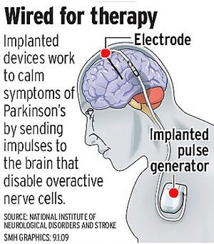
Notes:
Education to caregiver & patients
Community rehab
Horse therapy
Music therapy
Dance therapy
Hydrotherapy
Flexibility exercises
Motor learning strategies
Pnf
Relaxation exercises
Passive positioning/ postural correction/ mirror biofeedback
Strength training
Functional training
Facial exercises
Adaptive and supportive device
Environmental home modifications
Footwear modifications
Vestibular ball exercisers
Chest expansion exercises – PNF UL D2 pattern
Fatigue conservative techniques
Group exercises
Recreational activities

Slide 43
THANK YOU
Notes:
Early stage – prevention,education, reversal, musculoskeleton and cardiorespiratory, general condition improvement
Middle stage – compensatory strategies, strength training, improving quality of life
Later stage – avoid pressure sore, pulmonary hygiene, positioning, avoid malnutrition (except protien), psychosocial support, self management skills.

