Slide 1
Parkinson’s Management
Dr. Krina Ved
MPT Neuro, GPC-0214

Slide 2
Problem list
Counselling of patient, their relatives and caregivers
Improve secondary complications
Improve posture
Improve higher mental function
Improve sensory function
Improve musculoskeletal function – muscle flexibility
Reduce tone

Slide 3
Improve motor performance (grip)
Improve balance and gait training
Improve functional and endurance performance

Slide 4
PT in mild to moderate stages of Parkinson’s disease
Education
Emotional arousal & motivational psychosocial processes
Deep breathing & Chest expansion excercises
Motor learning strategies - Attentional strategies, postural cues and sensory cueing (auditory/visual/proprioceptive)
Relaxation techniques
Resistance training – FITT principle
low resistance & high repetition
Axial mobilisation & passive stretch

Slide 5
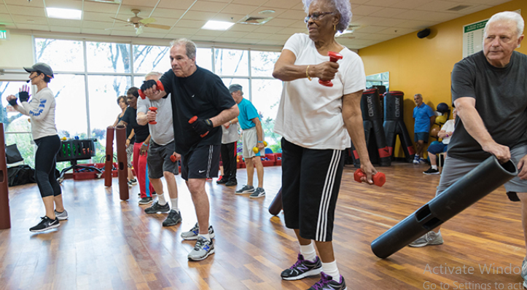
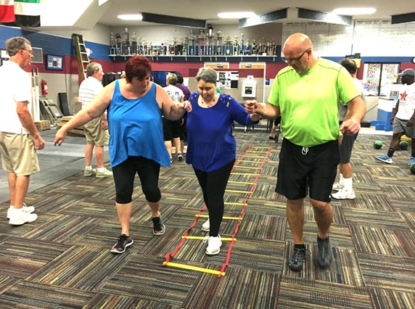
Motor performance
Rhythmic initiation – combination of isotonics & reversal of antagonist
Repeated stretch – from beginning & through range
Dexterity function

Slide 6
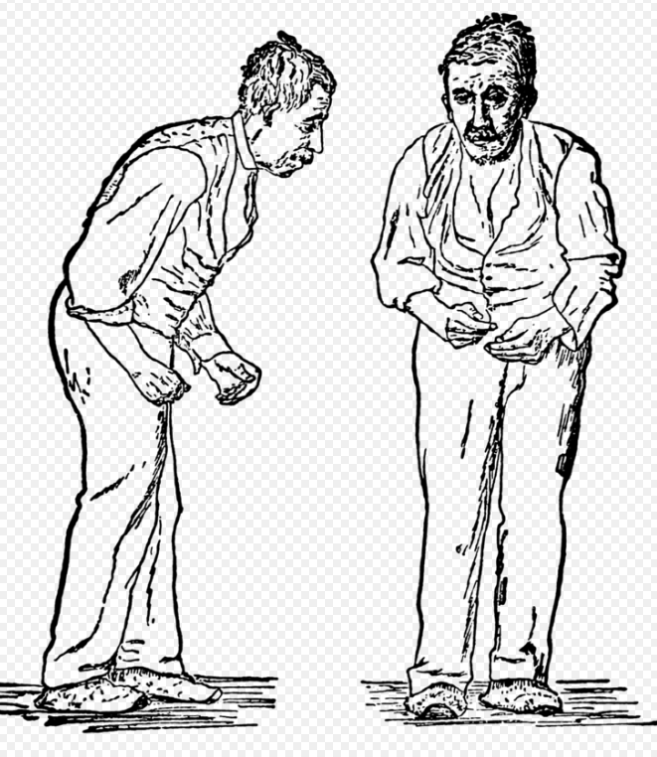
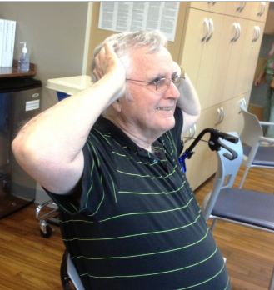
Musculoskeletal function
Flexibility exercises
Positioning
Night splints

Slide 7
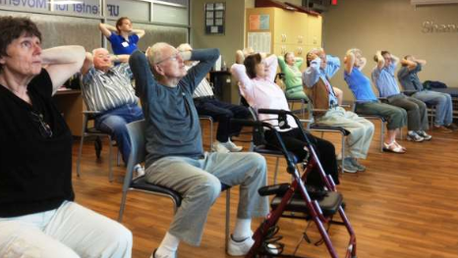
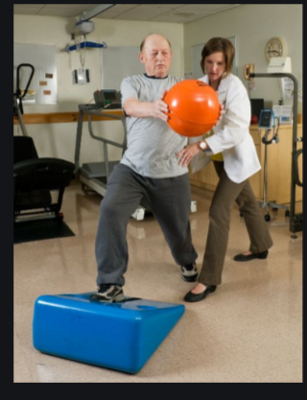
Group therapy
Balance training
Functional training transfers like sit to stand & walking, getting in shower, bath, car, etc
Dual task performance
Endurance training - treadmill training
Adaptive and supportive devices
(Foot wear modification)

Slide 8
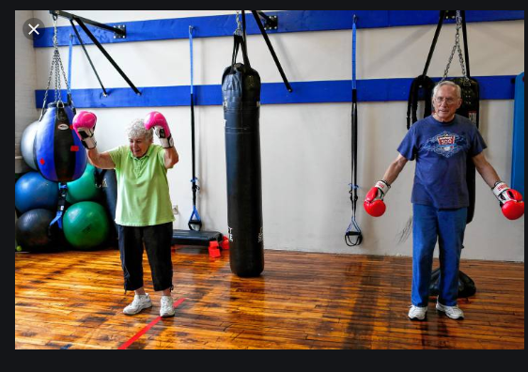
Long term benefits of PT
Sustained motor improvement
Maintaining strength
Maintain ambulation
Improve quality of life
Balance and gait training

Slide 9
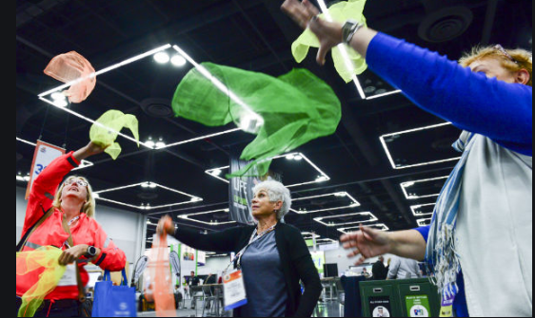
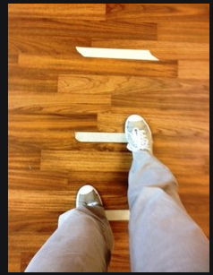

Slide 10
Compensatory strategies of PT in advance stage of Parkinson’s disease
Functional independence – automatic and consciously controlled movements
Task oriented executive function
Strategies for freezing (sensory & attentional)
Strategies to minimize postural instability (protective postural responses)
Avoid Dual task performance
Home modification
Ambulation assisted device

Slide 11
