Slide 1
Physiotherapy Assessment and management in Hydrocephalous
Dr. Hardik Suthar PT

Slide 2
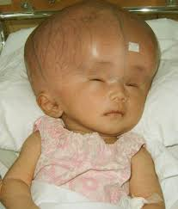
Hydrocephalous is increase in cerebrospinal fluid (CSF) circulating in and around the brain by any cause of block in pathway of circulation of CSF and cause enlargement of head as children having open sutures and fontanelles.
Causes:-
Neural tube defects
Congenital malformations e.g. Arnold-Chiari Malformations
Intrauterine Infections e.g. rubella, CMV
Midline and Posterior Fossa Tumours e.g. Medulloblastoma
Infectious Meningitis and encephalitis

Slide 3
Signs:-
Enlarged head size, delayed closure of fontanelles and sutures, abnormal skin contour with prominent forehead, prominent scalp vein can be seen.
Sunset sign, crackpot sign, spastic limbs, altered respiration, bradycardia and systemic hypertension can be present.
Symptoms:-
Headache, Nausea ,Vomiting, Irritability, Head banging, Apathy and drowsiness

Slide 4
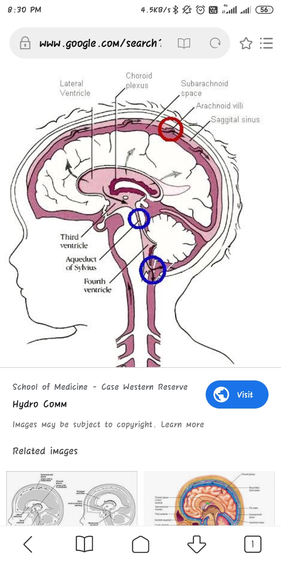
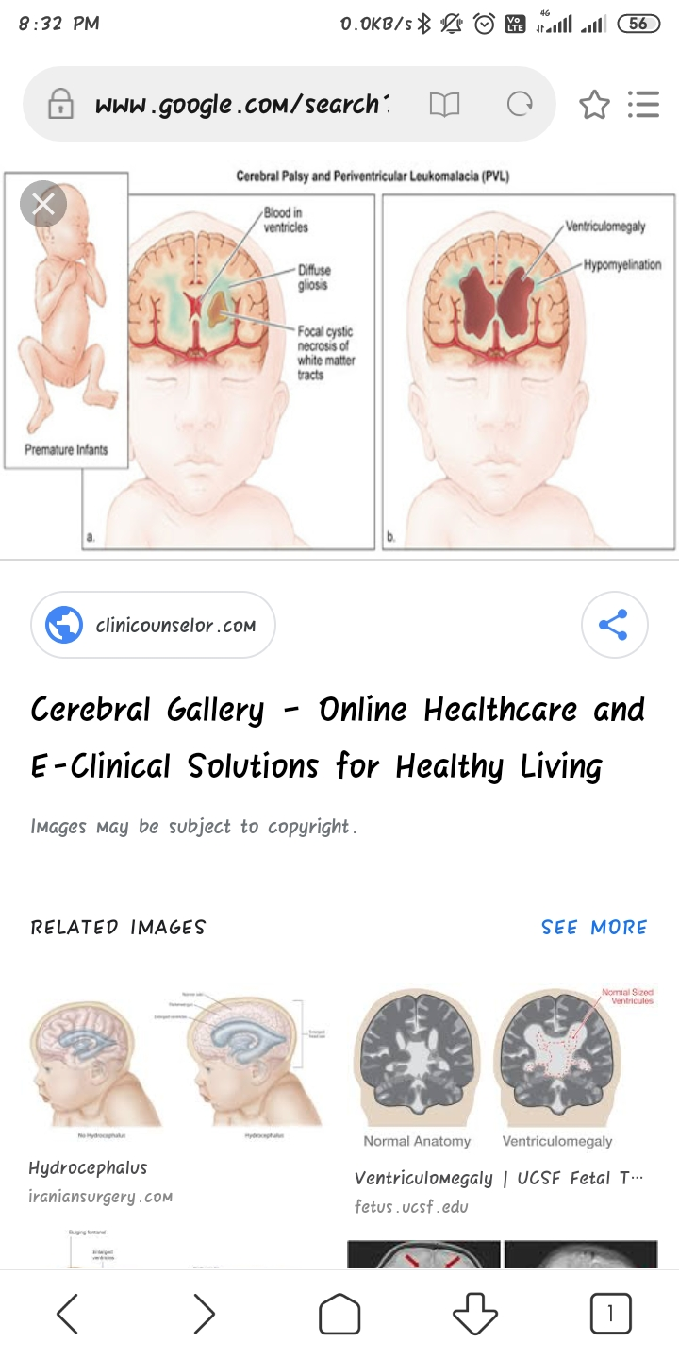
Types:-
Communicating
2. Non-Communicating

Slide 5
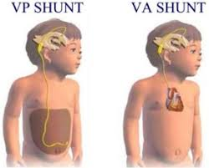
Surgical Management:-
Spitz-Holter shunting that drain excess CSF from the ventricle into right atrium of the Heart. Pudenz Shunt is known for shunting by same method. Many surgeons use the peritoneal sac, instead of circulation, to absorb the CSF.

Slide 6
Common Neurological Problem Occurring with Hydrocephalous:
Hypertonia in limbs
Cerebellar signs as incoordination, poor balance
Sensory and motor loss in arms and legs

Slide 7
Assessment:-
Demographics and chief complain by Informant, socio-economic status of parent
Birth history to rule out any positive findings, history of any illness, commonly history of fever, vomiting, abnormal eyeball movement.
Developmental history will show delayed milestones in gross and fine motor, social and language milestones by age wise to rule out developmental age.

Slide 8
Supine
Observation:
Head and face:- Enlarged head, eyeball movements as nystagmus, dysmorphic features of face, facial deviations, mouth breathing, drooling of saliva
Posture:- Position of head, attitude of upper limb that is usually in adducted and flexed position, use of upper limb after 4 months for reaching for, grasping according to normal fine motor milestones. Shoulder level, trunk is neutral or having lateral curvature. Position of hip in flexion and adduction, knee flexed and ankle planter flexed and inverted.

Slide 9
Supine
Palpation and examination:
Head and face:- Palpation of fontanelles, measuring the head circumference with inch tape from external occipital protuberance to frontal bone. Normal size in new born is 33 cm.
Examination:- Check for vision focusing and tracking by bright colour object, hearing by rattle to check attention and tracking see for nystagmus. Traction response to see head lag. Cranial nerve examination is done when child is able to follow command or can be interpreted by observing facial muscle movement in infants while they cry or eat.

Slide 10
Supine
Examination:-
Primitive Reflex:- Start from rooting reflex to neck righting in supine position.
Tone of muscle:- by Modified Ashowrth Scale, start from distal muscle to proximal muscles
Range of Motion:- active range is assessed in infants by their spontaneous movements, passive range of movement can rule out tightness in calf, hamstring and adductors commonly.

Slide 11
Supine
Examination:-
Deep tendon reflexes:- after age of 5 years has to assess whether child is still having upper motor lesion sign
Superficial reflexes:- Planters:- will be up going up to 2 years
Abdominal:- check after age of 5 years
Take baby in prone position with care(made to or voluntarily)
Higher mental functions

Slide 12
Supine
Chest observation and examination:-
Done for rule out respiratory functions
Respiratory rate:- it reduced with increasing age, should see for screening
Shape:- any abnormal shape has to mention as funnel chest, barrel chest
Breathing pattern:- usually abdomino-thoracic pattern is present
Rhythm:- irregular rhythm should mention
Observation of bilateral chest movements:- symmetrical or not
On auscultation:- respiratory sounds mostly inspiratory wheeze present if secretions present

Slide 13
Prone
Observation and examination:-
Protective side turning of head, neck holding, prone on elbow, prone on hands that according to age have to check.
Posture:- spinal lateral curvature, upper limb position i.e. in hypertonic child upper limb will be internally rotated and adducted at shoulder and flexed at elbow and lower limb will have adduction and internal rotation of hip, knee either flexed or extended, ankle will show planter flexed position.
Skin observation for tuft of hair or bulging at spine in thoraces-lumbo-sacral region.
Examination of Primitive reflexes i.e. TLR prone, Galent’s trunk incurvatum

Slide 14
Sitting
Observation and examination:-
Head control after 3 month of age
Posture has to assess after 6 months. Weight bearing in sitting, use of upper limb for support or playing
Pivoting and Protective reactions after age of 6 months
Reflexes:- Symmetrical tonic neck reflex which is pathologically present
To see whether able to go in quadruped and able to crawl or not

Slide 15
Ventral Suspension
Observation and examination:-
Observation of head position, trunk, upper limb, lower limb position
Examination of primitive reflex:- landau reflex
Then change position in vertical suspension

Slide 16
Vertical Suspension
Observation and examination:-
Head control is present or not,
Posture in suspension position of upper limb, trunk and lower limb
Weight bearing whether present or bending legs.
Primitive reflex:- primary walking up to 2 months of age have to assess
Gait examination:- check for heel to toe pattern, scissoring, toe walking crouch gait.

Slide 17
Problem List
Delayed development according to developmental history
Impaired respiratory functions and ventilations
Impaired muscle tone
Impaired ROM due to tightness, contractures
Impaired balance in sitting and standing
Physical and Functional Diagnosis
Patient named ___ , age __, gender case of hydrocephalous having Delayed development according to developmental history, Impaired tone of muscle , Impaired ROM due to tightness, contractures, Impaired balance

Slide 18
Management goals
Short term:-
To improve respiratory functions and ventilation, in patient mostly admitted post to surgery, gentle vibrations and percussions to removing secretions from lung. Intercostal stretch to improve ventilation by improving thoracic expansion.
Frequent turning for draining of secretions from lung as like side lying, elevating upper chest.

Slide 19
Management goals
Short term:-
To keep normal posture, in infants up to 3 months of age can give nesting, covering by cloth to keep physiological flexion. That can be applicable for younger infants also.
Gentle passive movements for range of motion exercise

Slide 20
Management goals
Long term:
For impaired tone: long duration stretching to reduce tone. As child age advances weight bearing activities as prone on hand, quadruped, cross leg sitting, standing can be given. Slow stroking by brush from proximal to distal for reducing tone for up to 3 minutes.
Positioning while child is sleeping, carrying and handling techniques should be taught to mother.

Slide 21
Management goals
Long term:
For impaired ROM: stretching of tight muscles like calf, hamstring, adductors have to apply for longer duration up to tolerable range of baby that can be observed by facial expression of baby.
Longer elongation can be given by splinting commonly for calf tightness.

Slide 22
Management goals
Long term:
For delayed development start from which milestone baby is having delayed development.
For head control:- in prone position baby in comfortable position on mat or over therapist lap can done by giving visual, auditory or tactile stimulus. Small heighted wedge can be used for baby if large in size.

Slide 23
Management goals
Long term:
For prone on elbow and prone on hand, take baby in prone position by rolling over and keep both hand near to trunk and keep weight of baby over elbow of baby, then give simultaneous visual, auditory stimulus by that baby will rise the head. Support over shoulder and arm.
In prone on hand extend elbow and support both the elbow by therapist hand. Give auditory or visual stimuli.
Can be done on low heighted wedge.

Slide 24
Management goals
Long term:
Rolling should facilitate in segmental pattern starting from prone to supine. First to turn lower segment followed by upper segment.
Supine to sit with help of own hand facilitate through side turning and transferring weight from trunk to hand.
Independent sitting encouraged with both hand support to one hand support to sitting with back support to independent sitting.

Slide 25
Management goals
Long term:
All other milestones are as sit to quadruped, quadruped to crawl, crawl to kneel, half kneel, standing encouraged.
Gait training is to given with pelvic support or in parallel bar.

Slide 26
Thank you

