Slide 1
Physiotherapy Assessment and management in
Spina Bifida
Dr. Hardik Suthar PT

Slide 2
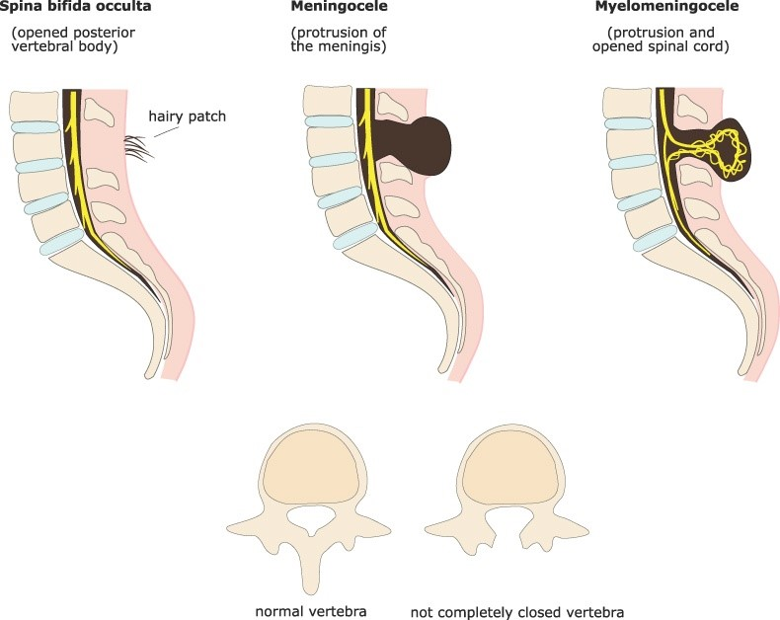
Spina Bifida
It is defect in neural tube continuity that fails to develop in intrauterine life. That seen in thoraco-lumbar area in spinal column.
Content:- Nervous tissue, meninges, unfused vertebral segments.
Types of defect:- Occulta
Aperta
Aperta have two types
Meningocele
Myelomeningocele

Slide 3
Clinical features:-
Lower body sensory and motor loss(or weakness)
Bladder and bowel dysfunction
Learning disabilities
Hydrocephalous
Cranial nerves palsy due to associated Arnold Chiari malformations
Swallowing difficulties

Slide 4
Types of lesion:-
According to spinal function level
Type 1:-
Complete loss of spinal cord function below a certain segmental level
Cause in sensory loss and absent reflexes.
They have muscle imbalance
Deformities depending upon level of lesion

Slide 5
Type 2:-
Associated with interruption of corticospinal tract with preservation of reflex activity in isolated distal segments
Below spinal cord complete flaccid paralysis, sensory and reflex loss, below this segment, isolated cord function, with reflex activity and spasticity
Flaccid segment almost absent, complete spinal cord transection with reflex activity below the level of lesion commonly seen in myelomeningocele
Incomplete transection of long cords that cause spastic paraplegia with preservation of some voluntary movements and sensation.

Slide 6
Assessment:-
Demographics and chief complain by Informant, socio-economic status of parent
Birth history:- ultrasonography, lack of supplement as folic acid, history of NICU admission.
Surgical history of defect closure
Developmental history to rule out developmental delay in gross motor, fine motor, social and language milestones.

Slide 7
Skull and cranial nerves
To determine the level of spinal cord functions and assess for hydrocephalous
Skull:- Examined for large head size, fontanelles, eye movements.
Cranial nerves:- may assessed by observation of the movement of the face, tongue and palate by watching sucking movements, or facial muscle actions.

Slide 8
Spine
Spine observation for sutures post to surgery.
Length of suture scars.
If patient come before surgery, hair tuft, bulging at lower spine level may visible

Slide 9
Limbs
Presence of active movements of lower limbs have to looked
Position of limbs
Power of muscle can be done by assessing in gravity eliminated and against gravity position.
Deformities or any associated orthopaedic condition have to see as congenital dislocation of hip, talipes equinovarus

Slide 10
Limbs
Stimulation of legs and eliciting primitive reflexes with stroking the leg
Deep tendon reflex after age of 5 years
Tone of muscle should be assessed for impaired tone.
Superficial reflex of planters, abdominal should be checked if higher segment is involved

Slide 11
Bowel and bladder
Sphincter muscle tone and bladder function should check once child is able to control the bowel and bladder
Anal reflex will be absent if lower sacral segment involved(s4-5)
Patulous anus and dribbling incontinence at S2, 3 and 4 level
Retention of urine with lesion as S1 level

Slide 12
Sensory level
Difficult to assess in baby
During sleep stimulation by pin , starting from sacral region as perianal, buttocks, thighs moving over up to abdomen.
Baby will cry in response to pin rick. Movement of limb is uncontrolled reflex action.
Radiological examination of skull, spine and hips.

Slide 13
Management
Neonatal Physiotherapy:-
Physical assessment for fairly give indication of future physical ability of child
Almost done when child in incubator
In hospital treat for deformities such as talipes equinovarus

Slide 14
Talipes equinovarus
To correct inversion and planter-flexion
Strapped or splinted with elastic strapping, look for impaired sensation, poor circulation and limbs in poor condition
Strapping from below knee to around heel to maintain in correct position. Another strap over lateral side of foot up to leg to correct forefoot
Not to give continues strapping because of poor skin condition and danger in circulation.

Slide 15
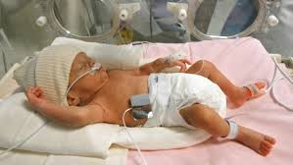
Hip
Dislocation, subluxation dysplasia common
Left untreated if both hips are dislocated until pure LMN lesion or child going to be community walker
Single hip cured if child is going to be able to walk.
Nesting can done with hip in abduction and in external rotation after relocating
Knee
Flexion or hyperextension may be present
Stretching and splinting
Try to mobilise the knee joint

Slide 16
Physiotherapy goals and management
To treat any deformities all joints should be exercised in full range of motion. Commonly hip, knee and ankle movements. That will also prevent any contractures or deformities from occurring.
Passive movement for full range of motion to help in pumping blood and maintain circulation.
Encourage the available movements, can give sensory stimuli by tickling or touching.
Advise for same to mother and teach how to carry out the exercise.

Slide 17
Physiotherapy goals and management
Long duration stretching to reduce tone in muscles are calf, hamstring, adductors, hip flexors
Prone position for hip flexor stretching
Hip in abducted position with pillow between two legs for adductors muscle
Cross leg sitting for adductor lengthening
Weight bearing as like standing for calf stretching.

Slide 18
Physiotherapy goals and management
Shoulder strengthening for crutch muscle to help them walk with sticks. That can be started as baby starts to responds.
Facilitation of developmental milestones from achieved milestone should be encouraged. Such as rolling over, sitting up, crawling.
This should be taught to mother to start as baby start taking interest in surroundings environment in home. With use of toys such as ball, rattle, simple puzzle, car.

Slide 19
Physiotherapy goals and management
Play therapy to encourage movements and to give general physiotherapy. Facilitate kicking in supine.
By use of toys that make loud noise like squeaky toys to press down by leg, coloured balls to push away.
Encourage bridging by passing toy car below child back for gluteal contractions.
Resisted exercise added encourage action in muscles which are innervated like kicking in supine over your hand, or pushing you far by kicking

Slide 20
Ambulation
At 18 months around when child is able to ambulate should re assessed for orthotic support
Level of paralysis | Equipment required
Above L1(Iliopsoas) | Knee Ankle Foot orthosis(KAFO)
Below L2(Quadriceps) | TLSO with KAFO or LSO(lumbar sacral orthosis)
Below L3-4(Tibialis ant.) | LSO with KAFO or only KAFO
Below L5(Ext. hallucis Longus) | KAFO or AFO
Below S1(Soleus, Plantaris) | AFO

Slide 21
Ambulation
Orthosis must become used most of time in child’s daily life.
Those who require higher than hip or lumbosacral orthosis for ambulation will use wheelchair in place or orthosis
Ambulation will improve circulation and renal functions get improved
Standing should encourage in place of walking also with help of standing table/frame can incorporated in school or play on to.

Slide 22
Ambulation
Weight shifting with help of rollator walker to enhance the gait pattern
One leg standing with activity of ball kicking
Initiate by jump to pattern, progressed by swing through pattern
Step up and step down
Slope walk with assistance
Care should taken for ankle and knee injuries

Slide 23
Ambulation
Continue the treatment at home as advised as ambulation
Fore severely handicapped children transfers from various place to place
Press up to practised daily. That will strengthen shoulder girdle muscle
In wheelchair using patient this should taught

Slide 24
Ambulation
Need to see the environment of school and home for classroom, toilets, railings, step height, slopes.
Orthotic management advised to parents
Toes should not curled
Regular chuck up of shoe size
Regular inspection of anaesthetic areas
Clothing under orthosis
Care while applying nappies

Slide 25
Spinal deformities
In high or severe lesions, acquired or present since birth.
Hemi-vertebrae, fusion of vertebrae that cause increase in curvature, kyphotic curve in patient with Aperta.
Paralytic curve associated with muscle imbalance causing lordosis or kyphotic curve associated with lateral curvature.
<45* conservatively, >45* surgical management
Exercise is to prescribe in both case for correction of spinal curves or maintaining the posture.

Slide 26
Management of anaesthetic skin
Regular inspection of anaesthetic areas for sores by friction or pressure, regular inspection should be done. Parent has to be counselled for this
Child who understand should be learn to examine self.
Factors causes pressure sores:
Excessive pressure to localised area
Poor circulation
Contaminated by urine or faeces
Prominent bony markings normal and abnormal
Scar tissue associated post to closure

Slide 27
Management of anaesthetic skin
Prevention:
Good basic hygiene, daily bath or sponge, sitting posture with proper cushion support to reduce pressure over bony prominence
Child taught to lift pelvic several times a hour
In lower limb fitting of orthosis with extra padding, uncurling toes
Lumbar sympathectomy for improving circulation

Slide 28
Management of anaesthetic skin
Cushion to relieve pressure with cut area where pressure will be more
Eusol and paraffin application with antibiotics application
Massage carefully once ulcer is healed
Plastic surgery and minor surgery can be given

Slide 29
Thank you

