Slide 1
Traumatic Brain injury
BY: DR. PINAL MODI

Slide 2
Introduction
One of the most disabling and challenging condition in physiotherapy rehabilitation. This is because of the multiple system involvement due to brain injury and high chances of developing secondary impairments after head injury.
25% of all trauma deaths
60% of all deaths from RTA
Lacks of people live with the disability caused by head injury

Slide 3
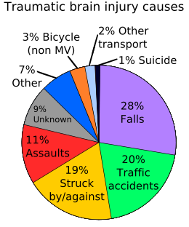
Causes

Slide 4
Epidemiology
Young males (15 to 24 years)
Men>>Women
Alcohol is frequently involved

Slide 5
Classification
1. Based on GCS: a) Mild
b) Moderate
c) Severe
2. Based on communication with outer environment:
a) Open – if skull fracture is present
b) Closed – if skull fracture is not present
3. Based on velocity of trauma:
a) High velocity impact – e.g.: motor vehicle accident
b) Low velocity impact – e.g.: blow from a blunt object
4. Based on extent of injury:
a) Focal injury – involving one part of brain
b) Diffuse injury – involving all the parts of brain

Slide 6
Classification of head injury
Based on Etiology
OPEN
HEAD INJURY
Penetrating
GSW, Stabbing
Non
penetrating
CLOSED
HEAD INJURY
High
velocity
RTA
Low
Velocity
Fall

Slide 7
Morphological Classification
Scalp injuries
Sub cutaneous haematoma
Sub Epineuronic Haematoma
(Black eye)
Sub Epicranial
haematoma
Skull injuries
Open #
Closed #
Linear # /
Communeted #
Depressed #
Compound #
Intracranial
injuries

Slide 8
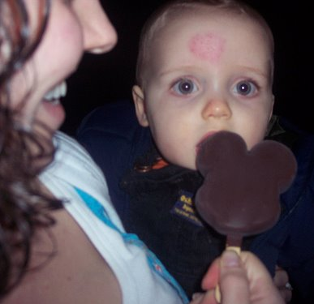
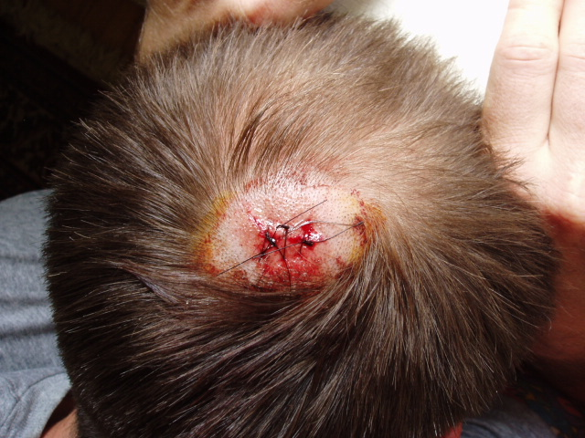
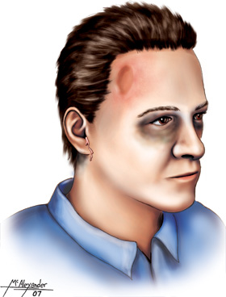
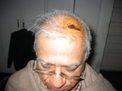
Scalp Injuries

Slide 9
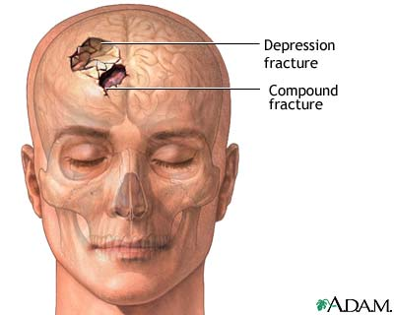
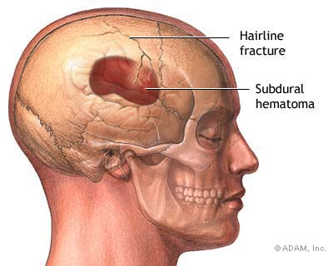
Skull fractures

Slide 10
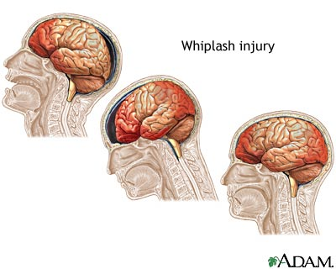
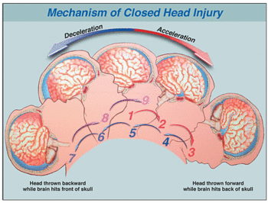
Based on
Mechanism
of injury
Acceleration
forces
Deceleration
forces
Combination
of forces

Slide 11
Based on Severity/
Glasgow Coma Scale
Mild
GCS (13-15)
Moderate
GCS (9-12)
Severe
GCS (<8)

Slide 12
Primary injury:
Primary injury can be of following types depending on nature, direction and magnitude of forces:
1) Local brain damage: concussion ( amnesia)
2) contusion: Coup – countercoup injuries
3) hematoma: Epidural and subdural

Slide 13
What is Diffuse axonal injury?
DAI is the result of acceleration/deceleration and rotational injuries and is seen exclusively in TBI.
Causes: Loss of consciousness in TBI.
Fibers at Grey white matter junction, corpus callosum, interventricular septum, parasagittal white matter, corona radiata, cereberum and cerebellar peduncles are disrupted.
The axonal injury is due to damage of the axoplasmic transport in axons with increased calcium influx leading to axonal swelling and detachment.

Slide 14
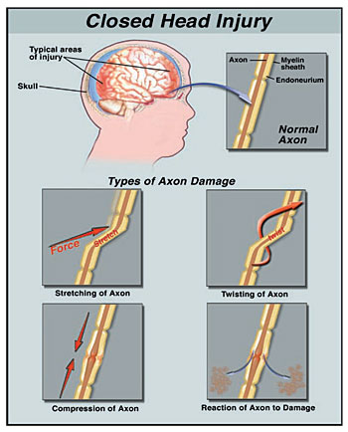
Diffuse Axonal injury
Characterized by widespread shearing and retraction of damaged axons.

Slide 15
Secondary injury:
Increased ICP
Anoxic injuies
Intracranial infection
Cerebral artery vasospasm
Post traumatic epilepsy
Obstructive hydrocephalus
Auto-destructive cellular phenomena

Slide 16
Clinical rating scales
Glasgow Coma Scale:
Activity | Score
Eye opening:
Spontaneous | 4
To speech | 3
To pain | 2
No response | 1
Best motor response:
Follows motor command | 6
Localizes | 5
Withdraws | 4
Abnormal flexion | 3
Extension response | 2
No response | 1
Verbal response:
Oriented | 5
Confused conversation | 4
Inappropriate words | 3
Incomprehensible sounds | 2
No response | 1

Slide 17
GCS is used to measure level of consciousness and defines the severity of injury. Patients who are having GCS score 8 or less are considered to be in coma and severe brain injury. A score of 9 to 12 shows moderate brain injury and 13 and above indicates mild brain injury.

Slide 18
Ranchos Los Amigos Level of Cognitive Functioning:
It is a descriptive scale which outlines a predictable sequence of cognitive and behavioural recovery seen in individuals with traumatic brain injury. It contains VIII stages of cognitive and behavioural recovery. A patient may plateau at any level. It helps in treatment planning.
I. No response
II. Generalized response
III. Localized response
IV. Confused-Agitated
V. Confused-Inappropriate
VI. Confused-Appropriate
VII. Automatic-Appropriate
VIII. Purposeful-Appropriate

Slide 19
Diagnostic procedures
Following diagnostic tests are used to confirm the diagnosis, to localize and quantify the lesion, to detect any secondary injury and to establish the prognosis.
Electroencephalograms
Computed tomography
Magnetic resonance imaging
Cerebral blood flow mapping

Slide 20
Direct Impairments
Cognitive impairment
Post-traumatic amnesia
Lack of orientation
Memory deficit
Decreased Attention span
Lack of insight
Later high level executive functioning, planning tasks and problem solving may be affected and become evident.

Slide 21
Neuromuscular impairments
Motor impairment may resemble hemiparesis in CVA. Motor impairment is much more complicated in head injury patients (because of multiple system affection). Ataxia and nystagmus accompany deficits in balance many a times.
Visual perceptual impairments
Swallowing impairments
Behavioural deficits
Communication impairments

Slide 22
Indirect impairments
Contracture
Mobility deficits
Skin breakdown
Heterotrophic ossificance : Heterotrophic ossificance is a abnormal formation of bone in muscle and other soft tisuue .it usually occurs more proximal joints.( shoulder ,hip and knees)
Infection
Deep venous thrombosis
Impaired speech because of tracheostomy etc.

Slide 23
Assessment of patients with head injury
Demographic data:
Note dominance and informant.
Date of assessment and repeat assessment must be mentioned to monitor any improvement and deterioration.
Chief complain:
In acute head injury patients: obtained by relatives as the consciousness of patient.
Cognitive and behavioural impairment.
Neuromuscular impairment in terms of paucity of movement in one limb, one side of the body or all four limbs.

Slide 24
History of presenting illness:
The exact mechanism of injury (or accident in case of RTA).
On the basis of mechanism of injury we can suspect type of head injury. (eg; High velocity impact, Low velocity impact etc.)
Ask also about how the patient was transported from the site of injury to hospital. Any bleed from ear of nose was present or not.
Duration of post traumatic amnesia.
Past history: Previous episode of head injury if any, and the recovery followed by it.
Ask about patient’s likes and dislikes which may be used for coma stimulation.

Slide 25
Observation:
  Patient body position
    Alignment of head, trunk and limbs
  Presence of movement
    Volitional- purposeful or non purposeful
  Spontaneous – automatic or reflexive
  Invasive lines , tubes and monitoring equipments
    Airways, chest tubes, nutritional management, IV lines, CVP lines, arterial lines, and ICP monitor

Slide 26
Physical examination:
The physical examination of the patient includes;
a general medical examination including vital signs, cardio-pulmonary examination (especially if any trauma to chest is present),
orthopaedic examination (especially if any trauma to limbs are present).

Slide 27
Post surgical assessment:
Monitor-ICP , LOC, behavior, motor and sensory functions, vital signs, Glasgow coma scale
Establish baseline assessment
Look for sudden changes
Monitor insertion site for CSF leakage, drainage or infection
Monitor changes in vital signs, chills, positive culture of drainage
Strict aseptic technique

Slide 28
Neurological examination:
Important components commonly affected:
Level of consciousness:
Altered level of consciousness
Coma: GCS less than 8.
Persistant vegitatve state: Affected cognitive neurological function and awareness. But preserved non-cognitive function and sleep-wake cycle.
Delirium or acute confusional state
Stupor: Difficult to arouse, medical emergency

Slide 29
Cognitive dysfunction:
Post traumatic amnesia
Attention span.
Orientation to person, place and time
Memory
Speech
Abstract thinking
Behavioural deficits
Perceptual functions to be assessed
Use Ranchos Los Amigos scale of Levels of Cognitive functioning and management

Slide 30
Cranial nerve integrity: same like stroke
Swallowing difficulties
Sensory integrity
Joint integrity and mobility:
ROM
soft tissue changes (swelling, inflammation or restriction)
heterotrophic ossification
contractures

Slide 31
Motor deficits
Motor impairment may resemble hemiparesis in CVA.
Ataxia and nystagmus accompany deficits in balance many a times.
Tonal abnormalities.
The quality of movement
Co-ordination and timing deficits should be assessed.
The ability to perform skilled movement (writing, dressing and feeding)

Slide 32
Observational gait analysis
Disturbance in postural control
Balance: berg balance scale
Functional assessment: Barthel Index or Functional Independence Measure

Slide 33
Management of patients with head injury
Early physical therapy goals in ICU:
Post surgical goals
Provide psychological support to patient and family
Maintain optimal cerebral perfusion; GCS > 13, ICP 10 mmHg or less

Slide 34
Baseline assessment and frequent monitoring
Monitor function of intra ventricular catheter to monitor ICP, Monitor temperature
Improve arousal of patients
maintain airway free of secretion
Reduce risk for infection

Slide 35
Post Operative Management
Pre-oxygenate 100% O2 before suctioning
Limit to 10 sec. suctioning to reduce the risk of sudden de-saturation
Monitor ABGs
Avoid hyperextension or exaggerated neck flexion
Avoid valsalva maneuver

Slide 36
Do not use foot board, avoid restraints if ICP is increased
Optimal spacing of activities should be done, provide frequent rest periods
Provide quiet environment to prevent abnormal increase in tone and fluctuation of vital signs.
To prevent bed sores
Strict aseptic precautions

Slide 37
Coma arousal therapy - an approach based on stimulating the unconscious person’s senses.
Allows for frequent monitoring of patient's responsiveness
May improve the quantity and quality of responses toward purposeful activity
May provide opportunities for the patient to respond to the environment in an adaptive way

Slide 38
Reduce secondary impairment:
Chest: infection – (Prevention of lung infection and maintenance of clear airways)
Skin: pressure sores ( positioning, air bed or water bed )
Avoid splint during raised ICP
Contracture - Positioning and passive handling to active movements wherever possible.
Vascular problem: DVT, Lung embolism, Edema, Affect wound healing

Slide 39
Positioning in ICU (supine):
Head – Neutral, Roll behind – neck, Roll parallel to head
Trunk - Roll behind shoulder, Roll behind hip
Maintain Normal alignment
Upper limb - Cone in hand, Wedge between fingers
Lower limb - Hip and knee in slight flexion, No pressure on ball of foot, Roll between legs
Foot splint to avoid plantar flexion contracture

Slide 40
Side lying:
Advantage
  Reduce spasticity
  No pressure on sacrum
  Assist drainage of secretions
Unconscious – passive turning
Legs in step position to reduce spasticity
Draw pelvis forward with supporting the lower limb
Guide the arm forward
As soon as reacting to stimuli – opportunity for active participation

Slide 41
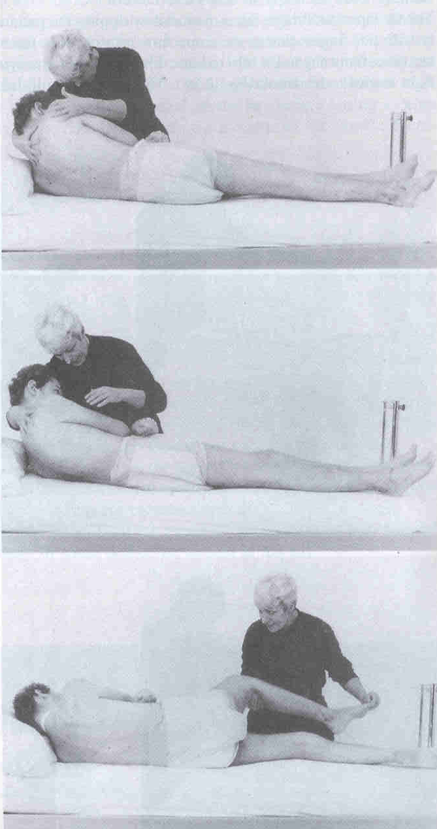
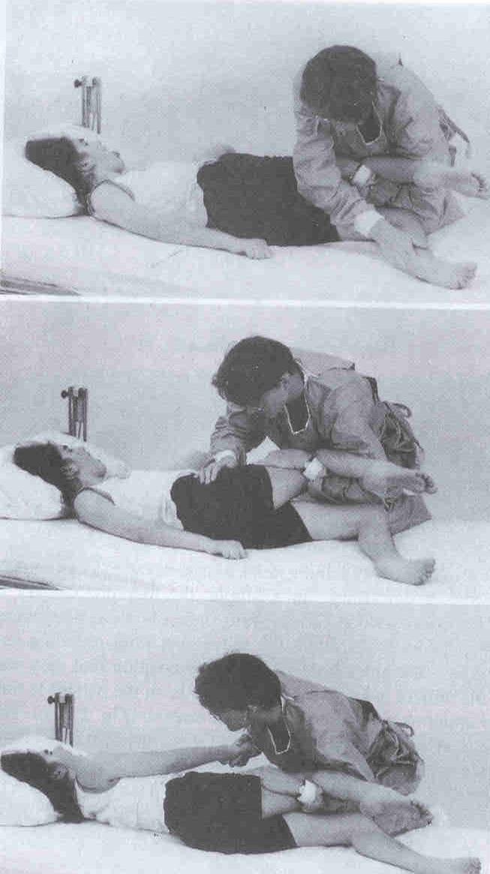

Slide 42
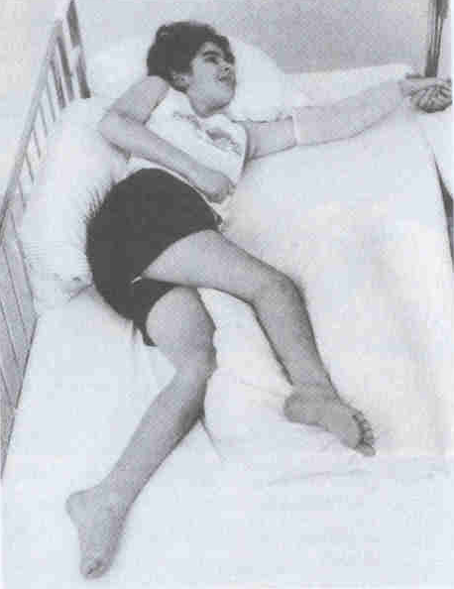
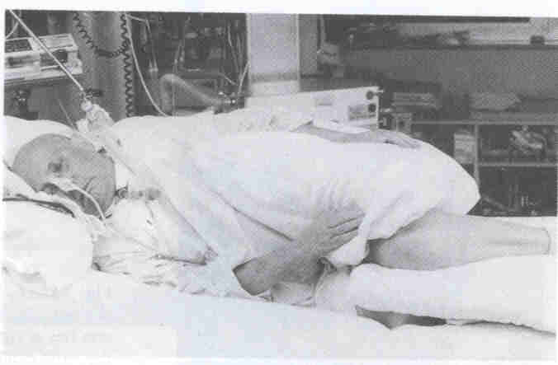

Slide 43
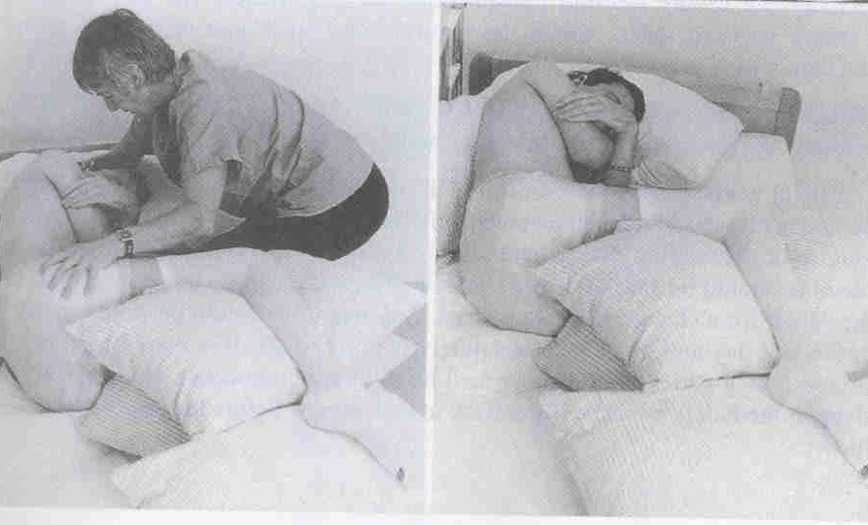
In marked extensor spasticity unable to flex the trunk or limbs
Flexion of neck and arms break this spasticity
Two large pillow in between thigh

Slide 44
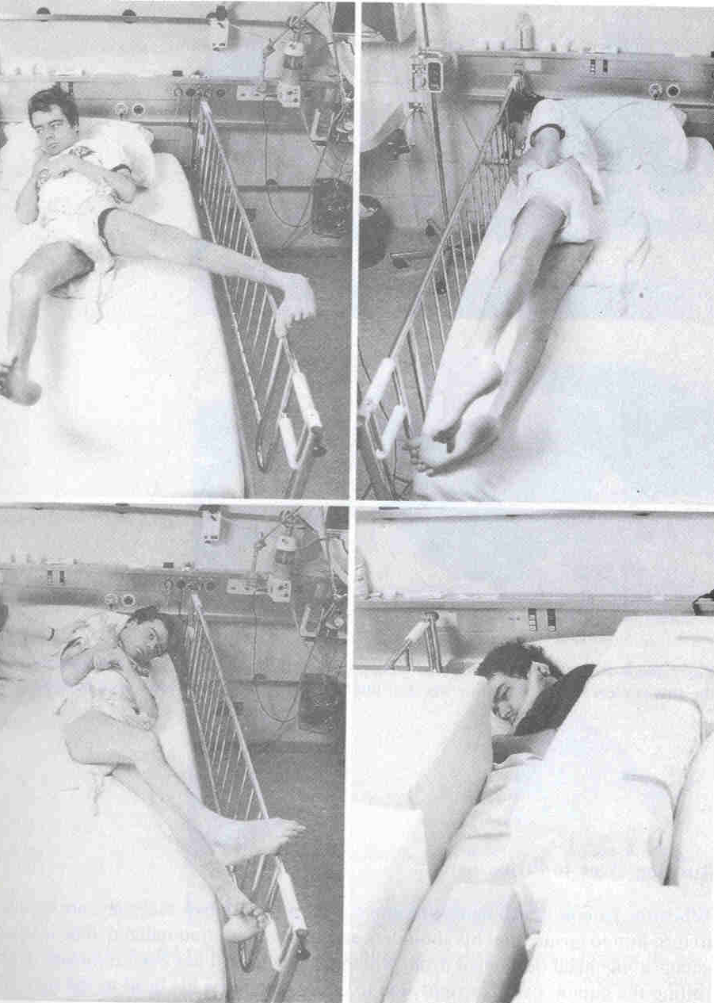
Restlessness and hyperactivity
  Desperate search for information from his surrounding
  Firm padded blocks around the patient to reduce the open area of bed
  Never be tied down
    Fight against
    Impede circulation
    Skin injury

Slide 45
Strategies for normalizing tone:
Abnormal sensation is the frequently underlying cause of the hyper tonicity. Patient may remain unable to feel some part of their body. Sensory input may be confusing unfamiliar and unstable for the head injury patients.
Management will remain the same as in stroke.

Slide 46
Physiotherapy for non - critical patient
Goals:
Increase level of alertness
Reduce secondary impairment
Improve postural control
Reduce the effect of tone
Increase tolerance of activity and positions
Improve joint mobility and integrity
Improve functional activity
Improve oro-motor function and communication
Provide Family education
Coordination between rehabilitation team
In addition to the physiotherapy treatment used in ICU, following is included in management.

Slide 47
Moving out of bed:
Vitals should be noted and should be normal
Moving away from bed – variety of situation gives further stimulationand may improve level of consciousness.
Wheelchair sitting can be given to even unconscious patients
Hypotension and pelvic fracture are contraindications
Patient with ventilator can be made to sit with careful handling
Moving from lying to sitting
Unconscious patient passively made to sit
Moving to edge of the couch

Slide 48
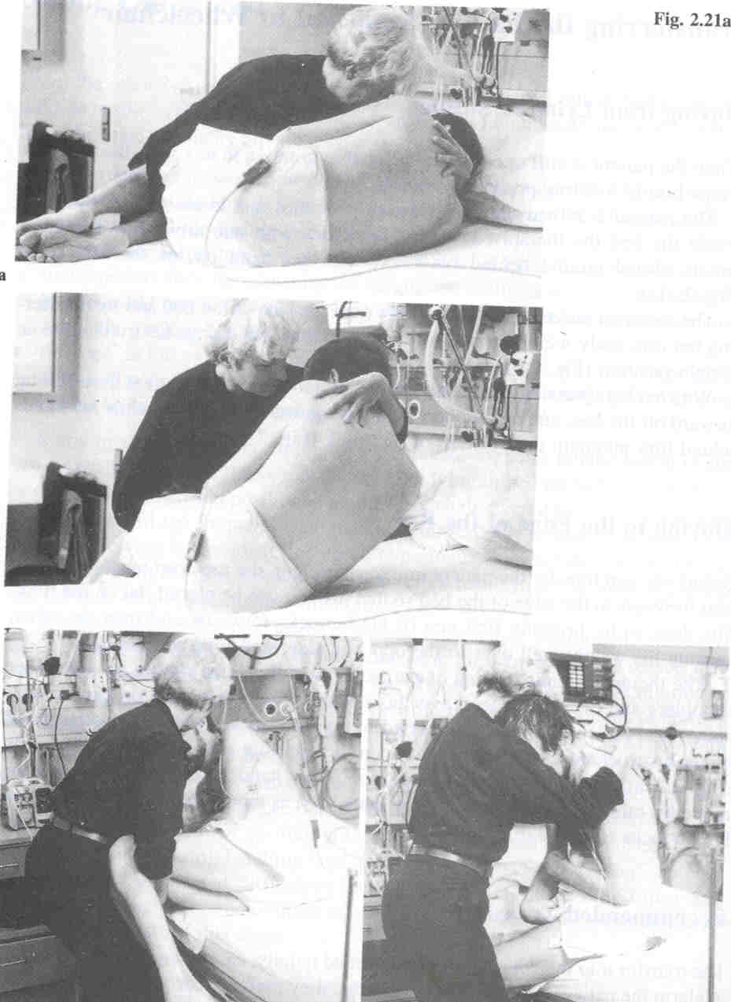

Slide 49
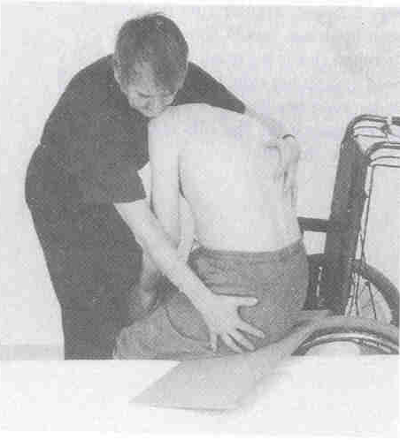
Transfer
Pivot – hold the trunk, head supported and arms left down With trunk flexed forward
Using slide board

Slide 50
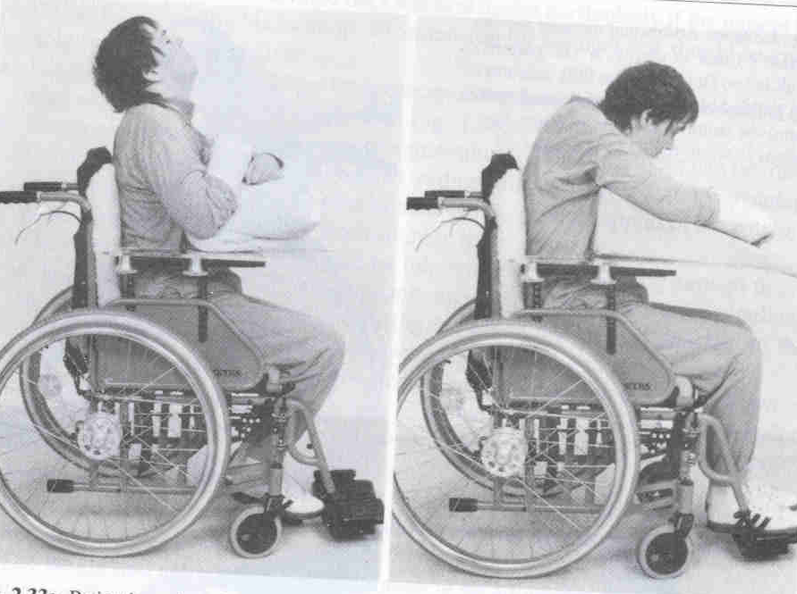
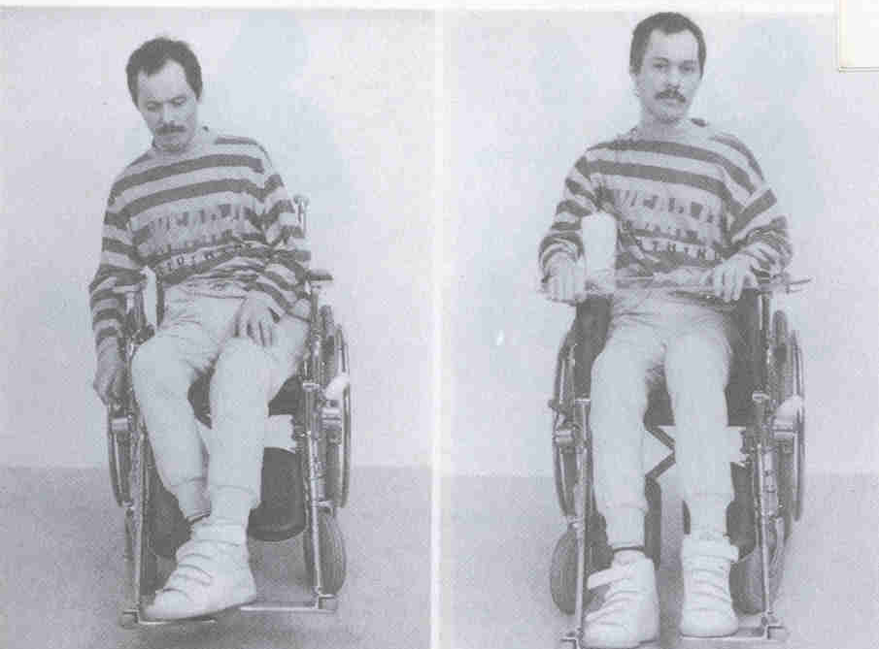

Slide 51
Strategies to improve trunk and proximal muscle control
Strategies to improve balance
Strategies to improve gait
Strategies to improve upper and lower extremity control
(Above mentioned strategies will remain same as in the case of stroke)

Slide 52
Management of head injury patients according to RLA Scale
Level I: No Response
Total Assistance
Coma arousal therapy
Complete absence of observable change in behavior when presented visual, auditory, tactile, proprioceptive, vestibular or painful stimuli

Slide 53
Level II: Generalized Response
Total Assistance
Demonstrates generalized reflex response to painful stimuli.
Responds to repeated auditory stimuli with increased or decreased activity.
Responds to external stimuli with physiological changes generalized, gross body movement and / or not purposeful vocalization.
Responses noted above may be same regardless of type and location of stimulation.
Responses may be significantly delayed.

Slide 54
Level III: Localized response
Total Assistance
Demonstrates withdrawal or vocalization to painful stimuli.
Turns toward or away from auditory stimuli.
Blinks when strong light crosses visual field.
Follows moving object passed within visual field.
Responds to discomfort by pulling tubes or restraints.
Responds inconsistently to simple commands.
Response directly related to type of stimulus.
May respond to some persons (especially family and friends) but not to others.

Slide 55
Level IV: Confused – Agitated
Patient is in a heightened state of activity and severely confused
Disoriented and unaware of present events
His behavior is frequently bizarre and inappropriate to his immediate environment
He is unable to perform self-care. If not physically disabled
He may perform automatic motor activities such as sitting, reaching and walking as part of his agitated state, but not necessarily as a purposeful act.

Slide 56
Goals of management of patient in RLA stage I, II, III and IV stages:
To improve endurance
Joint mobility and integrity
Secondary problems
Improve tolerance
Family education
Prevent the agitation
Highly structured, stable and closed environment

Slide 57
To reduce confusion
  Same person, time, routine
  Frequent orientation – non threatening
Medication and neuropsychological support
Expect no carry over
  no new skills
  Only automatic activity
Model calm behavior
  Patient perceive and reflect caregiver

Slide 58
Level V: Confused –Inappropriate, Non – agitated
Patient appears alert and responds to simple commands
More complex commands, however produce responses that are non-purposeful and random
The patient may show some agitated behavior it is in response to external stimuli rather than internal confusion
The patient is highly distractible and generally had difficulty in learning new information
can manage self-care activities with assistance
Memory is impaired and verbalization is often inappropriate.
Formal assessment possible.

Slide 59
Level VI: Confused – Appropriate
Patient shows goal – directed behavior, but relies on cueing for direction
He can relearn old skills such as ADL’s
But memory problems interfere with new learning
Patient has a beginning awareness of self and others.
Expect egocentric behavior
Difficult in assessment

Slide 60
Goals of management of patient in RLA stage V and VI:
Functional and ADL activities
Gait
Balance
Motor and Postural control
Strength and Endurance
Family education
Community re-entry

Slide 61
Level VII: Automatic – Appropriate
Patient goes through daily routine automatically
Robot – like with appropriate behavior and minimal confusion
Has shallow recall of activities, and superficial awareness of, but lack of insight to, his condition
requires at least minimal supervision because judgment, problem solving and planning skills are impaired

Slide 62
Level VIII: Purposeful – Appropriate
Patient is alert and oriented and is able to recall and integrate past and recent events
Can learn new activities and continue in home and living skills
Judgment, abstract reasoning, social, emotional and intellectual capacities may persist

Slide 63
Goals of management of patient in RLA stage VII and VIII:
To reintegration work
To increase leisure activity
To improve functional mobility, posture, balance and gait
To decrease level of supervision and assistance for task performance
Patient and family education

Slide 64
THANK YOU

