Slide 1
OSTEOARTHRITIS OF KNEE, Principles of assessment and physiotherapy management

Slide 2
Objectives
After completing this lecture, you will be able to:
Define Osteoarthritis
Explain principles of assessment of OA joint
Discuss principles of Physiotherapy management
Apply Evidence based Physiotherapy

Slide 3
DEFINITION
Osteoarthritis (OA), which is also known as osteoarthrosis or degenerative joint disease (DJD), is a progressive disorder of the joints caused by gradual loss of cartilage and resulting in the development of bony spurs and cysts at the margins of the joints.

Slide 4
CLASSIFICATION
There are many ways of classifying (or subdividing) OA.
Simple approach of dividing OA is primary and secondary.

Slide 5
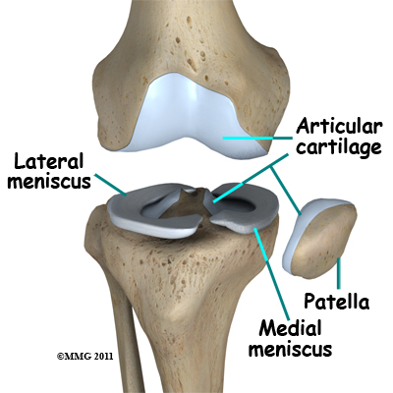

Slide 6

Symptoms
Pain
Tenderness at joint line
Inflammation
Swelling
Crepitus (a grating in the joint),
Morning Stiffness
Loss of function
Joint instability

Slide 7
Principles of assessment

Slide 8
History : patient will complain of pain at knee joint especially in weight bearing positions. Morning stiffness which is resolved within 30 min after knee movement. No H/O fall, trauma.
Patient will complain of pain in squatting positing and while climbing and descending stairs.
In secondary knee OA, patient will have a past history of knee surgery.

Slide 9
On observation
Body built
Deformity → patient may have fixed flexion deformity in chronic cases, genu varum (bow legs)
Attitude of limb → observe hip, knee and ankle.
Swelling → may be present at the knee joint
Muscle atrophy → check for quadriceps muscle

Slide 10
Redness over the knee joint may be pesent due to inflammation.
Gait → antalgic gait due to pain
ON PALPATION:
Tenderness over medial knee joint line
Muscle spasm
Warmth
Crepitus
Swelling (hard or soft), if present

Slide 11
On examination
Pain assessment:
Site : knee joint
Type: dull aching
Frequency: intermittent
A/F: weight bearing activities
R/F: rest

Slide 12
ROM → Loss of end range movement is most common. Extensor lag may be present due to weakness in quadriceps muscle.
Also examine ranges of Hip and Ankle
Muscle strength→ check muscle strength of hip muscles, knee and ankle muscles.
Quadriceps will be isometrically poor to fair compare to normal leg.
Also emphasize to check hip abductor muscle strength.

Slide 13
Functional assessment
All of the clinical features described above can result in functional difficulty, but this is variable from patient to patient.
OA knee patients may describe such problems as walking a distance, climbing stairs, getting out of chairs.

Slide 14

Investigation → X-ray

Slide 15
PRINCIPLES OF PHYSIOTHERAPY MANAGEMENT

Slide 16
GOALS
To increase/maintain ROM
Increase muscle power
Increase endurance
Increase aerobic capacity
Increase ADLs capacity

Slide 17
Ice therapy can be more beneficial to decrease pain and also in reducing effusion (temporarily).

Slide 18
To be contd…..

Slide 19
Evidence based Physiotherapy
Hip muscle weakness in individuals with medial knee osteoarthritis

Slide 20
Journal Authors | Study design Level of evidence | Aims | Methodology | conclusion
Arthritis Care & Research Rana S. Hinman, et. Al. | Case control | To compare the strength of the hip musculature in people with symptomatic medial knee osteoarthritis (OA) with asymptomatic controls. | 89 people with knee OA and 23 controls age >50 years were recruited from the community. The maximal isometric strength (torque relative to body mass) of the hip abductors, adductors, flexors, extensors, and internal and external rotators was evaluated using hand-held dynamometry or a customized force transducer apparatus. | People with knee OA demonstrate significant weakness of the hip musculature compared with asymptomatic controls. Findings from this study support the inclusion of hip strengthening exercises in rehabilitation programs.

Slide 21
MCQs
Which ROM is most common for loss in OA knee patients?
Loss of end range movement
Loss of midrange movement
Loss of initial range movement

Slide 22
2. Fracture through the joint or dislocation can lead to?
Primary knee OA
Secondary knee OA
3. Which type of gait is seen in an OA knee patient?
Trendelenburg gait
High steppage gait
Antalgic gait
Limping gait

Slide 23
4. Which type of knee deformity is commonly seen in OA knee patients?
Genu valgum
Genu varum
Genu recurvatum
5. Bow legs are also called as _______
Genu valgum
Genu varum
Genu recurvatum

Slide 24
Reference
Tidy’s Physiotherapy

