Slide 1
Ervilla Dass
Assistant Professor
Department of Pharmacology
S. B. K. S. Medical Institute and Research Centre
Sumandeep Vidyapeeth, Piparia.

Slide 2
MUSCARINIC RECEPTOR BLOCKING DRUGS
Ervilla Dass

Slide 3
ATROPINE

Slide 4
CHARACTERISTICS OF ATROPINE
SOURCE
  Atropa belladonna
  Datura stramonium
    Known as Jamestown weed or jimsonweed
CHEMICAL NATURE
  An alkaloid
Alternate name is d,l-hyoscyamine
Nature of blockade
  Competitive

Slide 5
ACTIONS OF ATROPINE AT TISSUE SITES
Eye
  Sphincter muscle of the iris: mydriasis
  Ciliary muscle: cycloplegia
Atropine limits focusing to distant objects
Accomodation is blocked by atropine

Slide 6
ACTIONS OF ATROPINE AT SMOOTH MUSCLES AND GLANDS
Eye
Lacrimal glands
Mucus glands of the pharynx and nasal cavity
Bronchial smooth muscle
Gastric glands
Intestinal glands
Pancreas
Mucus glands of the respiratory tract
Lacrimal glands
Eccrine sweat glands

Slide 7
CARDIOVASCULAR ACTIONS OF ATROPINE
Heart rate
  Low dose
  High dose
Systemic blood vessels
Peripheral resistance
Cutaneous blood vessels

Slide 8
SCOPOLAMINE (1)
Source - Hyoscyamus niger (henbane)
Chemical nature of the molecule
Nature of blockade
Changes in the dose response curve of muscarinic agonists in the presence of scopolamine
Lower doses of scopolamine (0.1 - 0.2 mg) produce greater cardiac slowing than an equivalent dose of atropine. Higher doses produce tachycardia
Low doses of scopolamine produce CNS effects that are not seen with equivalent doses of atropine

Slide 9
SCOPOLAMINE (2)
Therapeutic doses of scopolamine normally produce CNS depression, manifested as drowsiness, amnesia, fatigue, dreamless sleep, reduction in REM, euphoria
In the presence of pain, the same therapeutic dose occasionally cause excitement, restlessness, hallucinations, or delirium. Such excitement is always seen with large doses, as is also seen with large doses of atropine
Therapeutic use - prophylaxis of motion sickness; an adhesive preparation, the Transderm scop is used

Slide 10
Therapeutic Uses of Antimuscarinic Agents

Slide 11
THERAPEUTIC USES OF MUSCARINIC ANTAGONISTS (1)
Cardiovascular System - atropine is generally used for the following cases
  Improper use of choline esters
  Sinus or nodal bradycardia in cases of excessive vagal tone associated with myocardial infarct
  Hyperactive carotid sinus (syncope and severe bradycardia)
  Second degree heart block

Slide 12
THERAPEUTIC USES OF MUSCARINIC ANTAGONISTS (2)
Gastrointestinal Tract
  Peptic ulcers
    In Europe, Japan, and Canada, M₁ muscarinic receptor antagonists such as pirenzepine and telenzepine are used
    In the U.S. H₂ histamine antagonists such as cimetidine are used
  Spasticity of the g.i. tract
    M₃ muscarinic antagonists are being investigated
  Excessive salivation associated with heavy metal poisoning and parkinsonism
  Production of partial blockade of salivation in patients unable to swallow

Slide 13
THERAPEUTIC USES OF MUSCARINIC ANTAGONISTS (3)
Urinary Bladder
  Reverse spasm of the ureteral smooth muscle (renal colic)
  Increase bladder capacity in cases of enuresis
  Reduce urinary frequency in cases of hypertonic bladder

Slide 14
THERAPEUTIC USES OF MUSCARINIC ANTAGONISTS (4)
Central Nervous System
  Parkinson’s disease
  Motion sickness
  Produce tranquilization and amnesia prior to surgery and in certain cases such as labor (not a prominent use anymore)
  Anesthesia, to inhibit salivation (not a prominent use anymore)
  Prevent vagal reflexes induced by surgical manipulation of organs

Slide 15
THERAPEUTIC USES OF MUSCARINIC ANTAGONISTS (5)
Posioning by inhibitors of acetylcholinesterase
Mushroom poisoning due to muscarine
In conjunction with inhibitors of acetylcholinesterase when they are used to promote recovery from neuromuscular blockade after surgery
Injudicious use of choline esters
Prevent vagal reflexes induced by surgical manipulation of visceral organs
Atropine is used for the above

Slide 16
TOXICITY OF ATROPINE

Slide 17
CONTRAINDICATIONS TO THE USE OF ANTIMUSCARINIC AGENTS
Narrow Angle Glaucoma

Slide 18
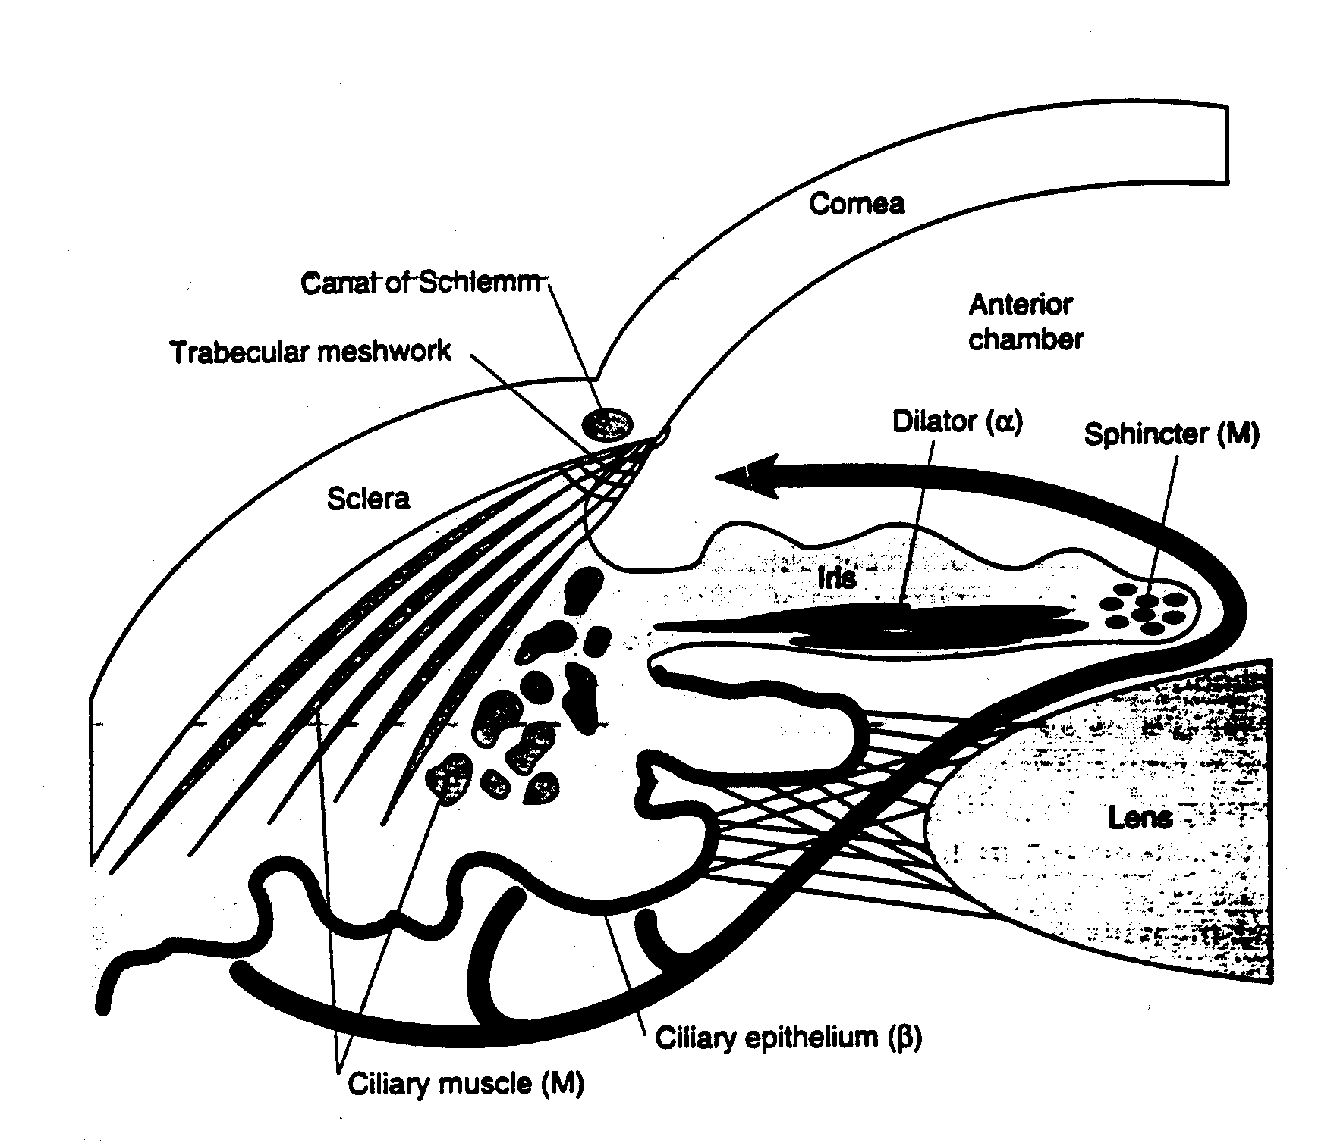
FLOW OF AQUEOUS AND ITS ESCAPE FROM THE EYE

Slide 19
CONTRAINDICATIONS TO THE USE OF ANTIMUSCARINIC AGENTS
Narrow angle glaucoma
Hypertrophy of the prostate gland
Atony of the bladder
Atony of the G.I. Tract

Slide 20
EVIDENCE

Slide 21
K. D. Tripathi M.D., Essentials of Medical Pharmacology , 7th Edition , 2013, pg. 113 to 121
Source of Information | Chapter | Author | Information | Level of evidence
K. D. Tripathi Essentials of Medical Pharmacology, Jaypee Brothers Medical Publishers (P) LTD, NEW DELHI | Section II DRUGS ACTING ON AUTONOMIC NERVOUS SYSTEM Chapter 8 Anticholinergic drugs and drugs acting on autonomic ganglia | Dr. K. D. Tripathi M.D. Ex-Director Professor and head of Pharmacology Maulana Azad Medical College and Associated LN B Pant Hospitals, New Delhi | Anticholinergic drugs, classification, atropine, actions | Level of evidence - Grade one

Slide 22
Satoskar & Bhandarkar, Pharmacology and Pharmacotherapeutics , Revised 23rd Edition , 2013, pg . 298 to 306
Source of Information | Chapter | Author | Information | Level of evidence
Pharmacology and Pharmacotherapeutics – R. S. Satoskar, S. D. Bhandarkar, Nirmala N. Rege POPULAR PRAKASHAN, Mumbai. Revised 23rd Edition, 2013 | Section IV AUTONOMIC NERVOUS SYSTEM Chapter 19 Muscarinic receptor blocking drugs | Satoskar & Bhandarkar | Anticholinergic drugs, classification, atropine, actions | Level of evidence - Grade one

Slide 23
Source of Information | Chapter | Author | Information | Level of evidence
Curr Opin Pharmacol. 2013 Jun;13(3):316-23. doi: 10.1016/j.coph.2013.04.004. Epub 2013 May 3. | A new perspective on muscarinic receptor antagonism in obstructive airways diseases. | Meurs H¹, Oenema TA, Kistemaker LE, Gosens R. | antimuscarinic Acetylcholine has traditionally only been regarded as a neurotransmitter of the parasympathetic nervous system, causing bronchoconstriction and mucus secretion in asthma and COPD by muscarinic receptor activation

