Slide 1
TA Rupture and Hamstring Strain

Slide 2
Objectives of the Lecture
At the end of the lecture, the student will be able to
Enumerate Mode of injury of TA rupture
Describe about Physiotherapy Assessment and Management of TA rupture
Enumerate Mode of injury of Hamstring strain
Describe about Physiotherapy Assessment and Management of Hamstring Strain

Slide 3
TA Rupture
Acute rupture of the Achilles tendon is a common soft tissue injury, occurring more frequently in men than in women, 30 to 50 years old, who intermittently participate in exercise or athletic activities.

Slide 4
The rupture usually is associated with a forceful concentric or eccentric contraction of the gastrocnemius soleus muscles (triceps surae) during sudden acceleration or abrupt deceleration, such as jumping or landing.
Degenerative and mechanical factors appear to increase the risk of acute rupture, including decreased strength or flexibility of the plantarflexors, excessive body weight, pre-existing tendinosis, corticosteroid injections into the tendon, and decreased vascularity of the tendon.
The tendon often ruptures proximal to the distal insertion of the tendon on the calcaneus.

Slide 5
Assessment
At the time of injury a complete rupture leads to pain, swelling, a palpable defect, and significant weakness in plantarflexion.
Pain History
Girth Measurement
ROM
MMT
Gait

Slide 6
A complete rupture of the Achilles tendon can be managed conservatively with extended cast immobilization or functional bracing; or it can be managed surgically.

Slide 7
Surgical intervention is routinely recommended for the young, active patient less than 30 years of age but non operative management is the better option for the sedentary patient older than 50 to 60 years of age.
Furthermore, surgery is considered the only option for the symptomatic patient with a chronic rupture in which the diagnosis or treatment was delayed for 4 weeks or more.
However, there is lack of agreement in the literature and in practice as to which is the better option for the middle-aged population.

Slide 8
With surgical repair there is a lower rate of re-rupture of the tendon than with non operative management, but there also is a risk of wound closure problems, infection, and nerve injury with surgery.
Non operative management requires a longer immobilization and is associated with a higher rate of deep vein thrombosis (DVT)

Slide 9
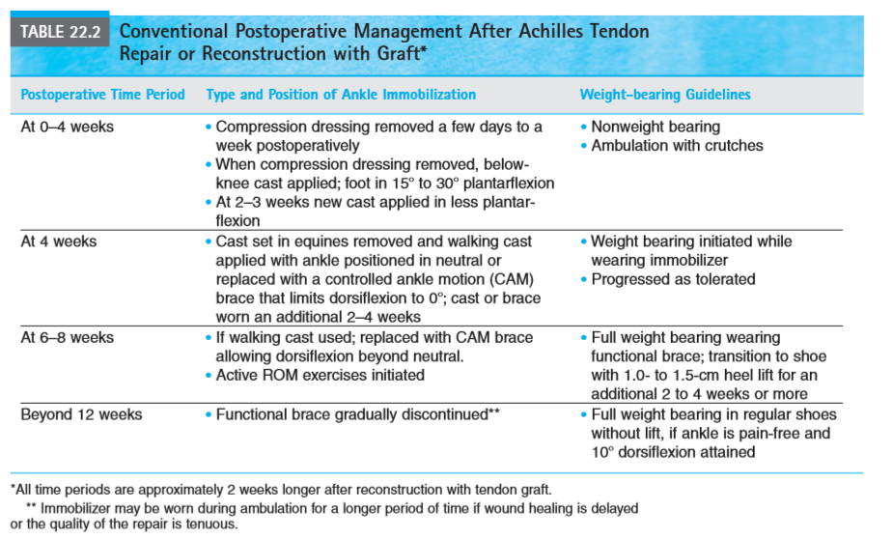
MANAGEMENT

Slide 10
Exercise: Maximum Protection Phase Achilles tendon repair
It is frequently performed on an out- patient basis.
Therefore, patient education is essential before surgery or prior to discharge. It focuses on wound care (if the immobilizer is removable), controlling peripheral edema by elevating the operated leg, gait training, and a home exercise program.

Slide 11
The following treatment goals and exercises are appropriate during the first 4 to 6 weeks after surgery.
Maintain ROM of nonimmobilized joints.
Prevent reflex inhibition of immobilized muscle groups. If early ROM is not permitted, begin submaximal, pain-free muscle-setting exercises of the ankle in the immobilizer within the first few days after surgery.
Start with setting exercises of the dorsiflexors, invertors, and evertors. At 2 weeks, add setting exercises of the plantarflexors.

Slide 12
Prevent joint stiffness and soft tissue adhesions in the operated ankle and foot.
If an early motion and weight bearing approach was planned, begin the ROM exercises within a few days to 2 weeks after surgery.
Maintain cardiopulmonary endurance. Use an upper extremity ergometry for endurance training, if available.

Slide 13
Exercise: Moderate Protection Phase
By 6 weeks postoperatively the patient may be permitted to bear weight as tolerated on the operated extremity regardless of whether an early weight-bearing program or conventional program was implemented.
However, a functional CAM orthosis is required during progressive weight bearing activities for several weeks. During this phase of rehabilitation, which usually extends from 6 to 12 weeks postoperatively, gradually increasing stress is placed on the operated tendon and surrounding structures. Patients typically begin a supervised exercise program at this time.

Slide 14
Increase ROM of the operated ankle.
Begin gentle self-stretching exercises in nonweight-bearing and weight-bearing positions.
Stretch the gastrocnemius– soleus muscle group with the knee extended and flexed.
Examples of stretching activities are: • Joint mobilization techniques if ankle or foot joints are restricted • Gentle manual stretching to increase inversion/eversion and dorsiflexion/plantarflexion • A towel stretch to increase dorsiflexion • While seated, active ankle ROM with the foot resting on a small rocker or wobble board • Standing stretch to increase dorsiflexion with the knee flexed and extended • Descend stairs step over step as ROM improves.

Slide 15
Improve strength of the operated lower extremity. Initiate open and closed chain, low-intensity resistance exercises at 6 to 8 weeks. Examples include.
• Open-chain resistance exercises of the ankle against a light grade of elastic resistance. • Bilateral, progressing to unilateral closed-chain activities, such as heel and toe raises while seated, mini- squats alternating heel raises and toe raises, and partial lunges using body weight as resistance.

Slide 16
Re-establish balance reactions. Initiate proprioceptive training and balance exercises in double-leg stance on a firm surface. Progress to single-leg stance on a soft surface. Improve muscular and cardiopulmonary endurance. Begin and gradually progress level-surface treadmill walking or stationary cycling (recumbent or upright) approach is employed.

Slide 17
Exercise: Minimum Protection/ Return to Function Phase
The final phase of rehabilitation, which begins around 12 to 16 weeks postoperatively, is directed toward returning a patient to a pre-injury level of function for expected work- related demands and desired recreational/athletic activities.
Stretching exercises continue until full ROM is achieved, and then the patient transitions to a maintenance program.
Eccentric resistance exercises of the gastrocnemius–soleus muscle group in weight-bearing positions and eventually plyometric training are added to the strengthening program.

Slide 18
More challenging proprioceptive training is added. Jogging, running, agility drills, and sport-specific training usually can be initiated at 16 weeks.
Patient education focuses on ways to reduce the risk of rerupture of the repaired tendon, such as warming up before strenuous activity and daily stretching.
Most patients are permitted to resume sports gradually at 5 to 6 months if the strength of the operated extremity is relatively comparable to that of the contra lateral extremity.

Slide 19
Hamstring Rupture
Overuse or trauma to any of the muscles in the hip region can result from excessive strain while the muscle is contracting (often in a stretched position) or from repetitive use and not allowing the injured tissue to heal between activities.
Common problems include hip flexor, adductor, and hamstring strains. Poor flexibility and fatigue may pre- dispose an individual to strain and injury during an activity or sporting event; and sudden falls, such as slipping on ice, may cause a strain.

Slide 20
Clinical Manifestations
Pain. Symptoms occur when the involved muscle con- tracts, when it is stretched, or when the provoking activity is repeated.
Gait deviations. Slightly shorter stance occurs on the painful side. There may be a slight lurch when the involved muscle contracts to protect the muscle resulting in impaired gait.
Imbalance in muscle flexibility and strength. Muscle flexibility or dominance in use may be the precipitating factor in many painful hip syndromes.
Decreased muscular endurance. Muscle fatigue may lead to faulty postures, stress, and flexibility imbalances as described above.

Slide 21
Assessment
Pain History
ROM
MMT
Gait
Posture

Slide 22
Management: Protection Phase
Control Inflammation and Promote Healing When there is chronic irritation or inflammation from an acute injury, with emphasis on resting the involved tissue by not stressing or putting pressure on it. Have the patient avoid the provoking activity; and if necessary, decrease the amount and time walking or use an assistive device.
Develop Support in Related Areas Initiate exercises to develop neuromuscular control for alignment of the pelvis and hip. Avoid stressing the inflamed tissue. Patient education and cooperation are necessary to reduce repetitive trauma.

Slide 23
Management: Controlled Motion Phase
Develop a Strong Mobile Scar and Regain Flexibility Remodel the scar in muscle or tendon by applying cross-fiber massage to the site of the lesion followed by multiple angle submaximal isometrics in pain free positions.
Develop a Balance in Length and Strength of the Hip Muscles

Slide 24
Stretch any muscles that are restricting motion with gentle, progressive neuromuscular inhibition techniques. Instruct the patient to do self-stretching with proper stabilization to ensure that the stretches are performed safely and effectively.
Begin developing neuromuscular control to train the involved muscles to contract and control alignment of the femur. Initially, the emphasis is on control, not strengthening. Once the patient is aware of proper muscle control and is able to maintain alignment, progress to strengthening the weakened muscles through the range.

Slide 25
Muscles not directly injured should be stretched and strengthened if they are contributing to asymmetrical forces. The patient may not have sufficient trunk coordination or strength, which may be contributing to the overuse because of compensations in the hip
Develop Stability and Closed-Chain Function
Initiate controlled weight-bearing exercises when tolerated. Because the individual is probably standing and walking, he or she may not tolerate much more closed-chain activities than those previously initiated early during the healing stage, so proceed with caution. Carefully observe the exercises so proper movement patterns are used. Use exercises such as biking or partial weight-bearing and weight-shifting activities in the parallel bars. Observe coordination between trunk, hip, knee, and ankle motions; and exercise only to the point of fatigue, substitute motions, or pain in the weakest segment in the chain.

Slide 26
Develop Muscle and Cardiopulmonary Endurance
For muscle endurance, teach the patient how to perform each exercise safely for 1 to 3 minutes before progressing to the next level of difficulty. Determine aerobic activities that do not exacerbate the patient’s symptoms. It may be that the patient just needs to modify the intensity or the techniques used in his or her current program.
Patient Education Initiate a home exercise program as soon as the patient has learned neuromuscular control techniques and correct stretching, strengthening, and aerobic activities. Provide follow-up instruction for modification and progression of the program.

Slide 27
Management: Return to Function Phase
Progress Strength and Functional Control
Progress closed-chain and functional training to include balance and muscular endurance for each activity. Use specificity principles; increase eccentric resistance and demand for controlled speed if necessary for return- to-work activity or sporting events.
Progress to patterns of motion consistent with the desired outcome. Use acceleration/deceleration drills and plyometric training; assess the total body functioning while doing the desired activity. Practice timing and sequencing of events.
Return to Function Prior to returning to the desired function have the patient practice the activity in a controlled environment and for a limited period. As tolerated, introduce variability in the environment and increase the intensity of the endurance activities.

Slide 28
Running exercises improve the strength of a partially ruptured Achilles tendon

Slide 29
JOURNAL AND AUTHORS |  | METHODOLOGY | RESULTS | CONCLUSION
E K N See, G Y F Ng, C O Y Ng, D T C Fung Br J Sports Med 2004;38:597–600. | Low level | 30 Sprague-Dawley rats had surgical transection of their right medial Achilles tendon. The rats were divided into running (n = 11), swimming (n = 10), and control (n = 9) groups. The running and swimming groups were given daily exercise training, starting from the fifth day after the injury; the control group did not exercise throughout the period of the experiment. An Achilles functional index (AFI) was recorded before the operation and on the third, 10th, and 30th days after the operation. On the 30th day, the rats were killed and their Achilles tendons harvested for biomechanical testing of load relaxation properties, stiffness, and ultimate tensile strength (UTS). The AFI data were analysed by two way analysis of variance; load relaxation, stiffness, and UTS data were analysed by multivariate analysis, with a at 0.05. | The UTS of the running group was higher than in the control group (p = 0.015), while there was no significant difference between the swimming and control groups | Running exercises can improve the strength of partially ruptured Achilles tendons at 30 days after injury.

Slide 30
PICO
P | MEDIAL ACHILLES TENDON SURGERY
I | SWIMMING
C | RUNNING, CONTROL
O | ULTIMATE TENSILE STRENGTH

Slide 31
MCQs
1. Which is not the common mode of Injury for TA Rupture is?
a. Acceleration Injuries c. Landing on Foot
b. Jumping Up d. Slipping on Ice
2. Which management is not applicable in Return to Function Phase in TA Rupture?
a. Strengthening Exs c. Endurance Exs
b. RICE protocol d. Flexibility training

Slide 32
3. Which is not the common mode of Injury for Hamstring strain?
Poor Flexibility
Over use of Muscles
Fall on Outstretched hand
Sliping on Ice
4. Which of the following is not the Clinical Manifestations of Hamstring strain:
Pain c. Impaired muscle strength
b. Gait deviation d. Increased Endurance

Slide 33
5. Which management is applicable in Maximum Protection Phase in Hamstring Strain?
a. Strengthening Exs c. Endurance Exs
b. RICE protocol d. Flexibility training

