Slide 1
Physiotherapy after Proximal humerus fractures

Slide 2
Objectives
At the end of the topic, students should be able to
Enumerate clinical features of proximal humerus #
Explain Mechanism of injury
Describe principles of assessment and management for the same

Slide 3
Proximal Humerus fractures
Fractures of the proximal humerus end involve the humeral end, anatomical neck and surgical neck of humerus.
Based on displacement and angulation of parts, NEER divided them into: 1-part, 2-part, 3-part, 4-part, which are : 1) anatomical neck 2) shaft or surgical neck 3) greater tuberosity 4) lesser tuberosity.

Slide 4
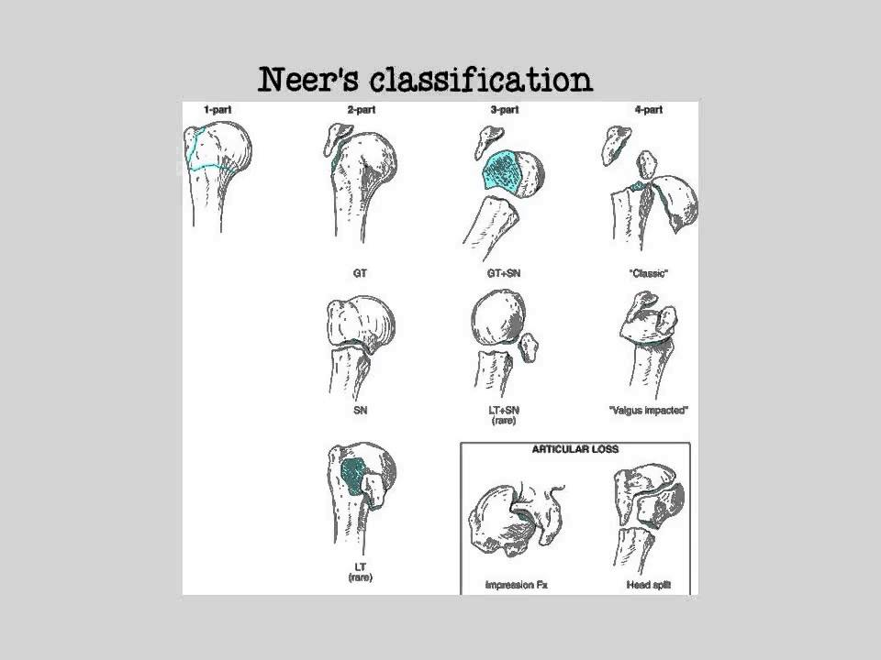

Slide 5
MOI: Fall on outstretched hands/ fall on elbow/ trauma to lateral aspect of shoulder.
C/F: Pain and loss of function with swelling of the involved extremity are the most common symptoms on initial presentation.

Slide 6
Mx: Since 80% of the #’s are minimally displaced early motion of the shoulder is the mainstay of treatment to prevent stiffness of the joint.
Stability achieved by means of external immobilization for non-displaced stable #’s, internal fixation for displaced 2-part/3-part #’s and endoprostheses for 4-part #’s.

Slide 7
Treatment methods
Sling | Nondisplaced, impacted or minimally displaced fractures
ORIF | 2/3 part # associated with rotator cuff tear
Closed reduction + percutaneous fixation with screw or tension band wiring | displaced surgical neck #’s
Closed reduction +immobilization | undisplaced #’s
External fixator | open + comminuted #’s
Arthroplasty | #s with risk of complications like AVN
Open reduction+ internal fixation | 2 or 3 part #s

Slide 8
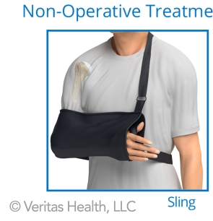

Slide 9
Callus formation: 2 to 3 weeks
Expected time of bone healing: 6 to 8 weeks
Rehabilitation duration: 12 weeks to 1 year

Slide 10
Complications or Special considerations of #’s: AGE: elderly develop joint stiffness
ARTICULAR involvement: if >50% loss of articular surface→ hemiarthroplasty
AVN: in # of anatomical neck
Malunion: due to muscle forces
Nonunion: of surgical neck
Myositis ossificans: due to massage and vigorous treatment

Slide 11
Principles of assessment in 1st week
c/o pain, paraesthesia, pin discomfort, drainage, signs of infection
Swelling
Wound inspection
Shoulder girdle
Elbow and wrist range and muscle strength

Slide 12
During 1st week
PRECAUSIONS | Avoid shoulder motion.
ROM | Shoulder is immobilized in a sling. No ROM to shoulder. For stable, undisplaced #’s and hemiarthroplasty pendulum exs are begun. Active ROM to wrist, hand and digits.
MUSCLE STRENGTH | No strengthening exs to shoulder. At the end of the 1st week isometric and isotonic exs to are given to the wrist flexors, extensors, and intrinsic muscles of the hand
FUNCTIONAL ACTIVITIES | The uninvolved extremity is used in self-care and personal hygiene. When wearing clothes the patient dons clothes on the involved extremity first and doffs them from the uninvolved extremity first.
WEIGHT BEARING | None

Slide 13
During 1st week:
Sling: Check the sling
ORIF: Check the wound. If repair of the rotator cuff then patient is not allowed active flexion, external rotation or assistive internal rotation till 6 weeks after surgery.

Slide 14
Principles of assessment in 2-4 weeks
Pain
Wound inspection
Assess active and passive ROM of elbow, wrist and digits
Isometric strength of shoulder girdle

Slide 15
2-4weeks
PRECAUSIONS | Avoid internal/external rotation of the shoulder
ROM | Sling is removed at the end of 3 weeks. Patients with conservative treatment with a sling can start gentle, active ROM exs to the shoulder in flexion, extension, abduction and adduction as these #’s are nondisplaced. Gravity eliminated or dependent-Pendulum exs are also taught. Continue Active ROM to wrist, hand and digits. Surgical- passive-assisted exercises
MUSCLE STRENGTH | Start isometric exs to shoulder girdle muscles only if treated conservatively. Patient should do ball-squeezing exs to maintain intrinsic muscle strength.
FUNCTIONAL ACTIVITIES | The uninvolved extremity is used in self-care and personal hygiene.
WEIGHT BEARING | None

Slide 16
Principles of assessment in 4-6 weeks
Tenderness
ROM of shoulder
Strength of shoulder muscles

Slide 17
4-6 weeks
PRECAUSIONS | Don’t apply force in attempting to regain the full ROM
ROM | Flexion/abduction-110, rotation limited for conservative, Continue passive ROM for surgical, elbow and wrist- continue
MUSCLE STRENGTH | Isometric exercises for shoulder Isotonic for elbow
FUNCTIONAL ACTIVITIES | Involved extremity should be used for dressing and grooming as tolerated.
WEIGHT BEARING | None

Slide 18
6-8 weeks
PRECAUSIONS | Don’t apply force in attempting to regain the full ROM
ROM | Active, active-assisted & passive ROM to shoulder and elbow in all planes to tolerance
MUSCLE STRENGTH | Continue Isometric exercises for shoulder, Isotonic for elbow for surgical. Start PRE for pts treated with sling
FUNCTIONAL ACTIVITIES | Involved extremity should be used for dressing and grooming as tolerated.
WEIGHT BEARING | Weight bearing as tolerated

Slide 19
8-12 weeks: Active and passive ROM in all planes. PRE for shoulder with weights started, full weight bearing and using the affected arm in all day to day activities begun.

Slide 20
During 1st week: wound check and active exs to wrist and hand
2nd week: Sutures are removed and affected extremity elevated to decrease swelling.
After 6-8 weeks: active movements begun
After 8-12 weeks: resistive shoulder exs are begun

Slide 21
Interventions for treating proximal humeral fractures in adults (Review)
Clinical query
Is there any difference in fractures around proximal humerus with different treatment options in improving function?
P-patients having fractures around proximal humerus
I- different treatments
C-none
O- improvement in function

Slide 22
Interventions for treating proximal humeral fractures in adults (Review)
Cochrane review 1 a level of evidence | Handoll HHG, Ollivere BJ, Rollins KE | search of Cochrane Bone, Joint and Muscle Trauma Group Specialised Register was done, the Cochrane Central Register of Controlled Trials, MEDLINE, EMBASE and other databases, and bibliographies of trial reports. All randomised controlled trials pertinent to the management of proximal humeral fractures in adults were selected in 2012. | Eight trials evaluated conservative treatment. One trial found an arm sling was generally more comfortable than a less commonly used body bandage. There was some evidence that ’immediate’ physiotherapy compared with that delayed until after three weeks of immobilisation resulted in less pain and potentially better recovery in people with undisplaced or other stable fractures. Similarly, there was evidence that mobilisation at one week instead of three weeks alleviated short termpain without compromising long termoutcome. | There is insufficient evidence to inform the management of these fractures. Early physiotherapy, without immobilisation, may be sufficient for some types of undisplaced fractures. It remains unclear whether surgery, even for specific fracture types, will produce consistently better long termoutcomes but it is likely to be associatedwith a higher risk of surgery-related complications and requirement for further surgery. There is insufficient evidence to establish what is the best method of surgical treatment, either in terms of the use of different categories of surgical intervention (such as plate versus nail fixation, or hemiarthroplasty versus tension-wire fixation) or different methods of performing an intervention in the same category (such as different methods of plate fixation). There is insufficient evidence to say when to start mobilisation after either surgical fixation or hemiarthroplasty.

