Slide 1
PT MANAGEMENT
IN
SEPTIC ARTHRITIS
DR.JAY SONI
ASSISTANT PROFESSOR
COLLEGE OF PHYSIOTHERAPY

Slide 2
Objectives
At the end of the lecture students should know
Causes,
Routes,
Pathogenesis,
clinical features,
Investigation,
Treatment

Slide 3
Cause / Organisms
Septic / Pyogenic infections of the joints are caused
commonly by Staphylococcus and
less commonly by streptococci, pneumococci, gonococci, meningococci, etc.

Slide 4
Routes of Invasion
Haematogenous: Spreads through the bloodstream. from a focus of infection in the body such as tonsils, teeth, respiratory tract and intestines
Secondary to osteomyelitis in the adjacent bone, e.g., septic arthritis of the hip following osteomyelitis of the upper end of the femur
Direct implantation of the bacteria into the joint through a punctured wound over the joint, infection Following surgical procedures on from a compound fracture
Iatrogenic: on the joint such as aspiration, arthrotomy and arthroscopy

Slide 5
Pathogenesis
Inflammation of the Synovial Membrane
Excessive Production of joint Fluid/Pus
(contains a large number of cells, bacteria and fibrin).
Destruction of the articular cartilage and the underlying bone starts.

Slide 6
When the joint is distended with pus, pathological dislocation of the joint may occur. The capsule may get perforated and the pus may escape out by forming sinuses.
If untreated, the joint may get disorganized and end up into fibrous or bony ankylosis.

Slide 7
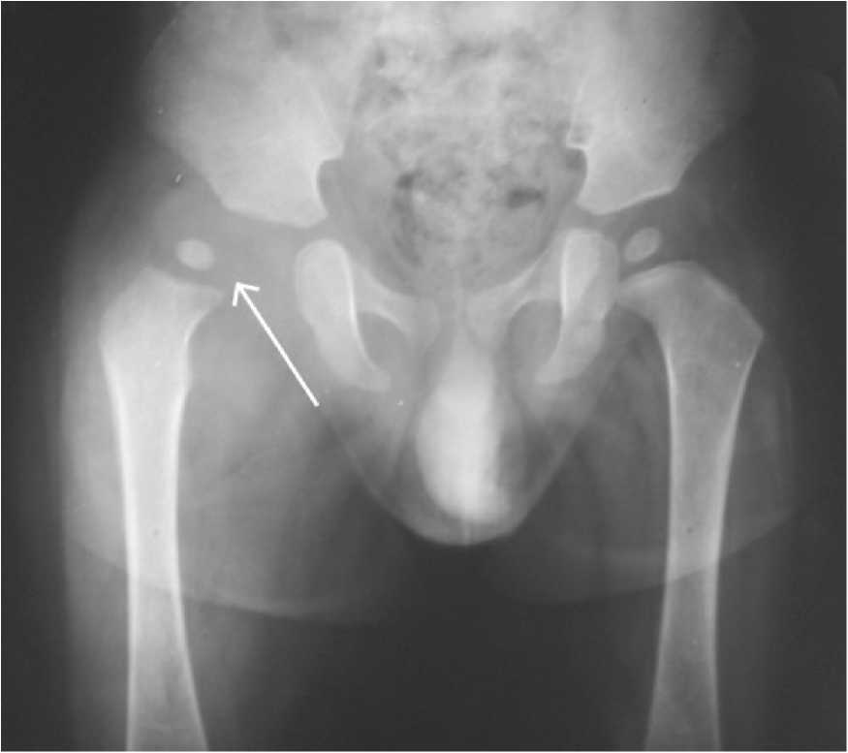

Slide 8
Clinical features
High-grade fever,
Swelling
Pain in the joint.
Restricted Range of Motion due to pain and muscle spasm.

Slide 9
Investigations
Radiographic investigations
normal or may show increased joint space due to fluid or pus collection.
Later radiographs show destruction of the cartilage, new bone formation, eventually bony ankylosis or even pathological dislocation.
Ultrasonography is required especially in children to detect collection of fluid.

Slide 10
Blood test
Elevation of ESR and leucocyte count
Blood culture shows growth of causative organism
Aspiration of the joint fluid may show organisms on smear and culture

Slide 11
Treatment
REST should be given to the joint by traction or splinting or by plaster of Paris slab till the symptoms subside.
Appropriate broad-spectrum ANTIBIOTIC drugs are started at the earliest.
ARTHROTOMY
Open drainage of the pus is carried out as early as possible to prevent permanent damage to the articular cartilage.
Gradual mobilization of the joint should be done.

Slide 12
Physiotherapeutic management
During the active stage of the disease
IMMOBILIZATION for comfortable resting position of the affected joint.
No ROM or strengthening exercises are required.
No attempt should be made to subject the limb to strenuous activities or weight bearing by assisted ambulation.
No Heat modalities
Cold therapy to temporarily relieve inflammatory symptoms

Slide 13
subacute
Isometrics should be guided to the functional muscle groups.

Slide 14
During the Inactive or Quiescent stage
Educate and guide the patient on how to perform self-assisted exercise and it has to be progressed to active.
Relaxed rhythmic active movements should be started to the affected joint by providing the required assistance.
Stretching and Resisted exercises should be started under the guidance and supervision of the physiotherapist.
Isometrics should be guided to the functional muscle groups.
Get necessary orthotic and prosthetic devices early to facilitate training towards self-sufficiency.

Slide 15
THANK YOU

Slide 16
Acute septic arthritis of infancy
(tom smith arthritis)
This arthritis is commonly seen in children younger than 1 year.
At this age, the head of the femur is cartilaginous and susceptible to complete destruction by the infection.
It occurs due to the spread of infection from the neighbouring bone lesion.

Slide 17
Clinical features
Fever occurs with signs of toxaemia.
(Toxaemia: Blood poisoning caused by bacterial toxic substance in the blood.)
Painful hip.
Swelling and tenderness around the hip joint.
Limping when he/she begins to walk.
Limb shortening are indicative of head destruction.
The condition resembles congenital dislocation of hip (CDH).

Slide 18
Investigations
Radiography
Complete loss of head and neck function with poorly developed acetabulum is seen. There is marked upriding of the trochanter with absence of femoral head and neck

Slide 19
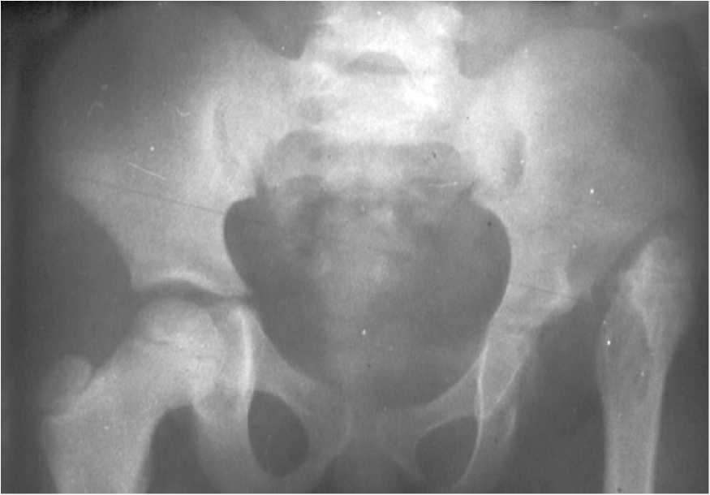

Slide 20
Significant feature
The hip joint is hypermobile as against stiff and ankylosed joints in other infective conditions.
Treatment
Drainage of joint in acute stage: In delayed cases, the major problem is the instability of the hip joint. Reconstructive stabilization procedure is carried out.
The end result is ambulatory independence with residual limp.

Slide 21
Physiotherapeutic management
Same as for infective arthritis; but, due to the involvement of the hip joint, the therapeutic procedures are directed mainly to achieve independence in ambulation, whether treated by conservative or surgical approach.

