Slide 1
PT MANAGEMENT
IN
SYNOVITIS
DR.JAY SONI
ASSISTANT PROFESSOR
COLLEGE OF PHYSIOTHERAPY

Slide 2
Objectives
At the end of lecture students
Definition
Causes
Treatment

Slide 3
SYNOVITIS
Synovitis is an inflammation of the synovial membrane
“It is a symptom common to many disorders;
it is not a diagnosis”

Slide 4
CAUSES
Trauma:
Damage to synovial membrane due to Direct blow
The extent of trauma will decide the degree of synovitis; within the knee the menisci, cruciate or collateral ligaments may be involved. If all three are involved the description 'unhappy triad’
Dislocation:
Dislocation will damage the synovial membrane, so it will nip the membrane between the bony ends.
Chondromalacia,
Loose Bodies / Arthritis
Tuberculosis
Syphilis or Hemophilia.

Slide 5
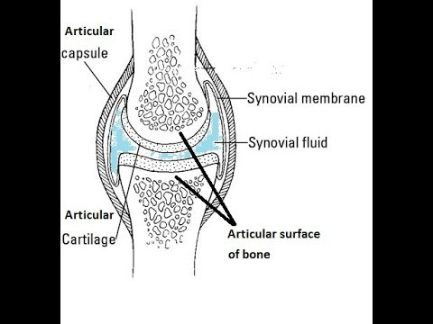

Slide 6
SIGNS AND SYMPTOMS
Swelling
Increased temperature, Redness, Pain
feeling of tension or pressure due to the swelling
If knee joint is involved, joint is swollen and immobilized it is most prone to go for wasting of Muscle specially vastus medialis & oblique.

Slide 7
If injury / Trauma is extensive & synovial membrane is ruptured, the patient typically describes getting up from a chair, going upstairs or circuit training such as Step-ups or stride jumps, and feels a sudden pain at the back of the knee which rapidly swells, spreading into the calf causing an increase in girth after several hours.
The synovial fluid is irritating and leads to an inflamed edematous leg.
Sometimes Homan's sign is positive which is actually misleading key for diagnosis for deep vein thrombosis.

Slide 8
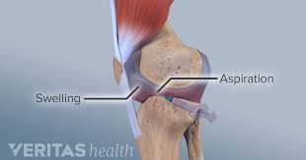
Treatment
RICE: Rest, Immobilization, Compression, Elevation
If swelling persists for 48 hours
if it interferes with mobility, then the joint may be aspirated.

Slide 9
Aspiration is the procedure of draining fluid which is accumulated inside the joint by creating negative pressure.

Slide 10
Physiotherapy Treatment after Aspiration
After aspiration isometric exercises should be encouraged
Progressive resisted exercise when the effusion has cleared.
In the initial phase Weight- bearing must be reduced to a minimum.

