Slide 1

Mechanical principles of tooth preparation
Resistance form and Structural Durability

Slide 2
Learning Objectives
Definition of Resistance form
Factors affecting resistance form
Definition of Structural Durability
Factors affecting Structural Durability

Slide 3
RESISTANCE FORM
The features of a tooth preparation that enhance the stability of restoration and resist dislodgement along an axis other than the path of placement (GPT).
It prevents dislodgement of a restoration by forces directed in an apical, oblique or horizontal direction.
The geometric configuration of tooth structure must place the cement in compression to provide the necessary resistance.
Lateral forces tend to displace the restoration by causing rotation around gingival margin
Rotation is prevented by any areas of the tooth preparation that are placed in compression and are called as RESISTANCE AREA

Slide 4
FACTORS AFFECTING RESISTANCE FORM
Magnitude and direction of dislodging forces
Leverage
Length of the preparation
Width of the preparation
Taper
Type of preparation
Rotation about vertical axis
Physical properties of luting agent

Slide 5
Magnitude and direction of dislodging forces
Normal occlusion - axially directed forces
Habits (pipe smoking and bruxing) – large oblique forces to restoration
Resistance decreases in following order:
- normal occlusion
- habits
- eccentric interferences
- anterior guidance

Slide 6
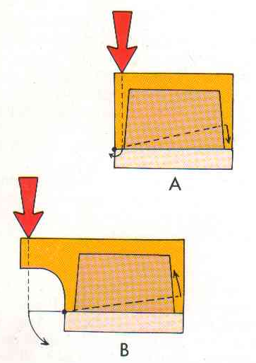
LEVERAGE AND RESISTANCE:
  Leverage occurs when the line of action of a force passes out side the supporting tooth structure.
  If the force passes within the margin of a crown no tipping of the restoration when compared to the line of action passing outside the margins of the restoration

Slide 7
Forces are outside the margin in the following cases:
- wide occlusal table of restoration
- crowns on tipped teeth
- retainers for cantilever bridge
- force at an oblique angle
Fulcrum point – the point on margin that lies closest to the line of action
Lever arm – the closest distance between line of action and fulcrum
Torque - force × lever arm
In equilibrium, this torque is balanced by the sum of all the resisting forces ( tensile, shear, compressive)
The farther these resisting forces lie from the fulcrum, greater is their mechanical advantage

Slide 8
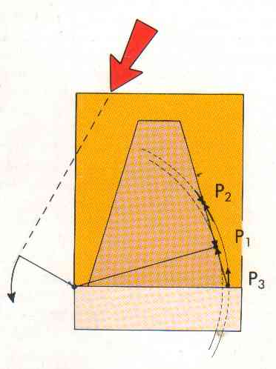
A line drawn from the center of rotation perpendicular to the cement film on the opposite wall of the preparation the point where the line intersects the cement film is known as tangent point.

Slide 9
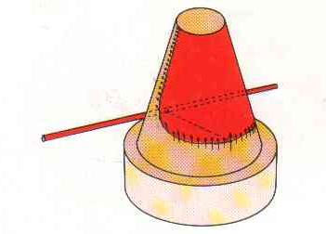
If the tangent points of all the arcs of rotation around a given axis are connected they form the tangent line. The area above the tangent line is resisting area.
To have effective resistance the tangent line should extend at least halfway down the preparation.

Slide 10
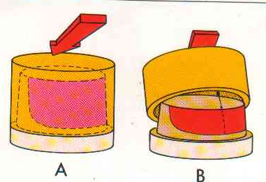
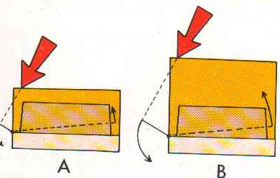
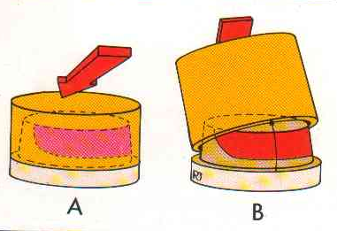
Preparation length and resistance:
Shortening of preparation will reduce the resistance area.
In short crown lifting force is small when compared to long crown.
Small restoration is less likely to fail through tipping than long restoration (on preparation of equal length).

Slide 11
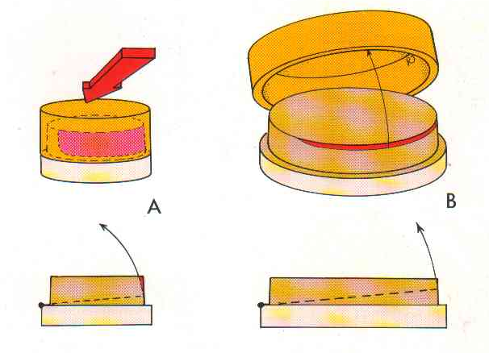
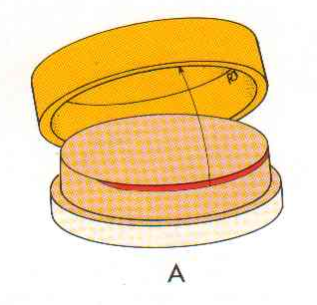
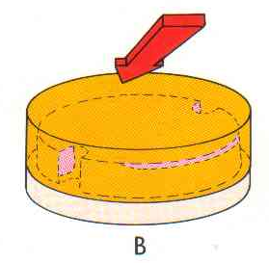
Resistance and tooth width:
  A wider preparation has a greater retention but a narrow tooth can have greater resistance to tipping.
Because of smaller diameter a tangent line falls low on the wall opposite to axis of rotation. Resulting in a large resisting area.
Weak resistance can be enhanced by placing vertical grooves/ boxes/ pinholes.

Slide 12
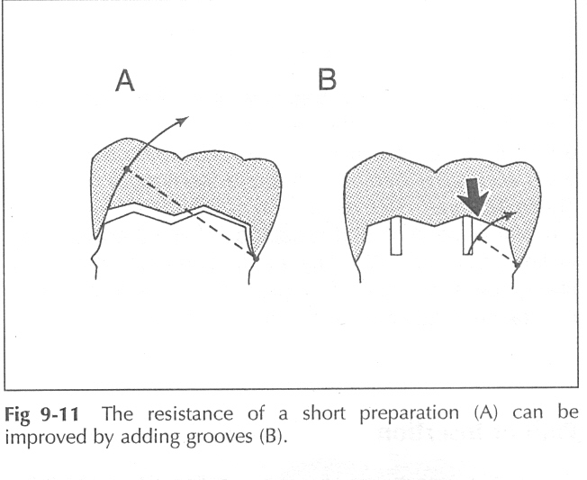
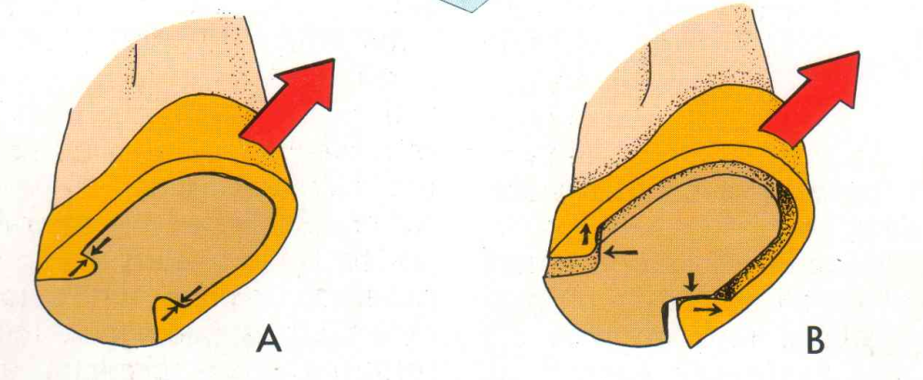
A grooved lingual wall must be distinct and perpendicular to the axial wall.
So U- shaped grooves or flared boxes provides more resistance than V-shaped ones

Slide 13
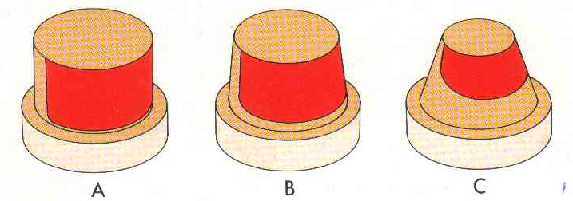
Taper and Resistance:
  More tapered a preparation less is resistance.
No taper the resisting area cover half the axial wall.
Ideal taper < ½ the axial wall.
Over tapered small resisting area near the occlusal surface.

Slide 14
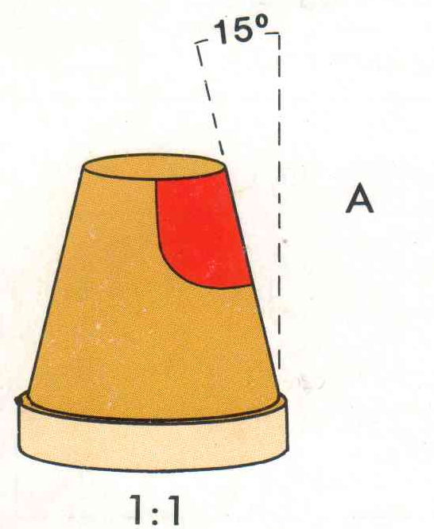
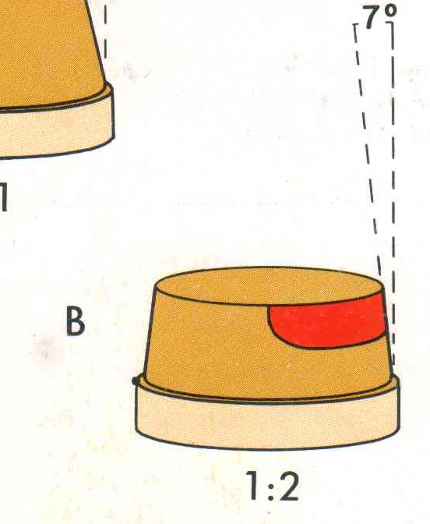
Permissible taper of a preparation is directly proportional to height : width ratio.
Taper that permit an effective resisting area for a preparation in which height equals width is double than in a preparation where height is only half width.

Slide 15
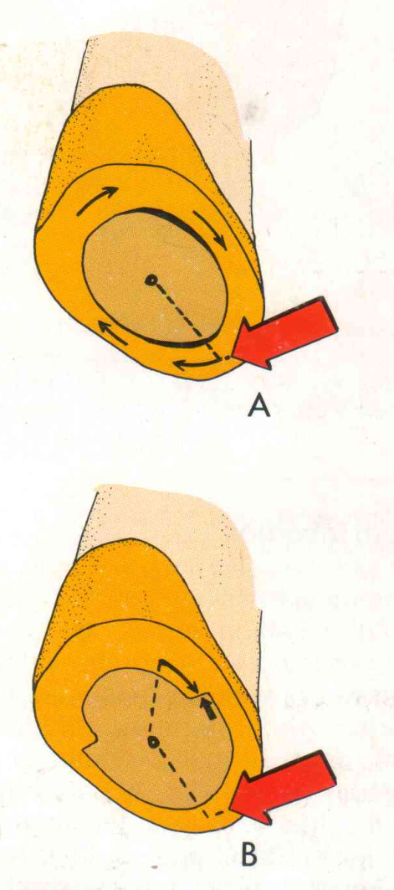

Rotation around a vertical axis:
A partial veneer crown which has no grooves offer little resistance to rotation.
Axial symmetry of a full veneer crown preparation may allow rotation of the restoration.

Slide 16
TYPE OF PREPARATION
Partial coverage restoration may have less resistance than a complete crown because it has no buccal resistance area
PHYSICAL PROPERTIES OF LUTING AGENT
Resistance to deformation is affected by physical properties of the luting agent, such as compressive strength and modulus of elasticity
Adhesive resin >GIC > ZnPO₄ > Polycarboxylate > ZOE

Slide 17
Title | JOURNAL & author | Material and method | Result | conclusion | Level of evidence
Evaluation of resistance form of different preparation features on mandibular molars | Farshad et al, Indian Journal of Dental Research, 24(2), 2013 | An acrylic tooth was prepared with 20° total occlusal convergence (TOC) angle, 2.5 mm of occlusocervical dimension and a shoulder finishing line. This design lacked resistance form. The crown preparation was subsequently modified by preparing Mesial Occlusal Distal isthmus, placing occlusal inclined plane, and reducing TOC. Four metal dies from these designs were constructed by lathe machine and then 10 metal copings were fabricated for each preparation. Metal coping were cemented on metal dies with temp‑bond cement. Force was applied at 45° from lingual to buccal direction with universal testing machine. Statistical analysis used: The data were evaluated by Kruskal‑Wallis and non‑parametric Mann‑Whitney test. | All features increased resistance form when compare to control group. However, reduce TOC group showed greatest value of resistance. | Within the limitation of this study, reducing the tapering of occlusocervival dimension is the most effective way in increasing resistance form, although, other features were also effective. | 5

Slide 18
STRUCTURAL DURABILITY
A restoration must have sufficient strength to prevent permanent deformation during function
DEFINITION- “The ability of a restoration to withstand destruction due to external forces is known as structural durability”.

Slide 19
Factors affecting structural durability
Adequate tooth reduction.
- occlusal reduction
- functional cusp bevel
- axial reduction
2. Alloy selection.
Metal-ceramic framework design.
Margin design

Slide 20
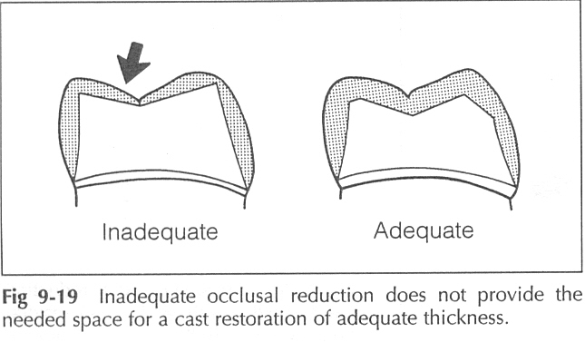
ADEQUATE TOOTH REDUCTION
OCCLUSAL REDUCTION:-
An important feature for providing adequate bulk of metal & strength to the restoration is occlusal clearance.
Occlusal thickness varies with different restorative materials
Gold alloys – 1.5mm (FC) & 1mm(NFC)
Metal-ceramic crowns- 1.5-2mm(FC)&1-1.5mm(NFC)
All-ceramic crowns – 2mm of clearance on preparation

Slide 21
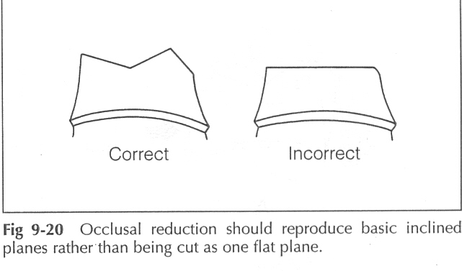
- Firstly, opposing occlusal equilibration is to be achieved eg. Plunger cusps to be rounded.
Round line and point angles, avoid deep grooves in the center of the occlusal surfaces to prevent stress concentration and to distribute the forces over a larger surface area.
Uniform and planar occlusal reduction.

Slide 22
This ensures:
-sufficient occlusal clearance
- preservation of tooth structure
- gives rigidity to crown because of
CORRUGATED EFFECT OF PLANE
OCCLUSAL OFFSET can be given on posterior partial veneer crown preparation to provide space for a TRUSS of metal to form reinforcing strap
INCISAL OFFSET can be given on anterior partial veneer crown preparation to provide space for metal that helps to strengthen the lingual-incisal margin

Slide 23
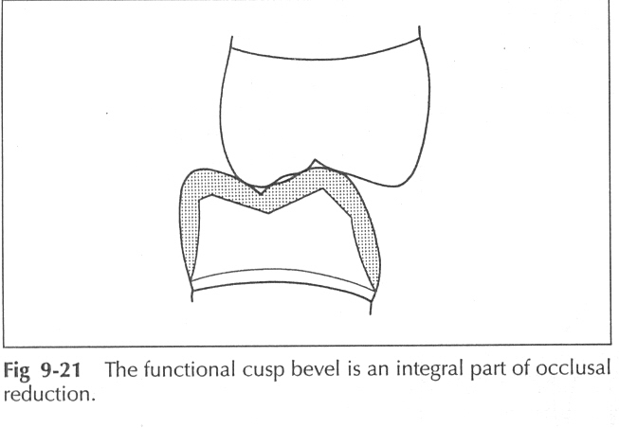
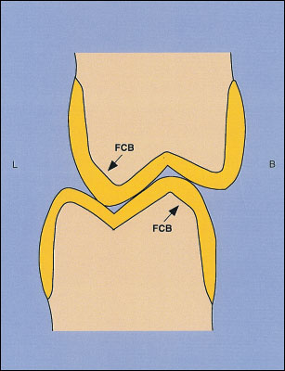
FUNCTIONAL CUSP BEVEL:-
It is an integral part of the occlusal reduction.
A wide bevel on the lingual inclines of the maxillary lingual cusps & the buccal inclines of the mandibular buccal cusps provides space for an adequate bulk of metal in an area of heavy occlusal contact.

Slide 24
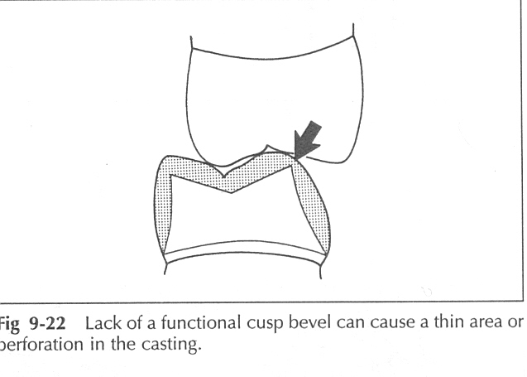
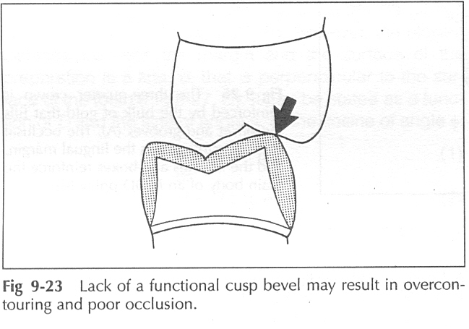
If a wide bevel is not placed on the functional cusp, several problems may occur :
- If the crown is waxed & cast to normal contour it can cause a thin area or perforation in the casting.
- To prevent this the crown may be waxed to optimal thickness resulting in overcontouring & poor occlusion.

Slide 25
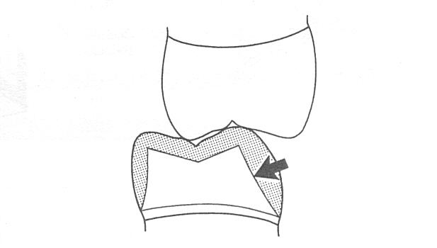
- If an attempt is made to obtain space for an adequate bulk in a normally contoured casting without a bevel, it will result in over inclination of the buccal surface which will destroy excessive tooth structure while lessening retention.

Slide 26
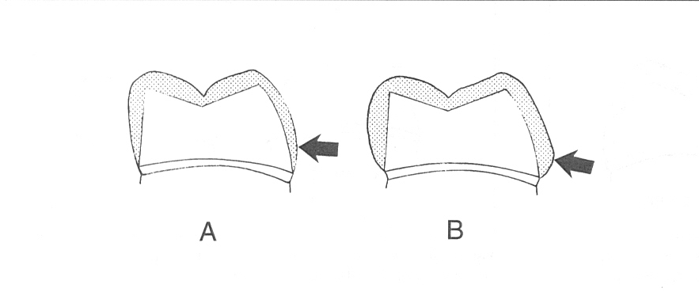
AXIAL REDUCTION:-
It plays an important role in securing space for an adequate thickness of restorative material.
Inadequate axial reduction can cause thin walls & a weak restoration subjected to distortion or a bulbous, overcontoured restoration which will strengthen the restoration but may have a disastrous effect on periodontium.

Slide 27
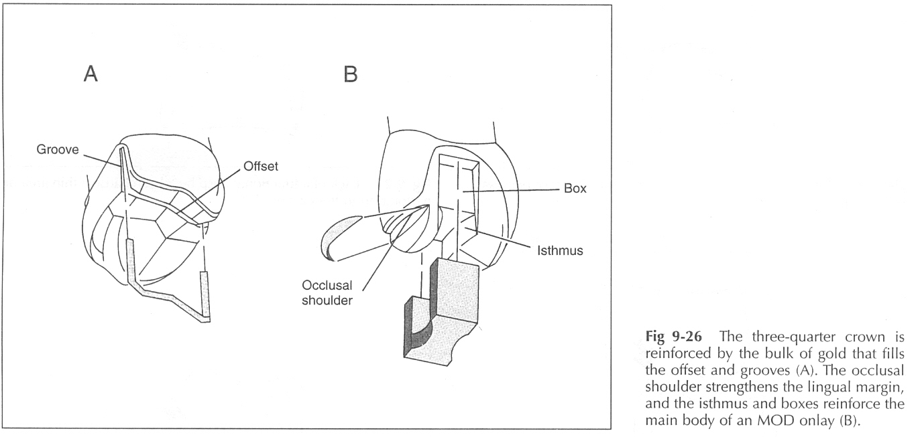
Other features that provide space for metal and improve the rigidity & durability of the restoration are:
The offset, the occlusal shoulder, the isthmus,
the proximal groove & the box.

Slide 28
Selection of the alloy:
-It is essential that there be sufficient clinical evidence of superiority, before selecting a particular material.
-Type I and II gold alloys…

Slide 29
Factors considered when selecting an alloy:
Intended use:
Traditionally alloys for casting were classified on the basis of their intended use-
-Type I: Simple inlays
-Type II: Complex inlays
-Type III: Crowns and fixed partial dentures
-Type IV: Removable partial dentures and pin ledges.
Porcelain: metal-ceramic alloys.
2. Physical properties: FDI (1965) classified casting alloys according to their physical properties as:
Type I: Soft
Type II: Medium
Type III: Hard
Type IV: Extra-hard

Slide 30
3. Color: The patients view on the subject should be sought if the metal will be visible in the mouth; otherwise the color is irrelevant.
4. Composition: The percentage composition by weight of the main ingredients must be mentioned.
5. Cost.
6. Clinical performance:
A) Biologic properties
-Gingival irritation
-Recurrent caries.
-Plaque accumulation.
-Allergies.
B) Mechanical properties:
-Wear resistance and strength.
-Marginal fit.
-Ceramic bond failure.
-Connector failure.
-Tarnish and corrosion.

Slide 31
7. Laboratory performance:
Factors like casting accuracy, surface roughness, strength, metal-ceramic bond strength should be considered.

Slide 32

Choice of material:
Gold:
Indications-
1.In situations of severe occlusal stress.
2.Following endodontic treatment of posterior teeth.
3.Full or partial coverage of posterior teeth where there has been significant loss of coronal dentin.
4.For restoration of adjacent or opposing teeth to avoid problems arising from use of dissimilar metals.
Contraindications:
-Aesthetics
--Cost

Slide 33

Porcelain (Ceramic):
Indications:
- Large inadequate restorations on the
anterior teeth provided there is enough
tooth substance.
- Severely discolored teeth.
- Over an existing post and core
substructure.
Contraindications:
-Teeth with short clinical crown
-Edge to edge occlusion
-Teeth which do not allow ideal preparation
form to support the porcelain.

Slide 34
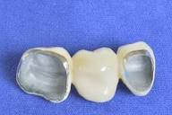
Metal ceramic:
Indications:
- Esthetics
- Failure of porcelain jacket crowns.
Posterior teeth where esthetics is necessary and partial
coverage gold crowns are contraindicated
Contraindications:
-Young patients at risk of pulp being exposed
-large pulp chamber
-Traumatic occlusion (heavy occlusal forces) , where wear of opposing occlusal surfaces is expected.

Slide 35
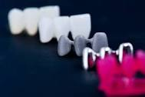
Metal ceramic framework:
-A metal occlusal contact requires 1-1.5mm of reduction
-A porcelain contact requires 2mm of reduction
-Occlusal contacts need to be 1.5-2.0mm from the porcelain-
metal junction
-The substructure must support an even thickness of the
porcelain veneer (1mm minimum and 2mm maximum).
-The minimum thickness of the metal is 0.2-0.3mm.
-Cut-back: porcelain-metal junction should be 90° or greater.
-Metal should preferably be in the area of the centric stop to
enhance the durability of the restoration.

Slide 36
MARGIN DESIGN
Distortion of restoration margin is prevented by designing the preparation outline to avoid occlusal contact in this area
Tooth reduction should provide sufficient room for bulk of metal at the margin to prevent distortion

Slide 37


