Slide 1
Physiotherapy Assessment & Management
Chondromalacia Patellae
Osgood-Schlatter’s Disease
Causalgia
Megha Jayswal
AP,
COP,SVDU

Slide 2
Objectives
In this session, students will learn:
What is CMP, OSD and Causalgia?
What are their signs and symptoms?
Common impairments and activity limitations caused by them
Points to be assessed
Physiotherapy management

Slide 3
Chondromalacia Patellae

Slide 4
With chondromalacia there is softening and fissuring of the cartilaginous surface of the patella, which is diagnosed with arthroscopy or arthrography.
The cause may be direct trauma, overuse, faulty patellar tracking from malalignment due to anatomical variations or soft tissue length and strength imbalances, degeneration, or a combination of these factors

Slide 5
Osgood-Schlatter’s Disease

Slide 6
It is described as a painful traction apophysitis of the tibial tuberosity primarily caused by repetitive strain of the quadriceps tendon.
Most often symptoms occur during a time of growth spurt in adolescents, when body physique is changing rapidly.
The primary cause seems to be continuous stress from the patellar tendon at its point of insertion at the tibial tubercle, resulting in a traction apophysitis.
Other risk factors include preexisting anatomical conditions such as sex, age, body height, body size, previous injuries, a faulty patellofemoral alignment, and repetitive strain on the quadriceps femoris muscle with concomitant tightness of the hamstring

Slide 7
Examination:
Complain of anterior knee pain that increases with frequent physical activity.
Pain increases with repetitive strain on the tibial tubercle during jumping and running with increased load on the knee during flexion.
The affected knee may present with mild swelling, tenderness of the tibial tubercle and possible thickening of the patellar tendon.
Muscle imbalance.

Slide 8
Common Impairments: CMP &OSD

Slide 9
Weakness, inhibition, or poor recruitment or timing of firing of the VMO
Overstretched medial retinaculum
Restricted lateral retinaculum, IT band, or fascial structures around the patella
Decreased medial gliding or medial tipping of the patella
Pronated foot
Pain in the retropatellar region

Slide 10
Tight gastrocnemius soleus, hamstring, or rectus femoris muscles
Irritated patellar tendon or subpatellar fat pads
Patellar crepitus, swelling, or locking
Weakness in the hip abductor or external rotator musculature

Slide 11
Functional Limitations/Disabilities

Slide 12
Pain or poor knee control when descending or ascending stairs
Pain with walking, jumping, or running interfering during ADL, instrumental ADL (IADL), work, and community, recreational, or sport activities
Pain and stiffness with prolonged flexed knee postures, such as sitting or squatting

Slide 13
Patellofemoral Symptoms: Management

Slide 14
Educate the Patient
Minimize or avoid stair climbing and descending until the hip and knee muscles are strengthened
Do not sit with the knees flexed excessively for prolonged periods. During sitting, periodically perform ROM to the knee to relieve stasis.

Slide 15
Increase Flexibility of Restricting Tissues
Stretching program for the gastrocnemius, soleus, quadriceps, and hamstring muscles and IT band.
Self stretching should be taught.

Slide 16
Patellar Mobilization:
Provide Medial glide to patella

Slide 17
Improve Muscle Performance for Functional Control
It is imperative that the therapist design an exercise program that addresses the specific impairments of each patient, considering factors such as trunk, hip, and foot strength and alignment.

Slide 18
Non-Weight-Bearing (Open-Chain) Exercises
Vastus medialis obliquus emphasis
Quadriceps setting (quad sets) in pain-free positions
Quad sets with straight-leg raising
Short-arc terminal extension.

Slide 19
Weight-Bearing (Closed-Chain) Exercises
If weight bearing is painful, begin with partial weight bearing exercises. Progress to standing exercises as tolerated.
To improve strength and muscular endurance, the patient should perform the repetitions of the appropriate exercise until symptoms or loss of control just begins. It is important to not push beyond that point in order to avoid faulty mechanics or loss of control.
Mini-squats, which may be useful for improving patellar tracking, are introduced early in the exercise program when weight bearing and partial squatting are tolerated and do not provoke symptoms.

Slide 20
Modify Biomechanical Stresses
If the patient has foot pronation, a foot orthosis may relieve the stresses at the knee. Assess lower extremity mechanics, and modify any faulty patterns.

Slide 21
Causalgia

Slide 22
“A syndrome of sustained, burning pain after a traumatic nerve injury, combined with vasomotor and sudomotor and later trophic changes” and reflex sympathetic dystrophy as “similar, but from other causes.” (by International Association for the Study of Pain)

Slide 23
Examination:
Pain or hyperesthesia at the shoulder, wrist, or hand out of proportion to the injury.
Limitation of motion develops.
Typically, the shoulder develops limitation in a capsular pattern with most restriction in lateral rotation and abduction.
In the wrist and hand, the most common restrictions are limited wrist extension and metacarpophalangeal and proximal interphalangeal flexion.

Slide 24
Edema of the hand and wrist secondary to circulatory impairment of the venous and lymphatic systems, which in turn precipitates stiffness in the hand.
Vasomotor instability.
Trophic changes in the skin.
As the condition progresses, the pain subsides but limitation of motion persists. The skin becomes cyanotic and shiny, the intrinsic muscles of the hand atrophy, subcutaneous tissue in the fingers and palmar fascia thicken, nail changes occur, and osteoporosis develops.

Slide 25
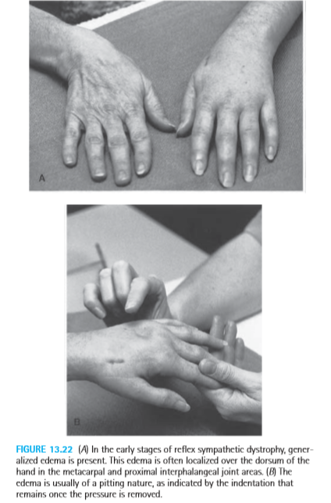

Slide 26
Causalgia: Management

Slide 27
Pain and edema control.
Use modalities such as ultrasound, vibration, transcutaneous electrical nerve stimulation (TENS), or ice.
Utilize retrograde massage.
Elevate and use elastic compression when not undergoing pneumatic compression treatment.

Slide 28
Mobility
In the early stages, use gentle, active exercises to manage the increasing stiffness.
Have the patient actively contract the musculature while the part is held near the end of the pain-free range.
In the hand, include tendon glide exercises

Slide 29
Muscle performance
Facilitate active muscle contractions.
Include joints proximal to the symptoms (shoulder/hip); they often develop restrictions due to pain or lack of use.
Use both dynamic and isometric exercise and alternating controlled stress loading (compressive loading) with distraction activities
Stress load the upper extremity in the quadruped position, beginning at 3 minutes and incrementally increasing to 10 minutes three times a day.
For the lower extremity, utilize progressive weight-bearing activities.
Distraction by carrying 1 to 5 pounds up to 10 minutes at a time frequently throughout the day

Slide 30
Total body circulation and cardiac output
Initiate a program of low-impact aerobic exercises.
Desensitization
Utilize desensitization techniques for brief periods five times per day, such as having the patient work with various textures and tap or vibrate over the sensitive area. The patient is instructed to wear a protective glove during activities of daily living

