Slide 1
Physiotherapy Assessment & Management:
Planter Fascitis and Gout
- Megha Jayswal
AP,
COP, SVDU

Slide 2
Objectives
In this session, the students will learn,
What is planter fascitis and gout?
Signs and symptoms of the same
Common impairments and activity limitation
Points to be assessed
Physiotherapy management based on the duration of the disease

Slide 3
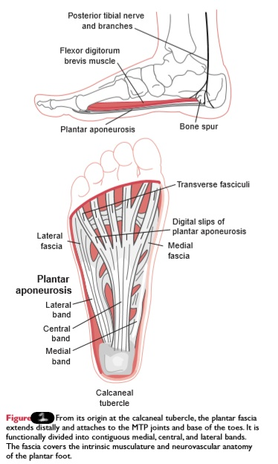
Planter Fascia
The plantar fascia is a dense, ﬁbrous connective tissue structure originating from the medial tuberosity of the calcaneus (Fig. 1).
The fascia extends through the medial longitudinal arch into medial, central and lateral bands and inserts into each proximal phalanx.
The plantar fascia is an important static support for the longitudinal arch of the foot.

Slide 4
Strain on the longitudinal arch exerts its maximal pull on the plantar fascia, especially its origin on the medial process of the calcaneal tuberosity.
The plantar fascia elongates with increased loads to act as a shock absorber, but its ability to elongate is limited (especially with decreasing elasticity common with age).
Passive extension of the MTP joints pulls the plantar fascia distally and also increases the height of the arch of the foot.

Slide 5
Myth of the Heel Spur:
The bony spur at the bottom of the heel does not cause the pain of plantar fasciitis.
Rather, this is caused by the inﬂammation and micro tears of the plantar fascia.
Heel spurs have been found in approximately 50% of patients with plantar fasciitis.
However, spur formation is related to progression of age. Anatomic studies have shown the spur is located at the short ﬂexor origin rather than at the plantar fascia origin.

Slide 6
Aetiology
Direct repetitive micro trauma with heel strike to planter fascia has been implicated, especially in middle-aged, overweight, nonathletic individuals who stand on hard, unyielding surfaces and in long-distance runners.

Slide 7
Planter fascitis
commonly found in
Sports that involve running and long-distance, walking and is also frequent in dancers, tennis players, basketball players
Non athletes whose occupations require prolonged weight bearing

Slide 8
Risk factors for plantar fasciitis
Overuse secondary to work-related prolonged weight bearing,
Unaccustomed running or walking,
Inappropriate shoe wear
Excessive pronation of the subtalar joint,
Hypo mobile gastrocnemius–soleus muscles, i.e., limited dorsiflexion
Excessively high arch (cavus foot)

Slide 9
Natural History
It is estimated that 90% to 95% of patients who have true plantar fasciitis recover with conservative treatment.
However, it may take 6 months to 1 year, and patients often require much encouragement to continue stretching, wearing appropriate and supportive shoes, and avoiding high-impact activities or prolonged standing on hard surfaces.
Operative treatment can be helpful in selected “failed” patients, but the success rate of surgery is only 50% to 85%.

Slide 10
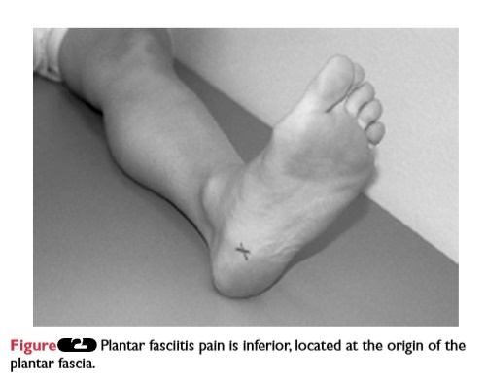
Signs and Symptoms
The classic presentation of plantar fasciitis includes a gradual, insidious onset of infero medial heel pain at the insertion of the plantar fascia (Fig. 2).

Slide 11
Pain and stiffness are worse with rising in the morning or after prolonged ambulation and may be exacerbated by climbing stairs or doing toe raises.
The diagnosis of plantar fasciitis is made with a reasonable level of certainty on the basis of clinical assessment alone.

Slide 12
History from the patient typically reports the following complaints:
Pain in the plantar heel region worse in a.m. with the ﬁrst few steps after waking or after a period of inactivity.
Insidious onset of pain in the plantar surface of the heel upon weight bearing after a period of non-weight bearing.
Some patients have an antalgic gait/limp.

Slide 13
Inferior heel pain will lessen with increasing levels of activity (e.g., walking) but worsens at the end of the day.
The history often indicates a recent increase in activity antecedent to onset of the presentation of plantar fasciitis.

Slide 14
Common Impairments and Functional Limitations/ Disabilities
Pain with repetitive activity, on palpation of the involved site, when the involved musculotendinous unit is stretched, and with resistance to the involved muscle
Pain with weight-bearing activities and gait
Muscle length–strength imbalances, especially tight gastrocnemius–soleus muscle group
Abnormal foot posture (may be from faulty footwear)
Functional limitations resulting from the impairments include decreased length of time the individual can stand, decreased distance or speed of ambulation, and restriction of sport or recreational activities

Slide 15
Physiotherapy Management

Slide 16
Planter Fascitis: Management - Protection Phase

Slide 17
While tissues are inflamed, foot symptoms should be treated as an acute condition, with rest and appropriate modalities.
Immobilization in a cast or splint with the foot slightly plantarflexed or a heel lift inside the shoe may be used to relieve stress.
Apply cross-friction massage to the site of the lesion.

Slide 18
Initiate gentle muscle-setting contractions to the involved muscle in pain-free positions.
Teach active ROM within the pain-free ranges.
Instruct the patient to avoid the activity that provokes the pain.
Use supportive taping to provide relief of symptoms.

Slide 19
FLEXIBILITY EXERCISES FOR THE ANKLE REGION

Slide 20
Increase Dorsiflexion of the Ankle
The muscles that restrict dorsiflexion of the ankle are the one-joint soleus and the two-joint gastrocnemius.
To effectively stretch the gastrocnemius, the knee must be extended while dorsiflexing the ankle.
To isolate stretch to the soleus, the knee must be flexed during dorsiflexion to take tension off the gastrocnemius.

Slide 21
Patient position and procedure: Long-sitting or with the knee partially flexed and with a towel or belt under the forefoot. Have the patient pull the foot into dorsiflexion.
Patient position and procedure: Sitting with the foot flat on the floor. Have the patient slide the foot backward, keeping the heel on the floor.
Patient position and procedure: Standing. Have the patient stride forward with one foot, keeping the heel of the back foot flat on the floor (the back foot is the one being stretched). To stretch the gastrocnemius muscle, the knee of the back leg is kept extended; to stretch the soleus, the knee of the back leg is flexed.

Slide 22
Patient position and procedure: Standing on an inclined board with feet pointing upward and heels downward. Greater stretch occurs if the patient leans forward. Little effort is required to maintain this position for extended periods.
Patient position and procedure: Standing, with the forefoot on the edge of a step or stool and heel over the edge. Have the patient slowly lower the heel over the edge (heel drop).

Slide 23
Stretching the Plantar Fascia of the Foot
Patient position and procedure: Sitting with the foot placed across the opposite knee. Teach the patient to use his or her thumbs to apply deep massage horizontally and longitudinally across the plantar surface of the foot.
Patient position and procedure: Sitting with a ball or small roller (or bottle) under the foot. Have the patient roll the foot forward and backward across the curved surface, using as much pressure as is comfortable. Pressing down on the knee with one or both hands can exert additional force.

Slide 24
EXERCISES TO DEVELOP AND IMPROVE MUSCLE PERFORMANCE AND FUNCTIONAL CONTROL

Slide 25
Activities to Develop Dynamic Neuromuscular Control
Patient position and procedure: Long-sitting or with the knees partially flexed. Have the patient practice contracting each of the major muscles while concentrating on his or her actions, for example, dorsiflexion with inversion (anterior tibialis), plantarflexion with inversion (posterior tibialis), and eversion (peroneus muscles).
Patient position and procedure: Long-sitting or with the knee partially flexed. Instruct the patient to “draw” the alphabet in space leading with the toes but moving at the ankle. For variety have the patient “print” using capital letters, then with lower case letters, or “write” words such as his or her name or address.

Slide 26
Patient position and procedure: Sitting on a chair or low mat table with feet on the floor. Place a number of small objects, such as marbles or dice, to one side of the involved foot. Have the patient pick up one object at a time by curling the toes around it and then placing it in a container on the other side of the foot. This emphasizes the plantar muscles as well as inversion and eversion.
Patient position and procedure: Sitting with feet on the floor or standing. Have the patient curl the toes against the resistance of the floor. Place a towel or tissue paper under the feet, and have the patient attempt to wrinkle it up by keeping the heel on the floor and flexing the toes.

Slide 27
Patient position and procedure: Sitting, with the feet on the floor. Have the patient attempt to raise the medial longitudinal arch while keeping the forefoot and hindfoot on the floor. External rotation of the tibia should occur but not abduction of the hips. The activity is repeated until the patient has consistent control, then it is performed while standing as a progression.
Patient position and procedure: Sitting with a tennis ball placed between the soles of the feet. Instruct the patient to roll the tennis ball back and forth from heel to forefoot.

Slide 28
Patient position and procedure: Sitting with both feet and just the involved foot on a rocker or balance board. Have patient perform controlled ankle and foot motions (with or without the assistance of the normal foot) into dorsiflexion and plantarflexion and inversion and eversion. If the equipment permits, the patient also can perform circumduction in each direction. Progress this activity to the standing position to further develop control and to develop balance.

Slide 29
Patient position and procedure: Standing. Have the patient practice walking while concentrating on placement of the feet and shifting body weight with each step. The patient begins by accepting body weight on the heel, then shifting the weight along the lateral border of the foot to the fifth metatarsal head and across to the first metatarsal head and great toe for push-off.

Slide 30
Open-Chain Strengthening Exercises
All of the following exercises in this section are performed without bearing weight through the foot and ankle.
Plantarflexion
Patient position and procedure: Long-sitting with the leg resting on a rolled towel to slightly elevate the heel off the treatment table. Have the patient hold onto the ends of elasticized material that is looped under the forefoot and then plantarflex the foot against the resistance.

Slide 31
Isometric Eversion and Inversion
Patient position and procedure: Long-sitting or sitting in a chair with knees flexed.
To resist eversion, the ankles are crossed; instruct the patient to press the lateral borders of both feet together against each other.
To resist inversion, the medial borders of the feet are placed beside each other; instruct the patient to press the medial borders of the feet against each other.
Eversion and Inversion with Elastic Resistance
Patient position and procedure: Long-sitting, supine, or sitting with the feet resting on the floor.

Slide 32
To resist eversion, place a loop of elastic tubing around both feet and have the patient evert one or both feet against the resistance. Instruct the patient to keep the knees still and just turn the foot outward, not allowing the thigh and leg to abduct or externally rotate.
To resist inversion, tie the elastic band or tubing to a structure on the lateral side of the foot. Again, have the patient keep the legs stationary and only turn the foot inward without allowing the hip to adduct and internally rotate.

Slide 33
Adduction with Inversion and Abduction with Eversion Using Weights
Patient position and procedure: Sitting with the foot on the floor. Place a towel under the forefoot and a weight on the end of the towel. Have the patient pull the weighted towel along the floor with the forefoot by keeping the heel fixed on the floor and swinging the foot either inward or outward.
Dorsiflexion
Patient position and procedure: Long-sitting or supine with a rolled towel under the distal leg to elevate the heel slightly. Tie an elastic band or tubing to the foot end of the bed (or other object), and place a loop over the dorsum of the foot. Have the patient dorsiflex against the resistance.

Slide 34
All Ankle Motions
Position of patient: Sitting in a chair or standing with one or both feet in a box filled with sand, foam, dry peas, dry beans, or other similar type material to offer resistance to various foot motions. Have the patient plantarflex, dorsiflex, invert and evert the foot and ankle, and curl the toes either with the foot on top or with the foot dug into the medium.

Slide 35
WEIGHT-BEARING EXERCISES FOR STRENGTH, BALANCE, AND FUNCTION

Slide 36
For these exercises, the patient position is standing. If the patient does not initially tolerate full weight bearing without reproduction of symptoms, begin by standing in the parallel bars or in a pool to reduce weight-bearing forces.

Slide 37
Stabilization Exercises
Apply resistance to the patient’s pelvis in various directions while she or he attempts to maintain control. At first, use verbal cues, then resist without warning, Also increase the speed and intensity of the perturbation forces.
Have the patient hold onto a wooden dowel rod or cane with both hands. Apply the resistance through the rod in various directions and with varying intensities and speeds as the patient attempts to remain stable.
Progress to standing only on the involved foot.

Slide 38
Dynamic Strength Training
Have the patient perform bilateral toe raises, heel raises, and rocking outward to the lateral borders of the feet.
Progress to unilateral toe raises, heel raises, and lateral border standing. When tolerated, resistance is added with a weight belt or handheld weights.

Slide 39
Resisted Walking
Have the patient walk on heels and on toes against resistance.
Apply resistance against the patient’s pelvis, or have the patient walk against a pulley weight or elastic resistance fixed around the pelvis.

Slide 40
Balance Activities
Have the patient rock the feet forward and backward, then side-to-side while attempting to control the motion and maintain balance.
Instruct the patient to maintain balance and not let the edges of the board hit the ground. As the patient learns to control the board, impose various challenges while he or she maintains balance on the board.
Examples:
  Have the patient move the arms forward, backward, and overhead.
  Perform various arm motions against elastic resistance, with free weights
  Toss a ball (unweighted or weighted) back and forth to the patient.
  Have the patient hold onto elastic resistance while you pull the resistance in various directions.

Slide 41
Gout
Gout is a disorder of purine metabolism characterized by hyperuricaemia, deposition of monosodium urate monohydrate crystals in joints and peri-articular tissues and recurrent attacks of acute synovitis.
Late changes include cartilage degeneration, renal dysfunction and uric acid urolithiasis.

Slide 42
Risk factors
Older age
Male gender
Genetic enzyme defects, hyperpara-thyroidism
Haemolytic disorders
Myeloproliferative disorders
Obesity
Diabetes
Hypertension
High consumption of red meat
Hyper-lipidaemia
Chronic inﬂammatory diseases
Long-term use of aspirin or diuretics
Alcohol abuse

Slide 43
Pathology
Urate crystals are deposited in minute clumps in connective tissue, including articular cartilage; the commonest sites are the small joints of the hands and feet.
For months, perhaps years, they remain inert.
Then, possibly as a result of local trauma, the needle like crystals are dispersed into the joint and the surrounding tissues where they excite an acute inﬂammatory reaction.
Individual crystals may be phagocytosed by synovial cells and polymorphs or may ﬂoat free in the synovial ﬂuid.

Slide 44
With the passage of time, urate deposits may build up in joints, peri-articular tissues, tendons and bursae; common sites are around the metatarsophalangeal joints of the big toes, the Achilles tendons, the olecranon bursae and the pinnae of the ears.
These clumps of chalky material, or tophi (L. tophus = porous stone), vary in size from less than 1 mm to several centimetres in diameter.
They may ulcerate through the skin or destroy cartilage and peri-articular bone.

Slide 45
Classification
Gout is often classiﬁed into ‘primary’ and ‘secondary’ forms.
Primary gout (95 percent) occurs in the absence of any obvious cause.
It may be due to constitutional under-excretion (the vast majority) or overproduction of urate.

Slide 46
Secondary gout (5 per cent) results from prolonged hyperuricaemia due to acquired disorders such as,
myeloproliferative diseases,
administration of diuretics or renal failure.
This division is somewhat artiﬁcial; people with an initial tendency to ‘primary’ hyperuricaemia may develop gout only when secondary factors are introduced – for example
obesity,
alcohol abuse, or
treatment with diuretics or salicylates which increase tubular reabsorption of uric acid.

Slide 47
Patients are usually men over the age of 30 years; women are seldom affected until after the menopause. Often there is a family history of gout.
The Acute Attack
The sudden onset of severe joint pain which lasts for a week or two before resolving completely is typical of acute gout.
The attack usually comes out of the blue but may be precipitated by minor local trauma, operation, intercurrent illness, unaccustomed exercise or alcohol consumption.

Slide 48
The commonest sites are the metatarsophalangeal joint of the big toe, the ankle and ﬁnger joints, and the olecranon bursa (Figure 3).
Occasionally, more than one site is involved. The skin looks red and shiny and there is considerable swelling.
The joint feels hot and extremely tender, suggesting a cellulitis or septic arthritis.
Sometimes the only feature is acute pain and tenderness in the heel or the sole.

Slide 49
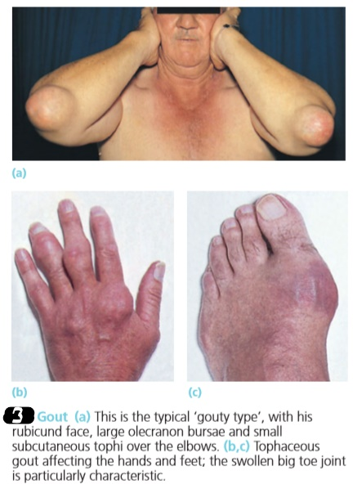

Slide 50
Hyperuricaemia is present at some stage, though not necessarily during an acute attack.
However, while a low serum uric acid makes gout unlikely, hyperuricaemia is not ‘diagnostic’ and is often seen in normal middle-aged men.

Slide 51
Chronic Gout
Recurrent acute attacks may eventually merge into polyarticular gout.
Joint erosion causes chronic pain, stiffness and deformity; if the ﬁnger joints are affected, this may be mistaken for rheumatoid arthritis.
Tophi may appear around joints over the olecranon, in the pinna of the ear and – less frequently – in almost any other tissue.

Slide 52
A large tophus can ulcerate through the skin and discharge its chalky material.
Renal lesions include calculi, due to uric acid precipitation in the urine, and parenchymal disease due to deposition of monosodium urate from the blood.

Slide 53
Physiotherapy Management

Slide 54
Gout: Management - Acute Episode

Slide 55
During acute episode, physiotherapy aims at controlling pain and inflammation.
The patient is advised for complete rest
Ice packs are applied over the inflamed and painful joints for 15-20 minutes
Patient is asked to avoid alcohol intake
Use of assistive devices is advisable

Slide 56
Gout: Management - Inter critical Phase

Slide 57
During the inter critical stages, physiotherapy aims at:
maintenance of Rage of Motion (rom)
maintenance of strength of muscles
maintenance of function
activity modification training
activity pacing
use of assistive technology
accommodations in the environment
weight control

Slide 58
Thank You

