Slide 1

VERTICAL JAW RELATION
Dr Tamanna Chhabra
Prof., Dept. of Prosthodontics,
K M Shah Dental College and Hospital

Slide 2
Learning Objectives
Definition of Vertical Jaw Relation
Importance of Vertical Jaw Relation
Methods of recording Vertical Jaw Relation
Effects of Increased and Decreased Vertical Jaw relation

Slide 3
JAW RELATION
Any spatial relationship of the maxilla to the mandible or any one of the infinite relationships of the mandible to the maxilla.

Slide 4
Jaw Relation
Orientation Jaw relation
Vertical Jaw relation
Horizontal Jaw relation

Slide 5
Vertical Jaw Relation / Vertical Dimension
Vertical dimension refers to the length of the face.
It is maintained either by the occlusion of the teeth or the balanced tonic contraction of the opening and closing muscles of mandibular movements.

Slide 6
Vertical Jaw Relation / Vertical Dimension
Definition : The distance between two selected anatomic or marked points (usually on the tip of the nose and the other upon the chin), one on a fixed and one on a movable member (GPT-8).
It is recorded after doing the facebow transfer.

Slide 7
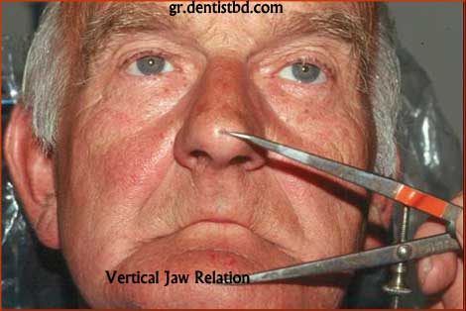

Slide 8
Significance
Provides optimal separation between maxilla and mandible.
If not measured accurately, the joint will be strained.
If the VD is altered, severe discomfort to both TMJ and muscles of mastication.

Slide 9
Factors affecting VD
Tooth : Acts as a vertical stop.
Musculature : Opening and closing muscles tend to be in a state of minimal tonic contraction.

Slide 10
3 components
Physiologic rest position / rest vertical dimension (RVD)
Occlusal vertical dimension (OVD)
Inter occlusal space / free way space

Slide 11
Physiologic rest position
Postural position of the mandible when an individual is resting comfortably in an upright position and the associated muscles are in a state of minimal contractural activity (GPT)..
Occlusal vertical dimension
The distance measured between two points when the occluding members are in contact (GPT).
Inter occlusal space
The distance between the vertical dimension of rest & the vertical dimension while in occlusion.

Slide 12
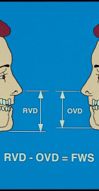
RELATION BETWEEN THE COMPONENTS
RVD – rest vertical dimension
OVD – occlusal vertical dimension
FWS – free way space

Slide 13
Vdr = vdo + iod
Vdr – iod = vdo

Slide 14
During the construction of complete dentures, the rest vertical dimension is determined first and then reduced or closed to the occlusal vertical dimension.
Some prosthodontists believe that the physiologic rest position tends to remain constant for variable periods of time.
Average inter occlusal distance = 2 to 4 mm

Slide 15
EFFECTS OF ALTERED vd
INCREASE IN VDO / DECREASE IN IOD
  The chin-nose distance will increase, and then patients will have an appearance of open mouth.
  Constant pressure to the basal seat area which will lead to bone resorption.
  Soreness of the tissues of the basal seat.
  “Clicking”, of dentures during speech.
  Improper phonetics

Slide 16
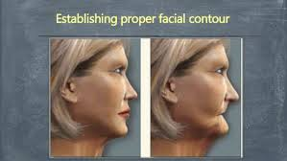

Slide 17
DECREASE IN VDO / INCREASE IN IOD
Potentially damaging to the TMJ.
The normal tongue space is limited. Facial distortion appears more noticeable with over closure that with the slightly opened closure because with over closure the chin appears to be closer to the nose, the commissure of the lips turns down and the lips lose their fullness.
The muscles of facial expression lose their tonicity and the face appears flabby instead of firm and full.
Over closure of jaws may lead to angular chelitis

Slide 18
PHYSIOLOGIC REST POSITION
General considerations:
The position of the mandible influenced by gravity.
When a patient is tensed, under strain nervous, tired, or irritable the values vary.
In patients who suffer neuromuscular disturbances.
The duration of maintaining the rest position is usually short.
No one method can be accepted for all patients.
If no space is present between teeth in dentures, discomfort, pain, generalized hyperemia and bone resorption occurs.

Slide 19
TECHNIQUES
PREEXTRACTION
POST EXTRACTION
MECHANICAL
PHYSIOLOGICAL

Slide 20
Techniques for recording rest position
Facial measurements
Tactile sense
Phonetics
Facial expression
Anatomic land marks

Slide 21

1) Facial measurements
Patient is instructed to stand or sit
comfortably with head upright
and eyes looking straight.
A reference point is marked on the tip of patient’s nose and chin.
The patient is asked to wipe his lips with his tongue, to swallow, and to drop his shoulders.
When the mandible drops to rest position, measure the points of reference.

Slide 22
Physiologic rest position technique by Nisswonger & Thomson (1934)
Two markings are made, one on upper lip below the nasal septum, and the other on the chin.
The patient is told to swallow and relax.
The distance between the marks is measured.
The occlusal rims are adjusted until the distance between the marks is 2 to 4mm less during occlusion.

Slide 23
2) Tactile sense
Patient is asked to open his jaws wide for a period of time till patient feels uncomfortable.
Ask him to close slowly until the jaws reach a comfortable, relaxed position.
Measure the distance between the points of reference.

Slide 24
3) Phonetics
Speech is used in several different ways as an aid in establishing rest position. Two of these are,
Have the patient repeat the name Emma. When the lips contact , the jaw movement is stopped and the distance between the reference points is measured.
Engage the patient in a conversation that will divert patient’s attention. A pause in speech, followed by relaxation as indicated by a drop of the mandible, is indication for measurement.

Slide 25
4) Facial expression
By recognizing the relaxed facial expression when a patients jaw are at rest.
Lips will be even anteroposteriorly and at rest.
The skin around the eyes and over the chin will be relaxed.
These are indications for recording the rest position.

Slide 26
5) Anatomic landmarks
The Willis guide is designed to measure the distance from the pupils of the eye to the rima oris and the distance from the anterior nasal spine to the lower border of the mandible.
When these measurements are equal, the jaws are considered at rest.
Asymmetry of faces makes the value of average measurements using anatomic landmarks questionable.

Slide 27
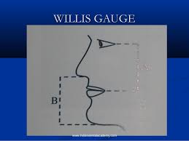

Slide 28
Occlusal vertical dimension
The measurement of occlusal vertical dimension even in dentulous patients may not be accurate because in the course of a person’s lifetime many things happen to the natural teeth.
Thus the pre extraction may not reliably indicate the dimension to be incorporated in complete dentures.
Modification from pre-extraction values or previous dentures should be made as indicated when the information is available.

Slide 29
References
Syllabus of complete dentures, Charles M. Heartwell, Jr, Arthur O.Rahn (4th edition)
Prosthodontic treatment for edentulous patients, Zarb-Bolender (12th edition)
Essentials of complete denture prosthodontics, Sheldon Winkler (2nd edition)

