Slide 1
Subcutaneous
FUNGAL INFECTIONS
Dr Himani Pandya

Slide 2
OUTLINE
Introduction
MYCETOMA / MADURA FOOT
SPOROTRICHOSIS
CHROMOMYCOSIS
RHINOSPORIDIOSIS

Slide 3
INTRODUCTION
The fungi that cause subcutaneous mycoses normally reside in soil or on vegetation. They enter the skin or subcutaneous tissue by traumatic inoculation with contaminated material.
In general, the lesions become granulomatous and expand slowly from the area of implantation. Extension via the lymphatics draining the lesion is slow except in sporotrichosis. These mycoses are usually confined to the subcutaneous tissues, but in rare cases they become systemic and produce life-threatening disease.

Slide 4
MYCETOMA / MADURA FOOT
Maduromycosis is a chronic infection of the skin and/or subcutaneous tissue resulting in tumefaction (swelling) studded with sinuses discharging grains.
It typically affects the lower extremities but can occur in almost any region of the body. Mycetoma predominates in farm workers but can also be seen in the general population.

Slide 5
The disease was first described by Gill in the Madura district of India in 1842, hence "Madura foot".
In 1860 Carter named the condition "mycetoma," describing its fungal etiology.
In 1813, Pinoy described the mycetoma produced by aerobic bacteria that belong to the actinomycete group and classified mycetomas as those produced by true fungi (eumycetoma) versus those due to aerobic bacteria (actinomycetoma). Both types have similar clinical findings.

Slide 6
MYCETOMA- causative agents
FUNGI
ACTINOMYCETES
Madurella mycetomatis
Madurella grisea
Leptosphaeria senegalensis
Neotestudina rosatii
Fusarium moniliforme
Fusarium solani
Actinomadura madurae
Actinomadura pelletieri
Nocardia brasiliensis
Nocardia asteroides
Streptomyces somaliensis
Portal of entry is usually trivial injury

Slide 7
MYCETOMA-Clinical features
Mycetoma is a chronic suppurative infection originating in subcutaneous tissue and characterized by the presence of grains, which are tightly clumped colonies of the causative agent.
The infected site is characterized by painless swelling, woody induration, and sinus tracts that discharge pus intermittently. Systemic symptoms do not develop, and spread to distant sites in the body does not take place.
Commonly affected sites are the foot and lower leg.

Slide 8
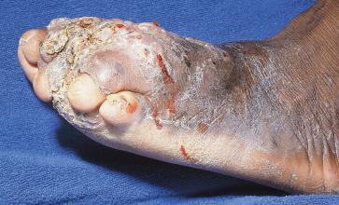
Madura foot
A 45 year old man with slowly progressive deformity since 13 years.

Slide 9
MYCETOMA- Diagnosis
Although the clinical picture is characteristic, mycetoma is sometimes confused with chronic osteomyelitis .
The diagnosis requires demonstration of grains in pus from the draining sinus or in biopsy sections. Many histologic sections may need to be examined to locate a grain.
The causative organism is cultured in Saborauds’ dextrose agar medium.

Slide 10
MYCETOMA- Treatment
Actinomycetoma may respond to prolonged combination chemotherapy—e.g., with streptomycin (14mg/kg daily IM for 3 months) and either dapsone (1.5mg/kg 12 hourly orally) or trimethoprim-sulfamethoxazole.
Eumycetoma rarely responds to chemotherapy; some cases caused by Madurella mycetomatis have appeared to respond to ketoconazole or itraconazole.
Surgery may be a valuable alternative to the often poor results of medical treatment, which is with systemic antibiotics or antifungal drugs, depending on the organism isolated.

Slide 11
SPOROTRICHOSIS
Aetiology
Sporothrix schenckii lives as a saprophyte on plants in many areas of the world. In nature and on culture at room temperature, the fungus grows as a mould; within host tissue or at 37^{O}C on enriched media, it grows as a budding yeast. It is identified by its appearance in mould and yeast forms.

Slide 12
SPOROTRICHOSIS-
Pathogenesis and Pathology
Infection results from the inoculation of S.schenckii into subcutaneous tissue through minor trauma.
Nursery workers, florists, and gardeners acquire the illness from roses, sphagnum moss, and other plants. Infection may be limited to the site of inoculation (plaque sporotrichosis) or extend along proximal lymphatic channels (lymphangitic sporotrichosis).
Spread beyond an extremity—the usual site of infection—is rare, and hematogenous dissemination from the skin remains unproven.

Slide 13
SPOROTRICHOSIS-Clinical Manifestations
In lymphangitic sporotrichosis, which is by far the most common manifestation, a nearly painless red papule forms at the site of inoculation. Over the next several weeks, similar nodules form along proximal lymphatic channels. The nodules intermittently discharge small amounts of pus.
Ulceration may occur. The proximal extension of these lesions, often with skip areas, is quite distinctive but may be mimicked by lesions of Nocardia brasiliensis, Mycobacterium marinum, or (in rare cases) Leishmania brasiliensis or Mycobacterium kansasii.

Slide 14
SPOROTRICHOSIS-Diagnosis
Culture of pus, joint fluid, sputum, or a skin biopsy specimen is preferred. The appearance of S.schenckii in tissue is variable.
In skin lesions, the organisms are hard to find.

Slide 15
SPOROTRICHOSIS-treatment
Itraconazole (100 to 200 mg daily) is the drug of choice for the treatment of cutaneous sporotrichosis.
A saturated solution of potassium iodide given orally is also effective, but side effects often prevent the effective use of this regimen. Therapy should be continued for 1 month after the resolution of all lesions.

Slide 16
CHROMOMYCOSIS
Also called verrucous dermatitis
Characterized by insidious development of verrucoid, papillomatous excrescences confined to the skin and subcutaneous tissues of the feet and legs.

Slide 17
CHROMOMYCOSIS- aetiology
Caused by a species of closely related fungi producing identical morphology. They are:
Phialophora verrucosa
Phialophora pedrosoi
Fonsecaea compacta
Phialophora dermatitidis
Cladosporium carionii

Slide 18
CHROMOMYCOSIS- aetiology ctd
Soil and wood are their natural habitats
They are introduced traumatically into human tissue
Incubation period varies from few months to a few years

Slide 19
CHROMOMYCOSIS- clinical features
A warty papule develops at the inoculation site.
This gradually ulcerates and/or enlarges to form a brownish black verrucous plaque with a raised border.
Ulceration occurs
Gross deformation of the foot ‘Mossy Foot’
New satellite warty papules emerge in the vicinity.
The disease is asymptomatic but secondary bacterial infection can cause itching
Underlying bone and muscle are spared
In extreme cases blockage of the deeper lymphatics may be responsible for secondary elephantiasis.

Slide 20
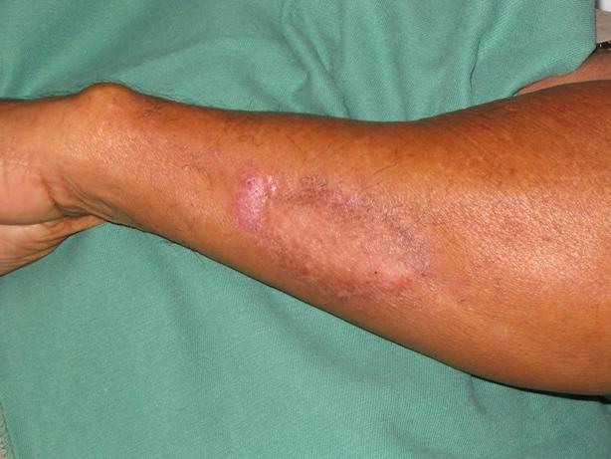
Chromomycosis of the forearm
6 cm annular violaceous plaque with overlying scaly and dyspigmentation at the border

Slide 21
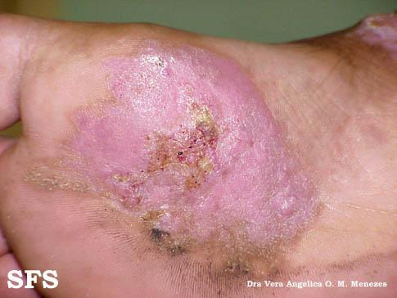

Slide 22
CHROMOMYCOSIS- diagnosis
Made by the clinical features, isolation of the fungus on culture and its demonstration on histopathologic tissue section.

Slide 23
CHROMOMYCOSIS- treatment
Excision followed by plastic repair can be performed in early lesions.
Localized lesions may respond to amphotericin B
Recently oral Ketoconazole has emerged as the treatment of choice

Slide 24
Rhinosporidiosis
Chronic granulomatous diesease characterised by development of friable polyps, usually confined to nose, mouth or eye but rarely seen on the genitalia or other mucous membranes
Although the disease was first identified in Argentina, most cases are found in India and Sri Lanka
The causative agent is Rhinosporidium seeberi

Slide 25
Pathogenesis & Clinical features
The mode of infection is not known, though infection is believed to originate from stagnant water or aquatic life.
It is a localised condition which frequently presents as polypoidal growth in the nasal cavity, lesions can also be seen in the eye, skin, buccal cavity or genitalia.
Hematogenous dissemination is rare

Slide 26
Diagnosis & Treatment
It cannot be cultivated in artificial medium
histologically the lesion is compossed oflarge numbersof fungal spherules embedded in a stroma of connective tissue and capillaries.
The spherules are a 10-200 micrometer in diameter and contain thousands of endospores
Excision is the treatment of choice

Slide 27
MCQ 1
Presence of grains in the infected site is a clinical feature of:
Sporotrichosis
Mycetoma
Chromomycosis
Rhinosporidiosis

Slide 28
MCQ 2
Mycetoma caused by true fungi is known as _____
Actinomycetoma
Botryomycosis
Eumycetoma
Chromycosis

Slide 29
MCQ 3
Chronic granulomatous disease characterised by development of friable polyps, confined to nose, mouth or eye but rare at other sites is called _____
Sporotrichosis
Mycetoma
Chromomycosis
Rhinosporidiosis

Slide 30
MCQ 4
The infection of hair in which arthrospores are seen as a sheath around the hair, is called ___
Sporotrichosis
Ectothrix
Chromomycosis
Endothrix

Slide 31
MCQ 5
Presence of sclerotic bodies on histological/KOH examination of the clinical specimen is diagnostic of:
Sporotrichosis
Mycetoma
Chromomycosis
Rhinosporidiosis

