Slide 1
TOTAL Knee ARTHROPLASTY
By Dr Neha Mukkamala

Slide 2
Objectives
The student at the end of the session will be able to
Enumerate the indications, contraindications of knee arthroplasty
List the principles of assessment and management of THR

Slide 3
Indications
Severe joint pain with weight bearing or motion that compromises functional abilities
Extensive destruction of articular cartilage of the knee secondary to advanced arthritis
Marked deformity of the knee such as genu varum or valgum
Gross instability or limitation of motion
Failure of nonoperative management or a previous surgical procedure

Slide 4
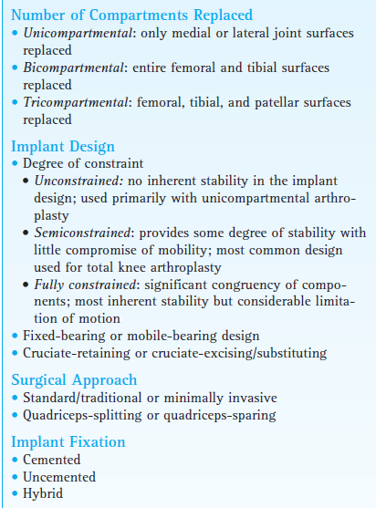
Types of knee arthroplasty

Slide 5
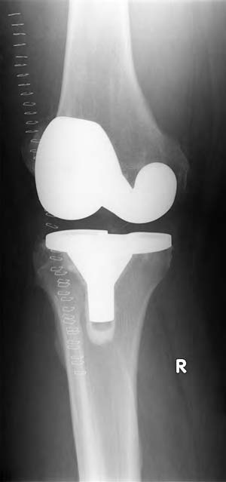

Slide 6
Surgical approach
Anteromedial parapatellar vertical or curved incision from the distal aspect of the femoral shaft, running medial of the patella to just medial of the tibial tubercle, ranging from 8 to 12 cm or 13 to 15 cm in length

Slide 7
Fixation
cemented, uncemented, or “hybrid”
Hybrid” TKA combines cemented fixation of the tibial component and cementless fixation of the femoral component.
Depends on: patient’s age, bone quality, expected activity level, and the tightness of fit of the femoral component

Slide 8
Operative Overview
quadriceps-splitting or a quadriceps-sparing approach is used. The knee is flexed; and osteophytes, menisci, and the ACL are resected. The lateral retinaculum may be released to improve patellar Tracking.
The wound is closed with the knee extended and with a small suction drain in place. A sterile dressing is placed over the incision, and the area is covered from foot to thigh with a compression wrap.

Slide 9
Complications
Intraoperative
intercondylar fracture or damage to a peripheral nerve (e.g., the peroneal nerve), is uncommon
Fracture or malpositioning of an implant
Early and late postoperative
infection
joint instability
polyethylene wear
mechanical loosening-the tibial component

Slide 10
limited knee flexion
joint instability leading to subluxation
patellar instability or tracking problems leading to impaired function of the extensor mechanism (most often an extensor lag).

Slide 11
Postoperative Management

Slide 12
Immobilization and Early Motion
the knee is immobilized in a bulky compression dressing for a day, or sometimes continuous passive motion (CPM) is initiated within a day after surgery.
The position of immobilization is extension.
During the initial postoperative period, patient advised to wear a posterior extension splint during ambulation until quadriceps control is re-established.

Slide 13
Although the addition of CPM increased the rate of return of knee flexion during the early postoperative period it provided no significant long-term benefits as to gains in ROM and functional mobility.
The literature currently reflects that it is either no longer recommended after primary TKA or, if used, is recommended as an adjunct to, not a replacement for, a postoperative exercise program.

Slide 14
Weight-Bearing Considerations
depends on the type of prosthesis implantedthe type of fixation used, the patient’s age, size, and bone
quality, and whether a knee immobilizer is worn during
ambulation or transfers. With cemented fixation, weight
bearing typically is permitted as tolerated immediately
after surgery using crutches or a walker. During the first
few days after surgery, use of a knee immobilizer may be
required. The patient progresses to full weight bearing
over 6 weeks.191

Slide 15
With biological/cementless fixation, recommendations vary from touch-down weight bearing for 4 to 8 weeks to weight bearing as tolerated within a few days after surgery.
Cane use is indicated as a patient progresses from partial to full weight bearing. Ambulation without an assistive device, is not advisable until the patient has attained full or nearly full active knee extension and adequate strength of the quadriceps and hip musculature.

Slide 16
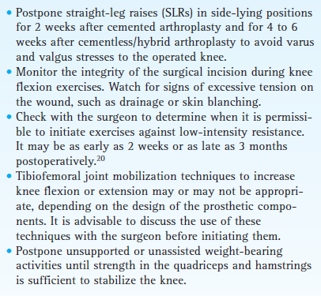
Exercise precautions following TKA

Slide 17
Exercise: Maximum Protection Phase (0-4 weeks)
to control pain and swelling (with cold and compression),
achieve independent ambulation and transfers
prevent early postoperative medical complications, such as pneumonia and deep vein thrombosis, and
minimize the adverse effects of postoperative immobilization.
The goal is to attain 90 of knee flexion and full knee extension
In addition to early postoperative exercise, neuromuscular electrical stimulation or biofeedback is recommended.

Slide 18
Prevent vascular and pulmonary complications
Prevent reflex inhibition or loss of strength of knee and hip musculature
Muscle-setting exercises of the quadriceps, hamstrings, and hip extensors and adductors
active SLRs in supine and prone positions
assisted ROM (AROM) of the knee while seated and standing
wall slides in a standing position, mini-squats, and partial lunges to develop control of the knee extensors and reduce the risk of an extensor lag.

Slide 19
Regain knee ROM
Heel-slides in a supine position
Neuromuscular facilitation and inhibition technique, such as the agonist-contraction technique
Gravity-assisted knee flexion
Gravity-assisted knee extension in the supine position-rolled towel under the ankle
Gentle inferior and superior patellar gliding techniques

Slide 20
Avoid placing a pillow under the knee
while lying supine or while seated with the operated leg elevated to reduce the risk of developing a knee flexion contracture.

Slide 21
Exercise: Moderate Protection Phase (4-8 to 12 weeks)
achieve approximately 110 degree knee flexion and active knee extension to 0 degree
regain lower extremity strength, muscular endurance, and balance.
By 4 to 6 weeks postoperatively if nearly full
knee extension has been achieved and the strength of the quadriceps is sufficient-cane during ambulation activities.

Slide 22
Increase strength and muscular endurance of knee and hip
Multiple-angle isometrics and low-intensity dynamic resistance exercises of the quadriceps and hamstrings
Resisted SLRs-emphasis on the hip
extensors and abductors.
continue or begin closed chain exercises including wall slides, mini-squats, and partial lunges. Add forward and backward, progressing to lateral step-ups and step-downs

Slide 23
Continue to increase knee ROM
Low-intensity self-stretching to increase knee flexion and extension
Stationary cycling with seat lowered to increase knee flexion.
Grade III inferior or superior patellar mobilization techniques to increase knee flexion or extension

Slide 24
Improve standing balance
progressing from bilateral to unilateral stance on stable surface, then to
balance activities on an unstable surface.
Functional reaching activities while standing, stooping.
Heel-toe walking; ambulation on a variety of surfaces and inclines.
Stepping over small objects.

Slide 25
Exercise: Minimum Protection and Return to Function Phases (8th week onwards)
task-specific strengthening exercises,
proprioceptive training
Cardiopulmonary conditioning so the patient develops the strength, balance, and endurance needed to return to a full level of functional activities.

Slide 26
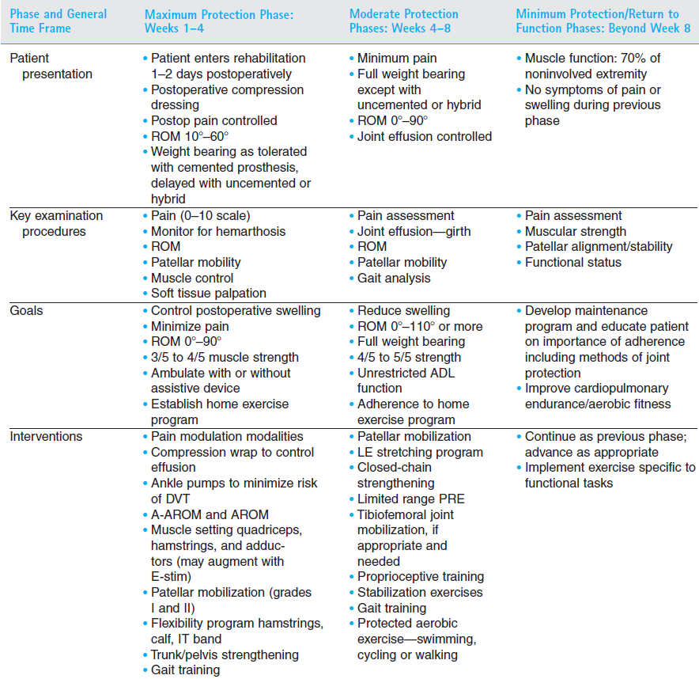

Slide 27
Outcomes
Pain relief.
Almost all patients who undergo knee arthroplasty report a significant reduction of pain during knee
motion and weight bearing, with most patients reporting good to excellent pain relief.

Slide 28
ROM.
Improvements in knee ROM are not as predictable as relief of pain. Stiffness often persists after the initial recovery from surgery has occurred. However, it also
has been reported that ROM may continue to improve up to 12 to 24 months postoperatively

Slide 29
Strength and endurance.
It takes a minimum of 3 to 6 months after surgery for a patient to regain strength in the quadriceps and hamstrings to a preoperative level. Quadriceps weakness tends to persist longer after knee
arthroplasty than does knee flexor weakness.

Slide 30
Physical function and activity level.
Relief of pain as the result of TKA significantly improves a patient’s QOL
and ability to perform functional activities.

