Slide 1
Systemic Mycoses
Dr. Himani Pandya, Dept. of Microbiology

Slide 2
OUTLINE
HISTOPLASMOSIS
BLASTOMYCOSIS
PARACOCCIDIOIDES
COCCIDIOIDES

Slide 3
HISTOPLASMOSIS
Caused by Histoplasma capsulatum , a yeast in its parasitic phase but is a filamentous fungus of the soil at other times.
The organism multiplies in soil enriched with the droppings of birds and bats and the spores remain viable for years
Infection is by inhalation of infected dust ( a hazard for cave explorers and people who clear out bird roosts)

Slide 4
HISTOPLASMOSIS- pathology
The parasite in its yeast phase multiplies in the monocytes and macrophages and produces areas of necrosis where parasites may abound. From these foci the blood stream may be invaded producing metastatic lesions in the liver, spleen and lymph nodes.
Pulmonary histoplasmosis may produce changes similar to those of tuberculosis

Slide 5
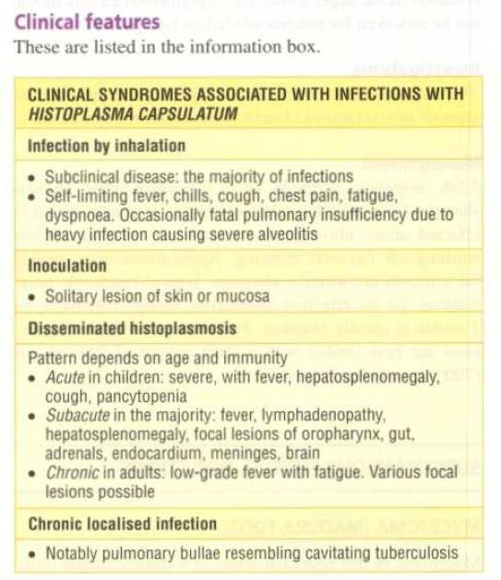
HISTOPLASMOSIS
Clinical Features

Slide 6
HISTOPLASMOSIS- investigations
In an area where the disease occurs, histoplasmosis should be suspected in every obscure infections in which there are pulmonary signs, enlarged lymph nodes or hepatosplenomegaly.
Tissue is obtained by biopsy for an impression smear, histology and culture
Radiological examination in long standing cases may show calcified lesions in the lungs, spleen and other organs.

Slide 7
HISTOPLASMOSIS- management
Only symptomatic acute pulmonary histoplasmosis, chronic histoplasmosis and acute disseminated histoplasmosis require therapy.
Itraconazole or ketoconazole are indicated for moderate disease. Severe infection is treated with intravenous amphotericin B to a total dose of 1.5 g followed by itraconazole.

Slide 8
Patients with AIDS usually require treatment with parenteral amphotericin B followed by lifelong maintenance therapy with itraconazole 200 mg twice daily. Surgical excision of histoplasmomas (pulmonary granuloma due to H. Capsulatum) or chronic cavitatory lung lesions and release of adhesions following mediastinitis are often required.

Slide 9
BLASTOMYCOSIS
Chronic infection, characteised by formation of suppurative and granulomatous lesions in any part of the body but with predilection for the lungs and skin
North American continent-North American blastomycosis to differentiate it from South American blastomycosis (caused by paracoccidioidomycosis)
Africa & India (Delhi from BAL)

Slide 10
BLASTOMYCOSIS
Blastomyces dermatitidis
Soil- source of infection by inhalation
primary infection of lungs

Slide 11
BLASTOMYCOSIS
resembles TB or histoplasmosis
May be asymptomatic or lead to focal or diffuse consolidation
Miliary lesions or abscess formation
through blood stream-disseminated disease- highly fatal
Cutaneous disease – affects skin of face or other exposed parts of the body-papule, around which secondary nodules develop and coalesce forming large elevated ulcerative lesions

Slide 12
BLASTOMYCOSIS
Laboratory Diagnosis:
Appears as budding yeast cell, which is large and spherical, with a thick, double contoured wall, only single broad based bud.
At room temperature, the culture is filamentous with septate hyphae and many round or oval conidia and old cultures show chlamydospores

Slide 13
Coccidioidomycosis
It is a primary pulmonary infection that may be inapparent, benign, severe or even fatal
The disease is endemic in dry, arid regions of southwestern USA, where the fungus is present in soil and rodents
It is caused by C. immitis, thermally dimorphic
Infection is acquired by inhalation of dust containing arthrospores of the fungus
Most cases respiratory infection is asymptomatic and leads to life-time immunity

Slide 14
Many persons develop a self-limited influenza like fever known as valley fever or desert rheumatism
less than 1% develop chronic progressive disseminated disease – coccidioidal granuloma which is highly fatal

Slide 15
Lab. diagnosis
it is occurring as sperules in tissues and in culture at 37 ⁰ C and as mycelial form in soil and room temperature cultures.
Spherule has a thick, doubly refractile wall and filled with endospores
Mycelial form consists of hyphae which fragment into arthropores and highly infectious
Culture confirmation can be performed rapidly and with less risk to staff by DNA probe or exoantigen testing
Skin test: Delayed hypersensitivity testing using coccidioidin

Slide 16
Paracoccidioidomycosis
It is a chronic granulomatous diseases of the skin, mucosa, lymph nodes and internal organs
diseases is confinec to South America and so called South American blastomycosis
It is caused by P. brasiliensis, thermally dimorphic
Spores are inhaled and result in primary pulmonary infection that spreads by the hematogenous route to the mucosa of nose, mouth, GIT, skin and lymphatics.
it leads to ulcerative granulomas of the buccal and nasal mucosa

Slide 17
Lab. diagnosis
the yeast phase occurs in tissues and cultures at 37⁰ C as large, globose or oval cells with multiple buds encircling the mother cell; this mariners or pilot’s wheel appearance is characteristic.
Mycelial phase is found in nature and can be isolataed from culture on incubation at 25-30⁰ C for 2 weeks

Slide 18
MCQ 1
A pulmonary infection in which the fungus is found as a yeast form inside the macrophages is caused by:
Blastomyces dermatitidis
Histoplasma capsulatum
Coccidioides immitis
Paracoccidioides brasiliensis

Slide 19
MCQ 2
A pulmonary infection in which the fungus is found in the form of spherules containing endospores from the tissue sample is caused by:
Blastomyces dermatitidis
Histoplasma capsulatum
Coccidioides immitis
Paracoccidioides brasiliensis

Slide 20
MCQ 3
A pulmonary infection in which the fungus appears as mariner’s or pilot’s wheel from the tissue samples caused by:
Blastomyces dermatitidis
Histoplasma capsulatum
Coccidioides immitis
Paracoccidioides brasiliensis

Slide 21
MCQ 4
A pulmonary infection which is also called as North American Blastomycosis is caused by:
Blastomyces dermatitidis
Histoplasma capsulatum
Coccidioides immitis
Paracoccidioides brasiliensis

Slide 22
MCQ 5
A pulmonary infection which is also called as South American Blastomycosis is caused by:
Blastomyces dermatitidis
Histoplasma capsulatum
Coccidioides immitis
Paracoccidioides brasiliensis

