Slide 1
PHYSIOTHERAPY IN SKIN CONDITIONS
By, Dr. Nandini Kushwaha

Slide 2
OBJECTIVES
To know about different skin conditions in brief .
To learn about physiotherapy treatment in various skin conditions.

Slide 3
WHAT IS SKIN ? WHAT ARE THE FUNCTIONS OF SKIN ?

Slide 4
SKIN CONDITIONS :
Different types of skin condition includes :
Acne vulgaris
Psoriasis
Vitiligo
Alopecia

Slide 5
ACNE VULGARIS
Acne by definition is multifactorial chronic inflammatory disease of pilosebaceous units.
It commonly occurs during adolescents affecting more than 85% of teenagers and frequently continues to adulthood.
Various clinical presentations includes :
Seborrhoea,
Comedones,
Erythematous papules and pustules,
Less frequently nodules,
Deep pustules or pseudocysts, and ultimate scarring in few of them.

Slide 6
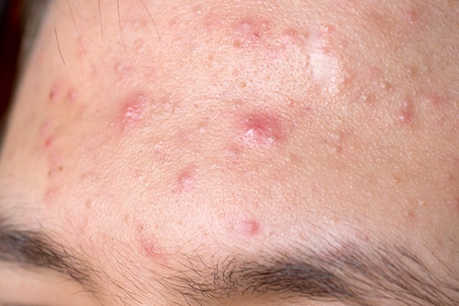
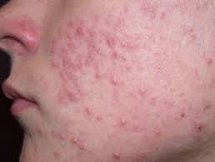

Slide 7
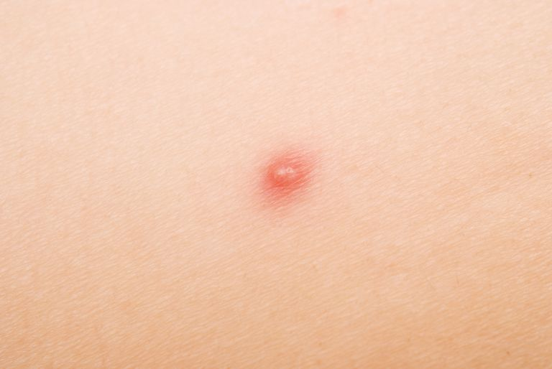
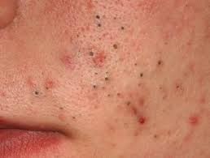

Slide 8
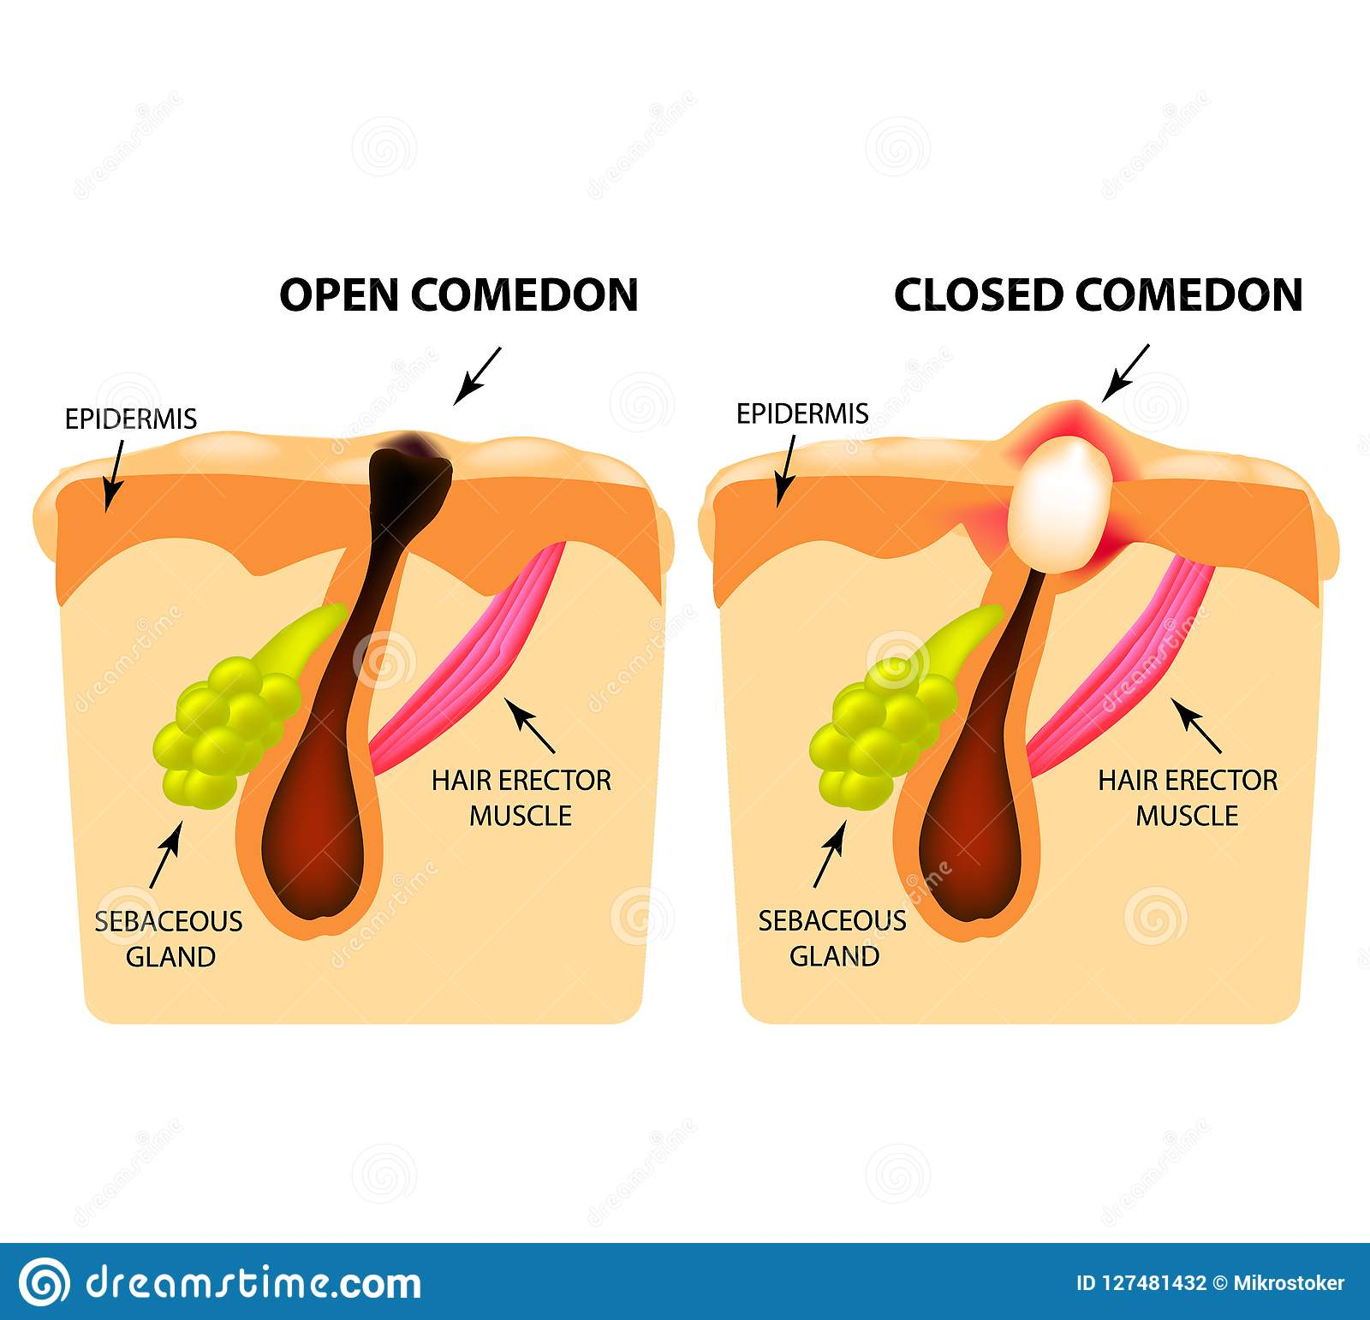

Slide 9
CAUSES OF ACNE VULGARIS
1)Family/Genetic history
2)Hormonal
3)Inflammation or Skin irritation
4)Stress
5)Hyperactive sebaceous glands.

Slide 10
CAUSES OF ACNE VULGARIS
6)Accumulation of dead skin cells
7)Bacteria in pores.
8) Anabolic steroids
9) Diet
10)Vitamin A and E deficiency

Slide 11
PATHOGENESIS
Acne has four main pathogenetic mechanism :
Increased sebum productions,
Follicular hyperkeratinization,
Propionibacterium acne (P. acne) colonization,
The products of inflammation

Slide 12
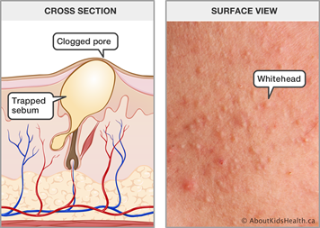
PATHOGENESIS

Slide 13
PHYSIOTHERAPY TREATMENT
GOALS
1)To obtain desquamation of skin.
2)To Increase vascularity.
3)To Reduce number of micro-organism.
4)To Improve general health and hygiene.

Slide 14
UVR
First the skin is washed with soap water and then gently dried with clean towel then irradiated by UVR.
E 1 dose is given 2-3 times a week for about 3-4 weeks. This is given to improve the condition of the skin and this is repeated.
E2 and E3 doses are given for healing purpose. This will open the block causing the infected material to discharge rather than retain it in the skin.

Slide 15
LASER
He-Ne laser with wavelength 632.8nm to burn away the follicle sac from which the hair grows. It burns away the infected sebaceous gland which produce oil.
Also it induce formation of oxygen which kills the bacteria which cause acne vulgaris.
LASER can be used for scar marks Keloids.

Slide 16
PSORIASIS
Psoriasis is a non-contagious, chronic inflammatory disease of the skin characterized by clearly defined dry, rounded red patches with silvery white scales on the surface.
Aetiology Age: Common age of first occurrence is 15-30 years. It can occur as young as 2 years. Also it can start as late as 80 years.
Sex: Both sexes are equally affected.
Climate: The condition is worse in damp, cold climates.

Slide 17
Common areas of distribution of psoriasis.
The lesions are usually symmetrically distributed and are characteristically located on the ears, elbows, knees, umbilicus, gluteal cleft and genitalia.
The joints (psoriatic arthritis), nails and scalp may also be affected.
The size of plaques and distribution varies so that different types are described.
Plaque psoriasis is characterized by raised inflamed lesions covered with a silvery white scale.
The scale may be scraped away to reveal inflamed skin beneath. This is most common on the extensor surfaces of the knees, elbows, scalp, and trunk.

Slide 18
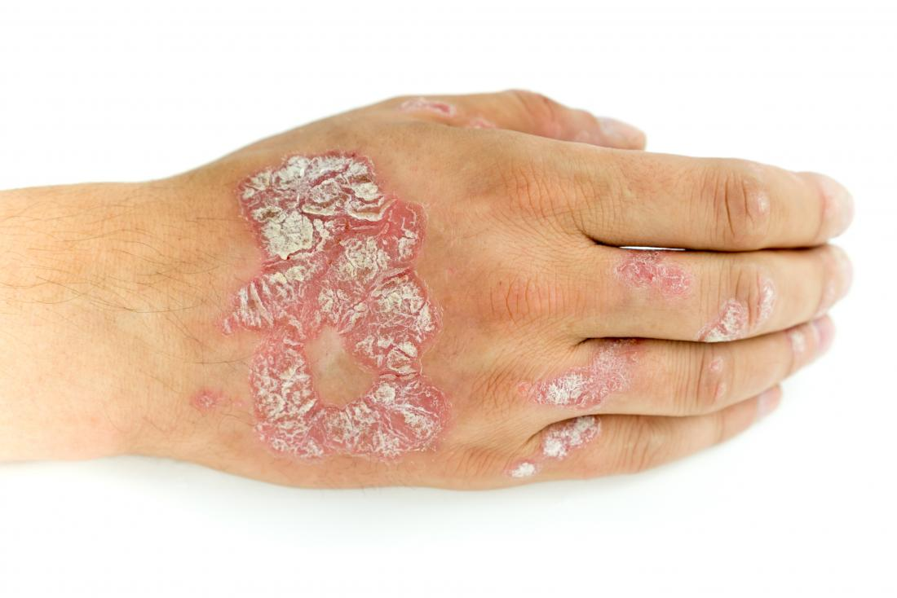

Slide 19
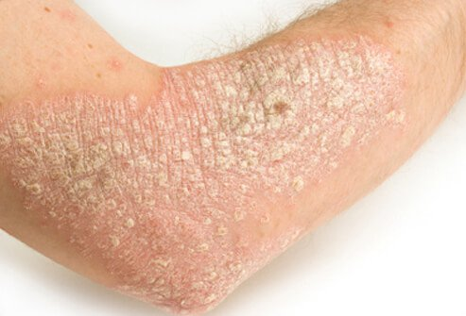

Slide 20
PREDISPOSING / PRECIPITATING FACTORS
A number of factors appear to predispose or precipitate an exacerbation of the psoriasis are :
Heredity: There is an inherited defect in the skin which results in psoriasis developing in certain circumstances; 30 percent of patients have blood relative with the condition.
Infection: Psoriasis has been known to develop after, for example, an upper respiratory tract infection.

Slide 21
CONTII..
Trauma: Lesions tend to develop at sites of potential or actual trauma, e.g. mechanical friction, cuts, stings etc.
Anxiety: Psoriasis often appears in relation to mental stress, e.g. bereavement, examinations etc.
Drugs: Some drugs, e.g. chloroquine, may precipitate the condition.
Diabetes: Some patients with diabetes develop the condition.

Slide 22
PATHOGENESIS
There is increased reproduction in the stratum granulosum.
The stratum spinosum is thicker due to an increased number of cells plus edema.
The strata lucidum and corneum are replaced by several layers of nucleated, incompletely keratinized, soft cells (para-keratotic cells).

Slide 23
PATHOGENESIS
There is no time for the normal changes to take place through the skin layers. The cells at the surface are sticky and do not fall off like normal keratin.
Accumulation of these cells forms scales, which over 2-3 weeks dry out and fall off in big flakes.

Slide 24
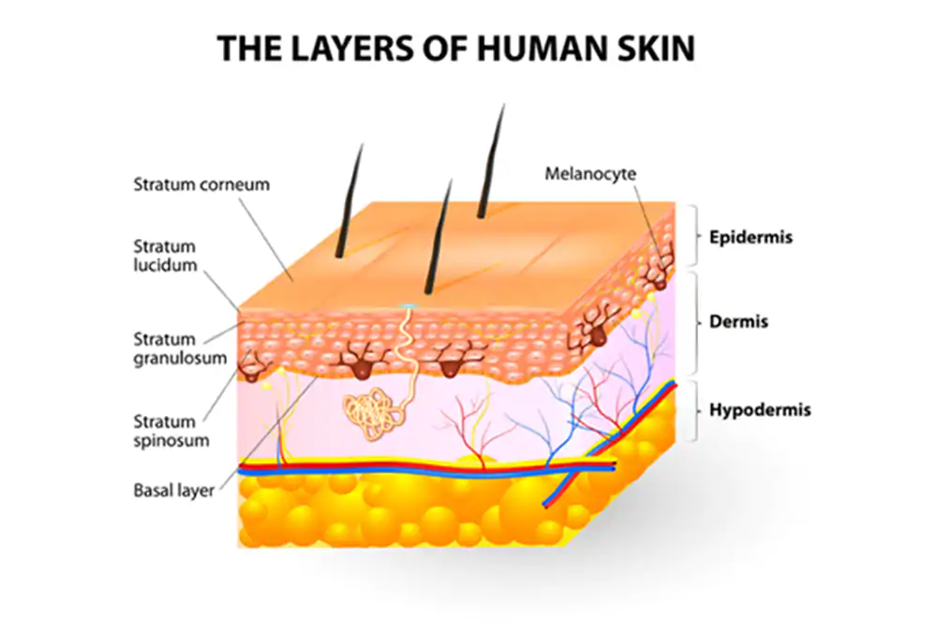

Slide 25
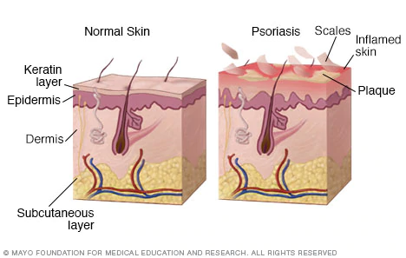

Slide 26
PHYSIOTHERAPY TREATMENT
GOALS
1.To decrease the rate of DNA synthesis in the cells of the skin.
2.To slow down the excessive skin proliferation.
3.Desquamation of the skin.

Slide 27
PHYSIOTHERAPY TREATMENT
The THERAKTIN is usually in the form of a tunnel with four fluorescent tubes.
The patient lies flat for the treatment, therefore in order to treat the whole body the patient is generally naked and lies supine for half the treatment session and prone for other half.
The spectrum of UVR emitted is 280-350 nm and peak emission is around 393nm,therefore this constitutes UVB treatment.
It may be used alone or in conjunction with coal tar or diathranol.

Slide 28
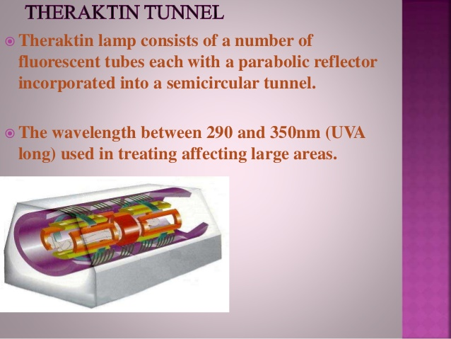

Slide 29
PUVA
This is psoralen plus UVA and is used for resistant psoriasis.
Psoralen is photosensitizing substance, which occurs in plants such as parsley, parsnips and celery.
The one used for psoriasis is 8-methoxy psoralen (8-MOP). UVA is produced from fluorescent tubes, mounted upright in a hexagonal shaped cabinet inside which the patient stands throughout the treatment.

Slide 30
PUVA
Psoralens are taken as pills (systemically) or can be applied directly to the skin, by soaking the skin in a solution that contains the psoralens. They allow UVA energy to be effective at lower doses. When combined with exposure to the UVA in PUVA, psoralens are highly effective at clearing psoriasis.
The spectrum of UVR emitted is 330-390 nm and peaks at 360 nm. Infrared rays are also emitted and it is essential to have a cooling fan so that the patient can tolerate up to ½ hour in the cabinet.

Slide 31
VITILIGO
Vitiligo Disease is a chronic disorder that causes depigmentation patches in skin. It occurs when the melanocytes, the cells responsible for skin pigmentation, die or are unable to function.
Vitiligo disease affects 1-2% of the population and affects both males and females of all races.
Vitiligo can begin at any age although about fifty percent of people who have Vitiligo developed it before they turned 25.

Slide 32
The patches often appear equally on both sides of the body, with some measure of symmetry. They often appear on skin that is commonly exposed to the sun, such as the face, neck, and hands.
Common areas include:
backs of the hands
arms
eyes
knees
elbows
feet
mouth
armpit and groin
nose
navel
genitals and rectal area
However, patches can also appear in other areas.

Slide 33
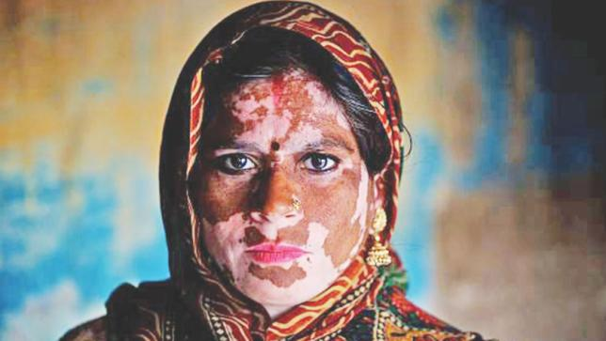
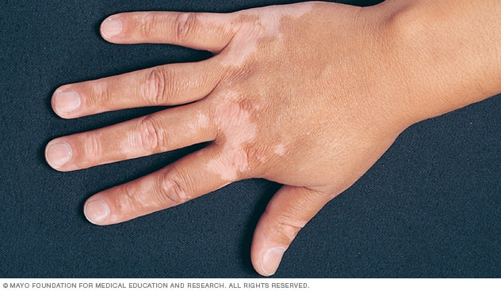

Slide 34
CAUSES
The exact causes of vitiligo are unclear. A number of factors may contribute. These include:
an autoimmune disorder, in which the immune system becomes overactive and destroys the melanocytes.
harm to the skin due to a critical sunburn or cut
exposure to some chemicals
a neural cause
heredity, as it may run in families
Viral infection

Slide 35
TYPES OF VITILIGO
Vitiligo generally appears in one of the three patterns:
Focal Pattern : Depigmentation is limited to one or only few areas.
Segmental Pattern : Depigmentation develops on only one side of the body.
Generalised Pattern : Depigmentation develops on different parts of the body.

Slide 36
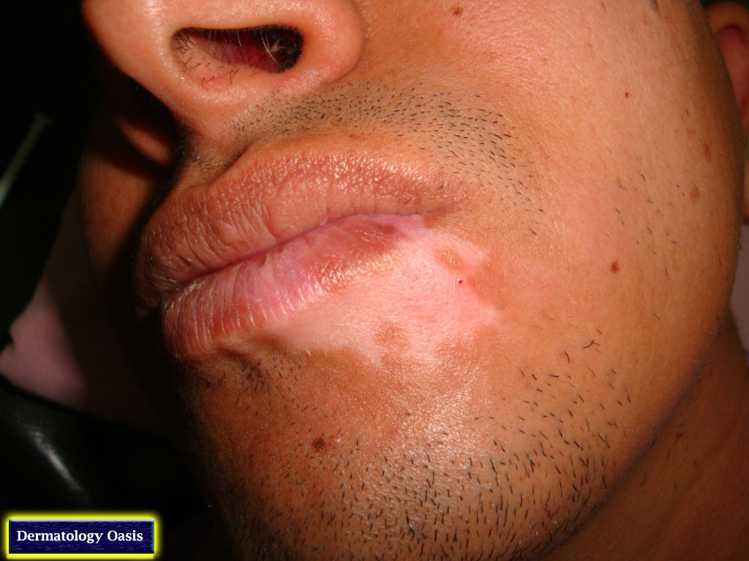
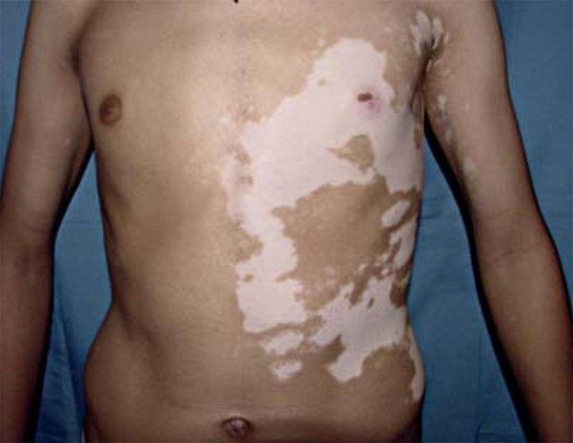

Slide 37
PHYSIOTHERAPY TREATMENT
GOALS
To activate the pigmentation process.
2)To Increase vascularity.
3)To Improve general health and hygiene.

Slide 38
PHYSIOTHERAPY TREATMENT
PUVA
PUVA is a form of repigmentation therapy where a type of medication known as psoralen is used. This chemical makes the skin very sensitive to light.
Then the skin is treated with a special type of ultraviolet light call UVA.
Sometimes, when vitiligo is limited to a few small areas, psoralens can be applied to the vitiligo areas before UVA treatments.

Slide 39
CONTI..
Usually, however, psoralens are given in pill form. Treatment with PUVA has a 50 to 70% chance of returning color on the face, trunk, and upper arms and upper legs.
Hands and feet respond very poorly. Usually at least a year of twice weekly treatments are required.

Slide 40
Narrow Band UVB (NBUVB)
This is a form of photo-therapy that requires the skin to be treated two, sometimes three, times a week for a few months.
At this time this form of treatment is not widely available. It may be especially useful in treating children with vitiligo disease.

Slide 41
ALOPECIA
Alopecia is defined as premature loss of hair. Some times leads to total loss of hair from the body.
The condition is thought to be an autoimmune disorder in which the body attacks its own hair follicles and suppresses or stops hair growth.
There is evidence that T cell lymphocytes cluster around these follicles, causing inflammation and subsequent hair loss.

Slide 42
CLASSIFICATION
Alopecia areata : Loss of hair from scalp in patches.
Alopecia totalis : Scalp hair loss along with eye brows.
Alopecia universalis : Loss of hair all over the body.

Slide 43
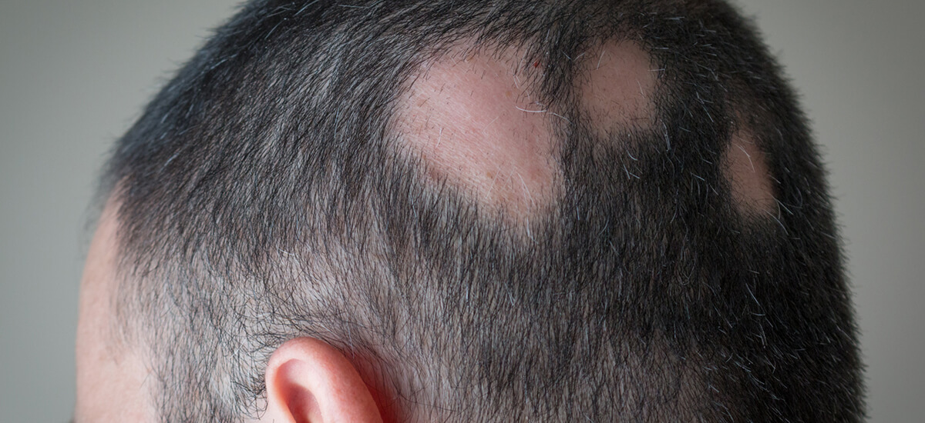
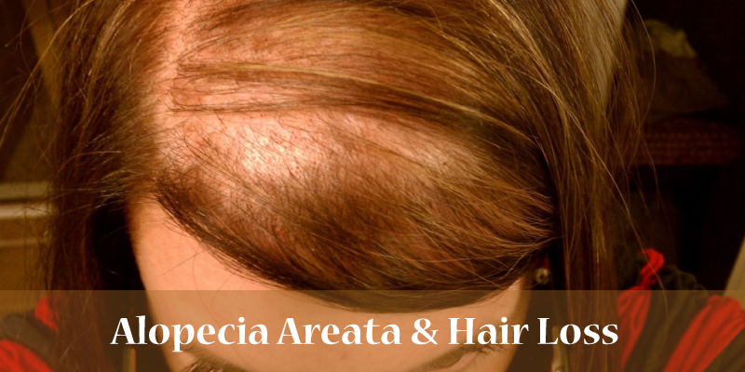

Slide 44
CAUSES
Age: Generally affects under 30 years of age.
Predisposing factors:
a) Poor health
b) Heredity plays an important role
c) Anxiety and fatigue.
Sex: It affects both the sexes equally.

Slide 45
PATHOGENESIS
There is evidence that T cell lymphocytes cluster around these follicles.
Hair becomes weak from root and comes out of follicle.
Atrophy of hair follicle occurs.
Sebaceous glands becomes inactive or less active.

Slide 46
PHYSIOTHERAPY TREATMENT
Aims:
To improve general health
To improve nutrition to hair follicles
Means:
To improve general health UVR treatment + Theraktin are given. Sub-erythema or doses of E1 are given for 5-8 minutes daily.
Individual patches are treated by E2 and E3 doses of UVR and Kromayer, twice a week.
Treatment should be continued for 2-3 months, and as the hair starts growing UVR must be stopped to that area.

Slide 47
PHYSIOTHERAPY TREATMENT
Few studies shows the efficacy of low level laser therapy in treatment of alopecia areata of the scalp.
It was observed that there were greater improvement in hair count and reduced visual analogue scale of hair loss in study patches who underwent LLLT.

Slide 48
REFERENCES
1. Physiotherapy In Diseases Of The Skin. By Norman Burgess, M.A., M.D., M.R.C.P.
2. Efficacy of lowlevel laser therapy in the treatment of alopecia areata nermeen mohamed abdelhalim. phd pt *
3. Psoriasis Treatment: Traditional Therapy. M Lebwohl, P T Ting, J Y M Koo.
4.Clayton Electrotherapy.8th edition.

Slide 49
THANK YOU !

