Slide 1
LEISHMANIA
Ms Sangita Vasava
Assistant Professor
Department of Microbiology

Slide 2
Taxonomy
Hemoflagellates of medical importance belongs to:
Phylum: Euglenozoa
Class: Kinetoplastidea
Order: Trypanosomatida
Family: Trypanosomatidae
Genera: Leishmania and Trypanosoma.

Slide 3
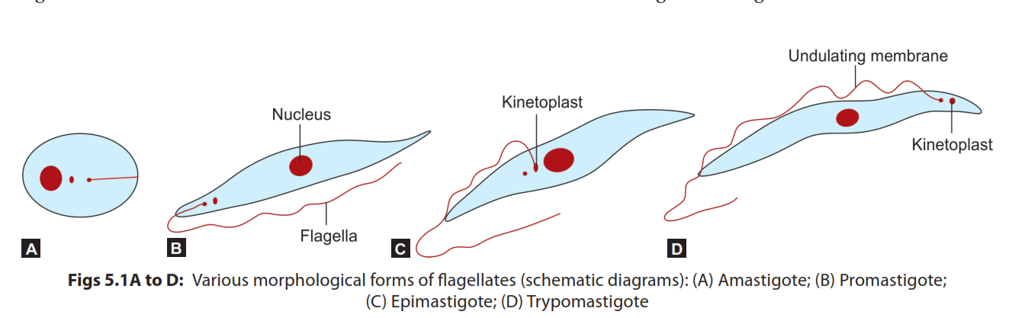
Morphological forms

Slide 4
LEISHMANIA
Classification of leishmaniasis
Leishmania has two subgenera: L. Leishmania and L. Viannia.
Old world leishmaniasis: Affects Asia, Africa and Europe and transmitted by sandfly (Genus Phlebotomus)
New World leishmaniasis: Affects Central and South America and trans mitted by Sandfly (Genus Lutzomyia).

Slide 5
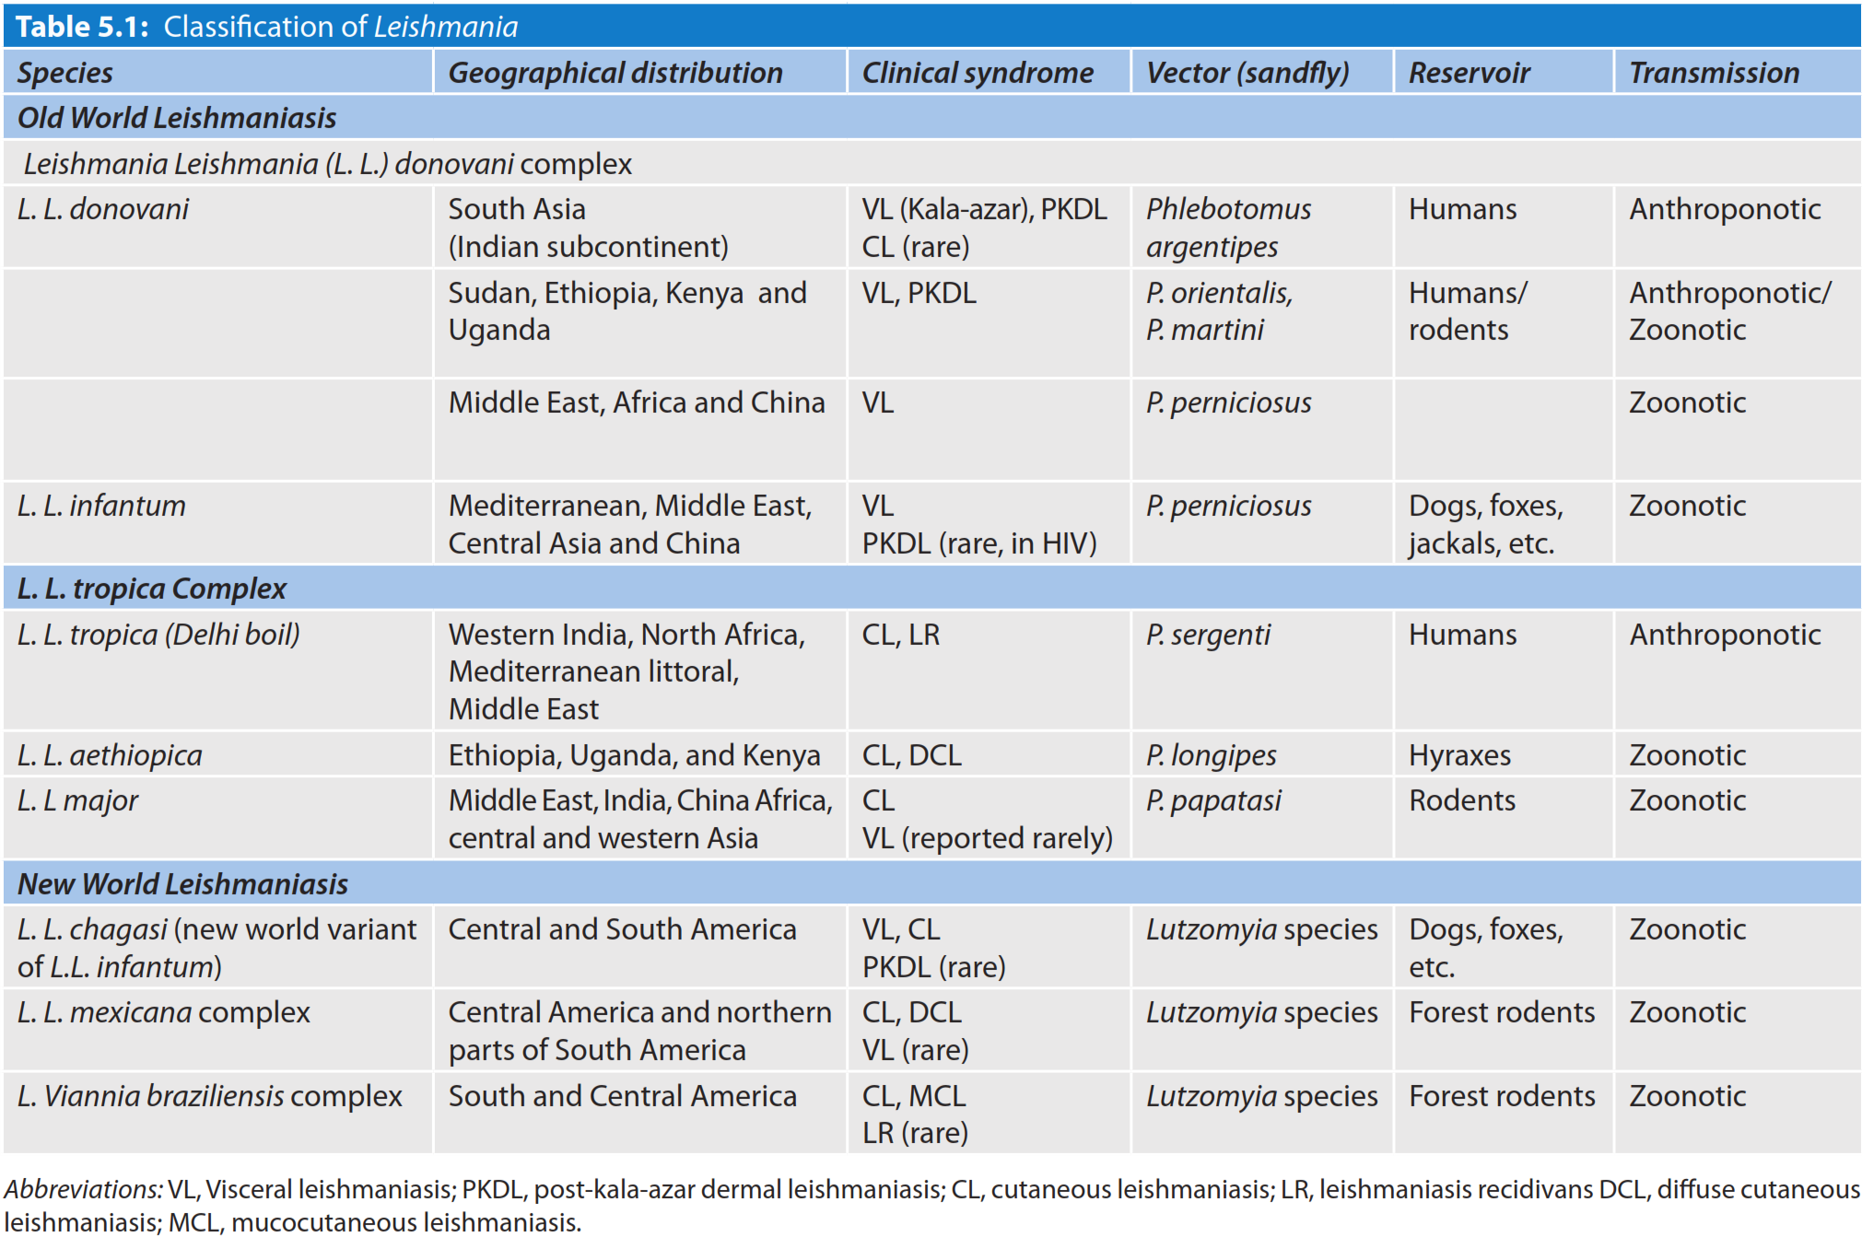

Slide 6
Clinical syndromes of leishmaniasis
Visceral leishmaniasis (VL)
Post kala-azar dermal leishmaniasis (PKDL)
Cutaneous leishmaniasis (CL)
Diffuse cutaneous leishmaniasis (DCL)
Leishmaniasis recidivans (LR)
Mucocutaneous leishmaniasis (MCL).

Slide 7
Epidemiology
Leishmaniasis is endemic in 97 countries; with four countries have previous reported cases. Most of them are developing countries of tropical and temperate regions.
More than 616 million people living in the endemic area are at risk

Slide 8
World
WHO estimated 7,00,000 to 1 million new cases and 20,000 to 30,000 deaths occur annually
VL: An estimated 50,000 to 90,000 new cases of VL occur worldwide each year. Over 90% of cases of VL come from three regions: (i) South-East Asia: India, Bangladesh, and Nepal; (ii) East Africa: Ethiopia, Sudan, and Kenya; and (iii) Brazil
CL is the most common form of leishmaniasis with a global annual incidence of 6,00,000 to 1 million new cases. About 95% of CL cases occur in the Americas, the Mediterranean basin, the Middle East and Central Asia
MCL: Over 90% of mucocutaneous leishmaniasis cases occur in Bolivia, Brazil, Ethiopia and Peru

Slide 9
India
India is one of the worst affected country.
Bihar is affected the most (>70% of cases) followed by Jharkhand, West Bengal and Uttar Pradesh
About 57 districts with more than 165 millions of people are at risk.
In 2017, about 5,758 cases of VL and 1,949 cases of PKDL have been reported from India with nil death.
VL reported maximum from Bihar (71.6%) and PKDL from Jharkhand (62%)

Slide 10
Old world leishmaniasis
Leishmania donovani
Causes VL or kala azar (a hindi term meaning black fever
Named after two scientists
  Sir William Boog Leishman in London observed the amastigotes form of the parasite in the spleen of a British soldier died at Dumdum, Kolkata
  Sir Donovan at Madras Medical College, Chennai, suggested that the causative agent was a new parasite.

Slide 11
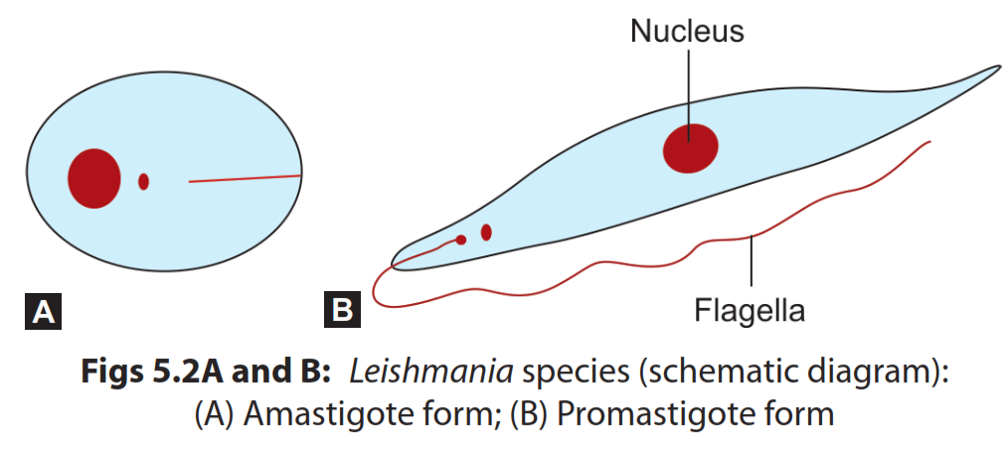
Morphology

Slide 12
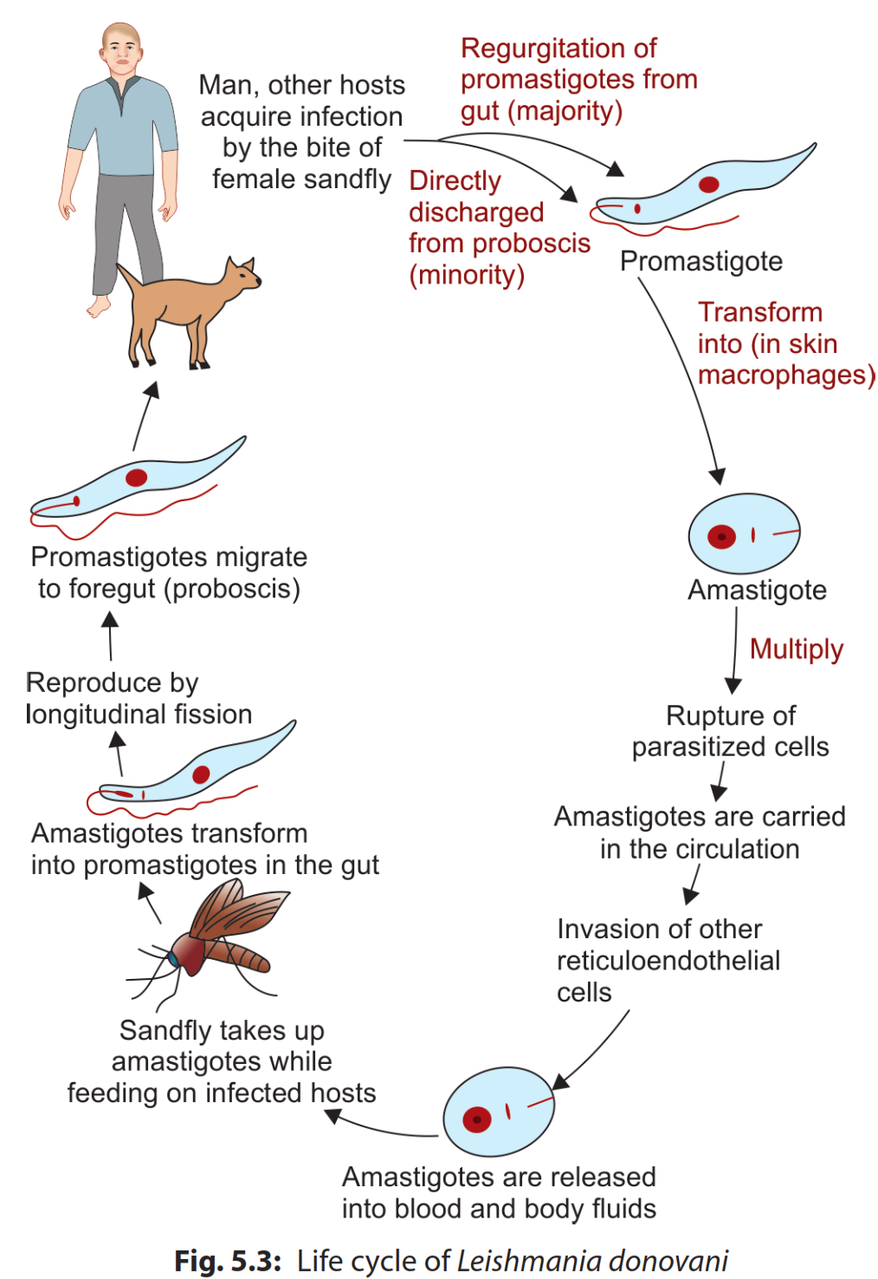
Life Cycle
Infective form: Promastigotes
Vector: Sandfly
Transmission: bite

Slide 13
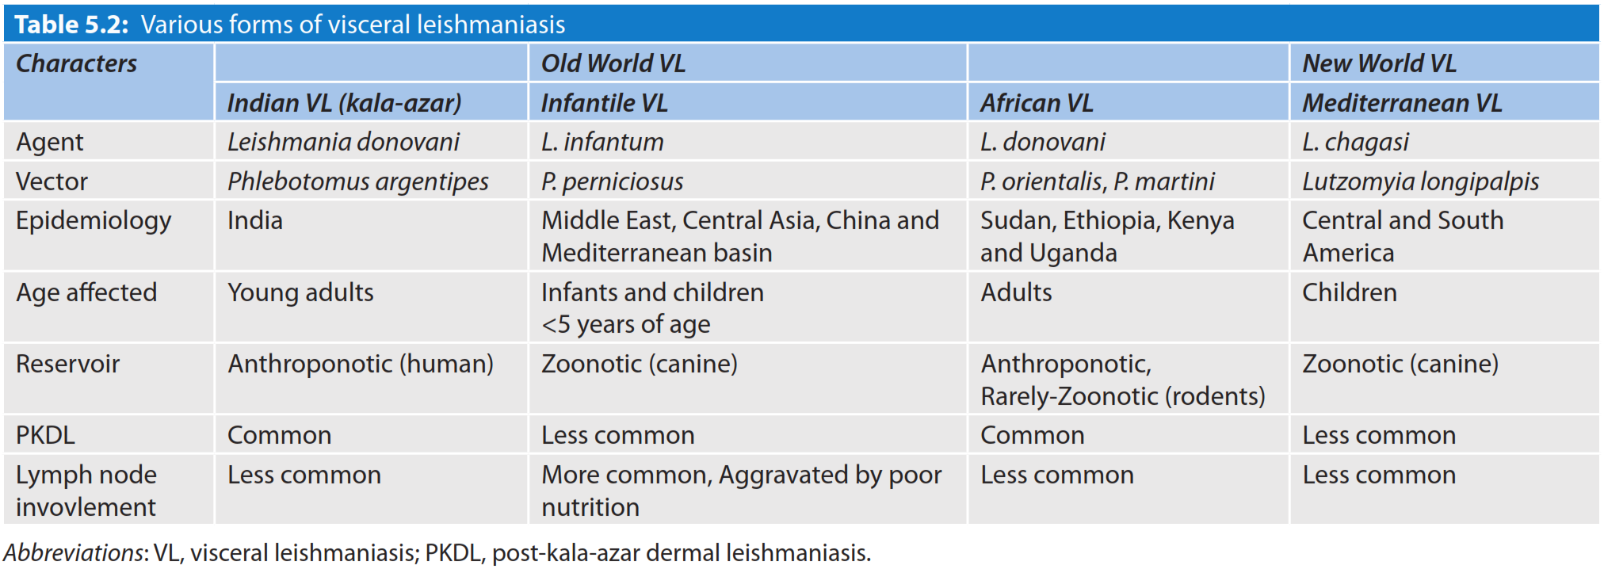

Slide 14
Clinical Features
Visceral leishmaniasis
Incubation period ranges from 2-6 months
The hallmark of VL is a pentad of fever, progressive weight loss, hepatosplenomegaly, pancytopenia and hypergammaglobulinemia
Fever and Hyperpigmentation
Splenomegaly
Lymphadenopathy
Pedal edema and ascites
Hematological abnormalities
  Pancytopenia: Anemia, leukopenia and thrombocytopenia
  Hypergammaglobulinemia
Leishmanoma

Slide 15
Post-kala-azar dermal leishmaniasis (PKDL)
PKDL is a nonulcerative lesion of skin occurs in 2-50% of patients of VL following incomplete or inadequate treatment or treatment with antimonials. It is aggravated by exposure to sunlight.
PKDL is also seen following L. infantum infection, although rare. It was first described by Brahmachari in 1922.
Mainly seen in India and East African countries
It develops as hypopigmented macule (most common feature) near mouth which later on spreads to face and then to arms and trunk (extensor surfaces) and finally becomes nodules resembling leprosy
Nodular lesions may serve as reservoir of infection during inter-epidemic period
Ocular lesions like conjunctivitis and uveitis are associated in some patients

Slide 16
PKDL continued…
Sometimes, PKDL occurs in subclinical patients without a history of VL
In East Africa, the lesions are graded into three types
  Grade-1 involves mainly face
  Grade-2 involves face, chest, back, upper arm and upper leg
  Grade-3 affects most parts of the body including hands and feet
Crusting and ulceration may be seen
The diagnosis is based on:
  Amastigote can be detected in the skin in more than 80% of cases in Sudan. It is more easily detected from nodular lesions than other lesions
  Serological tests: Direct agglutination test (DAT) and antibodies to rK39 antigen are positive in most of the cases.

Slide 17
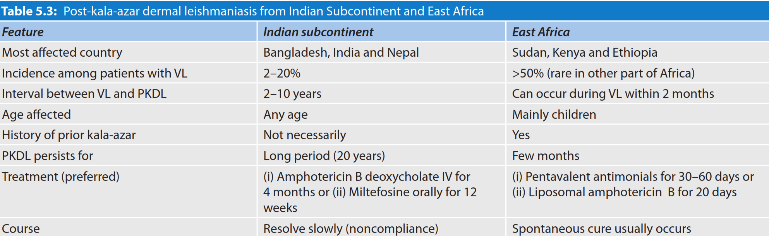

Slide 18
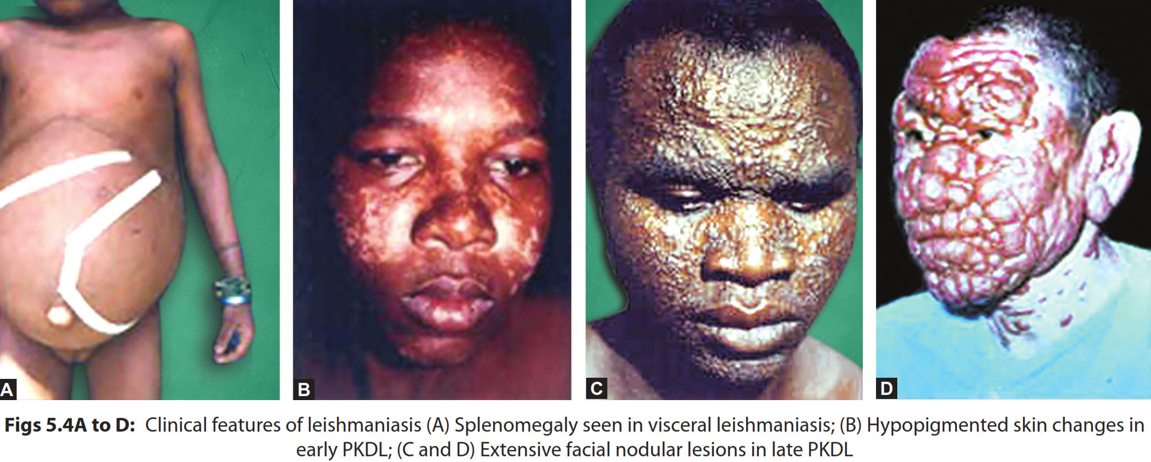

Slide 19
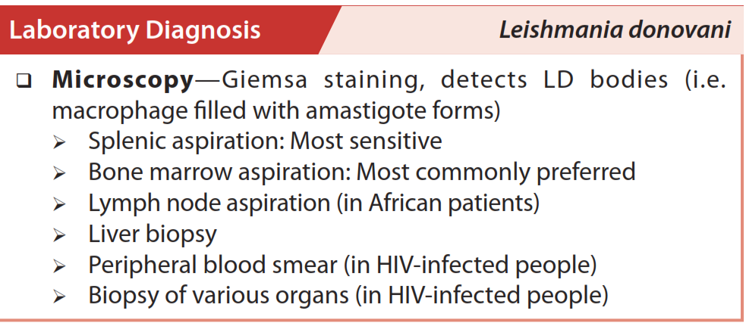

Slide 20
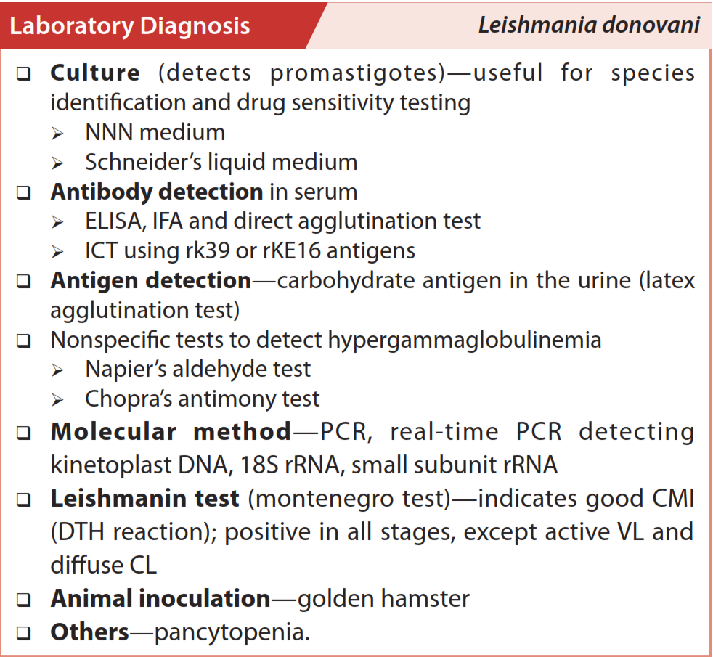

Slide 21
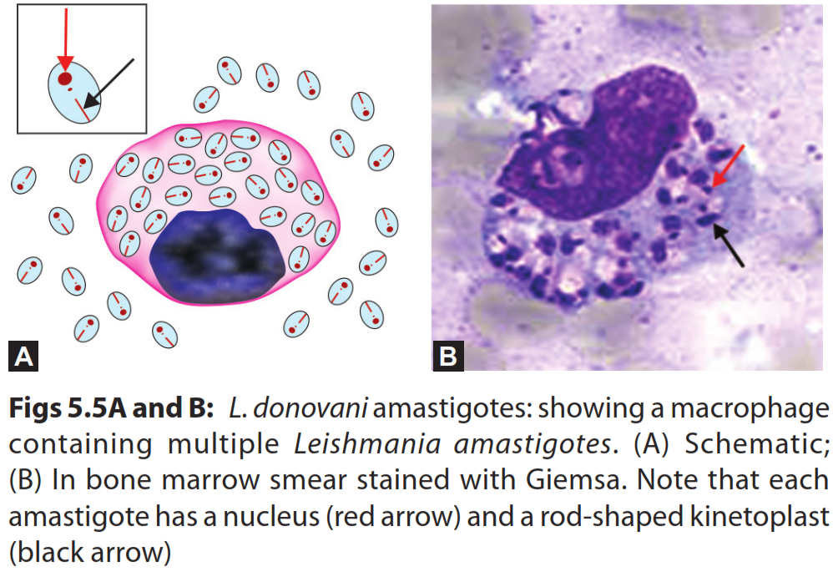

Slide 22
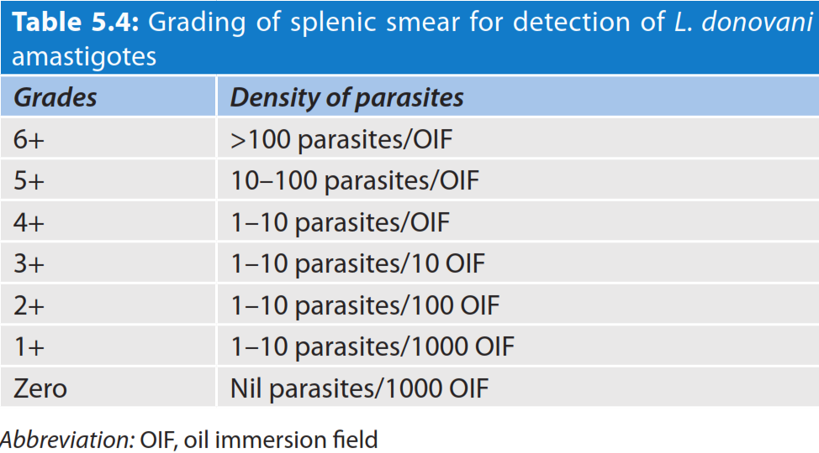

Slide 23
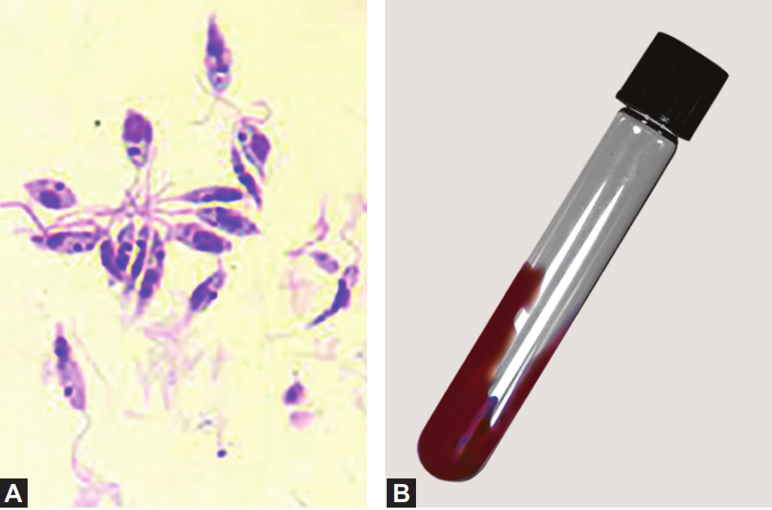

Slide 24
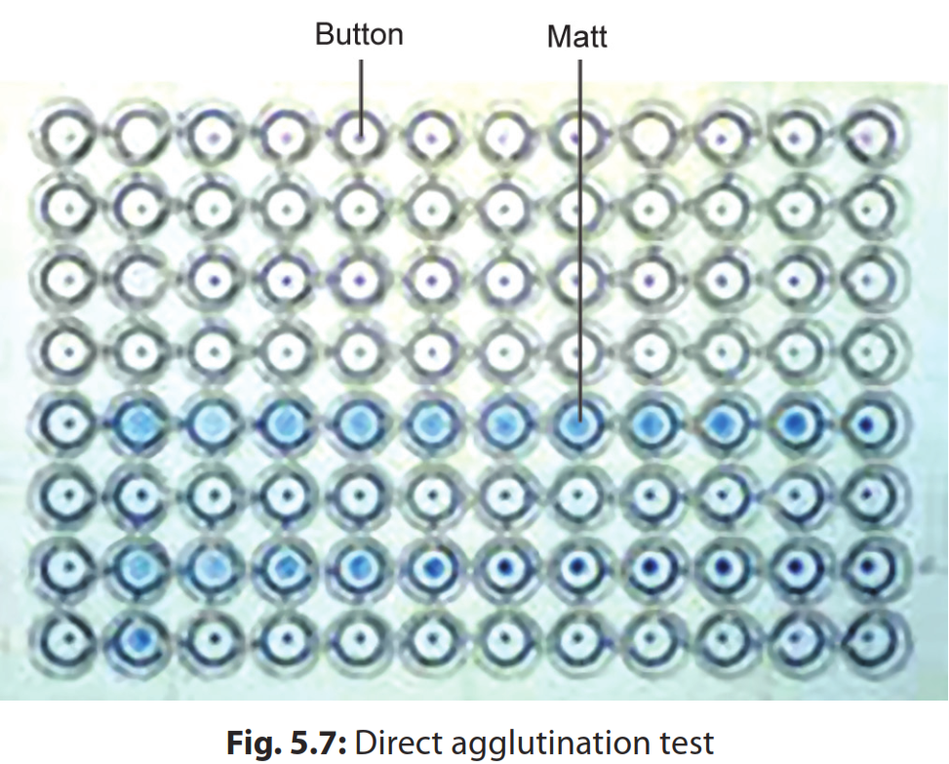

Slide 25
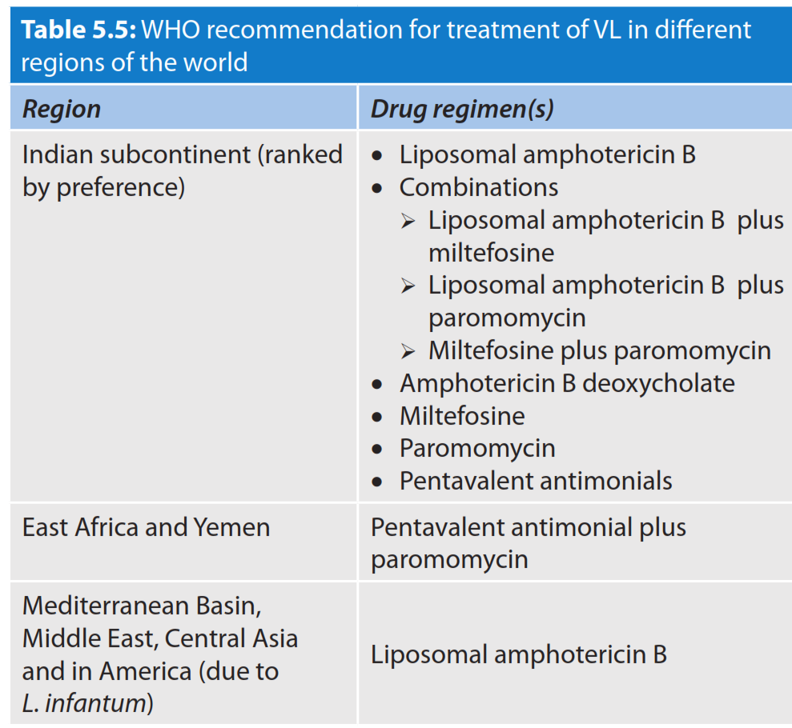

Slide 26
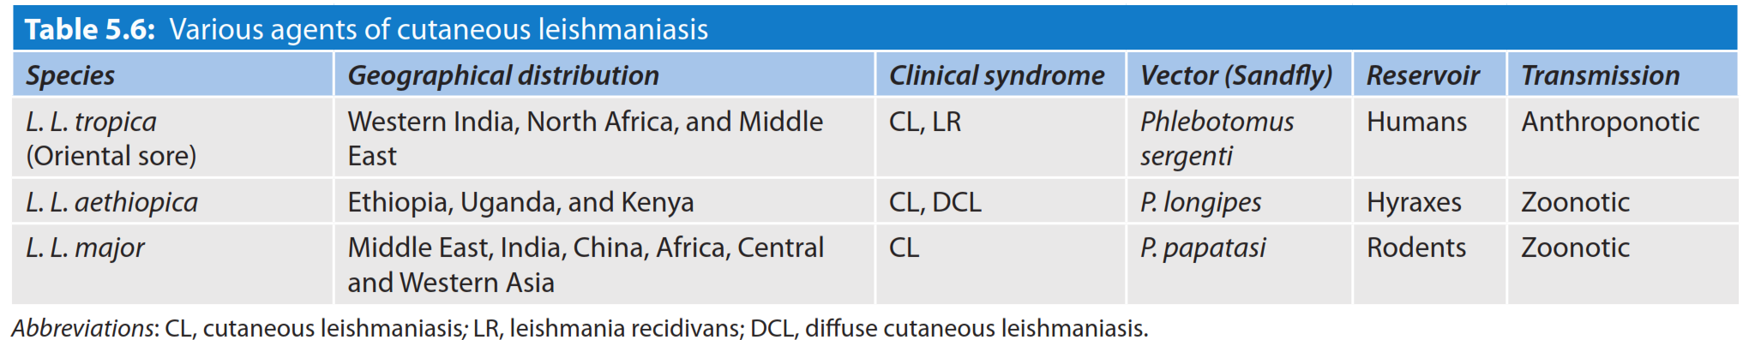
Cutaneous Leishmaniasis

Slide 27
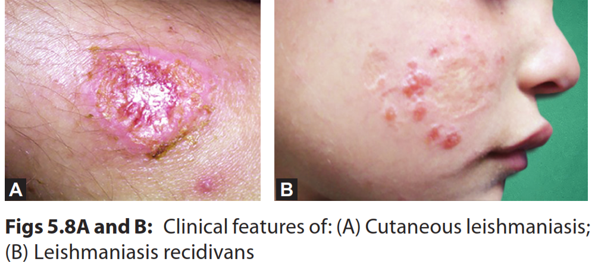

Slide 28
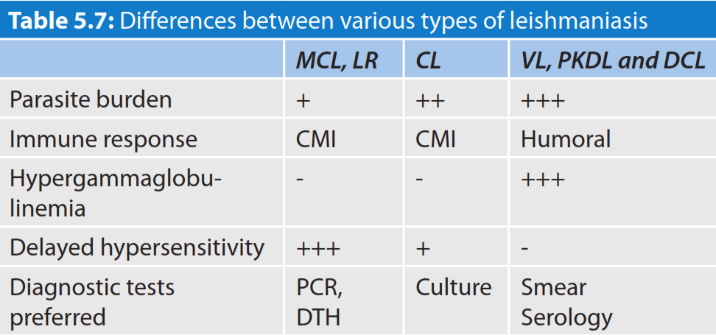

Slide 29
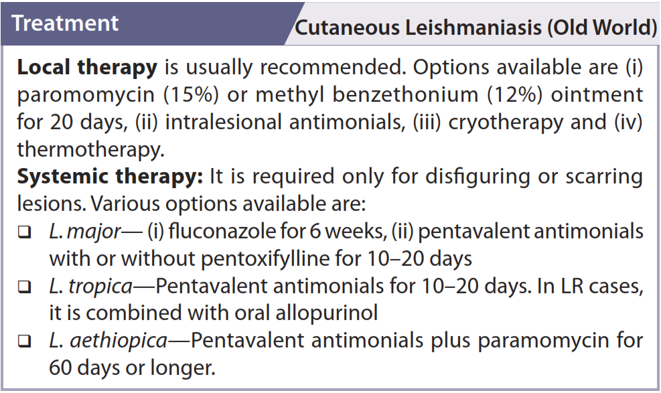

Slide 30
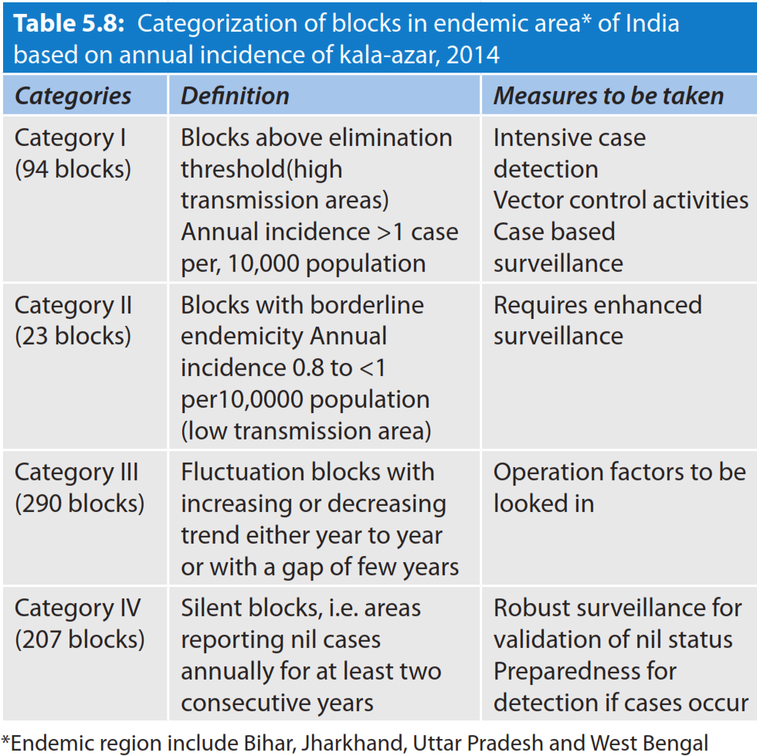
Elimination program

Slide 31
NEW WORLD LEISHMANIASIS
Leishmania Viannia (L .V. ) braziliensis complex
Leishmania Leishmania (L.L.) mexicana complex
L.L. chagasi (new world variant of L.L. infantum).

Slide 32
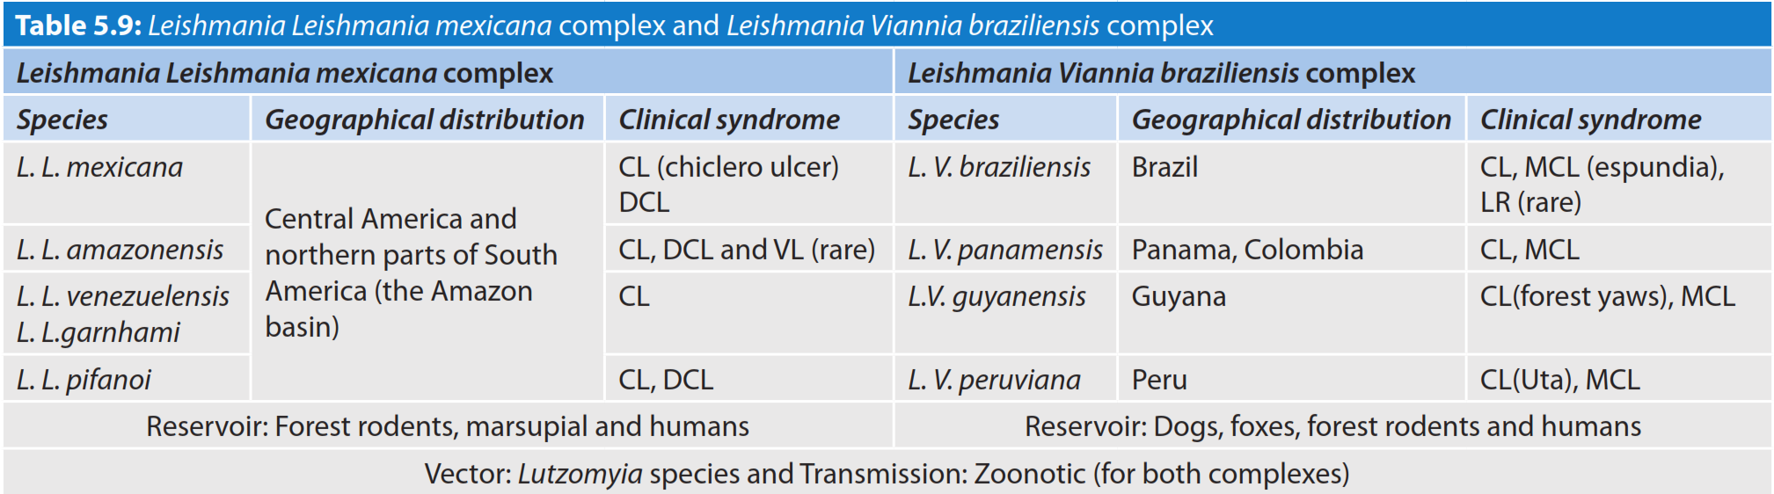

Slide 33
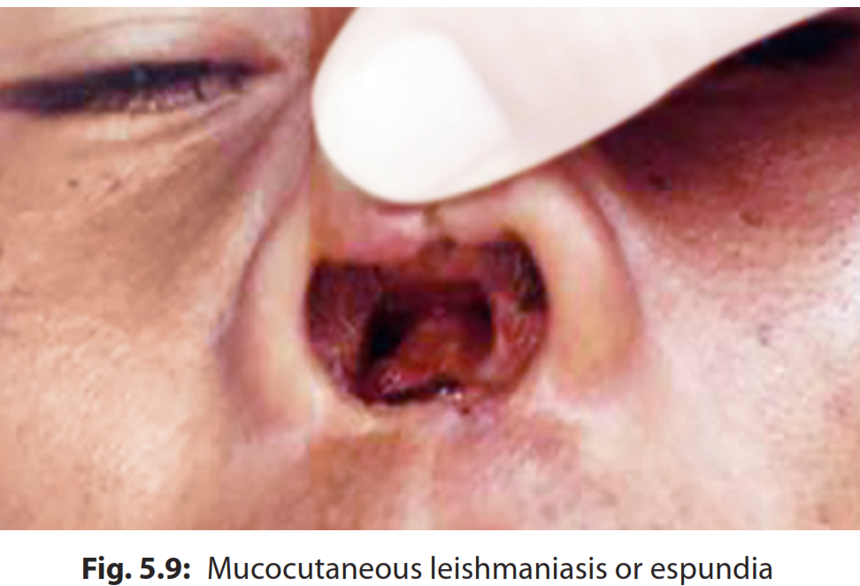

Slide 34
