Slide 1

MINOR CONNECTORS in Cast Partial Dentures
Dr Piyush Javiya
Reader, Dept. of Prosthodontics, KMSDCH,SVDU

Slide 2
Lesson Plan
Target: II BDS students
Duration: 45 Minutes
Topic: Minor connectors in CPD
Content | Duration in Minutes
Introduction | 05
Types of Minor connectors | 10
Minor connectors in Detail | 10
Discussion | 10
CCES | 10

Slide 3
Contents
Introduction
Definition
Functions of minor connectors
Basic principles of design of a minor connector
Types of minor connectors
Tissue stops and finish lines
Summary and conclusion
References

Slide 4
Introduction

Slide 5
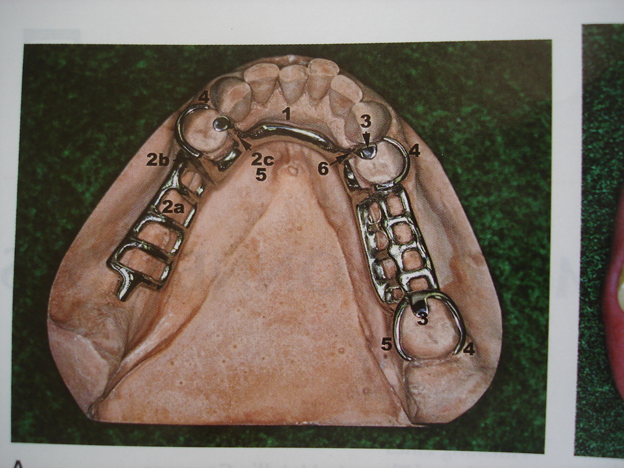

Slide 6
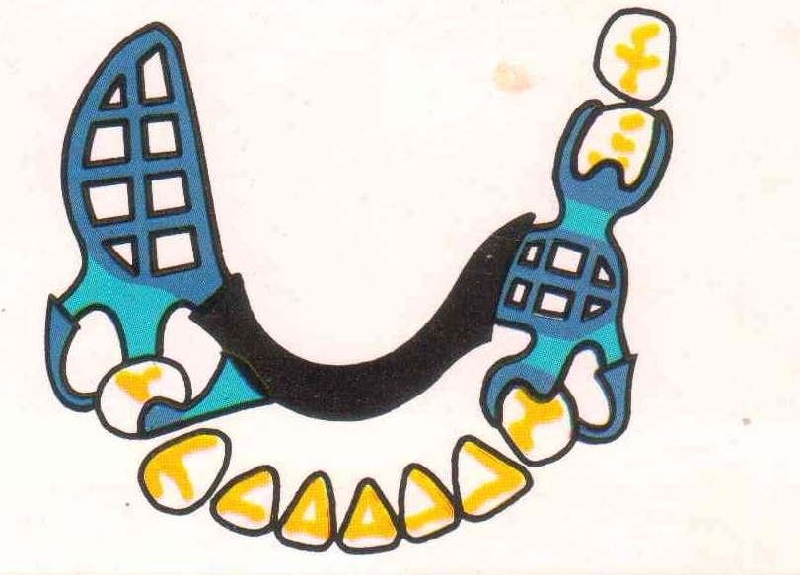
Definition
Minor connectors can be defined as the connecting link between the major connector or base of a removable partial denture to other units of a prosthesis such as clasp assembly, indirect retainers, rests etc

Slide 7
FUNCTIONS OF A MINOR CONNECTOR
1.Primary function
2.To transfer functional stress to the abutment teeth. Prosthesis- to- abutment function
3.To transfer the effect of retainers, rests and stabilizing components to the rest of the denture.
Abutment - to - prosthesis function

Slide 8
Basic principles of design of a minor connector
1. Should have sufficient bulk to be rigid
2. When contacting an axial surface it should not be located on a convex surface but instead should be located in an embrasure where it will be least noticeable to the tongue.
3. Should be thickest towards the lingual surface tapering towards the contact area.
4. Should form a right angle with the major connector so that the gingival crossing is abrupt and cover as little gingival tissue as possible.
5. Sharp angles should be avoided and spaces should not exist for trapping of food debris.

Slide 9
Types of minor connectors
1. Join clasp assembly to the major connector.
2. Join indirect retainers and auxilary rests to major connector.
3. Join denture base to the major connector
4. Serve as an approach arm for a vertical projection or bar type of clasp

Slide 10
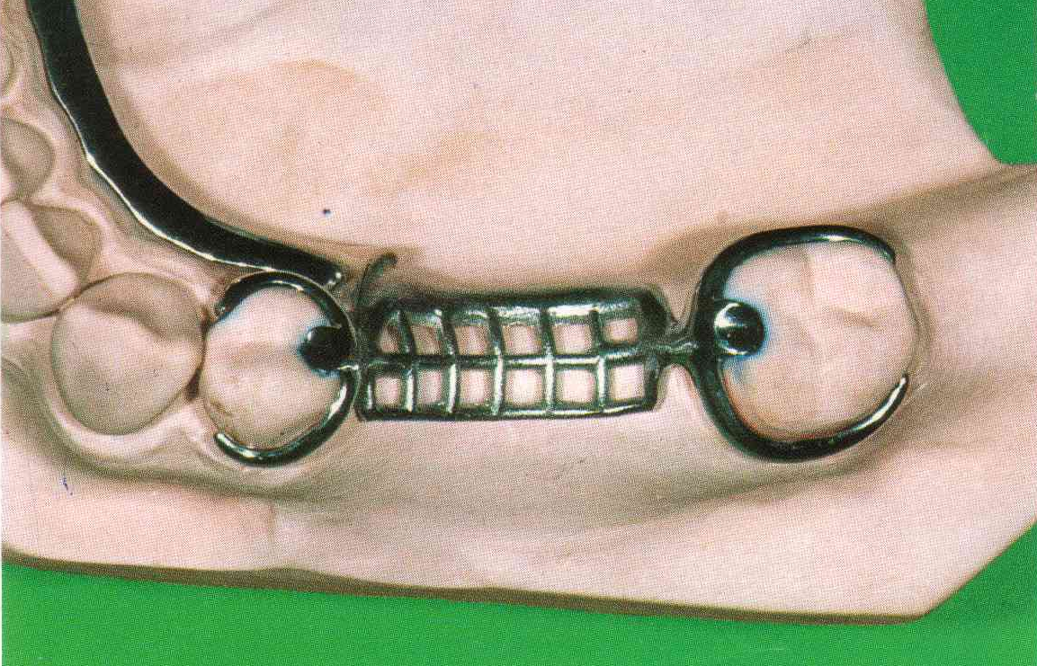
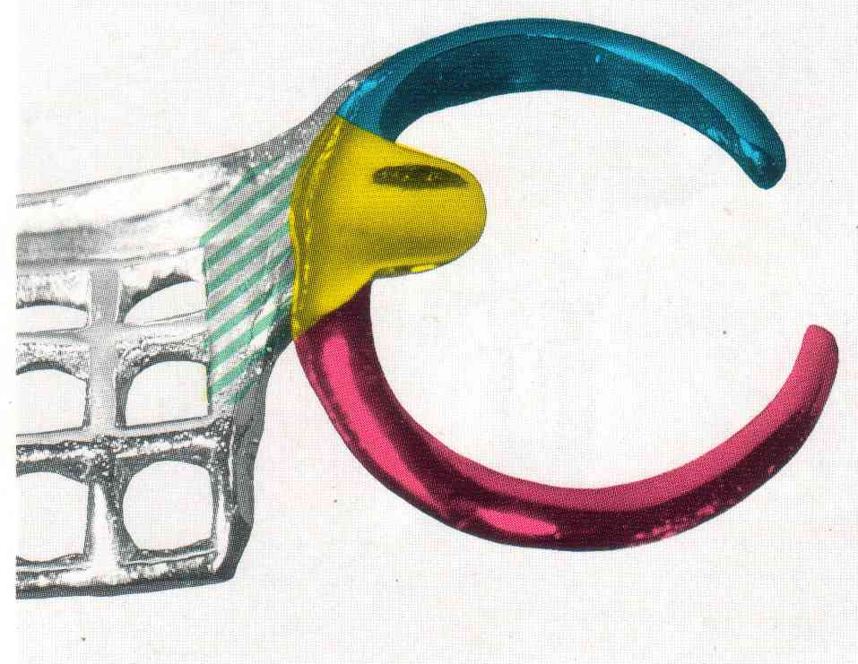
1.Minor connectors joining joining clasp assembly to major connector
Rigid

Slide 11
Minor connectors contacting the guide plane surfaces are as broad as 2/3 the distance between the tips of adjacent buccal and lingual cusps of the abutment tooth.
They should extend gingivally contacting an area of the abutment tooth from the marginal ridge to 2/3 the length of the enamel crown.
The connector should be tapered to the tooth below the origin of the clasp arm. If no clasp arm is formed as when a bar clasp originates elsewhere, the connector should be tapered to a knife edge the full length of the buccal surface.

Slide 12
When an artificial tooth is to be placed the thickest portion should be at the lingual line angle of the abutment tooth.This way bulk is ensured with least interference to the placement of the artificial tooth.
If the clasp assembly is not being placed on a tooth adjacent to the edentulous space, the minor connector must be positioned in the embrasure between two teeth.

Slide 13
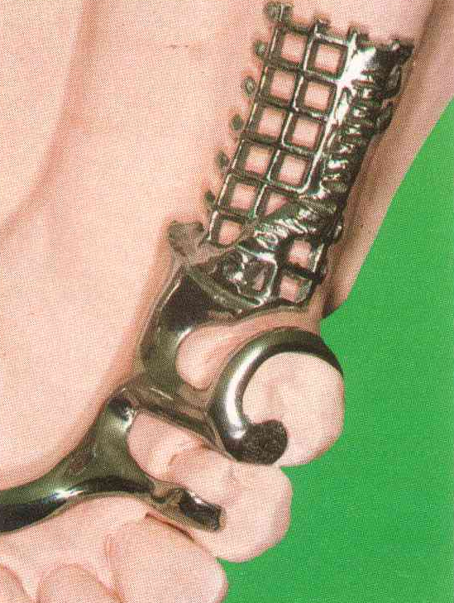

2. Minor connectors that join indirect retainers or auxiliary rests to major connector
- Should form a right angle with the major connector
- Should lie in embrasure between teeth to disguise its bulk as much as possible.

Slide 14
3.Minor connectors that join the denture base to the major connector
3 types:
1. Lattice work construction
2. Mesh construction
3. Bead,wire or nail head minor connector

Slide 15
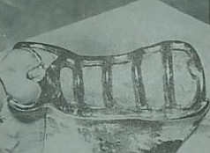
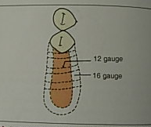
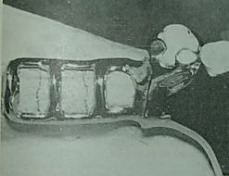
1.Open latticework construction

Slide 16
Advantages
Provides the strongest attachment of the acrylic resin denture base to the removable partial denture.
Easiest to reline if necessary because of ridge resorption.

Slide 17
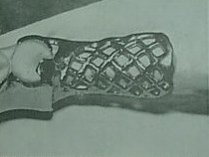
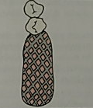
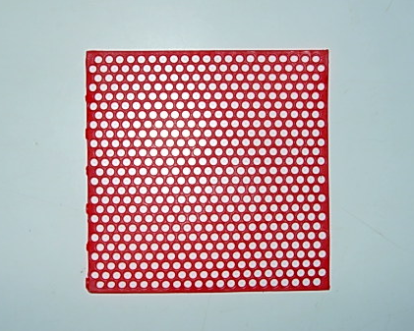
2.Mesh construction

Slide 18
Main drawback is that it is more difficult to pack acrylic resin dough because more pressure is needed against the resin to force it through the small holes.
It also does not provide as strong an attachment for the acrylic denture base as compared to the lattice framework

Slide 19
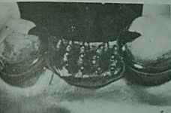


3.Bead ,wire or nail head retention minor connector
-
Used with a metal denture base which is cast to fit directly against the edentulous ridge.

Slide 20
Indicated when inter arch space is limited and acrylic resin by itself would not have sufficient strength to withstand the forces of occlusion.
Retention of the acrylic resin is obtained by projection of metal on its surface These projections may be in the form of beads,wires or nail heads.
Most hygienic

Slide 21
Shortcomings:
Difficulty to adjust the metal base.
Cannot be adequately relined in case of ridge
resorption.
Weakest attachment.

Slide 22
James A Dunny (1975) “Minor connector designs for anterior acrylic bases” and concluded that
The design of the metal retention is important in determining the strength of attachment of acrylic resin denture bases to the metal.
Larger openings in a retention design provides greater bulk than do small ones and therefore supply stronger attachment possibilities
Beads and nailheads do not provide for strong attachment of acrylic resin to the partial denture framework

Slide 23
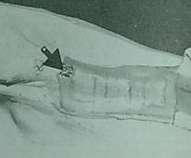
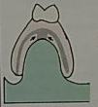
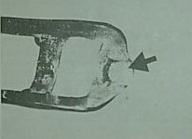
Tissue stops
Used on all distal extension partial dentures using latticework or mesh retention.

Slide 24

- Finishing index tissue stop

Slide 25
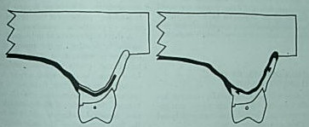
FINISH LINES
To provide sufficient bulk of acrylic resin to produce a smooth and even joint with the metal framework, provision must be made to provide space for a butt joint so that the acrylic resin can be finished evenly with the major connector.
2 types
-Internal finish line
-External finish line

Slide 26
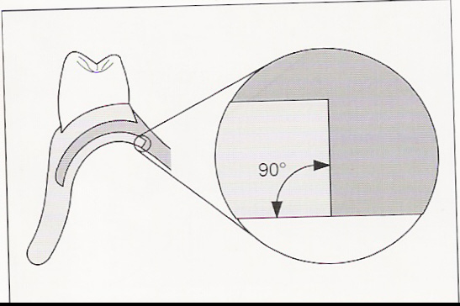
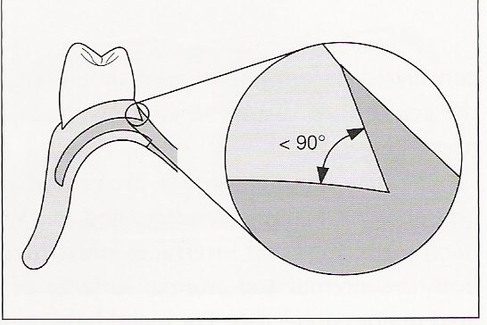
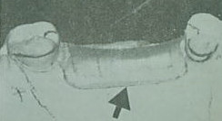
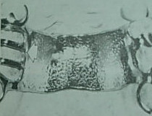
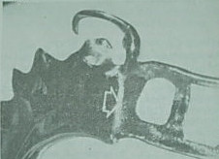
Internal finish line
External finish line

Slide 27
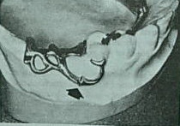
Finish line for minor connector of a bar type retainer

Slide 28
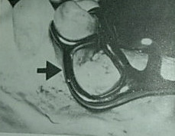
4. Minor connectors that serve as an approach arm for vertical projection or bar type of clasp

Slide 29
Summary and Conclusion

Slide 30
MCQs

Slide 31
Which component of RDP connects one component with other components? | Major connector | Minor connector | Juncture | All
Which of the following is function of a minor connector? | Joining components with each other | Transfer functional load to abutments | Transferring load from other rest to the other parts of RDP | All
Which of the following is not a requirement of minor connector? | Sufficient bulk | Least noticeable to tongue | Should cross the tissue at obtuse angle | Should not entrap the food particles
Minor connectors contacting the guide plane surfaces are as broad as | 2/3 distance between buccal and lingual cusp | 1/3 distance between buccal and lingual cusp | 1/2 distance between two cusps | 3/4 distance between two cusps
Which of the following are types of minor connectors that join the denture base to the major connector? | Lattice work | Meshwork | Beads/nail heads | All

Slide 32
REFRENCES
- Clinical removable partial prosthodontics, 2nd edition Kenneth L Stewart
- Removable partial prosthodontics,2nd edition ,
Ernest L Miller
McCrackens Removable partial prosthodontics, 8th edition
Glen p McGivney
Colour Atlas of Removable Partial dentures,
John C Davenport

Slide 33

THANK YOU

