Slide 1
Trypanosomes
Ms Sangita Vasava
Assistant Professor
Department of Microbiology

Slide 2
TRYPANOSOMA
African trypanosomes
Trypanosoma brucei rhodesiense: It is the causative agent of East African sleeping sickness in man
Trypanosoma brucei gambiense: It is the causative agent of West African sleeping sickness in man.
Trypanosoma brucei brucei: It causes nagana, a disease affecting cattle in Africa.
American trypanosomes
T. cruzi; which is the causative agent of South American trypanosomiasis in man (also called as Chagas’ disease)

Slide 3
TRYPANOSOMA CRUZI
Epidemiology
Chagas’s disease is mainly restricted to South and Central American countries like Brazil, Argentina, Venezuela, etc.
Currently, it is estimated that 16・8 million people are infected with T. cruzi. Annual incidence is around 2 Lakhs new cases with 50,000 deaths
It is a zoonotic disease, having many animal reservoirs like dogs, cats, opossums and rodents.

Slide 4
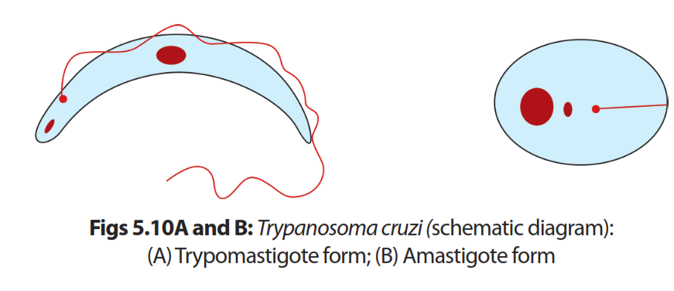
Morphology
In vertebrate host, it exists mainly in two forms
  trypomastigote form
  amastigote form
In insect vector (reduviid bug), it exists as
  Trypomastigote
  epimastigote form.

Slide 5
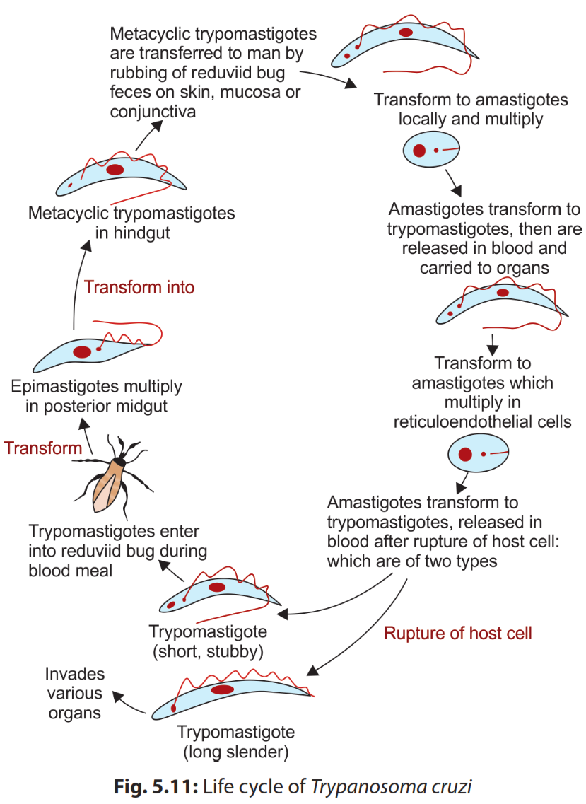
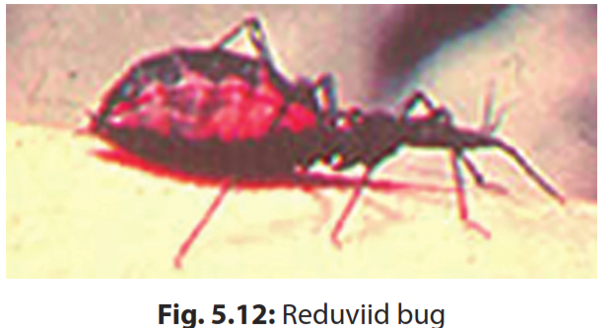
Life cycle
Vector: Reduviid bugs
Infective form: Trypomastigote forms

Slide 6
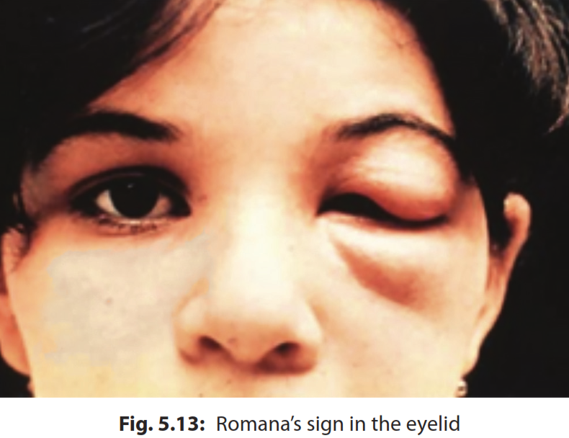
Pathogenesis and clinical feature
Early Stage disease
  Chagoma sign
  Romana’s sign
Acute Chagas’ disease
Indeterminate Stage
Chronic Chagas’ disease
  Cardiac form
  Gastrointestinal form

Slide 7
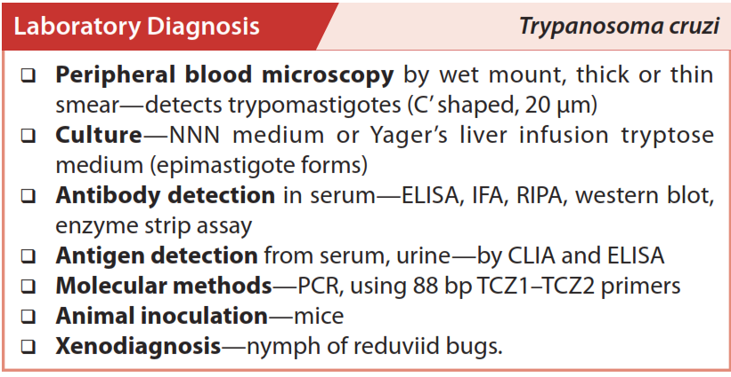

Slide 8
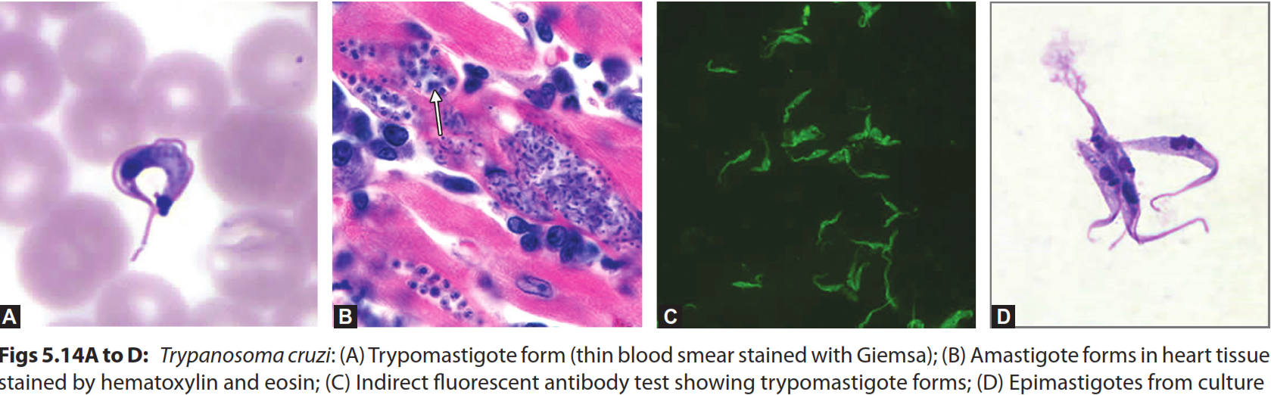

Slide 9
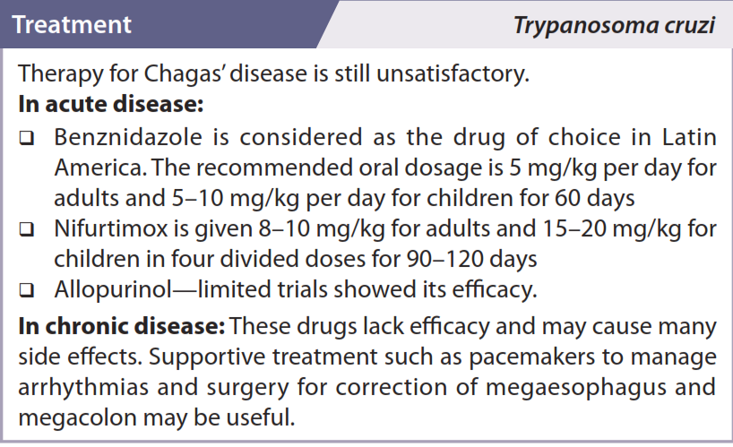

Slide 10
Trypanosoma brucei

Slide 11
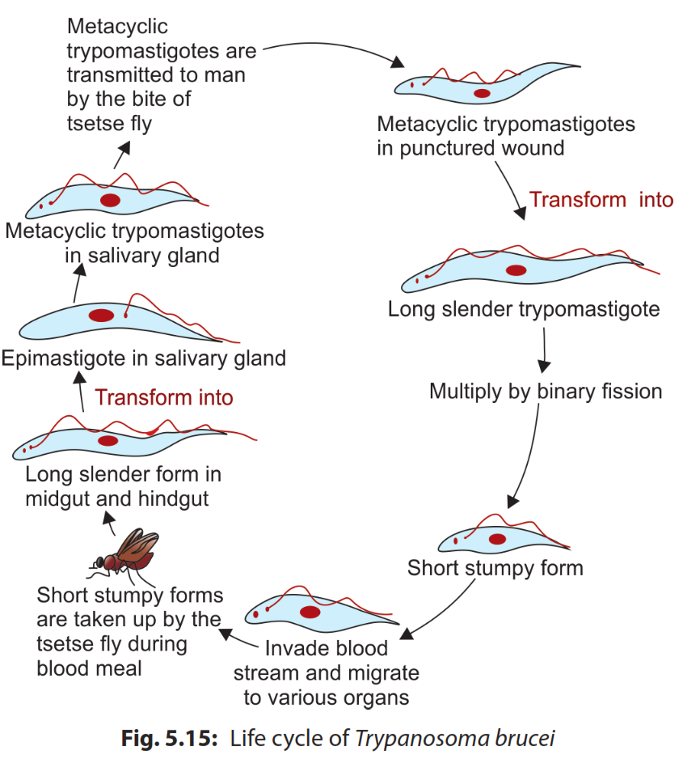
Life Cycle

Slide 12
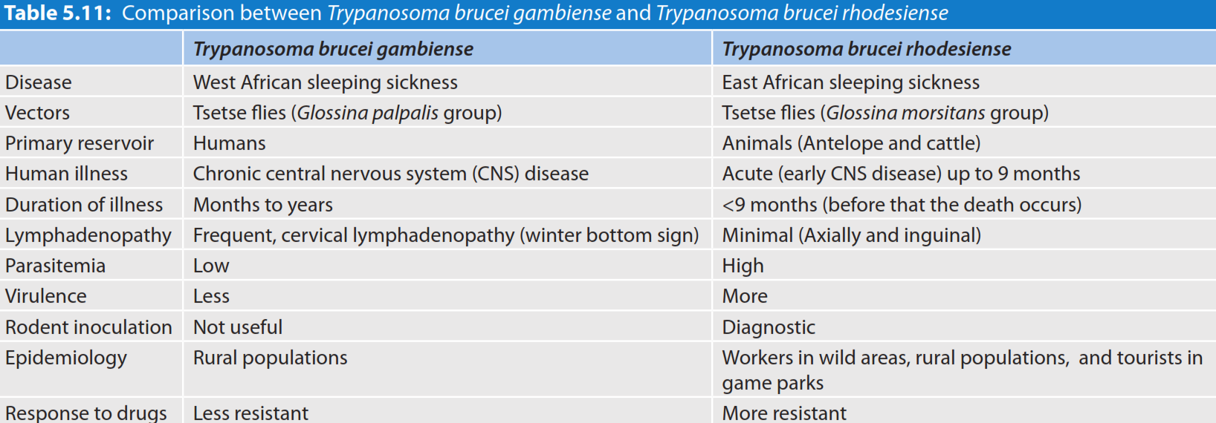

Slide 13
Pathogenesis and Clinical feature
Trypanosomal Chancre
Stage I disease (without CNS involvement)
  Asymptomatic period
  Systemic febrile illness
  Fever and lymphadenopathy (Winterbottom’s sign)
  Kerandel’s sign (Delayed sensation to pain)
  Hematologic- leukocytosis, thrombocytopenia, anemia

Slide 14
Stage II disease (CNS invasion)
  Characteristic progressive daytime somnolence (hence called as sleeping sickness),
  with restlessness and insomnia at night which may be related to increased prostaglandin D2 level in the body
  Behavioral and personality changes with apathy, confusion, fatigue and loss of coordination may be observed

Slide 15
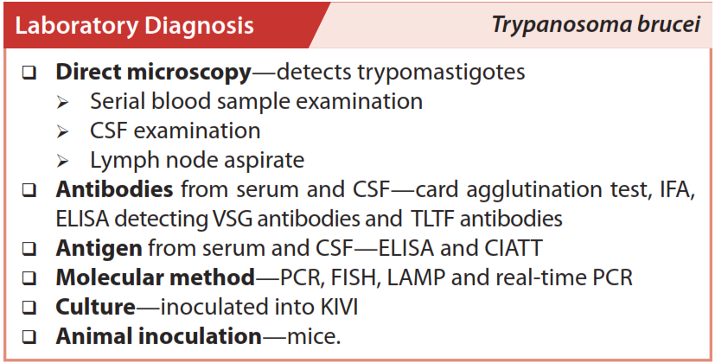

Slide 16
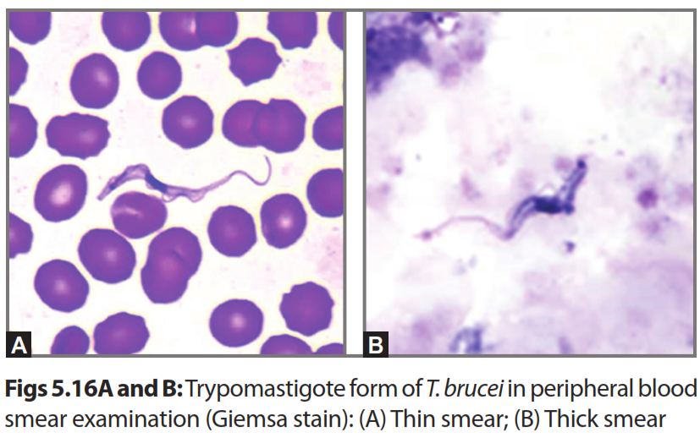

Slide 17
