Slide 1
Flagellates—I
(Intestinal and Genital)
Giardia and Trichomonas
Ms Sangita Vasava
Department of Microbiology

Slide 2
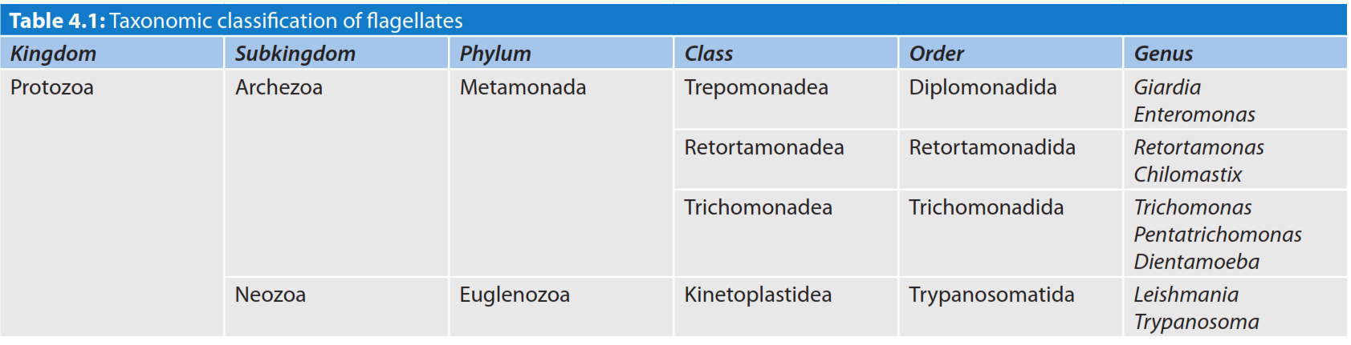
Classification of flagellates

Slide 3
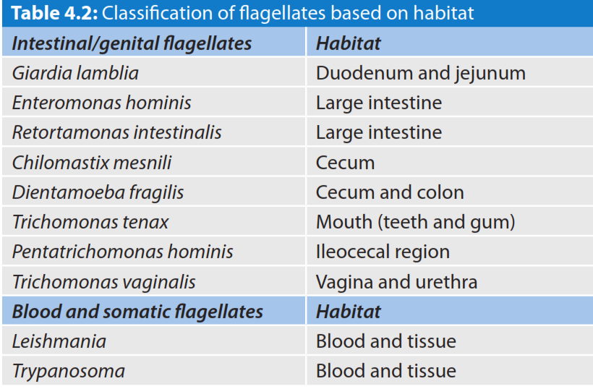

Slide 4
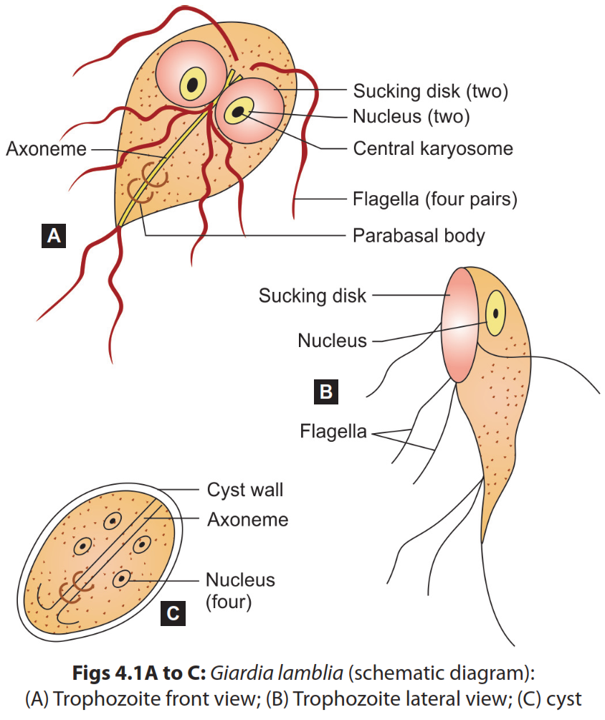
Morphology

Slide 5
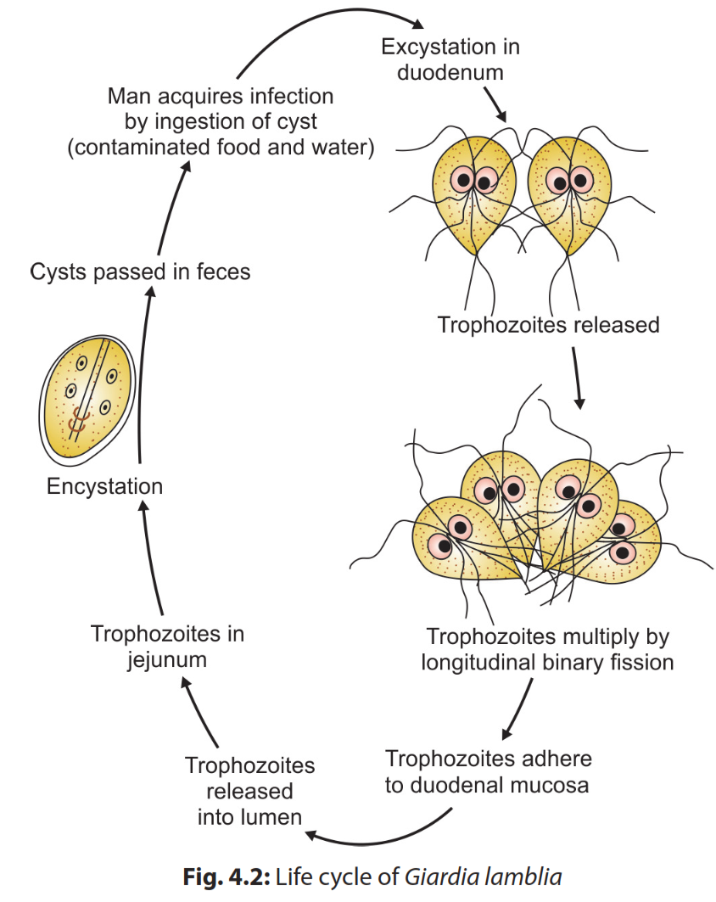
Life Cycle
Life Cycle
Host: Giardia completes its life cycle in one host.
Infective form: Cysts are the infective form.
Mode of transmission: Man acquires infection by ingestion of food and water contaminated with mature cysts or rarely by sexual route (mainly in homosexuals).

Slide 6
Pathogenicity
Infective dose: 10-25 cysts can initiate the Infection
Malabsorption: This could be of various types such as:
  Malabsorption of fat (steatorrhea)- leads to foul smelling profuse frothy diarrhea
  Disaccharides deficiencies (lactose, xylose)- leading to lactose intolerance
  Malabsorption of vitamin A, B12 and iron
  Protein loosing enteropathy.
Antigenic variation: Giardia undergoes frequent antigenic variations due to a cysteine rich protein on its surface called variant surface protein (VSP)

Slide 7
Clinical features
Asymptomatic carriers
Acute giardiasis
  Incubation period varies from 1 week to 3 weeks
  Common symptoms - diarrhea, abdominal pain, bloating, belching
  Diarrhea is often foul smelling with fat, and mucus but no blood
Chronic giardiasis:
  Recurrent episodes of foul smelling diarrhea
  Extraintestinal manifestations such as urticaria, anterior uveitis, salt and pepper retinal changes and arthritis

Slide 8
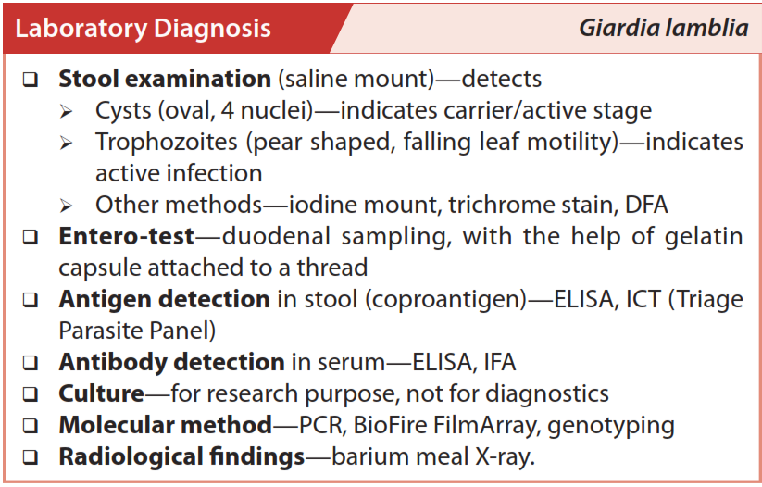

Slide 9
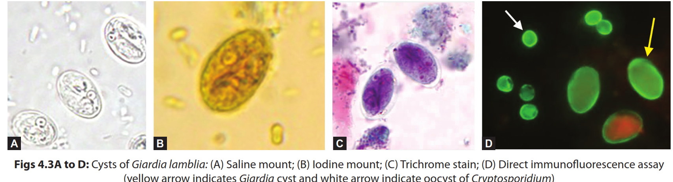
Cysts

Slide 10
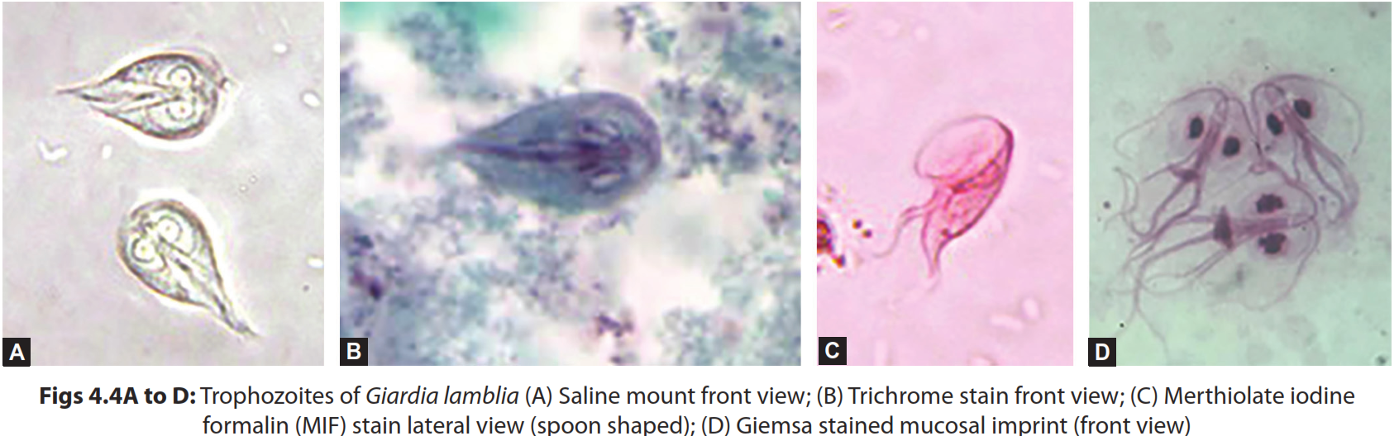
Trophozoites

Slide 11
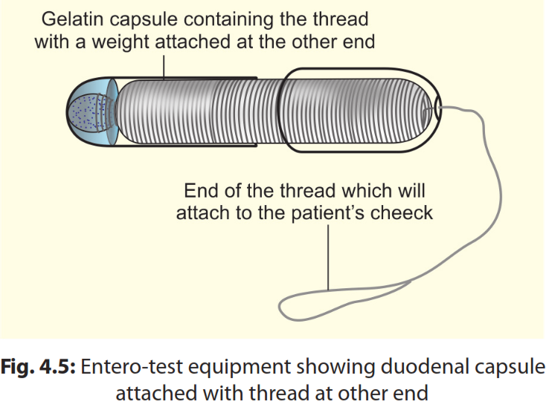
Entero-test

Slide 12
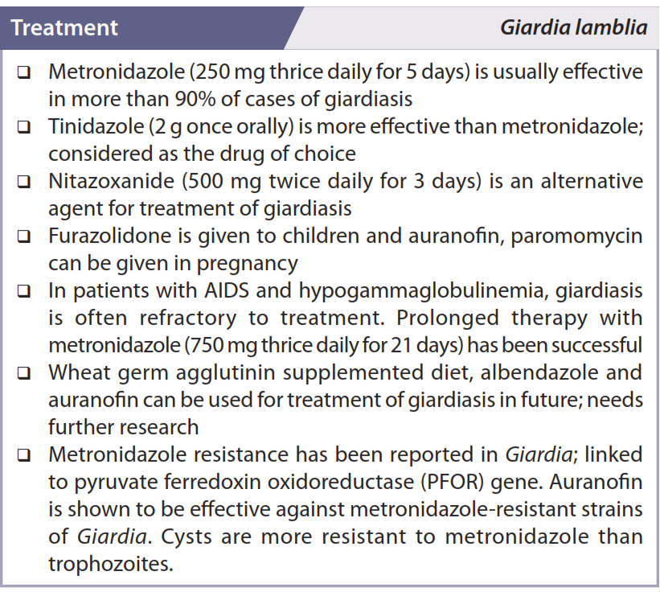

Slide 13
TRICHOMONAS
Trichomonas belongs to:
  Class: Trichomonadea
  Order: Trichomonadida
  Family: Trichomonadidae.
Species
  T. vaginalis is the only pathogen. It resides in the genital tract
  Pentatrichomonas hominis: Nonpathogen, large intestine
  T. tenax: Nonpathogen, resides in mouth (teeth and gum)

Slide 14
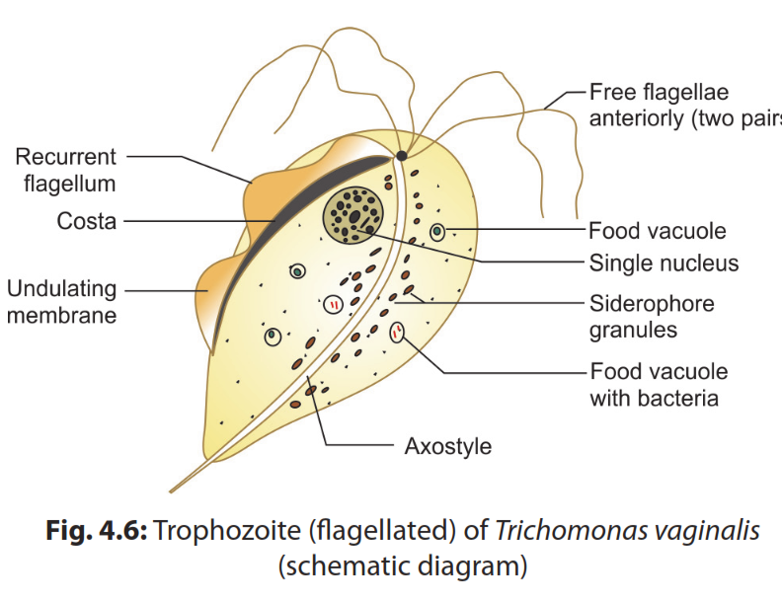
Morphology
Exists as
Trophozoite (flagellate and ameboid form)
Pseudocystic stages.
There is no cystic stage

Slide 15
Life Cycle
Flagellated trophozoites are the infective stage as well as the diagnostic stage.
Transmission:
  Asymptomatic females transmit the disease by sexual route.
  Though rare, but evidence of non-sexual transmission via fomites
On exposure to oxygen, the anaerobic flagellated trophozoites undergo cytoskeletal rearrangement and transform into tissue-feeding and actively dividing ameboid trophozoites
The amoeboid trophozoites divide by longitudinal binary fission and infect urogenital tract
They again transform back to flagellated trophozoites, which infect other individuals.

Slide 16
Clinical feature
Asymptomatic infection: 25-30%
Acute infection (vulvovaginitis)
  Females are commonly affected and are presented as vulvovaginitis (thin profuse foul smelling purulent discharge)
  Strawberry appearance of vaginal mucosa (Colpitis macularis) -in 2% of patients. It is characterized by small punctate hemorrhagic spots on vaginal and cervical mucosa
  Other features include dysuria and lower abdominal pain
  In males, the common features are nongonococcal urethritis and rarely epididymitis, prostatitis and penile ulcerations
Chronic infection
Complications

Slide 17
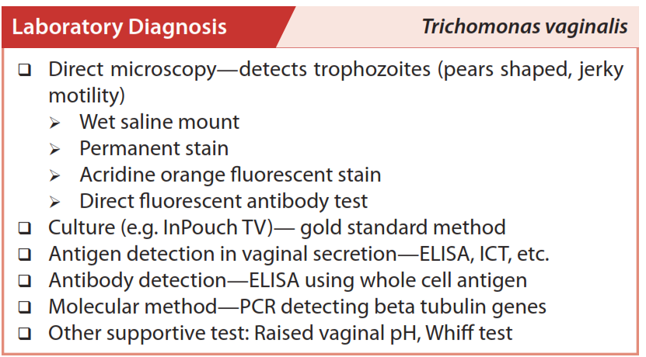

Slide 18
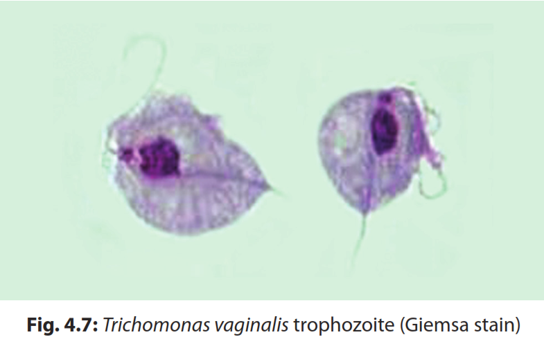

Slide 19
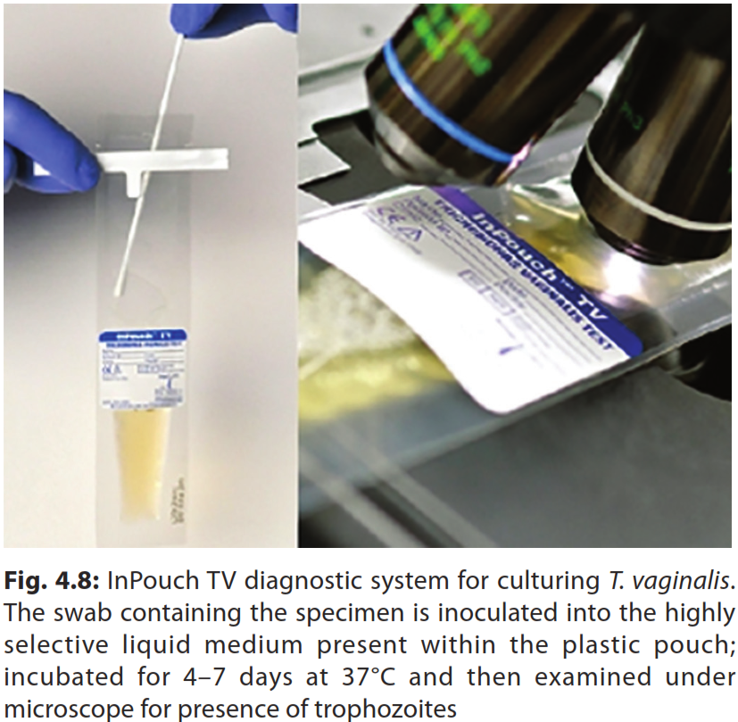

Slide 20
