Slide 1
PHYSIOTHERAPY MANAGEMENT IN THORACIC
SURGERIES
Dr. Parthkumar Devmurari, PT

Slide 2
Objectives
Brief introduction of thoracic surgeries
Indications for thoracic surgeries
Incisions used in thoracic surgeries
Brief descriptions for surgeries of lungs
Complications of thoracic surgeries
Pre and post operative Physiotherapy management in thoracic surgeries

Slide 3
Introduction
Thoracic surgery is the repair of organs located in the thorax, or chest.
The thoracic cavity lies between the neck and the diaphragm, and contains the heart and lungs (cardiopulmonary system), the oesophagus, trachea, pleura, mediastinum, chest wall, and diaphragm.
Patients who undergo a thoracic surgery, physiotherapy plays a significant role in the prevention and treatment of both pulmonary and musculoskeletal complications following major surgery.

Slide 4
Purpose Of Thoracic Surgery
Thoracic surgery is usually performed by a surgeon who specializes in either general thoracic surgery or cardiothoracic surgery.
Thoracic surgery repairs diseased or injured organs and tissues in the thoracic cavity.
General thoracic surgery deals specifically with disorders of the lungs and esophagus.

Slide 5
INDICATIONS OF THORACIC SURGERIES
Lung Cancer
Benign tumors
Bronchiectasis
Chronic infections
Tuberculosis
Pneumothorax and
Empyema

Slide 6
Thoracic Incision
Posterolateral thoracotomy
Lateral (muscle-sparing) thoracotomy
Posterior thoracotomy
Thoracoabdominal incision
Median sternotomy
Transsternal bilateral thoracotomy

Slide 7
Posterolateral thoracotomy
Most frequently used incision for thoracic surgery
Most pulmonary resection done through this incision.
Also provides excellent access to the mediastinum for resection of mediastinal masses.
Certain open and closed cardiac procedures, such as co-arctation repair, aneurysm resection, and mitral valve replacement, may also be performed through this incision.
See the figure in the next slide>>>>>>>>>>>>>>>>>

Slide 8
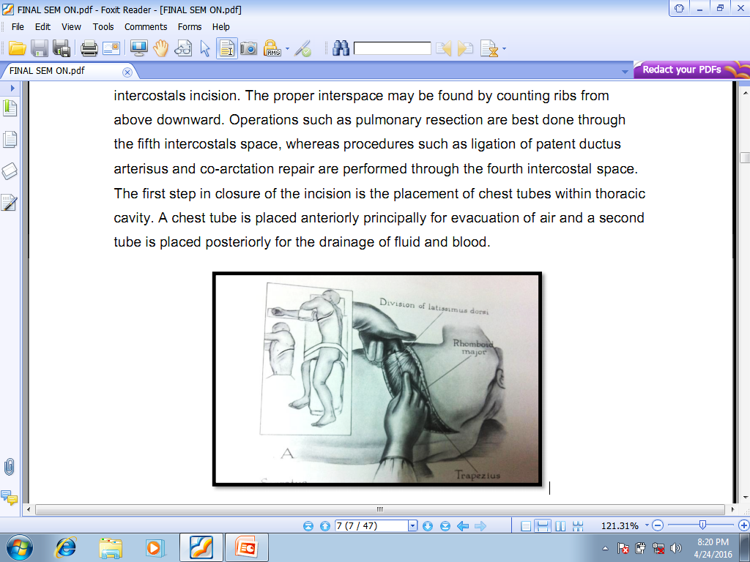
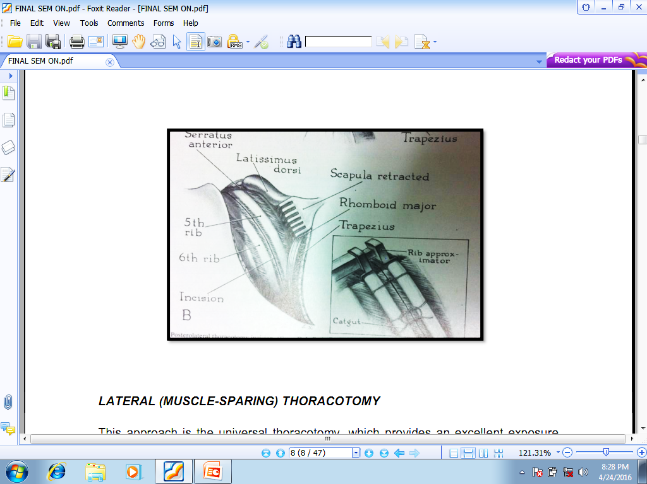
Both Images shows Posterolateral Thoracotomy incision

Slide 9
Procedure:
Patient is placed to lateral position
Skin incision extends from just below the nipple, posteriorly to 1 inch below the tip of the scapula and then extends upward between the scapula and the spine.
Subcutaneous tissues are divided along the course of the incision, as are the latissimus dorsi and the serratus anterior.

Slide 10
Once the muscles are divided the shoulder girdle will glide upward, allowing the scapula to retract away from the intended intercostals incision.
The first step in closure of the incision is the placement of chest tubes within thoracic cavity. A chest tube is placed anteriorly principally for evacuation of air and a second tube is placed posteriorly for the drainage of fluid and blood.

Slide 11
LATERAL (MUSCLE-SPARING) THORACOTOMY
This approach is called universal thoracotomy,
Provides an excellent exposure including extended procedures such as sleeve resections of the bronchi or intrapericardial pneumonectomy.
It is an excellent thoracic incision for single lung transplantation.

Slide 12
The skin incision is made on a horizontal line passing below the tip of the scapula to the sub-mammary fold, the other is a landmark for the cartilage of the 6th rib.
Incision would be between 12 and 15 cm long.
The subcutaneous tissue is divided until the fasciae are overlying the latissimus dorsi muscle and anterior serratus muscle.

Slide 13
POSTERIOR THORACOTOMY
This incision Permitted early division of the bronchus and lung collapse.
Patient is placed in a prone position.
An incision is extended from the anterior axillary line to the base of the neck, midway between the posterior edge of the scapula and the spine.
Rhomboid, trapezius, latissimus, and serratus muscles are divided. The selected interspace may then be entered.

Slide 14
THORACOABDOMINAL INCISION
The thoraco-abdominal incision permits simultaneous dissection in pleural and abdominal cavities.
The left-sided approach is particularly for esophageal surgery.
This exposure facilitates esophageal, gastric, splenic, and retroperitoneal surgeries.
The abdominal portion of the incision is made first to determine operability. An oblique incision from the midline to the left costal margin is utilized.

Slide 15
MEDIAN STERNOTOMY
The median sternotomy is now utilized for the majority of cardiac operations as well as for other procedures, including thymectomy and resection of mediastinal tumours.
The sternotomy incision is popular for cardiac procedures primarily because of the excellent exposure it provides for all parts of the heart.
Incision is made from just beneath the suprasternal notch to a point between the xiphoid and umbilicus.
Once the operative procedure has been completed, the sternum is approximated with five to eight heavy stainless steel wires.

Slide 16
TRANSSTERNAL BILATERAL THORACOTOMY
Incision provides good exposure of the heart and anterior mediastinum.
The right middle lobe is easily approached anteriorly, and bilateral anterior thoracotomy is gaining popularity for double-lung transplantation.
A bilateral submammary incision is made extending from the anterior axillary line on each side and crossing the sternum at the level of the fourth interspace.
The petoralis muscles are divided, sternum may or may not be divided.

Slide 17
SURGERIES OF THORAX
Operations of Lungs
Pneumonectomy
Lobectomy
Wedge resection
Segment resection
Lung volume reduction surgery (LVRS)
Operations of Pleura
Decortication
Pleurectomy

Slide 18
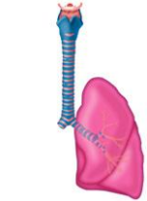
Pneumonectomy
Whole lung is removed and the resulting cavity will fill with protein-rich fluid and fibrin.
Removal of carinal, paratracheal and paraoesohageal lymph nodes if they appear to be involved and involving a main bronchus.
Lateral shift of the mediastinum, upward shift of diaphragm, and reduction of the intercostals spacing on the operated side reduce the size of cavity.

Slide 19
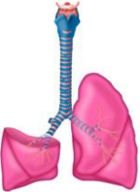
Lobectomy
Removal of whole lobe
Sleeve lobectomy: A surgical procedure that removes a cancerous lobe of the lung along with part of the bronchus (air passage) that attaches to it.
The remaining lobe(s) is then reconnected to the remaining segment of the bronchus. This procedure preserves part of a lung, and is an alternative of pnemonectomy.

Slide 20
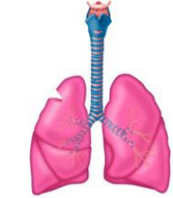
Wedge resection
Removes a small, wedge-shaped portion of the lung containing the cancerous cells along with healthy tissue that surrounds the area.
The surgery is performed to remove a small tumor or to diagnose lung cancer.

Slide 21
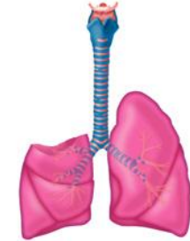
Segment resection
A segment resection removes a larger portion of the lung lobe than a wedge resection, but does not remove the whole lobe.
A segment of a lobe, with its segmental artery and bronchus is removed.

Slide 22
DECORTICATION
AIM-
The operation should result in full mobilization and expansion of normal lung, obliteration of the pleural space and restoration of normal respiratory movements and function.
If underlying lung tissue is diseased or destroyed, decortications can be combined with lobectomy or pneumonectomy.

Slide 23
Its indicated when thickened pleura leads to reduction in movements of the lung, chest wall and diaphragm that leads to restriction in respiratory function to the extent of interfering with the patient’s normal activity.

Slide 24
A standard lateral thoracotomy is made through the bed of the sixth rib.
There is usually considerable rib crowding and it is often necessary to resect one rib.
Stripping of the pleura off the ribs should continue superiorly and posteriorly onto the mediastinum.
Apical and basal intercostal drains are placed carefully through separate stab incisions.
The thoracotomy is closed in layers and adequate suction applied to the underwater drainage tubes as soon as the incision is closed.

Slide 25
Complications
After operation of lung:
Sputum retention (inability to remove secretion)
Broncho-spasm
Pulmonary Oedema
Atrial fibrillation
Surgical Emphysema (Iatrogenic/ surgery mistakes)
Haemorrhage (blood volume loss)
After operation of pleura:
Atelectasis (Collapse of lung)
Bronchopneumonia (Inflammation of lung parenchyma)
Haemorrhage
Persistant large air leak (Large broncho-pulmonary fistula)

Slide 26
General Complication
Atelectasis (Collapse of lung)
Pain (At incision site)
Drowsiness (due to low blood volume/ anesthesia effect)
Impaired diaphragmatic function (inhibition to respiratory centres)
Pleural effusion (production of more fluid in pleural space)
Hypoxemia (less oxygen in blood)
DVT (Deep Vein Thrombosis due to immobility)
Late Complication
Emphysema after lobectomy/segmentectomy
Post pneumonectomy empyma (pus in the plural space)
Post pneumonectomy Bronchopulmonary fistula (abnormal connection)

Slide 27
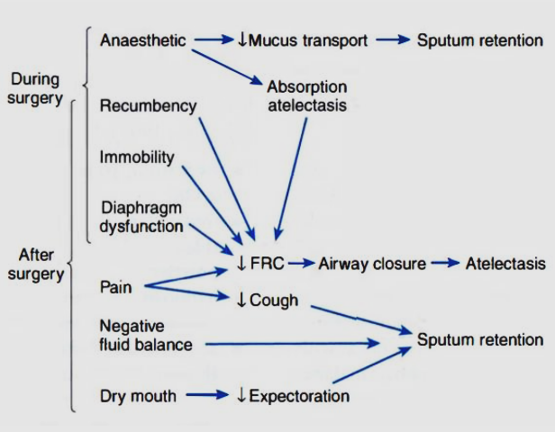
Complication-
Mechanism of Reduced Pulmonary function

Slide 28
PREOPERATIVE PHYSIOTHERAPY ASSESSMENT
EDUCATION AND INFORMATION :
Verbal information given to the patient at this stage,
Details should be brief and concise and ideally back-up written material should be provided.
Preoperative explanation regarding the effects of surgery on respiratory function, the location of the wound, drips and drains may help to reduce pain, quicken recovery after the operation.

Slide 29
The physiotherapist should also stress on the…
Importance of early mobilization,
Appropriate positioning while chair or bedbound,
Adequate pain control,
Regular thoracic expansion exercises and
Wound support during huffing or coughing if bronchial secretions are present.

Slide 30
The AIMS of preoperative physiotherapy treatment are to:
Gain the patients confidence and reduce anxiety
Educate the patient regarding postoperative routine
Assess the patients risks of developing Post operative Pulmonary Complication
Assist in the prevention of respiratory complications
Assist in the prevention of deep vein thrombosis

Slide 31
Explain
Role of physiotherapist within the team
The probable site of the incision
Presence of drips/drains/oxygen therapy/ catheter/intercostals catheter
Type of analgesia administered
Effects of general anaesthesia, surgery and pain on the cardio-respiratory system
The importance of optimal postoperative positioning, e.g. high-sitting, sitting out of bed and the importance of regular deep inspirations and early mobilization for making an uncomplicated recovery.

Slide 32
Demonstrate/Practice
Deep breathing exercises to increase lung volumes
Forced expiration technique (FET) and cough with support
The position they probably will be lying in
Shoulder girdle movements in supine lying- isotonically.
Trunk movements
Foot and ankle circulatory exercises
Recommend the frequency and number of times for the deep breathing exercise, FET, supported cough and foot and ankle exercises.
Education regarding underwater sealed drainage and discussion of rehabilitation on discharge.

Slide 33
POSTOPERATIVE PERIOD
Generally the main aims in the postoperative Phase are to promote the re-inflation of areas of atelectasis and to maintain adequate ventilation.

Slide 34
THE INTIAL PATIENT ASSESSMENT NOTES:
DATABASE: OBTAINED FROM MEDICAL NOTES
Preoperative information: PFTs/ABGs
Surgical procedure and incision
Concise relevant history of present condition
Relevant past medical history including previous surgery,
Social history,
Drug history, specific note of respiratory medicines; e.g. inhalers

Slide 35
SUBJECTIVE: INFORMATION WHICH PATIENT TELLS YOU
Ask open-ended questions: how do you feel?
Ask about pain control: can the person cough?

Slide 36
OBJECTIVE: INFORMATION BASED ON EXAMINATION OF THE PATIENT AND TESTS CARRIED OUT
Cardiovascular status (CVS): blood pressure, heart rate and rhythm
Oxygen delivery system and FEV1
Blood gases or O2 saturation
Respiratory rate
Chest x-ray
Method of pain control
Number and type of drains
Auscultation
Ability to cough
Range of movement of shoulder on incision side

Slide 37
After assessment commonly found problems are…
Reduced lung volume;
Retention of secretions;
Increased work of breathing;
Poor breathing control/pattern;
Ineffective cough;
Pain at incision site

Slide 38
GOALS OF POSTOPERATIVE PHYSICAL THERAPY
RELATED TO OXYGEN TRANSPORT
Maximize arousal
Maximize lung volumes and capacities, especially functional residual capacity
Optimize lung compliance
Optimize mucociliary transport and mucous clearance
Optimize ventilation and perfusion matching and gas exchange
Minimize undue work of breathing and work of heart
Maximize chest wall mobility and movement in three planes
Optimize body and posture alignment when sitting, standing. walking, and recumbent
Optimize circulatory status and tissue perfusion
Optimize muscle pump action
Maximize cardiopulmonary endurance
Optimize relaxation

Slide 39
In addition to goals related to oxygen transport, other important postoperative goals include the following:
Maximize joint range of motion
Maximize muscle length and ligament integrity with range of motion exercises
Maximize patient's ability to perform activities of daily living
Maintain or increase general muscle strength and endurance
Maintain normal cognitive function to avoid disorientation and hospital-related psychoses.
Pain

Slide 40
Post operative treatment plan (in brief)
1) Ensure the patient has adequate analgesia
2) Deep breathing exercises (unilateral costal on the good side and diaphragmatic with inspiratory holds and sniffs in sitting or half lying
3) a) Unilateral shakings on the good side during expiration
b) Huffing with good support on incision
4) Full range active/assisted shoulder exercises.
5) Active leg, foot and ankle exercise.
6) a) Bilateral costal and diaphragmatic breathing exercises.
b) Trunk and shoulder girdle exercises and postural correction
7) Early mobilization with controlled breathing pattern designed to improve exercise tolerance.

Slide 41
Physiotherapy key points for handling patients with chest tubes
Advice should be given on postural correction and upper limb exercises.
The tubes should empty of fluid, excessive loops should be avoided,
If there is any likelihood of blockage by clots, the tube needs milking.
Care should be taken when handling patients so that the tubes are always visible, to avoid kinking, stretching or disconnection.
Observation of changes in air leaks and drainage should be made before, during and after physiotherapy intervention.
In the presence of an air leak, positive pressure techniques are usually avoided as they may perpetuate the problem

Slide 42
HOME EXERCISES
All patients should have a list of simple progressive home exercises to do on discharge, and ideally the opportunity to return for a check in approx. 2 weeks.
Select 6-7 key exercises and indicate how each may be progressed and approximately when. These should include breathing, trunk and arm exercises and indicate how each may be progressed and approximately when.
They should include breathing, trunk and arm exercises, and should be written down.

Slide 43
PICO
P: Thoracic Surgery
I: Acapella (Positive expiratory device)
C: Incentive spirometer
O: Poste-operative Pulmonary complications

Slide 44
A randomized controlled trial comparing incentive spirometry with the Acapella ® device for physiotherapy after thoracoscopic lung resection surgery
Title | Methodology | Conclusion
A randomized controlled trial comparing incentive spirometry with the Acapella device for physiotherapy after thoracoscopic lung resection surgery* | A single-blind prospective randomized controlled trial: 78 participants: two groups: standard postoperative care with incentive spirometry (10 reps/ 2 hourly while awake), standard care plus positive vibratory expiratory pressure treatment using the Acapella device (10 Active exhalation/ 2 hourly) till discharge Outcome Measures: FEV1, FVC, PaO2/FiO2, VAS on 1 hours & 6 hours after surgery on 0 POD, 1st POD, 2nd POD, 3rd POD | postoperative Acapella treatment did not alter lung function after thoracoscopic lung resection surgery in this study; however, it was more comfortable to use than incentive spirometry

Slide 45
References
Porter S. Tidy's Physiotherapy. Elsevier Health Sciences; 2013 Jan 17. Chapter-9
Frownfelter D, Dean E. Cardiovascular and pulmonary physical therapy-E-Book: evidence to practice. Elsevier health sciences; 2014 Mar 12. Chapter-28

Slide 46
Thank You

