Slide 1
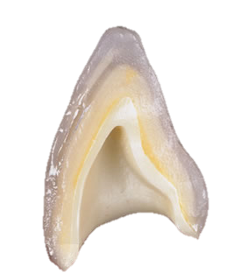

DENTAL CERAMICS - II
Dr. Namrata Shah Naidu

Slide 2


What will you learn from this lecture:
Composition of Ceramics
Properties of Ceramics

Slide 3
COMPOSITION

Slide 4
Silica – Filler
Kaolin – Binder
Feldspar – Basic glass former
Leucite
Nepheline syenite
Glass modifiers
Colour pigments
Opacifying agents
Stains and Colour modifiers
Fluoroscent agents
Glazes and Add-on products
Alumina
Alternative Additives

Slide 5
1.SILICA (Quartz or Flint) (SiO₂)
Can exists in 4 different forms :
  Crystalline quartz
  Crystalline Cristobalite
  Crystalline Tridymite
  Non-crystalline fused silica
Pure quartz crystals are used in dental porcelain.
It is made by selecting uniformly light coloured pieces of quartz free from traces of iron which are ground or milled to the finest grain size possible.

Slide 6
It is used in dental porcelain as a filler and strengthening agent.
Because it has a high melting point, it also provides a high strength framework for other ingredients.

Slide 7
2.KAOLIN (Al₂O₃.2SiO₂.2H₂O)
Is a hydrated aluminosilicate.
It gives porcelain its properties of opaqueness.
When subjected to high heat, it adheres to the framework of quartz particles.
It helps to increase the molding
ability of the plastic porcelain.

Slide 8
3.FELDSPAR
Precursor of natural clay.
Also known as aluminosilicates.
These feldspars are never pure.
Potassium and sodium feldspar are naturally occurring minerals composed primarily of potash (K₂O) and Soda (Na₂O) respectively.
For dental porcelains, a high potash content feldspar is generally preferred, because of increased resistance to pyroplastic flow.

Slide 9
Potash Feldspar Metal Oxides
1150⁰C – 1530⁰C
LEUCITE
GLASS PHASE

Slide 10
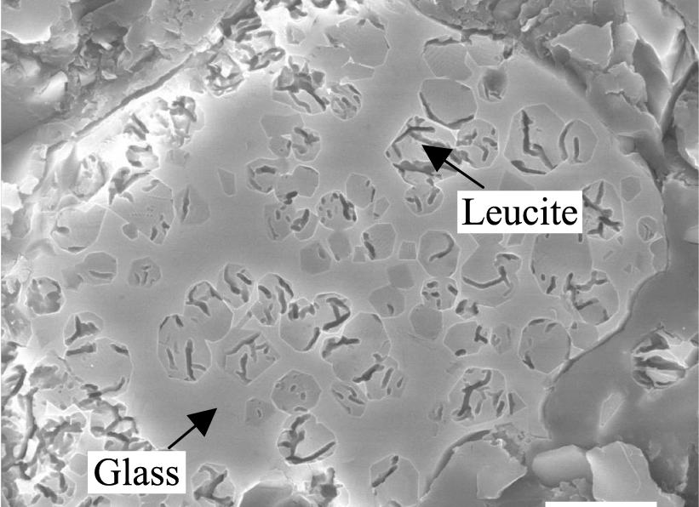

Slide 11
GLASS PHASE :
This glass phase will soften and flow slightly.
The softening of the glass phase during porcelain firing allows the porcelain powder particles to coalesce – called as liquid-phase sintering.
The driving force for sintering is the decrease in energy caused by a reduction in the surface area.

Slide 12
4.LEUCITE :
Is a potassium-aluminium-silicate mineral with a large co-efficient of thermal expansion (20-25ppm/⁰C) compared with feldspar glasses (10ppm/⁰C).

Slide 13
The leucite forms a refactory skeleton and glass fills the spaces in b/w adding special qualities required for dental porcelains.
FUNCTIONS :
  Raises coefficient of thermal expansion(CTE) and brings it closer to metal substrate, consequently hardness & fusion temperature.
  Creates a high expansion porcelain to match thermal expansion of the alloys, thus preventing a thermal mismatch.
  Strengthening of porcelain in high strength ceramics.
  Eg. Optec HSP, Cerinate & IPS Empress

Slide 14
5.NEPHELINE SYENITE :
Is an igneous rock, a syenite, somewhat resembling granite in texture, hardness and general appereance.
Essential mineral of syenite is nepheline.
Use of nepheline syenite has been tried as a replacement for feldspar (Orlowski 1944).
Major criticism level against it has been its greater pyroplasticity when compared to feldspar.

Slide 15
6.GLASS MODIFIERS :
Are elements that interfere with the integrity of the silica network and alters their 3-D state.
FUNCTIONS :
  Viscosity (Increasing flow)
  Softening temperature
  Thermal expansion
  Too high concentration can however :
  1. Reduce the chemical durability
  2.Glass may crystallize (devitrify) during firing.

Slide 16
Manufacturers employ glass modifiers to produce dental porcelain with different firing temperatures :
HIGH FUSING MEDIUM FUSING LOW FUSING ULTRA-LOW FUSING | 1300⁰C (2372⁰F) 1101⁰C – 1300⁰C (2013⁰ – 2072⁰F) 850⁰C – 1100⁰C (1562⁰ – 2012⁰F) <850⁰C (1562⁰F)

Slide 17
A.INTERMEDIATE OXIDES :
Boric oxide and alumina are the two glass-forming oxides used for dental purpose.
The addition of glass modifiers or fluxes to basic glass-forming network SiO₄ in dental porcelain will not lower the softening point but also decreases the viscosity.

Slide 18
Dental porcelains require a high resistance to slump or pyroplastic flow and it is therefore necessary to produce glasses with a high viscosity as well as low firing temperature.
This can be done using intermediate oxides which although not usually capable of forming a glass can take part in the glass network.

Slide 19
B.BORIC OXIDE FLUXES
Is a powerful flux (glass modifier) , and can also act as a glass former and form its own glass network, producing Boron glasses.
When added to a glass, it forms a separate lattice interspersed with the silica lattice resulting in a structure that is 3-D continuous network of strong SiO₄ tetrahedral and BO₃ triangles.

Slide 20
An additional oxygen atom results in formation of strong BO₄ tetrahedral, which is low expansion, more stable glass with good chemical resistance.
Hence, boric oxide is used in quantities of about 12%, above which less stable form BO₃ takes over.

Slide 21
C.WATER
Water is an important glass modifier.
The hydronium ion,H₃O⁺, can replace sodium or other metal ions in a ceramic that contains glass modifiers.
This fact accounts for the phenomenon of “slow crack growth” of ceramics that are exposed to tensile strength and moist environment and also for occasional long-term failure of the restoration after several years of service.

Slide 22
7.COLOUR PIGMENTS
Dental porcelains are coloured by the addition of concentrated colour frits which are prepared by fritting high temperature resistant-colouring pigments (generally metallic oxides) into the basic glass.
The glass thus obtained will be highly colour saturated and when ground to a fine powder, can be used in small amounts to modify the uncoloured porcelain powder.

Slide 23
Pink – Chromium-tin or chrome-alumina – warm tone
Yellow – Indium or praesodymium (lemon) – Ivory shade
Blue – Cobalt salts – Enamel shades
Green – Chromium oxide – is the main pigment for producing a greenish colour.
Grey – Iron oxide (black )or Platinum grey – produce effects of translucency
Lavender – Manganese oxide

Slide 24
8.OPACIIFYING AGENTS
An opacifying agent generally consists of a metal oxide ground to a very fine particle size (<5µm) to prevent a speckled appearance in the porcelain.
Common oxides used are
  Cerium oxide
  Titanium oxide
  Zirconium oxide – most popular

Slide 25
9.STAINS AND COLOUR MODIFIERS
Stains are used as surface colourants or to provide enamel check lines, de-calcification spots, etc. in the body of a porcelain jacket crown.
Colour modifier used to obtain gingival effects or high-light body colours.

Slide 26
10.FLUORESCENT AGENTS
Fluorescence is produced by the addition of uranium salt, sodium di-uranate.
This salt produces a strong greenish-yellow colour and when small addition of cerium oxide are made, a bluish-white fluorescence can be achieved very similar to human tooth.

Slide 27
Newer porcelain materials recently introduced are highly fluorescent and are described as optical brighteners.
Eg : Luminaries (Vita, Bad Sackingen, Germany) contain naturally occurring fluorescent agents that are non-toxic.

Slide 28
11.GLAZES AND ADD-ON
Dental glazes consist of uncoloured glass powders which can be applied to the surface of a fired crown to produce a glossy surface.
A glaze should normally mature at a temperature below that of the restoration and the thermal expansion of the glaze should be fractionally lower than the ceramic body to which it is applied.

Slide 29
In this way the glaze surface is placed under compression, and crazing or peeling of the surface is avoided.
Glazing porcelain should be applied to a slightly roughened surface to prevent glaze peeling.
It is suggested that porcelain crowns are better made without the use of glazes, since a modern feldspathic or single-phase glass can be lightly ground and self-glazed far more satisfactorily.

Slide 30
Glazes are used to seal off a poorly baked restoration.
ADD-ON :
Are generally made from the same frit as used for the manufacture of regular porcelain.
The glazing temperature is then reduced by finer grinding of the powder.

Slide 31
Surface characterization is almost impossible to obtain when separate glazes are used, thus add-on glazes should be used sparingly for simple corrections of tooth contour or contact point.

Slide 32
12.ALUMINA
Refers to aluminium oxide (Al₂O₃) one of the hardest and probably the strongest oxides of aluminium known which is prepared from alumina trihydrate by calcination.
Alumina Trihydrate λ-alumina α-alumina
α-form of alumina is used in ceramic application.
600⁰C
1250⁰C

Slide 33
13.ALTERNATIVE ADDITIVES
During fritting, small quantities of alternative modifying agents can be added to dental porcelain.
Lithium oxide (LiO₂) – as an additional fluxing agent.
Magnesium oxide (MgO) – used in minute quantities to replace CaO
Phosphate pentoxide (P₂O₅) – sometimes added to induce opalescence and is also a glass forming oxide.

Slide 34
PHYSICAL AND MECHANICAL PROPERTIES

Slide 35
1.COLOUR STABILITY
Ceramics – most stable tooth coloured materials.
The metallic oxides used as colourants do not undergo any change in shade after firing is complete.
The smooth glossy surface resists the adherence of exogenous stains.

Slide 36
2.DIMENSIONAL STABILITY
Porcelain has a co-efficient of thermal expansion, slightly less than that of the tooth structure.
Does not exhibit microleakage, nor does it imbibe or synergize water.
DENTIN ALUMINOUS PORCELAIN | 8.3 ppmK⁻¹ 6.6ppmK⁻¹

Slide 37
Thermal stresses produced from a thermal expansion or contraction difference are important in the production of metal-ceramic restorations.
Selection of materials should be such that the thermal expansion
co-efficients are matched fairly closely (within 4%).

Slide 38
3.ABRASION RESISTANCE
NATURAL TOOTH PORCELAIN | 343 KHN 460 KHN
Therefore, porcelain causes wearing of natural tooth and metal restoration

Slide 39
4.BRITTLENESS
Is defined as the relative inability of a material to sustain plastic deformation before fracture of a material occurs.
Ceramics are brittle at oral temperatures (5⁰ to 55⁰ C) .
Brittle material such as ceramics fail because of formation and growth of macroscopic flaws that can form during the fabrication or in service.

Slide 40
Fracture toughness describes the resistance of brittle materials to the propagation of flaws under an applied stress.
Small defects(porosity & microcracks) are randomly distributed in location and in size throughout a ceramic, causing large variations in otherwise identical ceramic specimens.

Slide 41
Furthermore, surface flaws caused by grinding, such as from coarse-grit, medium-grit, or fine-grit diamond particles, can greatly weaken the otherwise strong ceramic, especially in the presence of tensile stress in the area of these flaws.

Slide 42
5.DEGRADABILITY
Porcelain is generally resistant to degradation in the oral environment but is susceptible to
  mechanical degradation by brittle fracture(chipping), and
  chemical degradation by fluoride attack.

Slide 43
6. SHRINKAGE
Volumetric shrinkage - 35 – 45%
Linear shrinkage – 11 – 14%
Minimized by using
  lesser binder,
  proper condensation,
  build-up of restoration 1_{/3}^{rd} larger than original size and
  firing in successive stages

Slide 44
7.STRENGTH
Compressive strength : 48,000psi
Tensile strength : 3500-5000psi
Flexural strength, transverse strength, or modulus of rupture :
    Is essentially a strength test of a bar supported at each end, or a thin disk supported along a lower support circle, under a static load.
    For brittle material like ceramics, flexural tests are preferred to the diametral compressive test because they are more closely simulate the stress distribution in dental prostheses such as cantilevered bridges and multiple-unit FPDs

Slide 45
IMPACT STRENGTH :
  defined as the energy required to fracture a material under an impact force.
ELASTIC MODULUS :
  Describes the relative stiffness or rigidity of a material, which is measured by the slope of the elastic region of the stress-strain diagram.
  Dental porcelain is a material of low impact resistance .
  Elastic modulus – 40GPa
  Tensile strength – 50 – 100 MPa

Slide 46
It is possible to predict the strength of a substance based on the strengths of the individual bonds between the atoms in the material.
The values of strength obtained by such a prediction are typically 10% of the modulus of elasticity (0.1E)
Hence, a material with a modulus of elasticity of 20GPa has a predicted strength of 2GPa.

Slide 47
Based only on the strengths of the primary interatomic bonds (ionic, covalent, or metallic), a ceramic , a metal, and a polymer should have a modulus of elasticity of 20GPa and a strength of 2GPa.
However, the measured strength of most materials are more than 100 times lower than this theoretical value.

Slide 48


Slide 49


