Slide 1
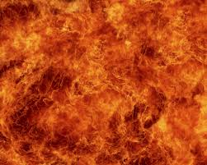
BURNS
Dr. Parthkumar Devmurari

Slide 2
Objectives
Brief introduction about burns
Different causative agents/ types of burn
Degree/classification of burn (New and old terminology)
Effects of burn on various systems of body
Assessment of burn
Rule of nine
Physiotherapy Management in burns

Slide 3
Introduction
Burn wounds occur when there is contact between tissue and an energy source, such as heat, chemicals, electrical current, or radiation.
Burn is a coagulative necrosis of tissue due to energy source like thermal injury
The resulting effects of the burn are influenced by the:
    Intensity of the energy
    Duration of exposure
    Type of tissue injured

Slide 4
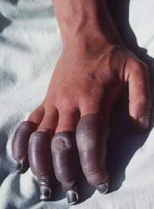
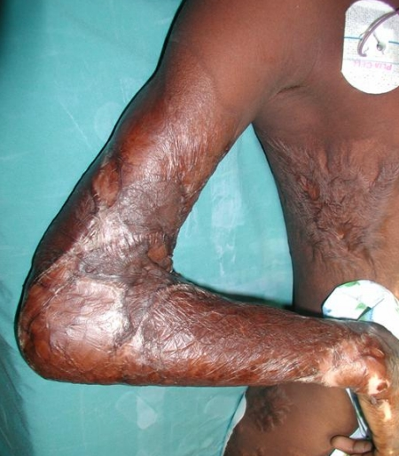
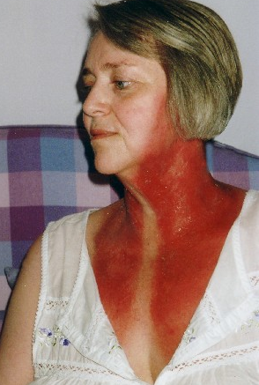
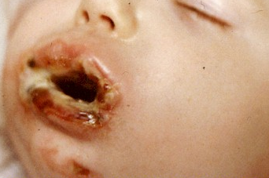
Causative agent
Thermal
Heat / Cold
Radiation
Chemical
Electrical

Slide 5
Older terminology
1st Degree
4th Degree
3rd Degree
2nd Degree
Epidermis injured
Dermis partially damaged
All dermis involved
Muscle, Nerve and Bone damage

Slide 6
Newer terminology
Superficial partial thickness
Subdermal
Deep partial thickness
Epidermis and upper part of dermis injured
Epidermis and large upper portion of dermis injured
All skin destroy, with fascia, muscle bone
Superficial
Full thickness
Damage to only epidermis
All skin destroy

Slide 7
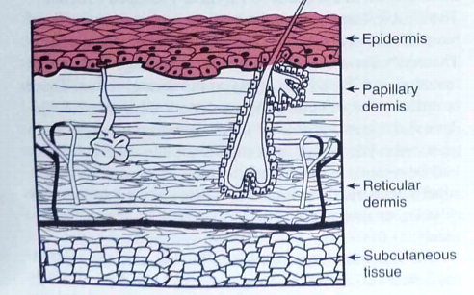
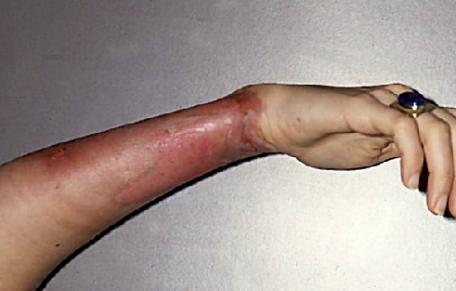
SUPERFICIAL BURN
Colour or Vascularity | Surface appearance or Pain | Swelling/ Healing/Scarring
Erythematous, pink or red, irritated dermis | No blister, dry surface, delayed pain, tenderness | Minimal oedema, spontaneous healing, no scars

Slide 8
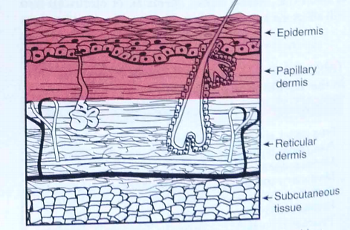
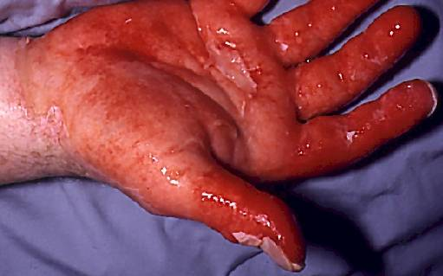
SUPERFICIAL PARTIAL THICKNESS BURN
Colour or Vascularity | Surface appearance or Pain | Swelling/ Healing/Scarring
Bright pink or red, inflamed dermis, erythmatous with blanching and capillary refill | Intact blisters, moist surface, Painful ; Sensitive to changes in temperature , exposure to air currents, light touch | Moderate edema, Spontaneous healing; Minimal scarring, Discoloration

Slide 9
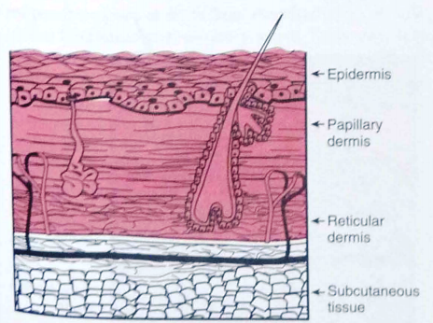
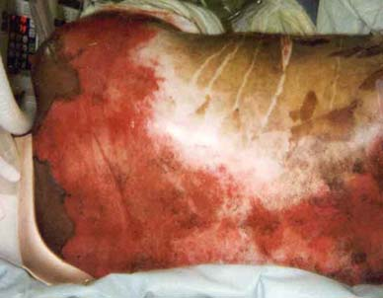
DEEP PARTIAL THICKNESS BURN
Colour or Vascularity | Surface appearance or Pain | Swelling/ Healing/Scarring
Mixed red-white; Blanching with slow capillary refill | Broken blisters, Wet surface; Sensitive to pressure but insensitive to light touch or soft pin prick | Marked edema: slow healing: excessive scarring

Slide 10
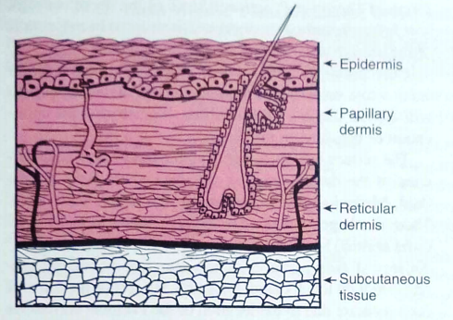
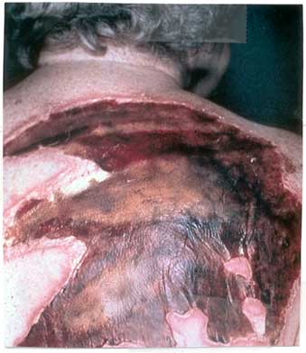
FULL THICKNESS BURN
Colour or Vascularity | Surface appearance or Pain | Swelling/ Healing/Scarring
White (ischemic), charred ,tan; Hemoglobin fixation ; No blanching ; Thrombosed vessels ; Poor distal circulation | Leathery, rigid, dry; Anesthetic; Body hairs pull out easily | Area depressed; Heals with skin grafting ; Scarring

Slide 11
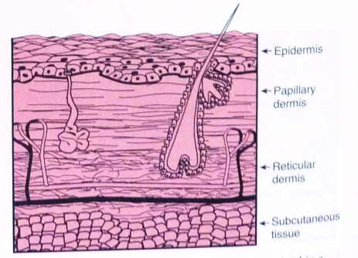
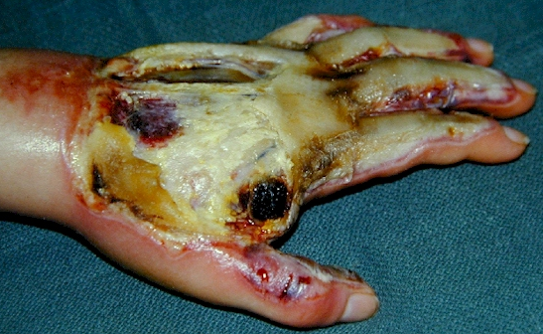
SUBDERMAL BURN
Colour or Vascularity | Surface appearance or Pain | Swelling/ Healing/Scarring
Charred | Subcutaneous tissue evident; Anesthetic; Muscle damage; neurological involvement | Tissue defects: heals with skin grafting ; scarring

Slide 12
Effects on
Body’s Systems

Slide 13
Cardiovascular response
Low Cardiac output
Hypovolaemia
Burn shock and hypoxia
Increased metabolic requirement of water, electrolytes and nutrients.

Slide 14
Respiratory response
Changes in absence of inhalation injury
Respiration may become shallow and rapid
Later on , hyperventilation may occur due to respiratory alkalosis
If chest infection – tachypnoea ,hypoxia and acidosis may lead to Acute Respiratory Distress Syndrome

Slide 15
Inhalation injury
Smoke inhalation is a major cause of morbidity and mortality in the immediate post burn period.
  Intoxication and Hypoxemia
  Respiratory tract injury by irritants
  Thermal damage to the airway
Lung injury from smoke inhalation is associated with
  Tracheo-bronchial mucosa damage due to release of chemotactic substance leads to heavy infiltration
  Formation of copious tracheal exudates
  Pulmonary capillary permeability changes resulting in a pulmonary edema

Slide 16
Inhalation injury (Cont…)
In alveoli – impair the function of Type 1 and Type 2 pneumocytes
Upper airway obstruction - due to laryngeal oedema by inhaled hot gases
Lower airway obstruction – leads to ventilation-perfusion imbalance and results into hypoxia and lactic acidosis
A reduction in the pulmonary immune function may lead to bacteria growth and pneumonia.

Slide 17
Immune system
Non specific immunity - skin is an important defence mechanism against microbiological invasion.
Suppression in T cells.
All immunoglobulin is decreased.

Slide 18
Clinical features of burn
At the site of the burn
Redness - erythema.
Blisters.
Yellow/white skin - leathery in nature.
Blackened crispy tissues - exposed blackened structures.
Inhalation injury
Burnt lips and nose.
Singed (superficial/mild burn) nasal and facial hair.
Hoarseness of the voice.
Sore throat.

Slide 19
During shock (up to 3 days post-burn)
Restlessness and disorientation.
Coldness and paleness of the skin.
Collapsed veins and rapid pulse.
Sweating.
Thirst.
Hypotension.
Tachycardia.
Rapid breathing - later becoming gasping.
Cyanosis.

Slide 20
Post-shock phase
Separation of the burned skin .
Formation of scar tissue.
Contraction of scar tissue, causing
Pain due to traction of the sensory nerve endings;
Limitation of joint movement;
Joint deformities;
Loss of function.

Slide 21
Long-term
The severity of dysfunction and disfigurement depends on the site and extent of burn:
Possible amputation of a limb
Disabling damage to the hands
Possible loss of independence
Loss of employment
Social rejection
Emotional trauma for both the patient and relatives.

Slide 22
ESCHAR
The necrotic tissue resulting from a burn is known as eschar.
It separates slowly from underlying viable tissue and is a good substrate for microorganisms.
If left untreated it becomes colonized, contaminated and eventually infected.
Infection attracts WBCs that can digest the interface and cause separation of the eschar from the underlying viable tissue.

Slide 23
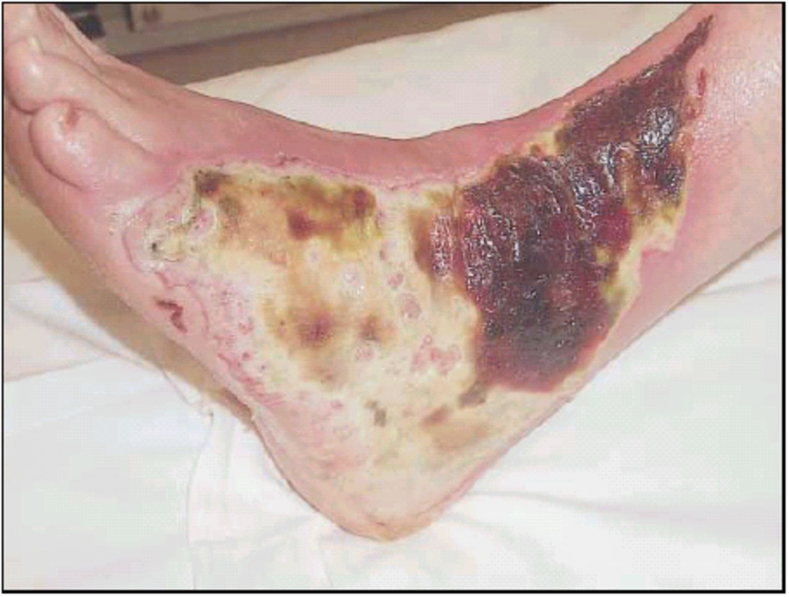

Slide 24
Investigations
Serum electrolyte
Serum creatinine
Hb, PCV, Blood count, blood group, cross matching
Blood sugar, blood urea

Slide 25
Assessment of BURN
Evaluation of general condition
Detailed history -
Cause & time of burn
Status of tetanus immunization
Drug allergies and current medication
Mental status
Vitals and sign of dehydration
Examination of Respiratory System ,Cardio Vascular System and GI.

Slide 26
Evaluation of magnitude of the injury
Age
Extent of body surface area
Depth
Inhalation injury
Co-morbid factors

Slide 27
Assessment of the burn wound
The following must be determined -
The depth of the burn wound
The size of the burn
The anatomical site of injury.

Slide 28
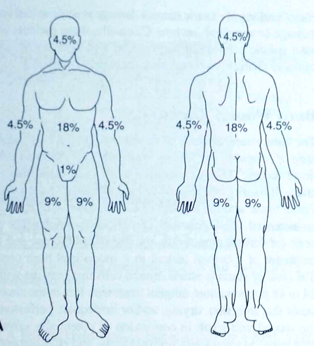
Body surface area
To calculate rapidly total body surface area of burn ‘Rule of Nine’ can be used,
Anterior
Posterior
Rule of nine
for adults

Slide 29
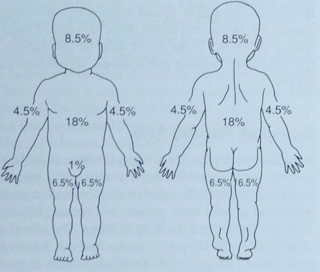
Rule of nine for children
Anterior Posterior

Slide 30
Estimation of the depth
History of injury and surface appearance of wound
Assess pain – pin prick test (with precations)
SUPERFICIAL
Blistering
Dermis pink and blanching
Painful and sensate

Slide 31
DEEP
Deep dermal Brownish Mottled (image)
Sensation variable
Full thickness Leathery, thick
insensate (lacking of sensation)
Major Burns : >10 % BSA deep burn in a child
>25% BSA deep burn in an adult
All major burns will need parenteral fluid resuscitation , since the main cause of early mortality is Burns Shock.

Slide 32
Depth | Degree | Cause | Surface/colour | Pain sensation
Superficial (partial loss of skin) | 1st degree | Sun, flash, minor scald | Dry, minor blisters, erythema | Painful
 | 2nd degree | Scald | Moist, reddened with broken blisters | Painful
 | Deep 2nd degree | Scald, minor flame contact | Moist white slough, red mottled | Painless
Deep (complete loss of skin) | 3rd degree | Flame, severe scald or flame contact | Dry, charred whitish | Painless

Slide 33
Physical therapist then examines the patient to determine the presence of impairments and functional limitations.
The therapist must also consider the potential for development of indirect impairments as the bum wounds heal and mature.
For example active or passive ROM may be limited as result of oedema restrictive eschar, or pain, and an initial baseline measure should be obtained.
In addition, the therapist need to obtain an accurate history from the patient and family embers regarding any pre-existing limitations or previous injuries that may affect rehabilitation potential.

Slide 34
Management of BURN
A guide for first responders to burn injuries
Thermal burn | Electrical burn
Examine for associated trauma and take care of airways
Assess the extent of burns
Remove from the heat source and extinguish fire and stop the heat
Prevent contamination
Relief of pain
Rescue from electric shock
Examine for associated injuries
Switch off the electrical supply and remove the victim away from the source
First aid for electrothermal burn

Slide 35
GOALS
The goal in the initial management of patient with burn are to address major life threatening problems and stabilize the patients through procedures designs to
  Establish and maintain airway
  Prevent cyanosis, shock and haemorrhage
  Establishment of base line data on patients such as extent and depth of injury
  Prevent or reduce fluid loss
  Clean the patient and wound
  Examine injuries
  Prevent cardiac and pulmonary complications

Slide 36
First aid
Extinguish fire
  Cold water
  Prevent contamination
  Water soluble topical application
  Analgesics
  Hospital admission
Extent of burn
  Rule of nine
Magnitude of injury
  Extent of burn
  Depth of burn
  Associated injuries
  Age of patient
  Concomitant disease
  Presence / absence of inhalation burns or respiratory burns

Slide 37
Emergency sedation
Morphine – IV only

Slide 38
Medical Management
Early hospital management (including the shock phase).
This involves:
• Maintenance of a clear airway
• Pain relief
• Assessment of TBSA
• Maintenance of fluid balance
• Removal of adherent clothing and covering of the burns with sterile cotton dressings

Slide 39
Application of neutralizing agents for chemical burns
• Reassurance and explanation to the patient
• Transfer to a burns unit or admission to an intensive care unit.
Whether the person is sent to the operating theatre for shaving of burns and grafting depends on the depth of the burns, the age of the patient and whether the patient is fit for surgery.

Slide 40
Fluid replacement is administered over a 36-hour period (from the occurrence of the burn, not the time of arrival at hospital).
The volume of plasma required by the burns patient is related to the TBSA and the size of the patient.
Management of wound areas varies according to the experience of the staff and facilities available.

Slide 41
Wound Management
Initial care
Done under a general anaesthetic or intravenous sedation
Thorough cleaning, removal of dead skin and carbon deposits by wiping with sterile wet gauze.
Application of liberal amounts of a topical antibacterial agents - Silver nitrate , Gentamicin ,Silver Sulfadiazine
Dressing with tulle gras, gauze, large gamgee pads and bandage and change dressings atleast every 48 hours.

Slide 42
Skin substitutes
Biological dressing –
  Mainly use for temporary coverage of wounds in superficial partial thickness burn
  Allografts and Xenografts
Synthetic dressing-
  Widely used is biobrane
  More susceptible for infection and potential for greater scar formation
Cultured epidermal autographs-
  Mainly use in <50% TBSA
  More chance of rejection and contracture

Slide 43
Surgical Management of the Burn Wound

Slide 44
Techniques for burn reconstruction
Without deficiency of tissue
Excision and primary closure
Z-plasty
With deficiency of tissue
Simple reconstruction
Skin graft
Dermal templates and skin grafts
Transposition flaps
Axial and random flaps
Myocutaneous flaps
Tissue expansion
Free flaps
Prefabricated flaps

Slide 45
PHYSIOTHERAPY MANAGEMENT OF BURNS

Slide 46
Treatment is directed toward
prevention of scar contracture
preservation of normal ROM
prevention or minimization of hypertrophic scar formation and deformity
maintenance or improvement in muscular strength and cardiovascular endurance
Return to pre burn function
Performance of ADL

Slide 47
Examination
Consider the potential for development of indirect impairment as the burn wounds heal and mature.
Accurate history regarding any pre-existing limitations or previous injuries that may affect rehabilitation potential should be taken.
Examine and monitor patients routinely for changes in skin integrity, ROM and mobility.

Slide 48
Intervention
Control & resolution of oedema – elevation of extremity & active movement especially of hands and ankle.
Preserving ROM – active movement.
Prevention of scar contracture – positioning, splinting, exercise , after wound closure, massage & compression

Slide 49
Positioning & splinting:
Goals of positioning are:
To minimize oedema
To prevent tissue destruction
Maintain soft tissues in elongated state

Slide 50
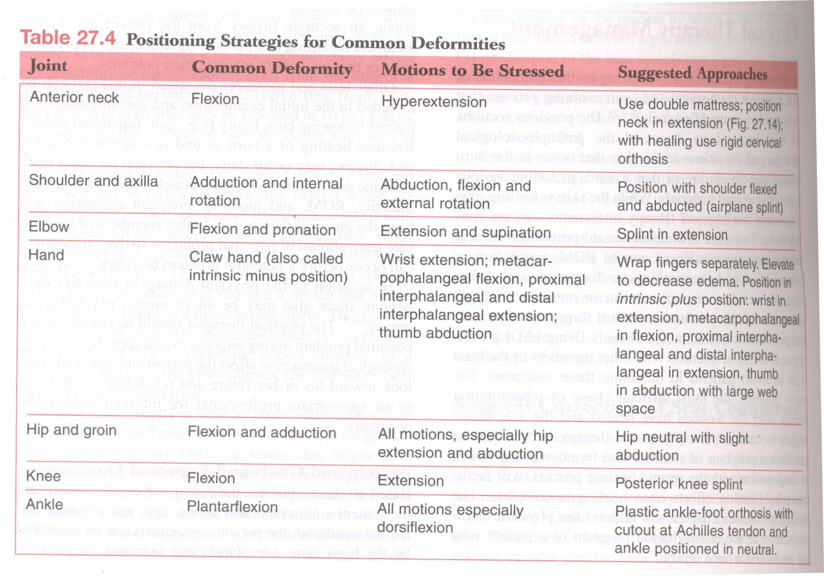

Slide 51
Joint | Deformity | Motion to be stressed
Anterior neck | Flexion | Hyperextn
Shoulder- axilla | Add & IR | Ab, Flx, ER
Elbow | Flex & prona. | Ext & Sup
Hand | Claw hand | Wrist extn
Hip & groin | Flex & add. | Extn & abdn
Knee | Flexion | Extn
Ankle | PF | DF

Slide 52
Splinting is an extension of positioning programme.
Indications for splints are:
Prevention of contractures
Maintenance of ROM achieved during an exercise session or surgical release
Correction of contracture
Protection of joint or tendon

Slide 53
Splint should be easy to apply, remove & clean and should be of light weight.
Splints
Should conform to the body part, care must be taken to ensure that there are no pressure points that may cause a breakdown in normal or healing skin.
Should be checked for proper fit & revised if necessary.
Static splints are usually used in burn therapy programme

Slide 54
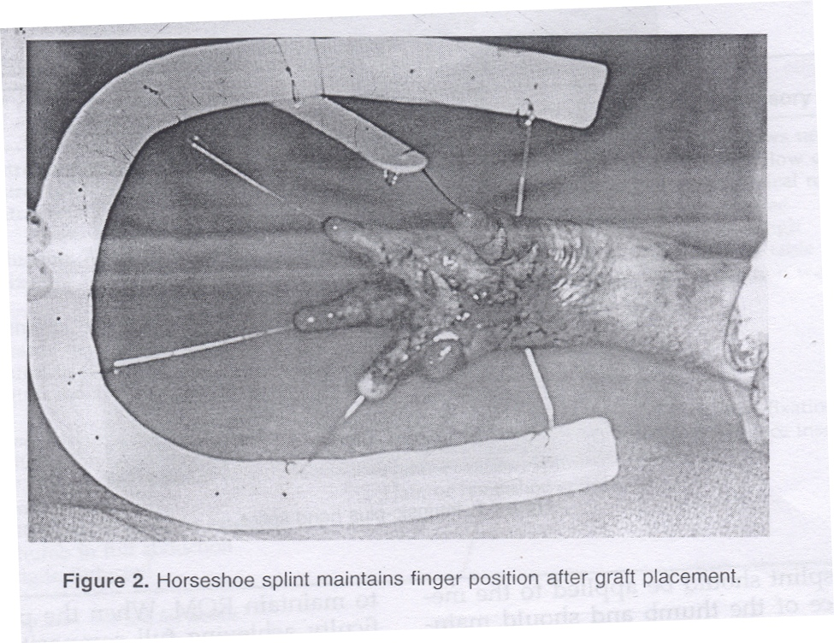
Hand & Wrist
Palmar surface burn or graft placement

Slide 55
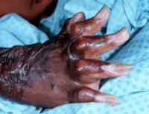
Intrinsic minor hand

Slide 56
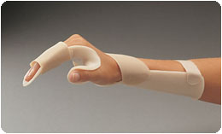
Intrinsic plus hand splint

Slide 57
Elbow:
Splint should maintain elbow in flexion or extension depending on burnt area
Splint is removed to perform ROM exs
Axilla:
Airplane splint with shoulder in 70-80 deg abducted & horizontally adducted 15-20 deg

Slide 58
Active and Passive Exercise:
Active exercise of all limbs & trunk including unburned should be performed.
After skin grafting, active & passive exercise of area should be stopped for 3-5 days to allow the graft adheres.
Active assisted & passive exercise should be initiated if patient cannot fully achieve active ROM.

Slide 59
If burn wounds are well healed, heating modalities ( e.g. paraffin, ultrasound ) may be used to increase the pliability of the tissue before exercise therapy.
ROM in unhealed area of burns can be extremely painful, so exercise under cover of pain medication will be helpful.

Slide 60
Resistive & conditioning exercises
As patient continues to recover, strengthening exercises can be included in programme as in major burn case patient may loss body weight & muscle mass.
Monitoring of pulse, BP & RR before, during & after exercise will be helpful to determine status of cardiovascular & pulmonary systems.
Walking, cycling, treadmill walking, stair climbing & other forms of aerobic exercise should be encouraged

Slide 61
Augmented Exercise in the Treatment of Deconditioning From
Major Burn Injury
Arch Phys Med Rehabil 88,(2) 2007
P | A patient with burn injury
I | Intensified graded Aerobic treadmill exercise program to work to quota group with usual care
C | Aerobic treadmill exercise according to tolerance of patient to work to tolerance group with usual care, and usual care alone
O | Maximum aerobic capacity

Slide 62
RCT High Level Evidence | Arch Phys Med Rehabil 88,(2) 2007 | To investigate the efficacy of a 12-week exercise program in producing greater improvement in aerobic capacity in adult burn survivors, relative to usual care. | A 12-week, 36-session, aerobic treadmill exercise program where work to quota (WTQ) participants intensiﬁed their exercise according to preset quotas and work to tolerance (WTT) participants continued to their tolerance. Par-ticipants completed a maximal stress test at baseline and 12 weeks to measure physical ﬁtness. The aerobic capacity of adult burn survivors can be improved with participation in a structured, 12-week exercise program after injury.

Slide 63
Ambulation:
Should be started at earliest appropriate time
If lower limbs are skin grafted, ambulation should be discontinued until it is safe.
After skin graft, lower limb should be wrapped in elastic bandages during ambulation to support new graft & promote venous return.
Assistive device should be used when necessary.

Slide 64
Scar management
If the scar is less than 6 months old, It will respond to pressure therapy by conforming to the pressure remaining flat on the surface and not developing into a hypertrophic scar.
In general, If a wound heal in less than 10 to 14 days, which would be indicative of a superficial partial thickness burn, pressure may not be needed.
If wound healing takes longer than 10- 14 days (as in a deep partial-thickness burn) or is skin grafted, pressure usually is indicated.

Slide 65
Pressure Dressings:
Elastic wraps can be used to provide vascular support of skin graft and donor sites as well as to control oedema and scarring.
Elastic wraps are applied in figure of eight pattern on lower limb, spiral wrap in upper limb & circular wrap on trunk.
The tubular support bandage is especially useful for small children.
Ultrasound over the scar

Slide 66
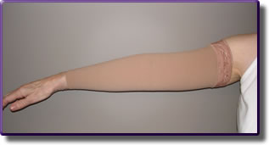


Slide 67
Some pressure garments are ready made and come in several sizes to fit most patients others are custom made for the individual patient.
Garments usually are worn 23 hours a day (removed for bathing) for as long as 12 to 18 months to assist with scar remodelling.
Garments should be washed daily to prevent build-up of perspiration and moisturizing cream which may lead to scar maceration.

Slide 68
A comparison of three different physiotherapy modalities used in the physiotherapy of burns
J Burn Care Res. 2013 Sep-Oct;34(5)
P | Patient with burn
I | LASER Treatment (LT)
C | Matrix Rhythm Therapy (MRT), Ultrasound Treatment (UT),
O | Pain and ROM

Slide 69
Case Series Low Level Evidence | Sar Z, Polat MG, Özgül B, Aydoğdu O, Camcoğlu B, Acar AH, Yurdalan SU. J Burn Care Res. 2013 Sep-Oct;34(5) | The present study compared the effectiveness of matrix rhythm therapy (MRT), ultrasound treatment (UT), laser treatment (LT) used in the physiotherapy of burns. | Pain was lower in the LT group than in the UT group, and passive ROM was higher in the UT group than the in LT group (P < .05). Active ROM was found to increase in all treatment groups, whereas passive ROM increased only in the MRT and UT groups; pressure sense increased only in the MRT group, and pain decreased only in the LT group (P < .05). LT was more effective in reducing pain than UT. No significant difference was observed in terms of skin elasticity according to the results of three treatment modalities.

Slide 70
Massage
Deep friction massage is helpful in loosening scar tissue by mobilizing cutaneous tissue from underlying tissue & act to break up adhesions.
Massage with ROM exercise make scar soften & elongated.

Slide 71
Skin care includes
Mild moisturizing soap without perfumes or other irritants.
Moisturizing cream applied for 2-3 times/day.
Sunscreen lotion

Slide 72
Follow up care:
Before discharge, home exercise programme, splinting, positioning & skin care should be explained to patient.
Home exercise include
ROM exercise
Massage
ADL as much as possible

