Slide 1


Community Physiotherapy and Rehabilitation
Final Year BPT, College of Physiotherapy

Slide 2
Objectives
At the end of the lecture the students will be able to:
Classify different Spinal Orthosis
Discuss in short about different types of Spinal Orthosis

Slide 3

BIONIC REHABS Opp.Baroda High School Alkapuri. Ph.0265 232 1234
DR. VEERENDRA SHANDILYA(CPO -USA)
Consultant Orthotist - Prosthetist

Slide 4
SPINAL CONDITION AND ITS ORTHOTIC PRESCRIPTIONS

Slide 5
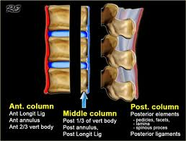
Spinal column

Slide 6
Orthotic goals
Correction
Accommodation
Stabilization
Pain reduction

Slide 7
Recommendation for spinal orthosis
Trunk support
Motion control
Spinal realignment

Slide 8
Types of spinal orthosis
Anterior control (Thorco-lumbar)
Becker
Jewett
Camp
Knit rite
Lenox baker
Dobi-simplex
Cash
Posterior control(lumbo-sacral)
Hollow back
Williams
Boston overlap
Rainey flexion orthosis
Wilner instrument for spinal stabilization
Sagittal (Tharaco-lumbar)
Taylor
Thoraco-lumbar corset
Sagittal coronal transverse
Cow horn
High magnuson
Steindler
Arnold baker
Plastic body jecket
Sagital lumboscacral
Chair back
Lumbo sacral corset
High low
Night spinal
Low back
Gold thwait
Sagittal coronal
Chair back
Knight spinal
Low cage
Lipscomb
Norton brown

Slide 9
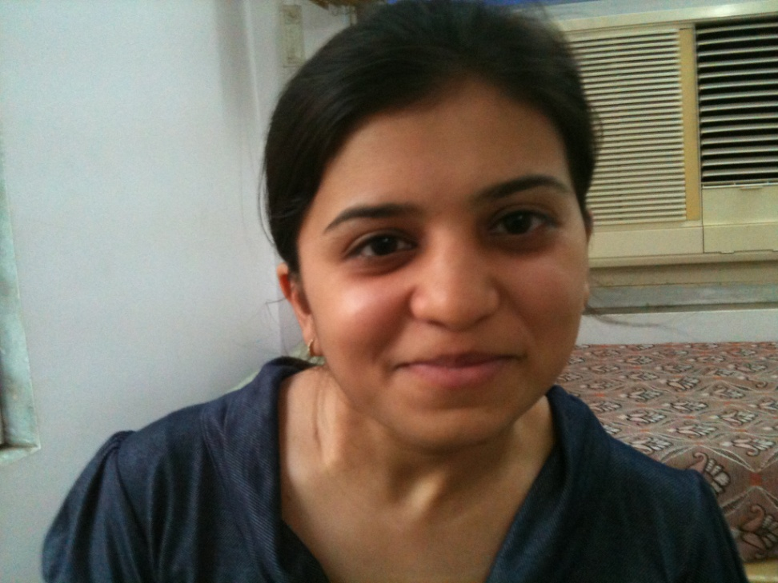
Torticollis
Early intervention needed in addressing torticollis for stretching SCM group of muscle.

Slide 10
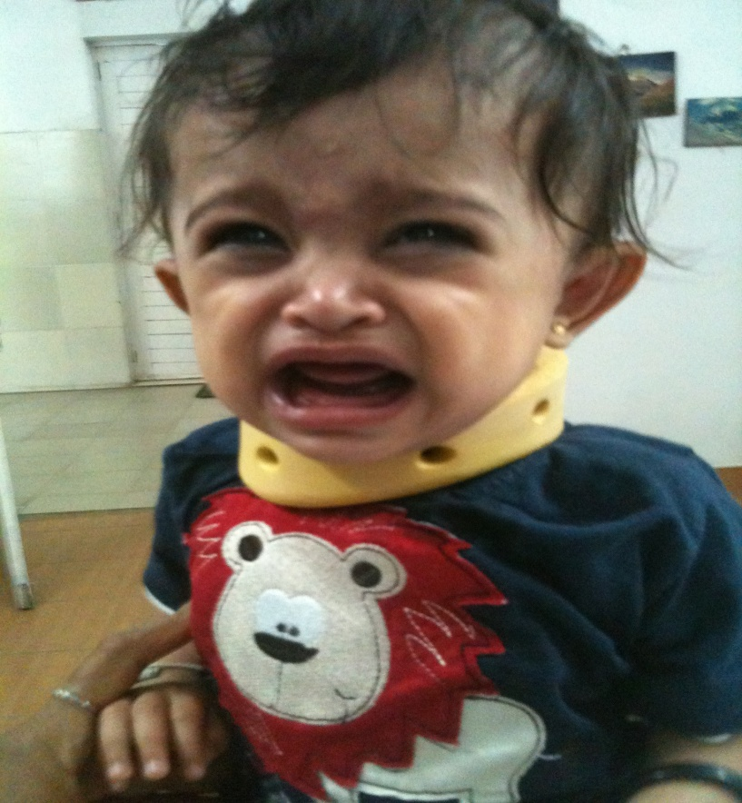
Asymmetrical cervical semi-rigid collar to maintain the stretched soft tissue.

Slide 11
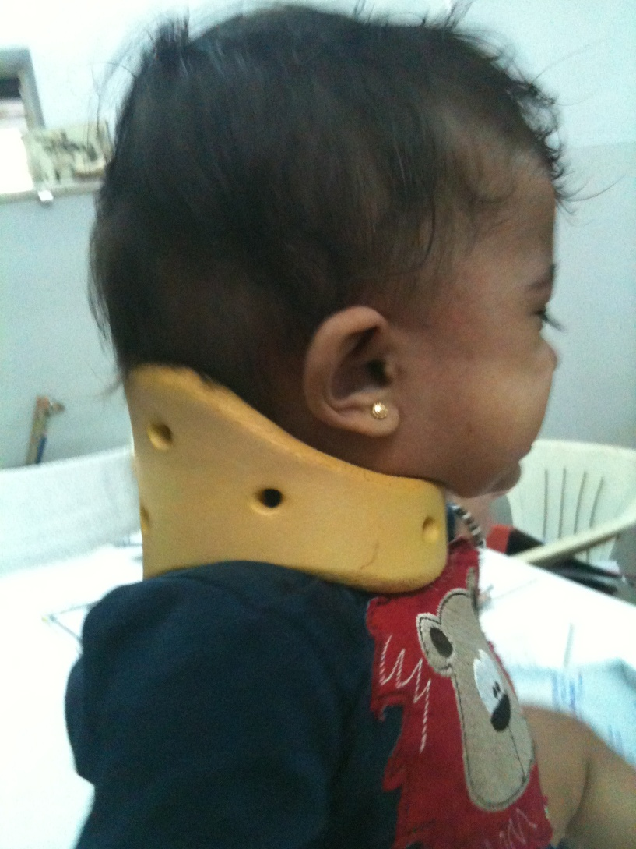
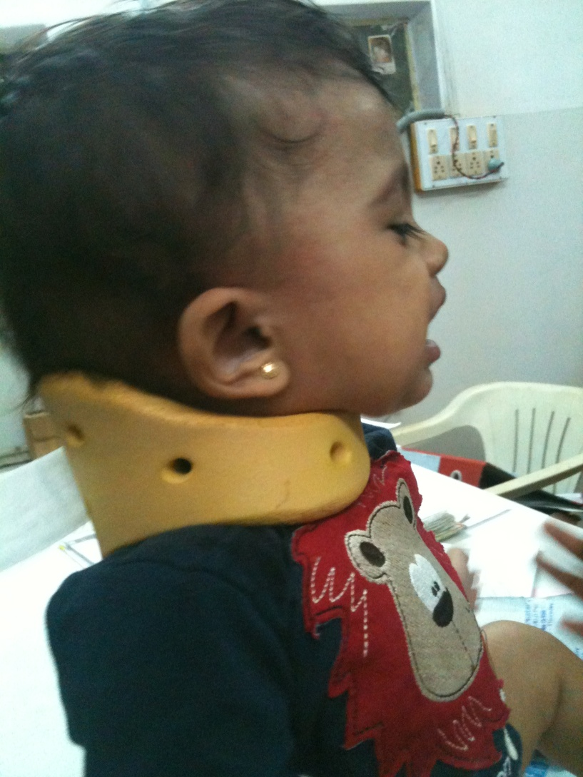
Control lateral flexion

Slide 12
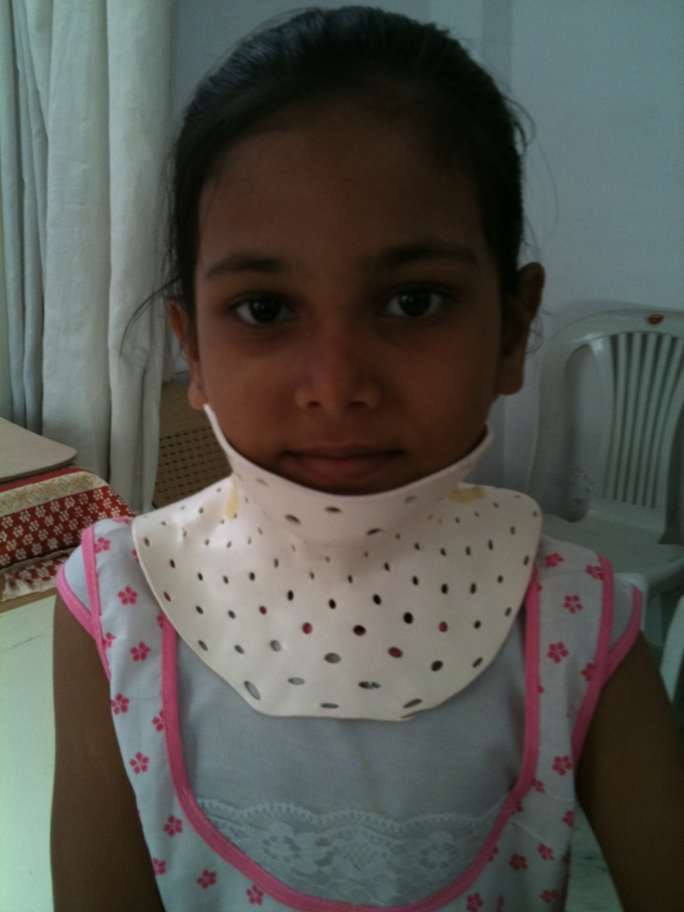
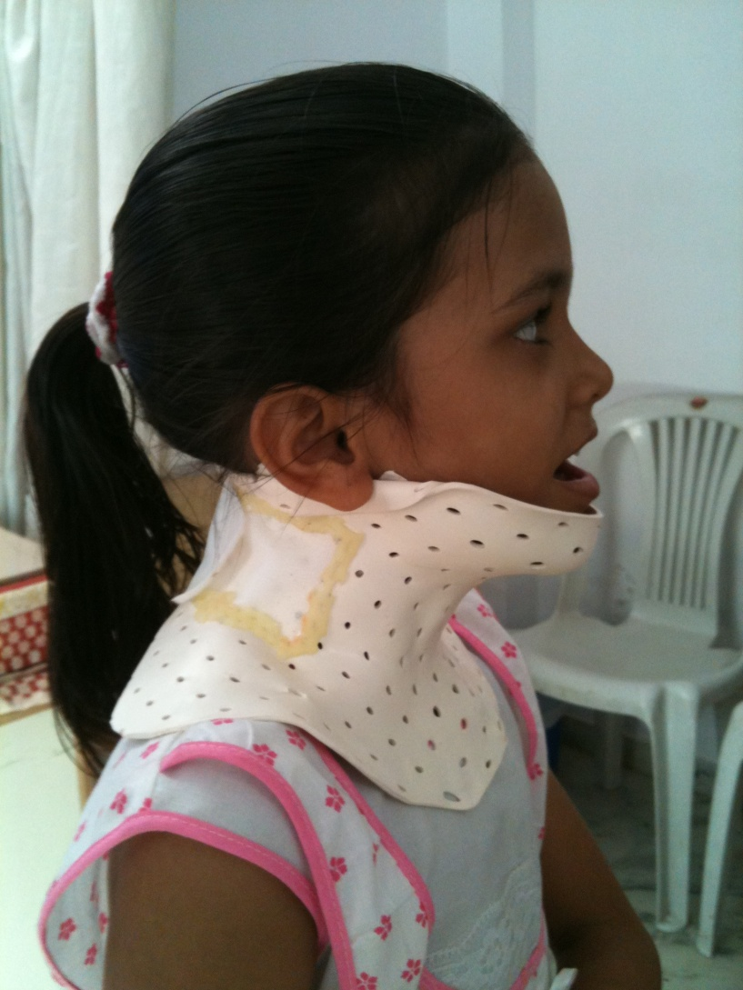
Post – Op rigid cervical total contact orthosis

Slide 13
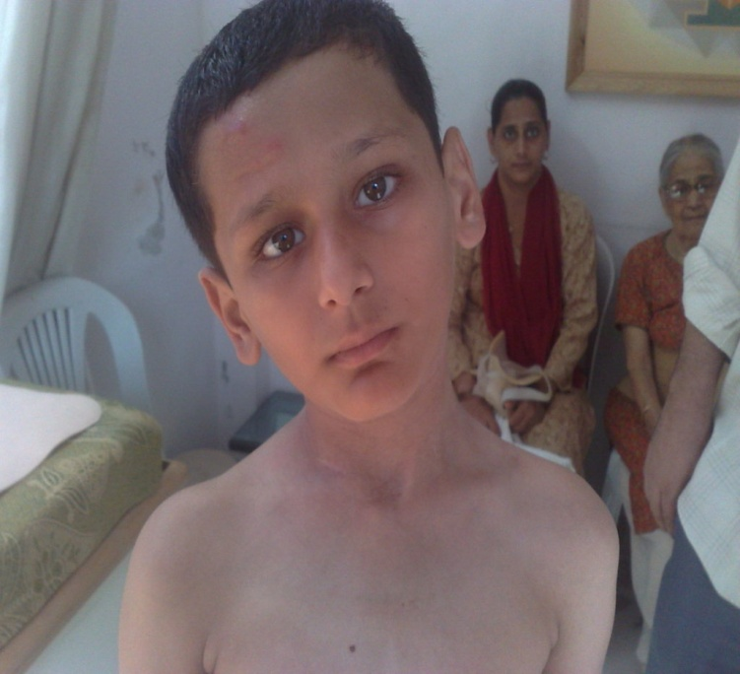
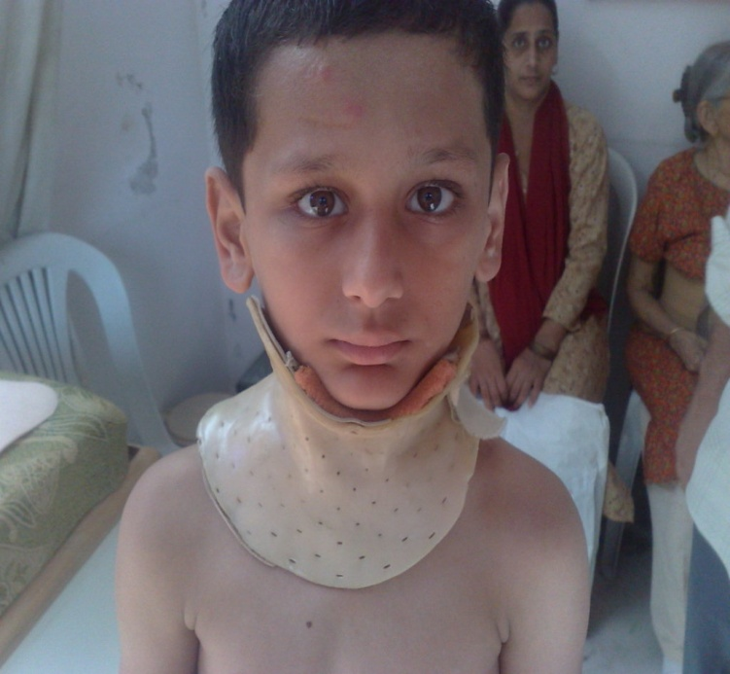
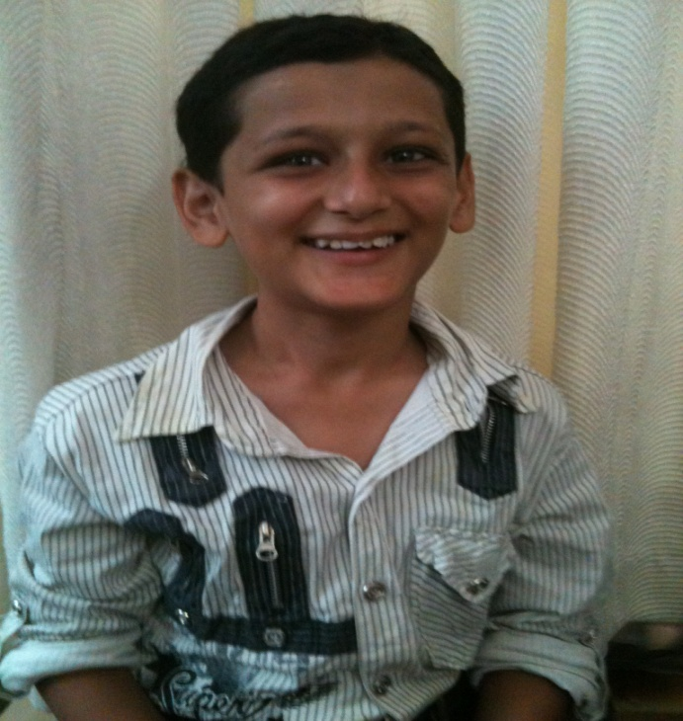
Rigid follow up protocol

Slide 14
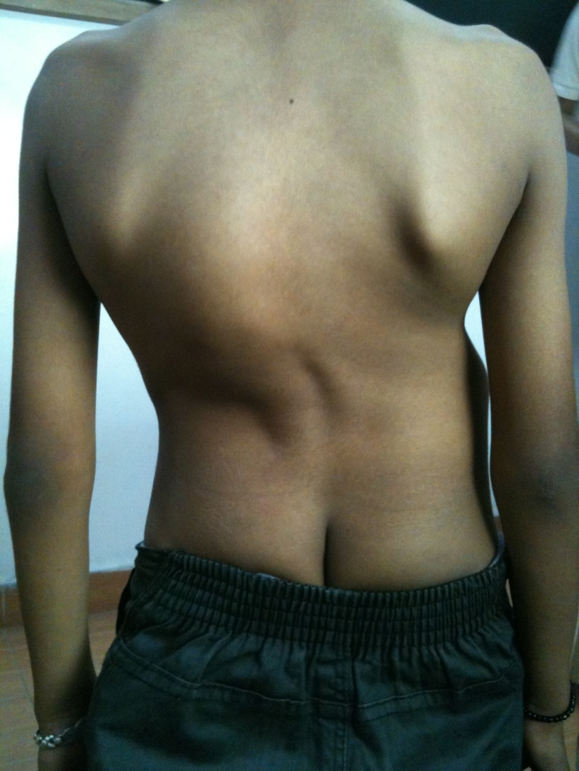
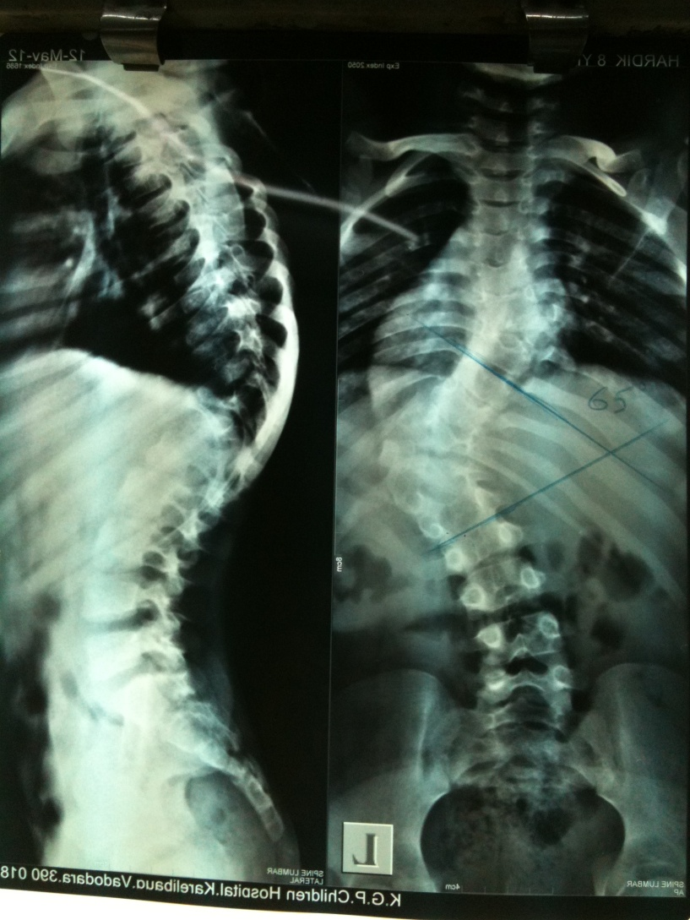
Scoliosis

Slide 15
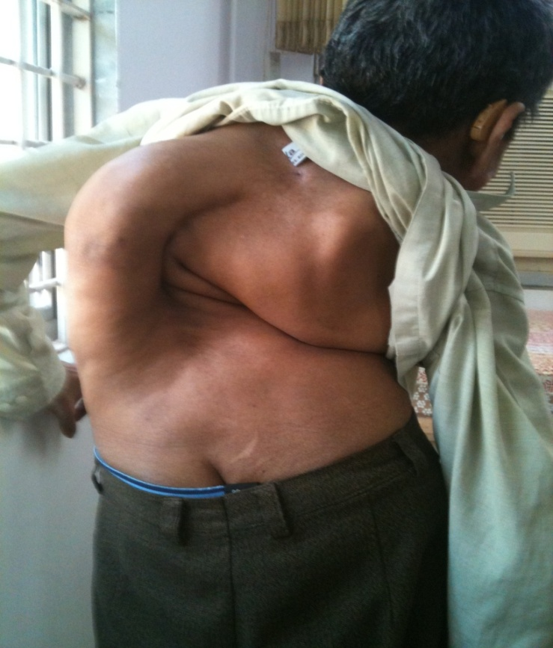
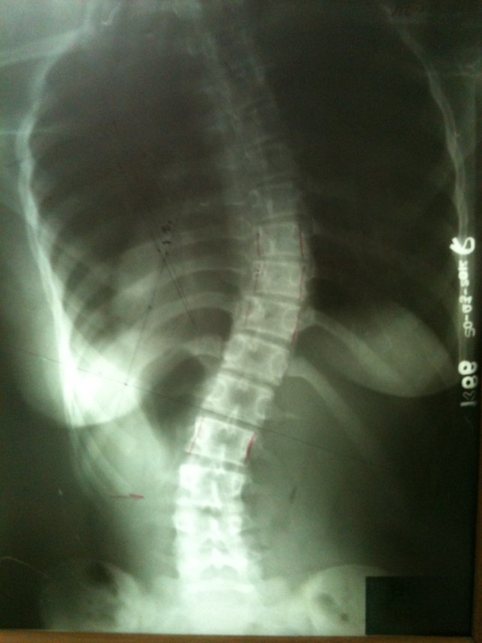
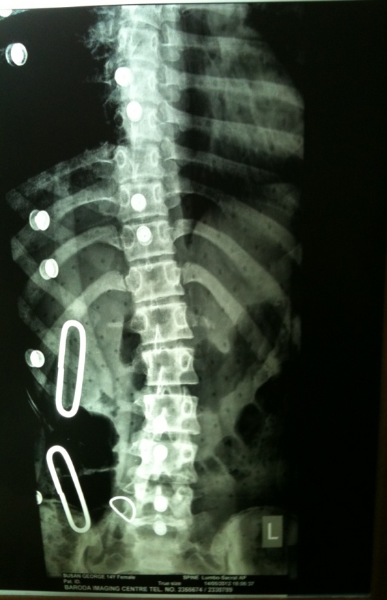
Untreated Evaluation Treatment

Slide 16
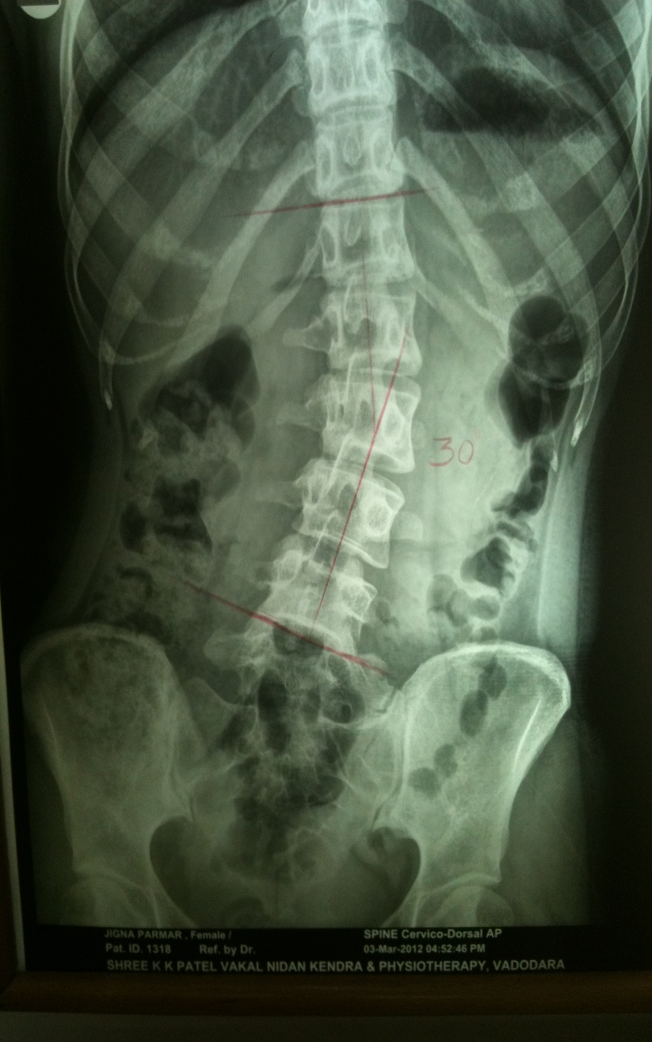
Evaluation
Decide shape/type-congenital, infective, traumatic, degenerative or idiopathic with/without hemi-vertebrae
Prescription varies early intervention before skeletal maturity, confirm with risser sign.
Cobb’s angle (Deviation curve has to be measured documented in a WB x-ray.

Slide 17
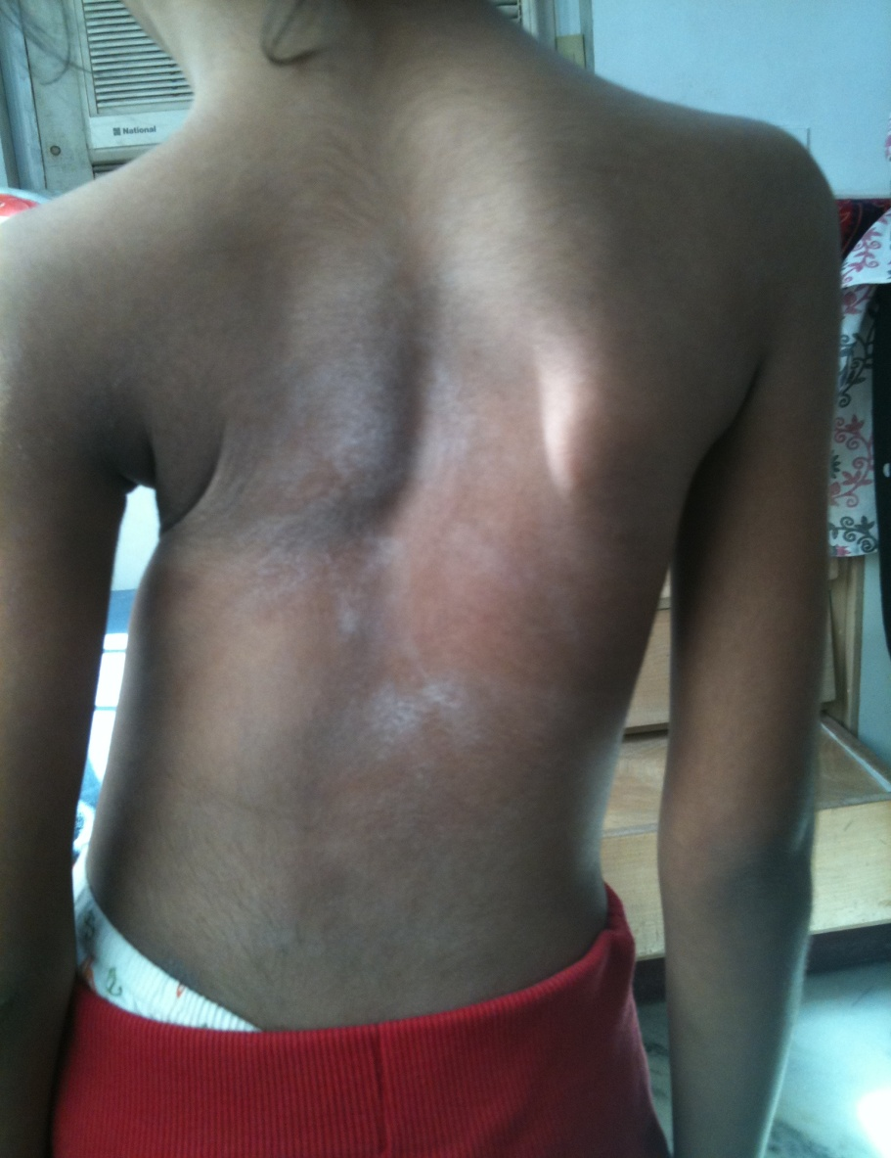
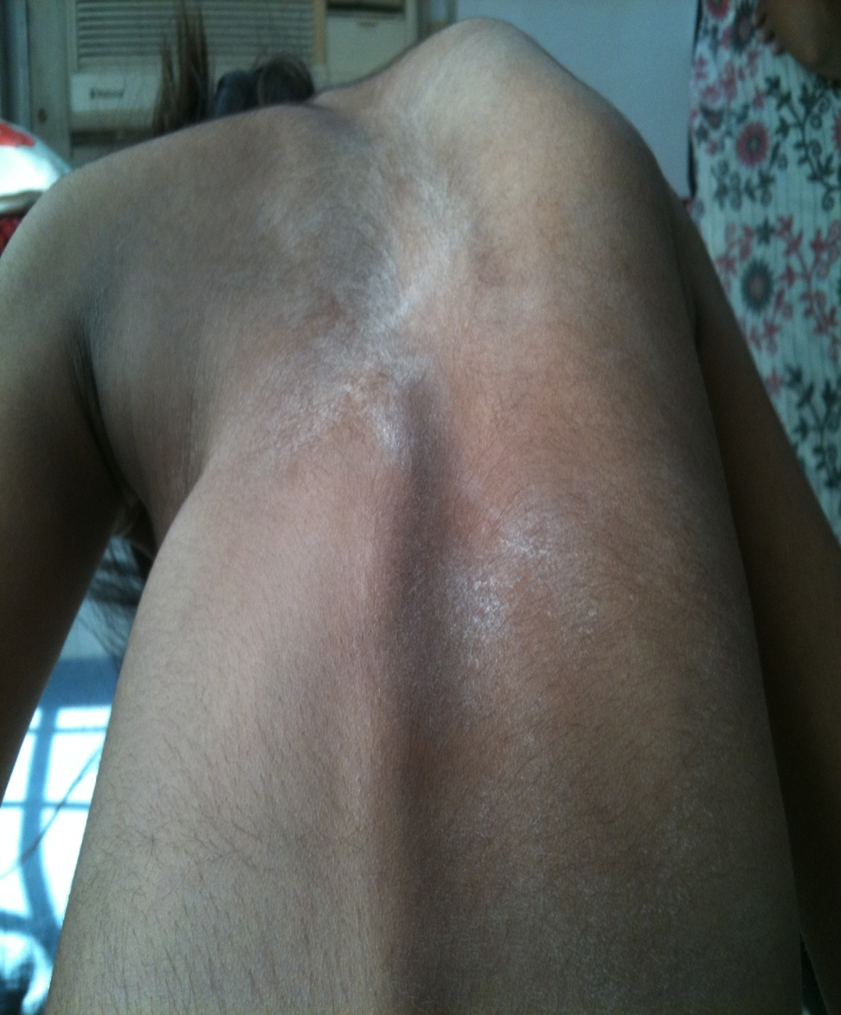
Determine Apex And Midline Drift

Slide 18
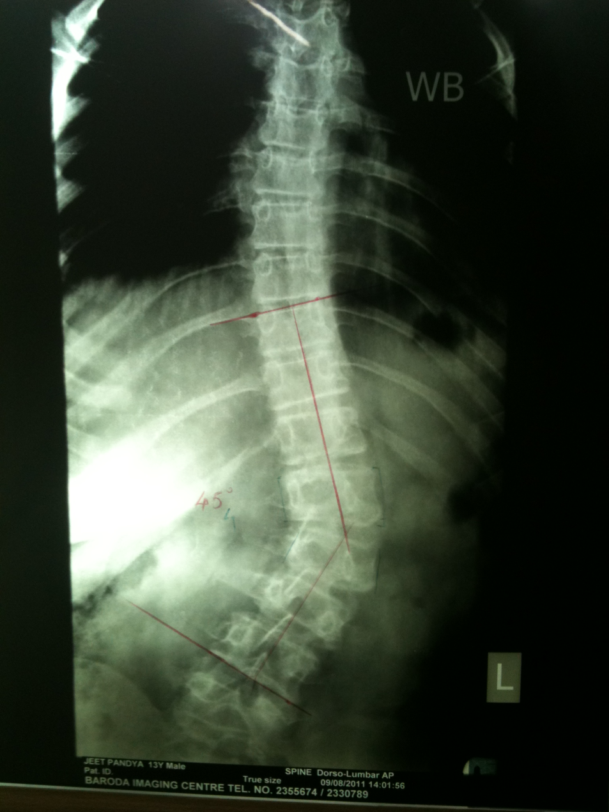
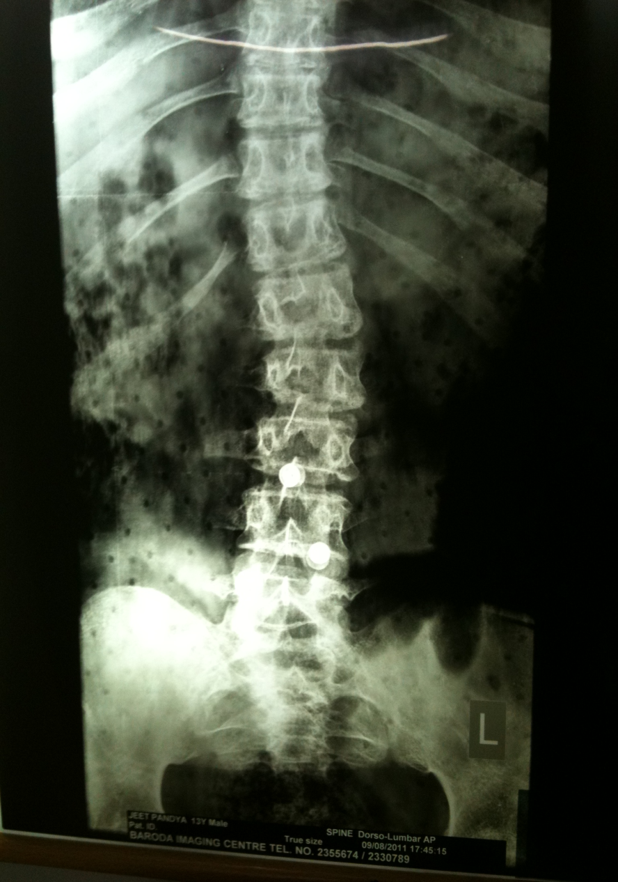
BEFORE
AFTER

Slide 19
Orthosis with various design
Providence,
Boston,
Charleston nocturnal flexion
Miami,
Wilmington,
NYOH,
Milwaukee style CTLSO
Knight spinal
Barr- buschenfeldt
Lyon TLSO
Rosenberger TLSO
Brewster.

Slide 20
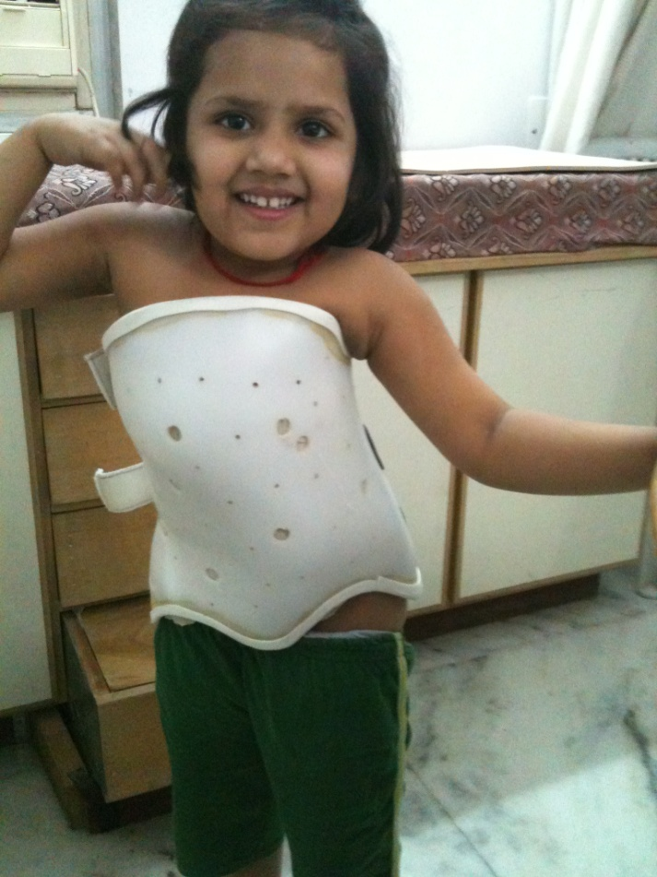
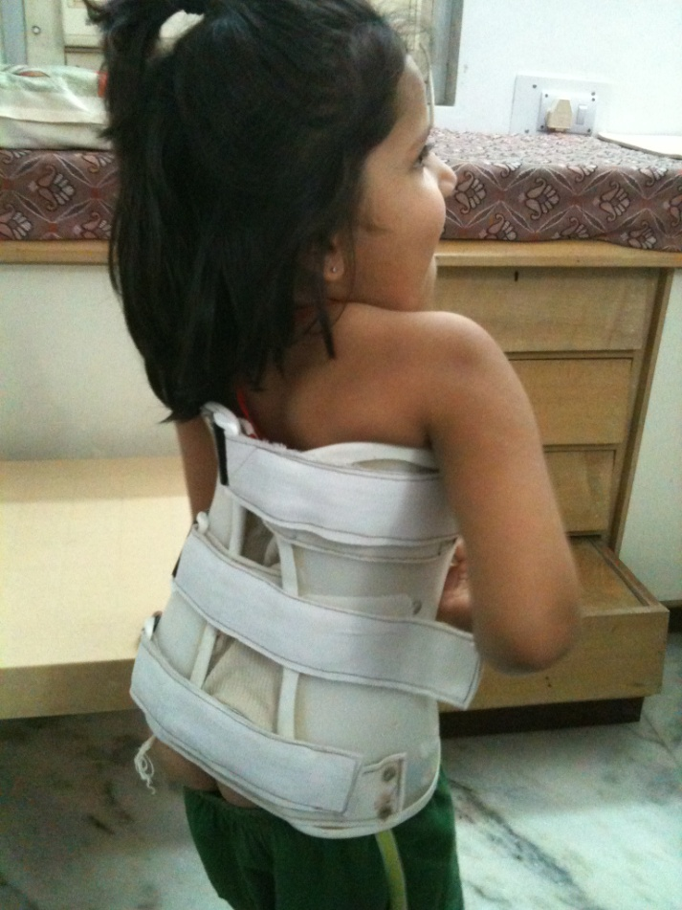

Slide 21
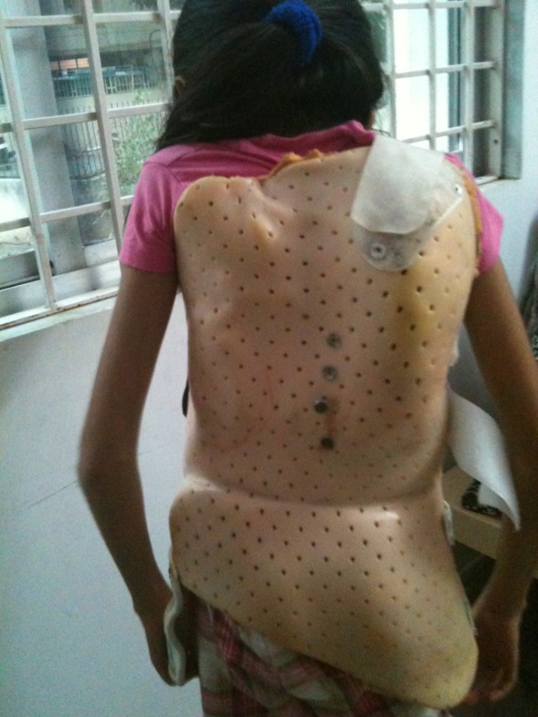
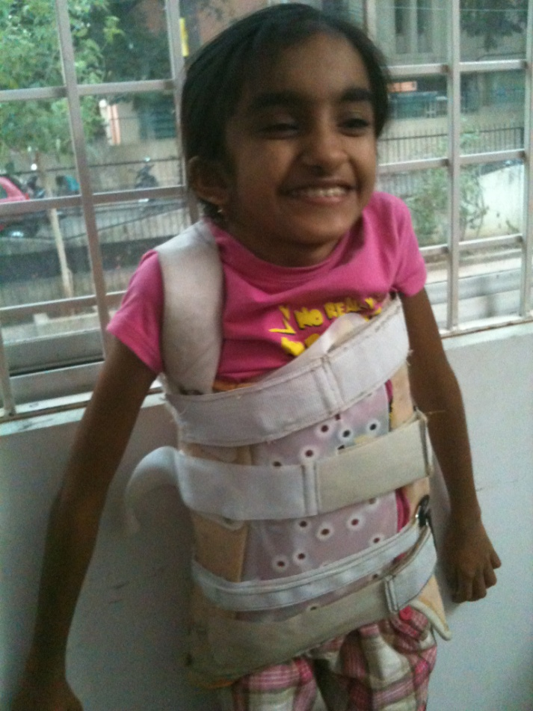

Slide 22
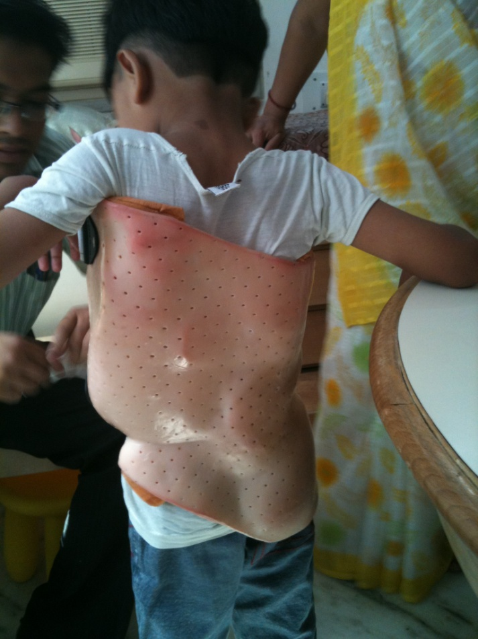
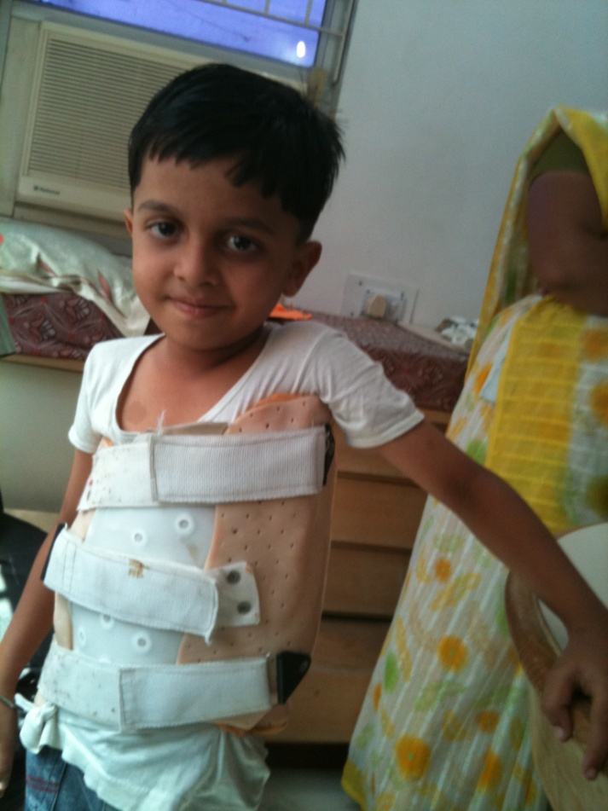

Slide 23
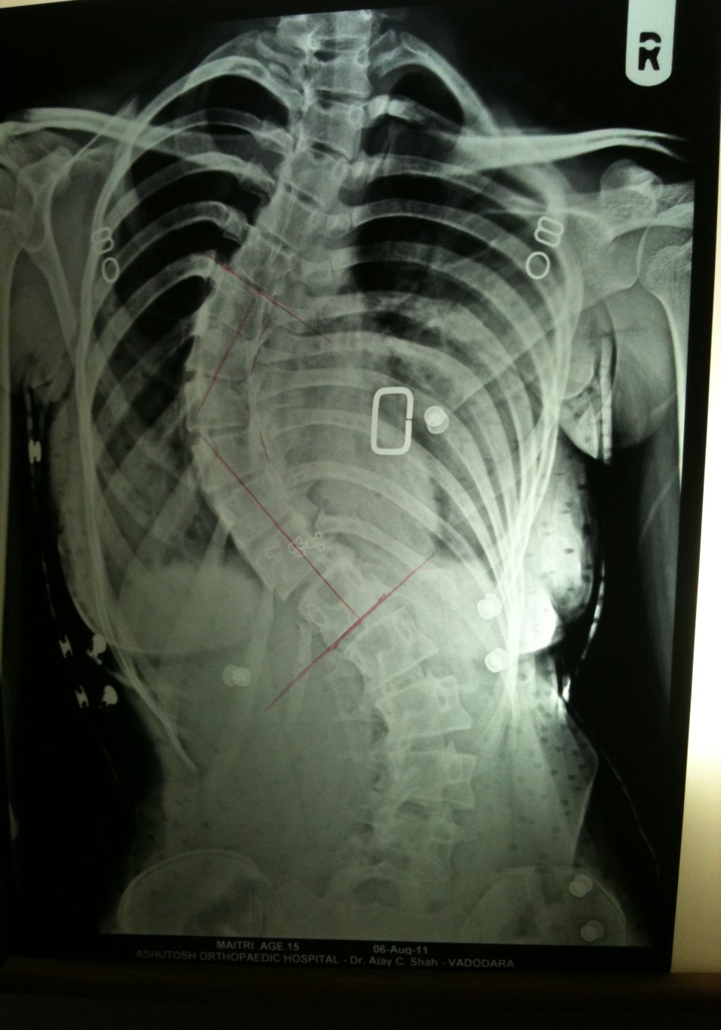
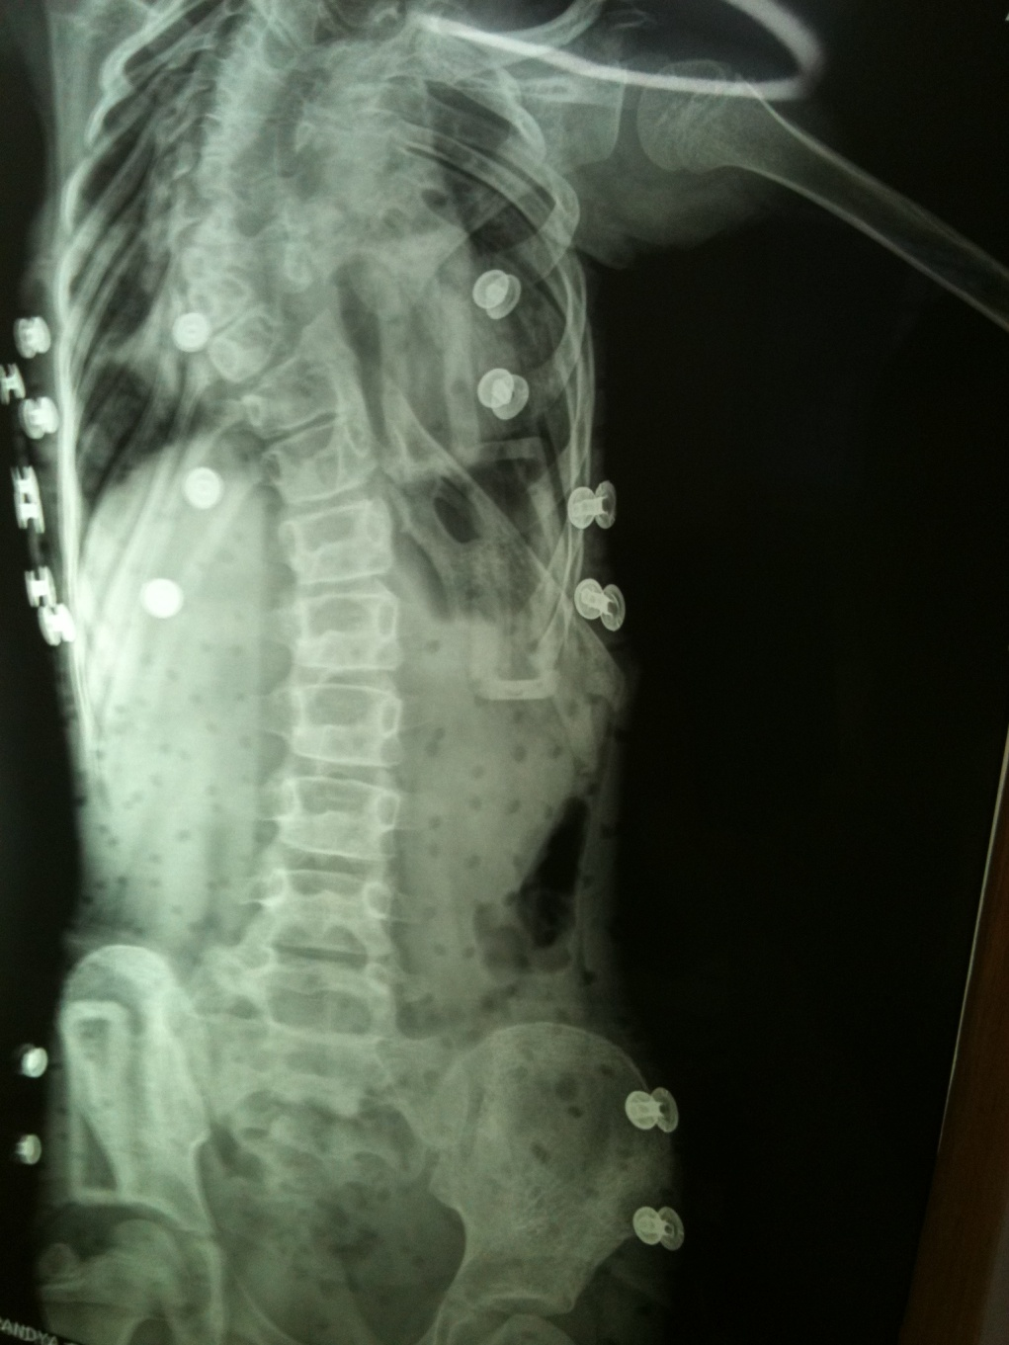
Judicious Reassesment Is Must

Slide 24
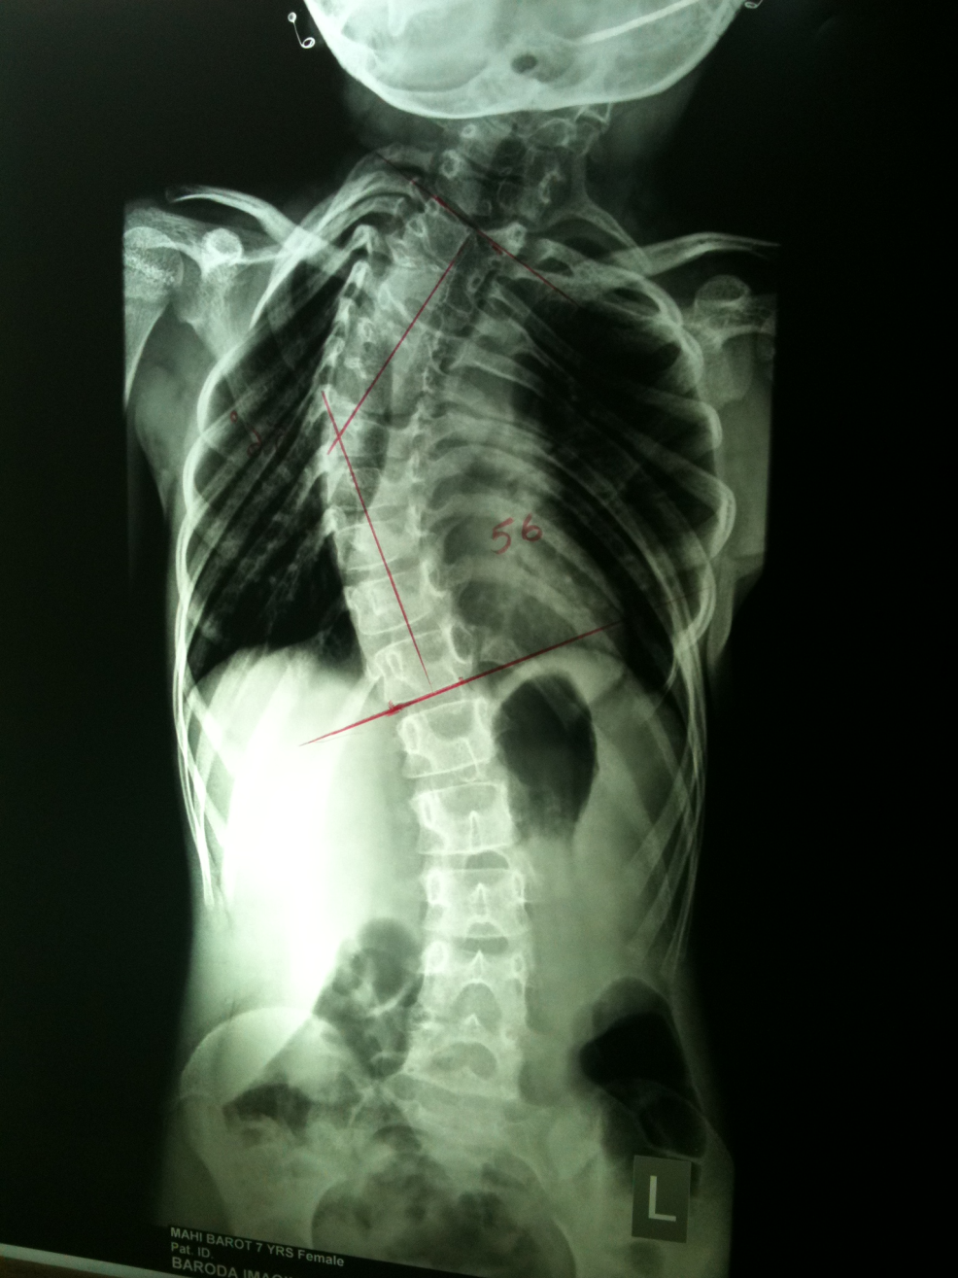
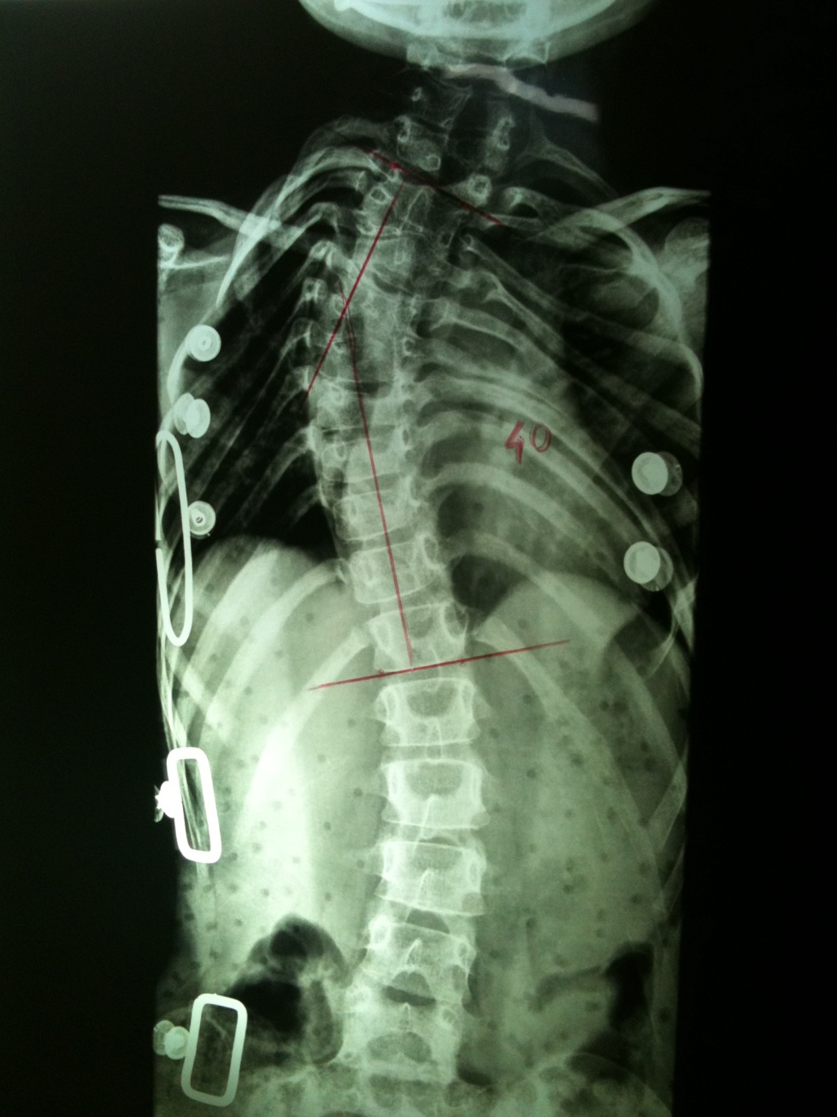
Try correction untill surgery

Slide 25
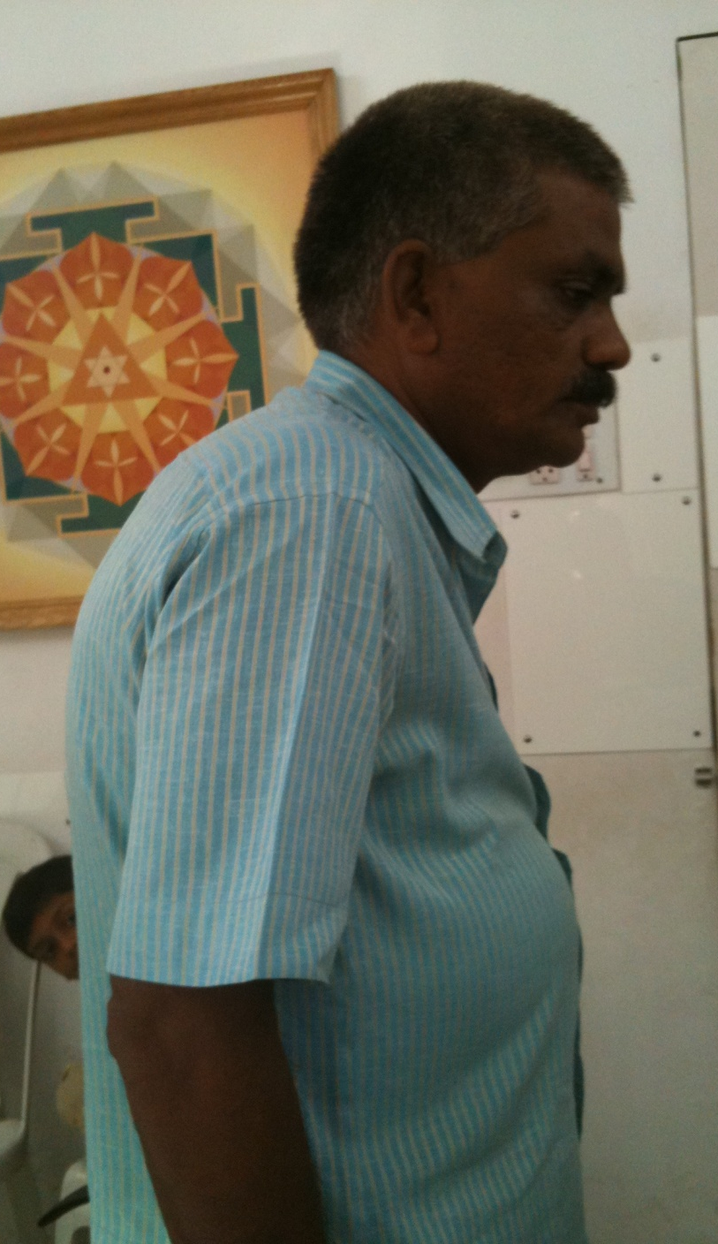
Kyphosis
Decide type- congenital, infective, postural, traumatic, adolescent, Schuermann’s,
Gibbus, senile osteoporosis and ankylosing spondylosis.

Slide 26
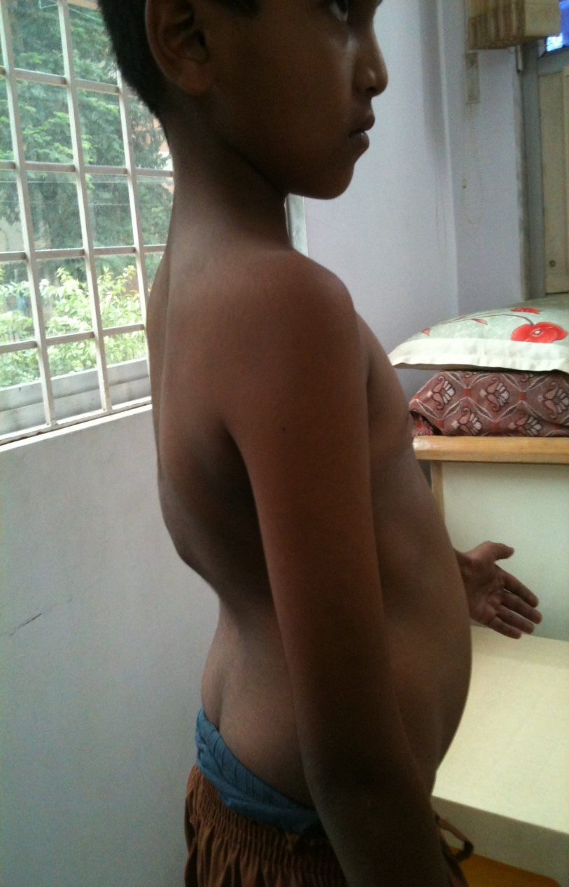
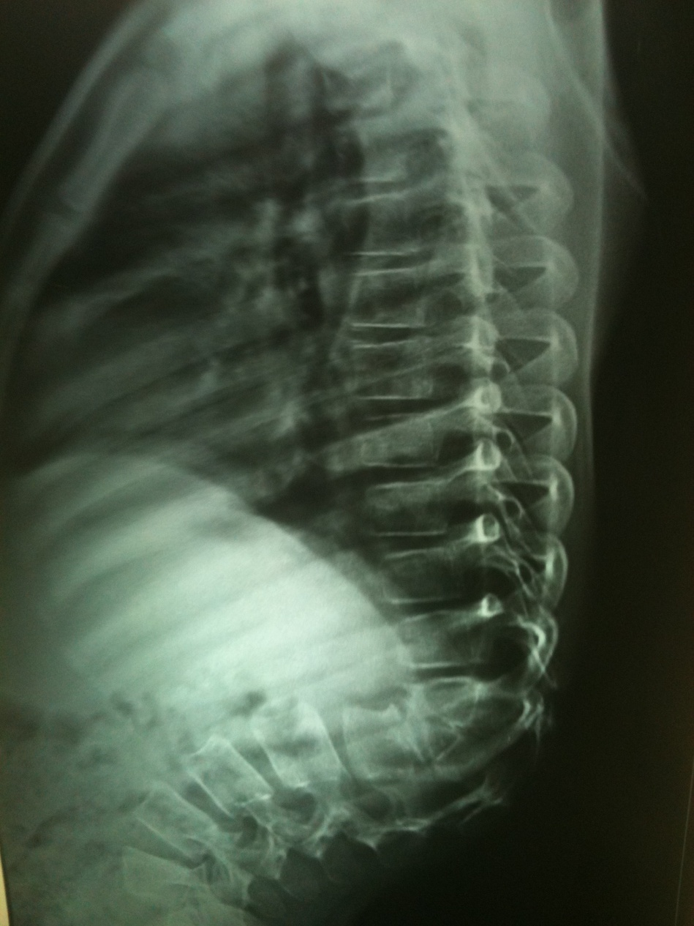
Focus on Gibbus

Slide 27
Measure kyphosis with S.V.A
S.V.A –Sagital Vertical Axis
Treat at the earliest with three point pressure system
Types –
Jewett,
CASH/ASH,
Taylors,
Custom molded TLSO braces.

Slide 28
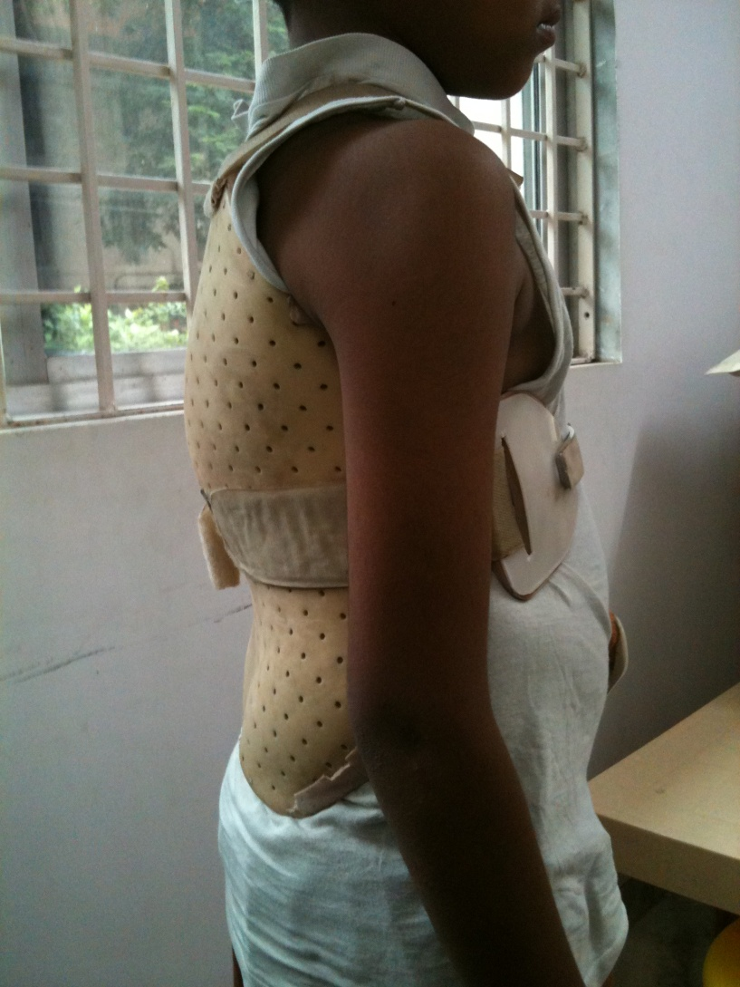
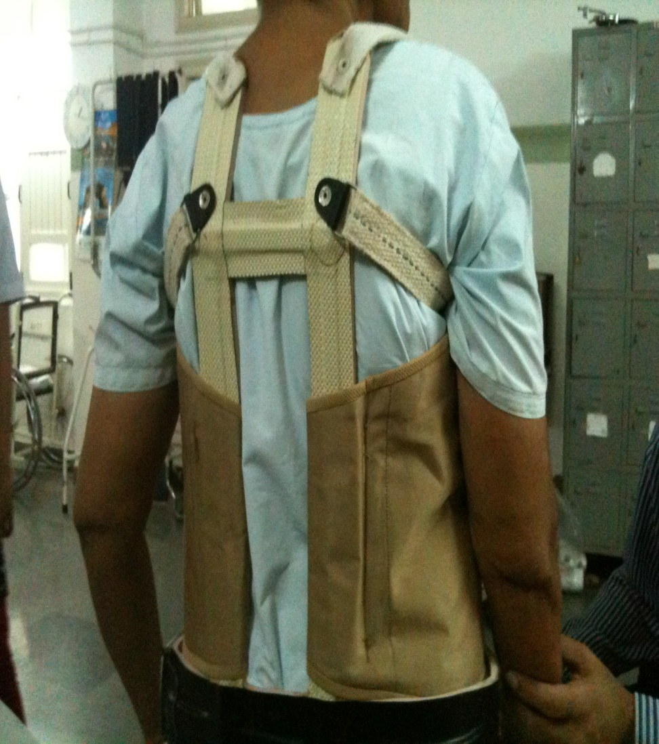

Slide 29
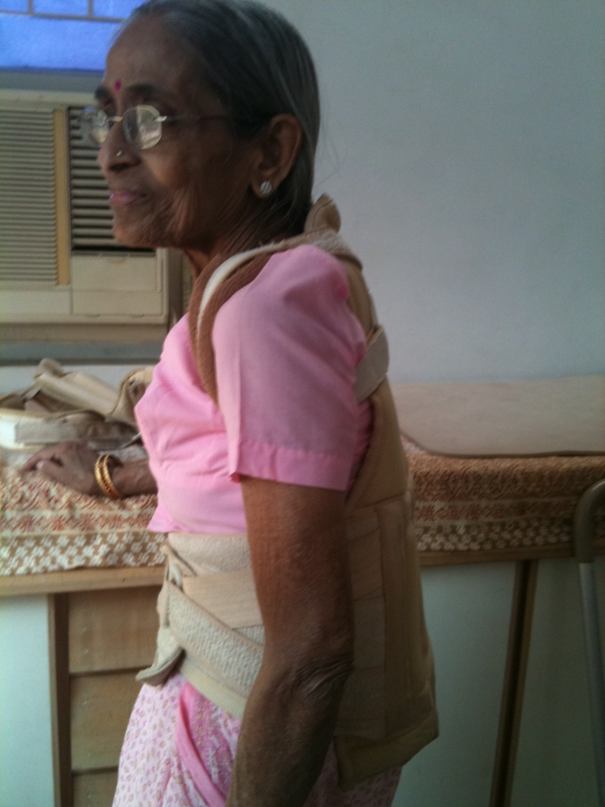
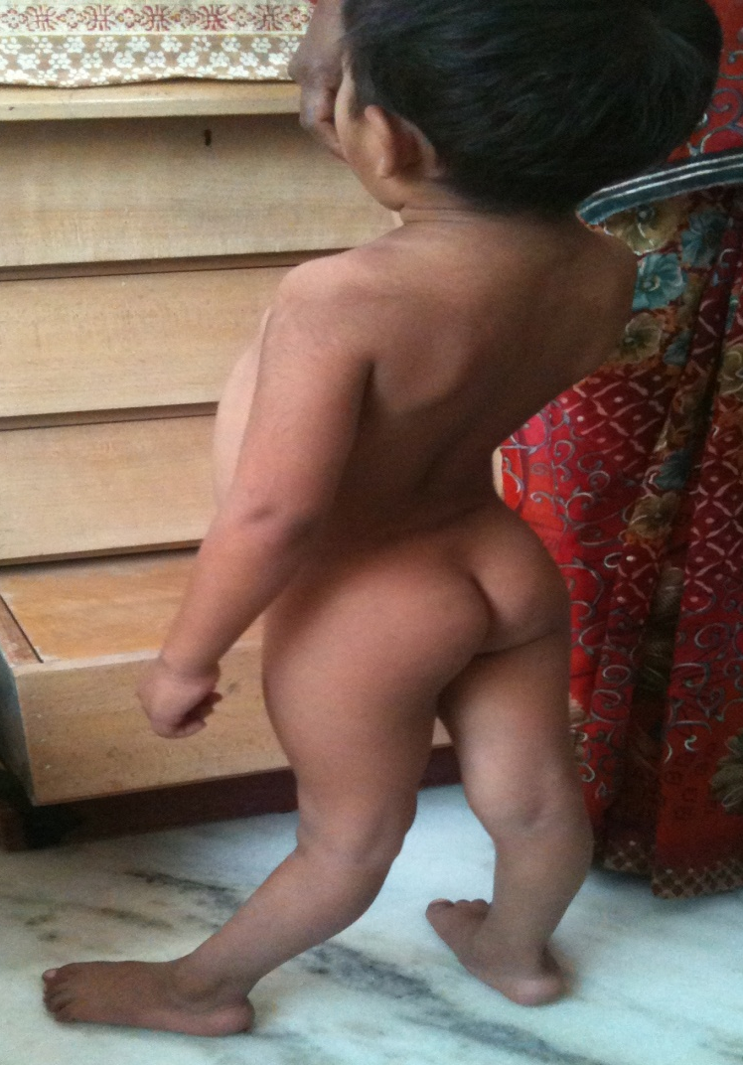
Management of
Kyphosis and exaggerated Lordosis

Slide 30
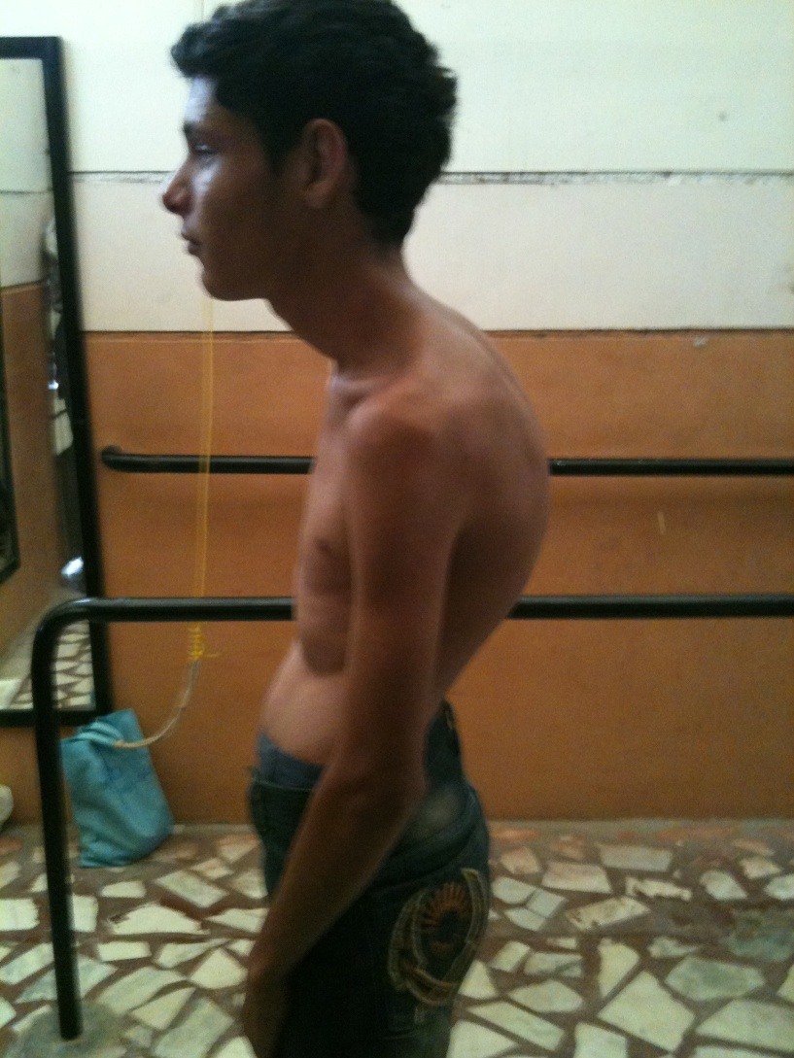
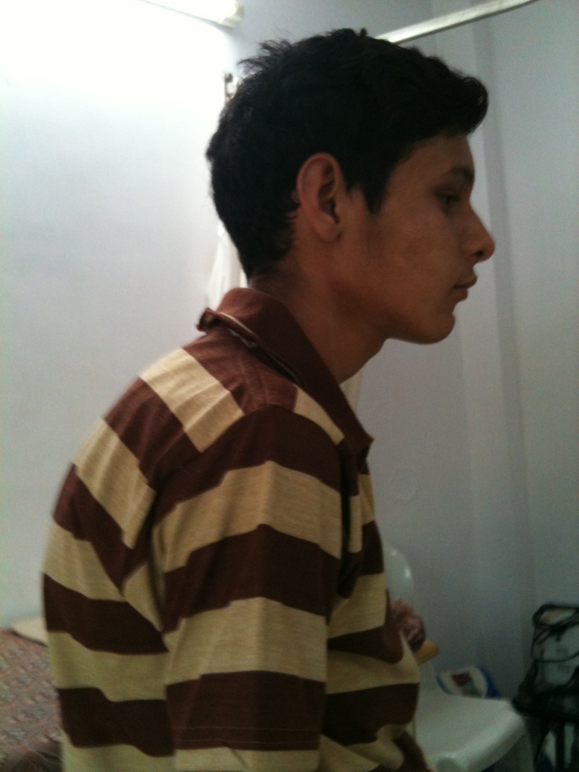
SVA

Slide 31
Fracture spine
Decide which column of spine has been stressed (anterior column/middle column/posterior column)
Type of fracture: single/multiple/chance/burst/seat belt,
Treat all spine fractures with thorough immobilization.
Generally spinal fractures take long time to heal, studies have proved that biological ossification takes six to twelve months post injury in an adult, it may be shorter duration for healthy individuals and pediatric group and longer duration in geriatric, osteoporotic conditions.
Treat metastasis of spine, multiple myeloma with thorough immobilization to avoid risk of fractures.
Region of spinal fracture decides the orthotic prescription; general thumb rule is segmental immobilization roughly four vertebra superior and inferior to the lesions.

Slide 32
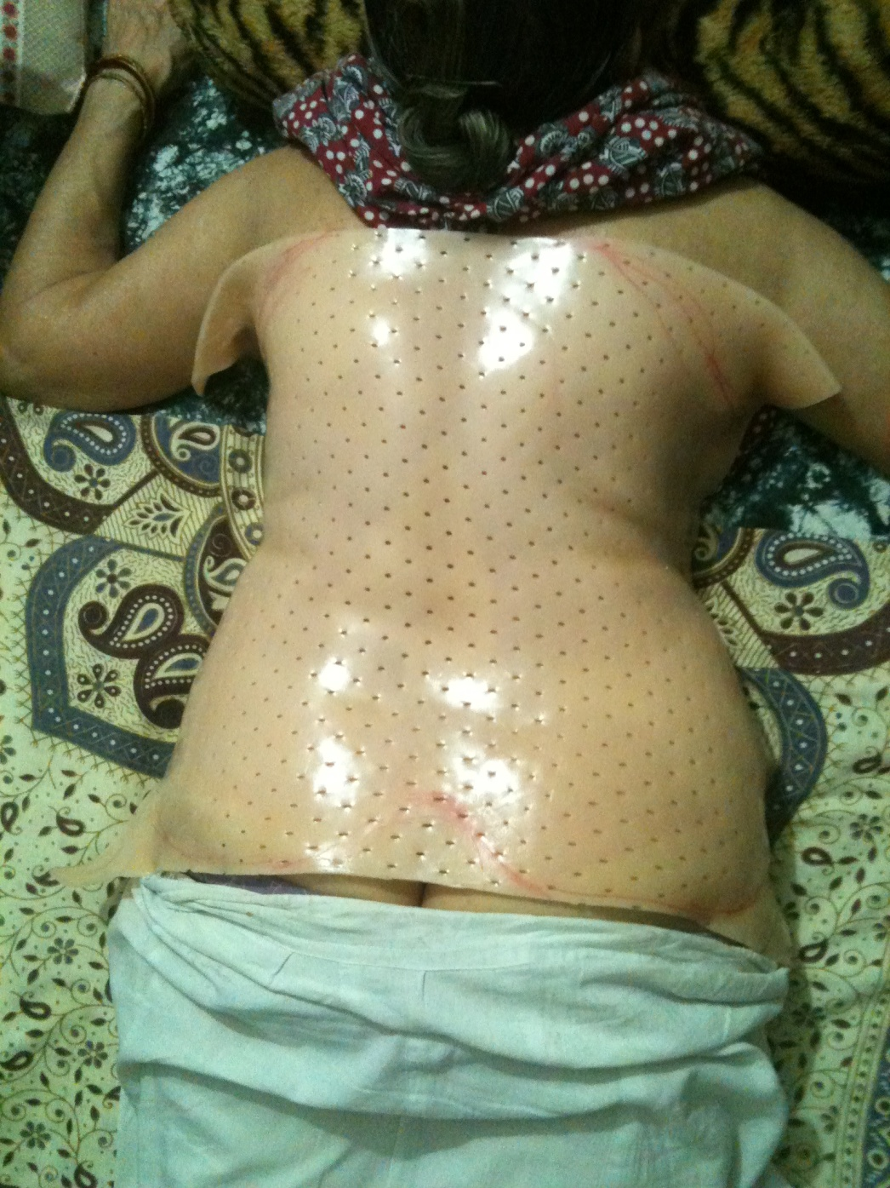
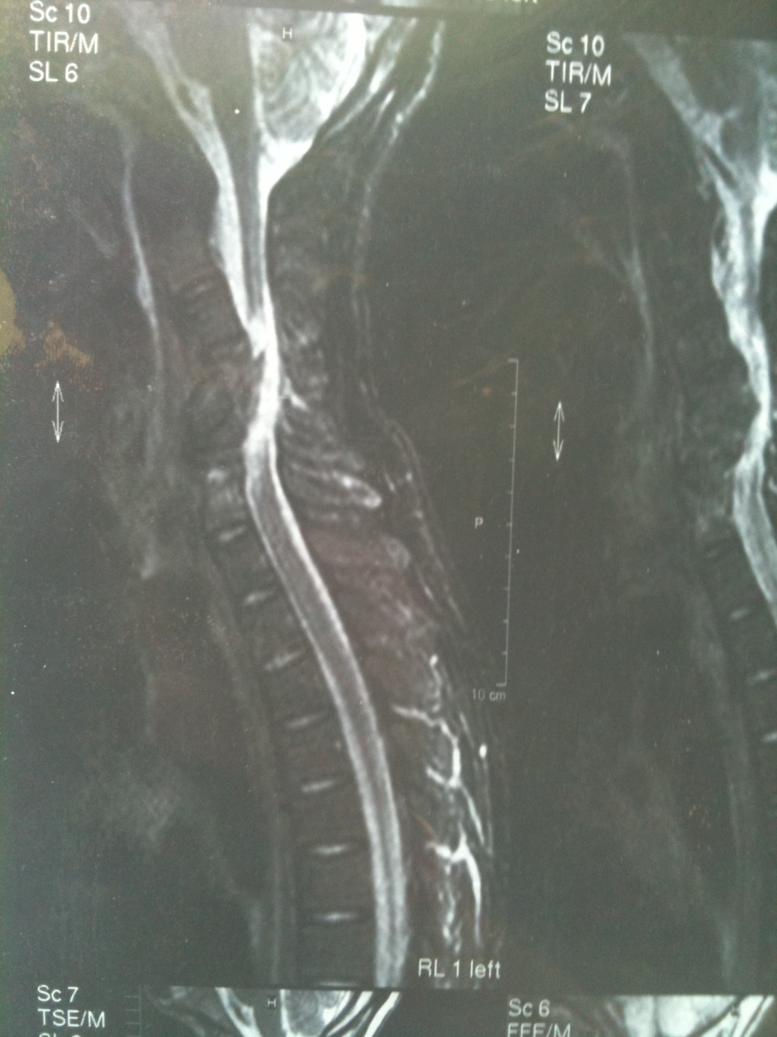

Slide 33
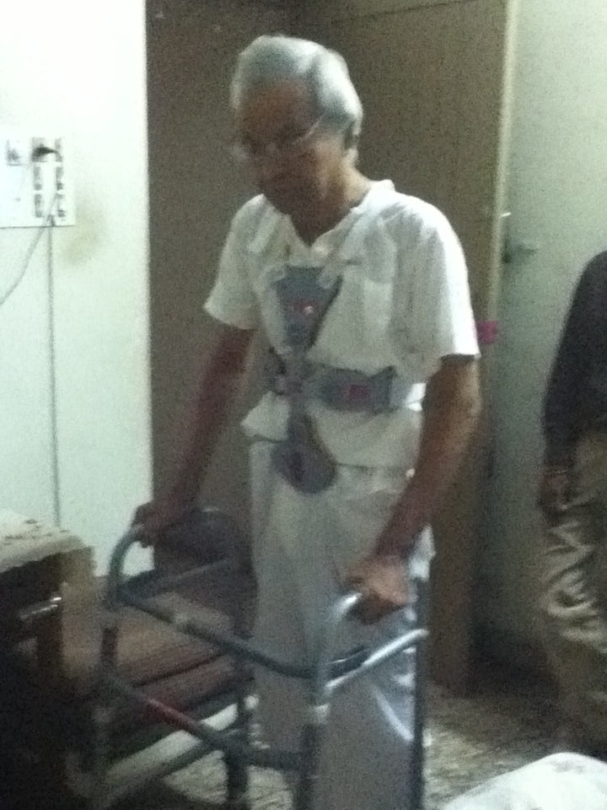
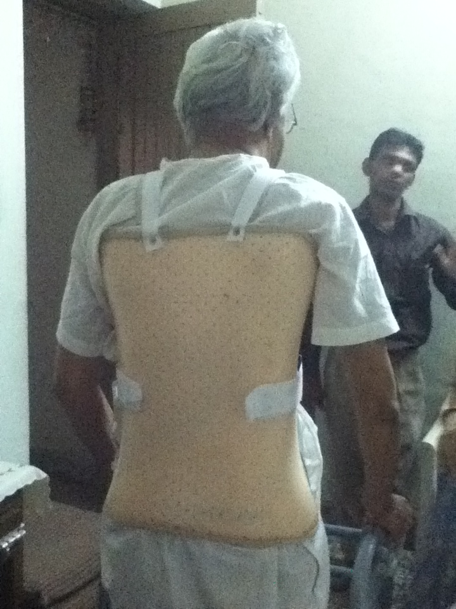
Need Base Combination Bracing

Slide 34
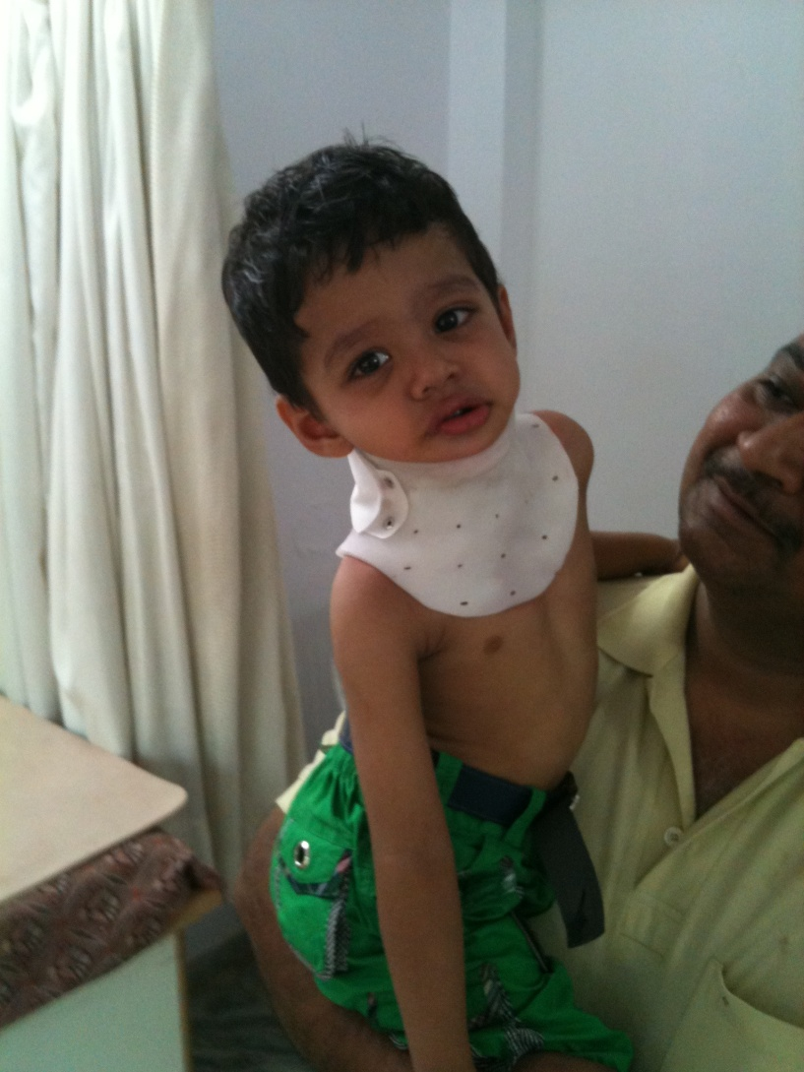
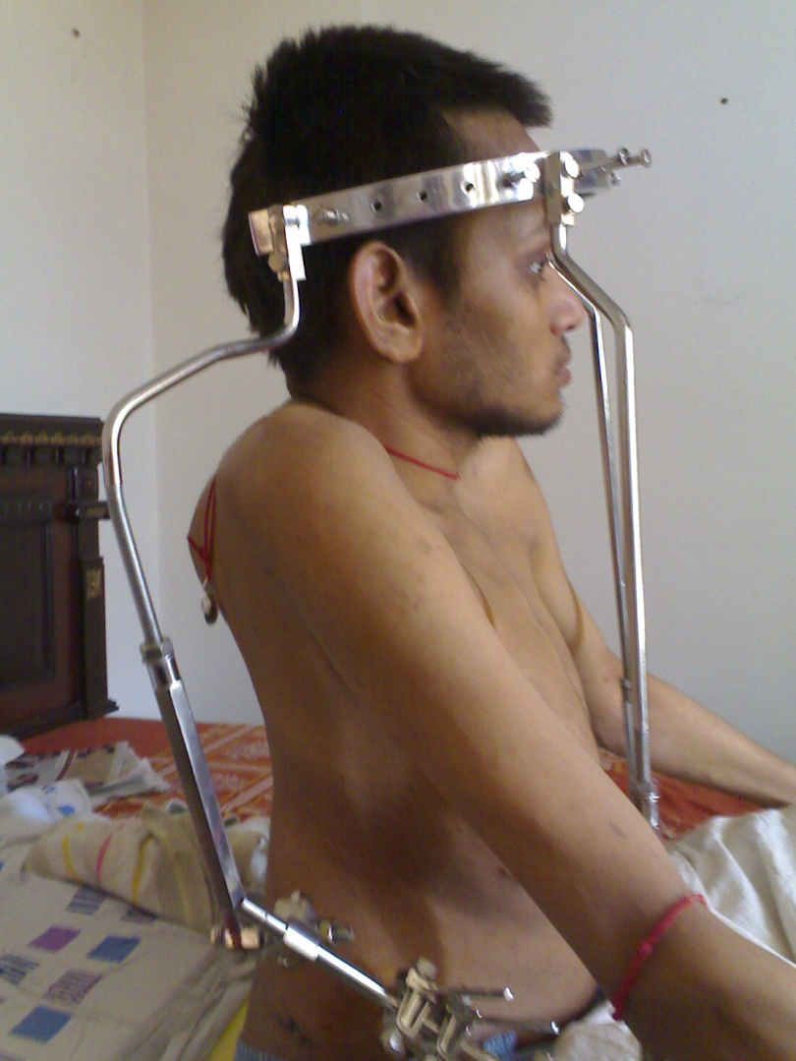

Slide 35
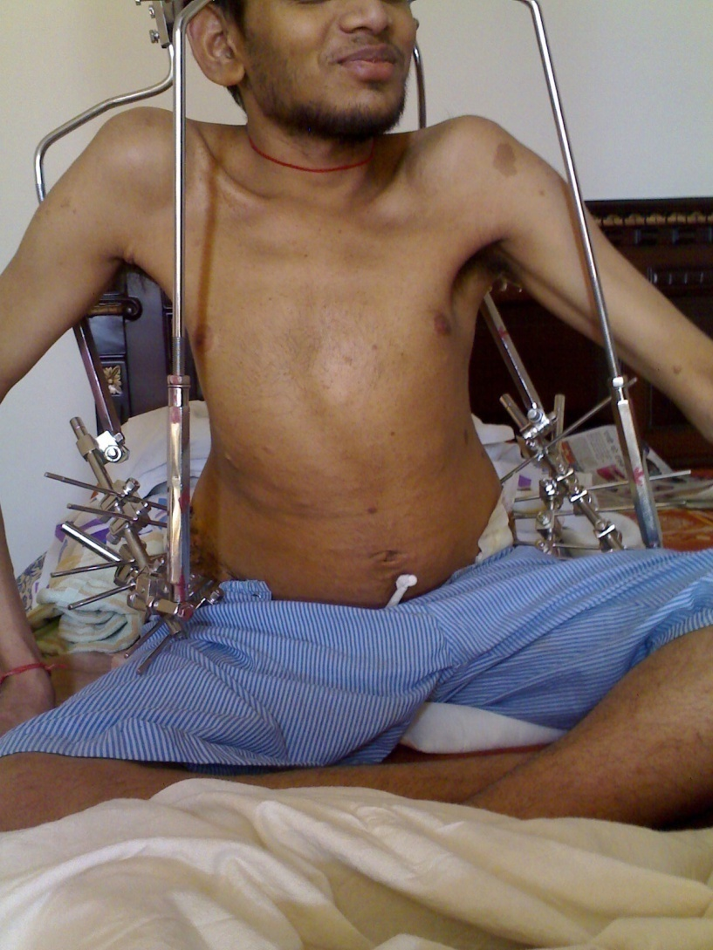
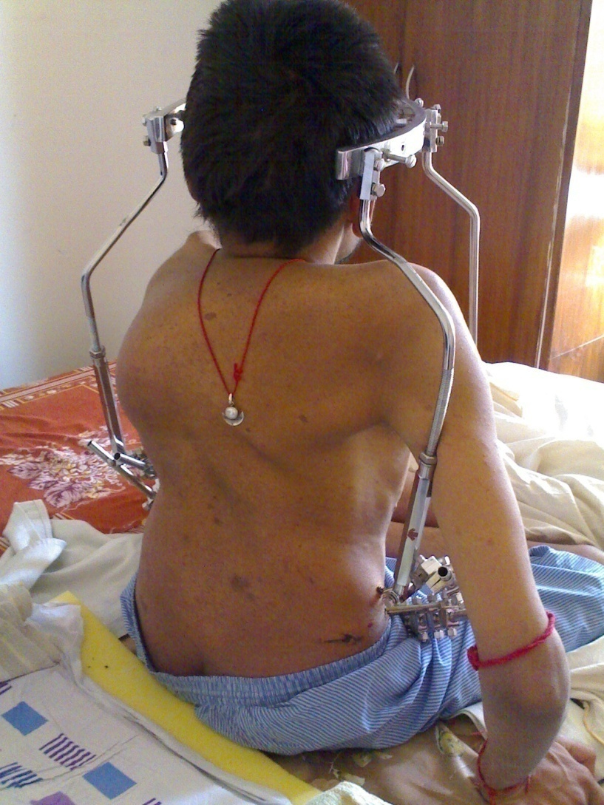
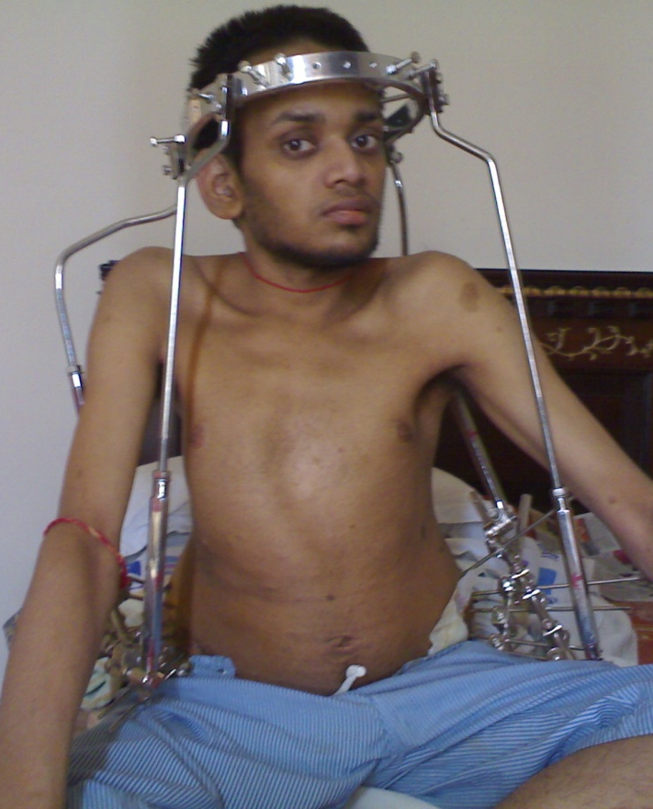
HALO Cx

Slide 36
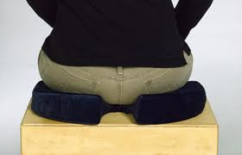
Coccyx Seat
In conditions of fracture coccyx or coccydynia offload/cut out seat is recommended for months until clinically pain free seating occurs.

Slide 37
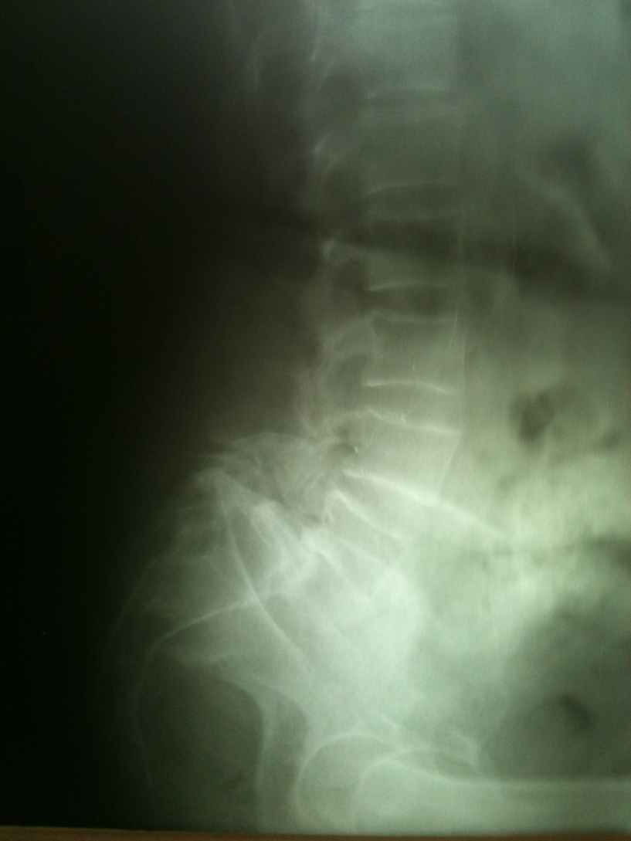
SPONDYLOLYSTHESIS
Rigid orthosis with three point pressure and immobilization to the affected vertebra.
LS/DLS frame orthosis.
Miami total contact custom moulded spinal orthosis.

Slide 38




Slide 39


SPINAL ORTHOSIS DURING PREGNANCY

Slide 40

Osteogenesis imperfecta
It needs thorough total contact immobilization and gradual weight bearing schedule.
Do not attempt rigorous correction of deformity in case.

Slide 41
Congenital anomalies
Meningomyeloceal,
Spina bifida,
Sacroagenesis
Needs thorough evaluation of lower limb muscle power in flail/poor muscle condition, early weight bearing stimulation is most needed with the help of RGO (if not HKAFO’s).
Paraplegics with spinal lesion below T4/D4
can walk.

Slide 42


RGO(Reciprocating Gait Orthosis)

Slide 43
Spinal conditions
Mechanical-structural low back pain
Pre operative
Surgical lumbar fusion
Disc surgery without fusion
Fractures
Osteoporosis with multiple verterbra compression fractures
Fractures with posterior element involvement
Inflammatory spinal arthritis
Tumor of the spine
Paralytic disorder
Paraplegia
Spina bifida
Sprains
Degerative disc disease
Fracture and dislocation

Slide 44


Slide 45



Slide 46



Slide 47

It’s always Team work

Slide 48
Thank you

