Slide 1
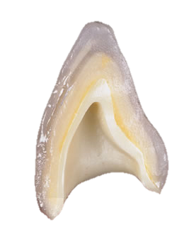

METHODS OF STRENGTHENING OF CERAMICS
Dr. Namrata Shah Naidu

Slide 2


What will you learn from this lecture:
Why ceramics need to be strengthened?
Methods of strengthening brittle material
Methods of designing components to minimize stress concentrations and tensile stresses

Slide 3
Why do materials fail to exhibit the strengths that would be expected from the bonds between atoms ??
The answer is found in the minute scratches and other defects that are present on the surfaced of nearly all materials.
These surface defects behave as sharp notches whose tips may be as narrow as the spacing between the atoms in the material.

Slide 4
A phenomenon known as stress concentration at the tips of these minute scratches or flaws causes the localized stress to increase to the theoretical strength of the material at a relatively low average stress throughout the structure.
When the theoretical strength of the material is exceeded at the tip of the notch, the bonds at the notch tip breaks and initiate a crack formation.

Slide 5
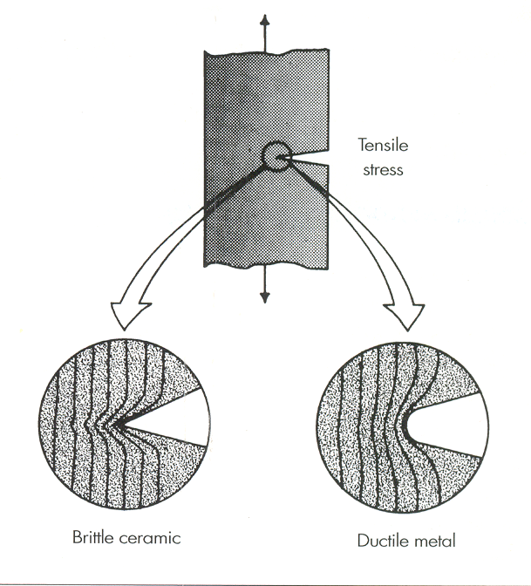

Slide 6
Because of the many desirable physical properties of ceramics – such as :
  Good esthetics qualities
  High hardness & compressive strength
  Good chemical durability
  Excellent biocompatibility
  A great effort has been expended to
  overcome their principal deficiencies –
  Brittleness
  Low fracture toughness
  Low tensile strength

Slide 7
Importance of surface flaws in determining the strength ??
Oral environment
Bending forces acting on the surface of the prosthesis
Tensile stresses
Fracture

Slide 8
According to K.J. Anusavice ; Phillips’ Science of Dental materials; 11th Edition;
METHODS OF STRENGTHENING BRITTLE MATERIALS:
  1.Development of residual compressive stresses:
  a. Ion exchange (Chemical tempering)
  b. Thermal tempering
  c. Thermal compatibility
  2.Interruption of crack propagation:
  a. Dispersion of crystalline phase
  b. Transformation toughening
METHODS OF DESIGNING COMPONENTS TO MINIMIZE STRESS CONCENTRATIONS AND TENSILE STRESSES :
1. Minimizing tensile stress
2. Reducing stress raisers

Slide 9
1.DEVELOPMENT OF RESIDUAL COMPRESSIVE STRESSES
This is one of the widely used methods of strengthening glasses and ceramics.
The strengthening is gained by the virtue of the fact that these residual stresses must first be negated by developing tensile stresses before any net tensile stress develops.

Slide 10
100MPa
CERAMIC A
CERAMIC B
60MPa
60MPa
100MPa
CERAMIC A
CERAMIC B
40MPa
CERAMIC A
CERAMIC B

Slide 11
These residual stresses are developed by:
  Ion Exchange ( Chemical tempering)
  Thermal tempering
  Thermal compatibility

Slide 12
ION EXCHANGE : aka Chemical tempering (Anusavice et al,1992)
Na⁺
Glass
K⁺
Molten potassium nitrate bath
Na⁺
Glass

Slide 13
THERMAL TEMPERING :
  Most common method of strengthening glass.
  This method creates residual compressive stresses by rapidly cooling (quenching) the surface of the object while it is hot and in the softened (molten) state.
  This rapid cooling produces a skin of rigid glass surrounding a soft (molten) core.

Slide 14
Rigid glass surrounding molten core
Rapid cooling
core
Pull of the solidifying molten core

Slide 15
Thermal tempering is used to strengthen glass for uses such as automobile windows and windshields, sliding glass doors, and diving masks.
Rapid cooling is accomplished by jets of air directed at the molten glass surface.
In dentistry, it is more effective to quench hot glass phase ceramics in silicone oils or other special liquids.
Thermal tempering induces a protective region of compressive stress within the surface.

Slide 16
THERMAL COMPATIBILITY (Thermal expansion co-efficient mismatch ) :
Ideally, porcelain should be under slight compression in the final restoration, hence for metal-ceramic restorations, the metal and porcelain selected should have a slight mismatch in their thermal contraction co-efficient.

Slide 17
Since the metal thermal contraction co-efficient is slightly larger, the metal contracts slightly more than the porcelain on cooling.
This mismatch leaves the porcelain in residual compression and provides additional strength for the restoration.

Slide 18
2.INTERRUPTION OF CRACK PROPAGATION
This method involves strengthening glasses and ceramics by reinforcing them with a dispersed phase of a different material that is capable of hindering a crack propagating through the material.
Methods:
  Dispersion of a crystalline phase
  Transformation toughening

Slide 19
DISPERSION OF A CRYSTALLINE PHASE
Method of strengthening glasses and ceramics is to reinforce them with a dispersed phase of a different material that is capable of hindering a crack from propagating through the material. This phenomenon is called as dispersion strengthening.
Eg. When a tough, crystalline material such alumina (Al₂O₃) is added to a glass, the glass is toughened and strengthened because the crack cannot pass through the alumina particle as easily as it can pass through the glass matrix.

Slide 20
Al₂O₃
GLASS
GLASS REINFORCED WITH AL₂O₃

Slide 21
Dental ceramics containing a glass phase can be strengthened by increasing the crystal content of
  Leucite (K₂O.Al₂O₃.4SiO₂),
  Lithia disilicate (Li₂O.2SiO₂)
  Alumina (Al₂O₃)
  Magnesia-alumina spinel (MgO.Al₂O₃)
  Zirconia (ZrO₂)

Slide 22
In contrast, dental ceramics based primarily on zirconia crystals (Cercon and Lava) undergo transformation toughening that involves :
At the tips of cracks that are in the region of tensile stress.
TRANSFORMATION TOUGHENING
TETRAGONAL CRYSTAL PHASE
MONOCLINIC PHASE

Slide 23
In this process 3 vol% expansion of the ZrO2 crystals or precipitates occurs that places the crack under a state of compressive stress and crack progression is arrested.
Because of this strengthening and toughening mechanism, the yttria stabilized zirconia ceramic is sometimes referred to as ceramic steel.

Slide 24
2.DESIGN OF DENTAL RESTORATION INVOLVING CERAMICS
Dental restoration containing ceramics should be designed in such a way as to overcome their weakness.

Slide 25
1.MINIMIZING TENSILE STRESS:
Conventional PJCs are contraindicated for restoring posterior teeth because occlusal forces can subject them to large tensile stresses, which usually concentrate near the interior surface of the crown.
  Metal-ceramic crowns
  Bonded platinum foil PJC technique
  Swaged gold alloy foil technique
  are used.

Slide 26
2.REDUCING STRESS RAISERS
Stress raisers are discontinuities in ceramic structures.
Conditions causing stress concentration :
  Creases or folds of the platinum foil substrate that become embedded in the porcelain and leave notches.
  Sharp line angles in the preparation.
  Large changes in porcelain thickness.

Slide 27
THANK YOU!!!

