Slide 1
Definition of Disability, Impairment and Rehabilitation
Dr. Deepak Kumar
Assist. Prof.
COP,SV

Slide 2
Objectives
At the end of the lecture the students will be able to:
Define and discuss in short about Disability and different types of Disability models
Define and discuss in short about Impairment
Define and discuss in short about Rehabilitation

Slide 3
Physical therapists intervene at the level of impairment, functional limitation and disability of the disablement process.
Hence understanding of the complex relationships of pathology and diseases, impairments, functional limitation and disability is essential.

Slide 4
WHO defined
Impairment- is defined as “Any loss or abnormality of psychological, physiological or anatomical structure or function. ” (Nagi, ICIDH)
E.g. loss of foot, defective vision or mental retardation.
An impairment may be visible or invisible, temporary or permanent, progressive or regressive.
One impairment may lead to development of secondary impairment as in case of leprosy where damage to nerves (primary impairment) may lead to planter ulcers (secondary impairment).

Slide 5
Disability- because of an impairment , the affected person may be unable to carry out certain activities considered normal for his age , gender etc. the inability to carry out certain activities is termed disability.
A disability is defined as Any restriction or lack of ability to perform an activity in a manner or within the range considered normal for a human being. (ICIDH)
Any restriction or inability to perform socially defined roles and tasks expected of an individual within socio-cultural and physical environment. (Nagi Model)

Slide 6
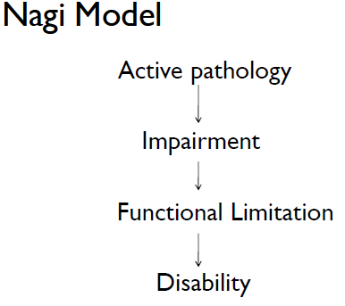
Models of disability
interruption of normal cellular processes and the efforts of the affected systems to regain homeostasis.

Slide 7
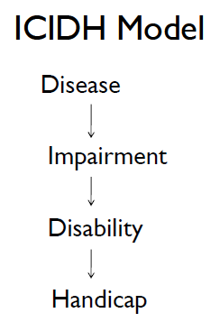
Biomechanical, physiologic and anatomic abnormalities of the human organism.

Slide 8
Handicap- as a result of disability, the person experiences certain disadvantages in life and is not able to discharge the obligations (duties) required of him and play the role expected of him in society. This is termed handicap. (ICIDH)
Handicap is defined as a disadvantage for a given individual, resulting from an impairment or a disability, that limit or prevents the fulfilment of a role that is normal (depending on age, gender and social and cultural factors) for that individual.

Slide 9
ICF Model
Disability is an umbrella term, covering impairments, activity limitations, and participation restrictions. (ICF)
An impairment is a problem in body function or structure (ICF)
Body Functions are physiological functions of body systems (including psychological functions).
Body Structures are anatomical parts of the body such as organs, limbs and their components.

Slide 10
Activity is the execution of a task or action by an individual.
An activity limitation is a difficulty encountered by an individual in executing a task or action.
Participation is involvement in a life situation.
Participation restriction is a problem experienced by an individual in involvement in the life situations.
            Thus disability is a complex phenomenon, reflecting an interaction between features of a persons body and features of the society in which he or she lives. (WHO 2012)
            Disability is a dynamic interaction between health conditions and contextual factors (personal and environmental factors)

Slide 11
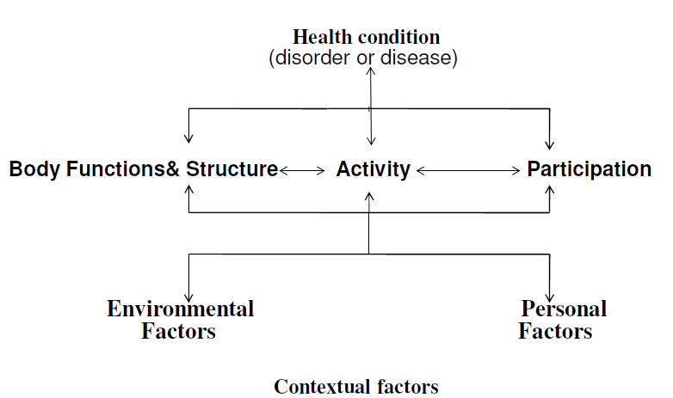
ICF Model

Slide 12
Environmental factors (for example, social attitudes, architectural barriers, legal and social structures, as well as climate, terrain and so forth); and
Personal factors, which include gender, age, coping styles, social background, education, profession, past and current experience, overall behaviour pattern, character and other factors that influence how disability is experienced by the individual.

Slide 13
Medical model, views disability as a characteristic or attribute of the person, which is directly caused by disease, trauma, or other health condition and requires some type of intervention provided by professionals to “correct” or “compensate” for the problem.

Slide 14
Social model of disability views the phenomenon of disability as a socially created problem and not as an attribute of the person. In the social model of disability, the underlying problem is created by an unaccommodating or inflexible environment brought about by the attitudes or features of the social and physical environment itself, which calls for a political response or solution.

Slide 15
Biopsychosocial model, attempts to integrate the medical and social models of disability.
In the biopsychosocial model, disability is viewed as a consequence of biological, personal, and social forces. The interactions among these various factors result in disablement.

Slide 16
Taking an accident as an example, the above terms can be explained further as follows
Accident | Disease or disorder
Loss of foot | Impairment
Inability to walk | Disability
Unemployed | handicap

Slide 17
Rehabilitation-defined as the combines and coordinated use of medical, social, educational and vocational measures for training or retraining the individual to the highest possible level of functional ability.
It includes all the measures aimed at reducing the impact of disability and handicapping conditions and enabling the disabled and handicapped to achieve social integration.
Rehabilitation of people with disabilities is a process aimed at enabling them to reach and maintain their optimal physical, sensory, intellectual, psychological and social functional levels. Rehabilitation provides disabled people with the tools they need to attain independence and self-determination.

Slide 18
According to United Nations Convention on the Rights of Persons with Disabilities (CRPD) rehabilitation is :
“… appropriate measures, including through peer support, to enable persons with disabilities to attain and maintain their maximum independence, full physical, mental, social and vocational ability, and full inclusion and participation in all aspects of life”.

Slide 19
The following areas of concern in rehabilitation have been identified.
Medical rehabilitation-restoration of function
Vocational rehabilitation- restoration of capacity to earn a livelihood
Social rehabilitation- restoration of family and social relationship
Psychological rehabilitation-restoration of personal dignity and confidence

Slide 20
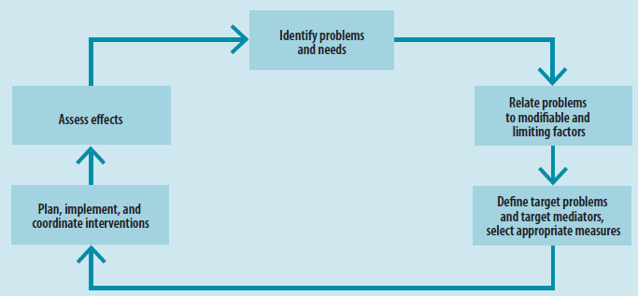
Rehabilitation process

Slide 21
Rehabilitation measures are broadly divided into three categories:
Rehabilitation medicine
Therapy
Assistive technologies.

Slide 22
Rehabilitation medicine is concerned with improving functioning through the diagnosis and treatment of health conditions, reducing impairments, and preventing or treating complications .
Doctors with specific expertise in medical rehabilitation are referred to as physiatrists, rehabilitation doctors, or physical and rehabilitation specialists. But other doctors can be involved in rehab medicine.
Rehabilitation medicine works in improving joint and limb function, pain management, wound healing, and psychosocial well-being.

Slide 23
Therapy is concerned with restoring and compensating for the loss of functioning, and preventing or slowing deterioration in functioning in every area of a person’s life.
Therapists and rehabilitation workers include occupational therapists, physiotherapists, orthotists, prosthetists, psychologists, rehabilitation and technical assistants, social workers, and speech and language therapists.

Slide 24
Therapy measures include:
Training, exercises, and compensatory strategies
Education
Support and counselling
Modifications to the environment provision of resources and assistive technology.
Modifications to the environment
Provision of resources and assistive technology.

Slide 25
An assistive technology device can be defined as “any item, piece of equipment, or product, whether it is acquired commercially, modified, or customized, that is used to increase, maintain, or improve the functional capabilities of individuals with disabilities.”

Slide 26
Common examples of assistive devices are:
Crutches, prostheses, orthoses, wheelchairs, and tricycles for people with mobility impairments;
Hearing aids and cochlear implants for those with hearing impairments;
White canes, magnifiers, ocular devices, talking books, and software for screen magnification and reading for people with visual impairments;
Communication boards and speech synthesizers for people with speech impairments;
Devices such as day calendars with symbol pictures for people with cognitive impairment.

Slide 27
Child with cerebral palsy and rehabilitation
Difficulty walking
→ Rehabilitation medicine– Botulinum toxin injections.– Surgical treatment of contractures and deformities (therapy interventions usually complement these medical interventions).
→ Therapy– Therapy, exercises and targeted play activities to train effective movements.
→ Assistive technology– Orthotics, wheelchair or other equipment.

Slide 28
1. Impairment is any loss or abnormality of
Psychological function,
Physiological function
anatomical structure
All of above
2. Loss of foot in an accident is an example of
Impairment
Disability
Handicap
Disease

Slide 29
3.A disability is defined as any restriction or lack of ability to perform an activity in a manner or within the range considered normal for a human being. According to
A. ICIDH B. Nagi C.ICF D. APTA
4. According to which model, disability is a restriction or inability to perform socially defines roles and tasks expected of an individual within socio-cultural and physical environment.
A. ICIDH B. Nagi C.ICF D. APTA

Slide 30
5. Handicap word is given by which model of disability
A. ICIDH B. Nagi C.ICF D. APTA
6. impairment is a problem in body function or structure, according to
A. ICIDH B. Nagi C.ICF D. All of them
7. According to which, Disabilities is an umbrella term, covering impairments, activity limitations, and participation restrictions.
A. ICIDH B. Nagi C.ICF D. ICIDH and Nagi

Slide 31
8. Rehabilitation measures are
Rehabilitation medicine
Therapy
Assistive technologies
All of above
9. According to which model Disability is views as a socially created problem and not as an attribute of the person.
Biopsychosocial model
Medical model
Social model
A and B

Slide 32
10. Inability to walk is a disability , according to which
A. ICIDH B. Nagi C.ICF D. ICIDH and Nagi

