Slide 1
HISTOPATHOLOGY ANALYSIS
- Dr SUNIL DOSHI

Slide 2
LIST OF ORGANS FOR HISTOPATHOLOGICAL ANALYSIS:
Neural Respiratory:
Brain : Cerebrum, Lungs and trachea
Olfactory, Cerebellum Other:
Spinal cord and peripheral nerves Eyes, Inner ear, nasal passages
Vascular: Hematologic:
Heart and blood vessels Spleen, Thymus, Bone Marrow Lymph nodes and Peyer’s patches
Integument: GastroIntestinal:
Skin, Bone, Cartilage Liver, Salivary Gland, Pancreas
Skeletal muscle, Stomach and Duodenum,
Stroma and Adipose tissue Small intestine (Ileum)
Large intestine (Colon), Cecum
GenitoUrinary Endocrine:
Kidney, Bladder Adrenals, Pituitary
Uterus, Ovary, Fallopian tubes Thyroid , Parathyroid
Testis, Prostate,
Breast, Placenta

Slide 3
When tissues are removed from the body, there is rapid onset of action of
degradative enzymes, which start the process of autolysis
Thus, the tissues need to be immediately processed,
perhaps to isolate cells
or frozen in order to be studied,
or fixed, in order to preserve them for study as archival material
Frozen tissues need storage space in either liquid nitrogen
or in minus 80 degree freezers which take up space
Fixed tissues are then subjected to a process of dehydration
before being infiltrated with paraffin wax (at high temperatures) in order
to be able to store them at room temperature for use as archival material
The fixatives used, preserve morphology of the tissue
but can alter cell surface molecules

Slide 4
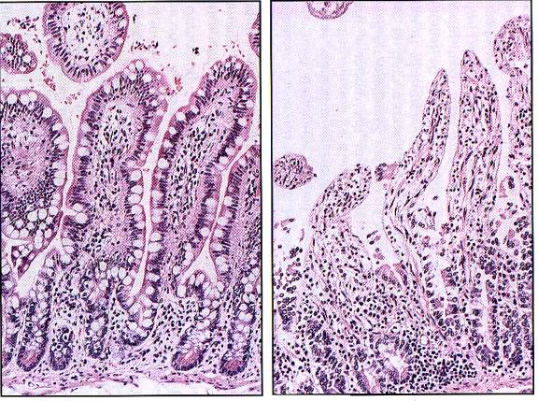
WELL FIXED SMALL BOWEL AND POORLY FIXED SAMPLE

Slide 5
Processing of tissue :
Isolate cells for culture
Process into paraffin blocks
Freeze for protein, lipid, sugar,
DNA/RNA etc.extracts
Process for EM
Freeze for histology/histochemistry/
& use for immunohistochemistry
-Fix
-Dehydrate
-Infiltrate with xylene
-Infiltrate with hot paraffin wax
-Make blocks for sections
-Store at room temperature
Dry ice in 2-methyl butane
OCT in plastic mold
Frozen or paraffin tissue can then be sectioned for histology
3--30 micron sections

Slide 6
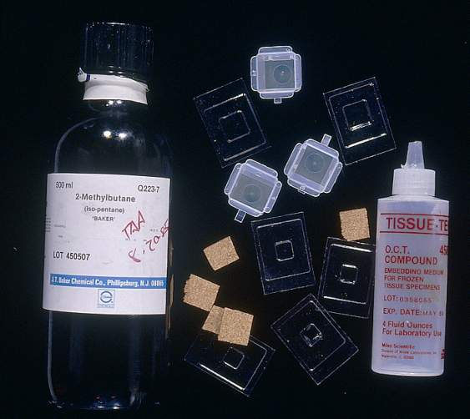
MATERIALS NEEDED TO FREEZE TISSUE SAMPLES

Slide 7
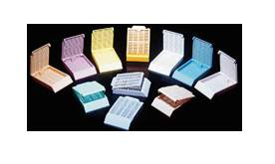
MATERIALS NEEDED TO PROCESS FIXED TISSUE
Place fresh or fixed, trimmed, tissue into cassettes to be processed into paraffin blocks for sectioning at room temperature

Slide 8
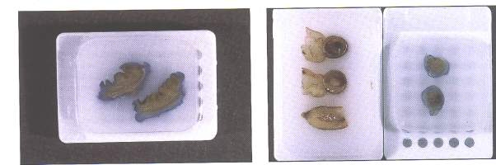
Paraffin embedded tissues ready for sectioning onto glass slides

Slide 9
HISTO: HISTOLOGY SECTIONS FOR VIEWING UNDER THE MICROSCOPE, using BRIGHTFIELD illumination
Always review sections using the basic hematoxylin and eosin (H&E) stain
before proceeding to perform an immunohistochemical assay
H&E= hematoxylin and eosin.
Hematoxylin colors nuclei blue
Eosin colors the cytoplasm pink
in order to check out the morphology of the tissue and to determine
that what you are looking for is present in the section to be immunostained
and that the section has no other abnormalities

Slide 10
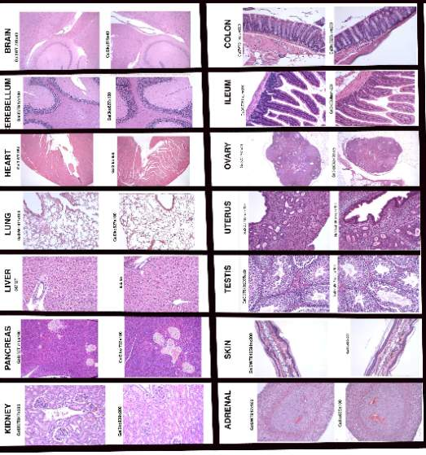
IF TISSUES ARE FIXED WELL AND PROCESSED WELL, ONE CAN THEN COMPARE H&E STAINED SECTIONS FROM CONTROL ANIMALS WITH THOSE FROM GENETICALLY ALTERED ANIMALS AND BE ABLE IDENTIFY DIFFERENCES

Slide 11
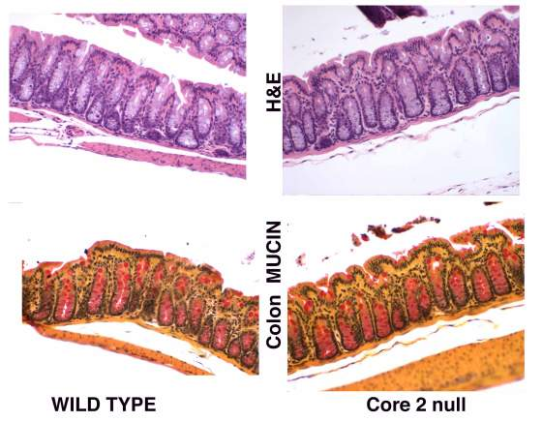
Mucin stained and H&E stained colon

Slide 12
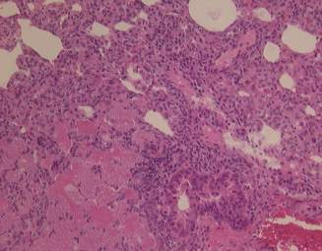
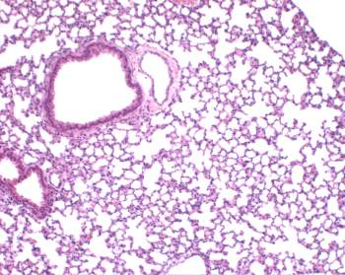
DO NOT USE THIS piece of lung
for immunostains
Use lung that has a good morphology, with no pathology

Slide 13
Immunohistochemistry assays may use
cells on slides
Cells grown, spun into a pellet, frozen or paraffin embedded and sectioned
Cells grown as a monolayer
OR use tissue sections that are frozen or paraffin embedded
Sections from tissues contain many different kinds of cells
as well as extra-cellular matrix components

Slide 14
If the tissue is frozen
The sections may need to be used
in immunohisto-assays as
Unfixed:
Positive feature:-antigens are unaltered
Negative feature: sections may fall off slide during staining
Acetone fixed:
-precipitates proteins onto cell surface---may extract lipids
-is needed for many of the “CD” antibodies
Paraformaldehyde fixed:
--needs to be freshly made, or frozen soon after
--is preferred over using 10% buffered formalin
Tissue section on glass slide: Frozen

Slide 15
If the tissue is paraffin embedded,
--deparaffinize ( remove the infiltrated paraffin wax,
by using organic solvents)
--the section then needs to be rehydrated, by sequential immersion
in graded alcohols (100%, 70% , 50% and then PBS)
--the deparaffinized section may need to be treated
to expose buried antigenic epitopes
with either proteases
or by heating in low pH citrate buffer ,
or high pH EDTA buffer
Tissue section: Paraffin embedded

Slide 16
DAB, AEC, red , SG, VIP
Blue, Red (also fluoresces)
HRP
Alk.Phos
AMCA
CY2 , FITC
PE, CY3
Tertiary
fluoresceinated compounds
or with an enzyme
Tertiary reagent is used usually labeled with :
Secondary
Primary
Remove endogenous binding sites in tissue,
( biotin, HRP, collagen)
Tissue section: Frozen or deParaffinized

Slide 17
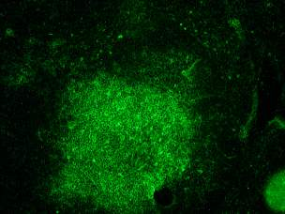
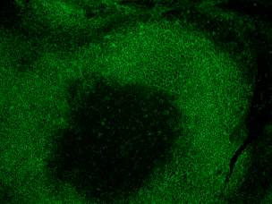
FITC-anti CD4 on frozen sections of wild type mouse spleen
B cell marker B220 on frozen section of mouse spleen, marking the outer aspect of lymphoid follicle
EXAMPLES OF IMMUNOFLUORESCENCE STAINS ON MOUSE SPLEEN SECTIONS

Slide 18
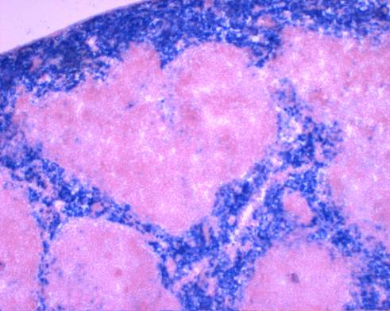
EXAMPLE OF IMMUNOSTAIN FOR MACROPHAGES ON MOUSE SPLEEN,
Biotinylated anti F480 on frozen section of spleen, detected with alkaline phosphatase conjugated streptavidin, Vector Blue substrate and nuclear fast red counterstain

Slide 19
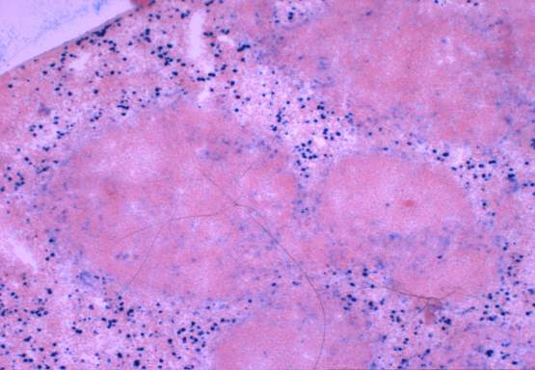
Biotinylated anti Mac 1 on frozen section of spleen, detected with alkaline phosphatase conjugated streptavidin, Vector Blue substrate and nuclear fast red counterstain
EXAMPLES OF IMMUNOSTAIN FOR A SUBSET OF MACROPHAGES IN MOUSE SPLEEN

Slide 20
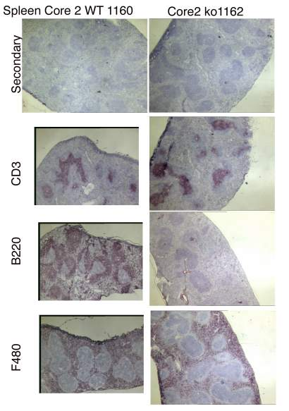
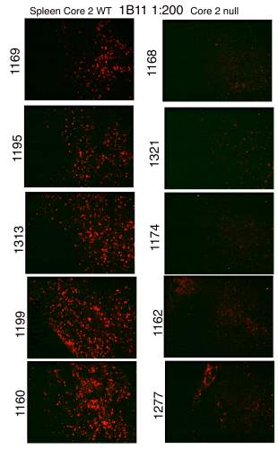
Wild type Spleen null
Wild type Spleen null
Immunofluorescence is more sensitive than enzyme labeled methods

Slide 21
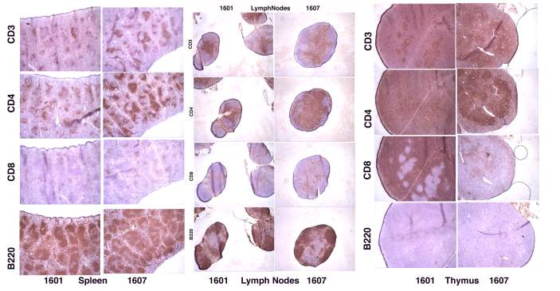
Many organs need to be examined, so that minor differences, between wild type and the genetically altered animal, if only observed in one organ, may be detected

Slide 22
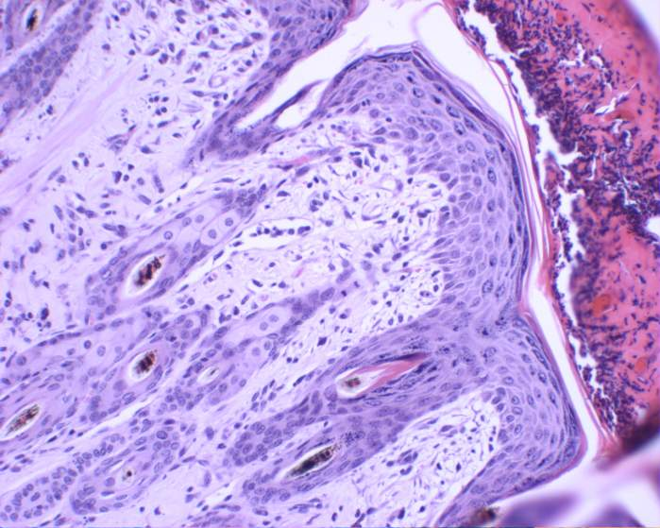
Hematoxylin and Eosin stain of skin from a wild type mouse showing good epidermis, which can be used as a positive control in TUNEL assays (for apoptotic cells)

Slide 23
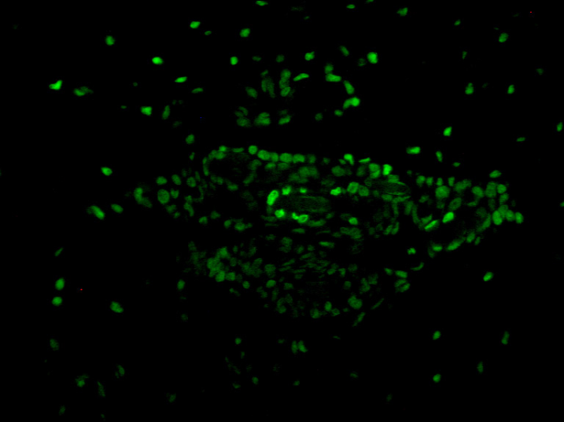
TUNEL positive nuclei of regenerating cells around hair follicle

Slide 24
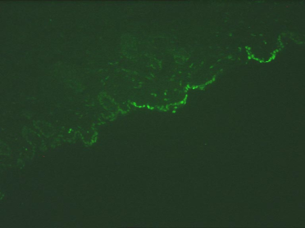
“Positive control” Skin sample
used for TUNEL assay Day 2
Buffer: PBS200x
“Positive control” Skin sample
used for TUNEL assay Day 1
Buffer: PBS-Tween 200x
Conclusion: Cannot fully interpret results on test samples from Day 2 because the positive control skin sample was negative

Slide 25
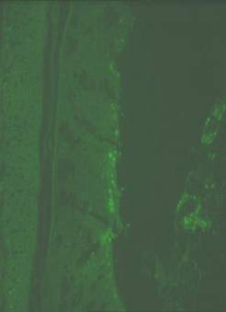
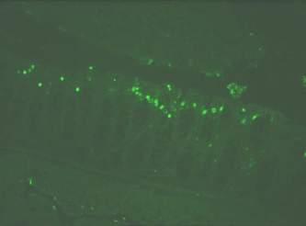
Colon: TUNEL assay Day 1 x400 Buffer: PBS/Tween
Colon: TUNEL assay Day 2 x400 Buffer: PBS
Conclusion: adding Tween to the buffer helps to decrease background noise so that the specific signal becomes more obvious

Slide 26
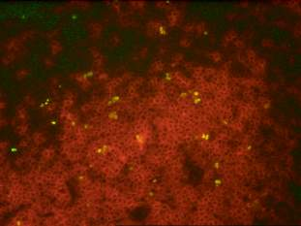
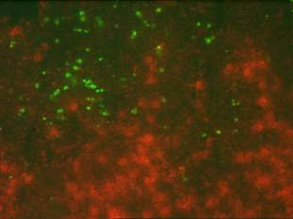
TUNEL+ in CD4+ area TUNEL+ not in CD4+ area
Apoptotic cells, detected using the TUNEL assay, shows FITC positive nuclei. Double labeling with CD4 shows that some of the TUNEL positive cells are of the CD4 cell lineage

Slide 27
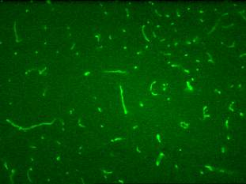
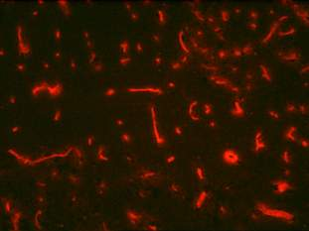

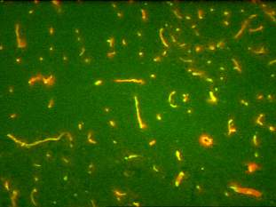
Ig G control
Co-localization and detection of similar epitopes on the same tissue section, using fluorescent markers

Slide 28
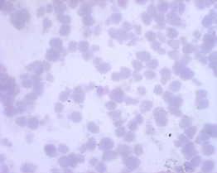
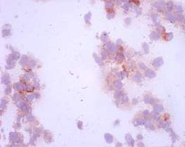
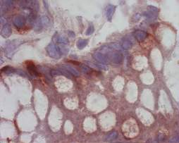
Negative control and Positive control:
293 cells untransfected or transfected with (-----) plasmid,
immunostained with the same antibody
Tissue section immunostained on the same slide with the same antibody

