Slide 1
Histopathological Examination in FM
- Dr SUNIL DOSHI

Slide 2
What to collect and How?
The tissues, suspected to be diseased are removed along with a portion of healthy tissue, and then placed in a fixative to prevent decay.
Most common fixative used is Formalin (10% formaldehyde solution).

Slide 3
How to prepare tissue for HP examination?
Tissues are prepared by making permanent sections in such a way that the relation of cells to one another, as it occurs in vivo, is not disturbed.
There are 3 common procedures of sectioning-
  Paraffin
  Celloidin
  Freezing

Slide 4
For sectioning by first 2 methods, tissues are to be passed through following steps:
Fixation
Dehydration
Clearing
Embedding

Slide 5
FIXATION
Aims:-
To prevent Autolysis
To prevent Bacterial attack
To preserve Morphology
To provide optimum hardness/softness to tissue for subsequent cutting
Convert semi solid in to solid
Acts as mordant
May alter refractive index so better visualization under microscope

Slide 6
Classification of Fixatives; by type

Slide 7
Classification; by composition
Aldehydes
  Formaldehyde, Gluteraldehyde.
Oxidizing agents
  Osmium tetroxide, KMnO4.
Protein denaturing agents
  Acetic acid, Alcohol.
Other cross-linking agents
  Carbodiimides.
Physical
  Heat, Microwaves.
Miscellaneous
  HgCl3, Picric acid.

Slide 8
DEHYDRATION
Removal of fixative and water from tissue
Done with progressively increasing concentrations of dehydrating fluid.
eg. 70% to 95% to 100% to prevent tissue disruption
For delicate tissue start with much lower concentration eg. 30%
Tissues are first cut into sizes of 1cm square with thickness of about 5mm and then dehydrated.

Slide 9
Dehydrating agents:
  Ethanol: though ideal but costly
  Methylated spirit: cost effective
  Methanol: highly toxic so rarely used
  Isopropyl alcohol: cost effective and good dehydrating agent
  Acetone: Rapid action but poor penetration and may cause brittleness if used for long time.

Slide 10
CLEARING
After dehydration with alcohol, it has to be removed by substance which may replace it in the tissues.
Only those chemicals are used as clearing agents which are totally miscible with dehydrating agents and embedding agents.
For wax which is commonly used embedding agent, hydrocarbon solvents are used as clearing agent.

Slide 11
Because these hydrocarbon solvents have same refractive index as protein, they impart clear transparent look to tissue hence k/a clearing agents.
Most commonly used agents are Xylol and Chloroform. Others are Benzene, Toluene, CCl4 and Cedarwood oil.

Slide 12
EMBEDDING
Various media used are:-
Paraffin wax (most common)
Other waxes
  Water soluble waxes; polyethylene glycol
  Ester wax
  Polyester wax
  Microcrystalline wax
Resins
  Acrylic
  Epoxy
  Urea-formaldehyde
Other media
  Agar
  Gelatin
  Celloidin

Slide 13
Procedure :
Tissues are embedded in paraffin in a thermostatic paraffin bath at 56˚C for 1½ to 4 hours under vaccum. The vaccum helps to remove any gaseous matter or vapours of clearing or dehydrating fluids, which helps in entry of paraffin into the tissues.
Block in moulds : Following impregnation with paraffin, the tissues are oriented in a block of paraffin; the surface to cut are placed downwards; cooled rapidly, as soon as the scum forms.

Slide 14
Leukhart’s L block

Slide 15
Leukhart’s L block

Slide 16
Leukhart’s L block

Slide 17
Sectioning : sections of paraffin wax embedded tissues are made with the help of microtomes, of which, the Rocking type is preferred. Other types-
  Rotary
  Sliding
  Base sledge
  Rotary rocking
  Freezing
  Ultra microtome

Slide 18
Fixing the sections to slide & Staining (HE)
Raw Slide on hot plate/oven for 20 mins
Xylene (clearing agent) for 15-20 mins
Pour alcohol (white appearance)
Running water bath for 15-20 mins
Hematoxylin
Running water bath for 5 mins
Acid alcohol(1% HCL in 70% alcohol) 1-2 dips
Running water bath/Lithium carbonate/0.05% ammonia for 10-15 minutes (Blueing)
Eosin
Washing with water
Alcohol
Xylin for 5-10 mins
Mount with DPX

Slide 19
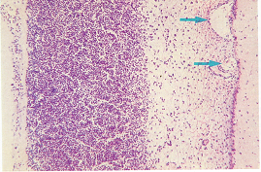
Acute Purulent Meningitis

Slide 20
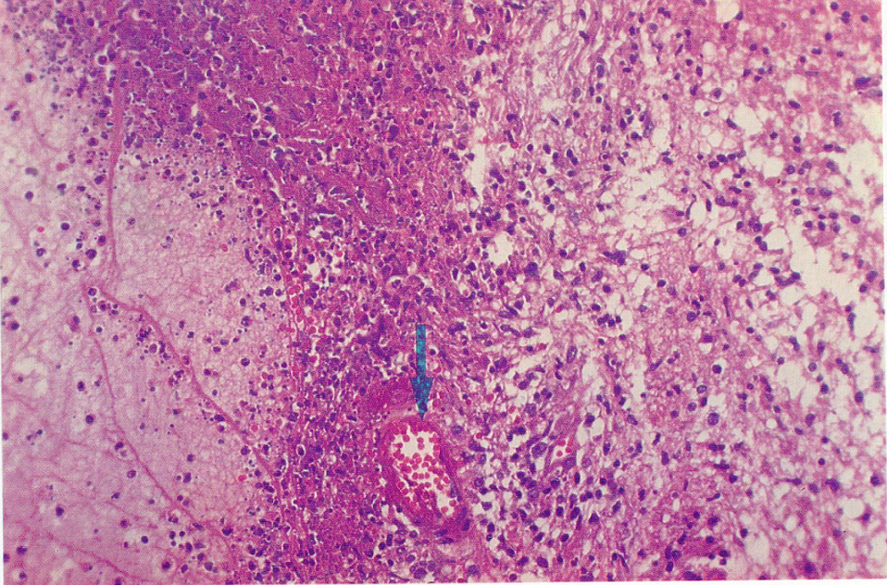
Tuberculous Meningitis

Slide 21
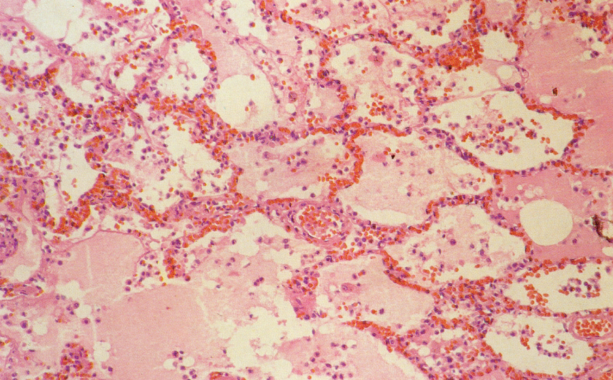
Lung congestion and Edema

Slide 22
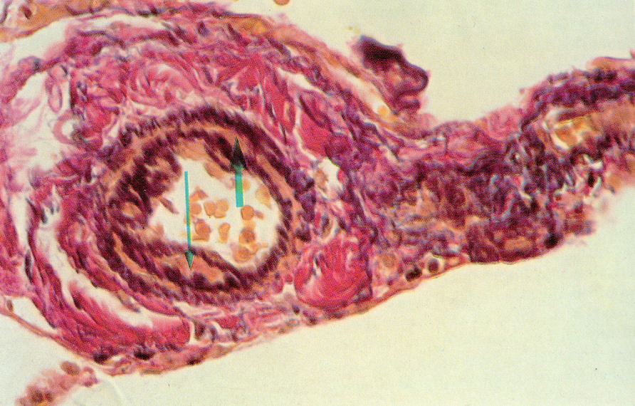
Pulmonary arterial hypertension

Slide 23
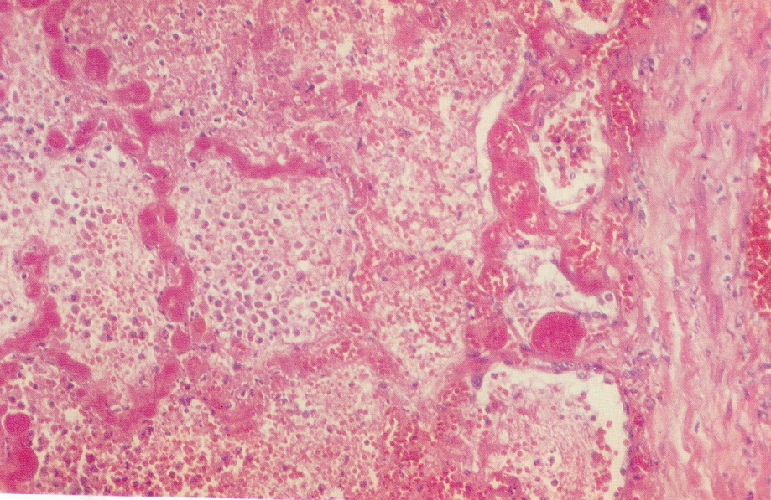
Lung infarct

Slide 24
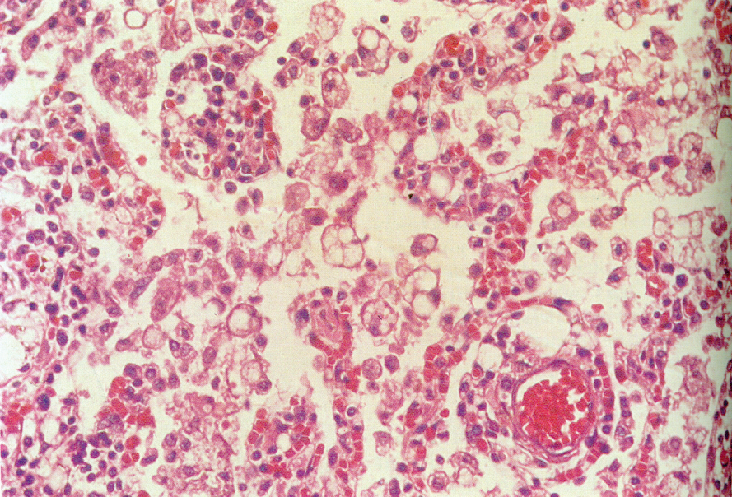
Lipid aspiration pneumonia

Slide 25
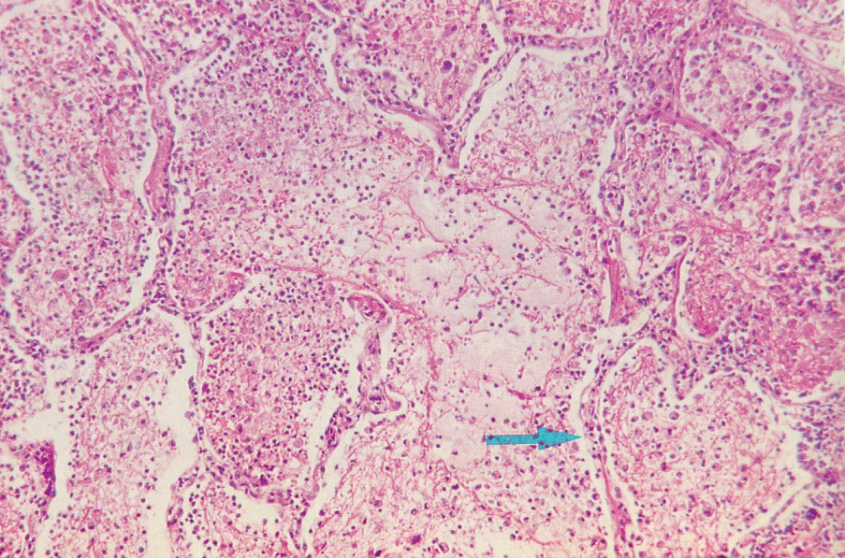
Lobar pneumonia (grey hepatisation)

Slide 26
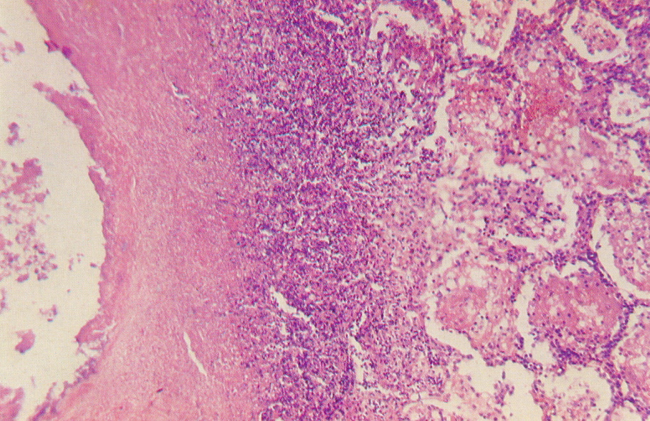
TB Bronchopneumonia (70x)

Slide 27
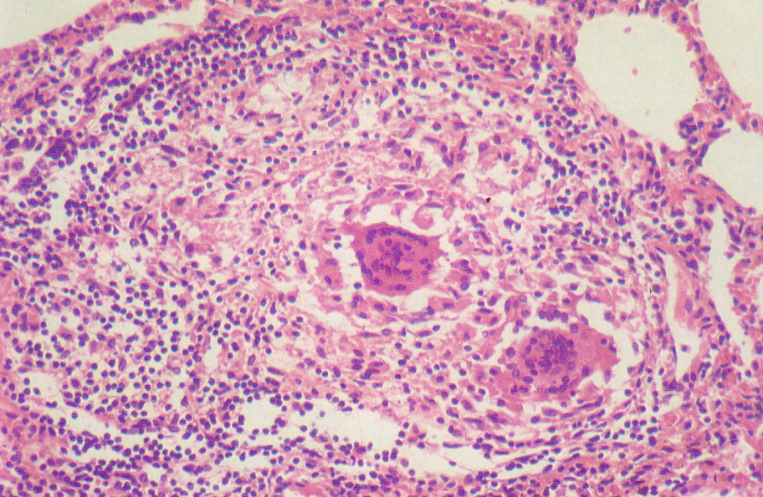
TB Bronchopneumonia (235x)

Slide 28
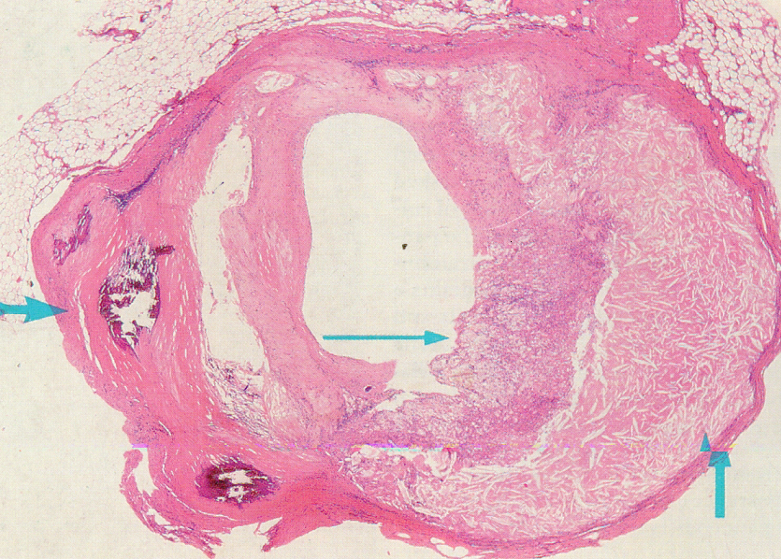
Atheroma : Coronary (15x)

Slide 29
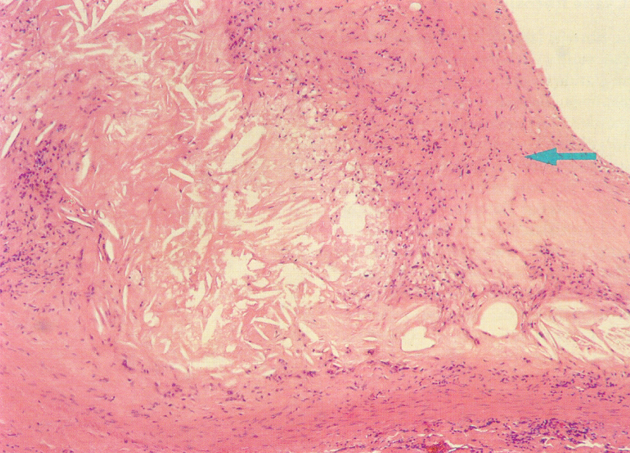
Atheroma : Coronary (60x)

Slide 30
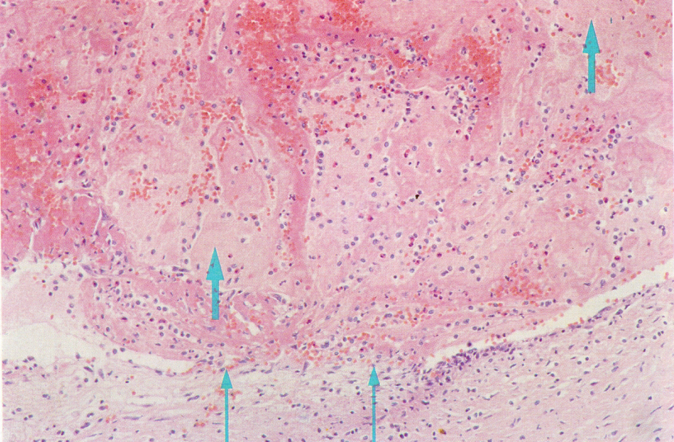
Coronary thrombosis

Slide 31
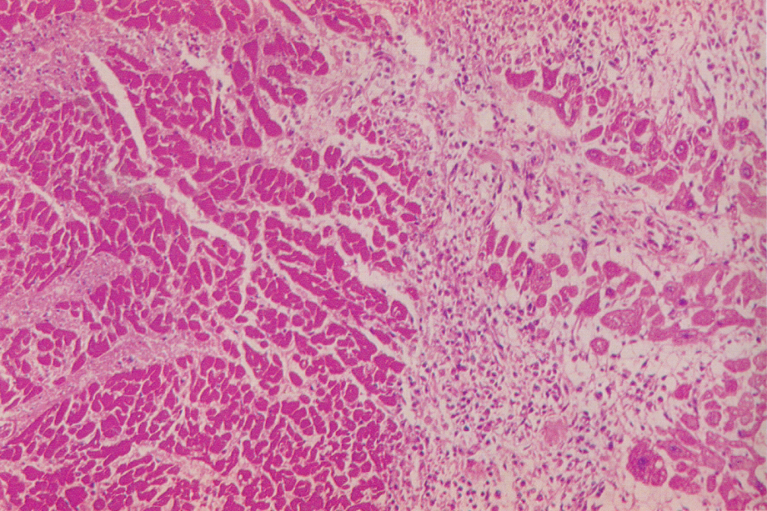
Myocardial Infarct (55x)

Slide 32
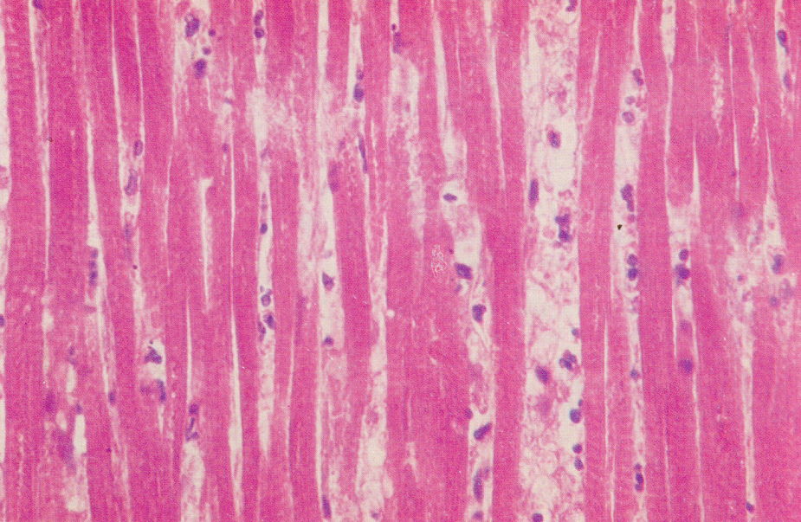
Myocardial Infarct (135x)

Slide 33
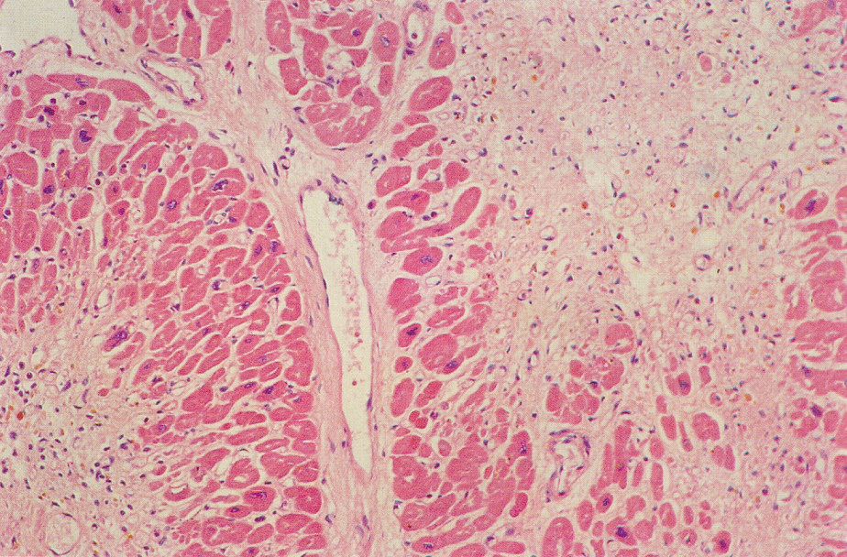
Chronic myocardial ischemia

Slide 34
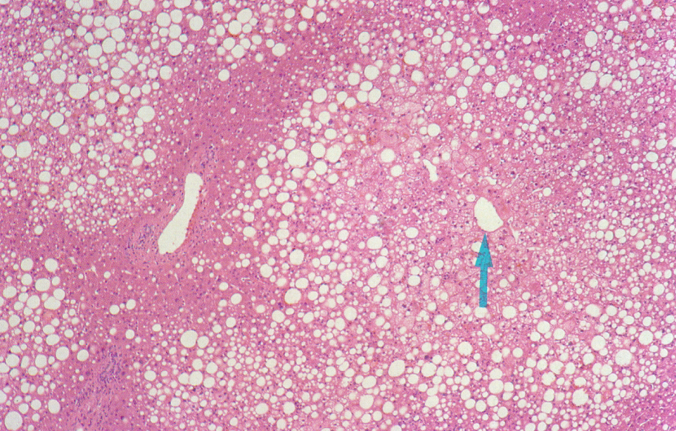
Alcoholic hepatitis

Slide 35
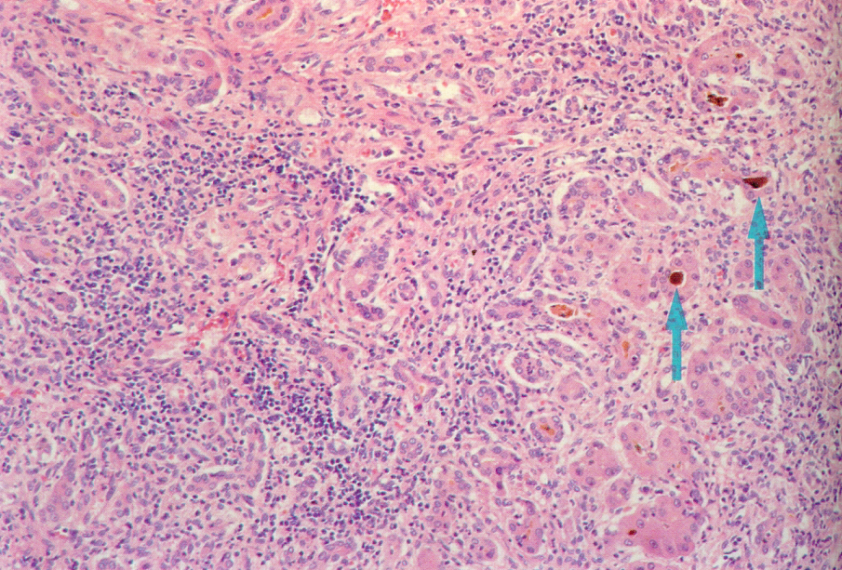
Viral hepatitis

Slide 36
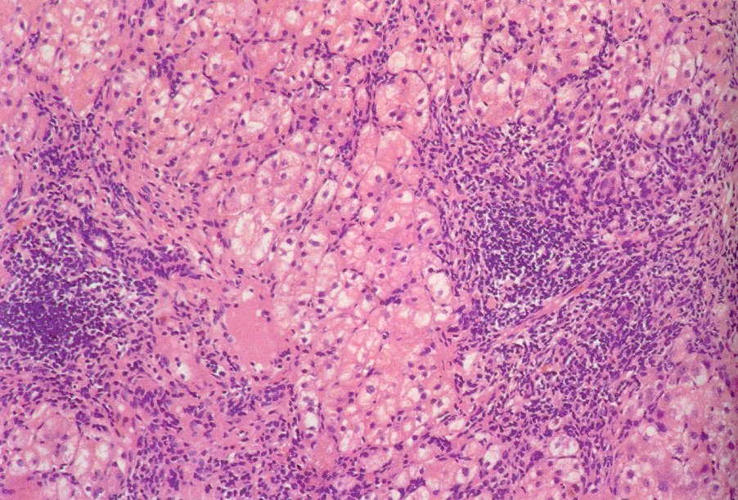
Viral hepatitis

Slide 37
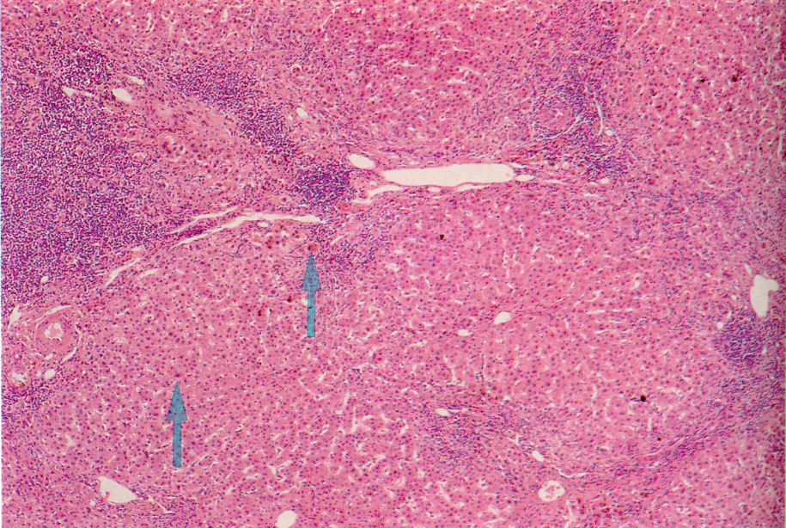
Primary biliary cirrhosis

Slide 38
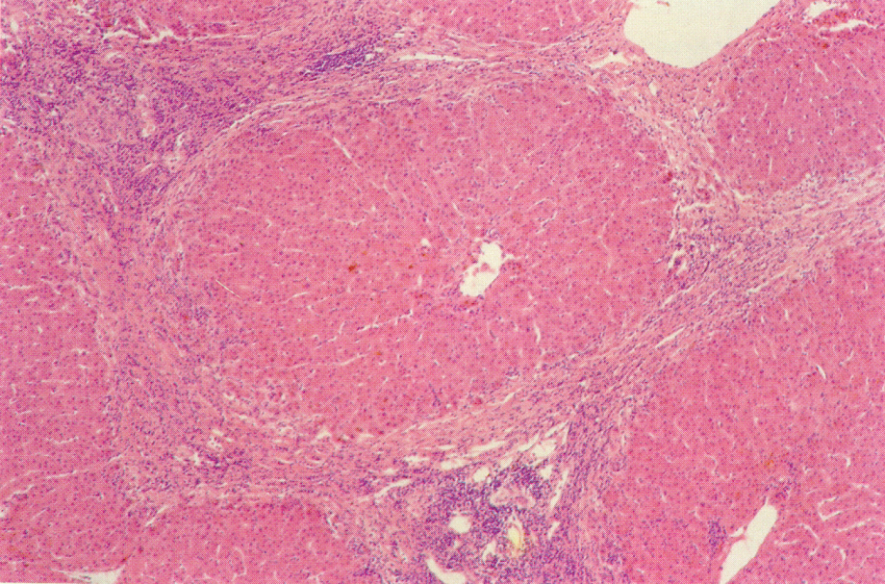
Primary biliary cirrhosis

Slide 39
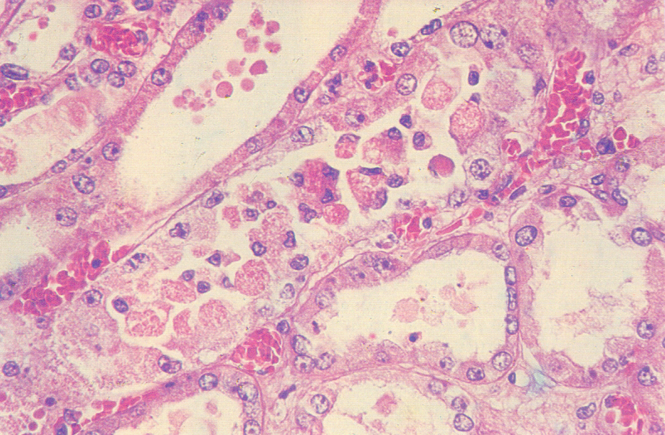
ATN

Slide 40
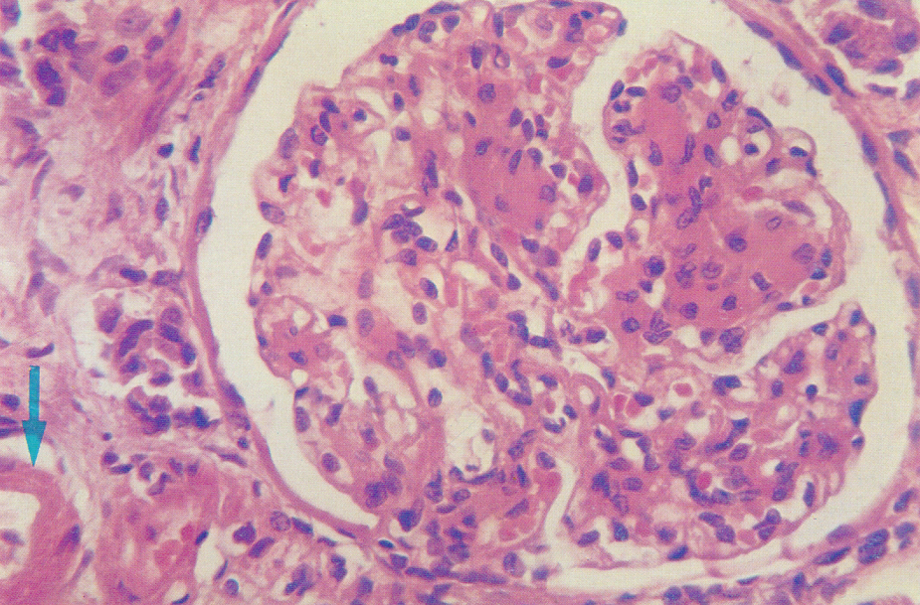
Diabetic Glomerulosclerosis

Slide 41
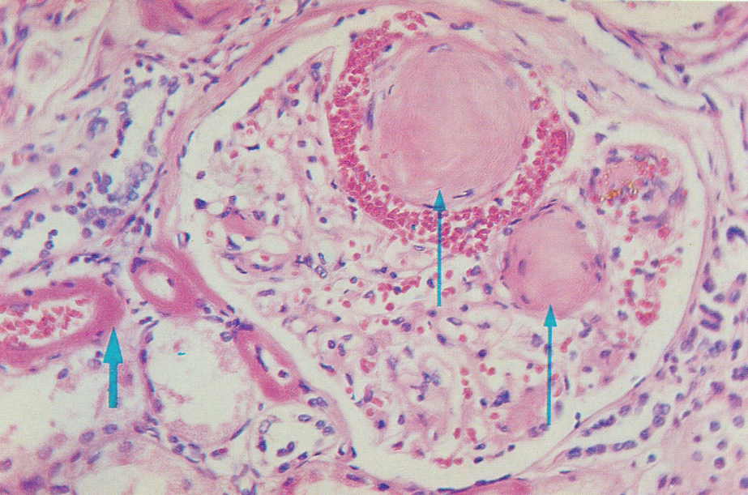
D G’sis : KW lesion

Slide 42
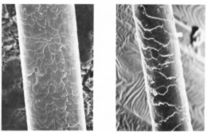
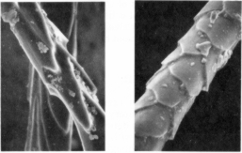
Cuticular patterns- comparison between human hair, dog fur, rabbit fur and cat fur.

Slide 43
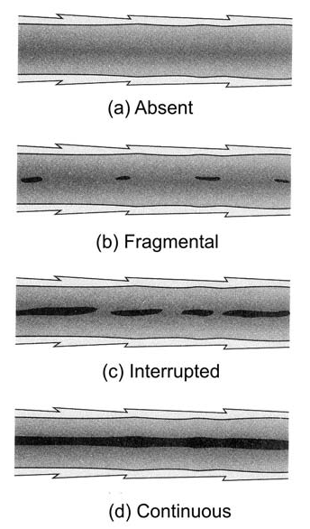
Medullary patterns of human hair

Slide 44
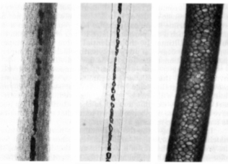
Medullary patterns of hairs of diff. species
a) Human hair b) Dog fur c) Deer hair

Slide 45
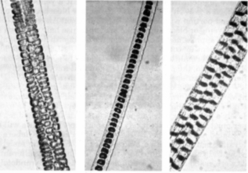
Medullary patterns of hairs of diff. species
a) Rabbit fur b) Cat fur c) Mouse hair

Slide 46
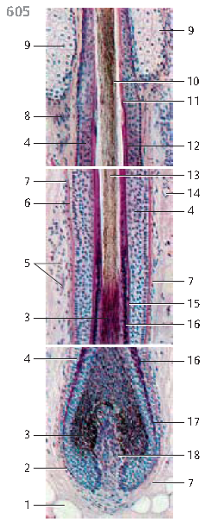
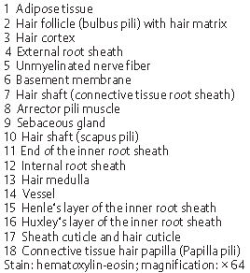

Slide 47
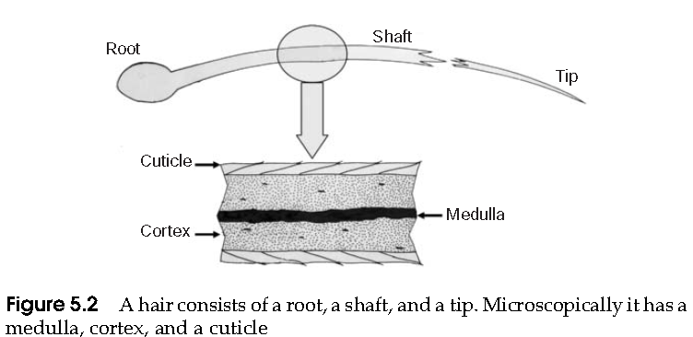

Slide 48
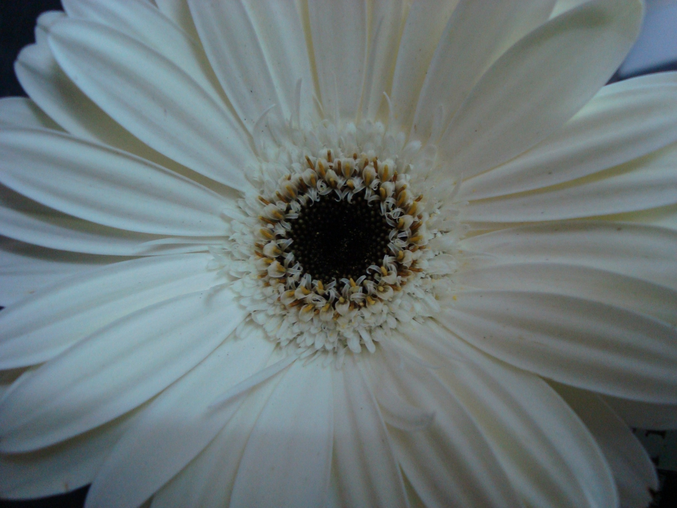
THANK YOU

