Slide 1

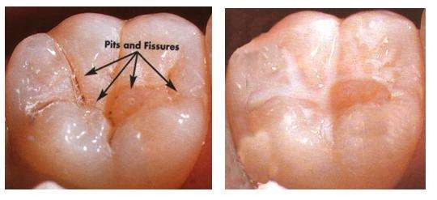


Dr. Radhika Pathak
Department of Public Health Dentistry
K.M.Shah Dental College & Hospital
Sumandeep Vidhyapeeth
(Deemed to be university)

Slide 2
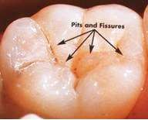

PIT : It is defined as a small pinpoint depression located at a
junction of developmental grooves or at terminals of those grooves. The central pit describes a landmark in the central fossae of molars where developmental grooves join. (ash 1993)
FISSURE : It is defined as deep clefts between adjoining cusps. They provide areas for retention of caries producing agents. These defects occur on occlusal surfaces of molars and premolars, with tortuous configurations that are difficult to assess from the surfaces. These areas are impossible to keep clean and highly susceptible to advancement of caries lesion. (Orbans 1990)

Slide 3

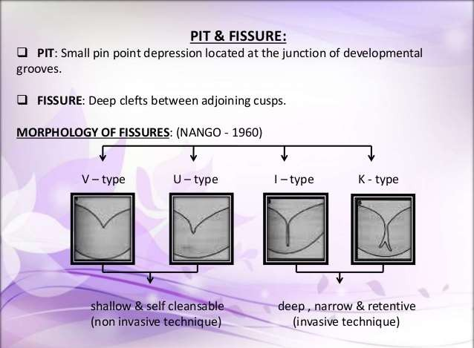

Slide 4

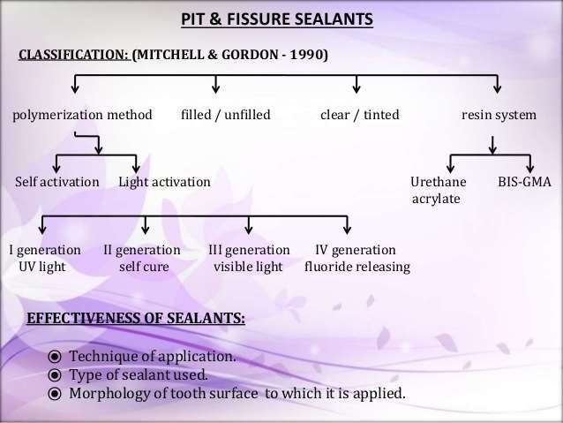
Mitchell and Gordan (1990) stated that the sealants can be differentiated in the following ways:
1. Polymerization methods
a) Self activation (mixing two components)
b) Light activation:
- First generation: Ultraviolet light
- Second generation: Self cure
- Third generation: Visible light
- Fourth generation: Fluoride releasing
2. Resin systems BIS-GMA Urethane acrylate
3. Filled and unfilled
4. Clear or tinted

Slide 5

A viscosity allowing penetration into deep and narrow fissures even in maxillary teeth.
Adequate working time
Rapid cure
Good and prolonged adhesion to the enamel
Low sorption and solubility
Resistence to wear
Minimum irritation to tissues
Cariostatic action

Slide 6

Thank You

