Slide 1
Maple syrup urine disease
- Dr. Jayesh Shah

Slide 2
Clinical Presentation
A 21-year-old male patient presented with acute onset of diplopia and severe headaches.
Neurological examination revealed mild bilateral papilloedema, dysarthria, ataxia.
Patient was advised MRI brain

Slide 3
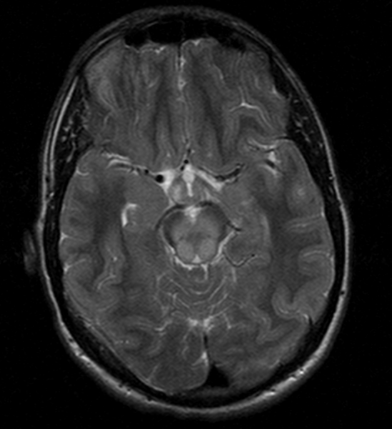
T2-weighted images
Axial T2-weighted images: hyperintensity abnormalities of cerebral peduncles and tegmentum of midbrain.

Slide 4
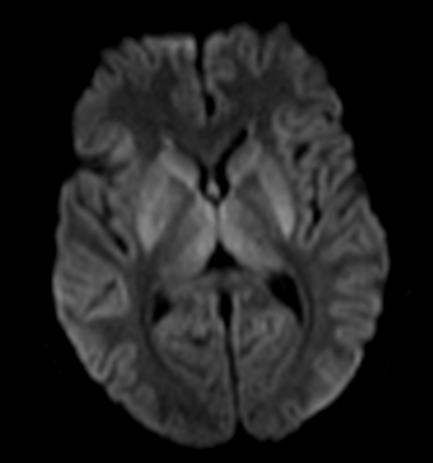
DWI
DWI abnormalities: bilateral symmetrical restricted diffusion within caudate and lenticular nuclei, thalamus and posterior limb of the internal capsule

Slide 5
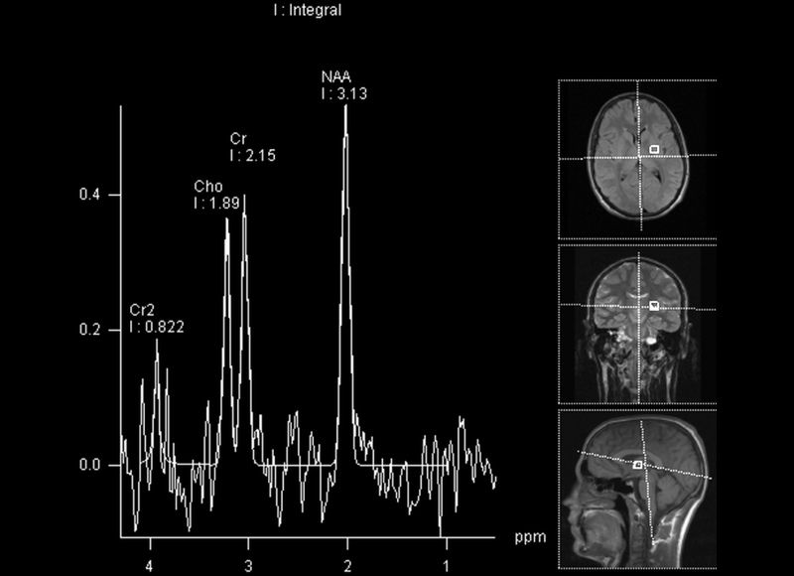
MR spectroscopy
Peaks at 0.9 ppm on MRS with a TE of 30 ms represent branched chain α-keto acids peaks, which can be seen during acute metabolic decompensation in maple syrup urine disease.

Slide 6
Differential diagnosis
Hypoxic-ischaemic encephalopathy
Marchiafava-Bignami
Canavan disease

Slide 7
Conclusion
Imaging features are diagnostic in the early weeks of life.
DWI is more sensitive than conventional MRI in detecting MSUD brain alterations and it can become a useful tool for early diagnosis and follow-up

Slide 8
THANK YOU

