Slide 1
Multilocular Cystic Nephroma
- Dr. Mayur Khandhedia

Slide 2
CLINICAL HISTORY
A 54 year-old asymptomatic woman, was referred to ultrasound examination due to the presence of microscopic hematuria discovered in a routine appointment. There were no other relevant clinical aspects.

Slide 3
IMAGING FINDINGS
Ultrasound showed a large cystic mass with various septa in the left kidney, with predominant anechoic areas, measuring 66 mm in maximum diameter (fig.1a). There wasn't evident solid areas, or vascularization at Doppler interrogation

Slide 4
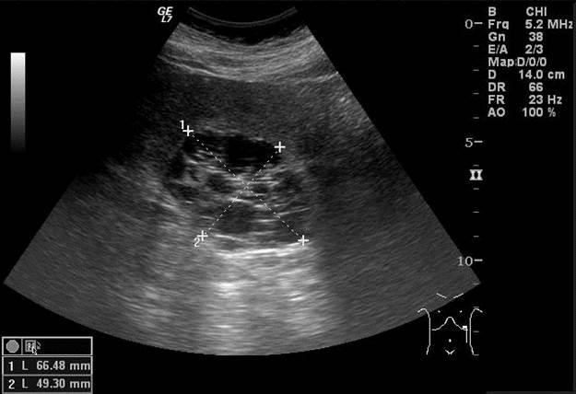
Longitudinal ultrasound of the lesion in the left kidney, demonstrating a cystic multiseptated mass, with posterior acoustic enhancement, thin septa and no evident solid areas.

Slide 5
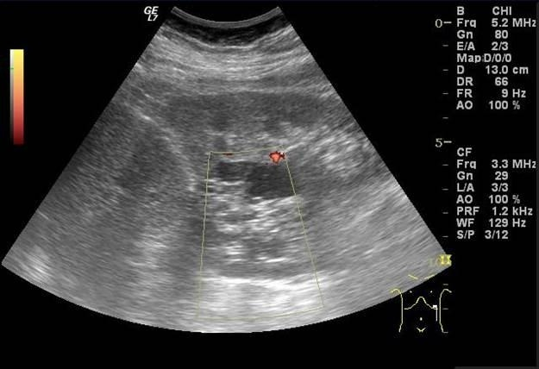
Color Doppler interrogation demonstrating no evident vascularization in the lesion.

Slide 6
Symptoms are nonspecific; they consist of abdominal pain and hematuria, sometimes with urinary tract infection depending on the obstruction of the calyx due to the cystic volume . The hematuria can result from the infection but also from cysts herniation into the renal pelvis

Slide 7
Sonographically MCN appears as multiple anechoic spaces separated by thin ecogenic septa, with no solid elements. The presence of multiple cysts can difficult the exam due to several acoustic interfaces. Color-Doppler imaging is suggested as a useful tool for the differential of malignant versus benign lesion

Slide 8
Thank You!

