Slide 1
A Case presentation of Ovarian Tumour
-Dr. Kalpesh Patel

Slide 2
CLINICAL PRESENTATION
A 60 yr old female pt came to our dept with complaints of breathlessness and abdominal pain.
Laboratory findings- Hb 8 mm of Hg.
CXR and CECT was done.

Slide 3
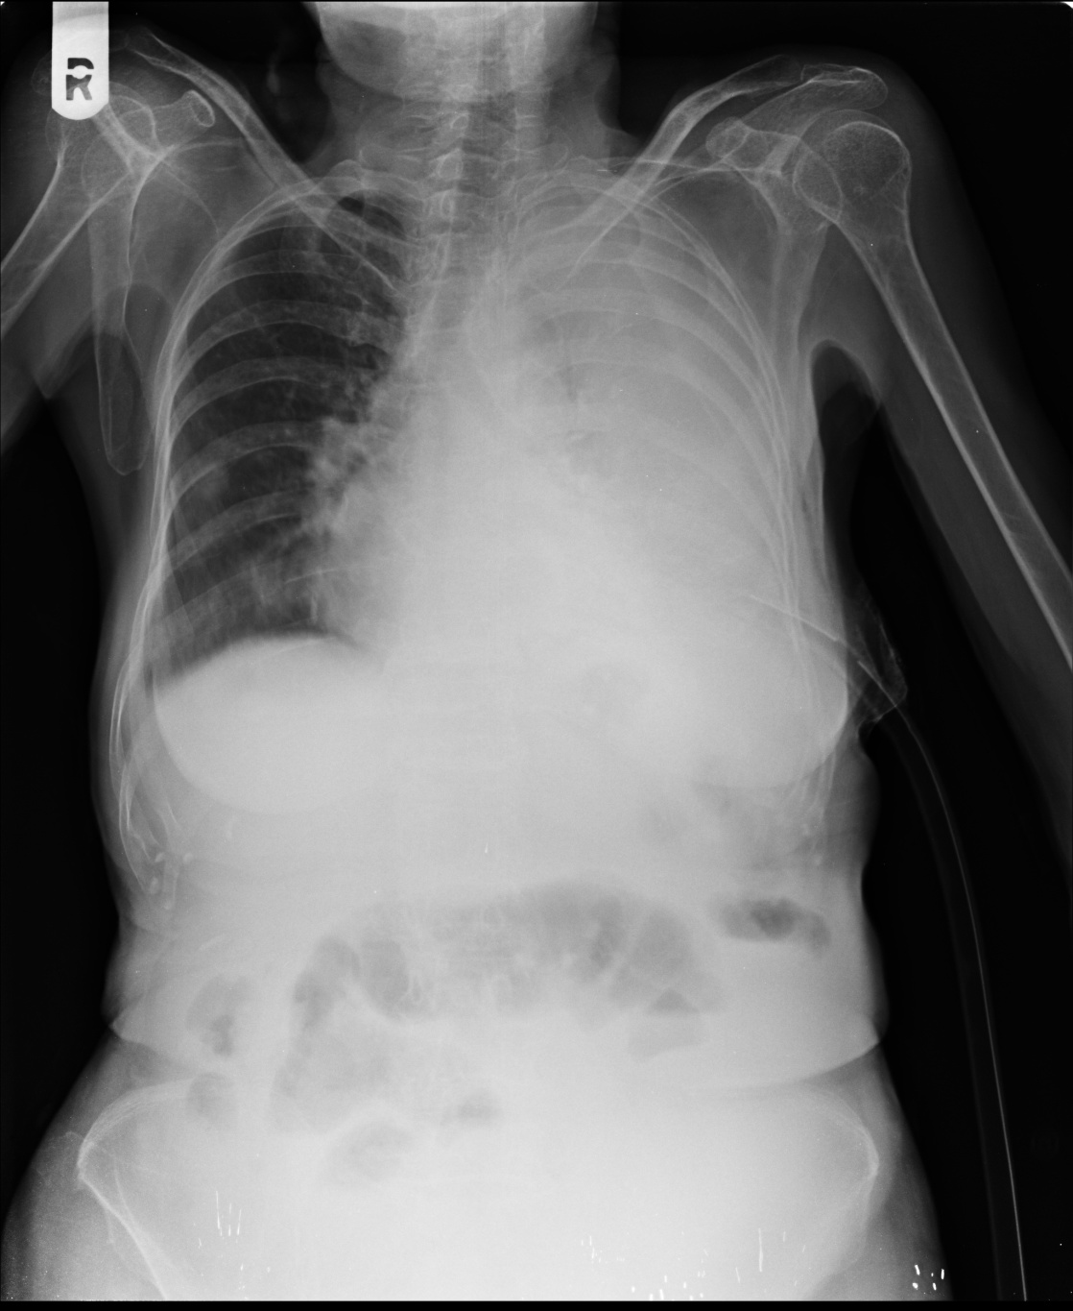
CXR

Slide 4
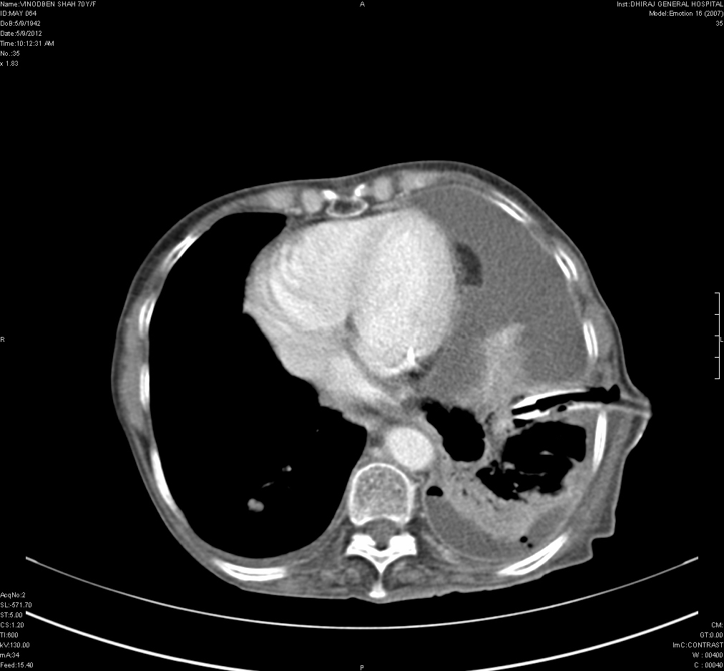
CT
Massive lt sided pleural effusion causing collapse of lt lung and shift of heart and med to right side.
ICD is seen.
Minimal rt sided pleural effusion.

Slide 5
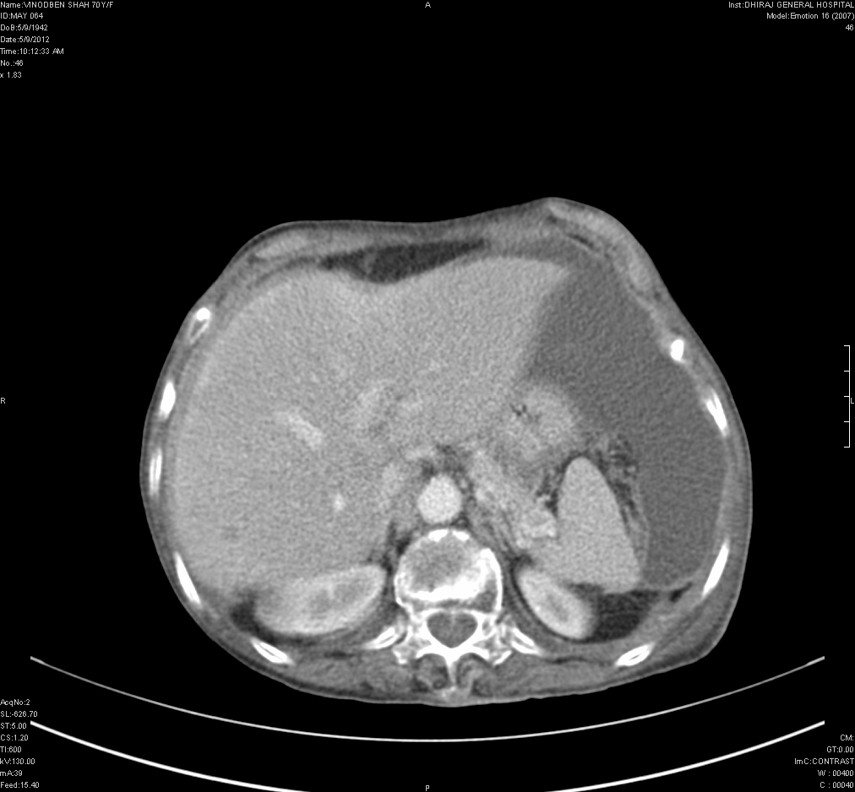
Gross ascites with hypodense lesion in liver.

Slide 6
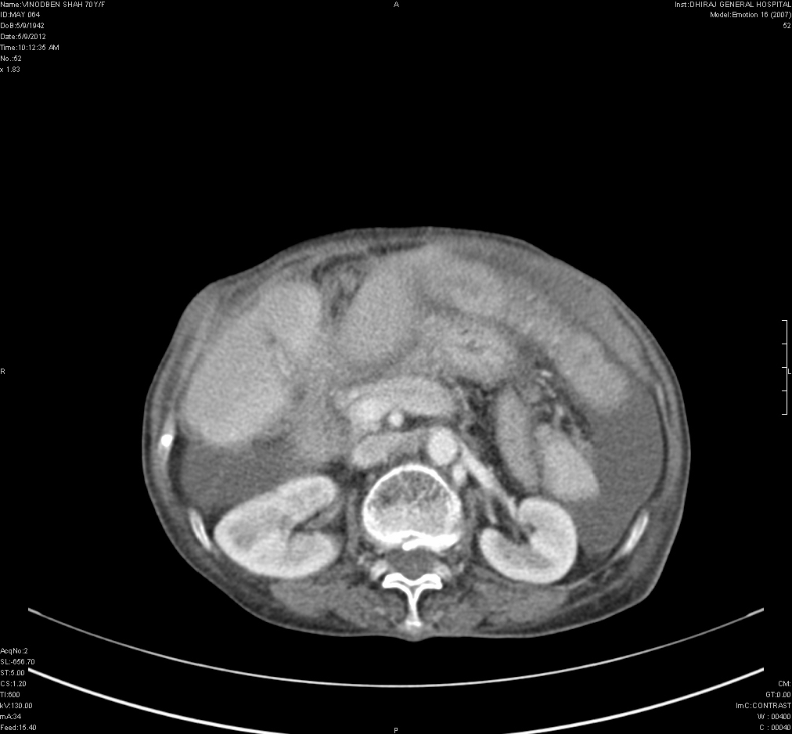
Peritoneal mets causing omental cake appearance.

Slide 7
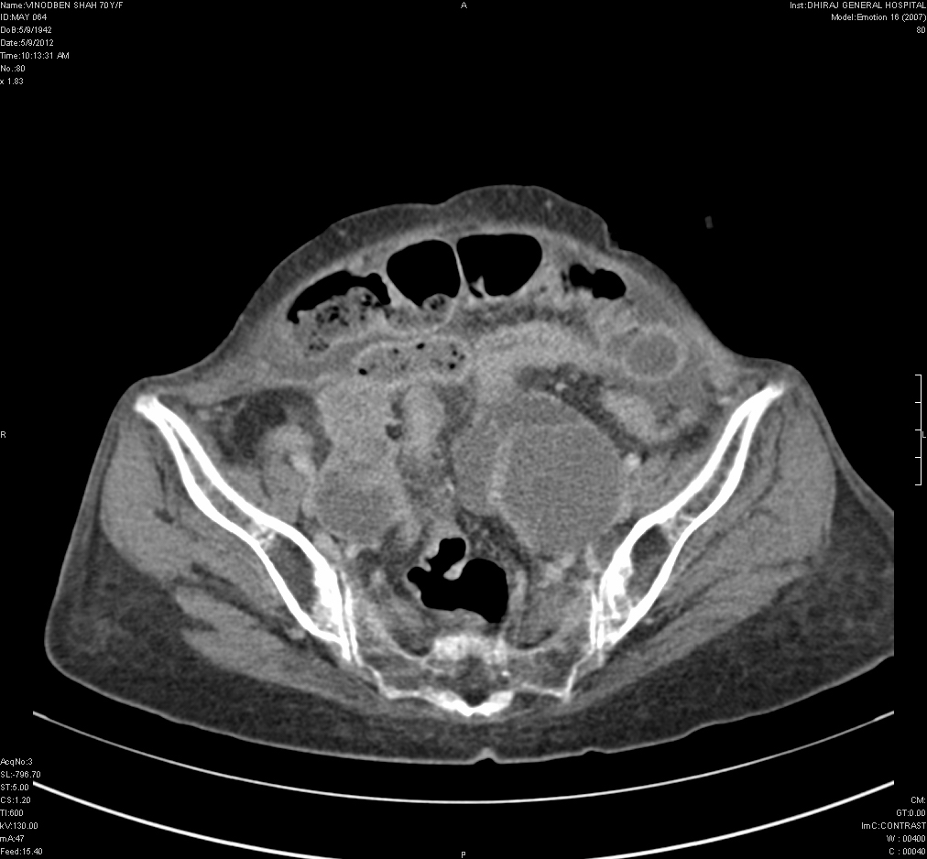
Lobulated mixed density inhomogenously enhancing lesion seen in b/l adnexa.

Slide 8
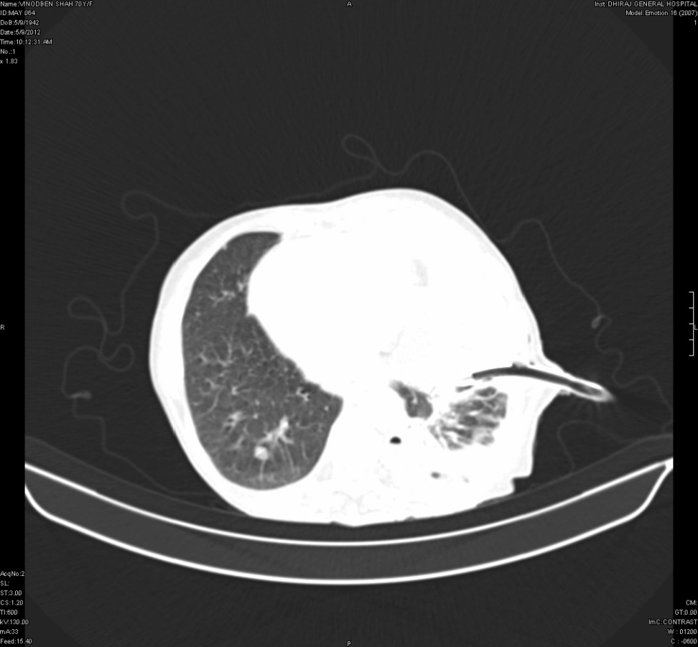
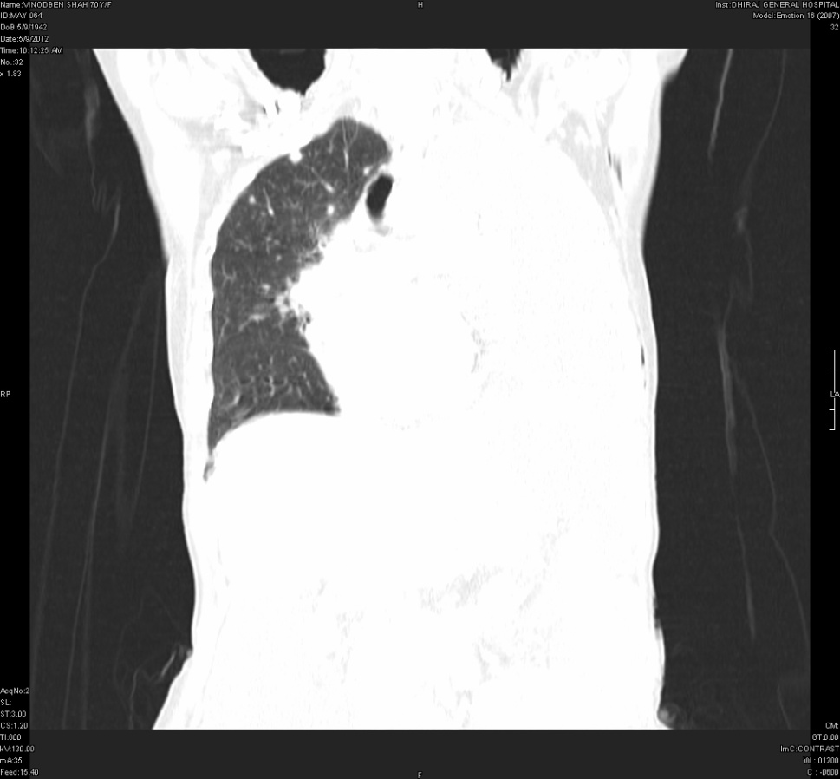
Pulmonary mets

Slide 9
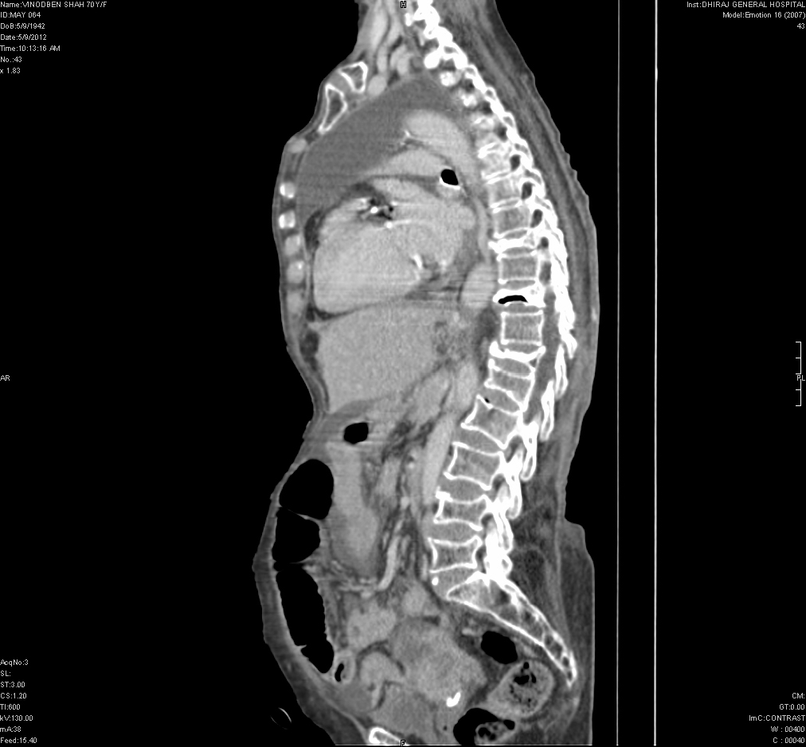
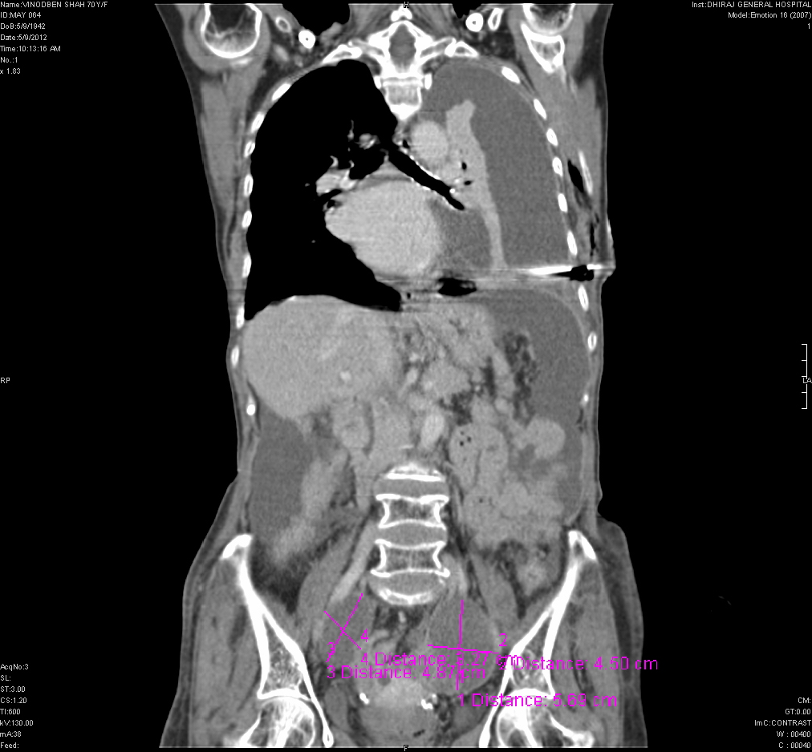

Slide 10
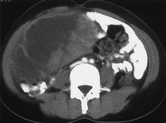
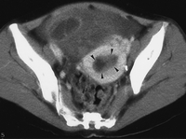
Contrast-enhanced lower abdominal CT scan shows a complex cystic and solid tumor with enhancement of the solid-tissue elements and a thick, irregular wall. (b) Contrast-enhanced pelvic CT scan shows a widened endometrial cavity with a nodular enhancing solid mass (arrowheads).

Slide 11
DISCUSSION
The colon and stomach are the most common primary tumor sites in ovarian metastasis, followed by the breast, lung, and contralateral ovary.
The tumors represent 10% of all ovarian tumors and develop during the reproductive years.
Krukenberg tumors are metastatic tumors to the ovary that contain mucin-secreting “signet ring” cells and usually originate in the gastrointestinal tract.
Imaging findings in metastatic lesions are nonspecific, consisting of predominantly solid components or a mixture of cystic and solid areas.
However, Krukenberg tumor demonstrates some distinctive findings, including bilateral complex masses with hypointense solid components (dense stromal reaction) and internal hyperintensity (mucin) on T1- and T2-weighted MR images, respectively.

Slide 12
D/D
Malignant features include a thick, irregular wall; thick septa; papillary projections; and a large soft-tissue component with necrosis.
Ovarian tumors associated with endometrial hyperplasia or carcinoma include endometrioid carcinoma, granulosa cell tumor.
The presence of fat opacity or fat signal intensity in an ovarian lesion is highly specific for a teratoma.
Ovarian tumors with highly enhancing solid portions, include sclerosing stromal tumor, Sertoli-Leydig cell tumor, struma ovarii, and cystadenofibroma.
Ovarian tumors that are frequently associated with calcifications include serous epithelial tumor, fibrothecoma, mature or immature teratoma, and Brenner tumor.
When bilateral complex ovarian masses are seen, metastatic ovarian tumors and serous epithelial tumors of the ovary should be considered.

Slide 13
THANK YOU.

